Slide 1
Welcome!
On behalf of the ASCCC OERI, we are pleased to have you here with us for “Emotional Intelligence for OER Advocacy” webinar!
If you are not already muted, please mute yourself upon arrival.
This event will be recorded. Archives of all ASCCC OERI events are available at asccc-oeri.org > Webinars and Events
You are encouraged to use the Zoom “chat” feature for questions and comments. To start, you’re invited to introduce yourself in the chat. You might want to provide
Your name,
Your college(s),
Your discipline/role, and
Your thoughts or experiences about emotional intelligence
Notes:
https://asccc-oeri.org/webinars-and-events/

Slide 2
Emotional Intelligence for OER Advocacy
Presented by Selena Kohel, NYC
OERL Webinar hosted by Michelle Oja
Thursday, March 7, 9:00 am – 10:30 am
This work is licensed under a Creative Commons Attribution 4.0 International License.
“RECord button” by Leo Reynolds on flickr; NonCommercial-ShareAlike 2.0 Generic

Slide 3
Description
Emotional intelligence can be defined as being able to perceive, understand, and manage one’s emotions, as well as have an awareness of and empathy for the emotions of others, in ways that are beneficial to relationships.
The OERI has invited Dr. Selena Kohel. a professor of psychology at Cottey College, to present a conceptual model of emotional intelligence and related tools that OER advocates may find helpful in building relationships and leading your local OER efforts.
Presented by Selena Kohel, Cottey College
Psychology
Hosted by Michelle Oja, Taft College
OER-I Regional Lead for Area A; Psychology
Notes:
A description of the presentation is included in the slide deck so that the purpose of the slide deck is established – and to inform anyone viewing the presentation as to what was planned.

Slide 4
Overview
Emotional Intelligence- What is it?
Conceptual Model
Tools for improving relationships
Q&A
Resources
Notes:
An Overview slide should be included that is an outline of the presentation.

Slide 5
Emotional Intelligence
March 7, 2024

Slide 6
Introductions
How are you feeling?

Slide 7
Culture and Emotions
 | Emotion(s) Feel Most Often | Emotion(s) Show Most Often
Sad
Mad
Glad
Scared
Disgusted
Surprised

Slide 8
Outline
What is emotional intelligence?
Why is emotional intelligence important?
In what ways might I increase my and others’ emotional intelligence?

Slide 9
What Is It?
It depends on whom you ask.

Slide 10
What Is It?
For example,
the Consortium for Research on Emotional Intelligence in Organizations
https://www.eiconsortium.org/about_us.htm

Slide 11
What Is It?
Mayer and Salovey
perceiving feelings
using feelings to facilitate thinking
understanding feelings
managing feelings

Slide 12
Why Is It Important?
Mental Health
Work
School
Relationships

Slide 13
Why Is It Important?
Mental health,
e.g., higher psychological well-being

Slide 14
Why Is It Important?
Work,
e.g., higher job performance, job satisfaction, and organizational commitment

Slide 15
Why Is It Important?
School,
e.g., higher academic achievement

Slide 16
Why Is It Important?
Relationships,
e.g., higher prosociality and deeper relationships

Slide 17
Perceiving Feelings
Definition:
correctly identify feelings in people
Purpose:
to better interact with others

Slide 18
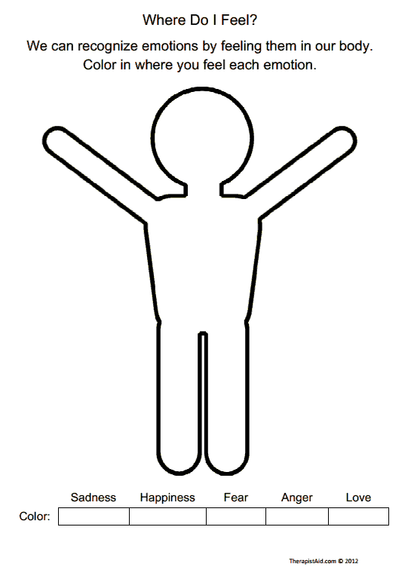
Perceiving Feelings: Internally

Slide 19
Perceiving Feelings: Internally
Chest discomfort, pain
Elevated heartrate
Trembling, shaking
Difficulty breathing
Muscle tension
Nausea, upset stomach
Lightheaded, faint, dizzy
Weak, unsteady
Feeling warm, sweaty
Chills, hot flushes
Difficulty swallowing, choking sensation
Dry mouth

Slide 20
Perceiving Feelings: Externally - The Face (Eyes, Nose, and Mouth)

Slide 21
Perceiving Feelings: Externally - The Face (Eyes, Nose, and Mouth)

Slide 22
Perceiving Feelings: Externally - The Voice (Volume, Pitch, Speed)
Glad
(get louder, get higher pitched, modulate their pitch, increase speed)
Mad
(get louder, get higher pitched, modulate their pitch, increase speed)
Sad
(get softer, get lower pitched, sustain their pitch, decrease speed)
Scared
(get louder, get higher pitched, sustain their pitch, increase speed)

Slide 23
Perceiving Feelings: Externally - The Body
Glad
Mad
Sad
Scared

Slide 24
Perceiving Feelings: Application
Describe one specific, concrete way you might use or strengthen your ability to perceive feelings accurately.

Slide 25
Using Feelings
Definition:
direct attention
garner different perspectives
generate feelings for particular aims
Purpose:
to better accomplish specific goals

Slide 26
Facilitating Thinking
What emotion(s) might be helpful to feel when creating a new program/initiative?
 | Not Useful |  |  |  | Useful
Annoyance | 1 | 2 | 3 | 4 | 5
Boredom | 1 | 2 | 3 | 4 | 5
Joy | 1 | 2 | 3 | 4 | 5

Slide 27
Using Feelings
Glad:
influences openness to new and creative ideas, broadens thinking
Mad:
Sad:
Scared:
Influence focus on details and perceived errors/limitations/dislikes, narrows thinking

Slide 28
Using Feelings
Glad
Mad
Sad
Scared

Slide 29
Using Feelings: Application
Describe one specific, concrete way you might use or strengthen your ability to use feelings.

Slide 30
Understanding Feelings
Definition:
identify progression of feelings
identify complexity of feelings
Purpose:
to act intentionally

Slide 31
Understanding Feelings
Kenji felt content as he thought about his life. The more he thought about the positive contributions, the relief and joy, he had brought to others, the more he felt ______.
 | Surprised
 | Depressed
 | Acceptance
 | Happiness
 | Amazement

Slide 32
Understanding Feelings
High
Medium
Low
Glad | Mad | Sad | Scared
Elated | Furious | Agonized | Terrified
Thrilled | Enraged | Hopeless | Horrified
Ecstatic | Seething | Miserable | Petrified
Cheerful | Frustrated | Lost | Frightened
Gratified | Mad | Let Down | Threatened
Relieved | Upset | Melancholy | Intimidated
Glad | Irritated | Unhappy | Cautious
Contented | Annoyed | Disappointed | Nervous
Pleasant | Touchy | Dissatisfied | Worried

Slide 33
Understanding Feelings
A feeling of concern combines the emotions of ________.
 | Love, anxiety, surprise, anger
 | Surprise, pride, anger, fear
 | Acceptance, anxiety, fear, anticipation
 | Fear, joy, surprise, embarrassment
 | Anxiety, caring, anticipation

Slide 34
Understanding Feelings
Situation Cards:
To elicit:
preceding events
complex emotions

Slide 35
Understanding Feelings: Application
Describe one specific, concrete way you might use or strengthen your ability to understand feelings.

Slide 36
Managing Emotions
Definition:
engage with your feelings if they are helpful
decrease, maintain, or increase yours and others’ emotional responses
Purpose:
to obtain a desired outcome

Slide 37
Managing Emotions
Decrease the intensity of a feeling:
breathe deeply
https://www.youtube.com/watch?v=UB3tSaiEbNY
tense and release
engage in systematic desensitization

Slide 38
Managing Emotions
Decrease the intensity of a feeling:
name the feeling
engage in cognitive reframing
find a silver lining

Slide 39
Managing Emotions
Sustain the intensity of a feeling:
Mara woke up feeling pretty well. She had slept well, felt well rested, and had no particular cares or concerns. How well would each action help her preserve her mood?

Slide 40
Managing Emotions
Action 1: She got up and enjoyed the rest of the day.
 | Very Ineffective
 | Somewhat Ineffective
 | Neutral
 | Somewhat Effective
 | Very effective

Slide 41
Managing Emotions
Action 2: Mara enjoyed the feeling and decided to think about and appreciate all the things that were going well for her.
 | Very Ineffective
 | Somewhat Ineffective
 | Neutral
 | Somewhat Effective
 | Very effective

Slide 42
Managing Emotions
Sustain or change a feeling:
name 10 things for which you’re grateful
write and deliver a gratitude letter

Slide 43
Managing Emotions
Change a feeling:
write a self-compassion letter
name 10 strengths you have
focus on utilizing one of your strengths in a new way throughout each of the next five days
perform five random acts of kindness in one day

Slide 44
Managing Emotions
Set aside a feeling:
engage in a sensing meditation
engage in a body scan meditation
https://www.youtube.com/watch?v=ZM3eYRODNbc&t=2s
engage in a breathing meditation
color

Slide 45
Manage Feelings: Application
Describe one specific, concrete way you might use or strengthen your ability to manage feelings.

Slide 46
In What Ways Might I Increase My and Others’ Emotional Intelligence?
Through:
observation,
imitation,
contingent reinforcement, and
strategic self management.

Slide 47
Closing
Please state:
how you are feeling.

Slide 48
Questions & Comments
Presenter Information:
Selena Kohel, Ph.D.
selenakohel@gmail.com

Slide 49
Resources: Emotional Intelligence
Consortium for Research on Emotional Intelligence in Organizations: https://www.eiconsortium.org/about_us.htm
EI Skills Group: https://eimanager.com/
Greater Good Science Center: https://greatergood.berkeley.edu/
Yale Center for Emotional Intelligence: https://medicine.yale.edu/childstudy/services/community-and-schools-programs/center-for-emotional-intelligence/
Emotional Intelligence 2.0, (Bradberry & Greaves, 2009) from VitalSource includes access to take an emotional intelligence assessment.
Notes:
https://www.vitalsource.com/products/emotional-intelligence-2-0-jean-greaves-travis-bradberry-v9780974320649

Slide 50
Resources: ASCCC OER-I
Link to these slides
OERI resources or OER advocacy
ASCCC OERI Website
Resources
Webinars and Events
Contacts:
oeri@asccc.org
Find everyone’s e-mail at: https://asccc-oeri.org/about-us/
Notes:
Link to slides: https://docs.google.com/presentation/d/1kwvcGYMf8zFfXb7g7tMpLmyFng_wjxMZ/edit?usp=sharing&ouid=109341909335930382529&rtpof=true&sd=true
https://asccc-oeri.org/oer-advocates/
https://asccc-oeri.org/
oeri@asccc.org
https://asccc-oeri.org/about-us/

Slide 51
Q&A
Photo CC0 by Mohamed Mahmoud Hassan on PublicDomainPictures.net

