Slide 1
Videos and Other Hard-to-Find Content.
  Thursday, March 14, 2024
  ECE AND OER Conversation

Slide 2
Table
of
Contents

Slide 3
Starting from Scratch
  Start with Outcomes
  Match with course outline of record
  Match assessment
  Reference a textbook (or two) you like
  Put together your concepts
    “I teach concepts, not chapters”
  Start building

Slide 4
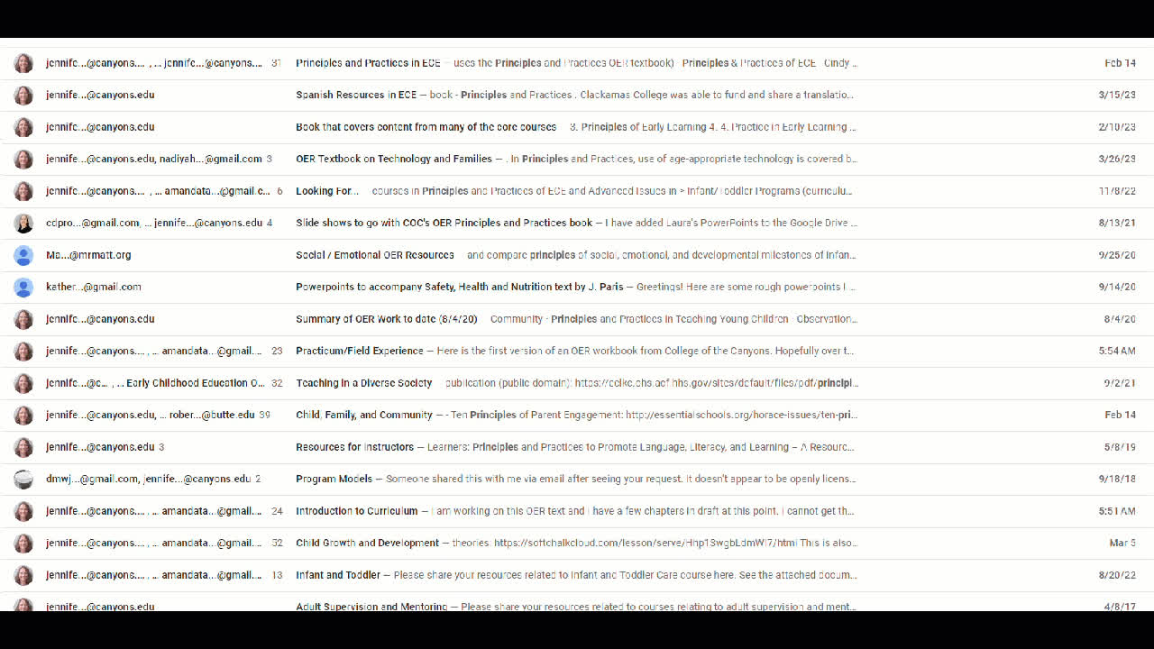
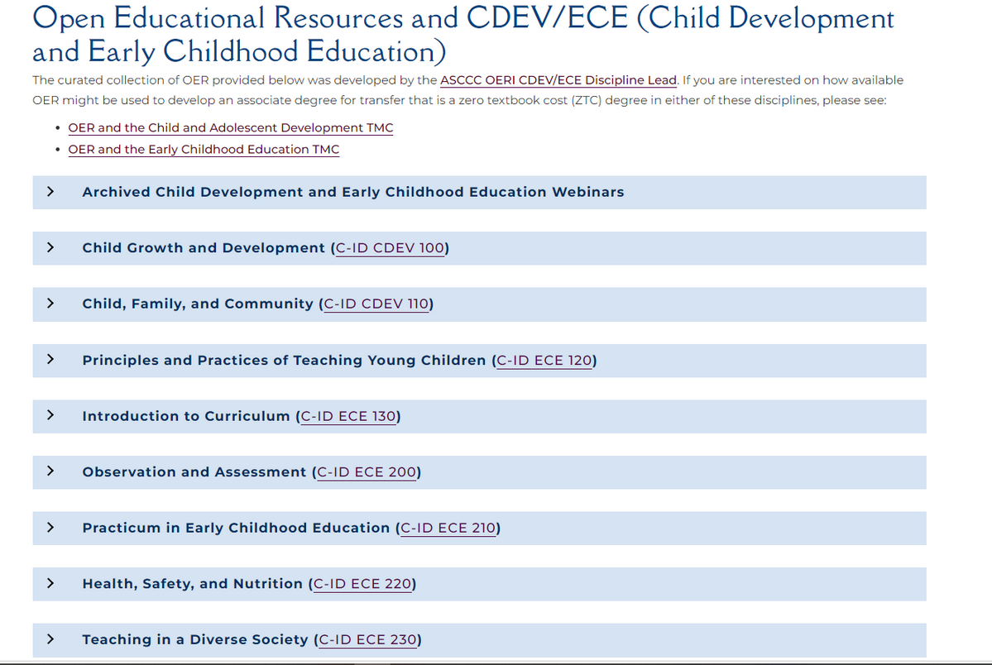
ECE Supports
ECE Google Group
ASCCC OERI

Slide 5
Difference between OER and ZTC

Slide 6
General Resources

Slide 7
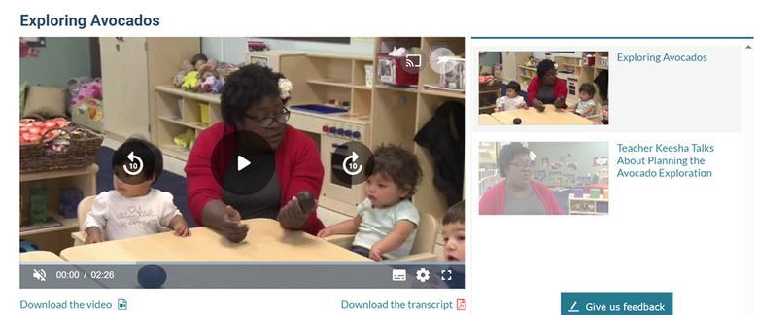
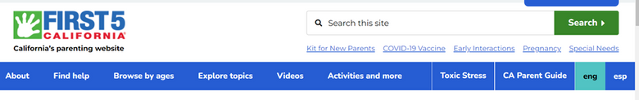
General Resources (cont.)
Head Start | ECLKC (hhs.gov)
First 5 California
  Videos, articles, images
  Bonus: you can download videos and transcripts
  Easy search fields
  Can embed from youtube
  English and Spanish

Slide 8
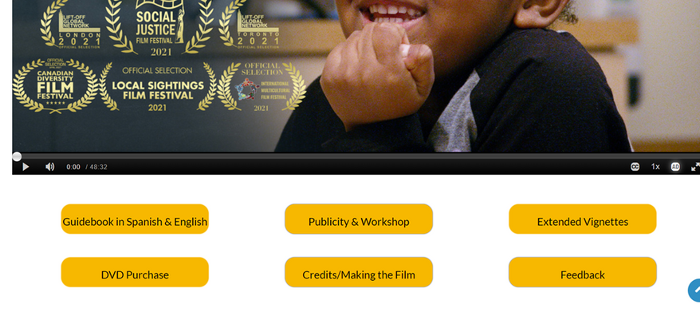
Reflecting on Anti-bias Education in Action: The Early Years - Anti-Bias Leaders ECE
Other Countries Stuff
  Inclusion in early childhood - free resources and professional learning — Early Childhood Australia Learning Hub
  Browse the AERO collection | Australian Education Research Organisation (edresearch.edu.au)

Slide 9
Youtube
  Pikler USA
  Inside Montessori
  Start Early
  CECE Early Childhood Videos at Eastern CT State U.
  FWIChannel (Families and Work Institute)
  ECE CompSAT
  RedleafPress
    Webinars
    Focused Ozbservations (Captions)
    Easy Songs for Smooth
    Focused Observation Video Clips
  WestEd DRDP Resources funded by CDSS
    Video Examples
    Dual Language Learners CPIN Online Module Series
    DRDP Recorded Webinars
    Watching my Child Grow
    DRDP Tutorials
    DRDP Resources Microlearning
    DRDP Online for Teachers
    Health & Safety
    DRDP Online for Administrators

Slide 10
Videos
General Observations
  ECA Learning Hub
      The ECA Learning Hub is well-regarded for producing high-quality online professional learning for educators and teachers.
  NPR
    Search preschool or other terms
  teachingforchange
  TEDx Talks
      .Search early childhood and a plethora of video resources are available around different topics
  Teaching Resources For Preschool Lessons | PBS LearningMedia
    Some of it bases too heavily on the use of their media but does have some helpful multi media resources
  Two RIE® Babies
  Observation of child #1
  Child Observation: Piaget Experiments
  Language for Learning: Infants and Toddlers
  ECELS Program
  http://toddlers.ccdmd.qc.ca/video

Slide 11
Open Images (openoregon.org)
  Wikimedia Commons Media file repository of public domain and freely-licensed educational media content.
  Open Peeps: Hand-drawn, mix-and-match illustration library
  American Education: Images of Teachers and Students in Action Repository of original print-quality photos of real preK–12 students
  American Education: Images of Teachers and
  Students in Action: Repository of original print-quality photos of real preK–12 students PICNOI: Stock photo library of diverse multi-racial images
  Disabled And Here: Photo collection featuring disabled Black, Indigenous, people of color (BIPOC) across the Pacific Northwes
  UK Human Development Institute: Stock photo collection that highlights disability representation licensed
  Images of Empowerment: nappy: Photo library of Black and brown people license
  The Gender Spectrum Collection: Stock photo library
  Disability:IN Disability inclusive stock photography licensed
  AllGo: collects free plus-size stock photos in Unsplash (see below).
  Unsplash: All of the impages you will find in this repository can be reused, modified, and shared for free; more information about the Unsplash license.
  Noun Project: Creative Commons licensed icons.
  Openverse: An extensive library of openly licensed and public domain stock photos, images, and audio.
  Pixabay: All of the impages you will find in this repository can be reused, modified, and shared for free; more information about the Pixabay License.

Slide 12
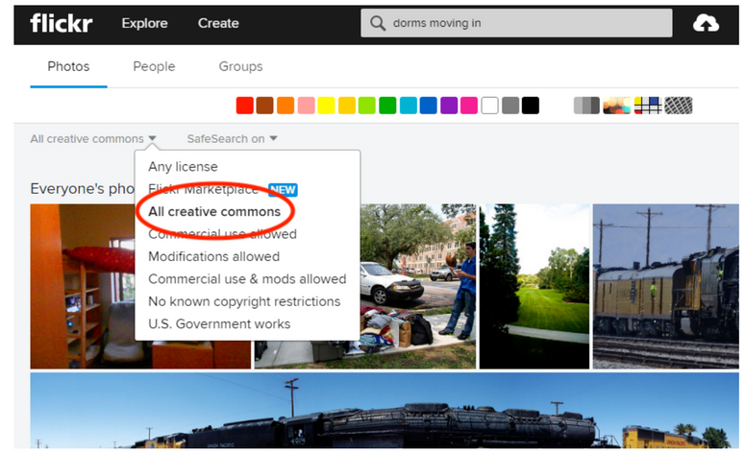
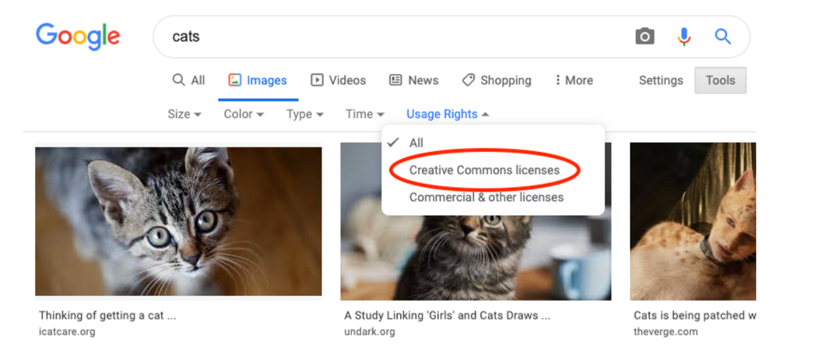
Flickr
Google image search
Use license dropdown menu in search results to limit your search to images with Creative Commons licenses.
From your search results, click on “Images” and then find the usage rights dropdown under search tools.

Slide 13
Early Childhood Education -Open For Antiracism (OFAR)
ECE Competencies Videos
It is often challenging to find educational video and video clips that can be incorported in an Early Childhood Education Course that prepares future educators working with children. This resources provides a collection of videos that educators can use in a college course to spark conversations about working with children.
Early Childhood Education - OFAR | Canvas Commons (instructure.com)
Videos in English and Spanish

