Slide 1
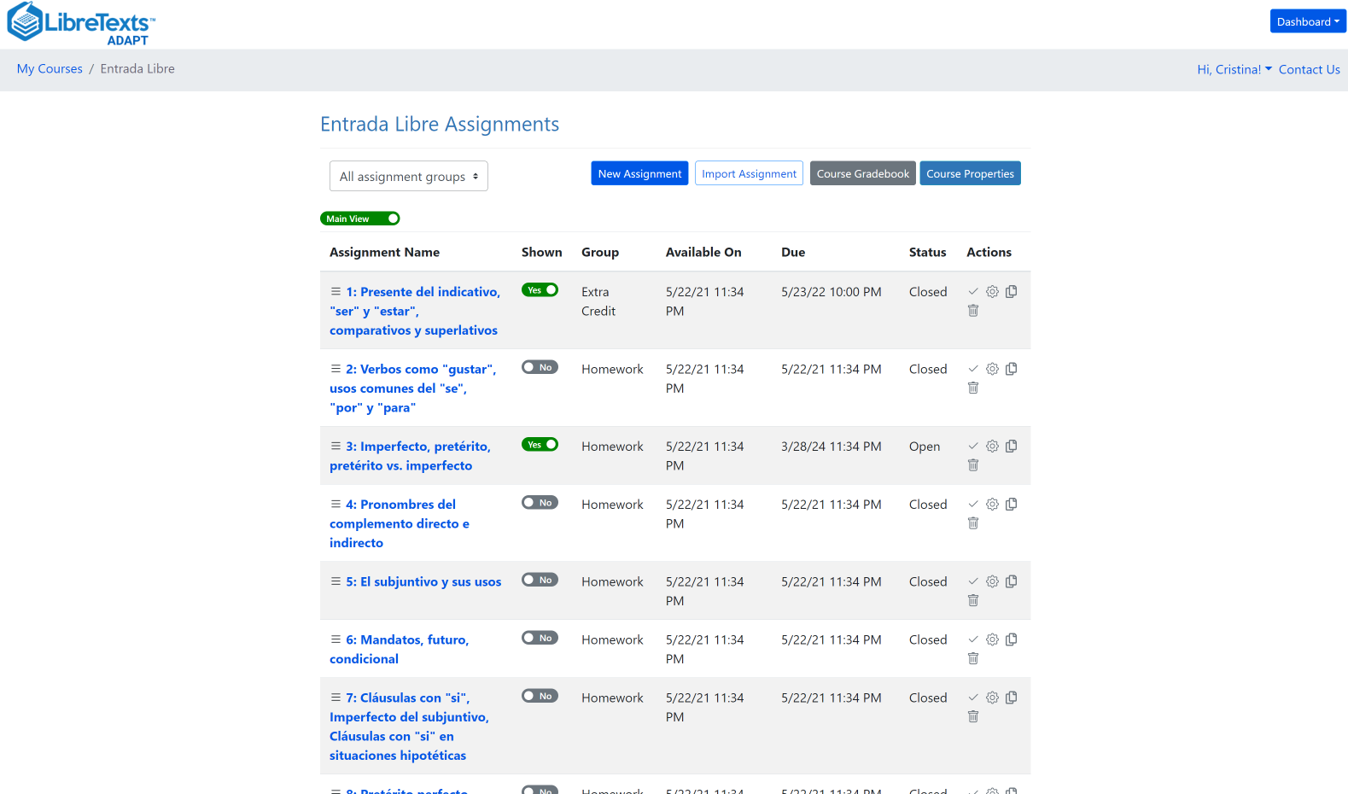
Getting Spanish HW to ZTC with LibreTexts ADAPT
Friday, April 26, 2024

Slide 2
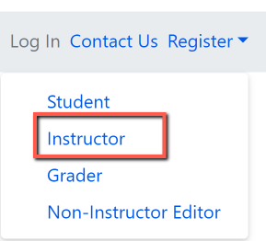
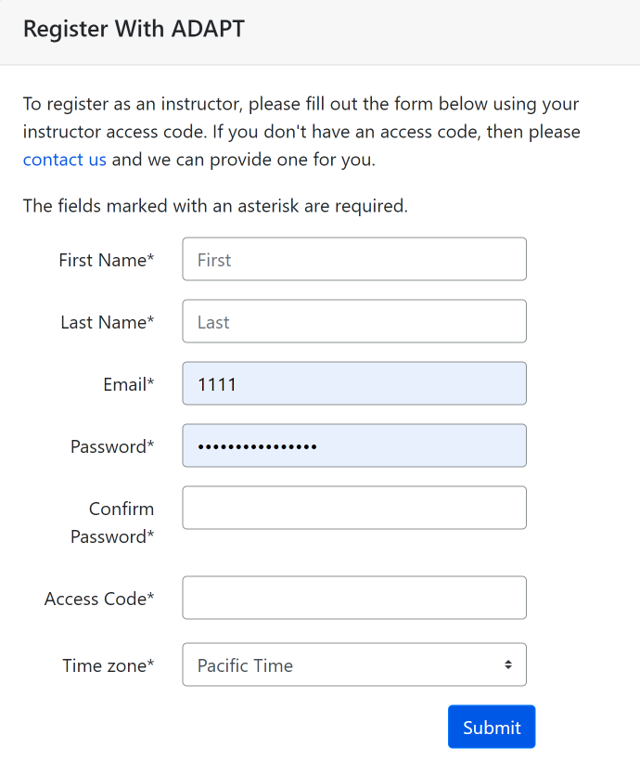
Create an instructor ADAPT account
Go to:
Login · ADAPT (libretexts.org)
Create an instructor account
Access code:
Click on “contact us” and complete the form. Once confirmed, you will receive an email with the access code which you will use to create the ADAPT account

Slide 3
Goals for this webinar
Find ADAPT questions, collections, and public courses.
Create an ADAPT course and set the Gradebook integration with Canvas.
Create an assignment and add existing questions.
Create new ADAPT native questions: multiple choice, select choice, etc.
Create a Canvas assignment and link ADAPT assignment in Canvas.

Slide 4
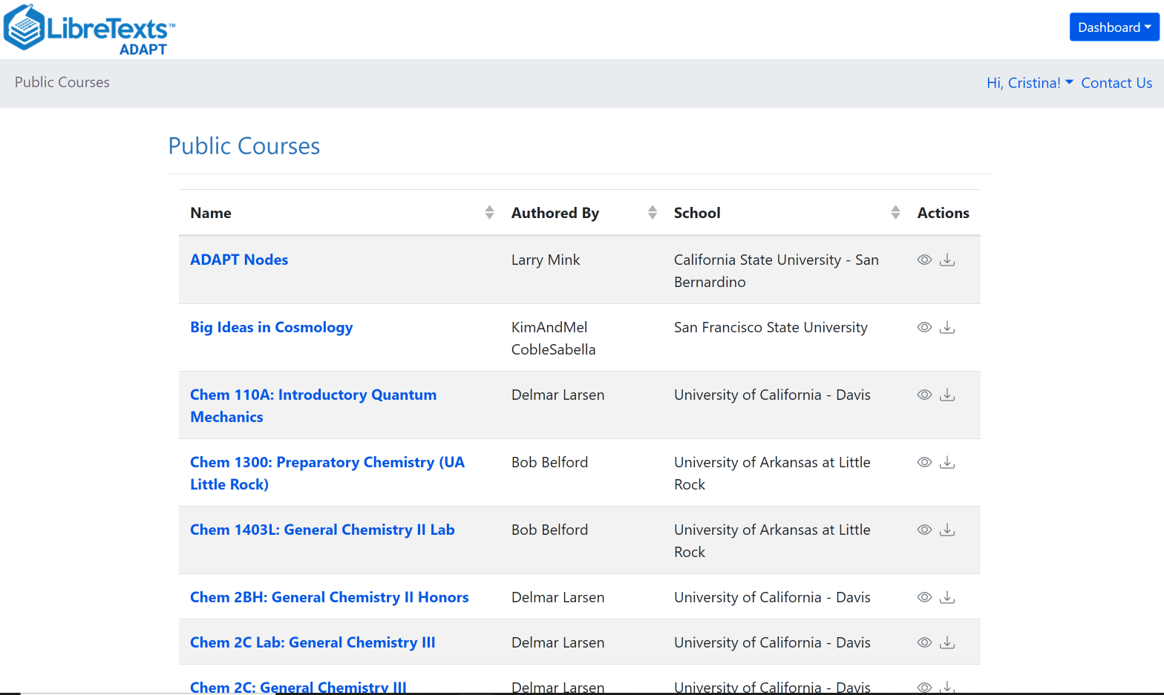
What is ADAPT?
ADAPT is a comprehensive online assessment/homework infrastructure that provides faculty the ability to include auto-graded and non-auto-graded activities from different platforms such as H5P, MyOpenMath, WeBWork, and it’s own native ADAPT questions.
ADAPT can be integrated into an LMS such as Canvas with full grade integration or it could be run independently.

Slide 5
Spanish OER in ADAPT
Title of Spanish OER Collection in ADAPT Commons | # of activities
Entrada Libre (Intermediate Spanish) | 116
¡Naveguemos juntos! (Introductory Spanish) | 463
Tarea Libre (First-year Spanish) | 1,410
Introducción al Español (Palacios) | 50
¡Chévere! Introductory Spanish I and II (Brown, Escudero, Montoya, and Small) | I = 626 II = 487
In addition, if you do a search for Spanish questions, you will find 4,889 question in ADAPT. 1,394 are ADAPT native questions.

Slide 6
Who is using ADAPT
Spring 2024
+ 115 active ADAPT courses
56 from Spanish classes
+3,500 students are using ADAPT
Almost 1,000 are from Spanish classes
Colleges using ADAPT for Spanish:
Allan Hancock College
American River College
Cal State LA
Cañada College
Cerro Coso CC
Chabot College
Columbia College
Cuyamaca College
Cypress College
Estrella Mountain CC
LA Pierce College
Madera CC
Montgomery College
Mount Saint Mary’s University (LA)
Reedley College
San José City College
Santa Mónica College
Santa Rosa Junior college
Sierra College

Slide 7
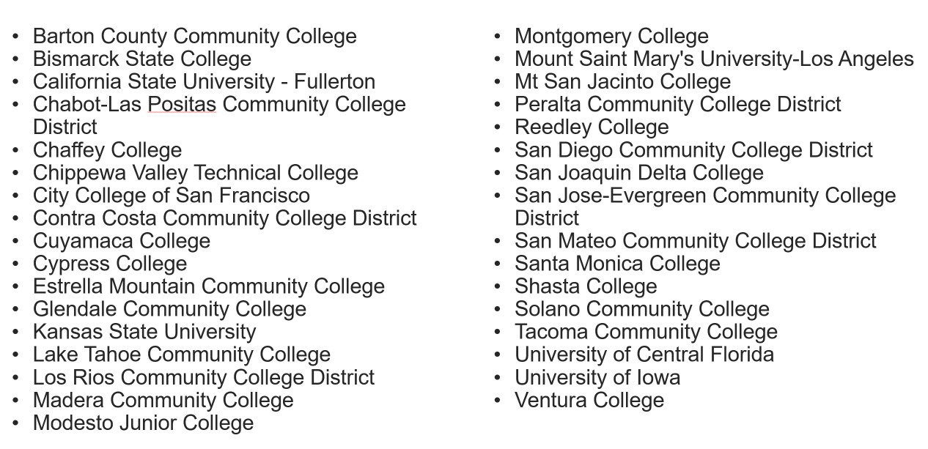
Colleges with Canvas ADAPT LTI (as of 7/31/23)
Updated list of 94 institutions as of 4/25/24.
Notes:
https://docs.google.com/spreadsheets/d/1KU973qDJobZqgf0A9yoqWPRn56mfu-u1dP-VtMKGkFc/edit#gid=0

Slide 8
Let’s get to work
Find ADAPT
Questions
Collections
Public courses
Notes:
12:40

Slide 9
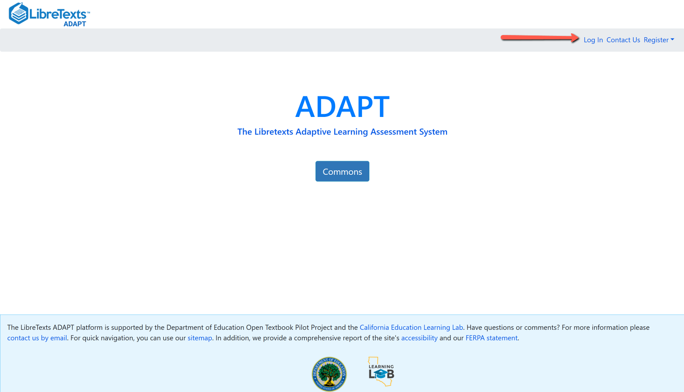
Login to your ADAPT account
Go to:
https://adapt.libretexts.org/login

Slide 10
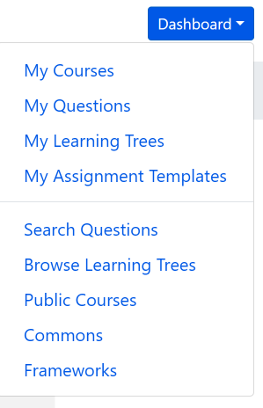
Search for ADAPT questions, collections, and
public courses
Questions: Search among 195,308 ADAPT questions.
Public Courses: Search among shared public courses.
Commons: Search from collections.

Slide 11
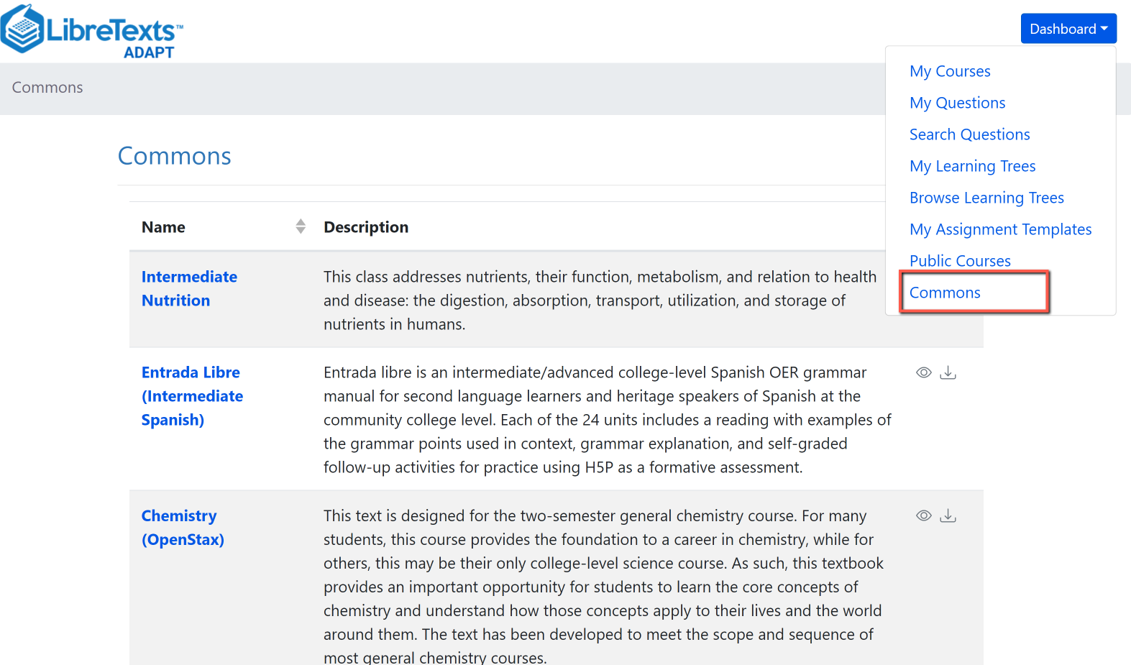
Search in Commons

Slide 12
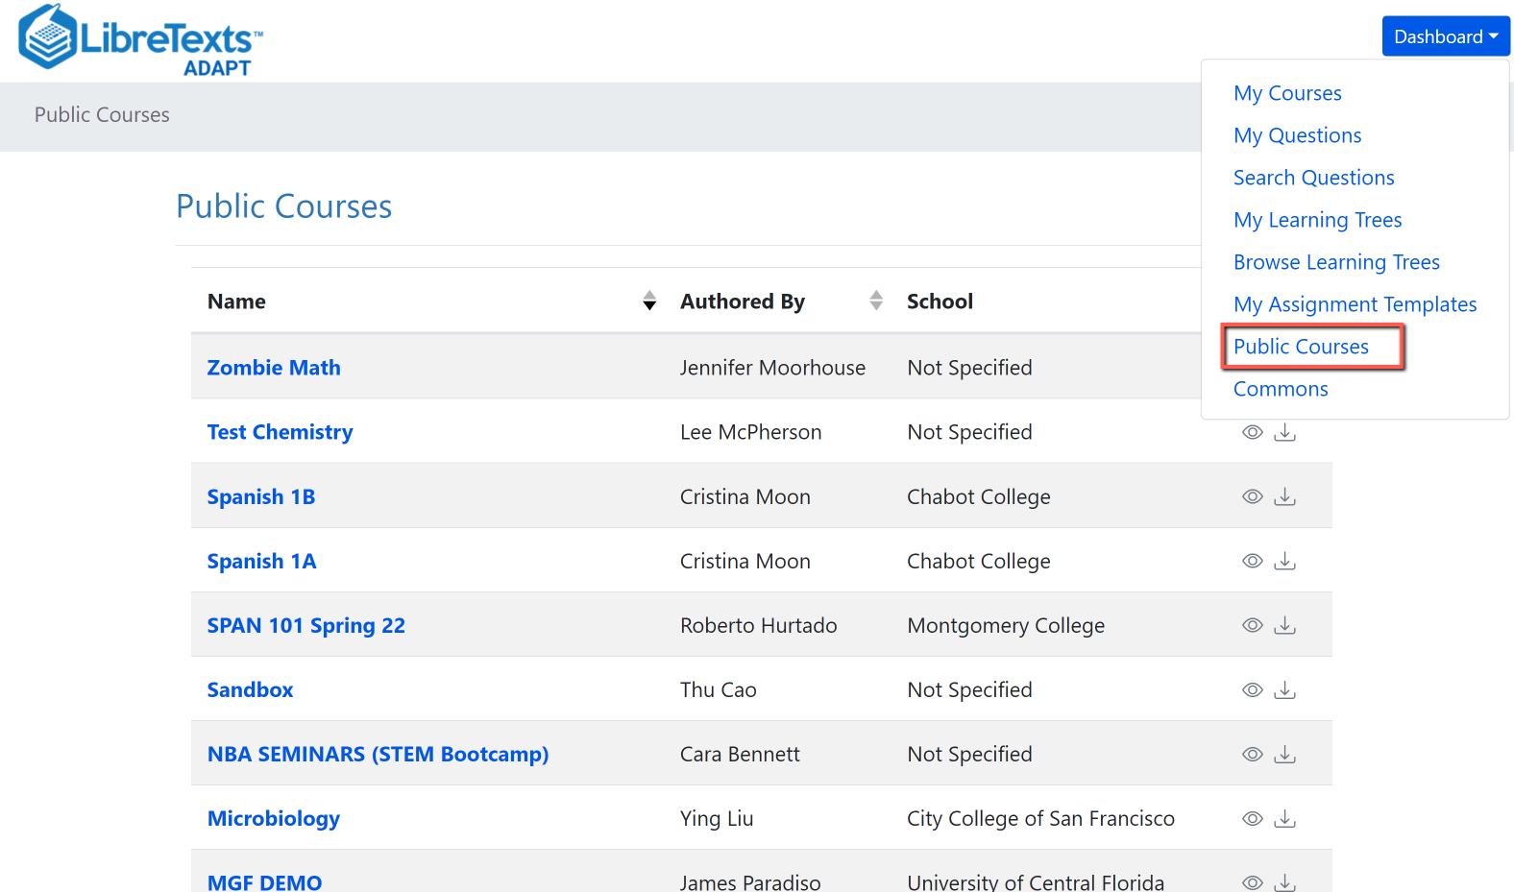
Search Public Courses

Slide 13
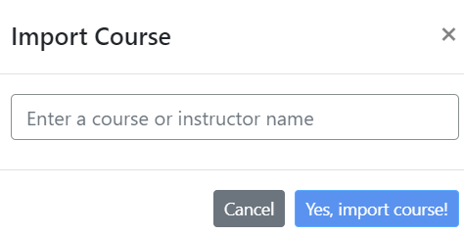
Import an existing course
You can look for public courses that other instructors have shared by going to “Public Courses”.
If you like what you see, you can import the course to your account:
Click on “Import course”
Search for course name or instructor name
Then, import.

Slide 14
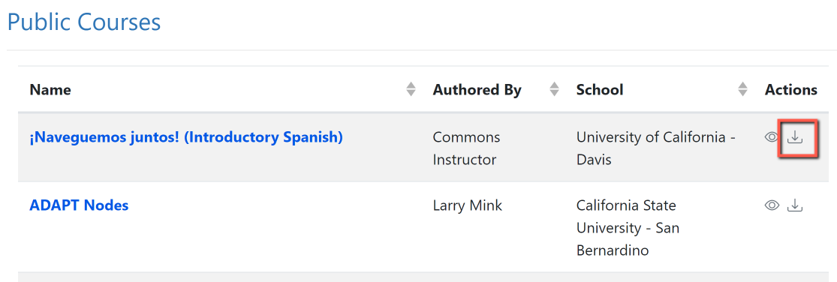
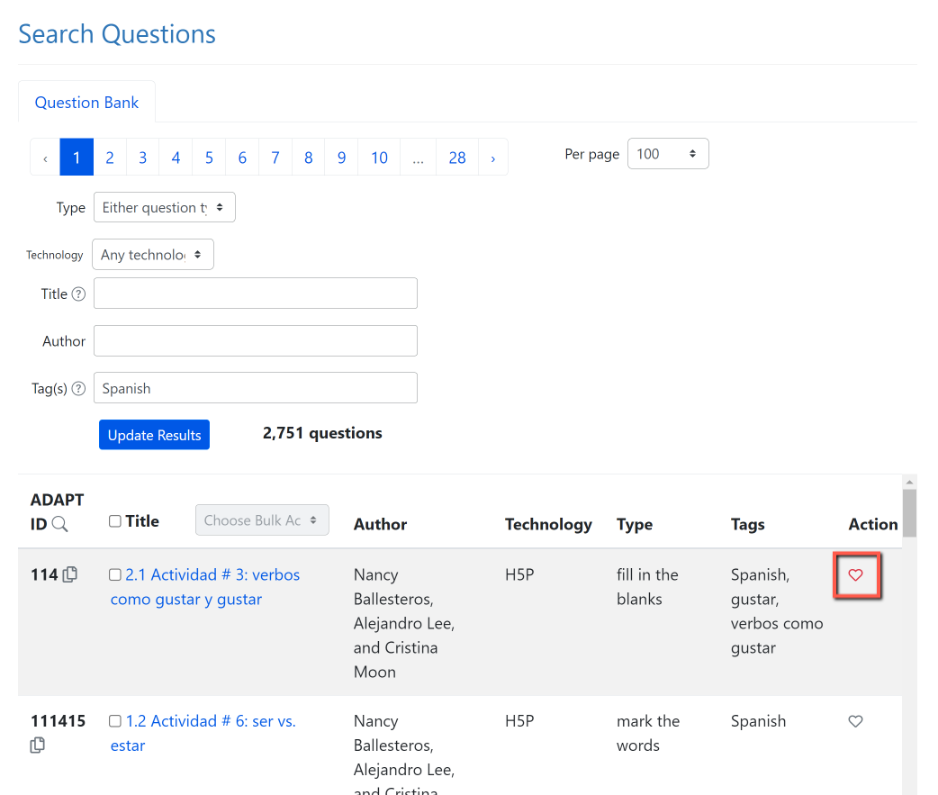
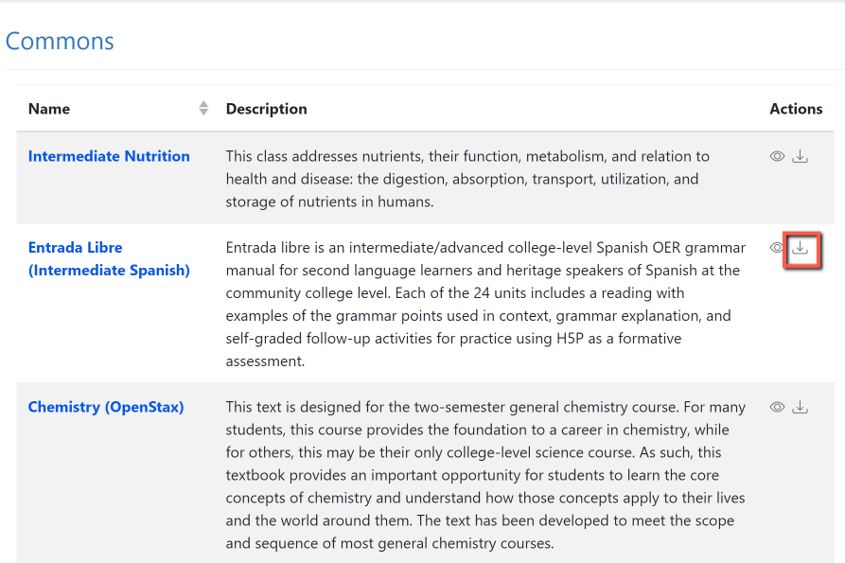
Activity # 1: Now, You Do It …
Search and import a Public Course or a collection from Commons
2. Search for questions and save to favorites.
Notes:
12:45

Slide 15
Let’s get to work
2. Create an ADAPT course and set the Gradebook integration in Canvas

Slide 16
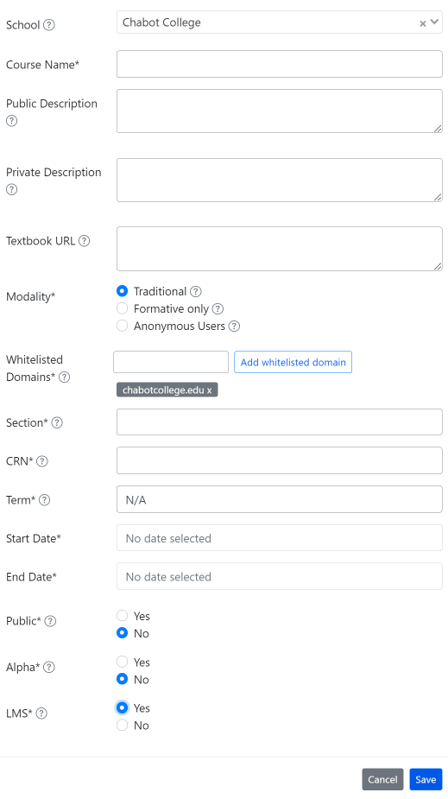
Create an ADAPT course and set the Gradebook integration with Canvas
Enter:
School: find your college if LTI was done
Course Name
Section/CRN
Term
Start/end date
Public: Yes >if you want to share your course with other instructors
LMS: select “Yes” for Canvas integration

Slide 17
Let’s get to work
3. Create an assignment and add existing questions

Slide 18
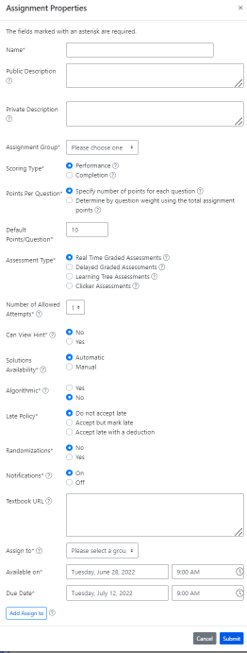
Create a new assignment
Enter:
Name of the assignment
Assignment group
Points (default is 10)
Assessment type
# of allowed attempts
Late policy
Assign to
Available on
Due date

Slide 19
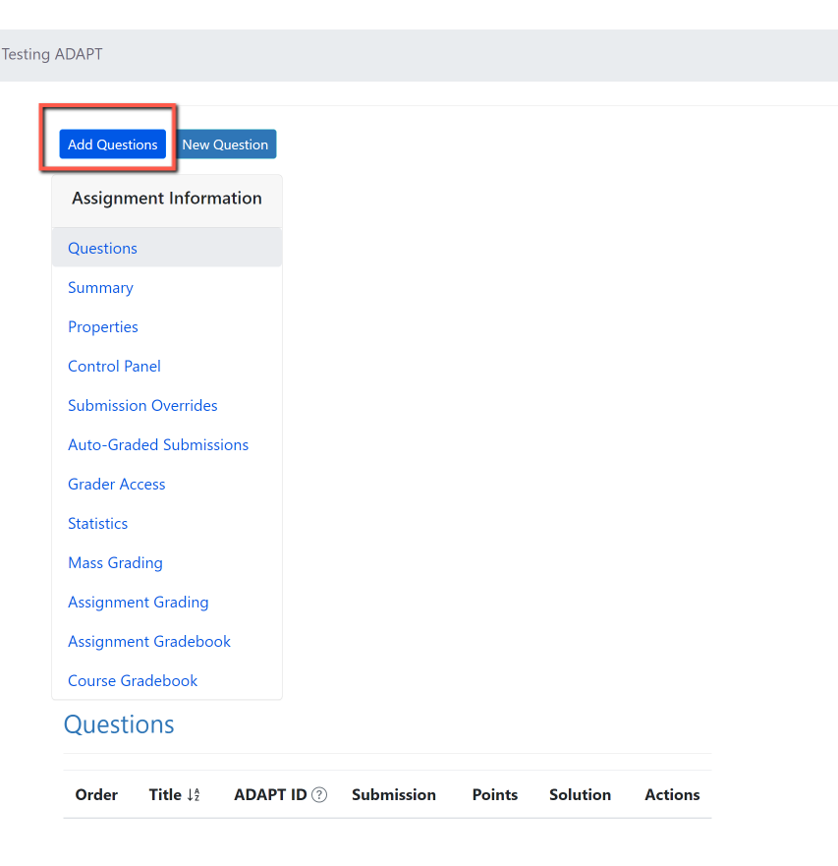
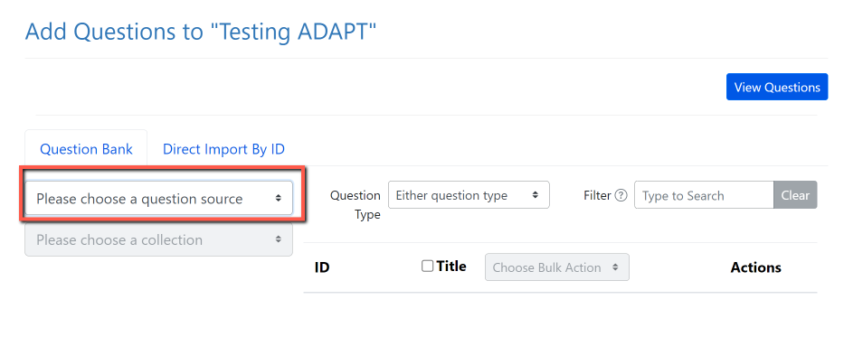
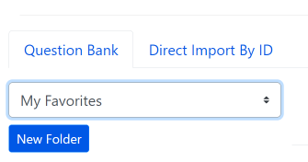
Activity # 2: Add Questions
Step 1: Add Questions
Step 2: Click on “Please choose a question source”
Step 3: Go to “My Favorites” and find the question you saved on activity # 1.
Notes:
12:55

Slide 20
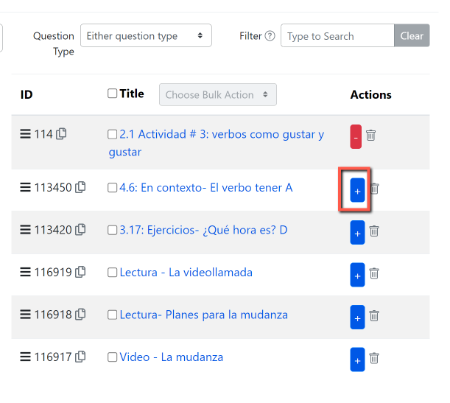
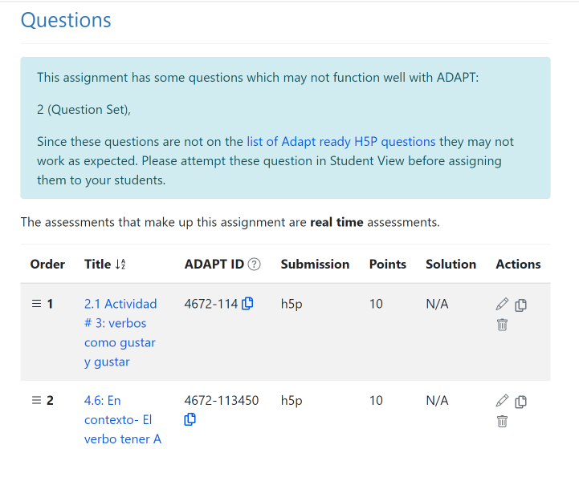
Step 4: Click on the + sign to add the activity to the assignment.

Slide 21
Let’s get to work
4. Create auto-graded ADAPT native questions:
Fill-in the blanks
Select choice
Matching

Slide 22
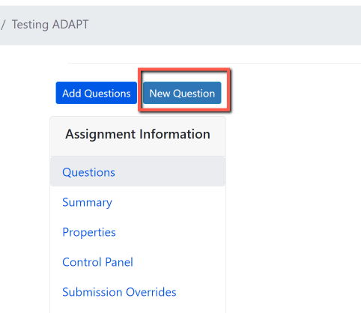
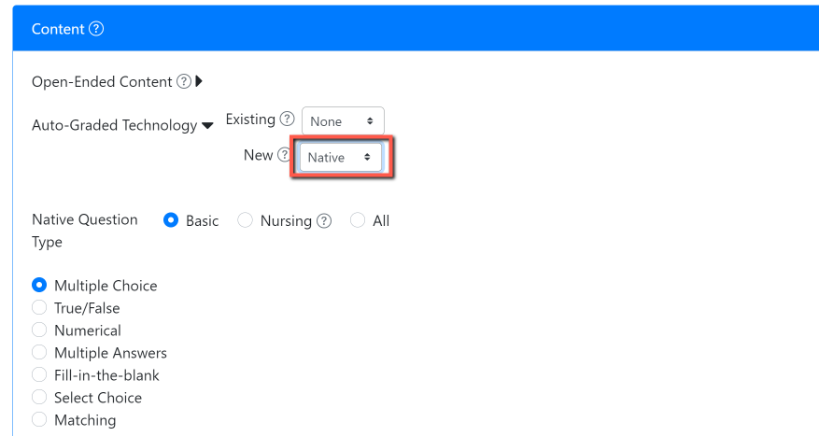
Activity # 3: Create a new auto-graded question in ADAPT
Step # 1: Click on New Question
Step # 2: Select “New” > “Native” question
Notes:
1:05

Slide 23
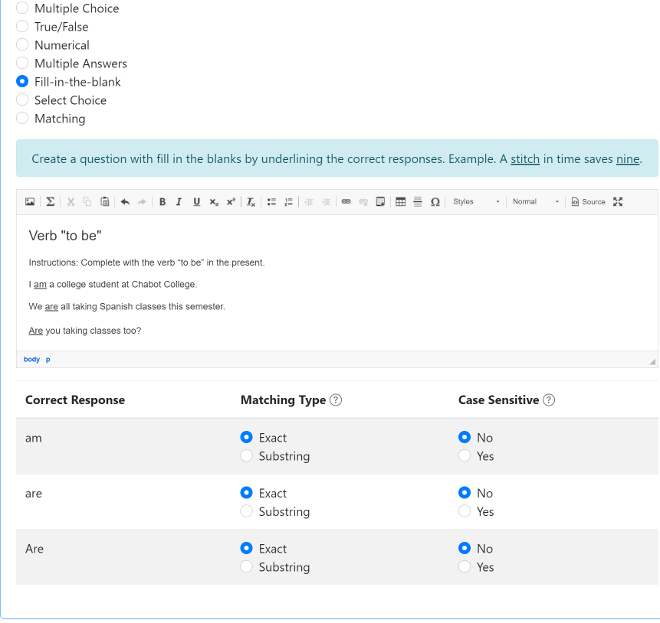
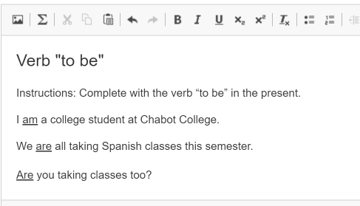
Create a fill-in the blanks activity
Create a question with fill-in-the blanks by underlining the correct responses.

Slide 24
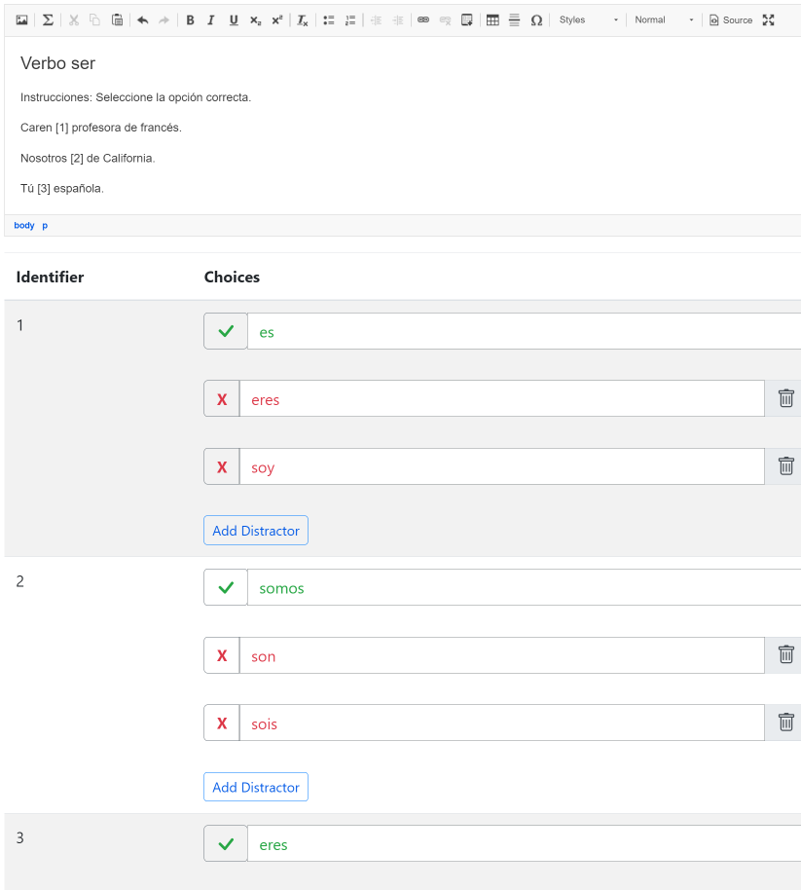
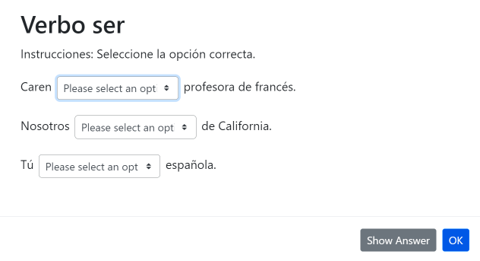
Create a select choice (drop-down) activity
Use brackets for answers. Example. The [planet] is the closest planet to the sun; there are [number-of-planets] planets. Then, add the choices below with your first choice being the correct response. Add distractors. Each student will receive a randomized ordering of the choices.

Slide 25
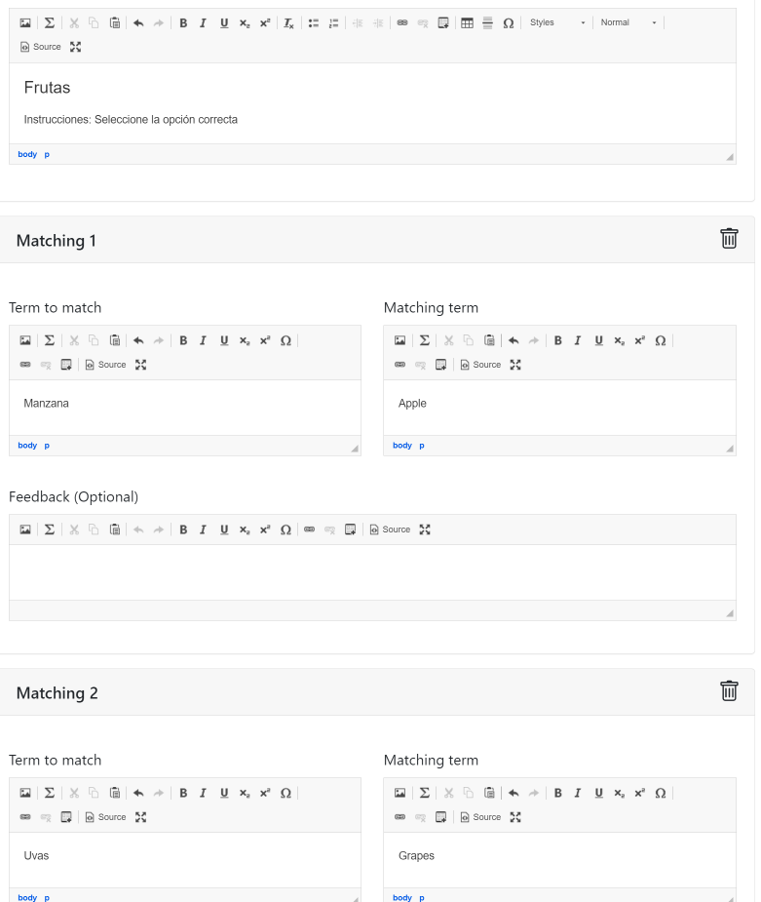
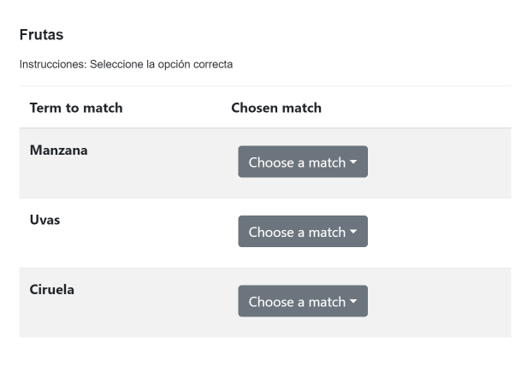
Create a matching
activity
Create a list of terms to match along with their matching terms. Matching terms can include media such as images. Optionally, add distractors which do not satisfy any of the matches.

Slide 26
Let’s get to work
5. Create a Canvas assignment and add ADAPT assignment in Canvas

Slide 27
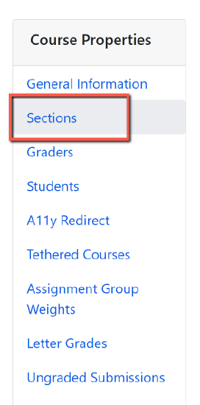
Accessing ADAPT directly
If LTI is not an option for your institution, you and your students can access ADAPT directly by creating an ADAPT account.
Students will need to create a student account.
The instructor will need to provide the Course Access Code. To find the code:
Go to the ADAPT course.
Click on Course Properties (the gear symbol).
Then, click on Sections.
You will find the Course Access Code here.

Slide 28
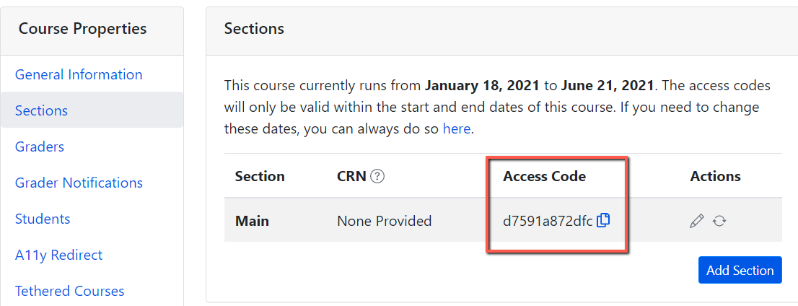
Important: ADAPT Access Code for Students
Go to your ADAPT course > course properties > sections > and get the “Access code”
Share this access code with your students. They will need to enter this code once when accessing ADAPT in Canvas.
Done.

Slide 29
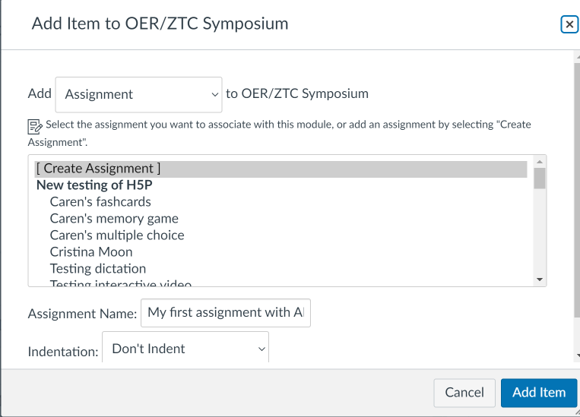
Activity # 4: How to link ADAPT in Canvas
Step # 1: Create an assignment in Canvas. Then edit.
Notes:
1:25

Slide 30
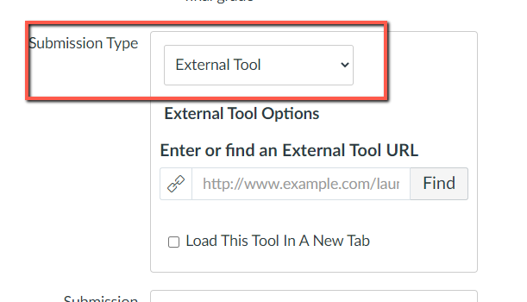
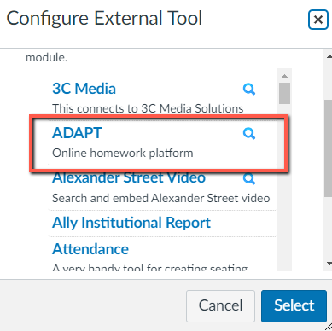
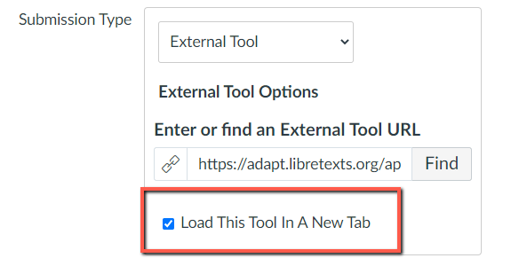
Select ADAPT in External Tool
Step # 2: Edit the assignment and choose “external tool” under submission type.
Step # 3: Click on “find” and look for ADAPT and “select”.
Step # 4: Click on “Load This Tool in A New Tab”

Slide 31
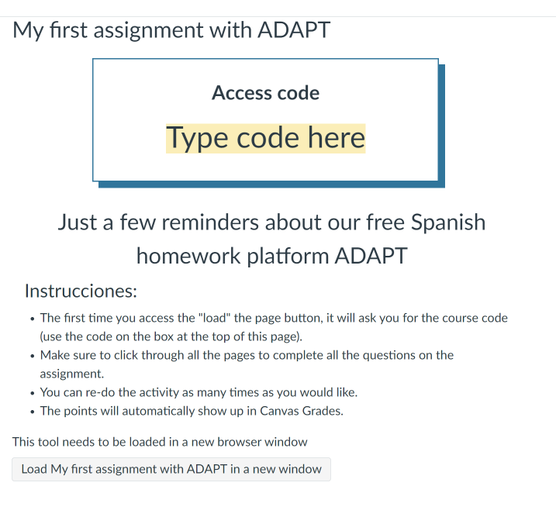
Example of an Assignment Description
This is an example of the description you can include on the assignment.
You should let the students know:
ADAPT Access code
Instructions about the assignment settings such as unlimited attempts.
Students need to click on “Load ….” to open the ADAPT assignment

Slide 32
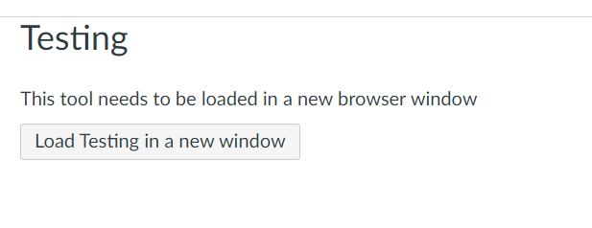
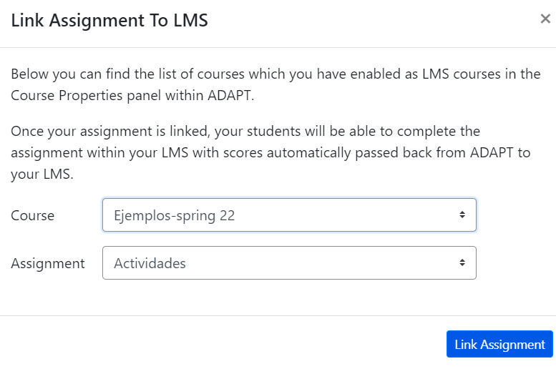
How to select the assignment in Canvas
In Canvas:
Click on “Load”
You will be able to see “Course” and “Assignment” you want to link to Canvas.
Click “Link Assignment”.
Done
This assignment is created and a column will appear in “Grades”.

Slide 33
Looking for more ADAPT training and resources?

Slide 34
More ADAPT Webinars
Continuing the Path to Zero in Spanish Open Educational Resources (OER): Tarea Libre 2
Friday, May 3, 2024 from 9:30 am – 10:30 am
Register
Join us for a sneak preview of Tarea Libre 2, a second-year Spanish homework ancillary that consists of a comprehensive and accessible OER question bank of more than 800 interactive activities created all in ADAPT for intermediate and advanced Spanish. Specifically aligned with C-ID SPAN 200 and 210, this supplementary resource will complement the Spanish OER text materials already identified on the ASCCC OERI Spanish Discipline page and will continue the work started with Tarea Libre (first-year).
Spanish Open Educational Resources (OER) Homework Hackathon 2: Let’s have fun with ADAPT
Friday, May 10, 2024 from 11:00 am-12:00 pm
Registration will be available soon in https://asccc-oeri.org/webinars-and-events/
Do you want to help us expand the Spanish OER homework activities in ADAPT? During our OER Hackathon 2, we will create a collection of activities using LibreTexts ADAPT homework system. Come and join the fun and share the newly created resources with the world!

Slide 35
Past Recorded Webinars on ADAPT
Spanish Open Educational Resources (OER) Hackathon: Let’s create a HW Collection | 2023/10/27
Getting Spanish to Zero – An Openly-Licensed Homework Option for Spanish | 2023/10/20
Integrating ADAPT in Canvas | 2023/09/08
H5P Part II – Introduction to ADAPT | 2023/08/18
H5P Part I – Introduction to H5P and LibreTexts Studio | 2023/08/11
Want to Learn About H5P/LibreStudio and ADAPT for Open Educational Resources (OER)? | 2023/05/05
What’s new in Spanish OER: Tarea Libre | 2023/05/05
Creating Summative Assessments with H5P and ADAPT | 2022/12/02
H5P Level III – Creating Summative Assessments with H5P in ADAPT | 2022/07/13
H5P Level II – Building Interactive Content in LibreStudio | 2022/07/11
H5P Level I – Introduction to H5P | 2022/06/27
Online Homework Solutions to Facilitate OER Adoption in Chemistry | 2022/05/13

Slide 36
ADAPT resources
Accessibility reports
ADAPT construction guide
Canvas LTI for ADAPT instructions
LibreTexts weekly office hours in Zoom:
Tuesdays at 9:00-10:00 PST
Thursdays at 9:00-10:00 PST

Slide 37
More Questions?
Cristina Moon
Spanish Faculty
OER/ZTC Coordinator at Chabot College
ASCCC OERI Spanish Lead, H5P/ADAPT Lead, and OERI Liaison
cmoon@chabotcollege.edu

