Slide 1
Incorporating IDEA in the Creation of OER
Tiffany Lanoix, IDEA Faculty Lead
Academic Senate for California Community Colleges

Slide 2
Agenda
IDEA Framework Background & Basics
Assessment Categories
IDEA Framework Guidebook Rubric
Guidelines & Suggestions
Goal: Learn how to use the IDEA Framework as a resource in creating anti-racist and inclusive OER.

Slide 3
IDEA Framework Background: OERI
Expanding availability and adoption of high-quality OER materials
Support implementation efforts
Professional development, technical support, and technical resources

Slide 4
What Do We Mean by IDEA?
Inclusion, Diversity, Equity and Anti-Racism
Inclusion: Intentional efforts to ensure students feel welcome, included, respected, and valued
Diversity: Materials are representative of the varied experiences of our diverse student body
Equity: Address issues of access to and relevancy of course materials for historically marginalized groups
Anti-racism: Materials do not attempt to be color-blind or culturally neutral since doing so perpetuates racial and ethnic inequities and white supremacy

Slide 5
IDEA Framework
Purpose
A review framework to evaluate existing and assist in the creation of new ASCCC OERI-supported materials
Support faculty as they implement culturally responsive and anti-racist pedagogy

Slide 6
Culturally Responsive Pedagogy
Design classroom learning opportunities that validate, respect and reflect the diversity, identities, and experiences of all students
Involves an active analysis of our own implicit biases and recognition of how they shape our teaching practices and interactions with students
Practices that makes students feel safe, respected and involved

Slide 7
Anti-Racist Pedagogy
An approach to teaching which centers the impact of racial histories and cultural experiences within and outside academic spaces
prioritizes institutional and social change, requiring instructors to critically reflect not only on what they teach but how they teach
Intent is to address the institutional and systemic failures that undermine student success
Doing otherwise upholds the status quo and contributes to the perpetuation of racial inequities

Slide 8
IDEA Framework Assessment Categories
Illustrations & Photos
Reflective of diverse populations and do not perpetuate stereotypes
Example Names
Names used for examples, exercises, and scenarios, and should represent various countries of origin, ethnicities, genders, and races and be properly portrayed
Gender Inclusive Language & Use of Pronouns
Use gender-neutral pronouns or language that intentionally dispels gender stereotypes
Diverse Authors, Researchers & Studies
Reference discipline contributors—e.g., researchers, scholars, academics—with backgrounds like those of your students

Slide 9
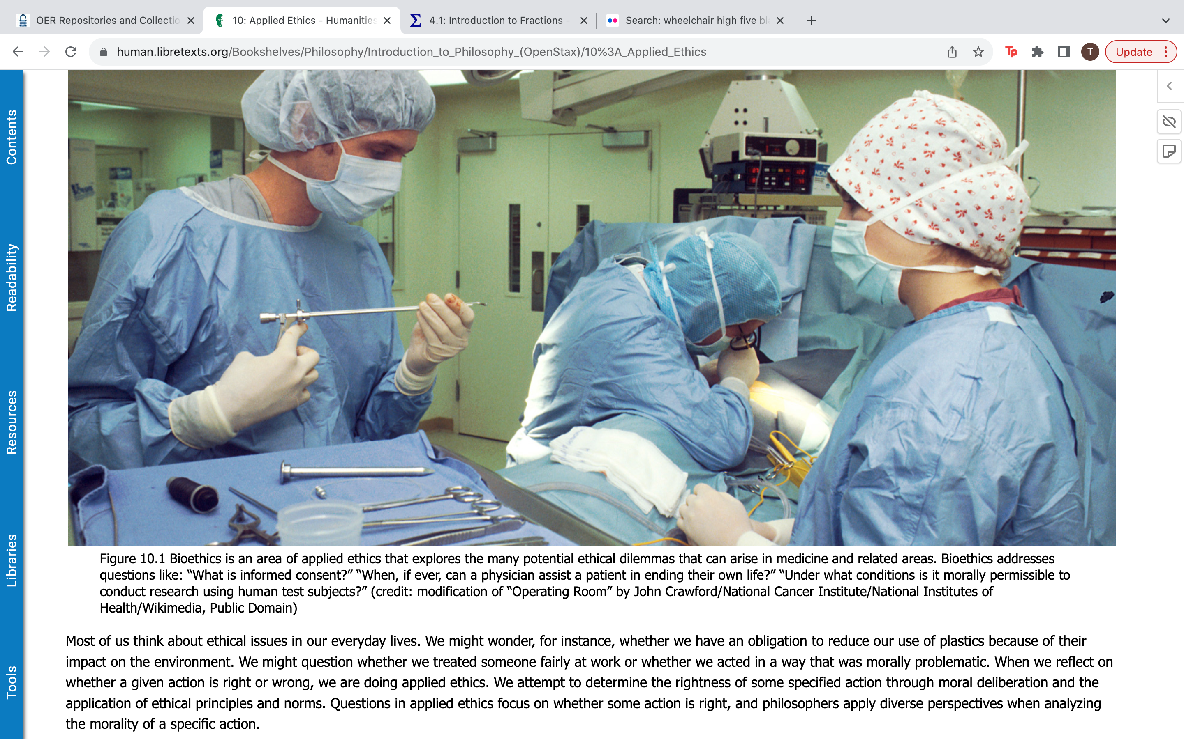
IDEA Framework Assessment Categories
Illustrations & Photos
Reflective of diverse populations and do not perpetuate stereotypes
Example Names
Names used for examples, exercises, and scenarios, and should represent various countries of origin, ethnicities, genders, and races and be properly portrayed
Gender Inclusive Language & Use of Pronouns
Use gender-neutral pronouns or language that intentionally dispels gender stereotypes
Diverse Authors, Researchers & Studies
Reference discipline contributors—e.g., researchers, scholars, academics—with backgrounds like those of your students

Slide 10
IDEA Framework Assessment Categories
Applications, Examples, and Problem Scenarios That Reflect Diverse Audiences
Include diverse and relatable examples for students and avoid stereotypes
Appropriate Terminology
Examine for derogatory, colloquial, inappropriate, or otherwise incorrect language
Keywords, Glossary & Metadata Representation
Ensure that diverse topics and terms are appropriately represented in these sections
Incorporating Diverse Perspectives on Issues, Events, and Concepts That Are Relevant to Diverse Populations
Diverse populations experience issues such as social problems, health, politics, business practices, and economic conditions that may differ from the mainstream

Slide 11
Example
Notes:
https://socialsci.libretexts.org/Bookshelves/Economics/Principles_of_Macroeconomics_(LibreTexts)/02%3A_Confronting_Scarcity%3A_Choices_in_Production/2.2%3A_The_Production_Possibilities_Curve

Slide 12
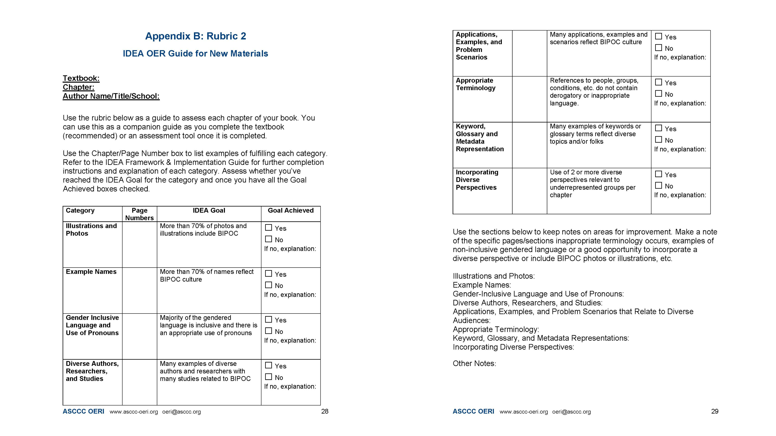
IDEA Framework

Slide 13
What’s the Goal?
Aim to achieve the goal in each category
Not always possible due to structural barriers faced by BIPOC
If not attainable, this should be acknowledged in your materials

Slide 14
Guidelines & Suggestions
Use the rubric along the way
Familiarize yourself with the categories
Have your resources ready and easily accessible
See “Additional Resources” in IDEA Framework Guidebook
Keep notes as you move along
You don’t have to figure everything out at once

Slide 15
Guidelines & Suggestions
Don’t get overwhelmed
Take it one chapter/assignment/chunk at a time
You will build this skill over time
Be deliberate & thoughtful
Commit to the additional time and analysis this will require

Slide 16
Guidelines & Suggestions
Continue to do the work
Implicit bias, equity practices, etc.
Future IDEA Framework workshops & office hours
Accept that you will make mistakes & it will not be perfect
Make it a student assignment
Create an assessment community
Find someone you can exchange assessments with (contact me!)
Support through the DEI backlash

Slide 17
Discussion
Thoughts, feelings, questions, vibes???
Do you have any hesitations or concerns about using the IDEA Framework rubric for new materials?
If so, what can ASCCC, your campus and/or you do to address them?
Do you have any other suggestions for the best way to approach using the rubric as faculty create OER?

