Slide 1
Welcome!
On behalf of the ASCCC OERI, welcome to this discipline webinar, “OER for Anatomy, Physiology, and Microbiology”
If you are not already muted, please mute yourself upon arrival. As this is set up as a meeting, we will be able to have an actual discussion – but we need all those who are not speaking to be muted.
You are also encouraged to use the “chat” feature.

Slide 2
Open Educational Resources (OER) for Anatomy, Physiology, and Microbiology
Revised March 25, 2024. This work is licensed under a Creative Commons Attribution 4.0 International License.
Attribute this slide deck as: "OER for Anatomy, Physiology, and Microbiology" by ASCCC OERI is licensed under CC BY 4.0.

Slide 3
Event Description
An analysis of zero-textbook-cost (ZTC) data obtained from California Community Colleges (CCC) reveals that the biology courses that commonly are needed for allied health pathways are being taught with OER at some colleges and that others have found the available resources lacking. What resources are CCC faculty using – and how have they addressed common complaints about the available OER? Join us to consider the available resources and discuss potential approaches to increasing OER adoption across the CCCs.

Slide 4
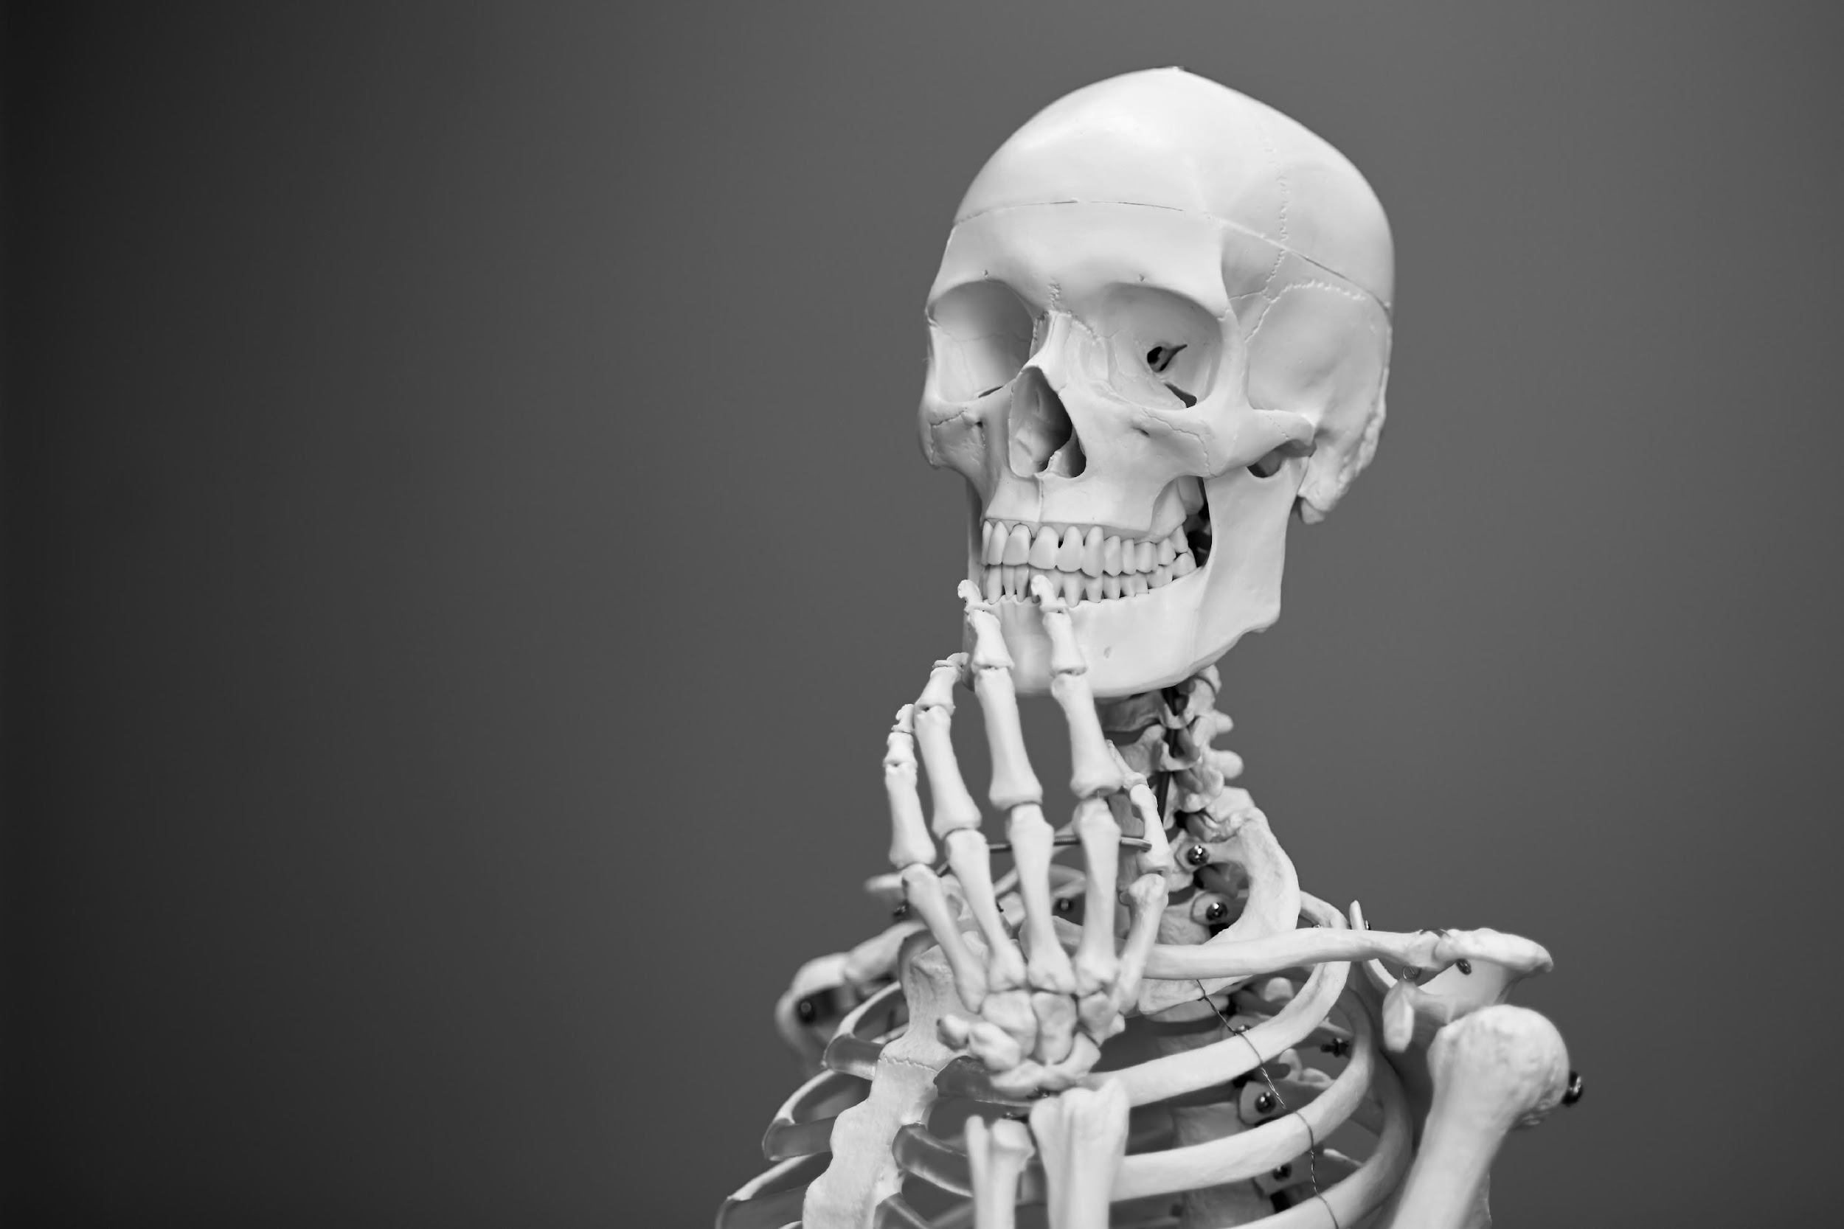
Presenters
Jennifer Lange - jlange@chabotcollege.edu
Life Sciences, Chabot College
Ying Liu
OERI Biology Discipline Lead
Biology, City College of San Francisco
ying.liu@mail.ccsf.edu
Suzanne Wakim
OERI Project Facilitator
Biology, Butte College
wakimsu@butte.edu
Photo by Mathew Schwartz on Unsplash

Slide 5
Overview
Biology Collaboration Cohort Findings
OER and Anatomy
OER and Physiology
OER and Microbiology
Questions and Discussion

Slide 6
Biology Collaboration Cohort Basics
All cohort colleges asked to share information regarding the courses in their proposed zero textbook cost (ZTC) pathways that are – and are not – ZTC.
If courses were ZTC, how was this accomplished?
If not, how do they plan to get to ZTC?

Slide 7
Anatomy and Physiology
Books being used
Challenges & proposed work
Anatomy and Physiology 2e (OpenStax)
Cosumnes
City College of San Francisco
OERI Human Anatomy
by Whitney Menefee, Julie Jenks, Chiara Mazzasette, & Kim-Leiloni Nguyen
Physiology Textbook
Anatomy Textbook - coming soon!
Openly licensed images - new resources on list, LibreTexts - coming soon!
Separate & Combined Lab Manuals
Book Available for Fall 2024
Human Anatomy (Lange et al.)
by Jennifer Lange, John Polos, Yancy Aquino, Cheri Calcagno; Illustrators Justin Greene, Mark Schaeffer, Sofia Elizondo, Gabrielle Spurlock, and Claire McGuire
Notes:
Form: https://forms.gle/dgbNVDmsmu3GsY8D7
Spreadsheet: https://docs.google.com/spreadsheets/d/16n5GtdBnz4jXFj1xPREiGkXPAKfk40ZXhVli9OlVzoM/edit?usp=sharing

Slide 8
A&P Discussion

Slide 9
Jennifer Lange (Anatomy OER)
Publisher books - written for upper division, textbook and atlas ~ $230
OpenStax - Anatomy & Physiology
Hard for students to parse between A & P
Terrible illustrations!
OERI - Anatomy
Mostly same terrible illustrations
Still at upper division level
Still some physiology

Slide 10
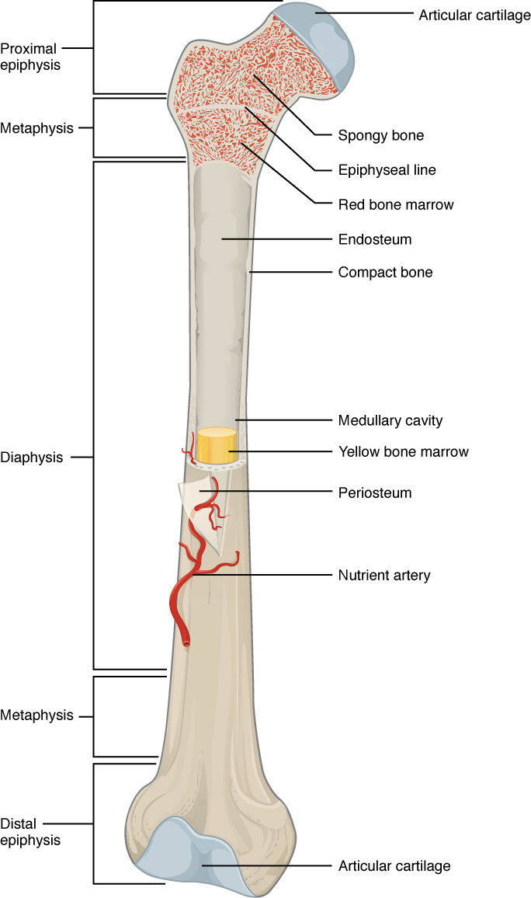
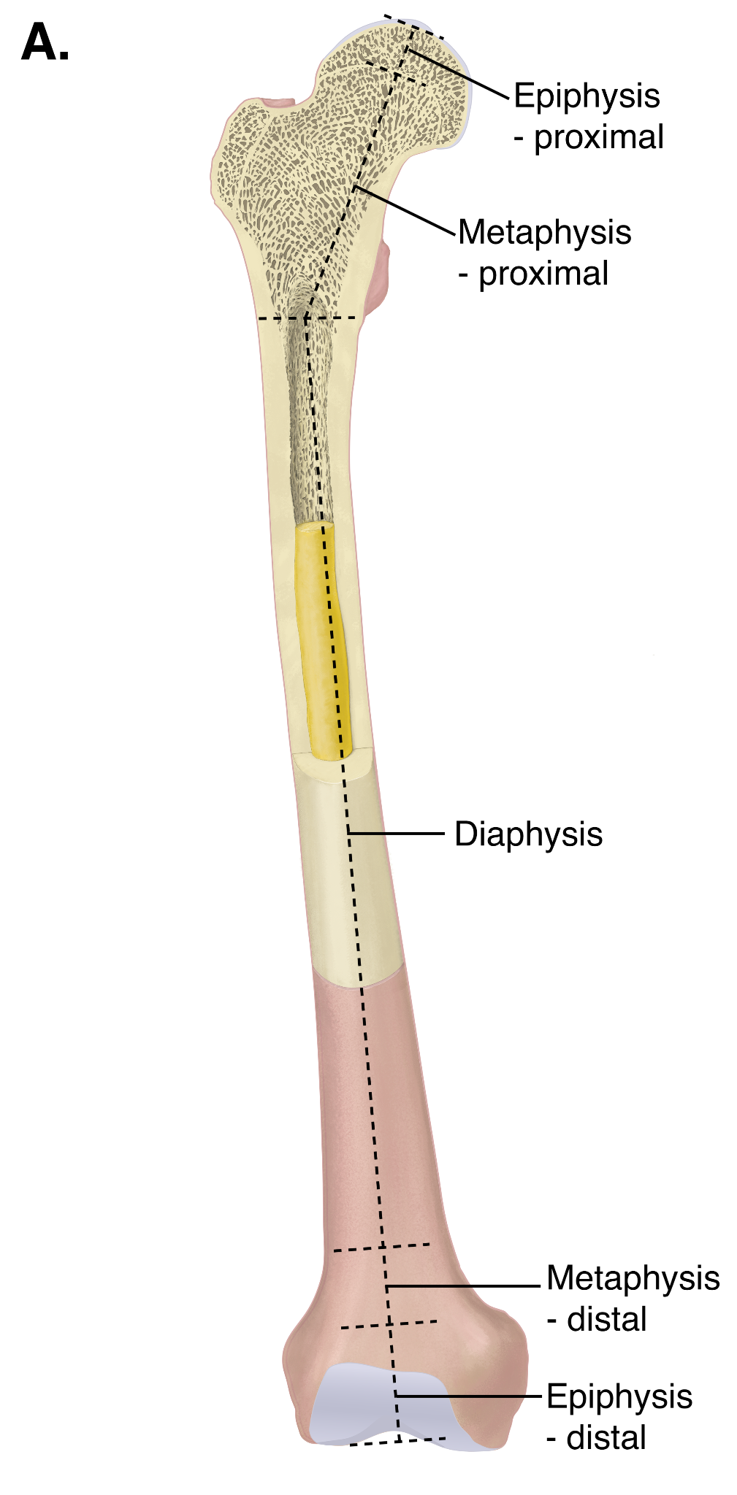
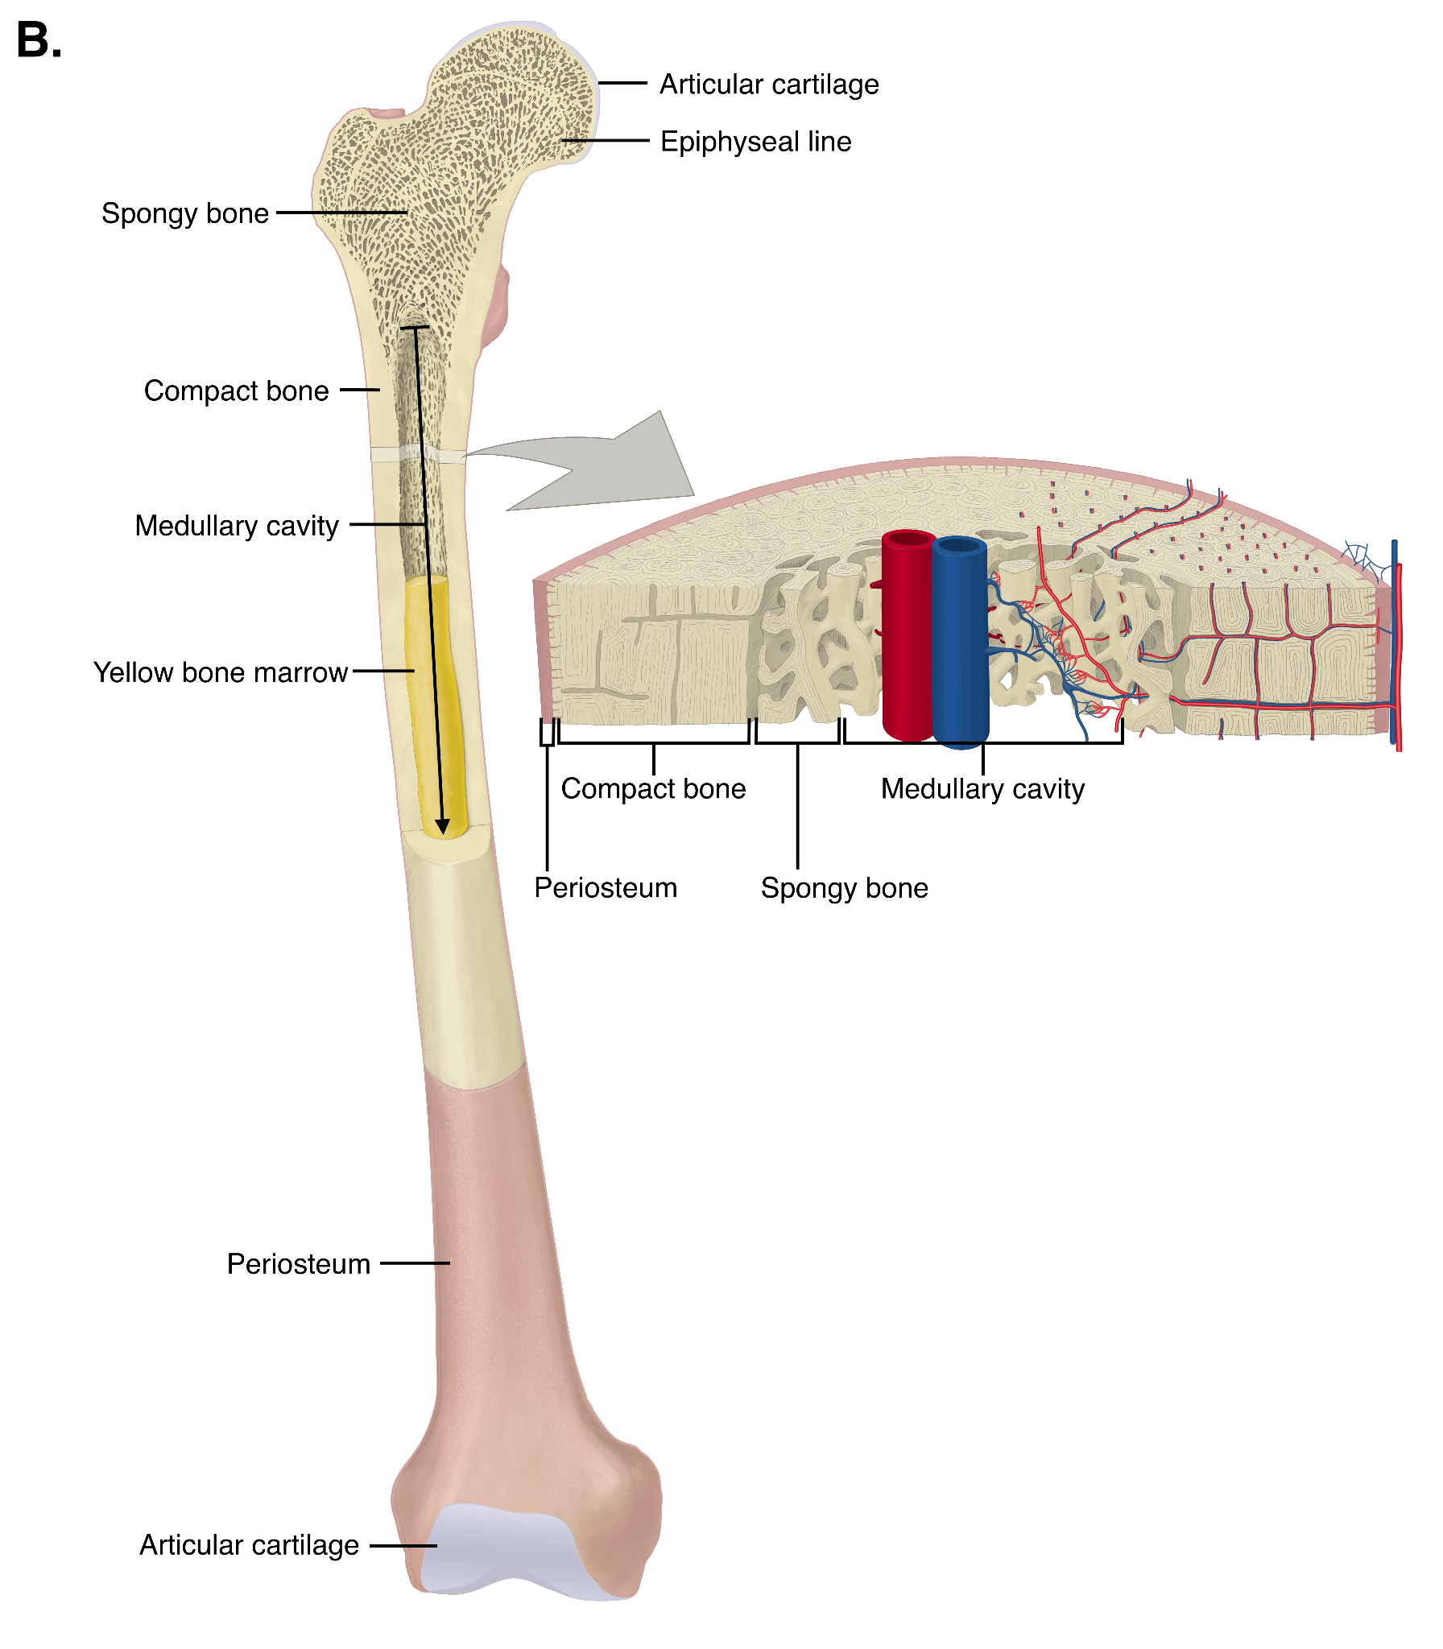
Jennifer Lange (Anatomy OER)

Slide 11
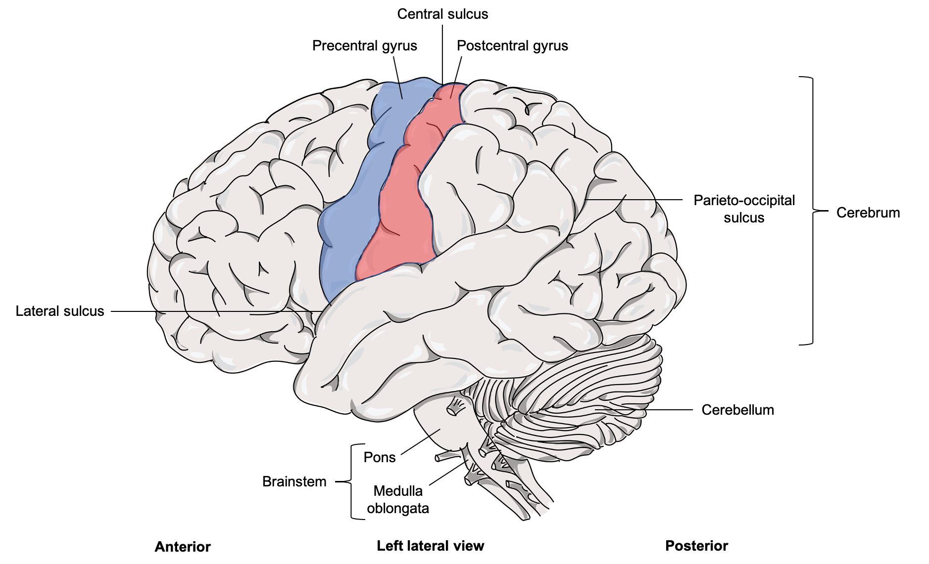
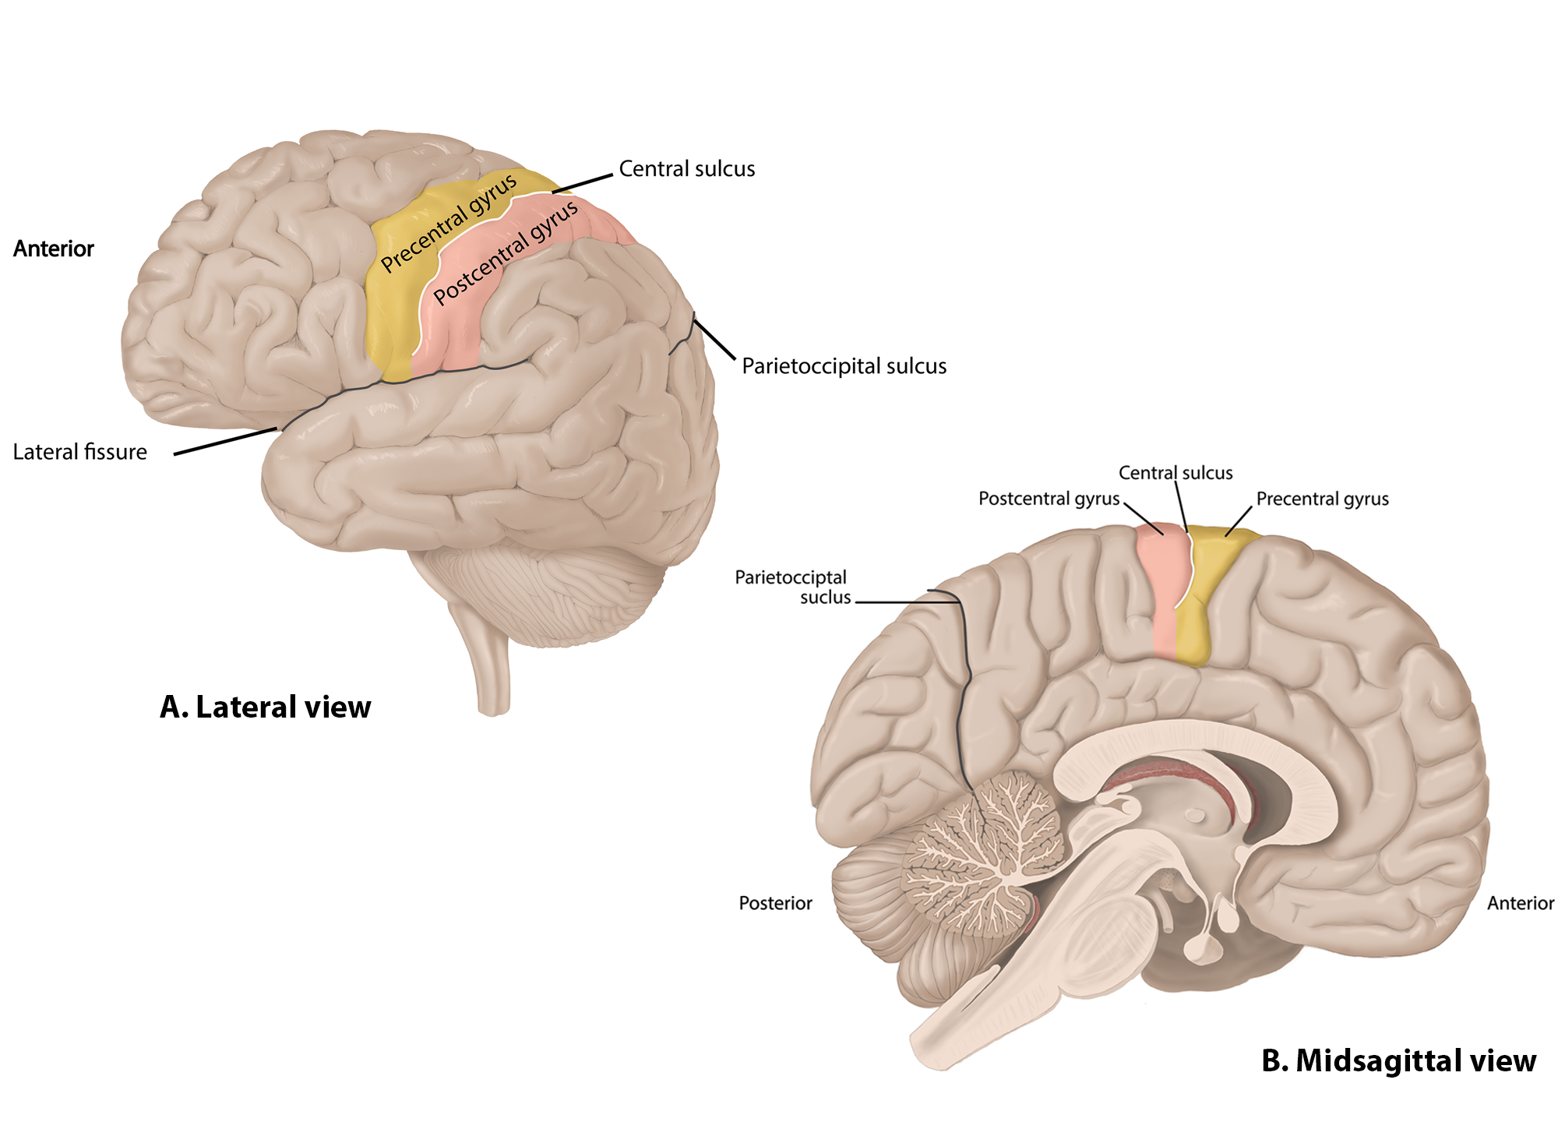
Jennifer Lange (Anatomy OER)

Slide 12
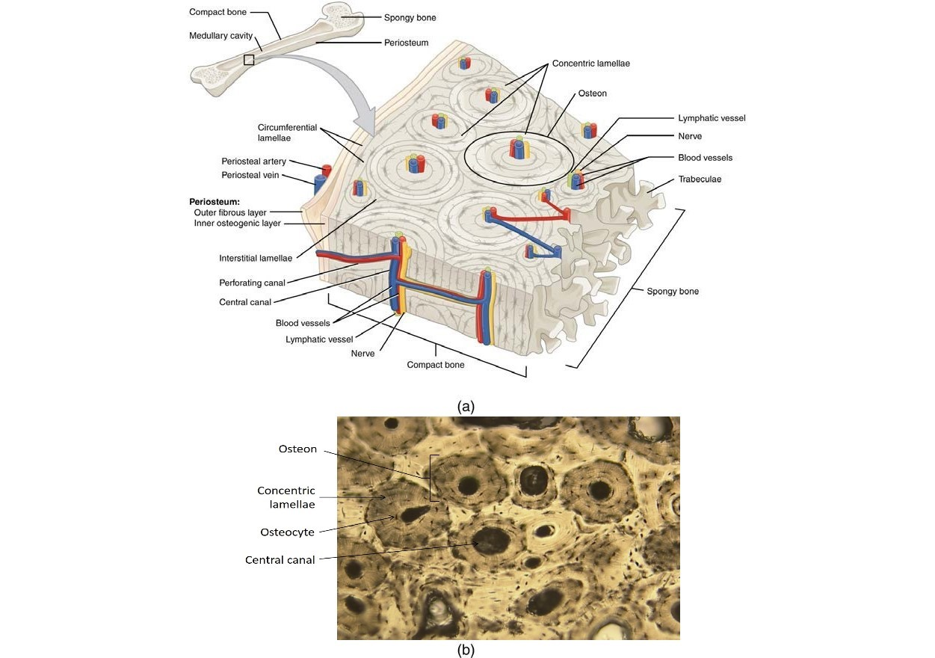
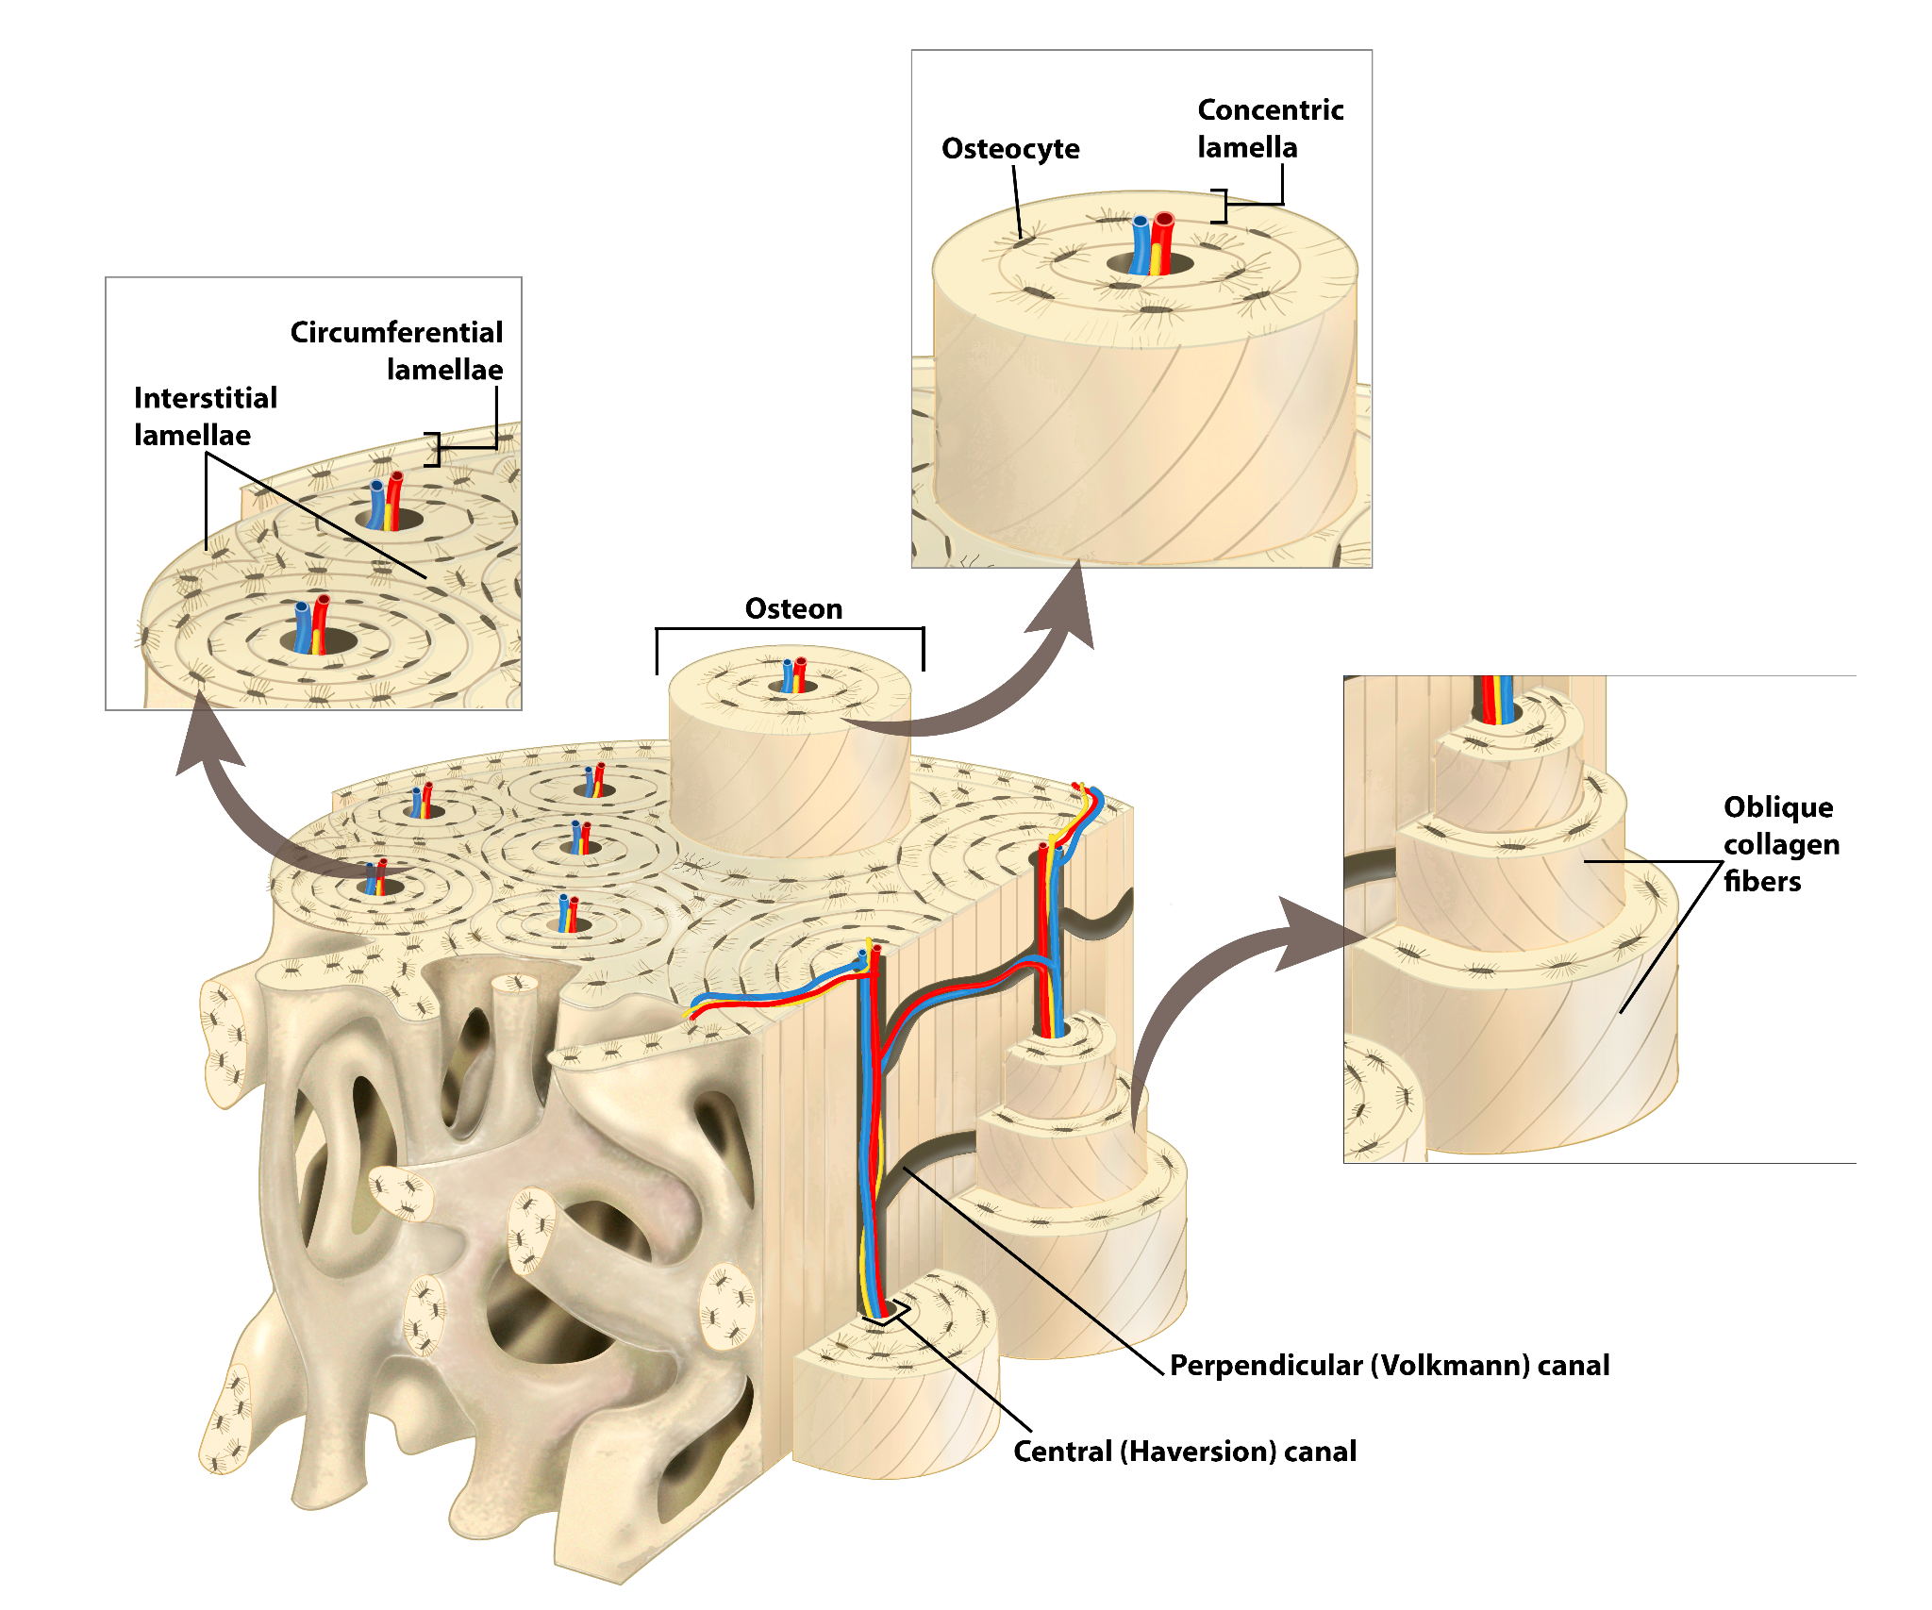
Jennifer Lange (Anatomy OER)

Slide 13
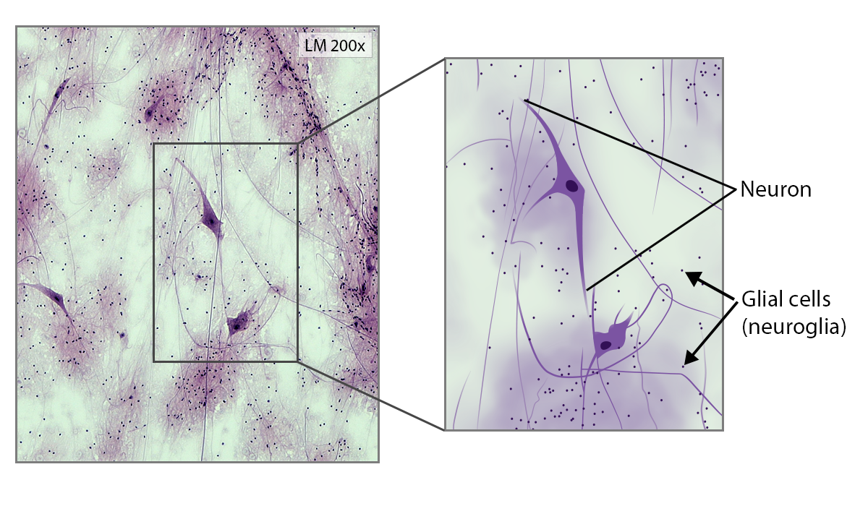
Jennifer Lange (Anatomy OER)

Slide 14
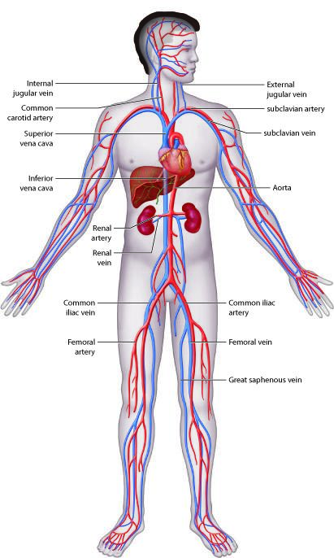
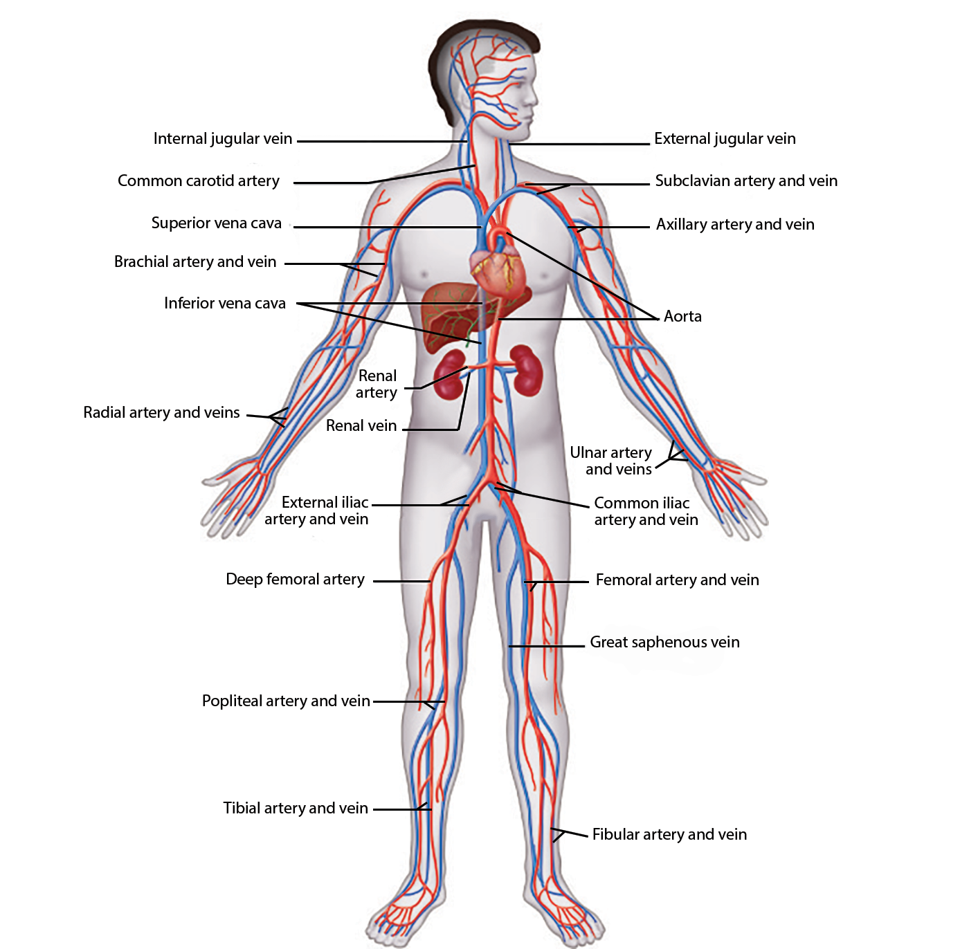
Jennifer Lange (Anatomy OER)

Slide 15
Microbiology
Books being used
Proposed work
Microbiology (OpenStax)
Cosumnes
CCSF
Planning to adopt - SD City
Lab Manual
Ancillaries in LibreTexts
Notes:
https://docs.google.com/document/d/1u9RXVtLew82hwsuCGkaSUmLF8OCKEZvMiASLMVvRk0U/edit?usp=sharing

Slide 16
Micro Discussion

Slide 17
Resources
ASCCC OERI Website (asccc-oeri.org)
Resources
Biology Resources
Image Resources
Webinars and Events

Slide 18
Questions / Discussions / Comments
Photo by Camylla Battani on Unsplash

Slide 19
And to contact us…
General OERI E-Mail: oeri@asccc.org
Find everyone’s e-mail at: https://asccc-oeri.org/about-us/

Slide 20
Thanks!
Photo by Thgusstavo Santana from Pexels

