Slide 1
Unlocking Open Educational Resources (OER)
Revised April 4, 2024. This work is licensed under a Creative Commons Attribution 4.0 International License.
Attribute this slide deck as: "Unlocking OER" by ASCCC OERI is licensed under CC BY 4.0.

Slide 2
Unlocking OER – Event Description
While OER can be open, some OER are effectively locked up – available only in formats that can’t be modified, housed in a course management system, built in proprietary software, or purposefully not allowed out into the wild of academia for specific reasons. Why should you consider freeing your OER? And what resources are available to help you unlock them? Join us to explore the challenges and benefits of releasing OER into the wild.

Slide 3
Presenters
Emilie Koenig
OER Co-Liaison, Chaffey College
Michelle Pilati
Project Director, Academic Senate for California Community Colleges Open Educational Resources Initiative

Slide 4
Overview
Why wouldn’t you let your OER roam freely?
Why should you free your OER?
What approaches are available to free your OER?
How do you prepare your OER for reintroduction into the wild?
Questions/Discussion

Slide 5
Curated OER Collections at Chaffey
Housed in Canvas to facilitate sharing.
Developed for discipline faculty following a needs assessment.
Photo by Mark Basarab on Unsplash
Notes:
An example of how/why a resource was developed in a restricted space.

Slide 6
Why have you caged your OER?
It’s not fit for sharing.
I don’t really know where it came from.
It’s not done.
I don’t want to share.
I know – or suspect – that it isn’t accessible.
I don’t want it to be judged by others.
I didn’t mean to.
Photo by Alexander Andrews on Unsplash

Slide 7
Reasons for Releasing Your OER
Sharing is caring – OER is about being open.
Making your OER generally available allows for students who need alternative versions to request them.
Allows students to access resources before and after the course.
If you are using ZTC dollars to do anything with your OER you are obligated to share your work.
Photo by Jessica Weiller on Unsplash

Slide 8
Benefits of sharing your OER:
Adopters can share feedback which will improve the resource. This makes a better resource for you, your students, and all who use it!
Others can (help) create new, updated editions of the OER, especially if you find yourself in a position where you're no longer able to do so. The OER can live on and be current without your constant attention.
Students, whether in your class or not, can utilize the OER as a reference or resource for lifelong learning.
Add to the shared knowledge and available resources. Sharing your OER means that someone else won't have to recreate a very similar resource from scratch.
Increase your visibility within your professional community. This can not only translate to increased name recognition but potentially increased opportunities based on your contribution.
Increase VCU's and/or your program's visibility. This is one way to increase national prominence, which is a part of the VCU Quest 2025 Strategic Plan.
Notes:
Source - https://guides.library.vcu.edu/create-oer/sharing – Virginia Commonwealth University - Creating Open Educational Resources

Slide 9
Freeing OER
Google
Harvesting
Canvas Commons
Canvas Site
Canvas > LibreTexts
Notes:
Thoughts about using Google?

Slide 10
Google
Usefulness dependent upon what your goals are.
If you built in Canvas, this requires a page-by-page copy and paste in order to share.
A benefit to Google Docs – if you are collaboratively building a document, this is a great tool. But once the document is built, sharing it in a different platform is better.

Slide 11
OERI Project Facilitators’ Google Thoughts
When downloaded, files change content and impact accessibility [reading order, access to links, alt text] between a Mac and PC, essentially undoing the work.
A lot of embedded code makes maintaining the format for Word files difficult.
You cannot maintain consistency of format and accessibility for slide decks.
Online accessibility checkers and other tools often don't interact well with Google tools, and embedded Google accessibility checkers are ineffective.
Any "accessibility fixes" in Google cannot be guaranteed to be maintained in other platforms.
Google tables can’t be made accessible.
Google doesn’t have a native accessibility checker - you must download Grackle. This tool has a free version that only identifies errors and a paid version that helps you fix errors. Also, some people have reported that this tool doesn’t work well in some browsers.
Notes:
Creating Accessible Documents in Word Processing and Presentation Software (https://guides.library.illinois.edu/c.php?g=1296806&p=9938787) – Confirms above statement about Google in #7.

Slide 12
LibreTexts Harvest
Review after harvesting required.
Quality of the harvest – and the time it takes to harvest – is dependent upon the original format.
LibreText’s goal is to house everything – so we why not request a harvest of a quality resource you wish to use?

Slide 13
Canvas Commons
Canvas Commons makes it very easy to share entire courses.
But:
Printing option not available.
Unable to view entire course without importing into a course shell.
Security of assessments may be a concern.

Slide 14
Canvas Site
A Canvas shell can be made into an open site – making all the content readily viewable.
View one of Chaffey’s Hubs as a website – log in required to access discussions.
Notes:
Chaffey Hub URL - https://ccconlineed.instructure.com/courses/11384

Slide 15
Canvas > LibreTexts
LibreTexts has automated the process of importing a Canvas export into LibreTexts.
This puts the content into an editable and printable format.
Review will be required to confirm quality of the import. Quality of import can vary.
Collaboration within LibreTexts is then possible.

Slide 16
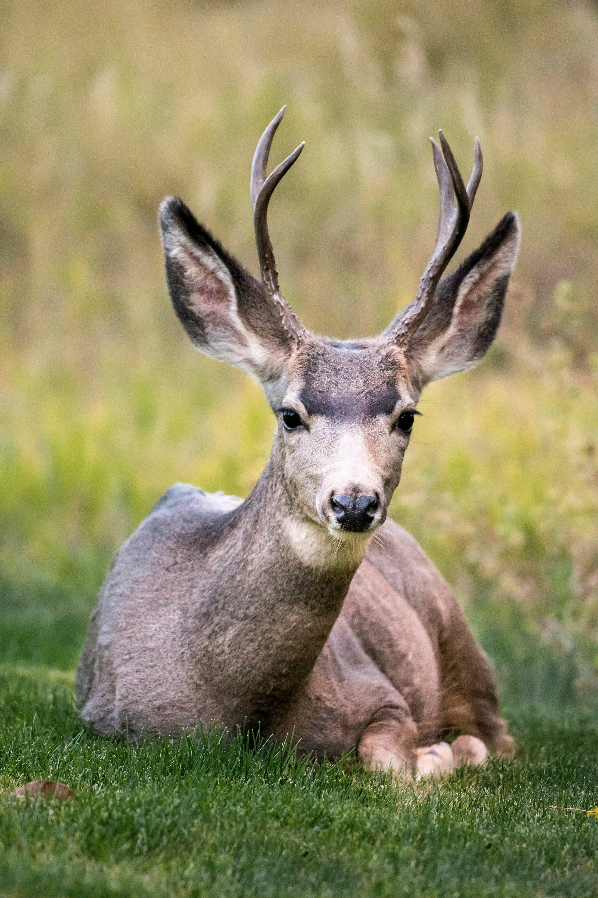
Preparing your OER for release
Remove resources and references as needed
Peer review
Accessibility review
Licensing review
IDEA review
If OER contains library resources - replace links with appropriate information
Photo by Pedro Lastra on Unsplash

Slide 17
More Information
ASCCC OERI Website (asccc-oeri.org)
Resources
Webinars and Events
ASCCC OER E-Mail (oeri@asccc.org)

