Slide 1
OER Curriculum
Teaching with Notebooks
Eric Van Dusen ericvd@berkeley.edu

Slide 2
UC Berkeley creates new set of courses in Data Science
Data 101 - 2021
Data 102 - 2019
Data 140
Data 88C
Data 88E
Data 88S
Data 6
Econ 148
Starting with Data 8
2015
Then Data 100
2017

Slide 4
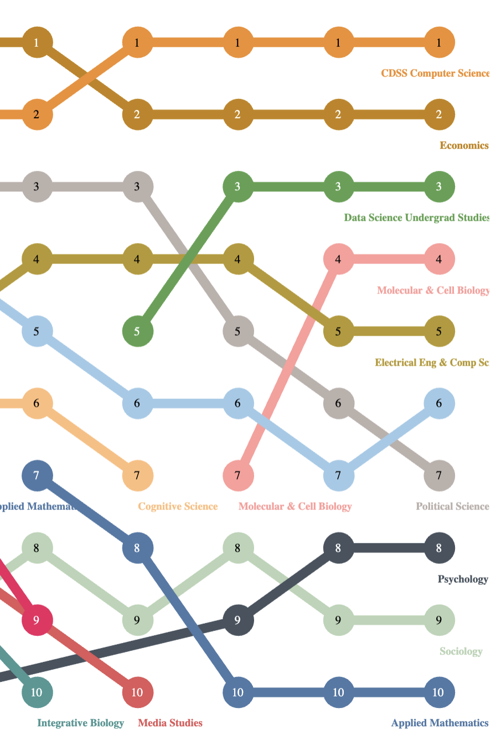
Top 10 Majors at Berkeley
Massive Growth to 3rd biggest major (740)
Open to all - not an “elite” major
Connections to other disciplines
https://pages.github.berkeley.edu/OPA/our-berkeley/degree-recipients-by-major.html
2019
2023
Notes:
Draft: (cumulative stats about # of domain emphases, diverse student body of data 8)
Draft: (something about the growth of the modules + connectors)
Draft: (student teams that work with professors to create lecture + lab content)

Slide 5
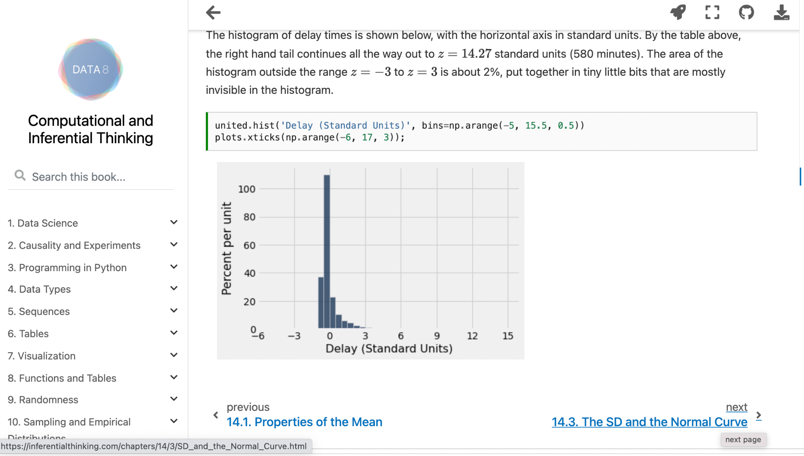
Data 8 Textbook - deployed on Github, built from Notebooks, code and outputs integrated

Slide 6
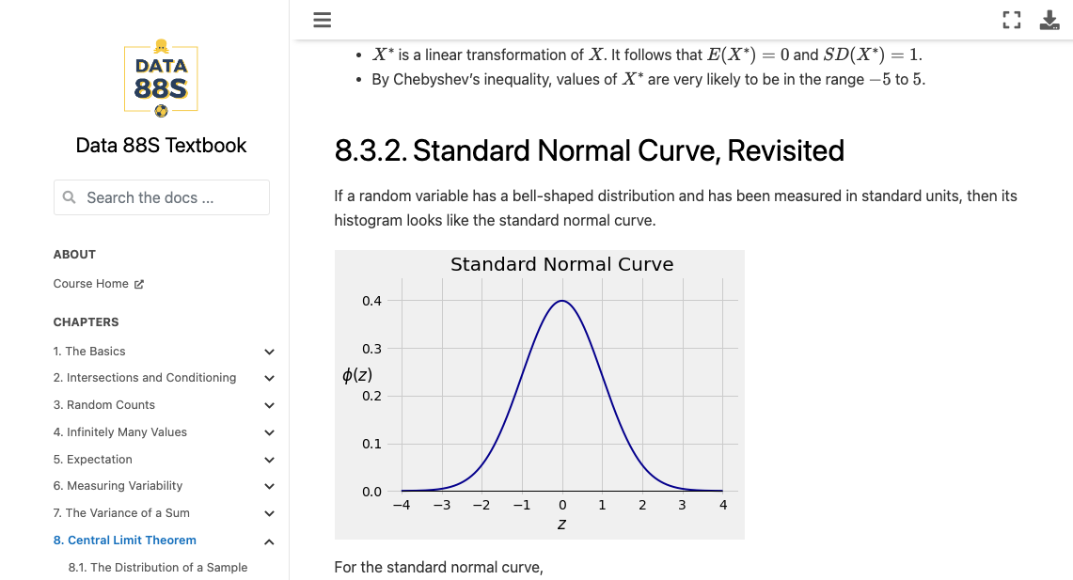
Textbooks - Data 88S

Slide 7
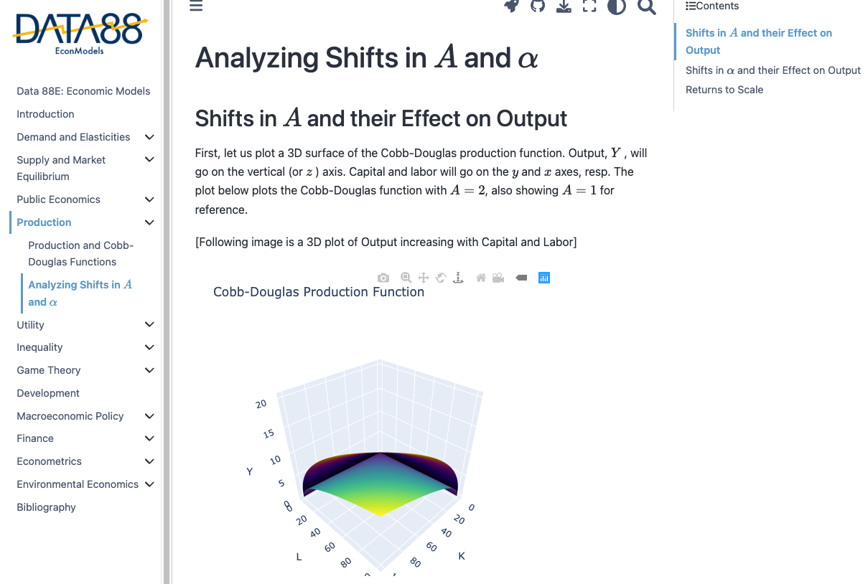
Data 88E Textbook

Slide 8
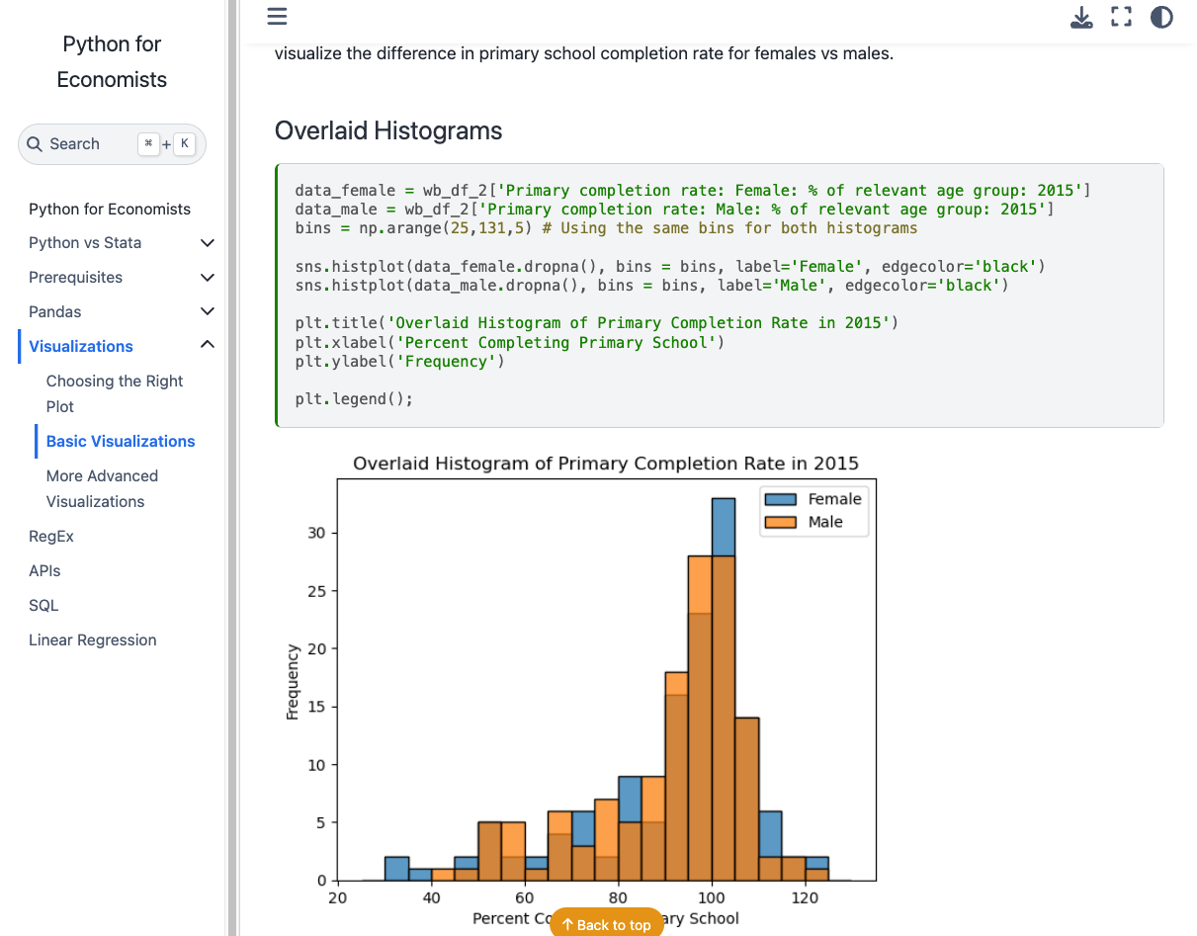
Econ 148 Textbook

Slide 9
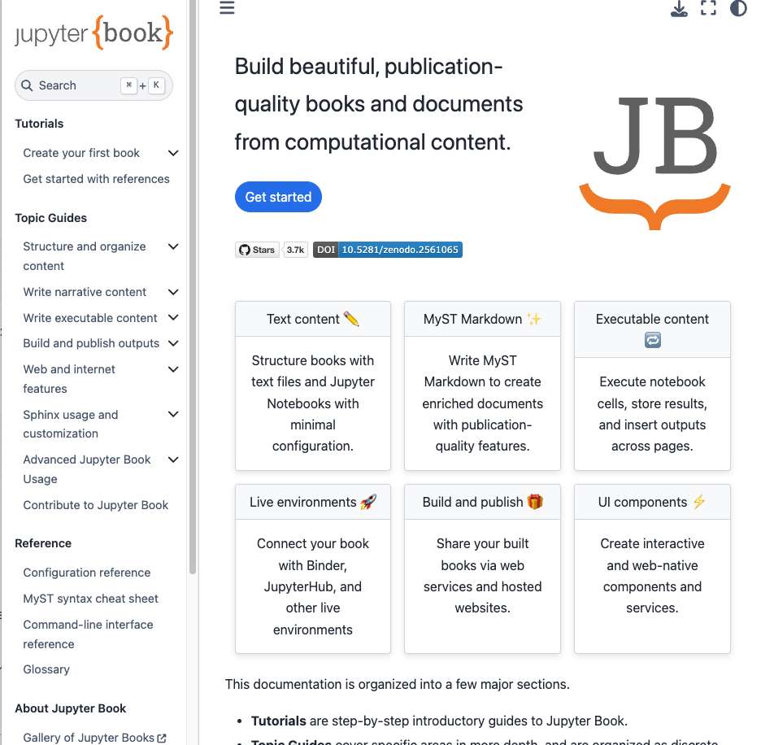
Jupyterbook
folder of ipynb and md files
toc.yml - chapters
“Stitch” into html folder
post to web

Slide 10
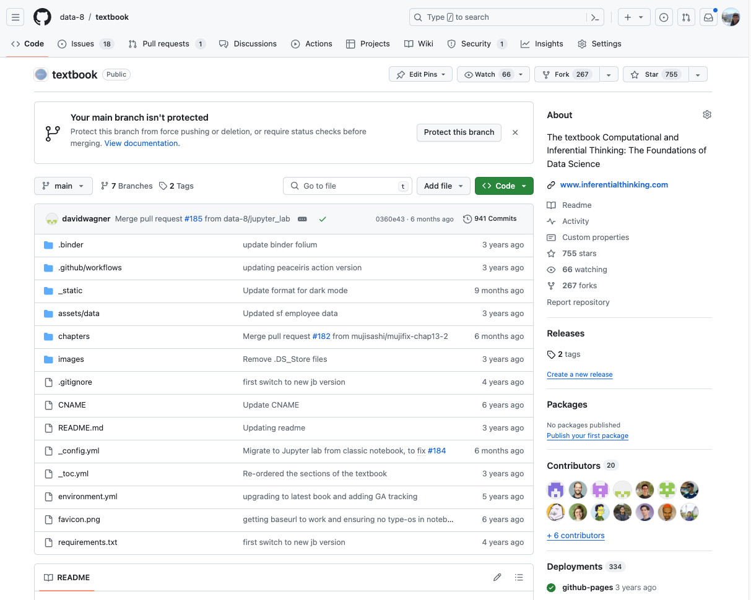

Slide 11
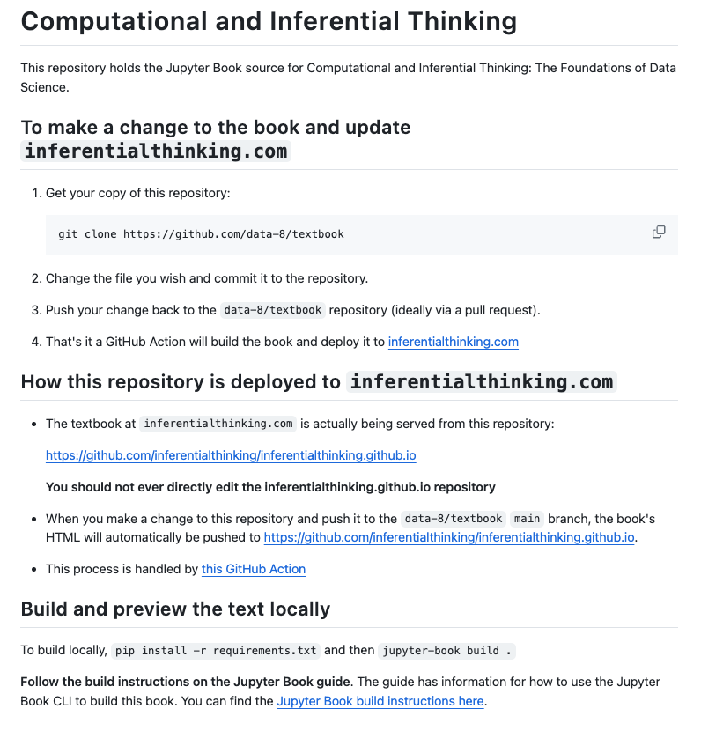

Slide 12
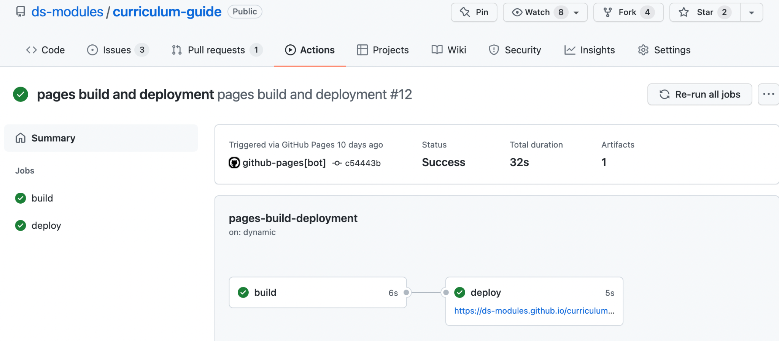
Jupyterbook build via GitHub Actions

Slide 13
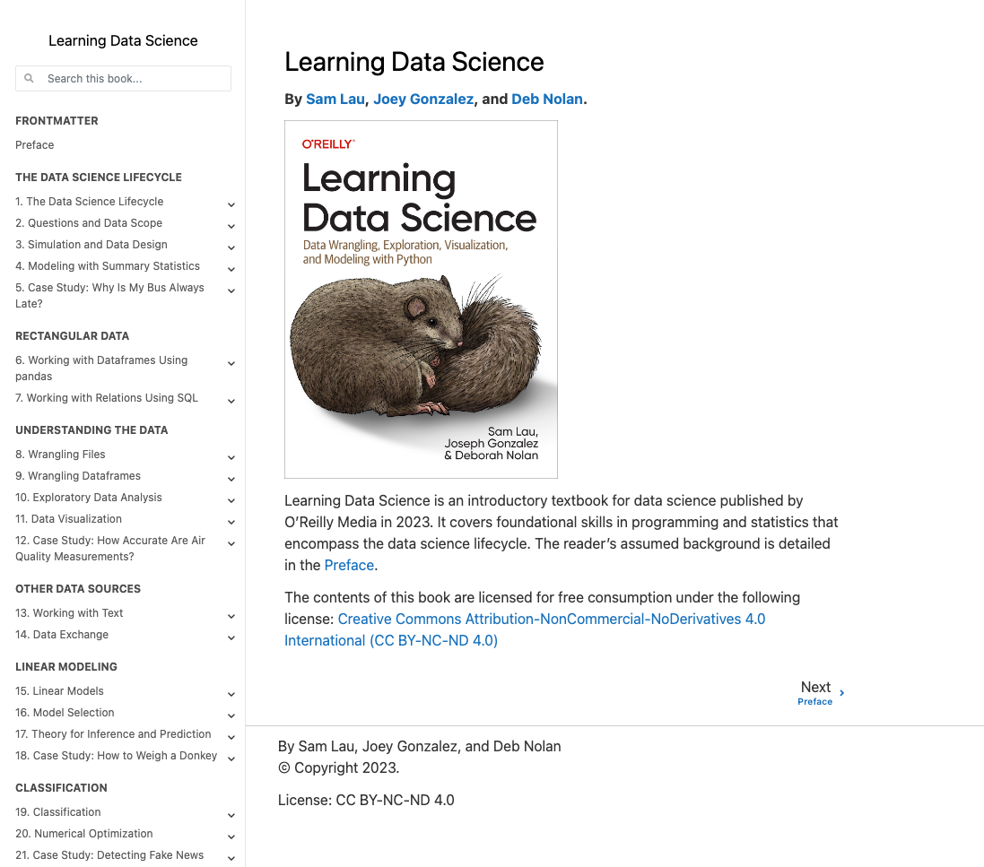
Data 100
OReilly +
Online Book

Slide 14
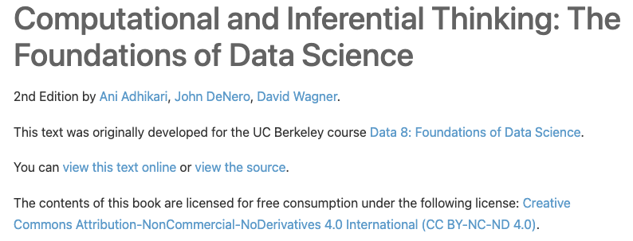
Lets talk about ND

Slide 15
No derivative
No taking out a single chapter
No remixing
No translations
Is this truly OER Is this truly Open

Slide 16
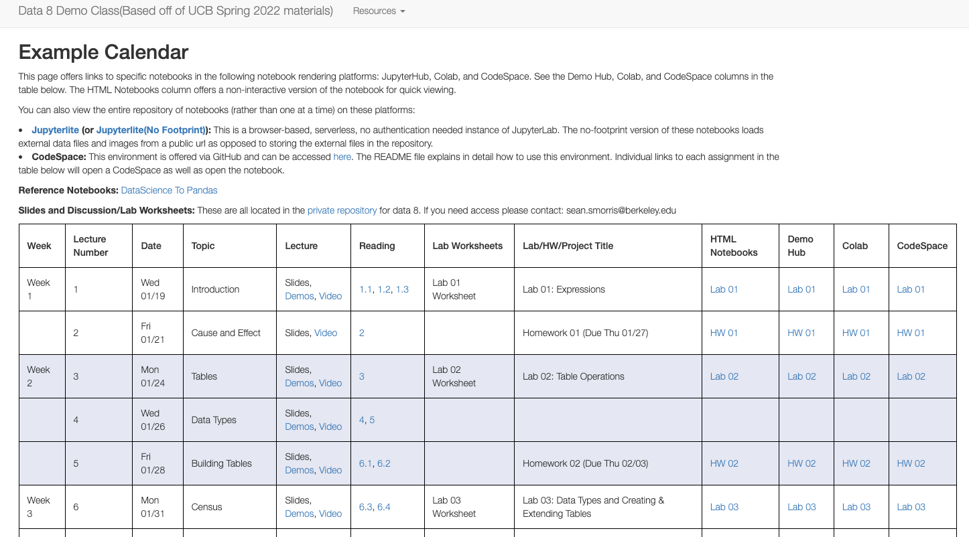
Other Resources - Data 8 Demo Site

Slide 17
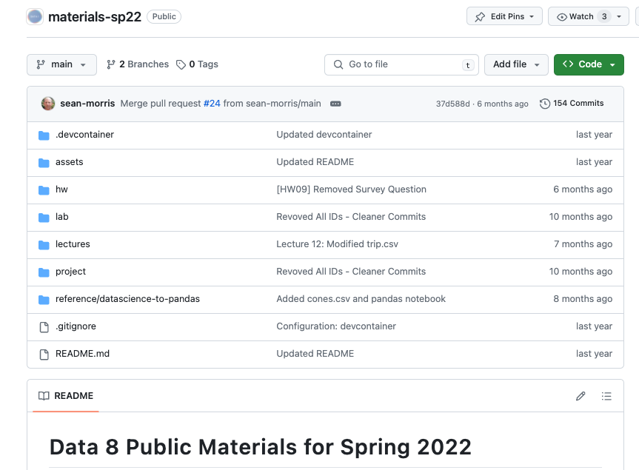
Data 8 - its the Labs!

Slide 18
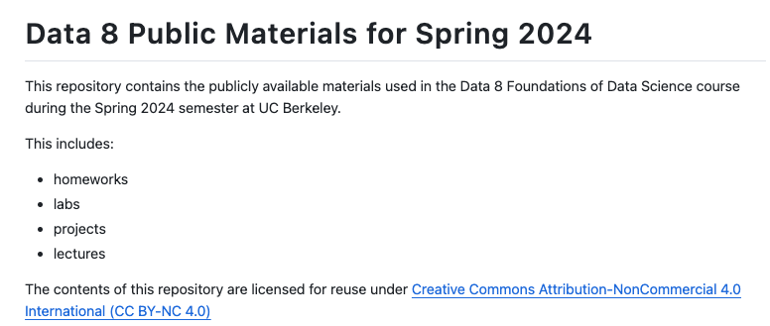
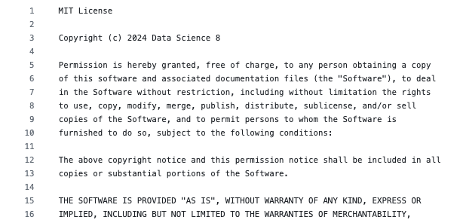
Data 8 Labs
Combo of
CC-BY-NC
and
MIT

Slide 19
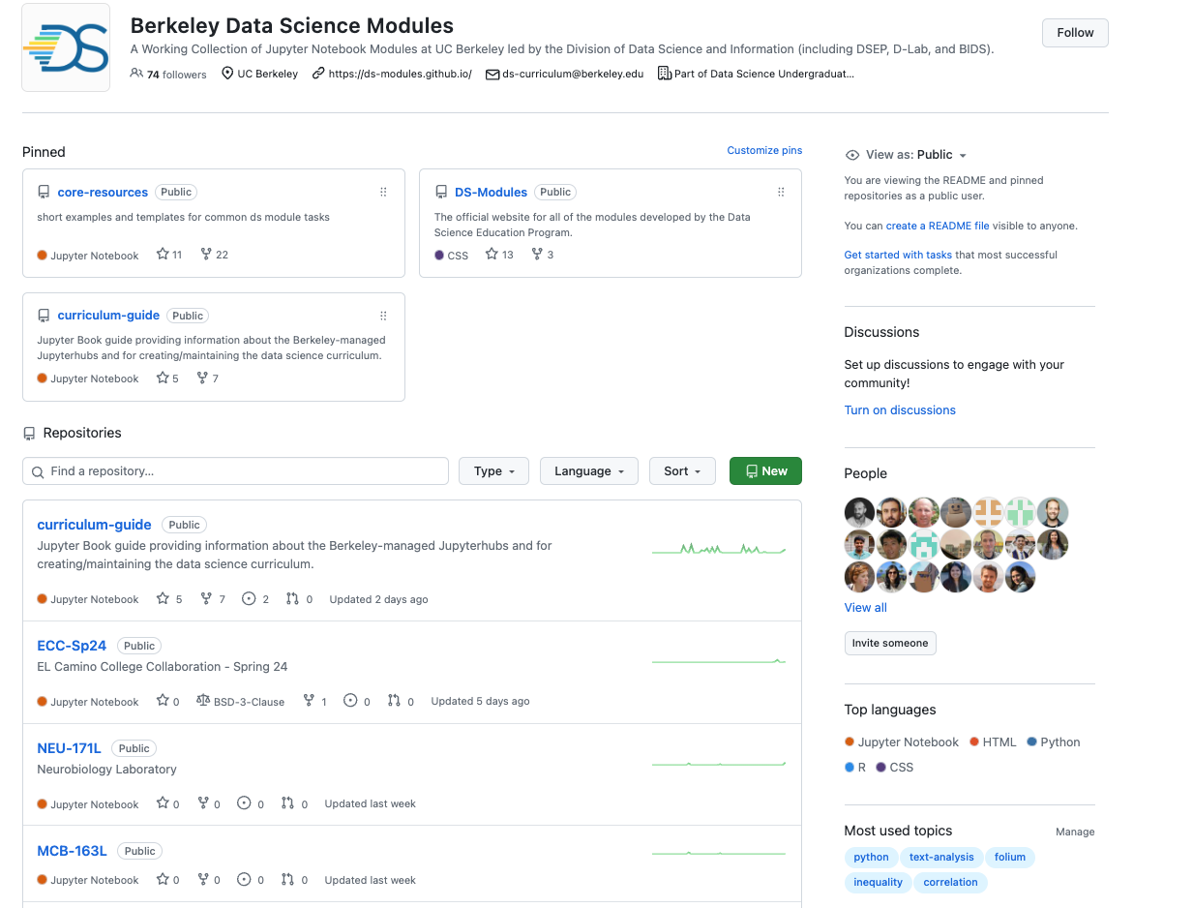
https://github.com/ds-modules

Slide 21
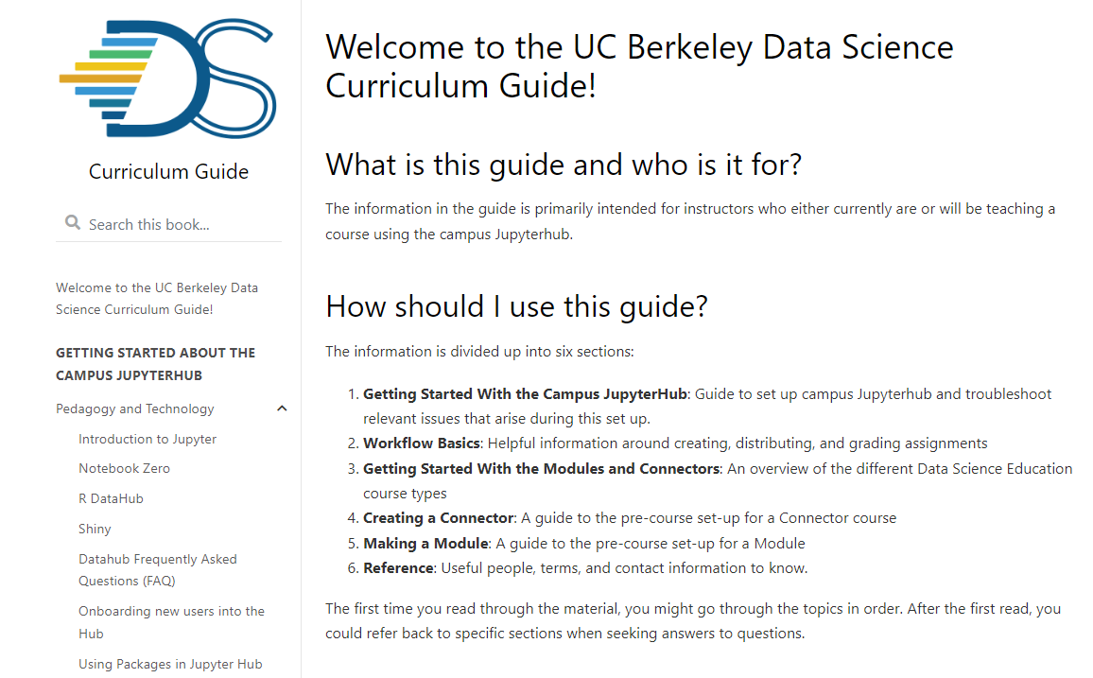
Curriculum Guide
https://ds-modules.github.io/curriculum-guide/intro
What if we wrote a free book for educators that brings together how to use these open sources tools for teaching…. and what if that book was written in notebooks and hosted on github

Slide 22
Pedagogy Choices –
Using Notebooks in Teaching: a spectrum
Notebooks Completely Filled Out:
Used to Demonstrate
Reproducible Exposition
Students Start Own Notebooks from Scratch
Scaffolding
Labs for Teaching
Homeworks & Projects
OER!
What Do You Want Students to Learn?
What Do You Want Students to Do?
Free Form Answers -
“Manual” Grading
No Automation
Autograding -
Closed form solutions
Code passes tests
Multiple Choice

Slide 23
Course-specific Python packages
http://data8.org/datascience/
http://prob140.org/prob140/
Beginner-friendly packages for introductory data science and probability courses
Accessibility of packages extends data science education to students of all backgrounds
( and .. eg babypandas from UCSD)
Notes:
(Prachi)

Slide 24
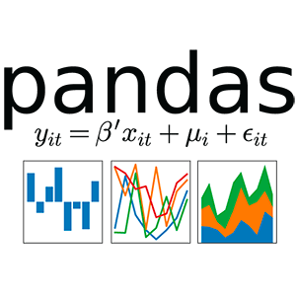
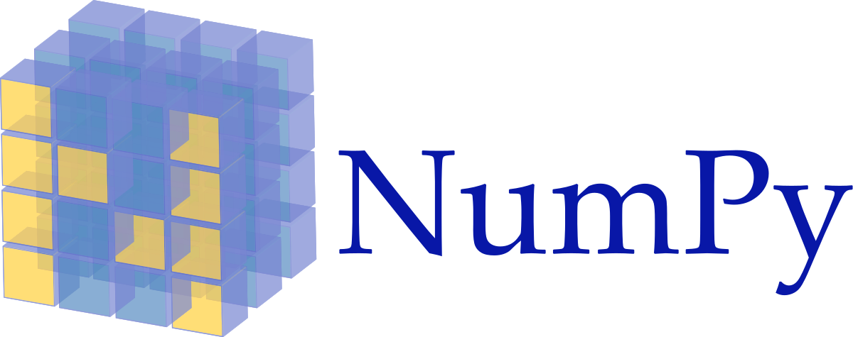
Classes Built on Open Source Packages!
Folium

Slide 25
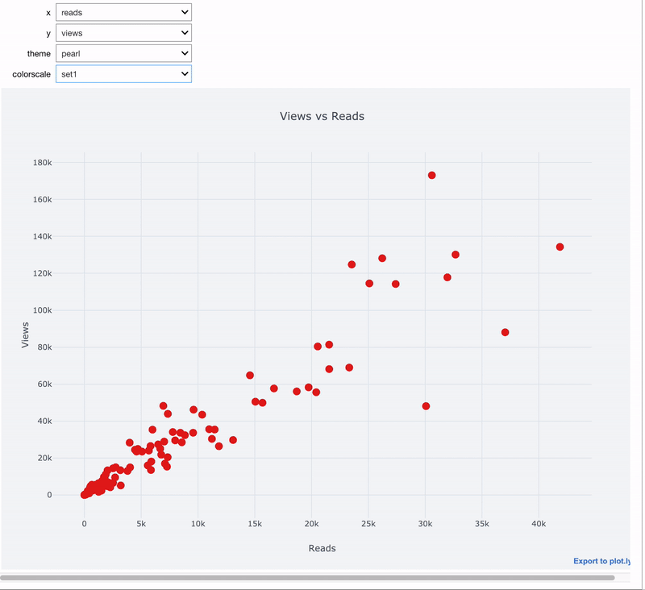
Interactive Widgets! - IPyWidgets
It’s also possible to make notebooks into interactive apps with simple widgets / sliders, radio buttons, dropdowns, etc
Notes:
Add demo GIFs

Slide 26
Notebook elements
Markdown
Descriptive / Narrative / Pedagogical
Can include Latex equations with $
Links / Videos / Images
Code
chunks of code
immediately view output
coding challenges, half written lines

Slide 27
Workflow within a notebook
Import Packages
Introduction
Read in Dataset
Show Dataset
Visualize a few variables
Coding challenges
Markdown related questions
Instructions for Download and Submission
What is Outline
What are learning outcomes
What are students required to do
What is linked across sections
Program Part A - use in Part B

Slide 28
Workflow in a class
Building Labs
Grading setup for Labs
Building Lecture Notebooks
Building Course Notes- Textbook
Building Website
or eg adapting Canvas
Course specific packages
Course management software

Slide 29
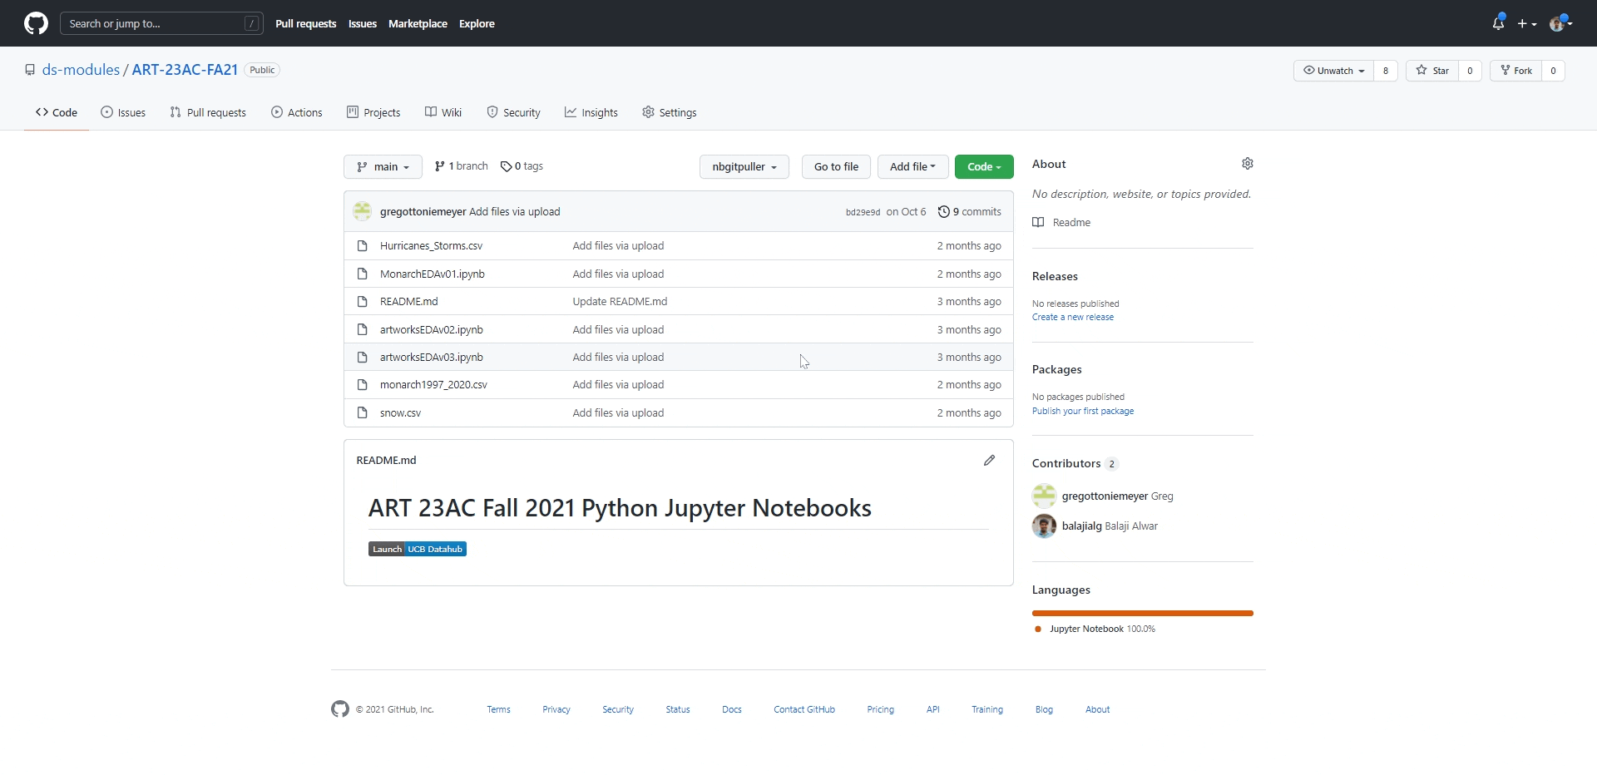

Slide 30
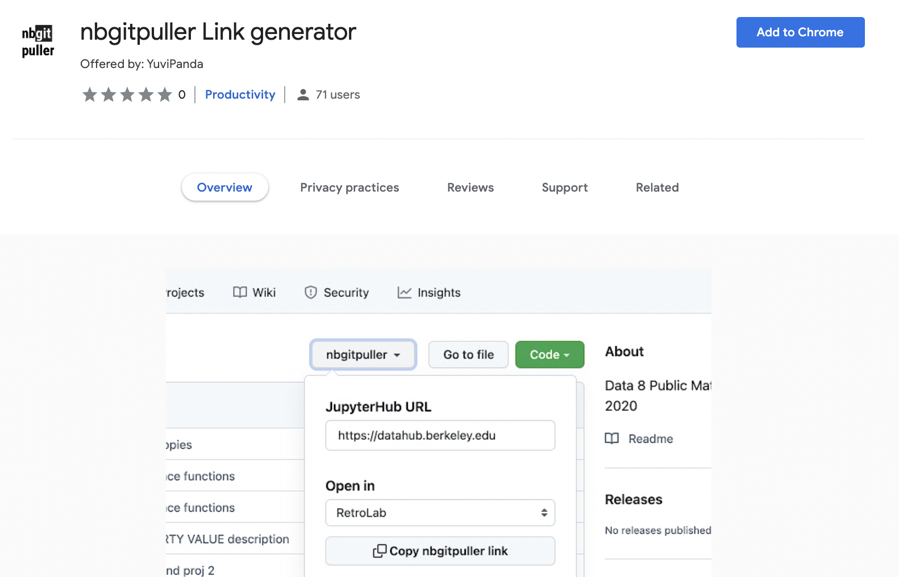
Chrome Extension!

Slide 31
Otter Grader - a python package
Light-weight open-source automatic grader designed to grade jupyter notebooks for any size group of students by abstracting away the autograding internals.
Handles jupyter notebooks in Python or R
Assignment development, distribution and grading tool
Submissions can be graded locally, in the cloud or via Gradescope(with license)
Otter v4 rolling out in Data 8
Needs to be present on JupyterHub
Big Change from v3: tests are in meta-data not in separate folder
Notes:
The key abstraction of Otter: “you provide the compute, otter takes care of everything else”

Slide 32
Otter Grader - in Data 8
All of the notebooks for Data 8 are created with Otter-Grader markdown
Essential to teaching a 1500 student courses
Students get real time checks that they are on the right path, within the notebook they get feedback
Coding part of assignments can be used for grading
Solutions are available for instructors but not students
Otter-Grader workflow:
create teacher notebooks
otter generates student notebooks and files to handle automatic grading
student notebook distribution
collect notebooks and grade
Notes:
The key abstraction of Otter: “you provide the compute, otter takes care of everything else”

Slide 33
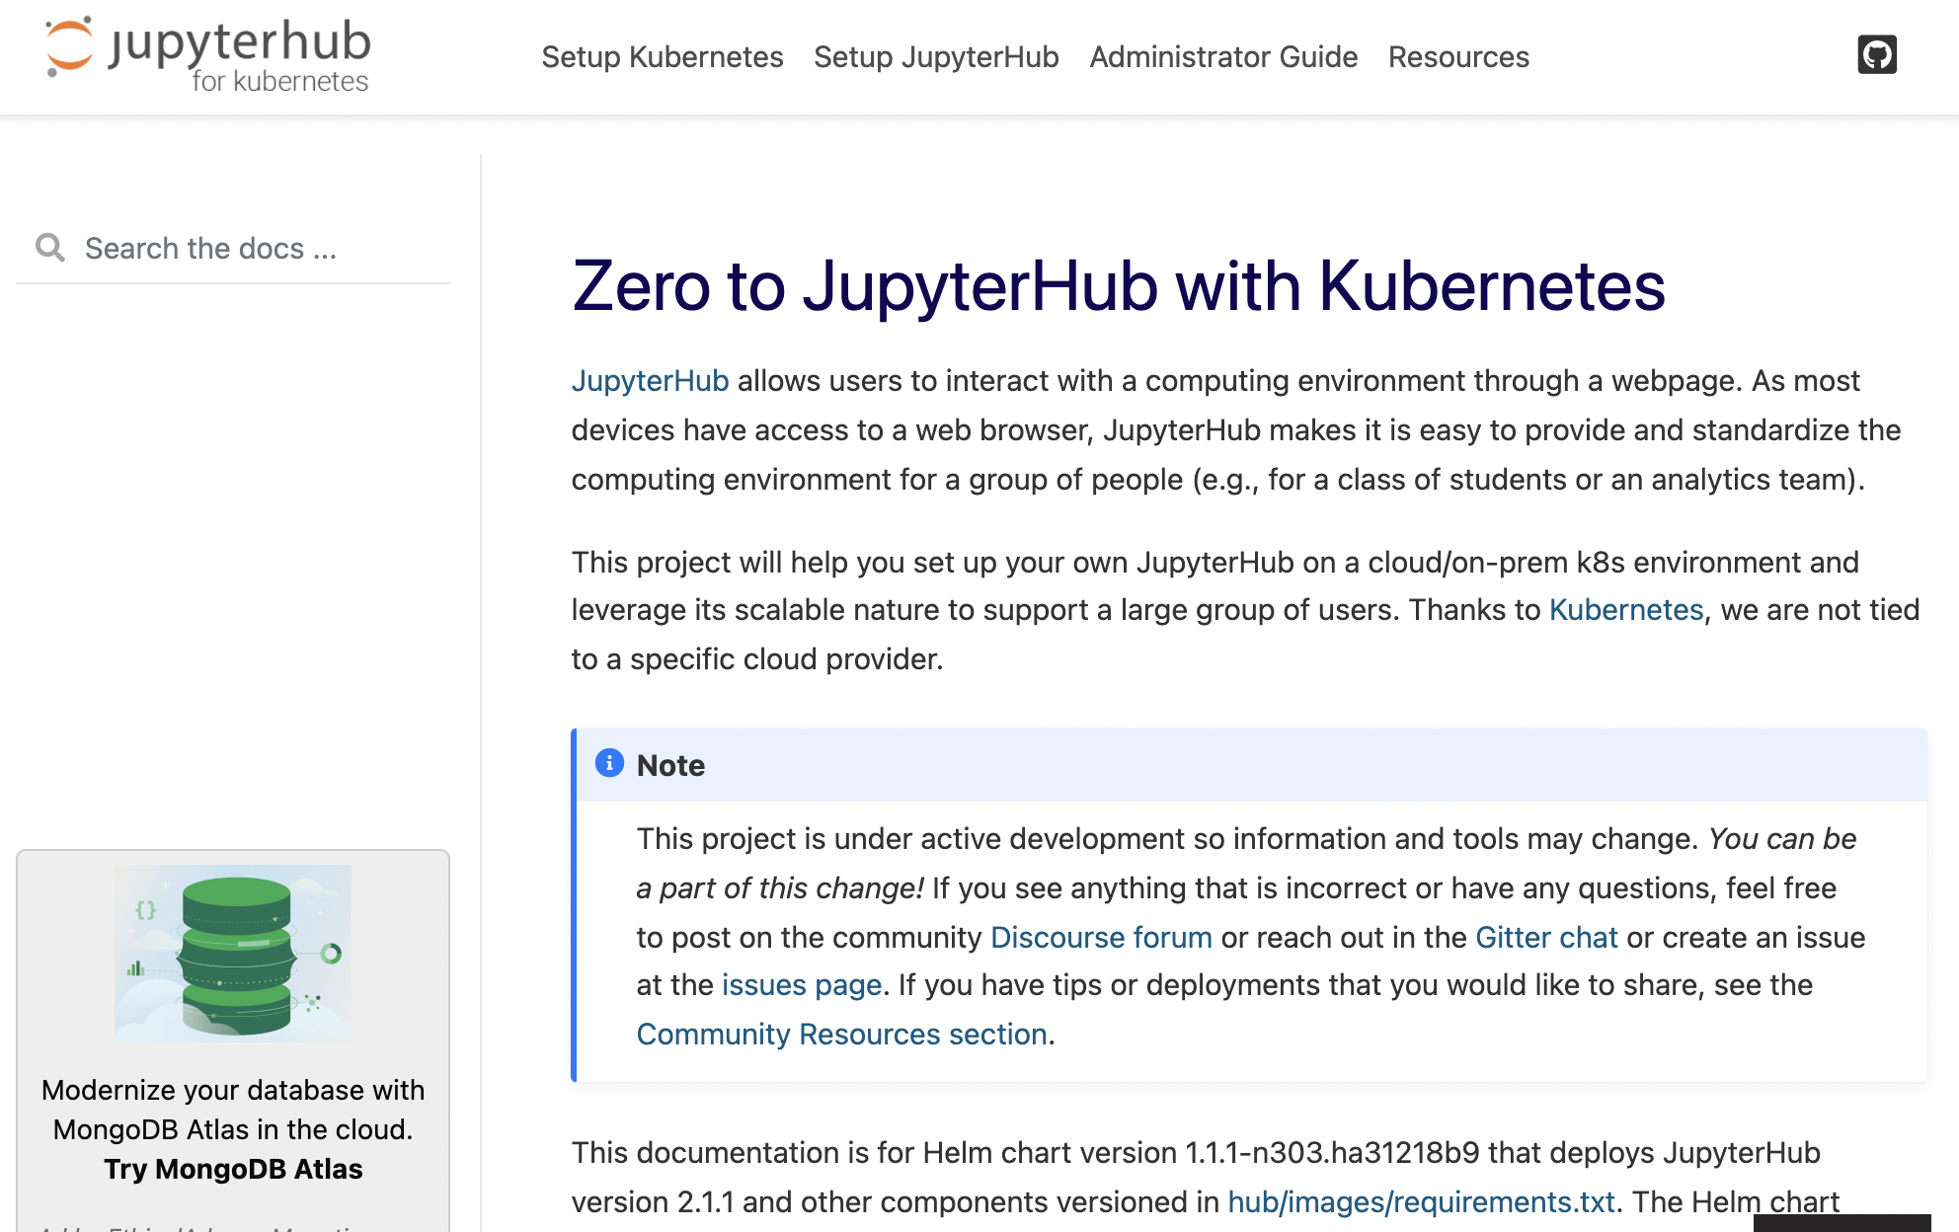

Slide 34
Jupyter Disambiguation
What are these technologies: Jupyter Notebook, JupyterLab, JupyterHub?

Slide 35
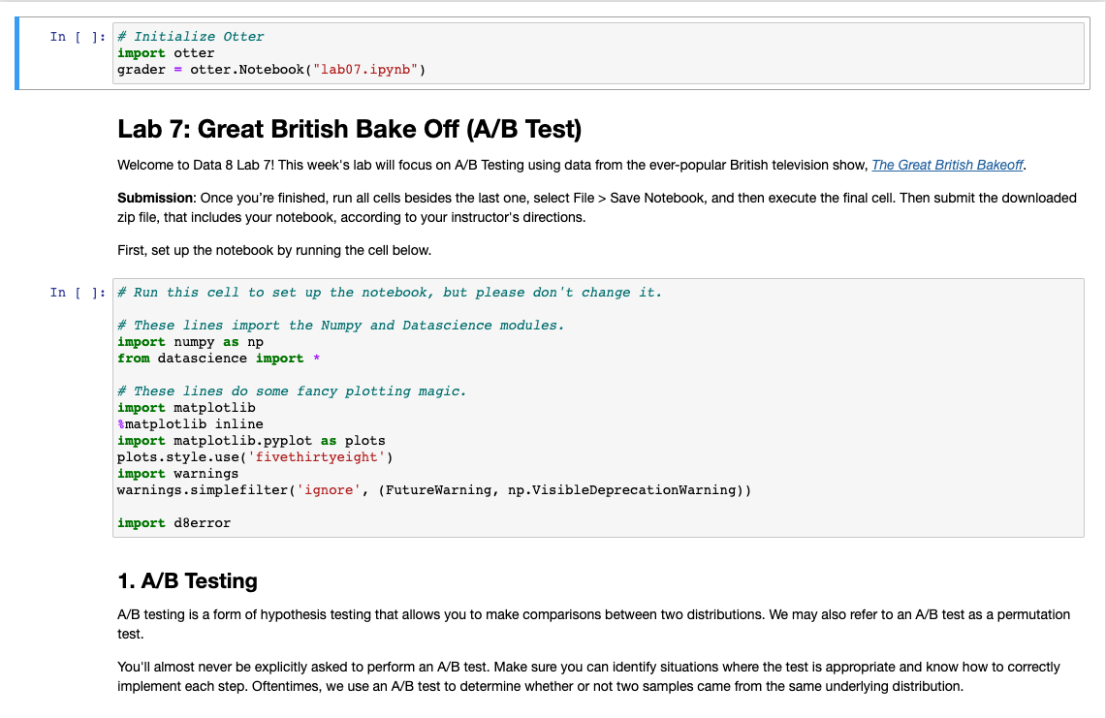
Jupyter Notebook - the File
Document Type (.ipynb) includes:
Explanatory text in Markdown
Code chunks (Python, R, …)
Outputs from code (e.g. visualization)
Data 8 curriculum: (~30) of these files
Students:
Get a copy
Read, Write Code, Evaluate Results
Submit the notebook to instructor
“a page of an interactive textbook”

Slide 36
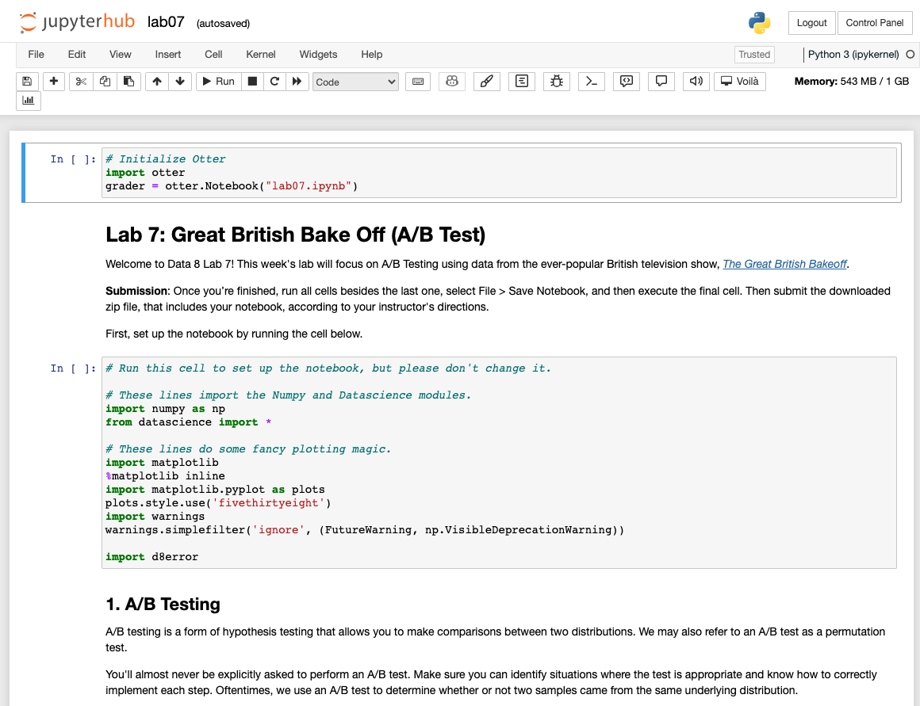
JupyterLab - the Web app
Web Application to:
render Jupyter Notebook files
edit elements of a Notebook
execute the code in a Notebook
handle files: download, save, etc
Data 8 Students work in this environment
JupyterLab is:
Open source software
installable via Anaconda
Python or R Interpreter

Slide 37
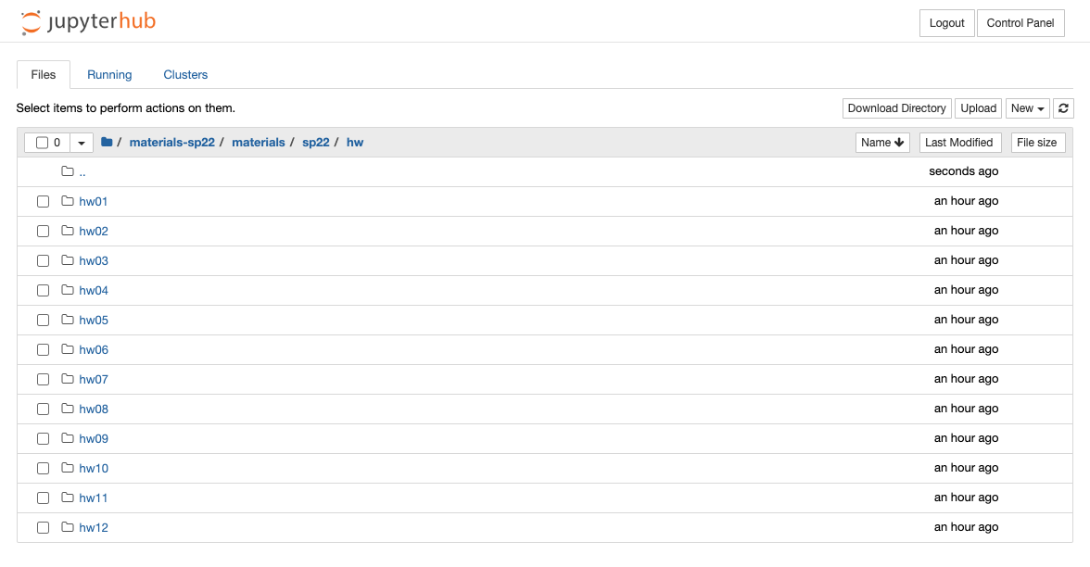
Jupyterhub - a server
Web Server to:
distribute notebooks at scale to students
provide disk space for storing notebooks
provide computing resources to students
handles student authentication
provide instructors ability to see student notebooks and offer help
Installations:
zero student installation of software
The Littlest Jupyterhub - simple install
Cloud based Jupyterhub via Kubernetes optimizes cloud costs

Slide 38
Workflow Authoring to teaching
Develop Notebook/Lab
(Otterize student version)
Push to Github
Make Nbgitpuller Link
Share Link to students
Students do Lab
Students Submit lab
Grading of Lab
How are students
Pushing to public repo on Github
( associated files and datasets)
What are students required to do
How are you sharing
Where are they submitting

Slide 39
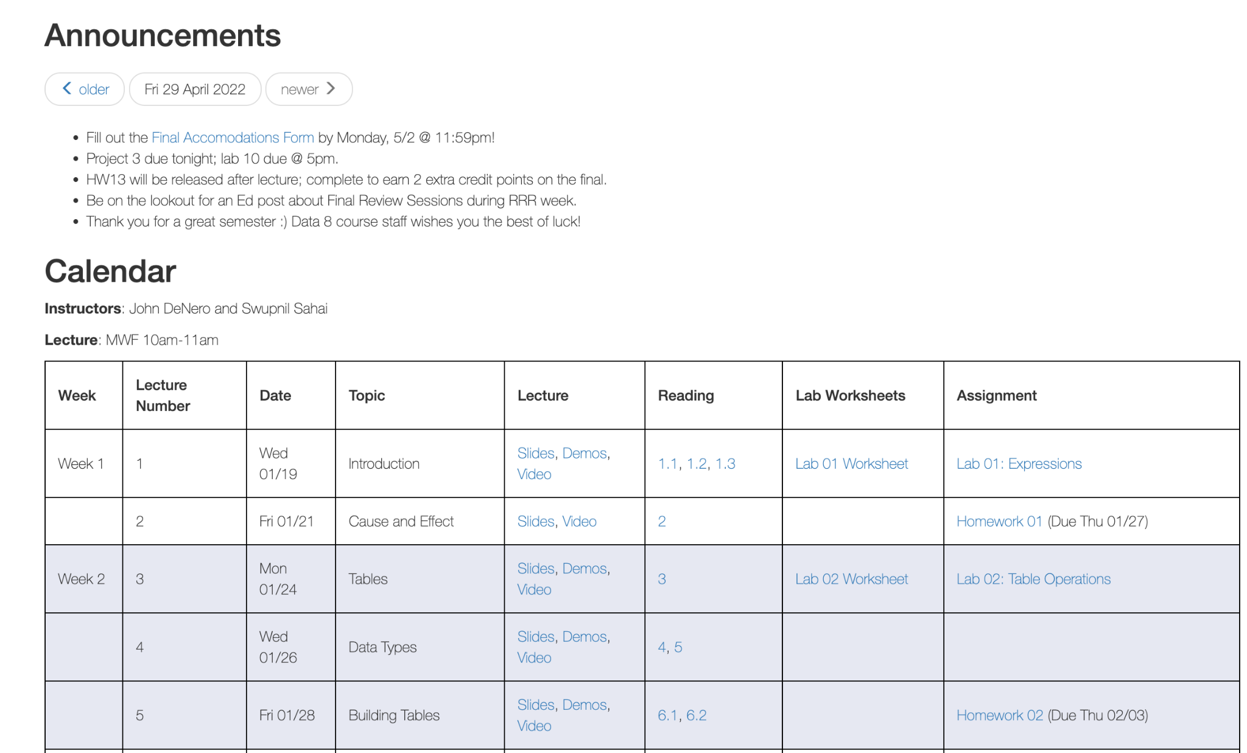
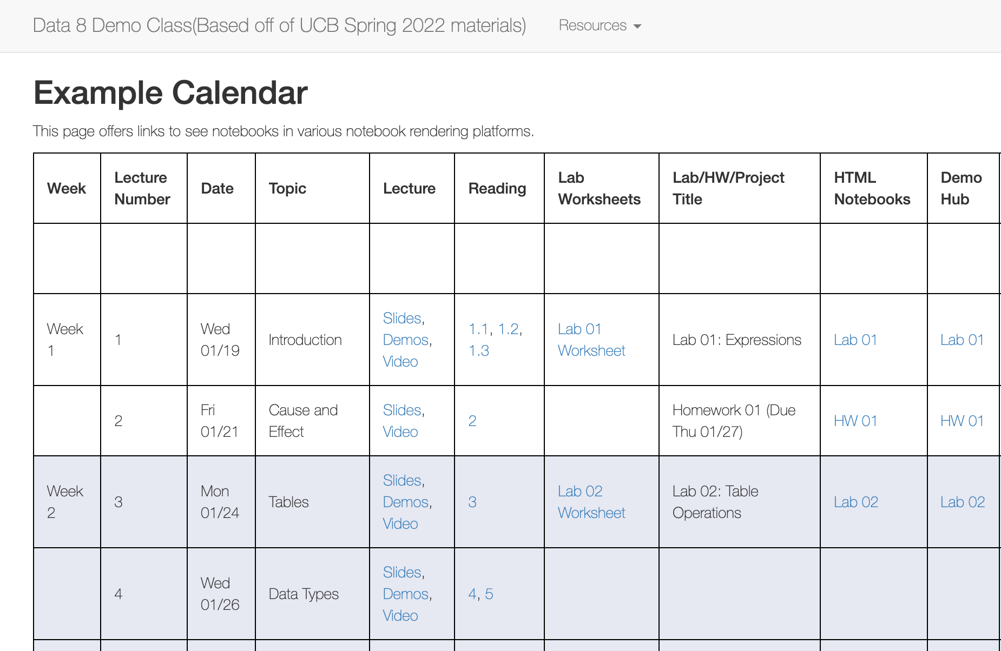
Data 8 - Course calendar with interact links
Data 8 at Berkeley
Data 8 demo external calendar
github - you can fork this for your course

Slide 40
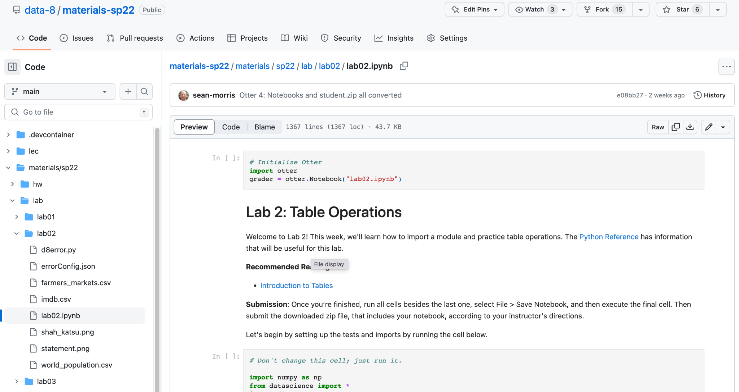
Data 8 Materials on Github

Slide 41
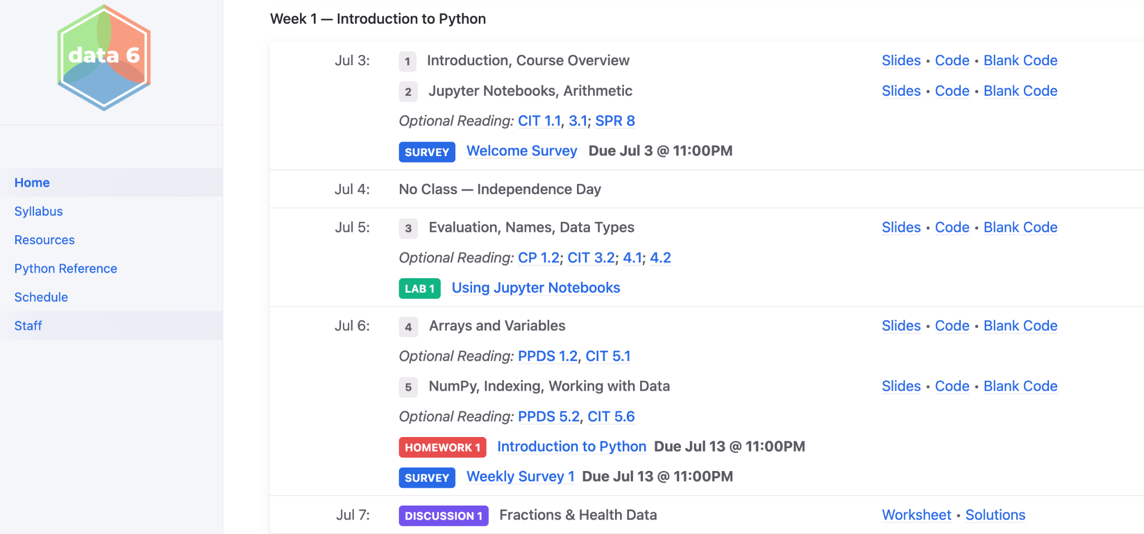
Data 6 - Summer 23

Slide 42
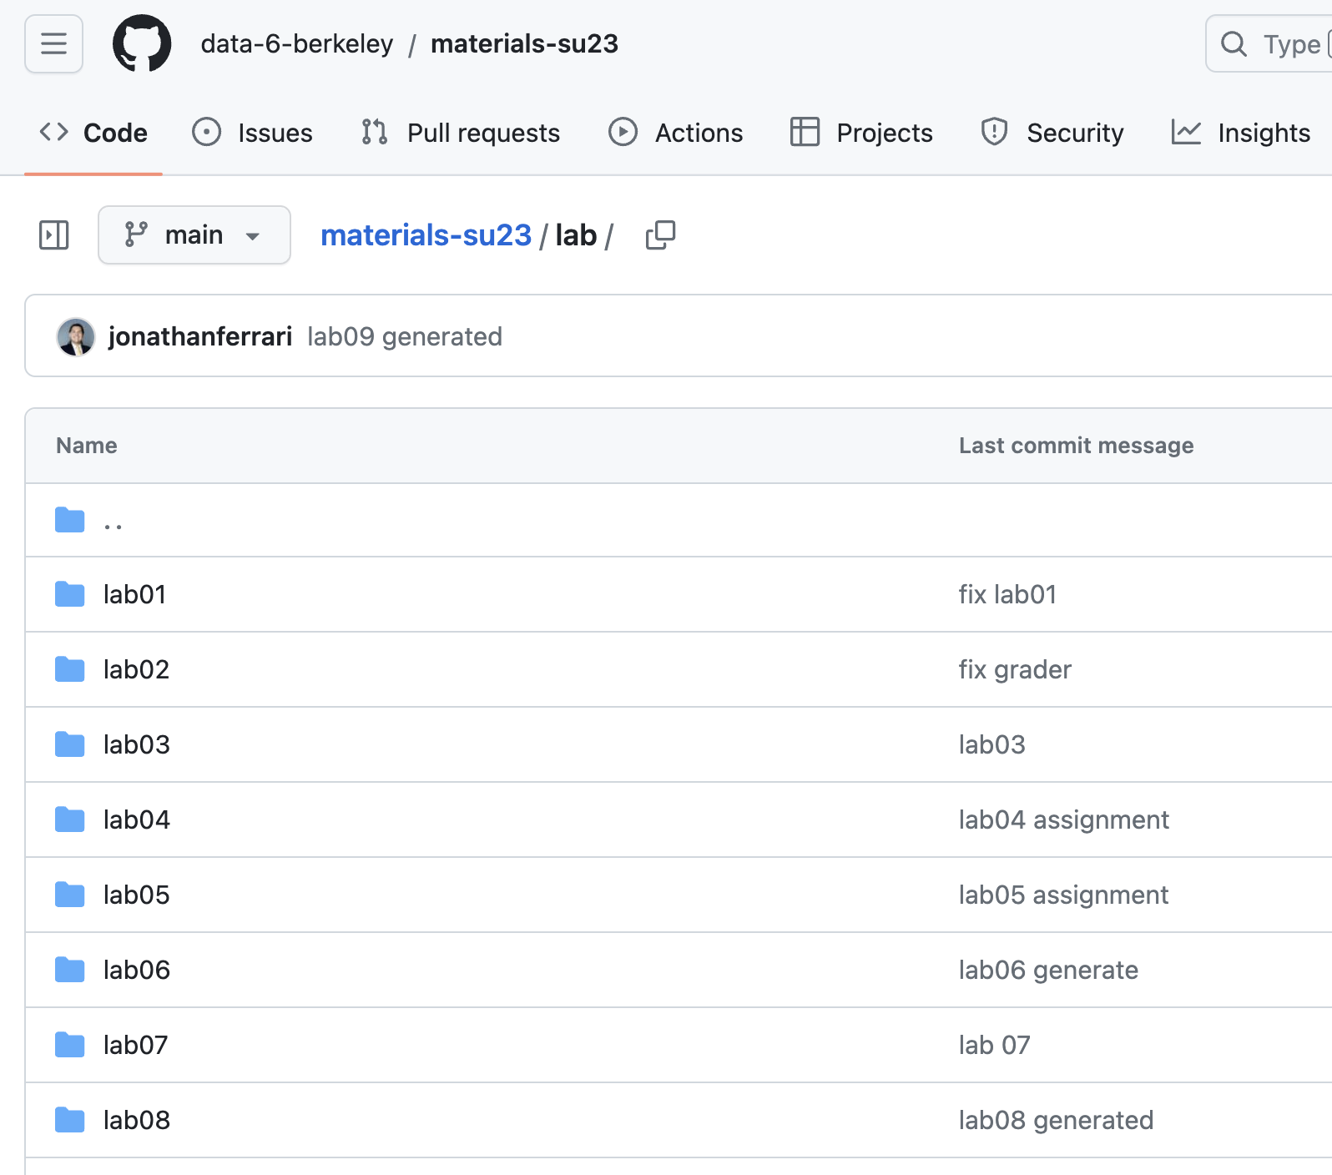
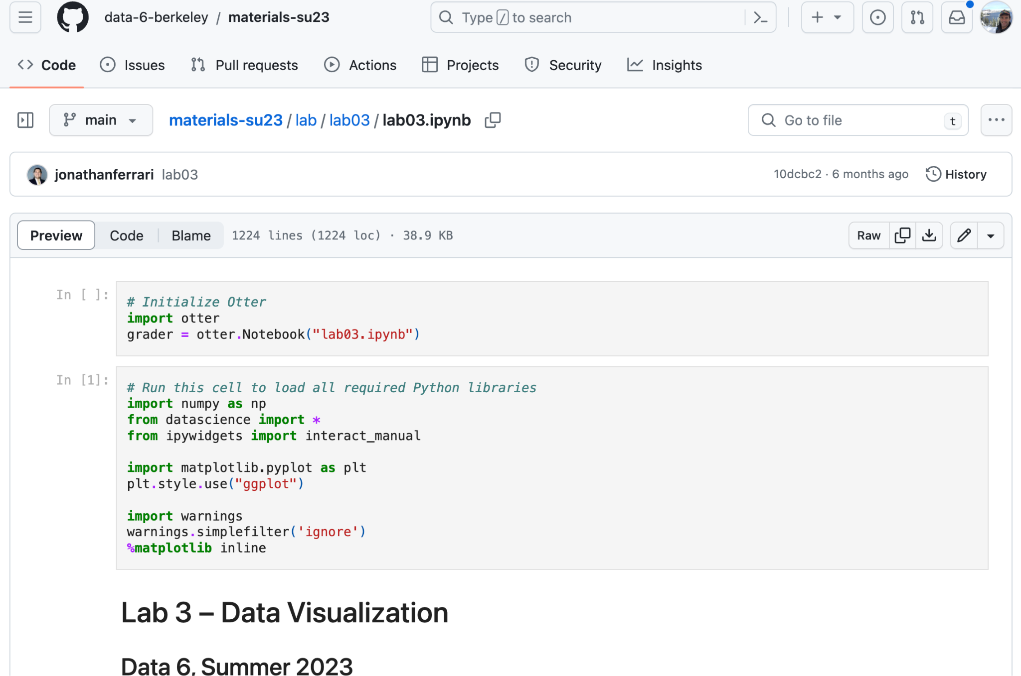
Data 6 repo

