Slide 1
The ASCCC Open Educational Resources Initiative (OERI): Resources and Services to Support Your ZTC Pathway Development
Revised May 1, 2024. This work is licensed under a Creative Commons Attribution 4.0 International License.
Attribute this slide deck as: "The OERI: Resources and Services to Support Your ZTC Pathway Development" by ASCCC OERI is licensed under CC BY 4.0.

Slide 2
Event Description
Establishing a ZTC pathway in a sustainable way can only be accomplished when faculty make the commitment to doing the work and they are supported to do so. The OERI’s statewide OER infrastructure can assist you in your ZTC journey, whether you are new to OER or are an experienced OER author who wants to share their work but is hesitant to do so. Join us for an overview of the available resources to prepare you for OER work and the available services to support that work.

Slide 3
Presenters
Suzanne Wakim
Biology, Butte College
Project Facilitator, OERI
Julie Bruno
Communication Studies, Sierra College
Communications Coordinator, OERI
Notes:
Be sure to change for FF. :-)

Slide 4
Overview
The OERI, ASCCC, and ZTC
OERI Infrastructure
OERI Resources
OERI Services

Slide 5
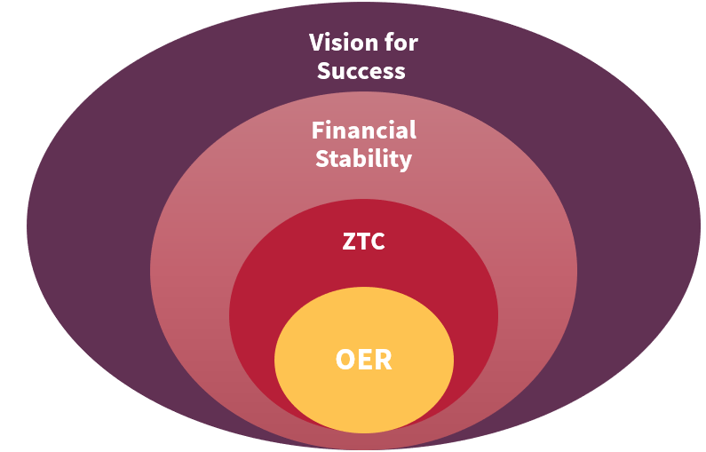
OER as a Core ZTC Strategy
Notes:
This is from at presentation by the CCCCO at last year’s Cal OER - where they viewed centered OER not only as a key component of ZTC, but of the Vision for Success.

Slide 6
OER and ZTC
While not every course can achieve ZTC status with OER, ASCCC has identified OER as the preferred approach.
The ASCCC recognizes OER as the preferred and most sustainable mechanism for eliminating course costs but acknowledges that instances will arise in which eliminating costs is not possible;
The ASCCC asserts that while OER can reduce or eliminate instructional materials and textbook costs, resources should be dedicated to convening discipline faculty to determine the most sustainable mechanisms for reducing the costs of course resources; and
CO ZTC Memo - The program intends to develop and implement ZTC degrees and prioritize Open Educational Resources (OER) as a strategy to “reduce the overall cost of education for students and decrease the time it takes students to complete degree programs offered by community colleges.”
Notes:
Zero Means Zero Textbook Cost, 21 Fall, Resolution Number, 03.05
The ASCCC encourage the use of approaches that significantly reduce course resource costs such that course sections with a low-cost can obtain ZTC status by virtue of the cost being absorbed by the college, district, or the state.

Slide 7
ASCCC OERI
A 5-year project to implement OER systemwide by coordinating state level activities to increase OER availability and supporting local OER implementation.
At the end of the initial project period, the structure and accomplishments of the OERI would be evaluated and future funding needs identified.
The OERI has been operational for 5.5 – 6 years.
$6 million allocated in summer of 2018.
Notes:
This is a slide that was used to introduce the OERI in August of 2020. The Academic Senate for California Community Colleges Open Educational Resources Initiative (OERI) was funded by the California legislature in trailer bill language during the summer of 2018. Preparations for its launch were made during the fall 2018 term and this state-wide faculty-led effort had its kick-off with a webinar on February 1, 2019. 2018-19, 2019-20, 2020-21, 2021-22, 2022-23, 2023-24.

Slide 8
OERI’s Goal?
Increase the use of open educational resources in lieu of commercial texts by all reasonable means available.

Slide 9
Increase OER Use By…
Increasing awareness.
Increasing the availability of high-quality OER.
Making the adoption of OER easier.
Supporting local OER advocates to help your faculty join us…

Slide 10
In the beginning…
Everyone did everything..
Photo by 2Photo Pots on Unsplash
Notes:
Today, we have more specialized roles that reflect how our work has evolved.

Slide 11
OERI Leadership Team
Project Director
OERI Regional Leads
OERI Project Facilitators
Communications Coordinator
Discipline Lead Coordinator
IDEA Framework Lead
Supported by AMAZING staff and the resources of the ASCCC

Slide 12
Statewide structure
Regional Leads
OER Liaisons
Appointed by local senate
Share OERI’s messages with the college community
Share local issues with the OERI

Slide 13
OERI Communication
List-servs
Monthly newsletters
Webinars
Canvas space
Surveys
Website

Slide 14
Discipline Connections
Discipline Leads
Develop (and update) curated resource collections
Host events for discipline faculty
Serve as a resource for their discipline colleagues
Ensure OERI’s awareness of discipline needs, issues, and advances
The OERI is currently recruiting Discipline Leads for the 2024 – 2025 academic year.
Access information about Discipline Leads using tinyurl.com/DL4OERI

Slide 15
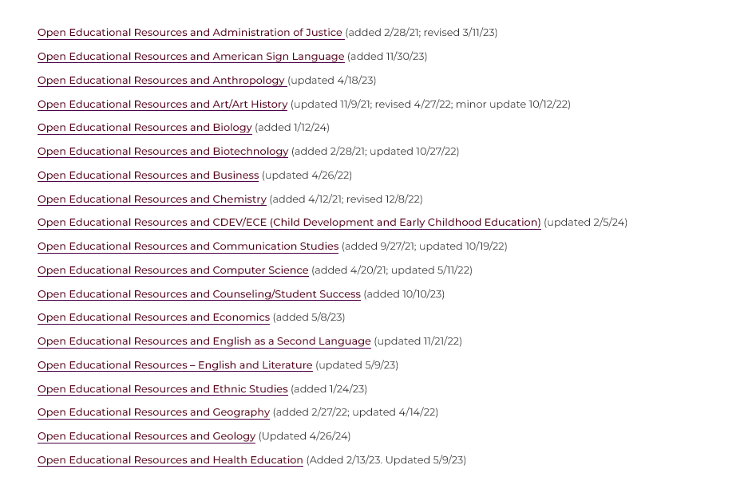
OERI Curated Collections
Notes:
https://asccc-oeri.org/open-educational-resources-by-discipline/

Slide 16
Resources Page
Notes:
https://asccc-oeri.org/resources/

Slide 17
Resource List for Each Discipline

Slide 18
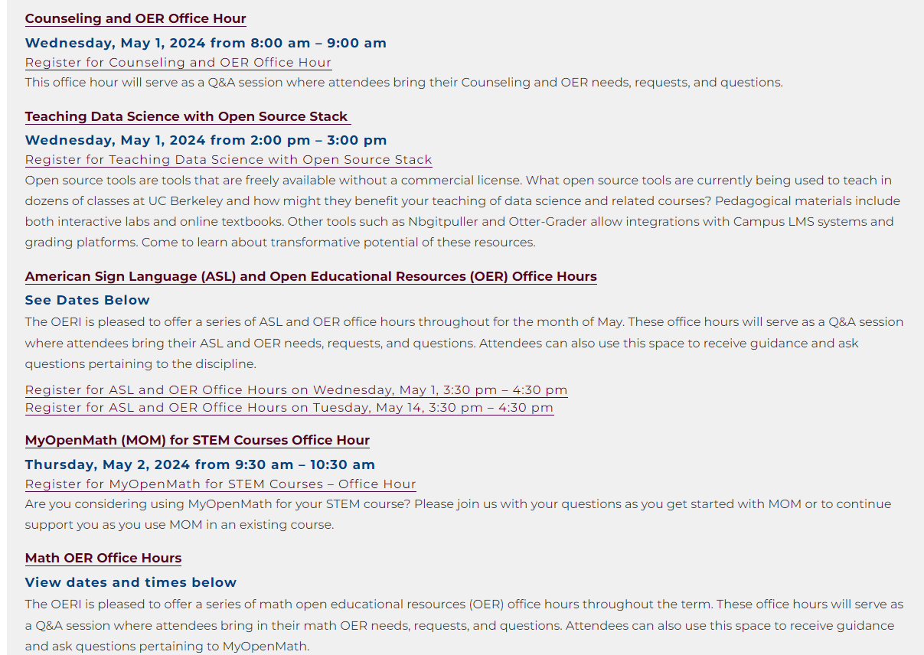
Discipline Specific: Trainings, Webinars and Office Hours

Slide 19
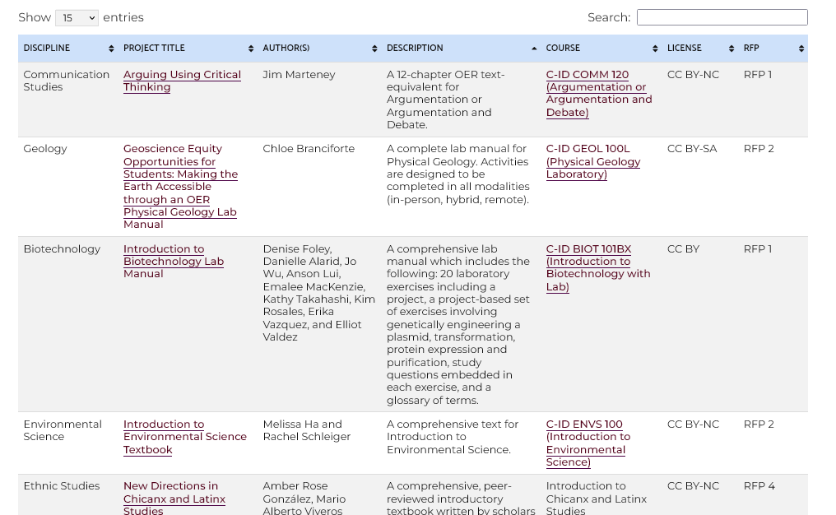
OER Created through ASCCC OERI
Notes:
https://asccc-oeri.org/asccc-oeri-resources/

Slide 20
OER as a starting point for sustainability - OERI Model
Request for Proposals (RFP)#1
Project Cycle: 6 months
24 projects developed
RFP#2 - RFP#4
Project Cycle: 1 year
42 projects developed
Added trainings on Licensing and Accessibility
Multiple checkpoints and deliverables
Centralized tracking
Currently in RFP#5
A focus on IDEA and ancillaries in multiple platforms

Slide 21
OER Program Cycle
Step 5: Sharing and Sustainability
Step 1: Training
IDEAA
Step 4: Platform Support
Step 2:
Discipline Exploration and non-duplication
Step 3: Project Development
Notes:
We have gone through this for 5 years in various cycles 6 month to 15 months and in that process we have discovered process, tools and best practices which we hope help you set up your own programs.

Slide 22
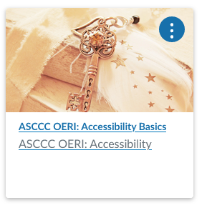
Professional Development
Webinars (archived and live)
Surveys
Website
ASCCC-developed self-paced online courses.
Summer Training Series
Campus Specific Trainings
OER – and Beyond.
How can we help you incorporate OER into your local professional development opportunities?

Slide 23
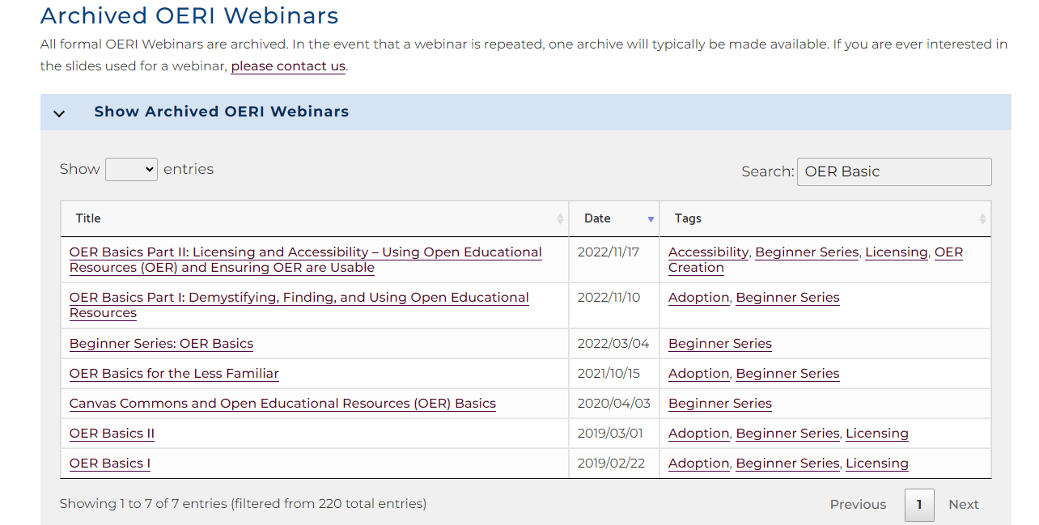
Webinars and Events

Slide 24
Project Support
Project Facilitators
Project Management
Training
Establish deliverables and deadlines
OER Basics, OER Accessibility Basics
Accessibility Support
IDEA Framework Lead
LibreTexts Liaison
MOM, ADAPT, H5P Leads

Slide 25
How can the OERI elevate your ZTC efforts?
Notes:
Photo by ian dooley on Unsplash

Slide 26
OERI Services: Faculty helping faculty
In addition to the resources we provide as part of our work, we can also provide all of our project management services at cost.
Does your faculty need training and ongoing support as they build a ZTC pathway?
Are you building with accessibility and sustainability in your plan?
Perhaps you have “homegrown” OER that has not been shared and you would like to share it - how do you overcome concerns about releasing that OER for broader use?

Slide 27
Project Management Support
Streamlining OER project creation and management
Chapter Templates
Guides and handouts on accessibility, templates, and best practices.
Accessibility
Co-Development of accessibility guides and rubrics
Webinars and self-paced course
Licensing
Webinars and self-paced course
Ongoing Support
Support for IDEA reviews
Webinars and IDEA Review Checklist
Identifying and creating content for Libraries.
Platform Training: LibreTexts, H5P, ADAPT, and more

Slide 28
IDEA Support

Slide 29
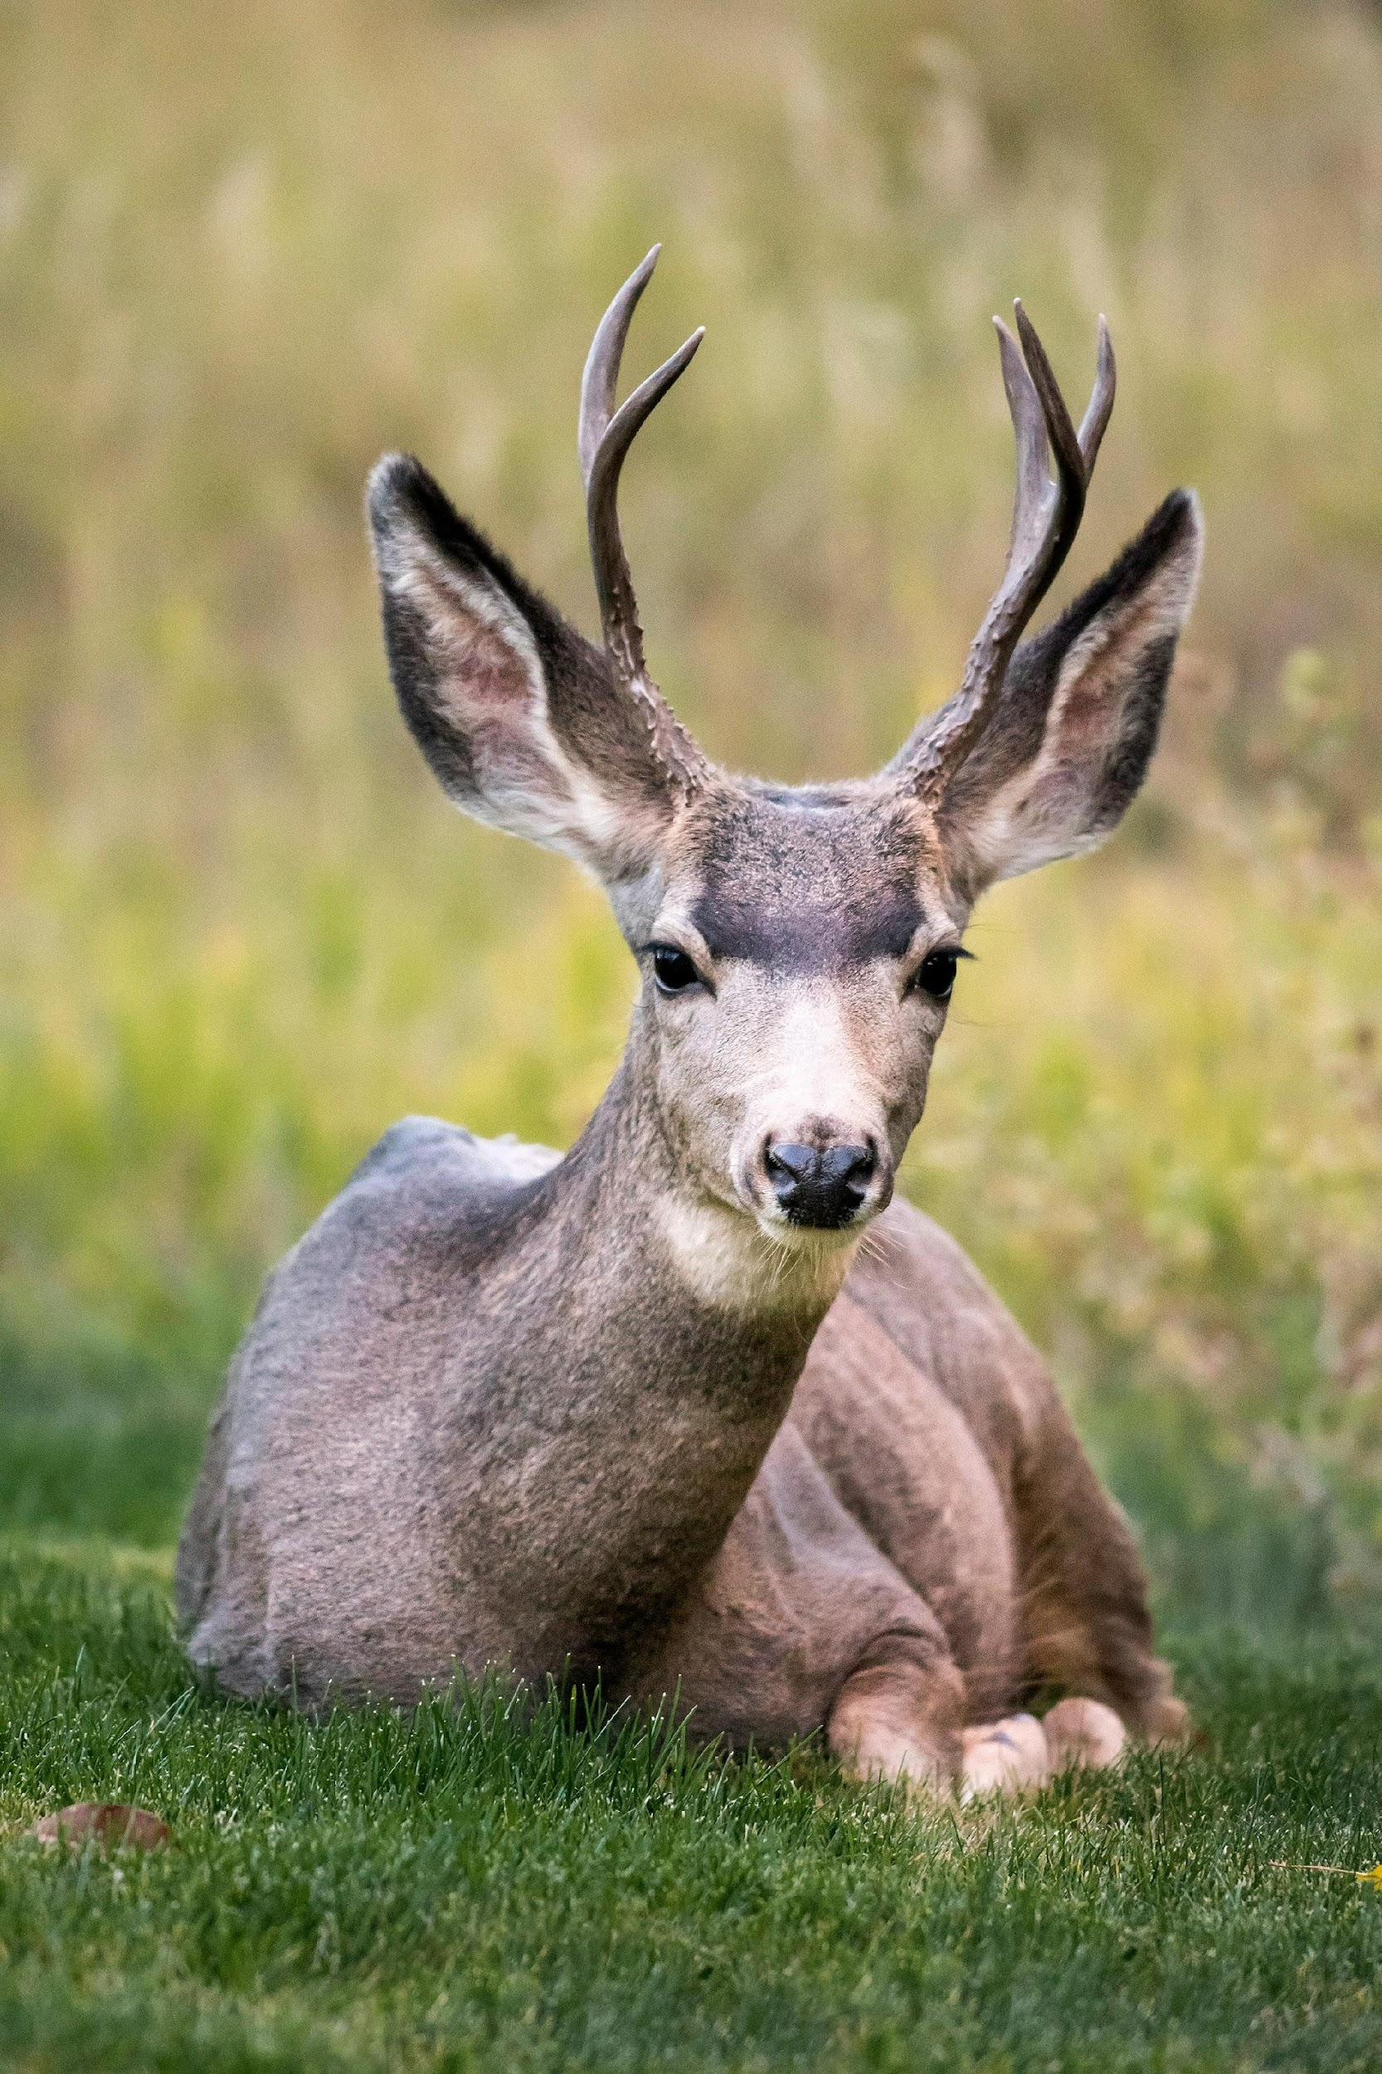
Preparing your OER for release
Remove resources and references as needed
Peer review
Accessibility review
Licensing review
IDEA review
If OER contains library resources - replace links with appropriate information
Photo by Pedro Lastra on Unsplash

Slide 30
Questions / Discussions / Comments
Photo by Camylla Battani on Unsplash

Slide 31
More Information
ASCCC OERI Website (asccc-oeri.org)
Resources
Webinars and Events
ASCCC OER E-Mail (oeri@asccc.org)

Slide 32
And to contact us…
General OERI E-Mail: oeri@asccc.org
Find everyone’s e-mail at: https://asccc-oeri.org/about-us/

Slide 33
Thanks!
Photo by Thgusstavo Santana from Pexels

