Slide 1
Welcome!
On behalf of the ASCCC OERI, we are pleased to have you here with us for “Using Open Educational Resources (OER) to Teach Statistics- A Focus on the How and Why” webinar!
If you are not already muted, please mute yourself upon arrival.
This event will be recorded. Archives of all ASCCC OERI events are available at asccc-oeri.org > Webinars and Events
You are encouraged to use the Zoom “chat” feature for questions and comments. To start, you’re invited to introduce yourself in the chat. You might want to provide
Your name (if it’s not clear from your Zoom name),
Your discipline/role,
Your college(s),
Your experience with OER, and
An interesting statistical fact!
Notes:
https://asccc-oeri.org/webinars-and-events/

Slide 2
Using Open Educational Resources (OER) to Teach Statistics- A Focus on the How and Why
Friday, May 3, 9:00 am – 10:00 am
This work is licensed under a Creative Commons Attribution 4.0 International License.
“RECord button” by Leo Reynolds on flickr; NonCommercial-ShareAlike 2.0 Generic

Slide 3
Presenters
Kevin Smith
Psychology, Rio Hondo
Cindy Moss
Math, Skyline
Host: Michelle Oja
ASCCC OERI Region A Lead
Psychology, Taft
Tips for Teacher: TechBoomers.com content is licensed under a Creative Commons Attribution- NonCommercial 4.0 International License.
Notes:
Presenters can be included following the description or the overview. Where images are used, they should include an attribution (Photo by…) and appropriate alternative text should be used (or the image marked decorative).

Slide 4
Description
Have you wondered how faculty use OER to teach statistics? What are the benefits of using OER to teach statistics? What options are available to address the need for a homework system?
Join us to explore what is possible when using OER to teach statistics and, hopefully, increase the probability that you will give OER a try.
Notes:
A description of the presentation is included in the slide deck so that the purpose of the slide deck is established – and to inform anyone viewing the presentation as to what was planned.

Slide 5
Overview
Experience using an open textbook
Experience using an open homework system
Share the OER that you use
Q&A
Resources
Lavender OER from Techie Teacher Coach. This work is licensed under a Creative Commons Attribution 4.0 International License.
Notes:
Math discipline: https://asccc-oeri.org/open-educational-resources-and-mathematics/
Psych: https://asccc-oeri.org/open-educational-resources-and-psychology/#:~:text=Psychological%20Statistics/Statistics%20for%20the%20Social%20Sciences/Introduction%20to%20Statistics%20(C%2DID%20MATH%20110)
Soc: https://asccc-oeri.org/open-educational-resources-and-sociology/#:~:text=Introduction%20to%20Statistics%20in%20Sociology%20(C%2DID%20SOCI%20125)

Slide 6
Textbook (Kevin)
OER for Psychological Statistics: Multiple options available through Libretexts
Image by Opensource.com; found at https://opensource.com/education/12/6/introducing-last-language-textbk
Notes:
10 minutes

Slide 7
Kevin’s Preference
I use the Foster et al. text as a base
Primary reason I liked this text:
Critical values instead of p values
Helps protect against students that use AI
Problem with the text:
Probability section was weak
Solution: used a probability section from a Statistics book from the math discipline
Libretext makes it easy to insert a chapter from a different textbook

Slide 8
Other reasons I love OER for PSY stats!
Libretexts allows for customization of the ways topics are taught
I customized how it teaches
hypothesis writing
conclusions/decision making

Slide 9
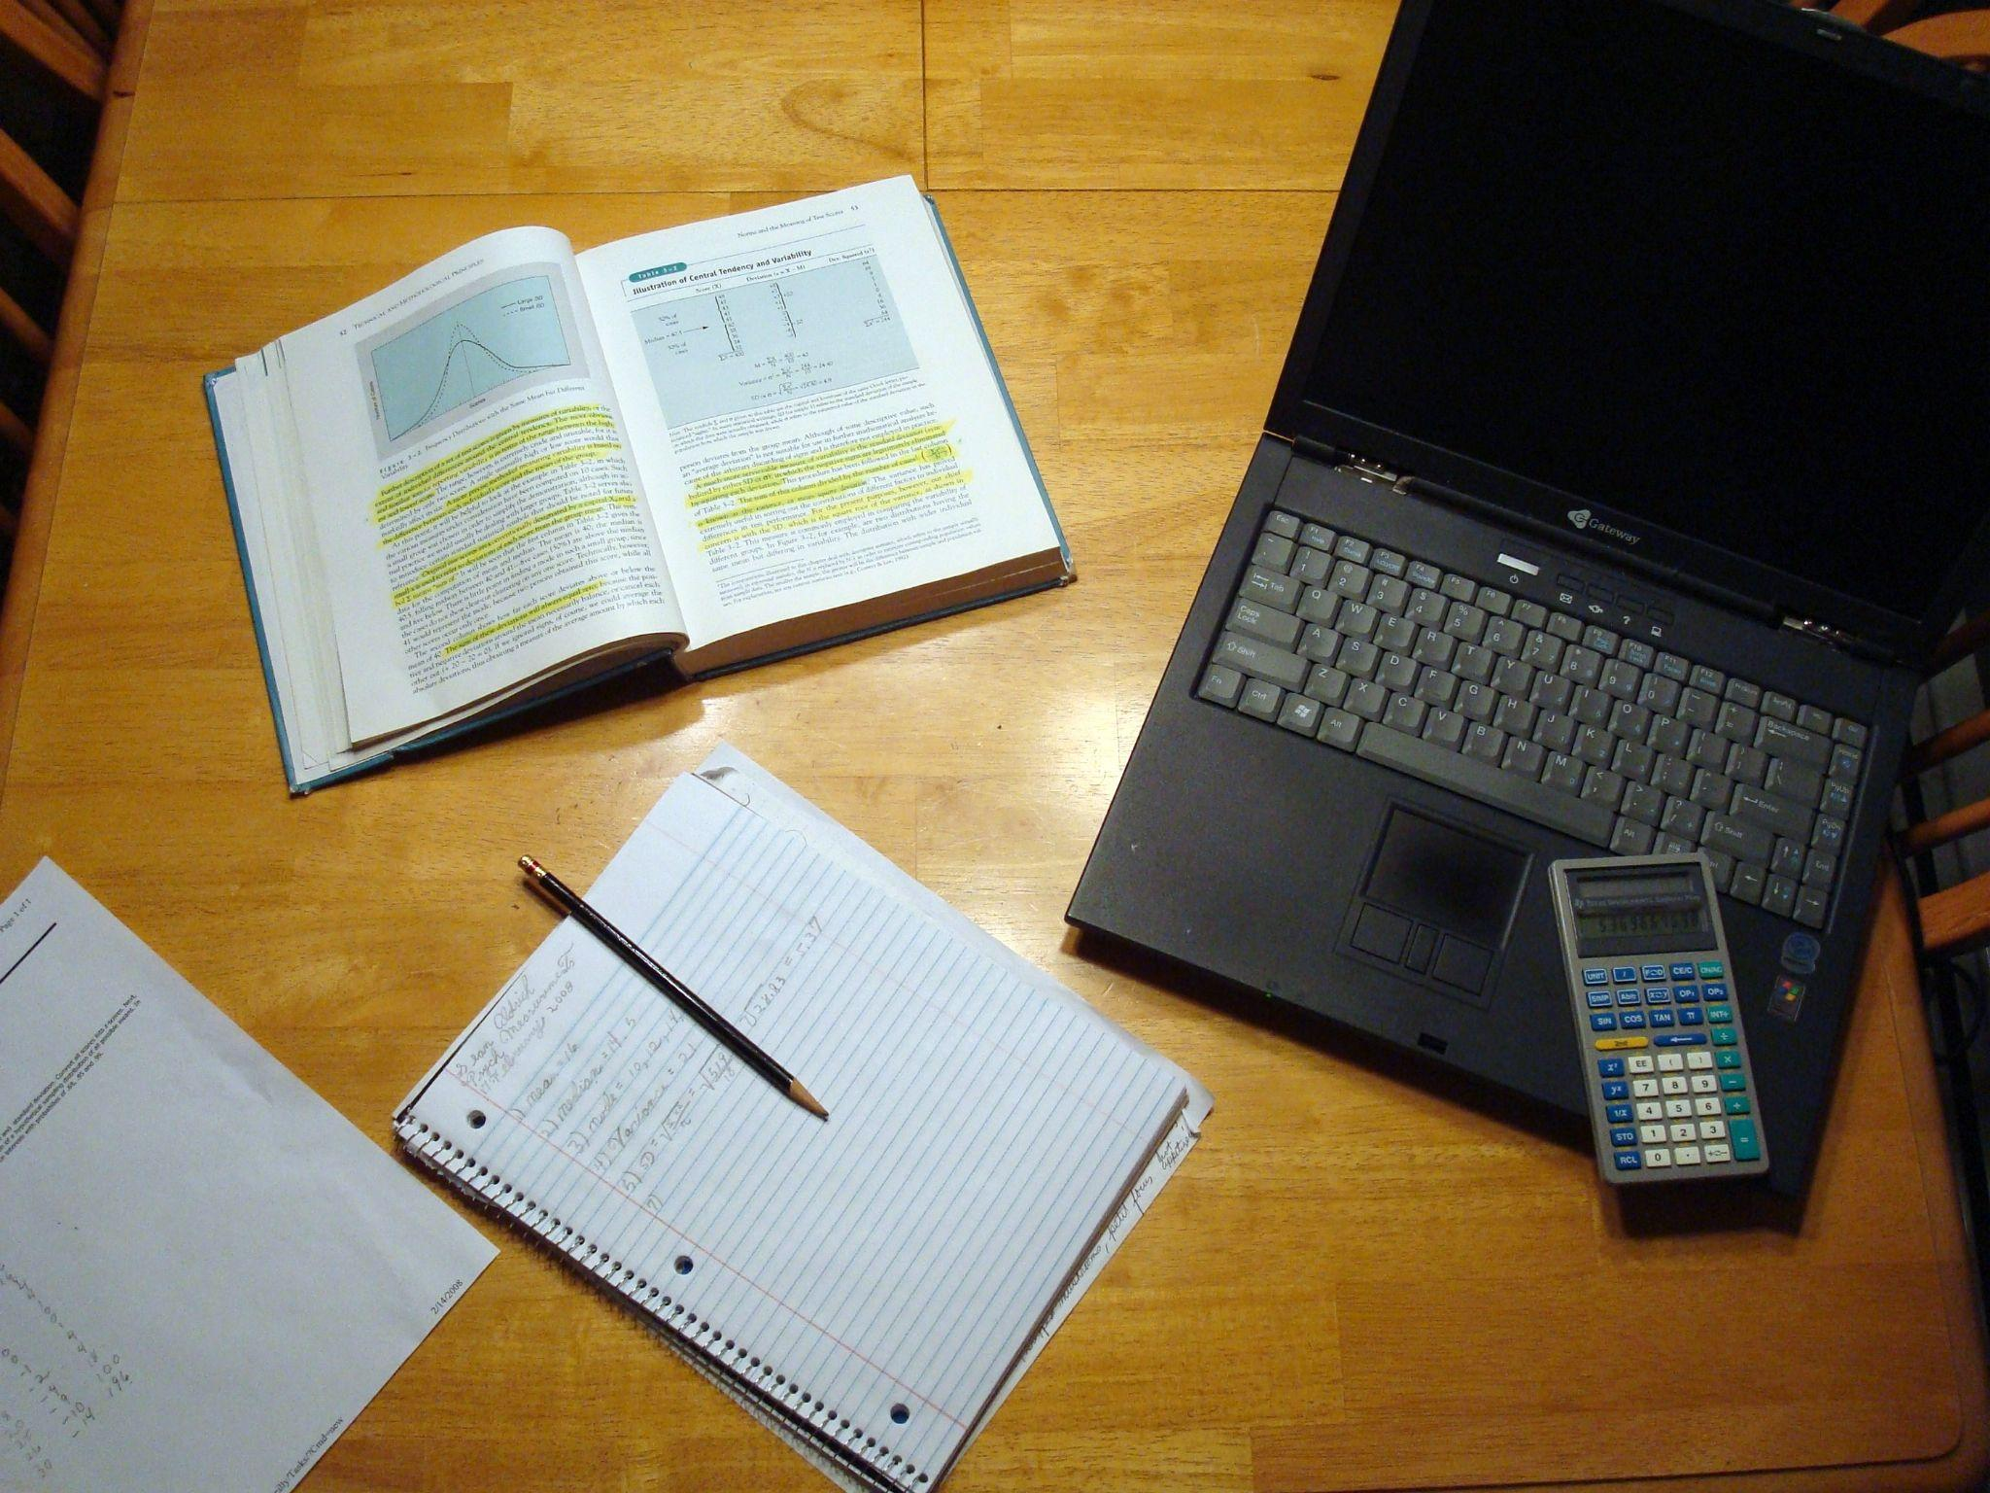
Homework (Cindy)
MyOpenMath: https://www.myopenmath.com/
“Homework” by Sean from Flikr.
CC-BY-ND
Notes:
10 minutes

Slide 10
Share the OER that you use!
Please post OER links in this Google doc!
Textbooks
Homework
Other resources
Q: Does anyone have questions about what you see posted?
Q: Would anyone like to share something about the resource that they posted?
Network Peer to Peer image by Clker-Free-Vector-Images on Pixabay.
CC0 License
Notes:
Google doc: https://docs.google.com/document/d/1UAy1l1wn15amjI_Ndw-POvb3r-Z7LxGhGJTjDqXw0OY/edit?usp=sharing

Slide 11
Q&A
Photo CC0 by Mohamed Mahmoud Hassan on PublicDomainPictures.net

Slide 12
Resources: ASCCC OER-I
Link to these slides
Link to the Google doc that we created together today!
From OERI
OER for Math Statistics: OER suggested by the OERI for MATH-110 C-ID
OER for Psych Statistics: OER suggested by the OERI for Psychology courses
These courses often cover the MATH-110 C-ID and the SOC-125 C-ID.
OER for Soc Statistics: OER suggested by the OERI for SOC-125 C-ID
ASCCC OERI Website
Resources
Webinars and Events
Contacts:
oeri@asccc.org
Find everyone’s e-mail at: https://asccc-oeri.org/about-us/
Notes:
Link to slides: https://docs.google.com/presentation/d/1tfat3L2PWWRwfVi9V24YLfshBX9KRrIi/edit?usp=sharing&ouid=109341909335930382529&rtpof=true&sd=true
Google doc: https://docs.google.com/document/d/1UAy1l1wn15amjI_Ndw-POvb3r-Z7LxGhGJTjDqXw0OY/edit?usp=sharing
https://asccc-oeri.org/oer-advocates/
https://asccc-oeri.org/
oeri@asccc.org
https://asccc-oeri.org/about-us/

