Slide 1
ADMJ/CJ OER Collaboration
Discipline Lead Presentation

Slide 2
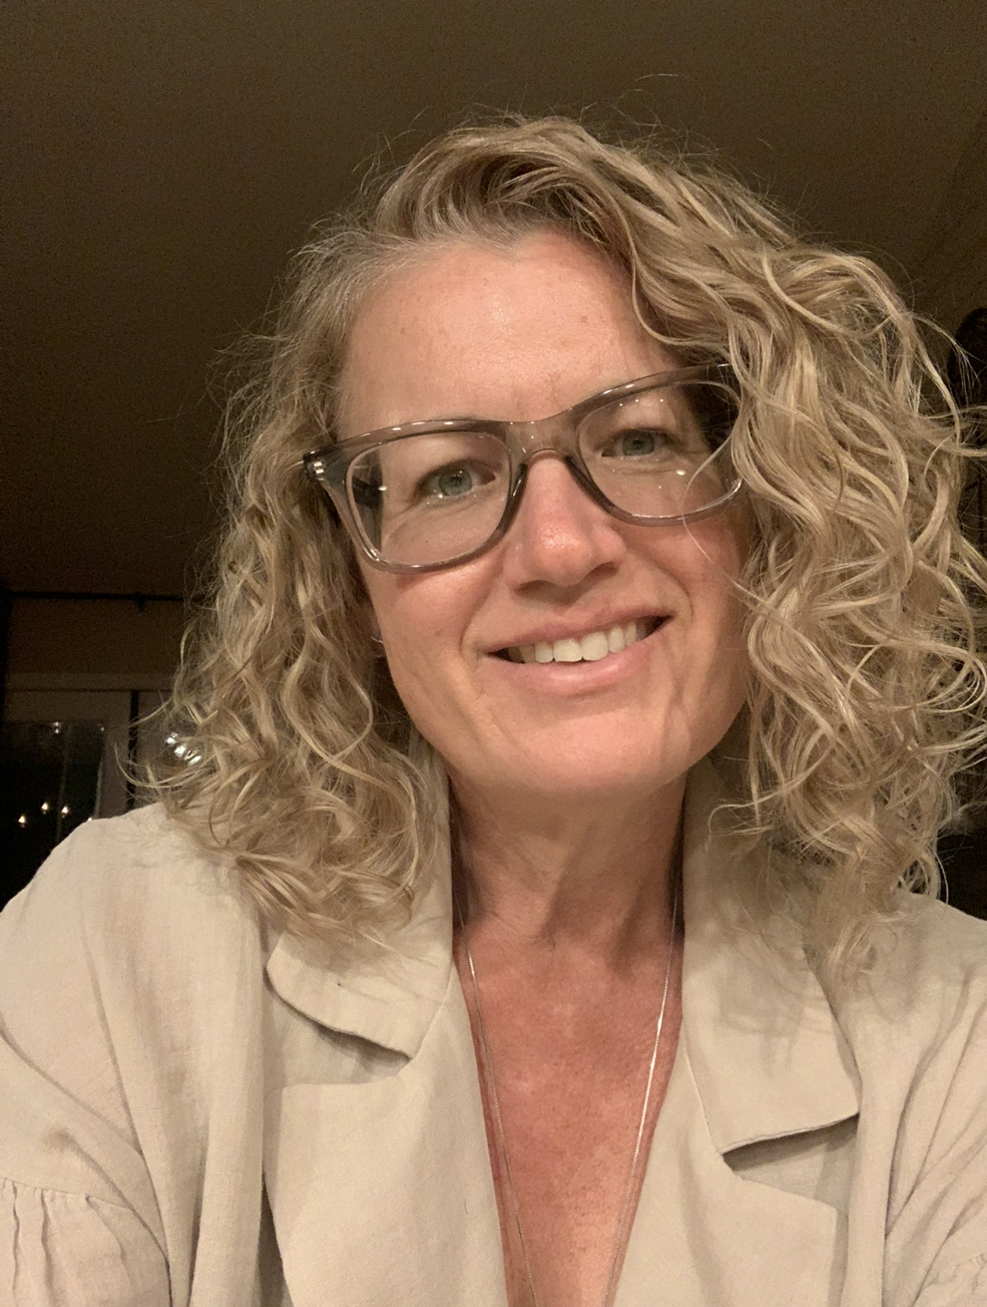
Introduction & Contact Information
Tabitha Raber
Taft Community College
traber@taftcollege.edu
661-301-0826 (cell)

Slide 3
Current Status of ADMJ – Discipline Collections
Open Educational Resources by Discipline
Open Educational Resources and Administration of Justice (update in process)
LibreText

Slide 4
OER MATERIALS BY CID/GAPS
CURRENT OER BY CID
GAPS IN OER
AJ 110 - INTRO
AJ 120 - CRIMINAL LAW
AJ 122 - COURTS
AJ 124 - EVIDENCE
AJ 140 - INVESTIGATIONS
AJ 160 - COMMUNITY (PENDING REVISION)
AJ 200 CORRECTIONS (PENDING REVISION)
AJ 150 FORENSICS
AJ 220 JUVENILE

Slide 5
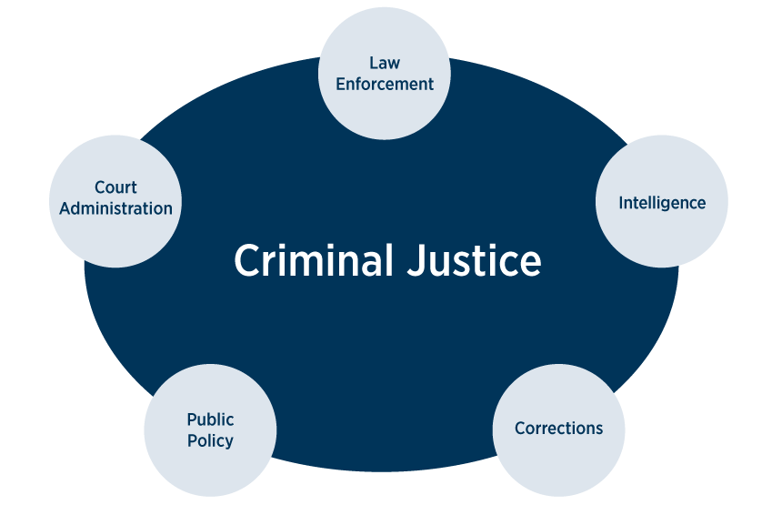
Pathways Based on the Current Available OER
ADMJ/CJ local degree should be attainable
ADMJ/CJ CSU transfer degree should be attainable
Certificate programs could be developed

Slide 6
Courses not covered by CID #s
Ethics
Gangs
Violence
Victimology
Forensic Psychology
Correctional Counseling
This is just an example, what courses do you have on campus that require OER?
What pathways need resources for local degrees and certificates?

Slide 7
Duplication, Development, & Revision
We do not want duplication in materials while gaps exist.
We need to identify gaps that are required in ADMJ/CJ to develop degrees and certificates in the field.
Organized development of new materials.
Revisions of existing OER to maintain relevancy.

Slide 8
Modern Policing Program – AB 89
Initial understanding – Not going to impact current ADMJ/CJ programs.
New program/degree that will be developed over the Summer of 2024
Speculated implementation 2025 to 2028?

Slide 9
Future of ADMJ OER
Based on Modern Policing Program – New Potential Gaps
Sociology or Social Psychology
History of Policing
Racial and Cultural Diversity
Social Justice
Interpersonal and Cultural Communications
Statistics or Introduction to Statistics for Sociology
Policing in the Community
Community and the Justice System
Ethical Reasoning/Ethics in Practice
Introduction to Logic
Introduction to Crime
Introduction to Transformational Policing
Introduction to Critical Thinking
Emotional Intelligence
Health and Wellness/Mental Health

Slide 10
Questions/Comments/Concerns?

