Slide 1
How Can We Best Assign Diverse Contemporary Literature and Nonfiction Books in Zero Textbook Cost (ZTC) Classes? A discussion for English Faculty
May 16, 2024
Anna Mills, College of Marin and Cañada College
ASCCC OERI English Discipline Lead
Heather Dodge, OERI Host

Slide 2
Agenda
OER and ZTC: definitions
What you can find in OER literature texts
Options for recent books from commercial publishers
Slides: https://bit.ly/ZTClit
Please say hello in the chat! Name and college?

Slide 3
Academic Senate for California Community Colleges Open Education Resources Initiative Michelle Pilati, Faculty Lead
OER Liaisons on every campus
OER Discipline Leads make resource lists and host webinars
Resources at ASCCC-OERI.org

Slide 4
What are Open Educational Resources?
Creative Commons defines OER as teaching, learning, and research materials that are either (a) in the public domain or (b) licensed in a manner that provides everyone with free and perpetual permission to engage in the 5R activities– retaining, remixing, revising, reusing and redistributing the resources.
-- Creative Commons

Slide 5
The 5R Permissions of OER
Make and own copies
Retain
Reuse
Use in a wide range of ways
Adapt, modify, and improve
Revise
Combine two or more
Remix
Share with others
Redistribute
The framework, freely available under a Creative Commons Attribution 4.0 license (CC BY), was designed by Lumen Learning as the 5Rs

Slide 6
How Do You Know if Something is OER and Not Just Free?
Look for Creative Commons licenses:

Slide 7
The ASCCC OERI English page has many resources, including a general introduction

Slide 8
Argumentative Writing and Critical Thinking through Literature
OER Texts for C-ID English 110:
Writing and Critical Thinking Through Literature
Writing and Literature: Composition as Inquiry, Learning, Thinking, and Communication
Introduction to Literature (Lumen)
Literature for the Humanities (Lumen)
Composition and Literature: A Handbook and Reader (BC Campus Open Education)

Slide 10
A sample chapter with learning objectives

Slide 11
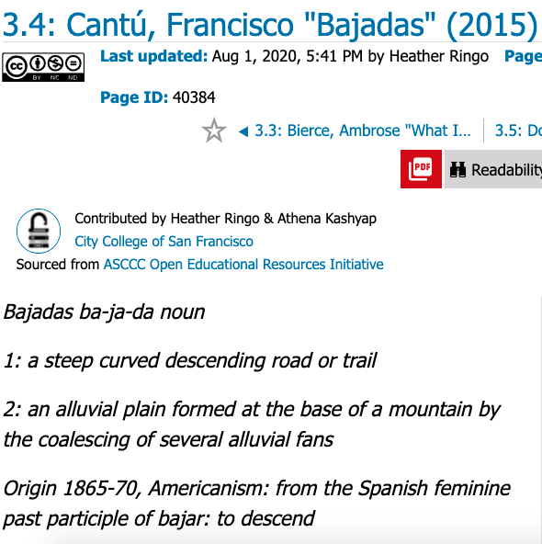
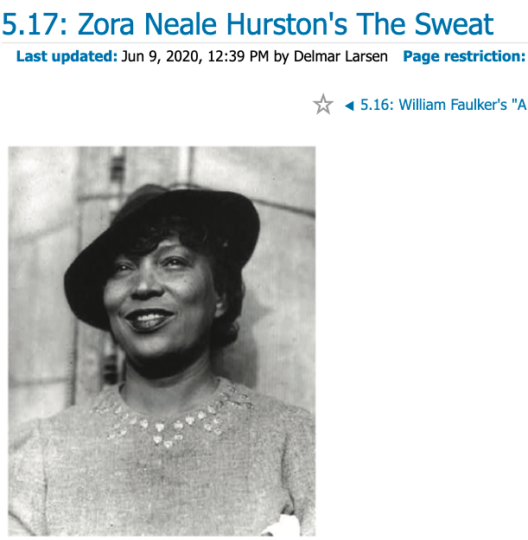
Some non-white authors

Slide 12
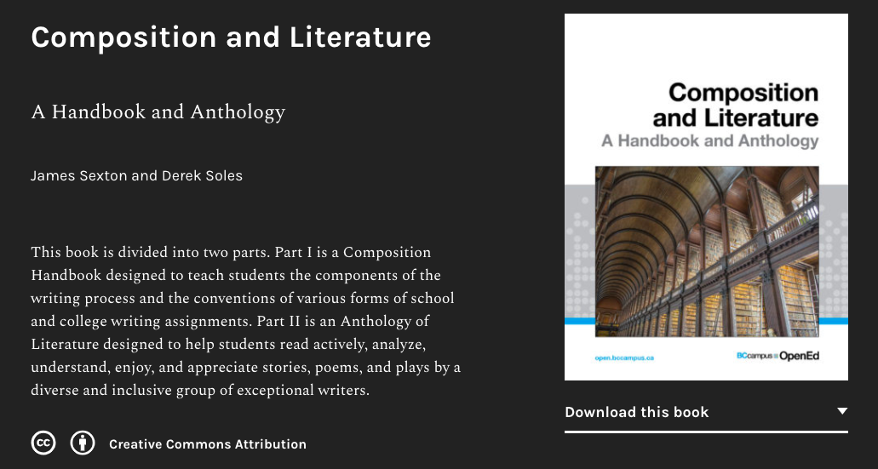
A literature anthology from BC Campus Open Education with discussion questions, essay assignments, and sample analyses

Slide 13
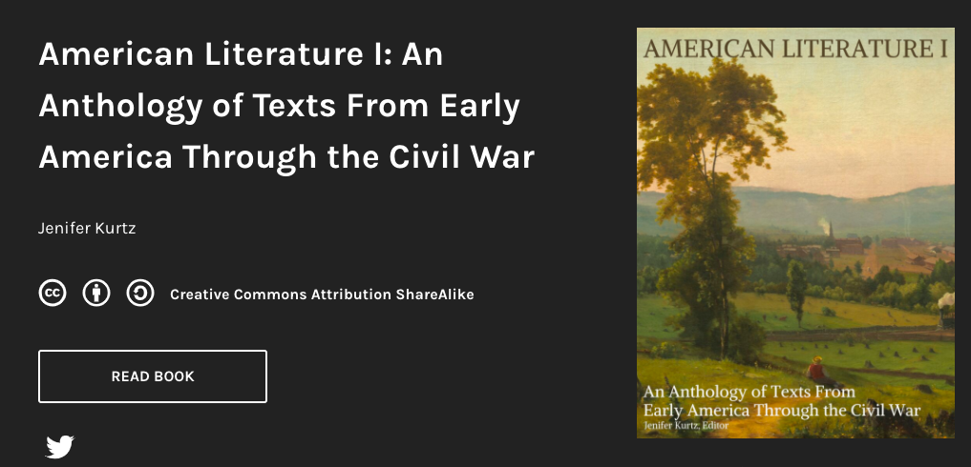
A few sample landing pages for literature textbooks:

Slide 15
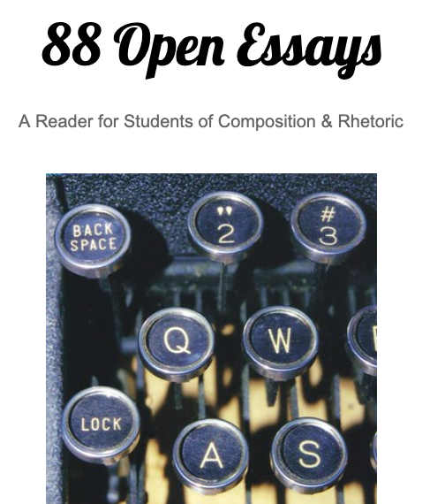
Open Readings
See the resource list for open-licensed contemporary work and public domain anthologies
One great open reader

Slide 16
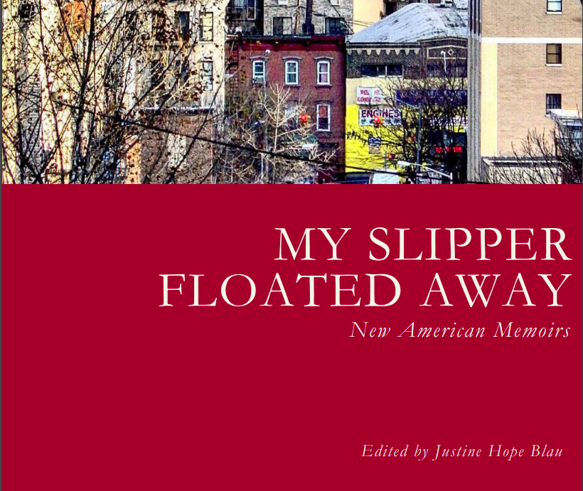
OER (increasingly) include diverse voices, like this new anthology from Lehman College in the Bronx.

Slide 17
What do we do when we want students to read full-length books?
Often course outlines require a novel or nonfiction book in addition to a textbook
We can assign public domain books, but these won’t be contemporary
College libraries offer many eBooks, and librarians can often purchase specific titles at our request.

Slide 18
How can I get to Zero Textbook Cost (ZTC)?
The library may be able to purchase an unlimited license or enough single user licenses for your class to read a specific ebook, or a hard copy class set.
Some public libraries subscribe to services like Hoopla, which doesn’t limit how many people can borrow a given title at once.
Meet with a librarian to learn what the local practices for supporting ZTC courses are.

Slide 19
Let’s brainstorm
Recent books from commercial publishers in ZTC? What are our options? What thoughts do you have about strategies, possibilities, and concerns?
Please share at https://www.menti.com/alie47m8mjb6!

Slide 21
Join the English OER listserv
A place to ask for and recommend specific OER for college English
An informal community of practice
133 members as of 5/15/24
Join at https://groups.google.com/g/englishoer

Slide 22
Thank you for the discussion!
To be continued…
Slides: https://bit.ly/ZTClit
This work is licensed under a Creative Commons Attribution-NonCommercial 4.0 International License.

