Slide 1
Moving Math and Statistics courses to OER/ZTC
Larry Green, Lake Tahoe Community College

Slide 2
Things to Discuss
Textbooks
MyOpenMath
Other Resources
Calculus
Statistics
DiffEQ and Lin Alg
Other Courses
Collaboration
Challenges

Slide 3
Where to Find OER Math Books
OERI Page
OpenStax
LibreTexts Math and Statistics
MERLOT
CCCOER Listserve

Slide 4
Over 1,378,815 Questions Available
Connected to Most OER Math Textbooks and Courses
LTIs Directly Into Canvas
Support Course and Help Forum
Questions Can Be Randomized and Computer Graded

Slide 5
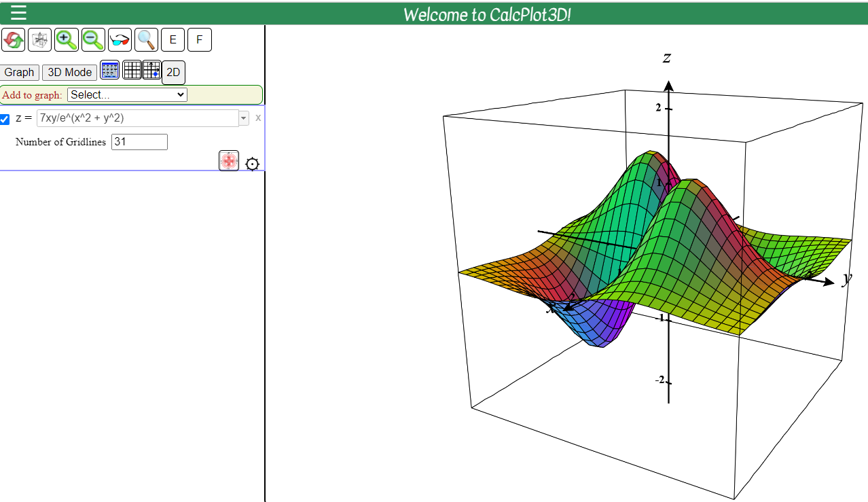
Other Resources
Desmos
CalcPlot3D
Symbolab
Geobebra
My Statistics Calculator
MERLOT
MathGPT

Slide 6
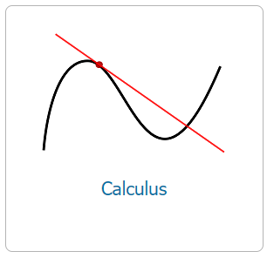
Calculus
Quarters, Semesters, Early Trans, Late Trans
Most Use OpenStax
We Use my LibreTexts Version from OpenStax
Videos from MathIsPower4U or My Videos
Plenty of MOM Assignments
Convincing Faculty to Change is the Biggest Challenge

Slide 7
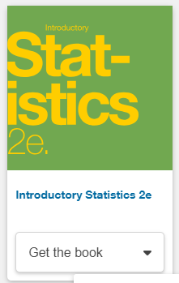
Statistics
Most Use OpenStax
New OpenStax Edition (2e) Available
Plenty of Videos (Including Mine)
MOM Course Available
You Can Still Use the TI Calculator, but Free Online Calculators Can Be Used.
Get a Class Set of Cheap Laptop Computers for Exams and Quizzes

Slide 8
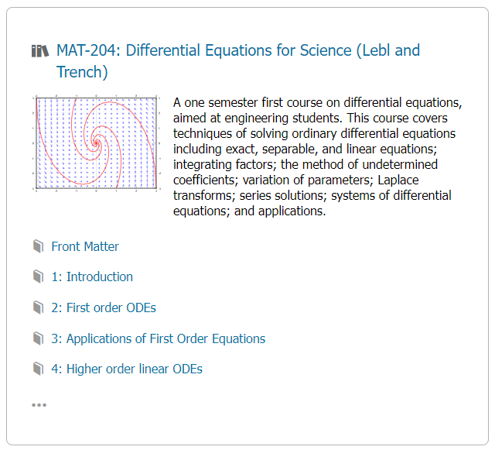
Differential Equation and Linear Algebra
Differential Equations
Lebl
Trench
Others
Linear Algebra
Kuttler
Others
OERI Grant MyOpenMath Course
Computer Graded
Hand Graded

Slide 9
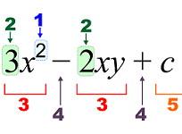
Other Courses
Business Calculus
Math for Elementary Education Teaching
Math for Liberal Arts
Discrete Math
Option D: Innovative Pre Calculus
Support Courses
Others?

Slide 10
Work with Your College’s Math Faculty
Collaborate with Other College’s Math Departments
ZTC Math Degree Collaboration
To Create New Materials, Form a Team and Split Up the Work

Slide 11
Convincing Faculty to Change
Give them $$$$
ZTC on Schedule so Students Only Take ZTC
What You Teach May not Exactly be Easily Found as ZTC
Funding for Authoring
Ask Other Colleges and OERI
Other Ancillaries

Slide 12
The Future of Math Resources

Slide 13
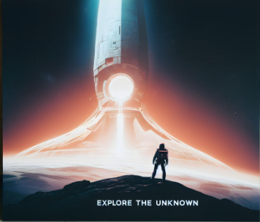
Questions and Exploration?

