Slide 1
A Deep Dive in OER Options for Digital Journalism & PR
Kelsey Stuart
ASCCC Journalism Discipline Lead
Moorpark College Journalism Instructor/ MR Faculty Advisor

Slide 2
Brand New Additions
OER Journalism & News Writing

Slide 3

A Beginner’s Guide to Journalism News Writing
A perfect resource for
Introduction to Reporting and Newswriting (C-ID JOUR 110)

Slide 4
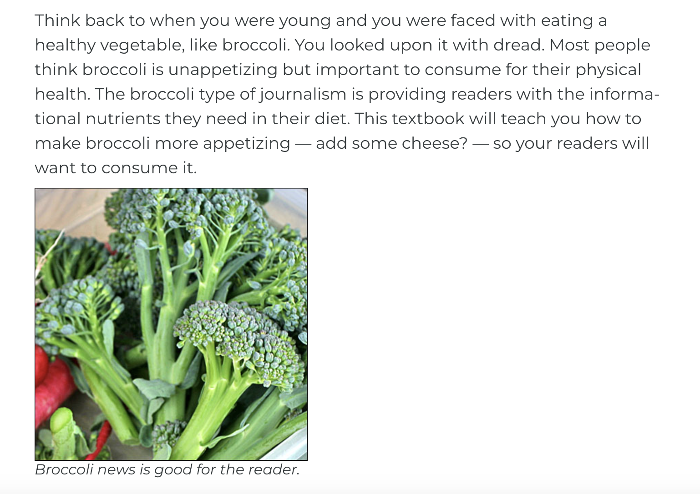
Engaging, Easy to Read, and Well Structured!

Slide 5

Skills for Effective Research Writing
A perfect resource for
Introduction to Reporting and Newswriting (C-ID JOUR 110)
Lower Division Student Media Practicum I (C-ID JOUR 130)

Slide 6
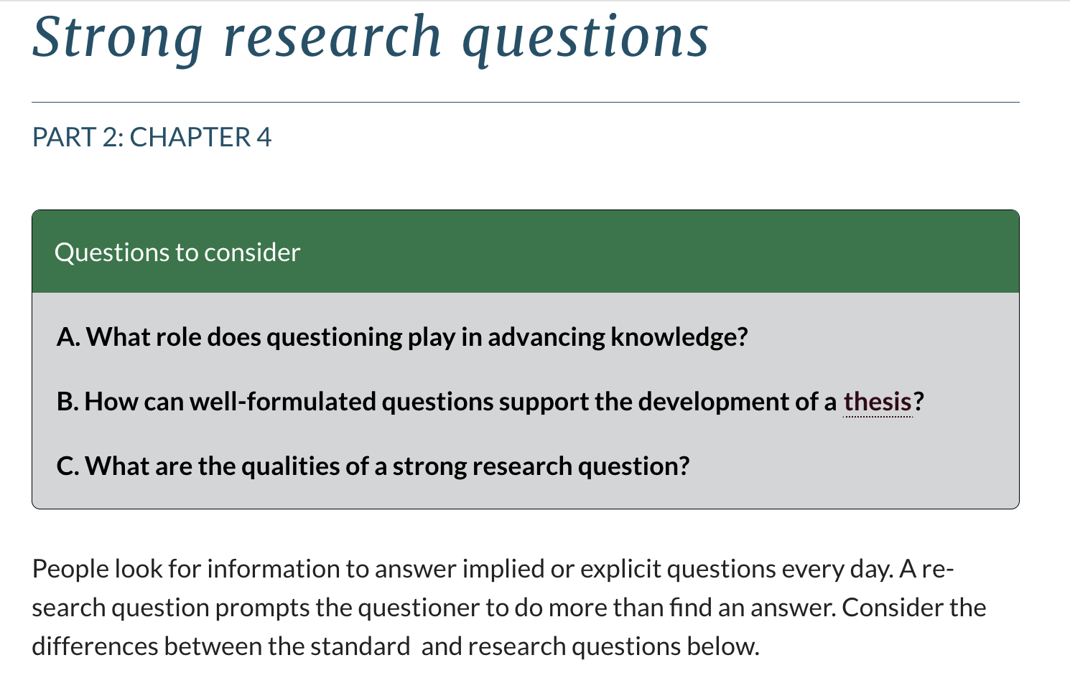
Clear in Offering Students Foundational Techniques for Investigative Reporting

Slide 7

Writing Fabulous Features
A perfect resource for
Introduction to Reporting and Newswriting (C-ID JOUR 110)
Lower Division Student Media Practicum I (C-ID JOUR 130)

Slide 8

An Incredible Section on Interviewing Tips & Tricks

Slide 9

Quite the Dialogue on Nut Graphs

Slide 10

Learning Features with Owen Daugherty

Slide 11
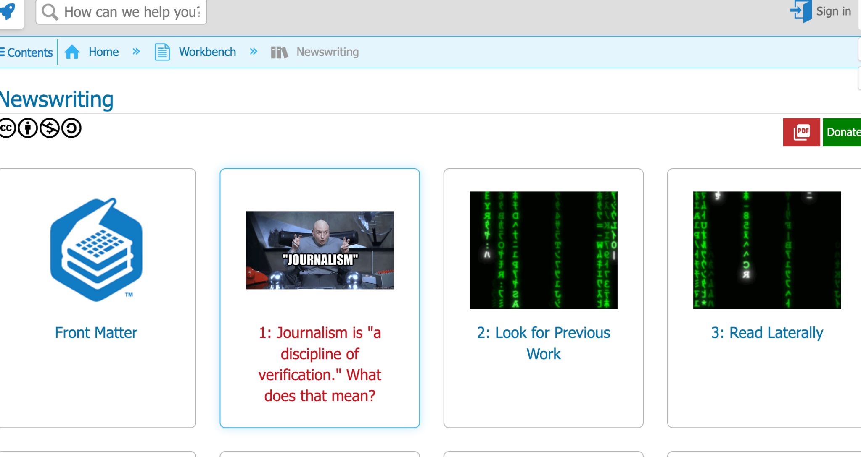
Journalism is…
A perfect resource for
Introduction to Reporting and Newswriting (C-ID JOUR 110)
Lower Division Student Media Practicum I (C-ID JOUR 130)

Slide 12
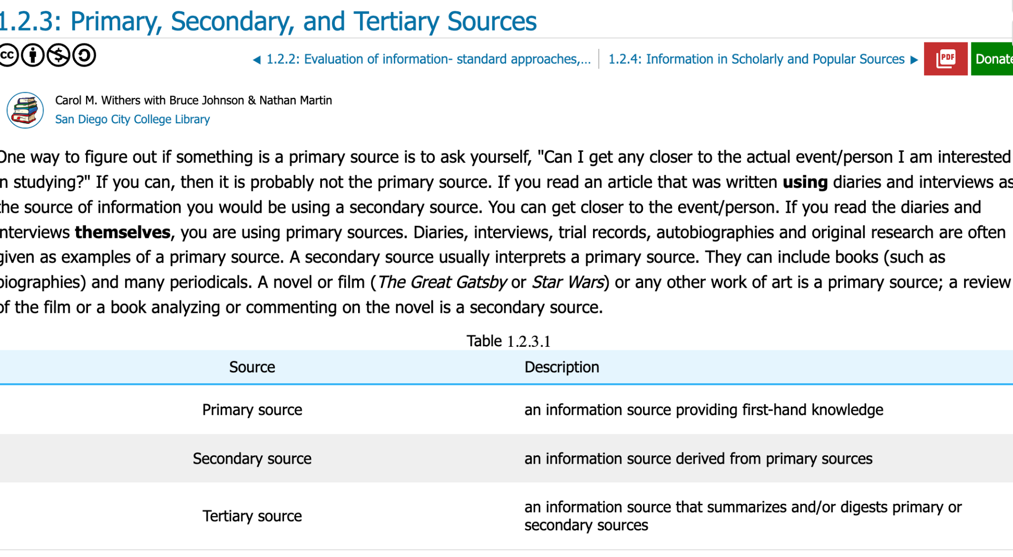
A layout of Sources

Slide 13
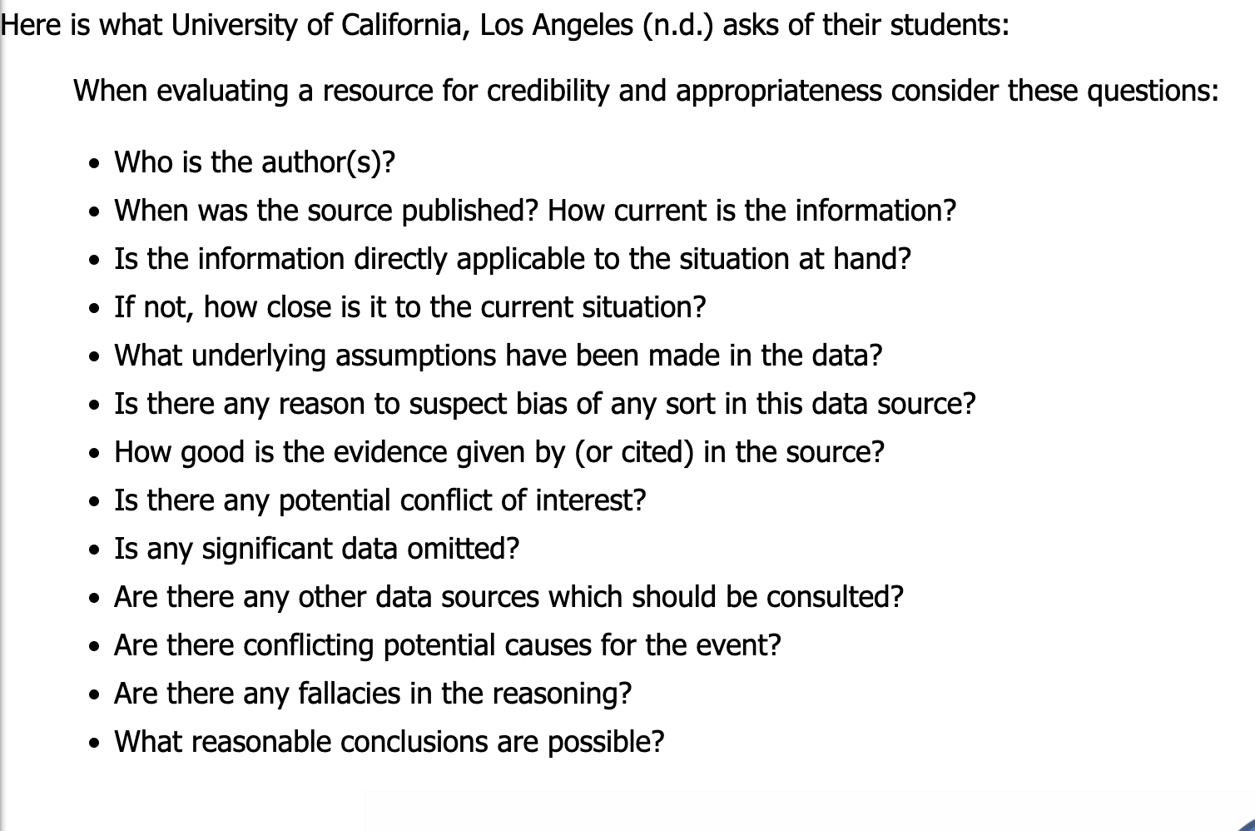
Evaluating Information - Where did you Get it?

Slide 14
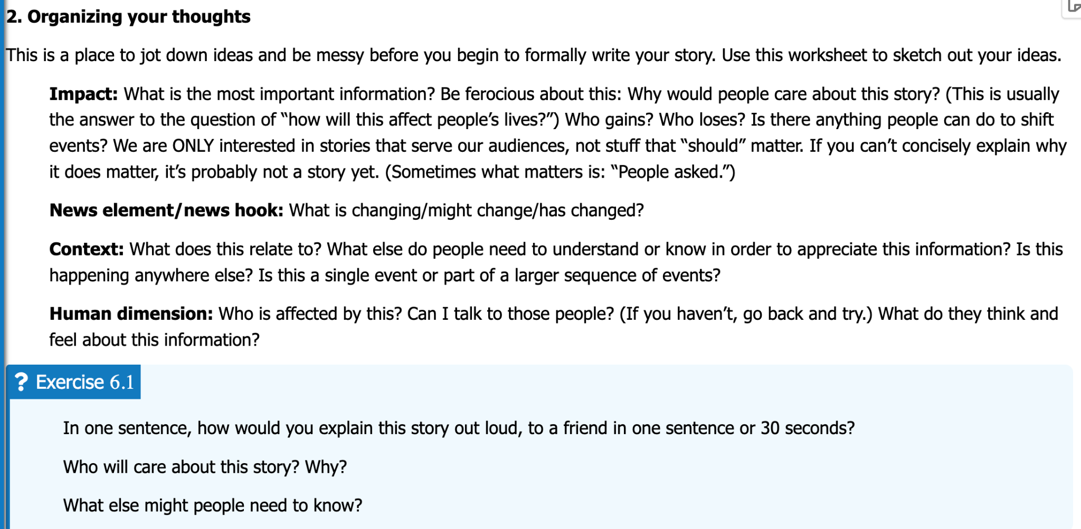
Exercises within the chapters that can work as Class Discussion prompts

Slide 15
In the Works…
Journalism Faculty Statewide are currently working on collaborative and individual OER options for their Journalism Students
Intro to Mass Communications
Reporting & Writing for Media
Student Media News Writing

Slide 16
Intertest in Writing your own OER?
ACCESSIBILITY TRAINING: You can self-enroll in the two courses (OER Basics & Accessibility Basics) by using the following links. Once you're on the course page, simply click on the "+Join this Course" button to self-enroll.
ASCCC OERI Basics: https://ccconlineed.instructure.com/courses/7709
ASCCC OERI: Accessibility Basics: https://ccconlineed.instructure.com/courses/7893

Slide 17
How to add OER Resource
Copy URL of OER Text
Click on Setting
Click on Apps Tab
Type in Redirect in space tab
Click Add App
Name is Textbook and paste URL
Turn off Force open and then select Show in Course Navigation.
Navigation - drag up textbook link and save
Now students will have a textbook link in main navigation.
Streamline your Canvas Shell

Slide 18
The Deep Dive into Engaging Instruction
Unique & Engaging Content
Live Sources - Show the Story!
Collaborations on Campus and Off!
Networking
Updates on style of Instruction and application of skill sets

Slide 19
Show the Story
Bring in Guest Speakers
News articles & Broadcast segments as lesson content
Have students use live application methods
Instead of just having students read text get them excited and passionate about what they are learning.

Slide 20

Resource Layout

Slide 21
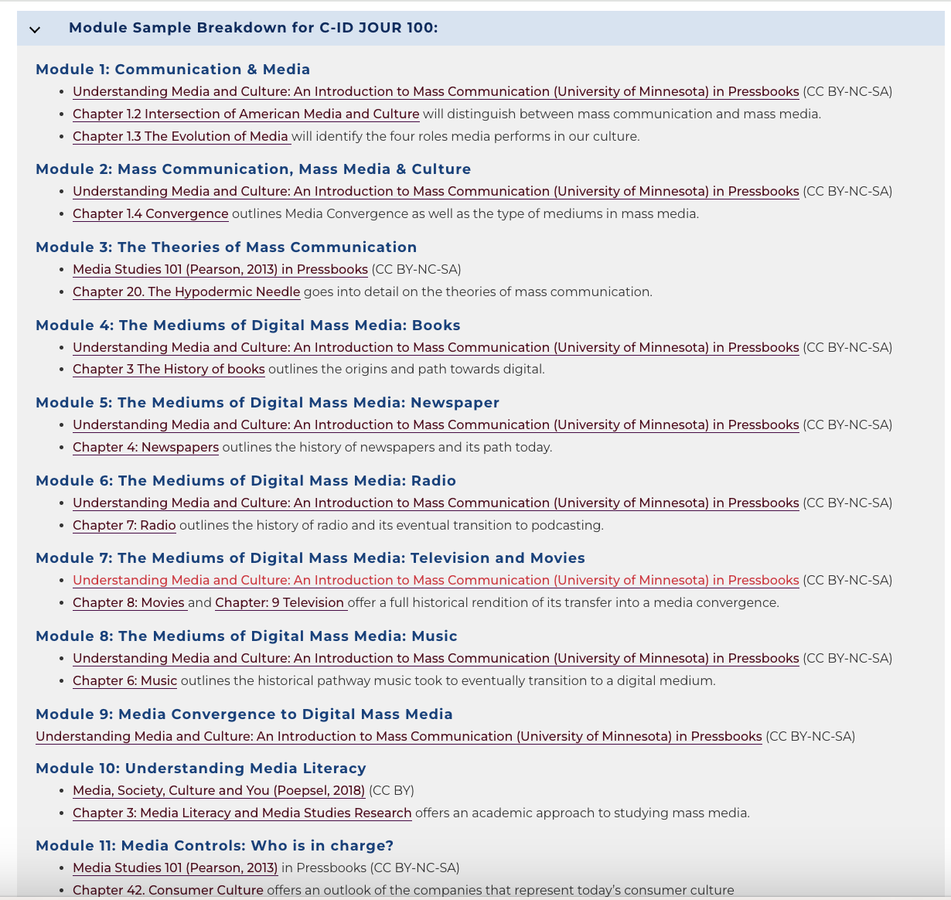
Module Layout

Slide 22

A Community Resource
Public Relations - Collaborate with a 4 year!

Slide 23

A Community Resource
Join JACC Here

Slide 24

Collaborations & Networking
Reach out to close 4-year programs and connect
Work up to crafting relationships within your community industry
Craft a clean space for your students to do what they do best - report on news!

Slide 25

Sno Flow
We know that overseeing a journalism program involves a lot of moving parts. That’s why we created FLOW, an all-in-one virtual newsroom management system designed to help you manage the chaos. With fully customizable assignment types and workflows, and built-in communication tools through chat and phone notifications, FLOW enables you and your staff to collaborate, plan and execute online.

Slide 26
Thank you for Attending!
Questions?
Kelsey Stuart
Kstuart@vcccd.edu

