Slide 1
ADAPT Level 1
Accessing ADAPT and Finding Existing Assessments
June 14, 2024. This work is licensed under a Creative Commons Attribution 4.0 International License.
Attribute this slide deck as: “ADAPT Level 1” by ASCCC OERI is licensed under CC BY 4.0.

Slide 2
Agenda
Introduction to ADAPT
Collections, Public Courses, and Questions
ADAPT Native Questions
Creating an ADAPT Course
Creating an Assignment and Add Existing Questions
Cloning and Editing ADAPT Native Questions

Slide 3
Overview
What is ADAPT?
Why ADAPT?
How to access ADAPT?
Notes:
Suggest delete

Slide 4
What is ADAPT?
ADAPT is a comprehensive online assessment/homework infrastructure that provides faculty the ability to include auto-graded and non-auto-graded activities from different platforms such as H5P, MyOpenMath, WeBWork, and it’s own native ADAPT questions.
ADAPT can be integrated into an LMS such as Canvas with full grade integration or it could be run independently.
Integration via LTI (Learning Tools Interoperability) – requires action by your Canvas Administrator.
Instructions for LTI integration with Canvas.
Notes:
Changed language

Slide 5
Why ADAPT?
ADAPT, part of the LibreTexts platform, provides a repository of openly licensed activities/assessments within an environment focused on increasing the availability of OER.
Activities/assessments can be created in ADAPT, a creation tool that has focused on addressing the issues associated with other homework systems (e.g., accessibility).
Easier to create alternative pathways (A11y).
ADAPT is a tool to connect your openly-licensed homework resources into the Canvas gradebook.
While ADAPT may not already do all that you want it to, like the LIbreTexts platform, it is ever-evolving.

Slide 6
Who is using ADAPT?
Spring 2024
115+ active ADAPT courses
3,500+ students used ADAPT
90+ colleges across the US have the ADAPT Canvas LTI.
Updated list of 94 institutions as of 4/25/24.

Slide 7
Accessing ADAPT
Create an instructor ADAPT account
https://adapt.libretexts.org/login
If you don’t have an account, click on Register and then select Instructor
Register with ADAPT
If you have not yet registered, access codes are available
Note: Code for access must be used within 48 hours.

Slide 8
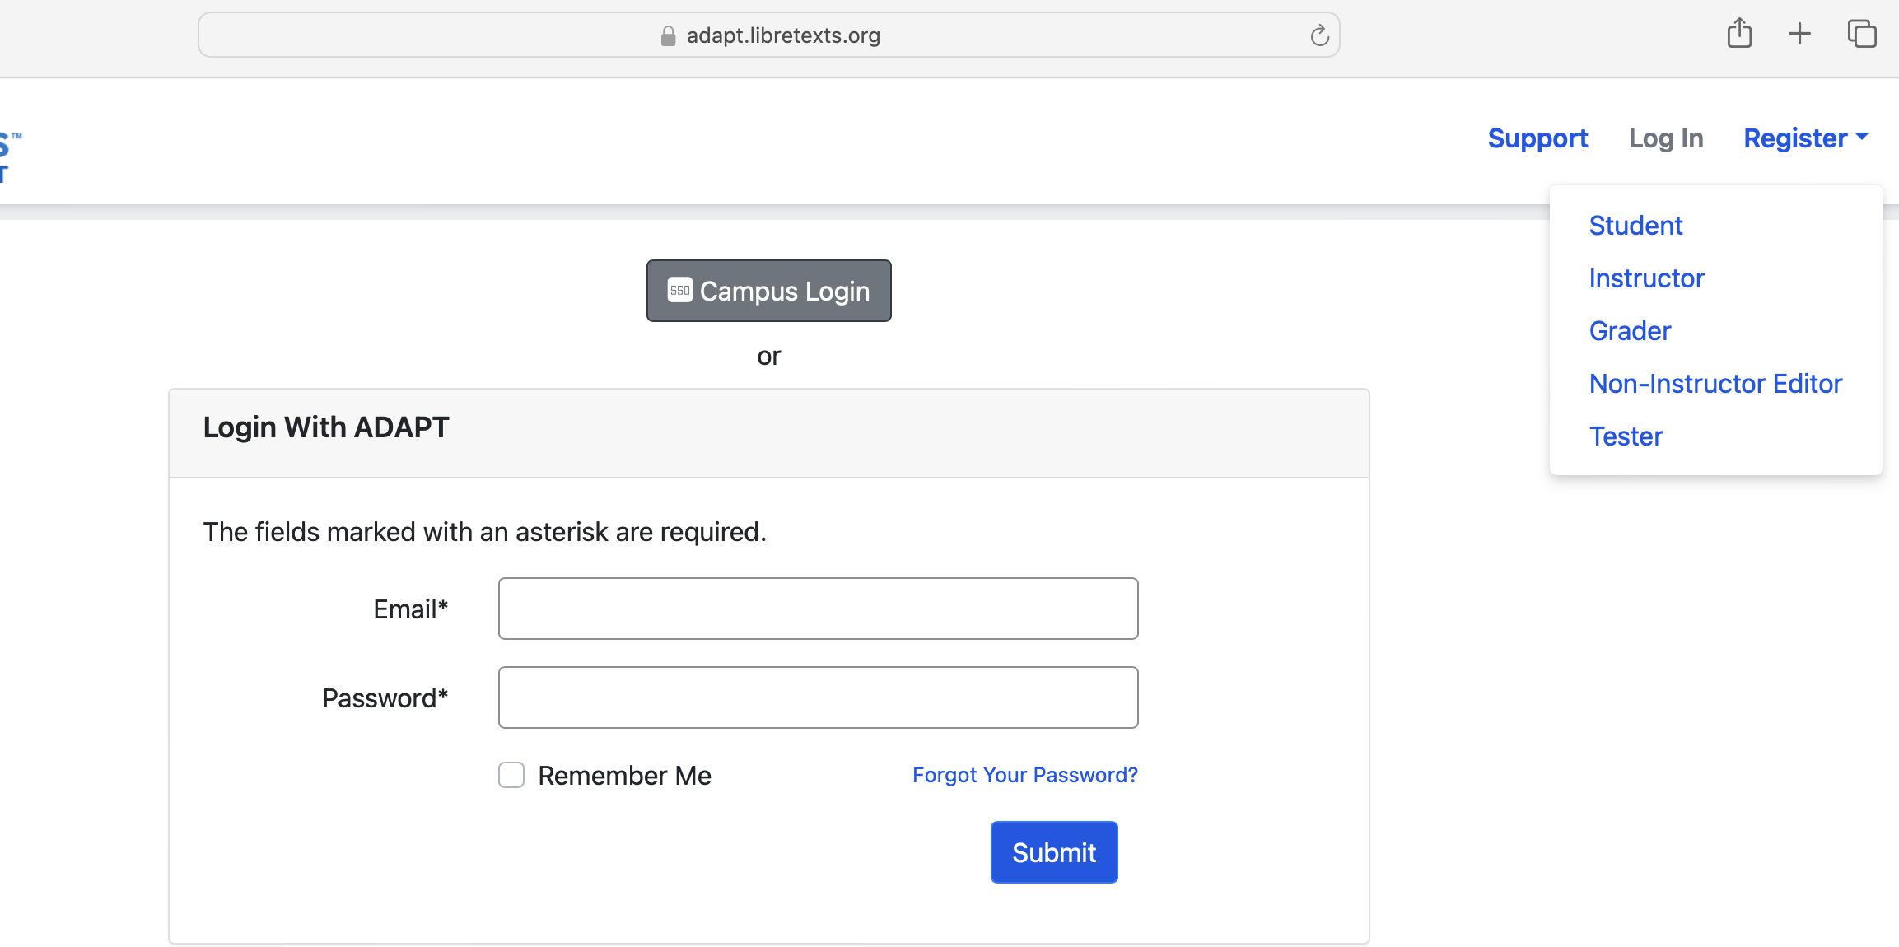
Register > Instructor

Slide 9
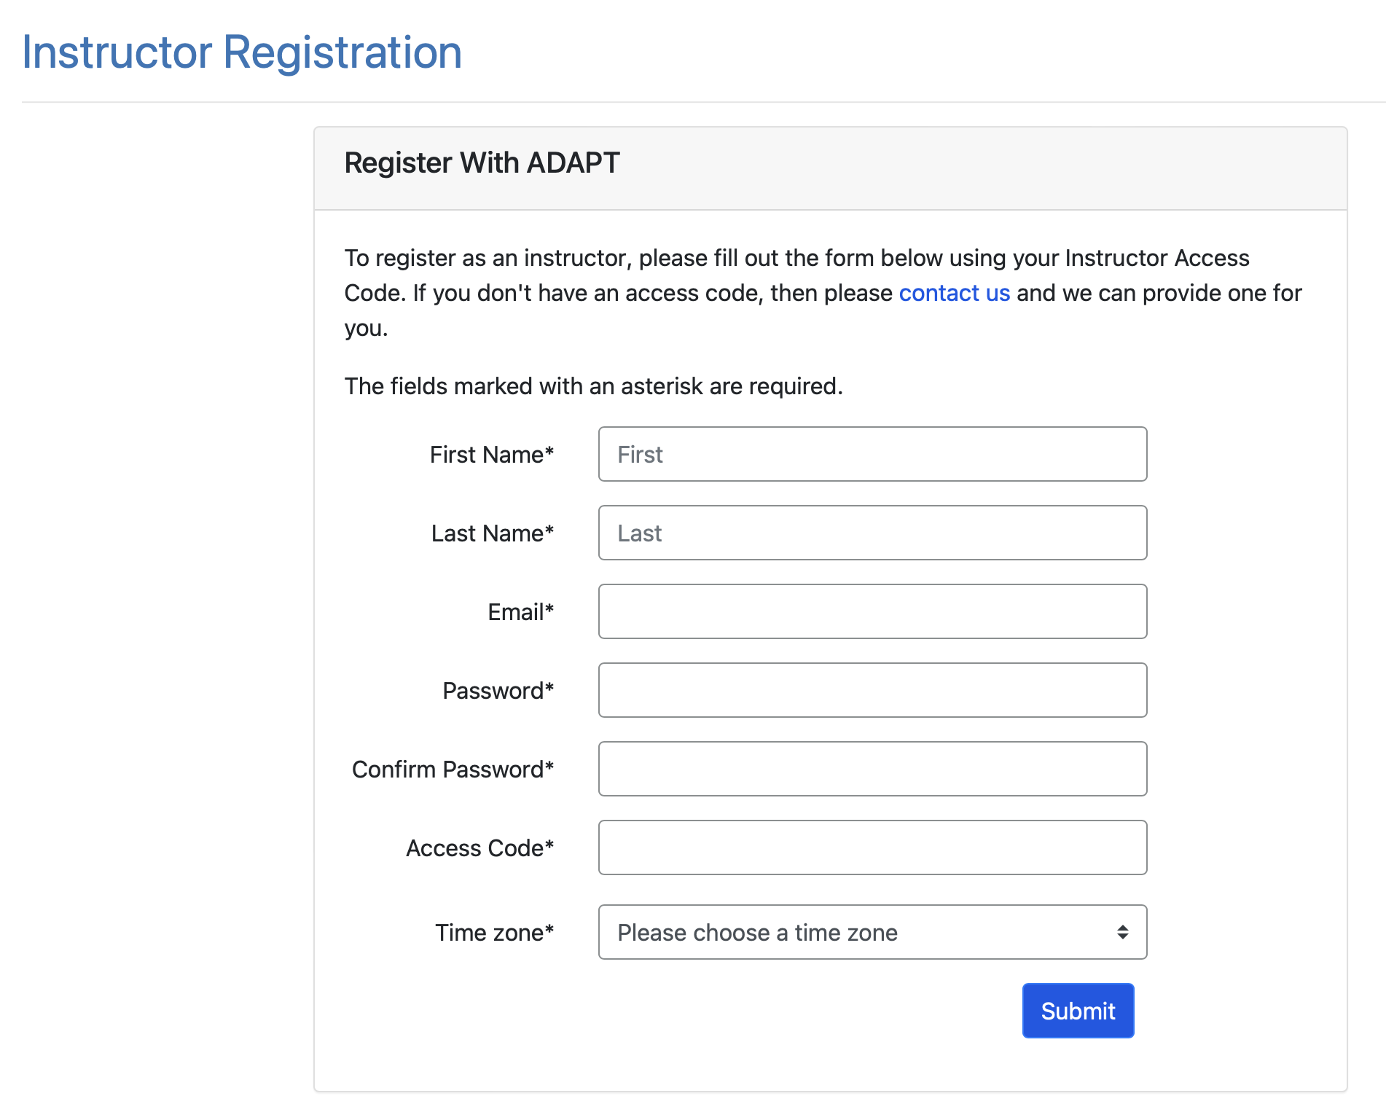

Slide 10
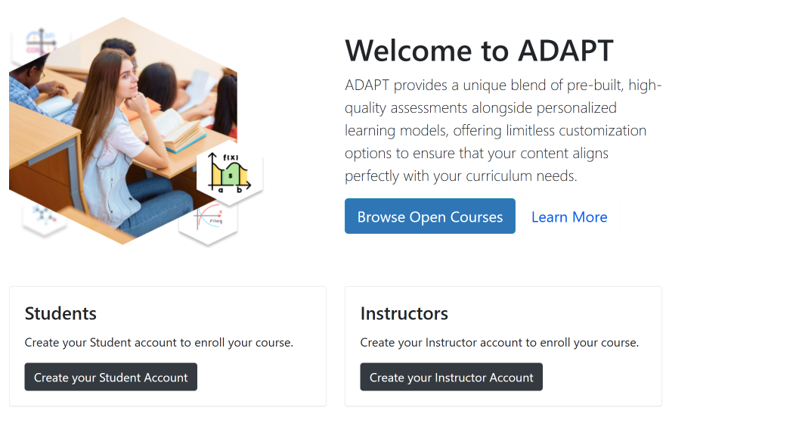
Exploring ADAPT – adapt.libretexts.org
Browse Open Courses
Without logging in, you see what “courses” are there – but you can’t see details.

Slide 11
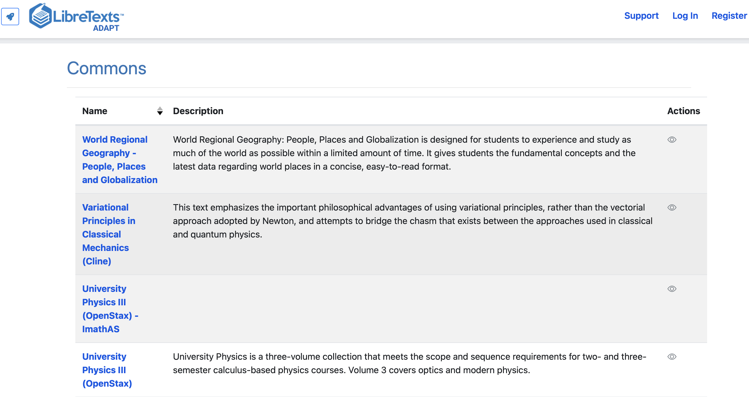
Exploring ADAPT – adapt.libretexts.org

Slide 12
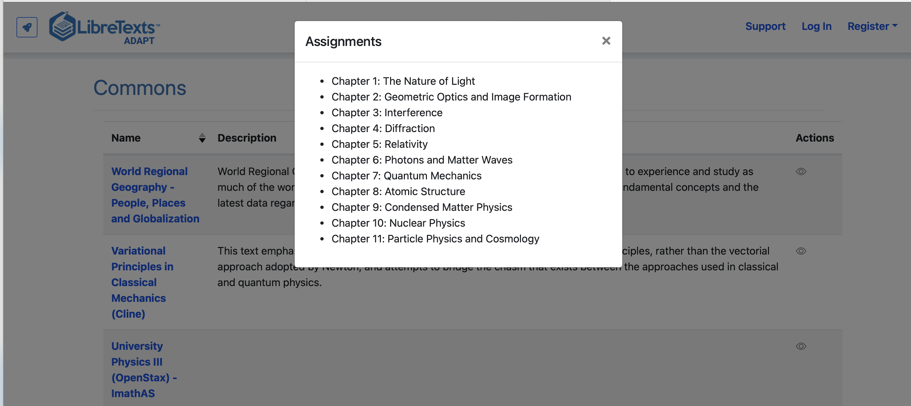
Click on the “actions eyeball”…
… to get a sense of what is there.

Slide 13
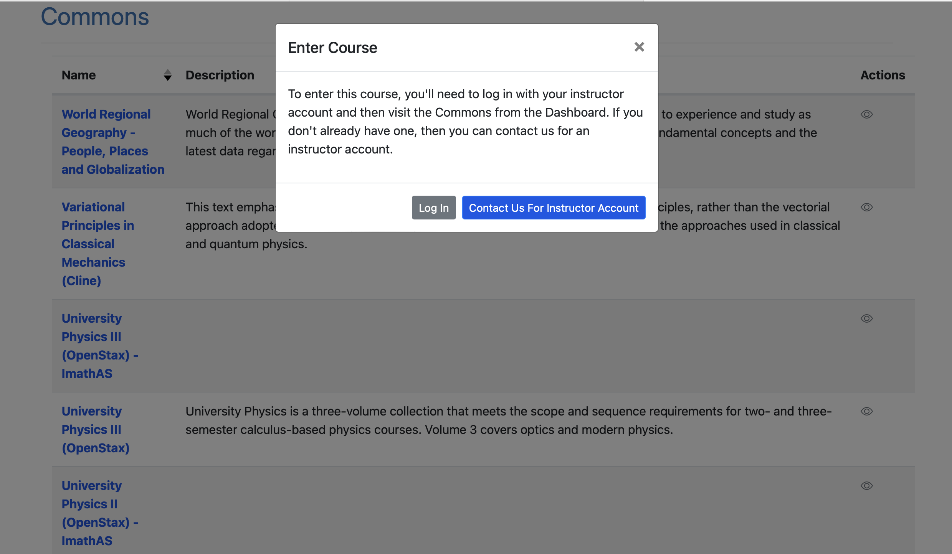
Log into ADAPT for full access

Slide 14
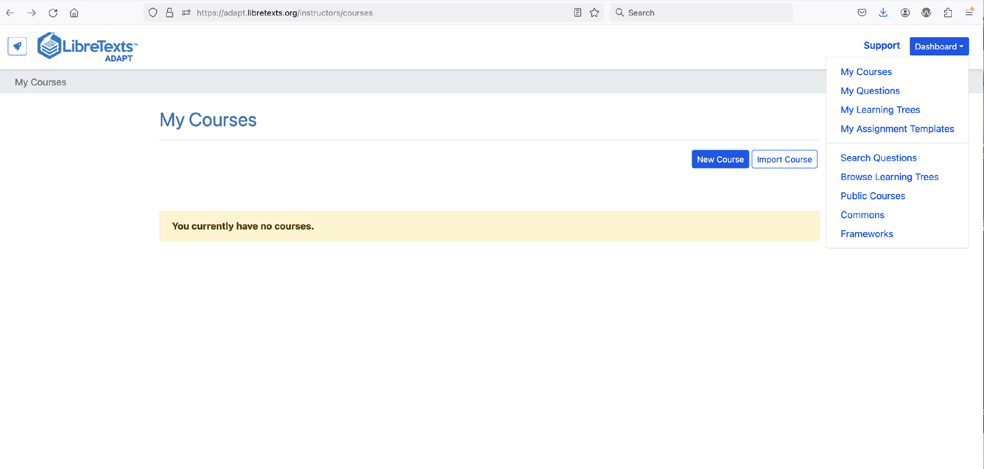
Dashboard > Questions

Slide 15
Technology Options
Total # of activities in ADAPT = 199,454
WeBWork - 43,966
IMathAS - 70,350
H5P - 18,488
Native - 15,917
Open-ended - 50,191

Slide 16
Search Questions
Type
Any type
Question
Exposition
Report
Content
Either content type
Auto-graded, only
Open-ended, only
Technology
Search challenges
Descriptions not descriptive
Tags missing

Slide 17
Creating in ADAPT
•Questions will live in the ADAPT library
•If you create a course and assignments, these live within your ADAPT account – if you delete them, they are gone.
•A course serves as a place to store resources for a given course.
•You can start by importing an existing course and/or by creating one.
•Options available when you go to My Courses in the Dashboard.

Slide 18
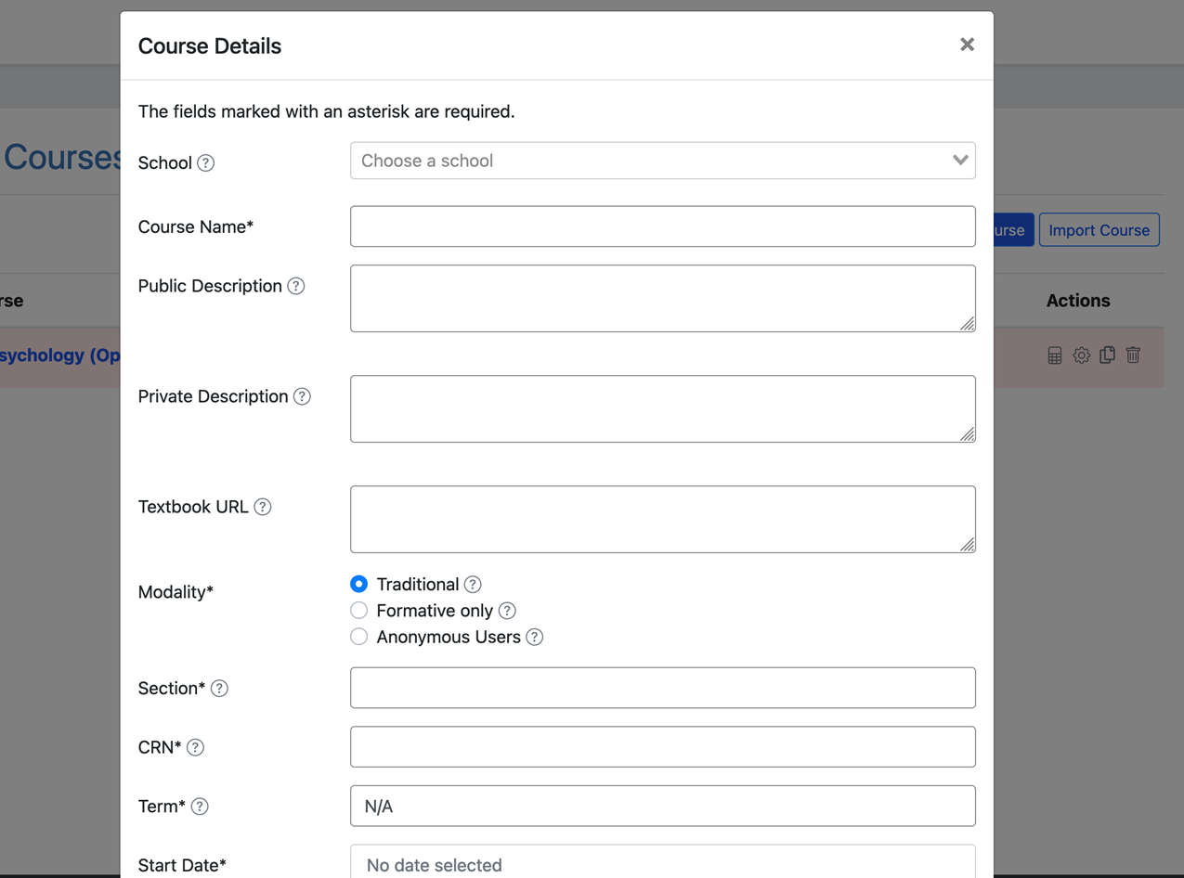
Course Details - Screenshot

Slide 19
Required Course Details
Course Name: The name of the course students are enrolling in.
Modality: There are three modality options – traditional, formative, and anonymous.
Section: a course may contain different sections.
CRN: The course reference or identification number.
Term: The term of the course. Your entry can vary and depends on how you or your institution identify terms.
Start Date: the start of the course - the course will not be available to students before this date.
End Date: the end of the course – the course will not be available to students after this date.
Public: the options are yes or no.
Alpha: the options are yes or no.
LMS: Adapt can integrate into your school’s learning management system. If you are interested, have your LMS administrator contact Adapt.

Slide 20
Types of Courses
Course Modalities
Traditional: courses using summative or formative assignments that are only viewable by the students enrolled in the course. This modality is best used as a homework platform where students are graded for their assignments.
Formative Only: courses that only use formative assignments. This modality is great for in-class clicker questions, practice assignments, and other ungraded assessments.
Anonymous Users: courses where anyone can view the assignments. The users are anonymous, and their responses are not saved. This modality is best for surveys in a course or optional practice assignments.
Public Courses
A public course is available for copying or importing by any instructor using ADAPT and they are great for those who want to share their materials with other faculty at their institution or the greater community. When another instructor copies your course, they copy the assignments and settings. They do not copy any student information, grades, responses, etc.
Alpha and Beta Courses
An alpha course is like a master course that can have connected beta courses. When a beta course is connected to an alpha course, all of the assignments, properties, and changes in the alpha course are transferred to the beta course. This option is best used when multiple instructors are teaching the same course or you have multiple courses of the same class.

Slide 21
Let’s Get to Work

Slide 22
Create a Course in ADAPT
Enter:
School: find your college
Course Name
Section/CRN
Term
Start/end date
Public: Yes >if you want to share your course with other instructors
LMS: select Yes* for Canvas integration
Note: You will need to create one ADAPT course per Canvas course if your answer is yes.

Slide 23
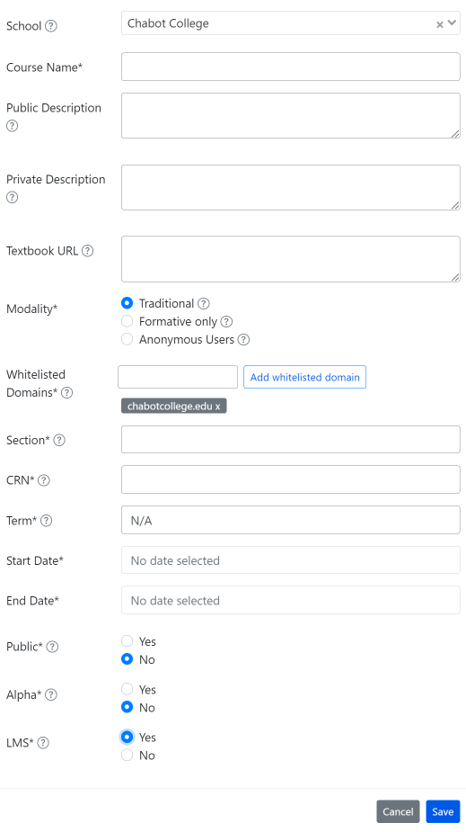

Slide 24
Do you teach more than one section of the same course?
If you teach multiple sections of the same course, you can easily clone the course and then link it to Canvas.

Slide 25
Create a New Assignment
Enter:
Name of the assignment
Assignment group
Points (default is 10)
Assessment type
# of allowed attempts
Late policy
Assign to
Available on
Due date

Slide 26
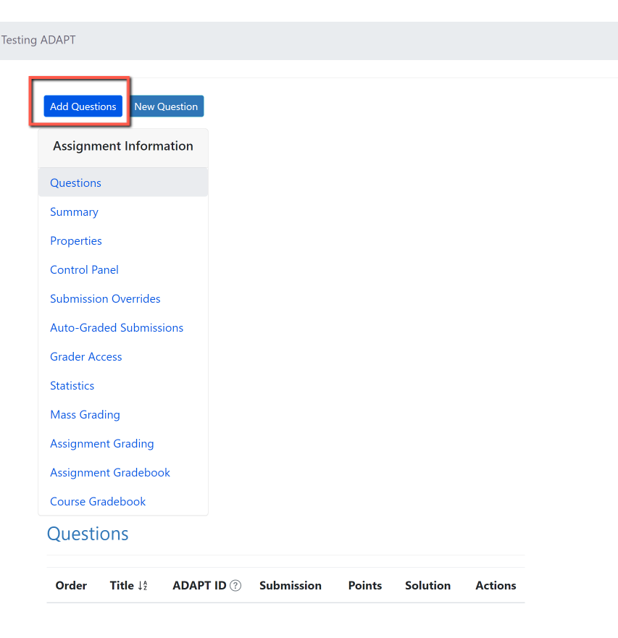
Add Questions

Slide 27
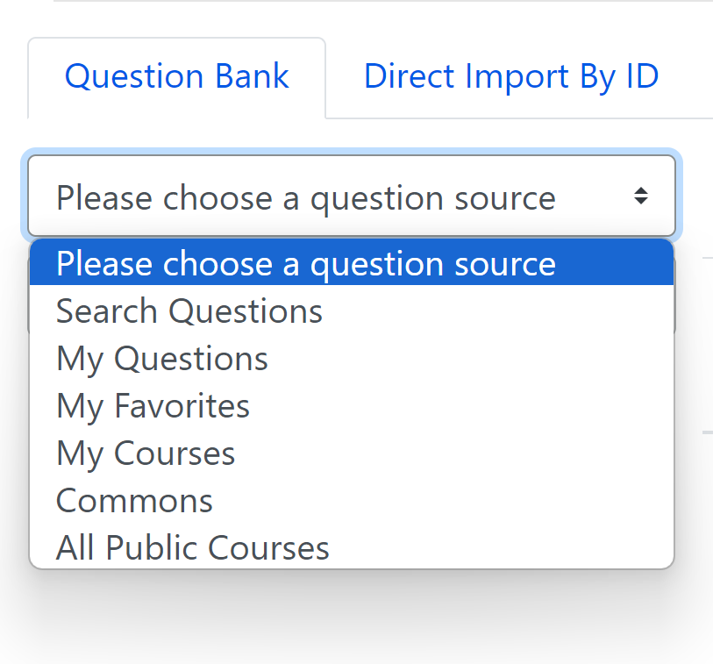
Choose a Question Source
You can search from:
Questions
Collections (OER projects)
Public Courses (open courses)

Slide 28
Organize Questions
Once you find a question you like, you can:
save it to your favorites (the heart) or
add it to your assignment (+ symbol)

Slide 29
Do you Want to Edit an ADAPT Question?

Slide 30
What is Cloning?
No, we are not cloning Dolly the sheep.
In ADAPT, you can copy (or clone) a native question, an assignment, and even a course.
Why clone a question?
You can clone a question (created by you or someone else) and edit it which will save you lots of time.

Slide 31
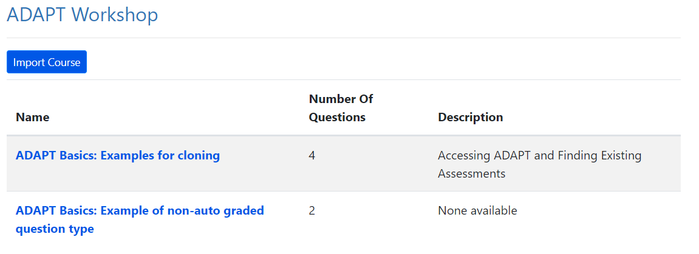
Ready to Practice?
Go to the ADAPT Dashboard and find Public Courses.
Find ADAPT Workshop and import the course.
I have added examples of question types that you will clone and edit.

Slide 32
Clone an activity and Edit
Clone (or copy) the activity by clicking on the paper icon next to the pencil. That will create a copy version of the same activity that now you can edit.

Slide 33
Need more ADAPT Training?
ADAPT Level 2 – Creating in ADAPT Friday, June 21, 2024 from 1:30 pm – 3:00 pm In this webinar, you will learn how to create auto-graded activities in ADAPT, featuring various question types like fill-in-the-blank, multiple choice, true or false, select choice, and matching that are accessible and adaptable. Register for ADAPT Level 2
ADAPT Level 3 – Using ADAPT in Canvas Monday, July 15, 2024 from 3:00 pm – 4:30 pm Having created assessments in ADAPT, how can you integrate them into Canvas? Explore ADAPT’s seamless integration with Canvas grades. Register for ADAPT Level 3

Slide 34
Virtual LibreFest-July 8-12, 2024
This virtual workshop will provide four and a half days of teaching and working sessions covering: how to create Open Education Resources (OER); how to edit/modify existing OER to build textbooks and other learning resources; how to use the LibreTexts Conductor project management platform and new Workbench; and the ADAPT open homework and assessment system. Sessions will begin at 9:00 am on Monday. Office hours will be held every day from 8:00 – 9:00 am. There will be time for questions and reflections at the close of each day's sessions from 3:00 – 4:00 pm.
If you do not already have a LibreTexts account, you will be prompted to create one during the LibreFest Registration process.
The LibreFest Registration fee for this workshop is $35 and includes a LibreTexts shirt and other small swag. Please use the payment link at the end of the LibreFest Registration form to pay.
Note: No swag will be offered when using the fee waiver option.
The LibreFest Registration will close no later than July 5, 2024. However, capacity is limited, so the registration may close sooner.

Slide 35
Looking for more ADAPT Resources?

Slide 36
ADAPT resources
Accessibility reports
ADAPT construction guide
Canvas LTI for ADAPT instructions
LibreTexts weekly office hours in Zoom:
Tuesdays at 9:00-10:00 PST
Thursdays at 9:00-10:00 PST

Slide 37
ASCCC OERI Recorded Webinars on ADAPT
Continuing the Path to Zero in Spanish Open Educational Resources (OER): Tarea Libre 2 | 2024/05/03
Getting Spanish Homework to Zero Textbook Cost (ZTC) with LibreTexts ADAPT | 2024/04/26
Beyond Traditional Spanish Homework: Adding Project Based Learning to your Open Educational Practices | 2024/04/12
Spanish Open Educational Resources (OER) Hackathon: Let’s create a HW Collection | 2023/10/27
Getting Spanish to Zero – An Openly-Licensed Homework Option for Spanish | 2023/10/20
What’s new in Spanish OER: Tarea Libre | 2023/05/05
Remixing Spanish OERs in LibreTexts and importing to Canvas | 2023/04/28
What’s new in Spanish Open Educational Resources (OER) | 2022/11/04
What’s New in Spanish OER? | 2022/03/25
Remixing Spanish OER | 2021/10/15
Spanish, LibreTexts, and Adapt – Using OER to Customize Your Spanish Text and Integrate a Homework System | 2021/05/07
OER and Spanish | 2021/05/03

Slide 38
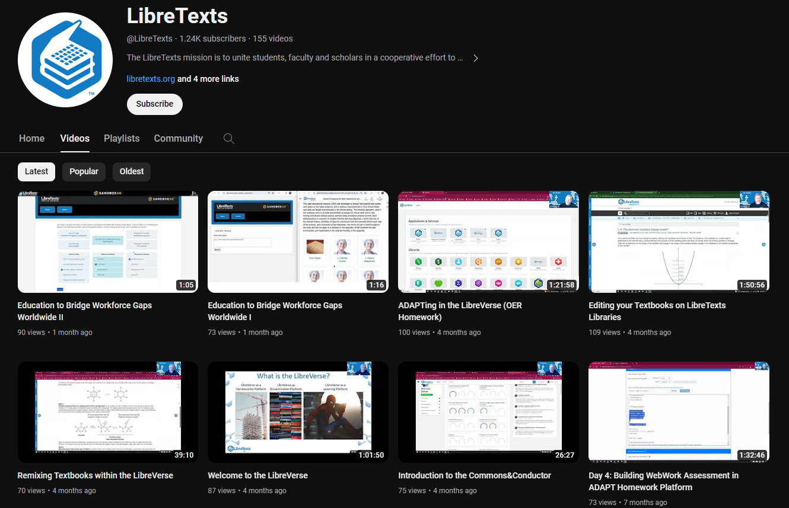
LibreTexts Workshops Recordings
LibreTexts News and Events page has more information.

Slide 39
More Information
ASCCC OERI Website (asccc-oeri.org)
Resources
Webinars and Events
ASCCC OER E-Mail (oeri@asccc.org)

Slide 40
And to contact us…
General OERI E-Mail:
oeri@asccc.org
Find everyone’s email at: https://asccc-oeri.org/about-us/

Slide 41
Questions about ADAPT?
Cristina Moon
Spanish Faculty
OER/ZTC Coordinator at Chabot College
ASCCC OERI Spanish Lead, H5P/ADAPT Lead, and OERI Liaison
cmoon@chabotcollege.edu

Slide 42
Thanks!
Photo by Thgusstavo Santana from Pexels

