Slide 1
ADAPT Level 2
Creating in ADAPT
June 21 2024. This work is licensed under a Creative Commons Attribution 4.0 International License.
Attribute this slide deck as: “ADAPT Level 2” by ASCCC OERI is licensed under CC BY 4.0.
Notes:
Xochi – Please add link for CVC-OERI.

Slide 2
Agenda
ADAPT - What and Why
Why Create ADAPT Native Questions?
Creating ADAPT Native Questions
Fill-in the blanks
Select choice
Matching
Highlight text
Non-auto graded/open-ended question

Slide 3
What is ADAPT?
ADAPT is a comprehensive online assessment/homework infrastructure that provides faculty the ability to include auto-graded and non-auto-graded activities from different platforms such as H5P, MyOpenMath, WeBWork, and its own native ADAPT questions.
ADAPT can be integrated into an LMS such as Canvas with full grade integration or it could be run independently.
Integration via LTI – required action by your Canvas Administrator
Instructions for LTI integration with Canvas.

Slide 4
Why ADAPT?
ADAPT, part of the LibreTexts platform, provides a repository of openly licensed activities/assessments within an environment focused on increasing the availability of OER.
Activities/assessments can be created in ADAPT, a creation tool that has focused on addressing the issues associated with other homework systems (e.g., accessibility).
ADAPT is a tool to connect your openly-licensed homework resources into the Canvas gradebook via LTI/API.
While ADAPT may not already do all that you want it to, like the LIbreTexts platform, it is ever-evolving.

Slide 5
Why create ADAPT native questions?
Unlike H5P questions, ADAPT native questions were created with accessibility in mind.
H5P accessibility report.
Easy to create. If you can create Canvas quiz questions, you can create ADAPT native questions.
Easy to clone (copy) questions and edit.
New questions types and new features are being developed and added.

Slide 6
Accessing ADAPT
Create an instructor ADAPT account
https://adapt.libretexts.org/login
If you don’t have an account, click on Register and then select Instructor
Register with ADAPT
Note: Code for access must be used within 48 hours.
If you need a code, type “Code” in the chat.

Slide 7
Let’s get to work
Now that we know what is ADAPT and how to search in ADAPT … let’s create the following question types:
Fill-in the blanks
Select choice
Matching
Highlight text
Non-auto graded question (ex: recording)

Slide 8
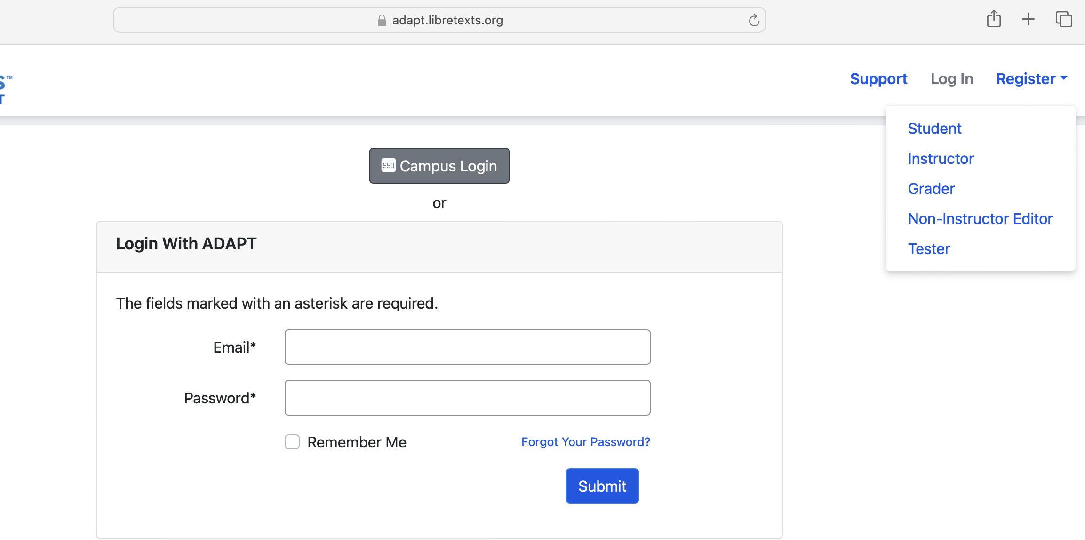
Register and create an Instructor Account
Notes:
Are these all to be hidden?

Slide 9
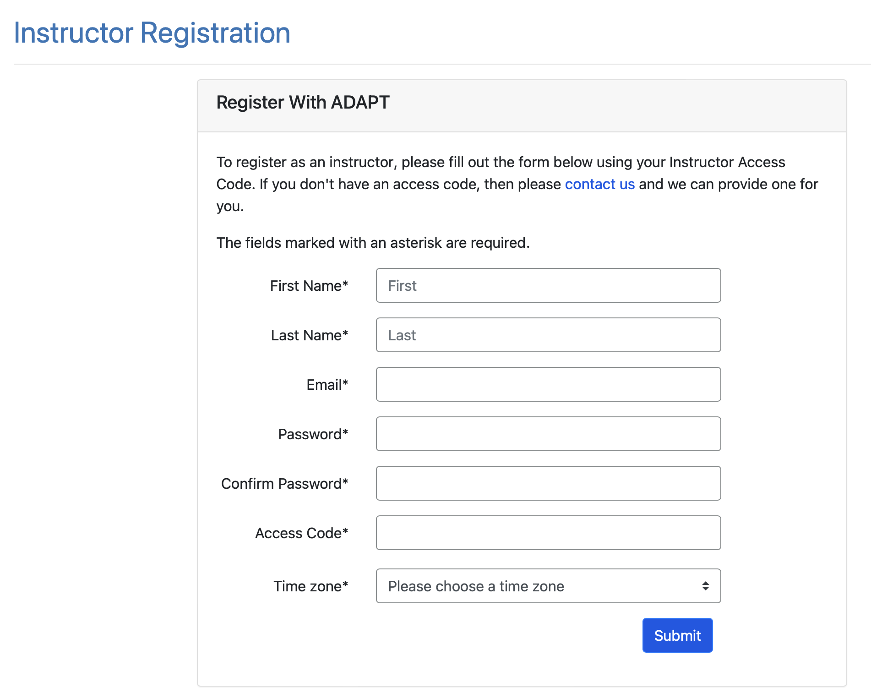

Slide 10
Create a Course in ADAPT
Enter:
School: find your college
Course Name
Section/CRN
Term
Start/end date
Public: Yes >if you want to share your course with other instructors
LMS: select Yes* for Canvas integration
Note: You will need to create one ADAPT course per Canvas course if your answer is yes.

Slide 11
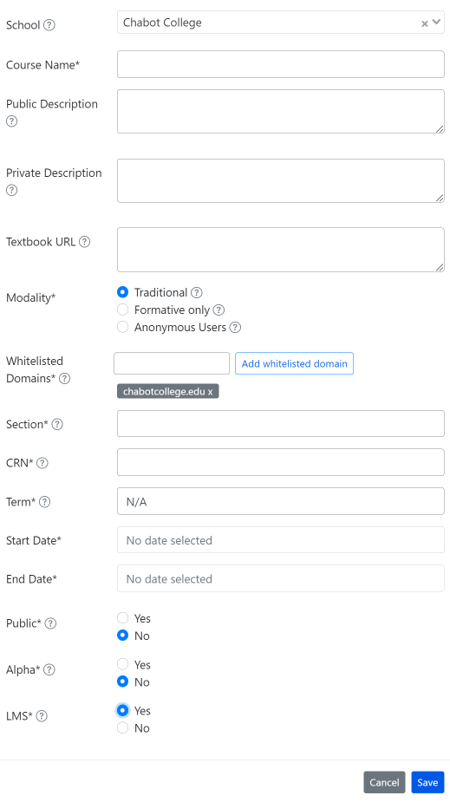

Slide 12
Create a New Assignment
Enter:
Name of the assignment
Assignment group
Points (default is 10)
Assessment type
# of allowed attempts
Late policy
Assign to
Available on
Due date

Slide 13
Let’s create some questions

Slide 14
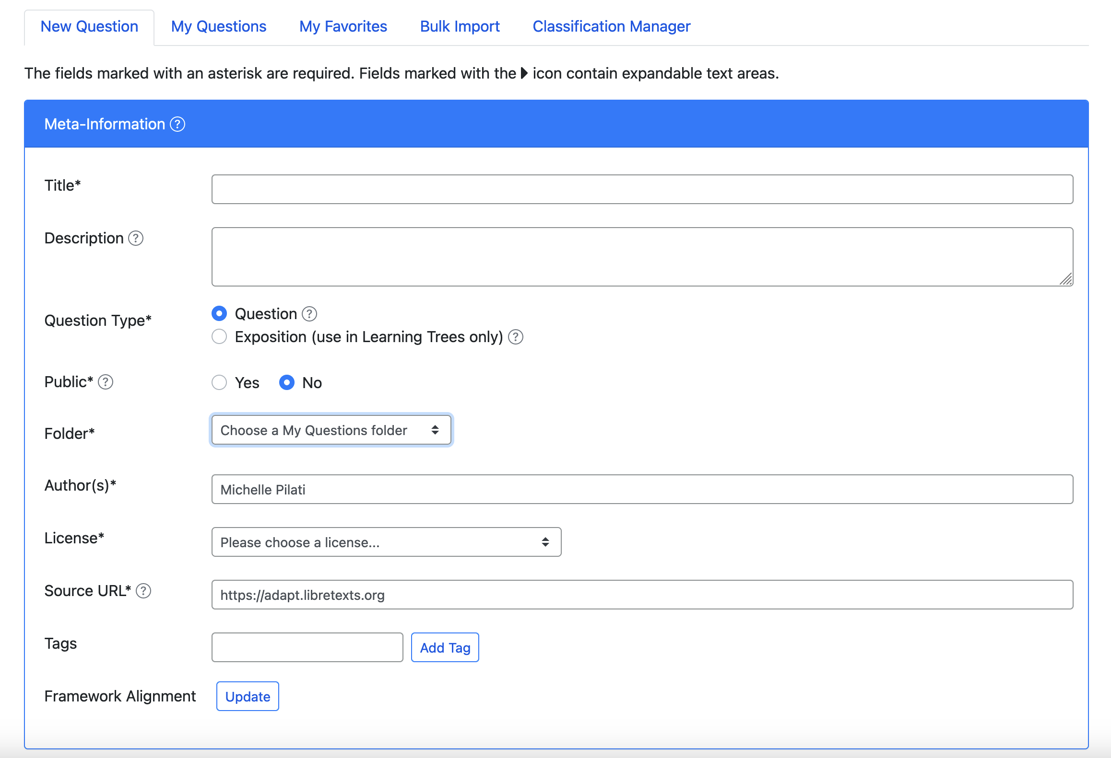
My Questions > New Question

Slide 15
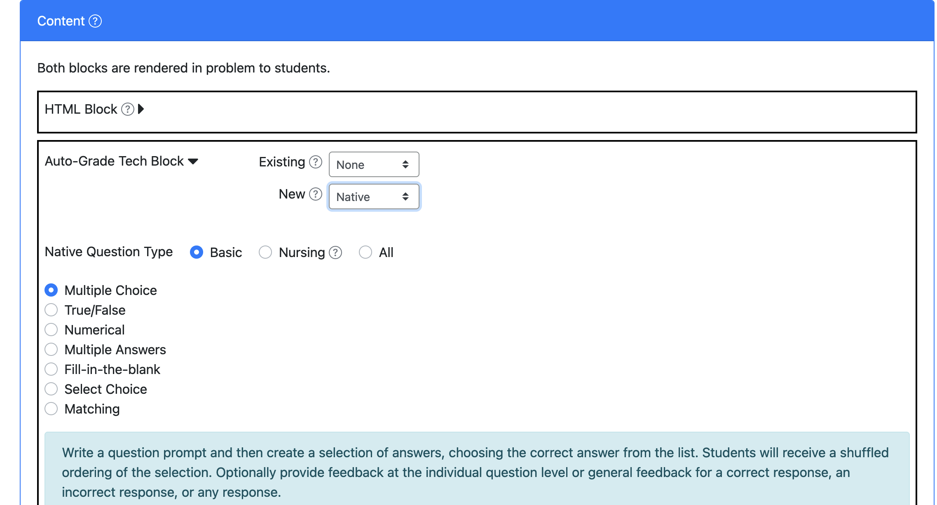
Selecting Content Type
New > Auto-Grade Tech Block > Native

Slide 16
Fill-in the Blanks
Create a question with fill in the blanks by underlining the correct responses.
Example: A stitch in time saves nine.
If you would like to accept multiple answers, separate them with a vertical bar: "|".
Example: January|February is a month that comes before March.

Slide 17
Select Choice (drop-down)
Use brackets for answers.
Example:
The [planet] is the closest planet to the sun; there are [number-of-planets] planets.
Then, add the choices below with your first choice being the correct response.
Add distractors. Each student will receive a randomized ordering of the choices.

Slide 18
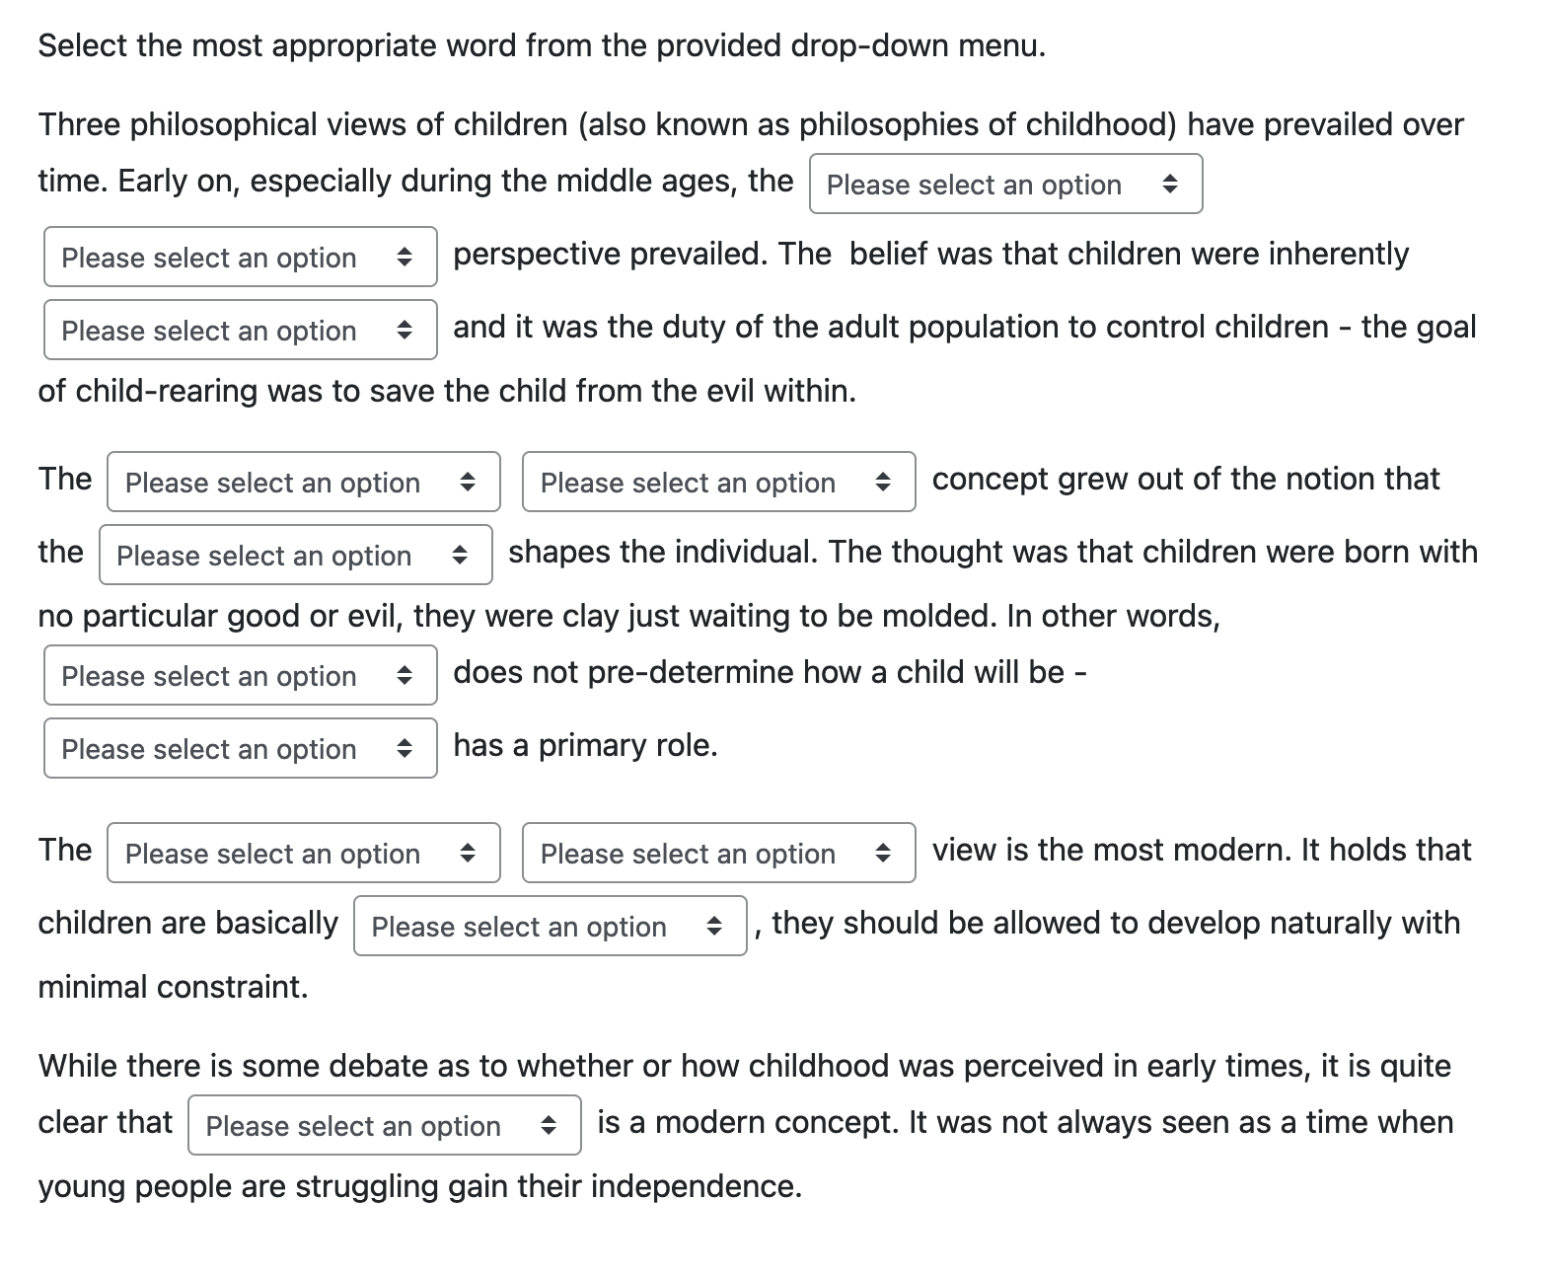
Select Choice Example

Slide 19
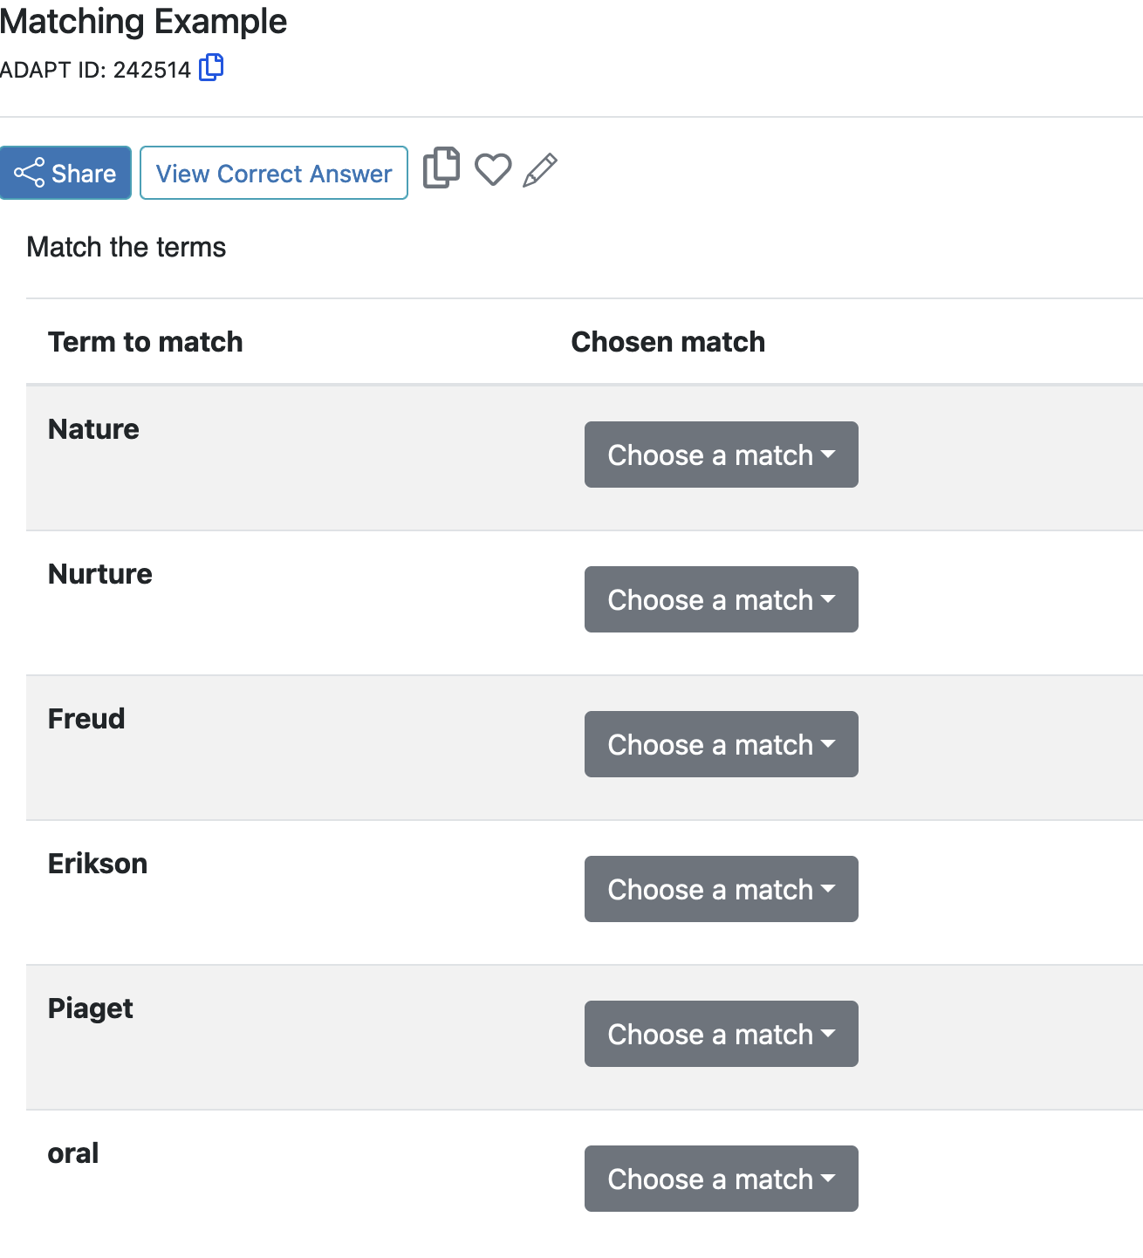
Matching
Create a list of terms to match along with their matching terms. Matching terms can include media such as images. Optionally, add distractors which do not satisfy any of the matches.

Slide 20
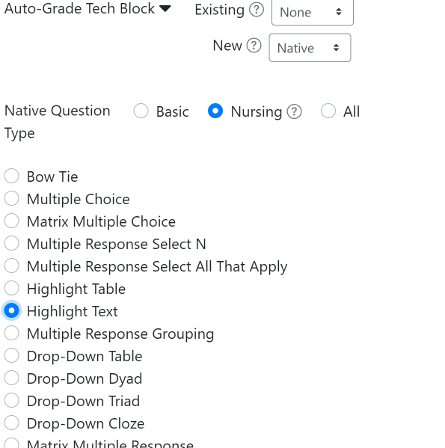
Highlight Text
You will find highlight text under the Nursing area.

Slide 21
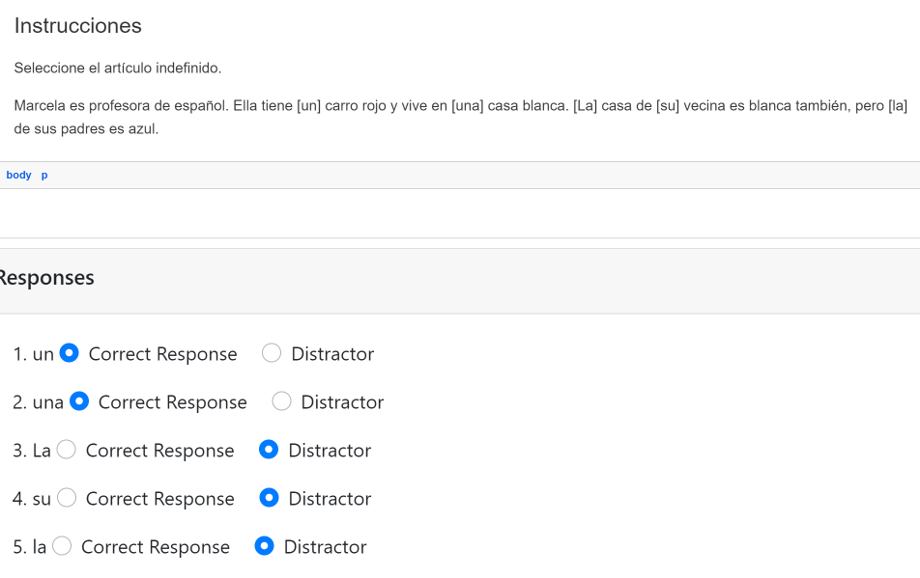
Highlight Text
Write out a prompt, where text within brackets [ ] will automatically become your highlighted text. Once the text is added, determine it is a correct answer or a distractor.

Slide 22
NEW!
Adding Audio/Video to Questions
You can add audio or video files to questions.
Once uploaded, it will create auto-create the captions and transcript.
Once you choose the type of question:
Click on Select Audio or Video File.
Upload the file.
Copy the link.
Create a link with the URL and add it to your question.
Note: You will receive an email notification when the captions are ready.

Slide 23
Edit Captions and Transcripts
The AI generated auto-captions are pretty accurate but if you need to edit, you can simply click on the pencil tool and edit.

Slide 24
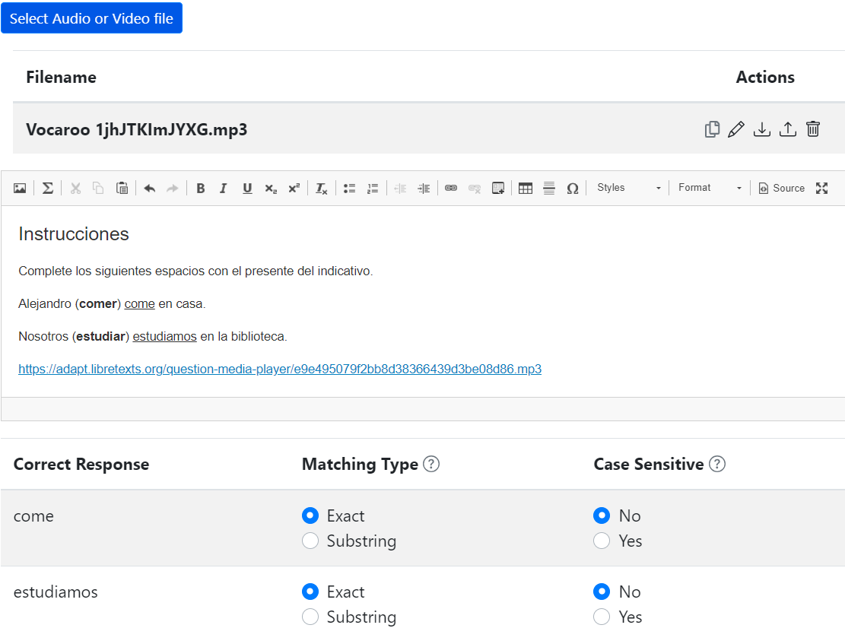
Sample of Audio File (back end view)

Slide 25
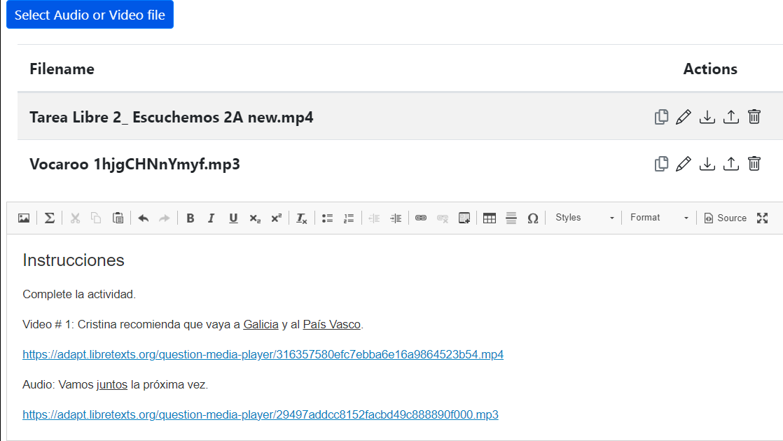
Sample of Video File (back end view)

Slide 26
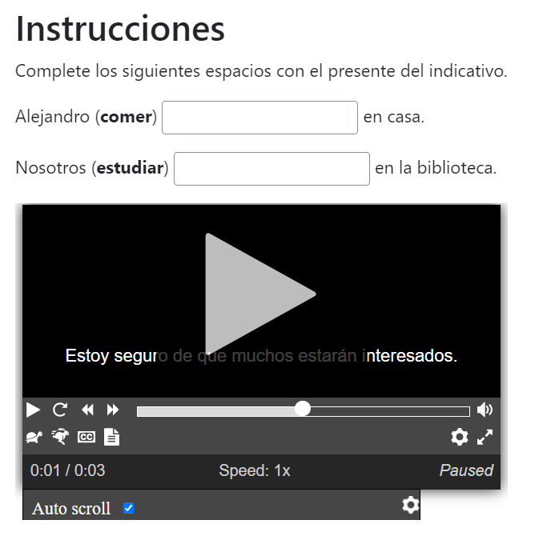
Sample of Audio File

Slide 27
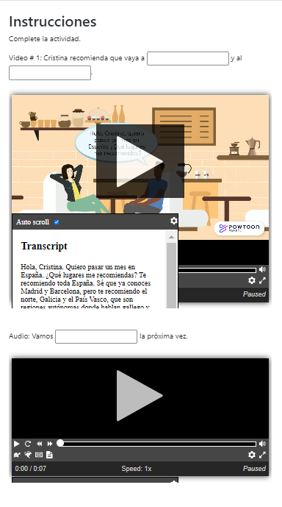
Sample of Video and Audio Files
Within the same question, you can include more than one file.

Slide 28
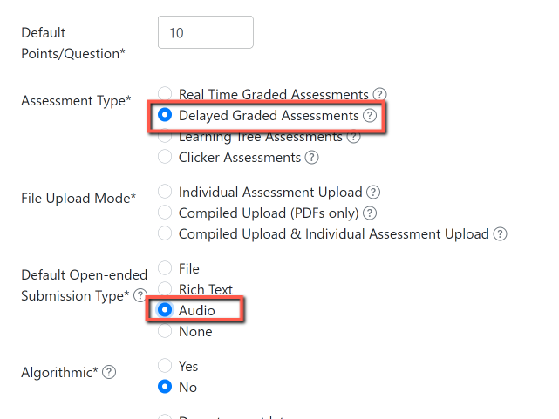
Non-auto graded/open-ended question
Are you interested in creating a speaking test type of question where students will have to record their answers?
Create a delayed graded assessment and select audio as the type of submission.
You can choose the type of open-ended submission.

Slide 29
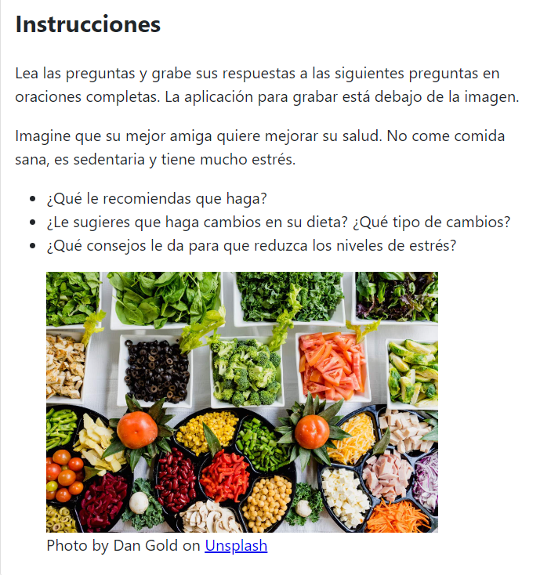
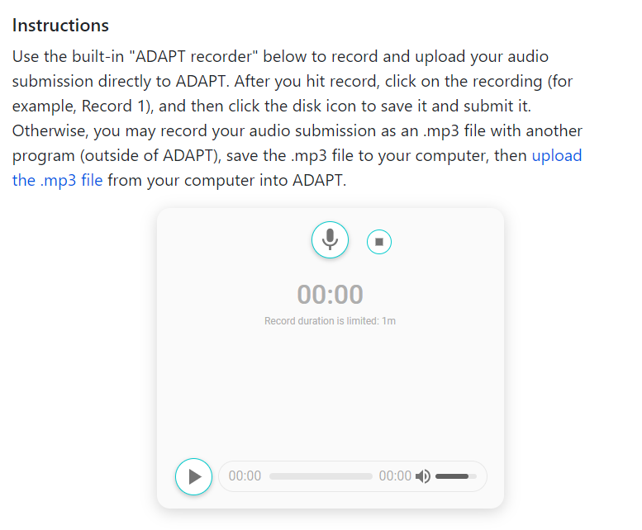
Speaking Test (non-auto graded)

Slide 30
Need more ADAPT Training?
ADAPT Level 3 – Using ADAPT in Canvas Monday, July 15, 2024 from 3:00 pm – 4:30 pm
Having created assessments in ADAPT, how can you integrate them into Canvas? Explore ADAPT’s seamless integration with Canvas grades.
Register for ADAPT Level 3

Slide 31
Virtual LibreFest-July 8-12, 2024
This virtual workshop will provide four and a half days of teaching and working sessions covering: how to create Open Education Resources (OER); how to edit/modify existing OER to build textbooks and other learning resources; how to use the LibreTexts Conductor project management platform and new Workbench; and the ADAPT open homework and assessment system. Sessions will begin at 9:00 am on Monday. Office hours will be held every day from 8:00 – 9:00 am. There will be time for questions and reflections at the close of each day's sessions from 3:00 – 4:00 pm.
If you do not already have a LibreTexts account, you will be prompted to create one during the LibreFest Registration process.
The LibreFest Registration fee for this workshop is $35 and includes a LibreTexts shirt and other small swag. Please use the payment link at the end of the LibreFest Registration form to pay.
Note: No swag will be offered when using the fee waiver option.
The LibreFest Registration will close no later than July 5, 2024. However, capacity is limited, so the registration may close sooner.

Slide 32
Looking for more ADAPT Resources?

Slide 33
ADAPT resources
Accessibility reports
ADAPT construction guide
Canvas LTI for ADAPT instructions
LibreTexts weekly office hours in Zoom:
Tuesdays at 9:00-10:00 PST
Thursdays at 9:00-10:00 PST

Slide 34
ASCCC OERI Recorded Webinars on ADAPT
Continuing the Path to Zero in Spanish Open Educational Resources (OER): Tarea Libre 2 | 2024/05/03
Getting Spanish Homework to Zero Textbook Cost (ZTC) with LibreTexts ADAPT | 2024/04/26
Beyond Traditional Spanish Homework: Adding Project Based Learning to your Open Educational Practices | 2024/04/12
Spanish Open Educational Resources (OER) Hackathon: Let’s create a HW Collection | 2023/10/27
Getting Spanish to Zero – An Openly-Licensed Homework Option for Spanish | 2023/10/20
What’s new in Spanish OER: Tarea Libre | 2023/05/05
Remixing Spanish OERs in LibreTexts and importing to Canvas | 2023/04/28
What’s new in Spanish Open Educational Resources (OER) | 2022/11/04
What’s New in Spanish OER? | 2022/03/25
Remixing Spanish OER | 2021/10/15
Spanish, LibreTexts, and Adapt – Using OER to Customize Your Spanish Text and Integrate a Homework System | 2021/05/07
OER and Spanish | 2021/05/03

Slide 35
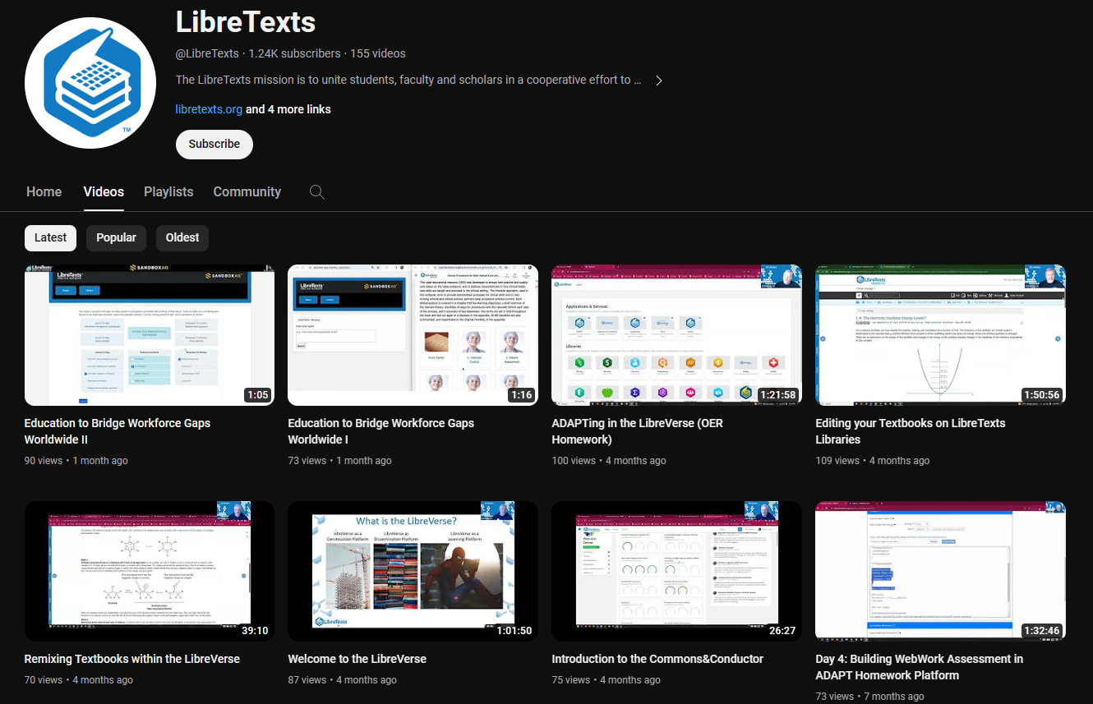
LibreTexts Workshops Recordings
LibreTexts News and Events page has more information.

Slide 36
More Information
ASCCC OERI Website (asccc-oeri.org)
Resources
Webinars and Events
ASCCC OER E-Mail (oeri@asccc.org)

Slide 37
And to contact us…
General OERI E-Mail:
oeri@asccc.org
Find everyone’s email at: https://asccc-oeri.org/about-us/

Slide 38
Questions about ADAPT?
Cristina Moon
Spanish Faculty
OER/ZTC Coordinator at Chabot College
ASCCC OERI Spanish Lead, H5P/ADAPT Lead, and OERI Liaison
cmoon@chabotcollege.edu

Slide 39
Thanks!
Photo by Thgusstavo Santana from Pexels

