Slide 1
Introduction to Remixing in LibreTexts Workshop
Created by Shagun Kaur and Suzanne Wakim
Licensed CC BY 4.0

Slide 2
Welcome!
On behalf of the ASCCC OERI, we are pleased to have you here with us for “Introduction to Remixing in LibreTexts Workshop”
If you are not already muted, please mute yourself upon arrival. As this is set up as a meeting, we will be able to have an actual discussion – but we need all those who are not speaking to be muted.
Please note that you are encouraged to use the Zoom “chat” feature for questions and comments.
This event will be recorded. Archives of all ASCCC OERI events are available at asccc-oeri.org > Webinars and Events

Slide 3
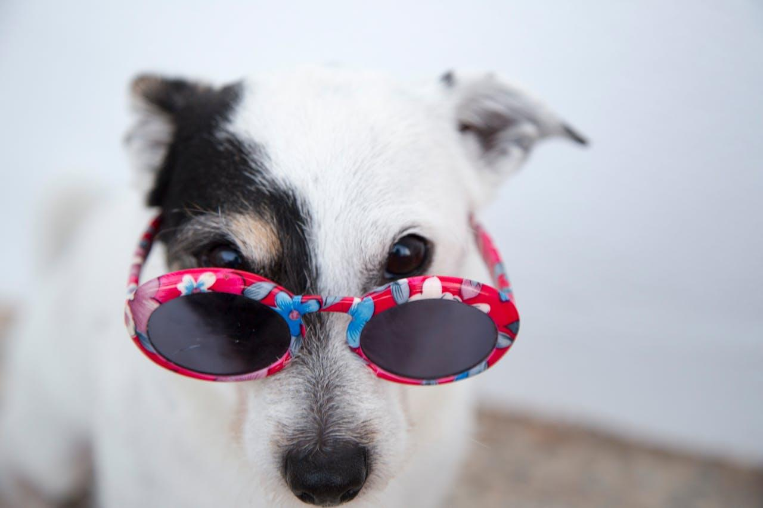
Your Presenters
Shagun Kaur
Faculty, Comm Studies, De Anza College
OERI Project Facilitator
Suzanne Wakim
Faculty, Biology, Butte College
OERI Project Facilitator
White dog wearing glasses by Ilargian Faus under Pexels license

Slide 4
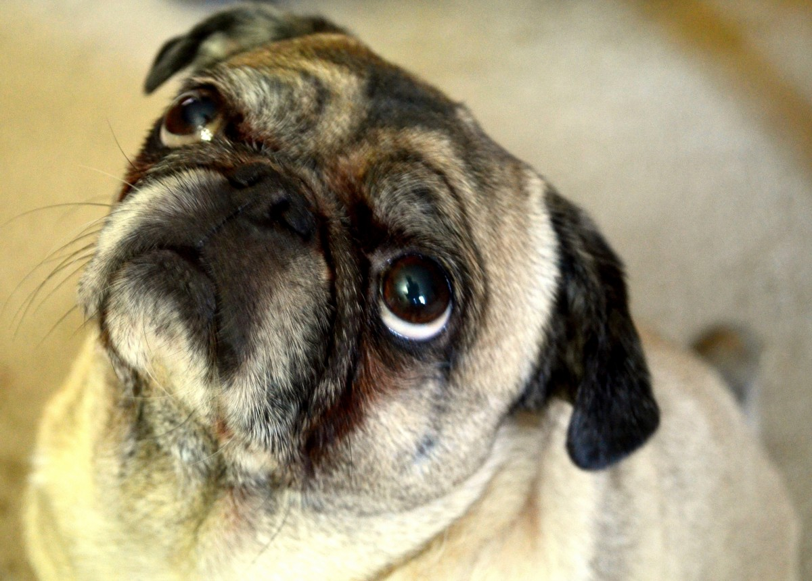
Agenda
LibreTexts: An Overview
Planning a book
Templates
OER Tracking
Licenses
Gathering Resources in LT
Remixer
Final book and control
Pug looking up is in the Public Domain

Slide 5
The Purpose of the slide deck
This slide deck serves as a resource for those attending the LT remixing webinar. Its purpose is to assist faculty via shared materials and processes, to facilitate their navigation of the LibreTexts build process.
Resources are included in the slide deck to help augment the learning and for more information please refer to the:
LibreTexts: How to get started Guide
LibreTexts Construction Guide

Slide 6
Accessibility Commitments
We have done our best to make these slides as accessible as possible by:
Using a slide template that has been vetted as accessible.
Including alt-text for all images. We acknowledge that screenshots do not offer the best alt text. Our hope is that the recorded video and audio augment your understanding and navigation.
Sharing the presentation with you so that you can download it and customize the appearance on your own device as needed.

Slide 7
How can you use LibreTexts
Without creating an account
Find textbooks that are ready to use
Some also have homework and other ancillaries
If you create an account
Find a textbook to adapt
You can make your own copy and edit
Remix a textbook
You can pull content from different books and create a fully customized book
Notes:
If you already created account - you can follow along in your own account
If not - you can watch us. The video will be available to watch again later We are focusing on using the remixer to create a book from scratch

Slide 8
Begin by visualizing the course
This will help you create a cohesive book
Strategies
General outline from a pre-existing textbook
Use the Course Outline of Record
Use C-ID
Consider the book you are currently using
What is working well?
What would you like to change?
What is missing?
Dog reads Newspaper? by steve eng is licensed
CC BY-NC-ND

Slide 9
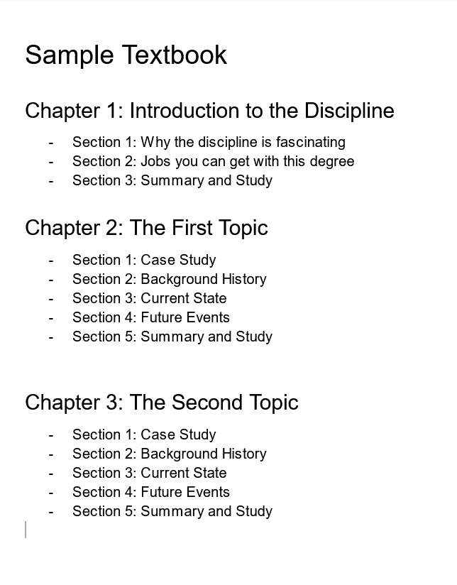
Create the book template in a document or spreadsheet
Chapter 1
Section / Topic
Section / Topic
Section / Topic
Section / Topic
Chapter 2
Section / Topic
Section / Topic
Section / Topic
Section / Topic
Notes:
This will help you as you find resources
Sample outline from LibreTexts Construction Guide

Slide 10
Use your template to track what you find
Chapter 1
Section / Topic
Resource 1 - link and license
Resource 2 - link and license
Resource 3 - link and license
Section / Topic
Resource 1 - link and license
Resource 2 - link and license
Chapter 2
Section / Topic
Resource 1 - link and license
Resource 2 - link and license
Resource 3 - link and license
Section / Topic
Resource 1 - link and license
Resource 2 - link and license
Resource 3 - link and license

Slide 11
Spreadsheet Tracking Guide
Topic/Outcome | Evaluation/Assessment | Resource Type | Resource format | Resource Title | License Type | Link to Original Resource | Attribution | Accessibility | Notes
 | How are students being assessed? | Image,Text,Video
"Getting Started: A Content Catalog" by Quill West, CCCOER is licensed CC BY 4.0
Notes:
You can also use this tracking spreadsheet which is more thorough (delete any columns that are not helpful)

Slide 12
Be sure to track licenses
Creative Commons licenses are the most common
Each license specifies how you can use it
Some licenses can be remixed together, others cannot
Be sure to provide attribution for anything you use

Slide 13
Learn more about licensing
Self-paced Canvas Class
ASCCC OERI Webinars - Search bar in archived webinars
Introduction to Creative Commons Licensing
Open Educational Resources (OER) Curation and Advanced Licensing

Slide 14
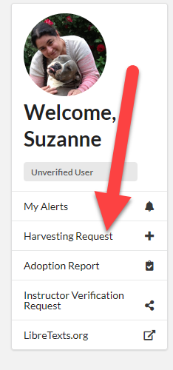
Finding Content
Be sure to track what you find
Search LibreTexts
Libraries and Bookshelves
Search Bar
OERI Curated Collections
If you find content that isn’t in LibreTexts
Copy/paste for content [10-15 pages]
Harvest request for large content [40% and above of a book]

Slide 15
Let’s Search LibreTexts
Accessing LibreTexts
Libraries
Commons
OPEN" by mag3737 [CC BY-NC-SA 2.0]​
Notes:
LT: https://libretexts.org/platforms/adapt-open-homework/

Slide 16
Creating your project
Log in to the LibreTexts Conductor
Go to “Create Conductor Project”
Give your project a title
Leave as “private” until you’re ready to share it
Notes:
Link to Conductor: https://commons.libretexts.org/home

Slide 17
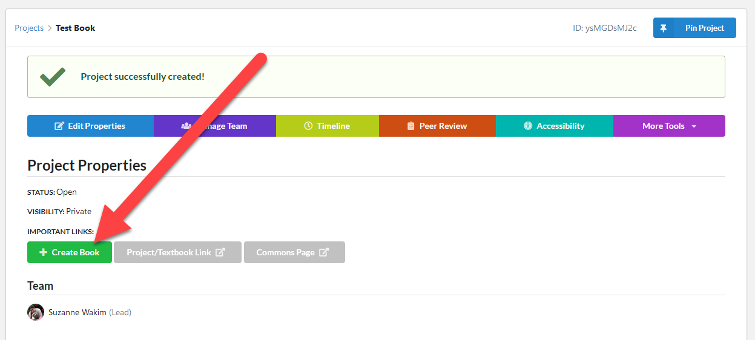
Creating your book
Create a Book
Select a library for your book to be housed - This can’t be changed after the book is created.
Give your book a unique title

Slide 18
Go to the Remixer
Select “More Tools”
Select “OER Remixer”

Slide 19
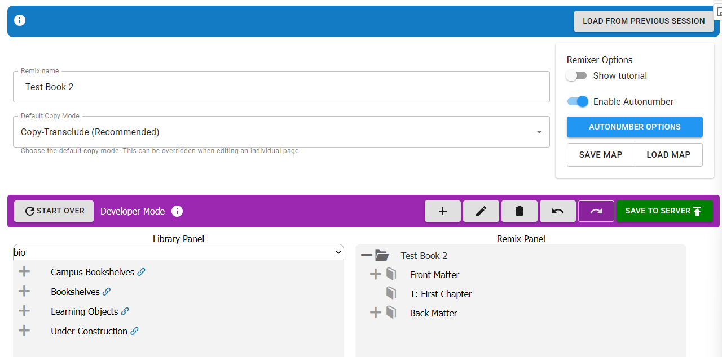
Your book shell
Your book is on the right
The books you can pull from are on the left
Can pull from different libraries.

Slide 20
Use your template to build the your book
Highlight the book title
Select “➕” to add a chapter
Select “✏️” to edit the chapter title

Slide 21
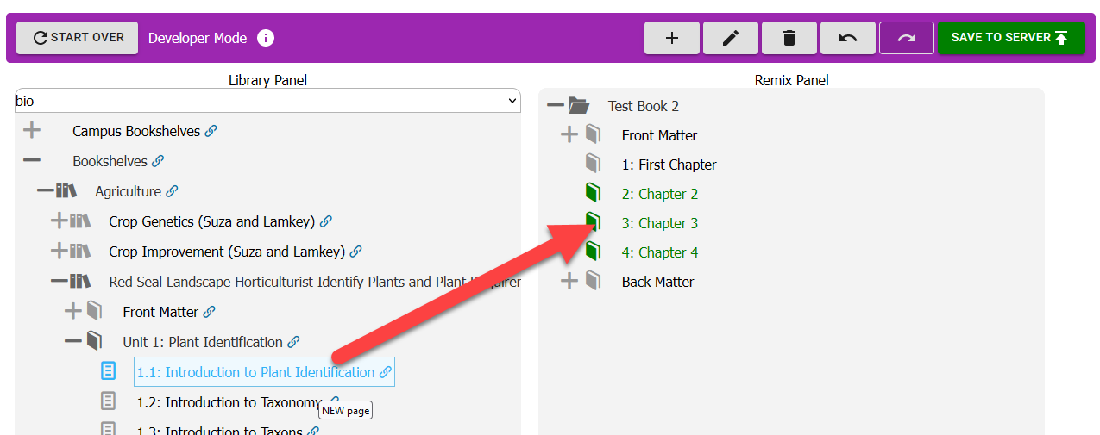
Add content to your book
Find content using the tracking information you created
Click and drag the content to your book

Slide 22
Add blank pages
If there are topics with no content to remix, create blank pages
Include extra “buffer” pages
Highlight the chapter and select “➕” to add a page
Select “✏️” to edit the page title

Slide 23
Rearranging content
Click and drag content to rearrange it
Pay careful attention to where the arrow is
pointing to the name
pointing below the name

Slide 24
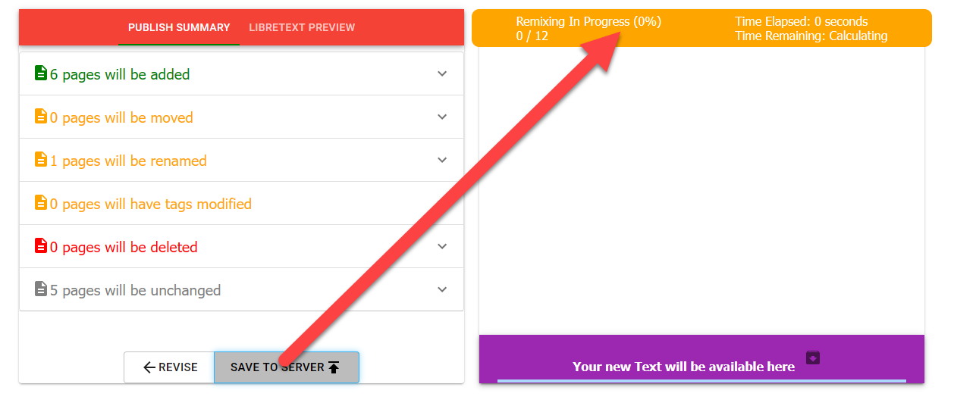
Save to Server
Select “Save To Server”
Select “Save To Server” again on the next screen
Wait until the “Remix in Progress” is 100% done

Slide 25
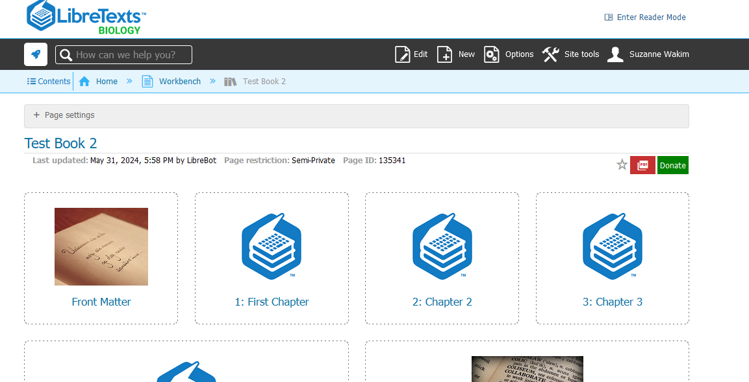
Go to your book
Select “Your new Text will be available here” to go to your book.

Slide 26
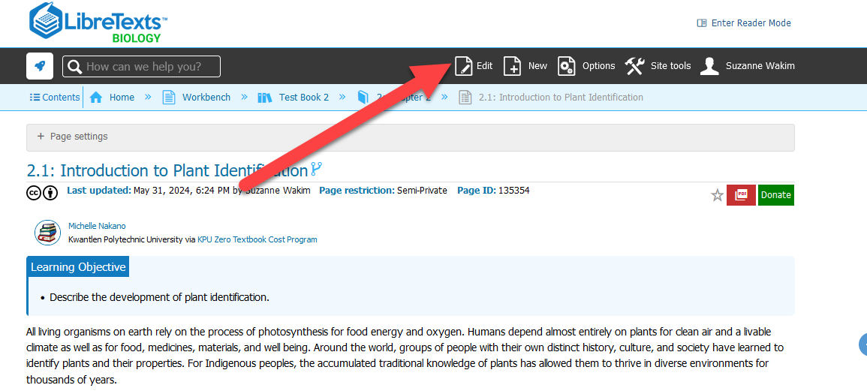
Edit a page
Go to the page and select the “Edit” button
Webinar on Editing LibreTexts pages

Slide 27
Attributions: How to and Help
Attribution for the page is at the bottom
If you add content to the page from LibreTexts the attribution should automatically update but double check
If you add content from elsewhere - add the attribution
For more on how to attribute go to OERI Style Guide

Slide 28
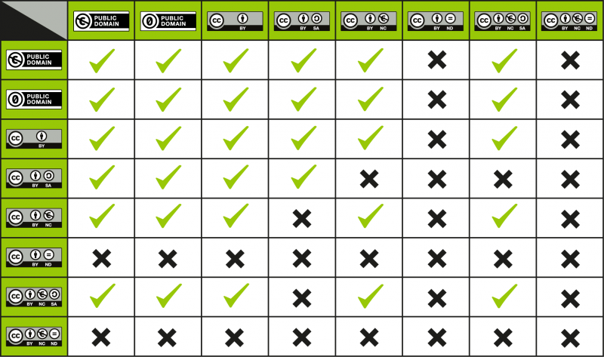
Make sure the licenses can be combined
Before you remix content onto a single page, double check that the licenses can be combined.
Notes:
Image Source: https://wiki.creativecommons.org/wiki/Wiki/cc_license_compatibility

Slide 29
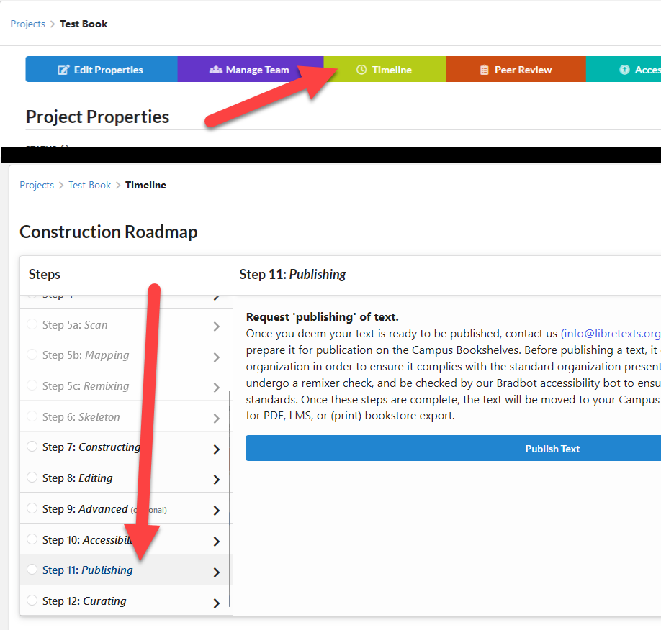
Publish
Once you are ready to share the book you can publish it in conductor:
Go to “Timeline”
Select “Step 11: Publishing”

Slide 30
Into the future
You can go back to the remixer to move, add, or delete content
Keep track of the content you import or combine
Give attribution to all content you use
If you change your course, you can update the book to match!
If you add or delete content, send the book through the remixer to make sure the numbering is update.
Dog doing Yoga on Wikimedia is licensed CC BY 2.0

Slide 31
Questions?

