Slide 1
ADAPT Level 3
Creating in ADAPT
July 15 2024. This work is licensed under a Creative Commons Attribution 4.0 International License.
Attribute this slide deck as: “ADAPT Level 3” by ASCCC OERI is licensed under CC BY 4.0.

Slide 2
Agenda
ADAPT - What and Why
Recap from ADAPT level 1 and level 2 webinars:
Create a course and an assignment
Add questions
Integrate ADAPT with Canvas
Alternative without LTI (Learning Tools Interoperability)

Slide 3
What is ADAPT?
ADAPT is a comprehensive online assessment/homework infrastructure that provides faculty the ability to include auto-graded and non-auto-graded activities from different platforms such as H5P, MyOpenMath, WeBWork, and its own native ADAPT questions.
ADAPT can be integrated into an LMS such as Canvas with full grade integration or it could be run independently.
Integration via LTI – required action by your Canvas Administrator
Instructions for LTI integration with Canvas.

Slide 4
Why ADAPT?
ADAPT, part of the LibreTexts platform, provides a repository of openly licensed activities/assessments within an environment focused on increasing the availability of OER.
Activities/assessments can be created in ADAPT, a creation tool that has focused on addressing the issues associated with other homework systems (e.g., accessibility).
ADAPT is a tool to connect your openly-licensed homework resources into the Canvas gradebook via LTI/API.
While ADAPT may not already do all that you want it to, like the LIbreTexts platform, it is ever-evolving.

Slide 5
Why create ADAPT native questions?
Unlike H5P questions, ADAPT native questions were created with accessibility in mind.
H5P accessibility report.
Easy to create. If you can create Canvas quiz questions, you can create ADAPT native questions.
Easy to clone (copy) questions and edit.
New questions types and new features are being developed and added.

Slide 6
Who has the ADAPT Canvas LTI?
Allan Hancock
Chabot Las Positas CCD
Chaffey College
City College of San Francisco
Coast CCD Office
College of the Canyons
College of the Desert
Contra Costa CCD Office
Cuesta College
Cuyamaca College
De Anza
Feather River College
Glendale Community College
Imperial Valley
Kern CCD
Lake Tahoe Community College
Los Angeles CCD
Los Rios CCD Office
Modesto Junior College
Mt San Antonio College
Mt San Jacinto College
North Orange CCD
Ohlone College
Peralta CCD
San Diego CCD
San Joaquin Delta College
San Jose-Evergreen CCD
San Mateo CCD
Santa Monica College
Santa Rosa Junior College
Shasta College
Sierra College
Solano Community College
Southwestern Community College
State Center CCD
Ventura College
Victor Valley College
Yuba CCD
Data current as of 6/27/24
Notes:
Note – this list may not be complete.

Slide 7
Accessing ADAPT
Create an instructor ADAPT account
(https://adapt.libretexts.org/login)
If you don’t have an account, click on “Register” and then select “Instructor”
If you are signing up for ADAPT outside of a webinar, you will need to request an access code – “To register as an instructor, please fill out the form below using your Instructor Access Code. If you don't have an access code, then please contact us and we can provide one for you.”

Slide 8
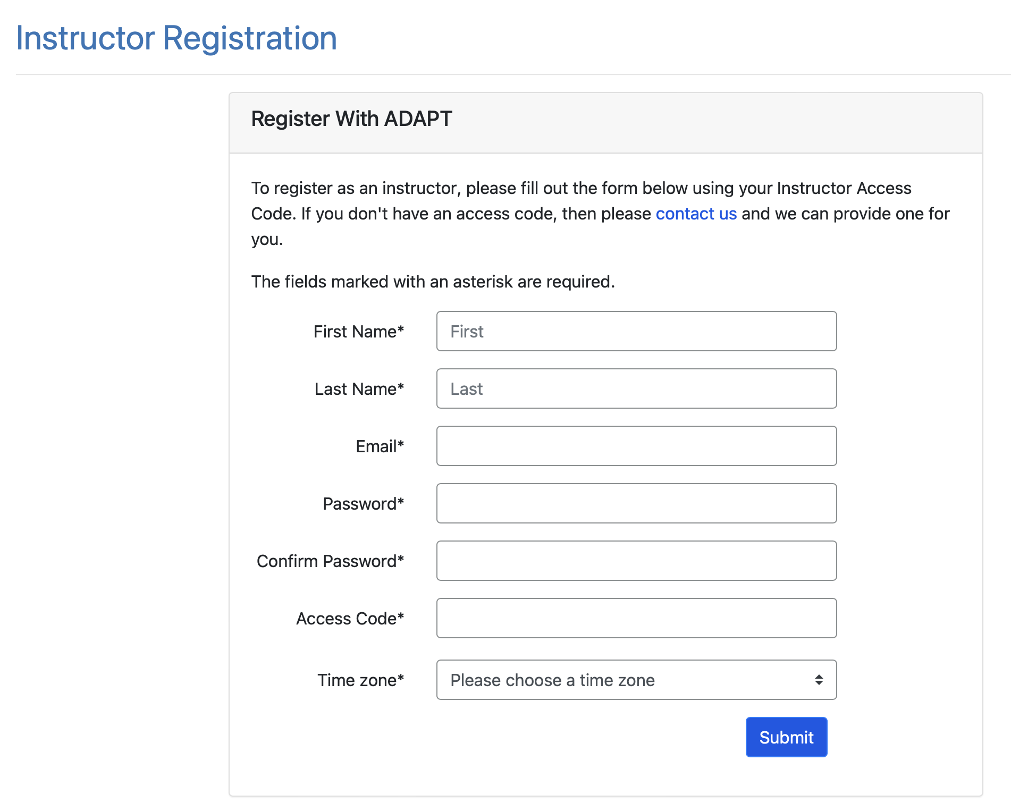

Slide 9
Let’s Recap Levels 1 and 2

Slide 10
Create a Course in ADAPT
Enter:
School: find your college
Course Name
Section/CRN
Term
Start/end date
Public: Yes >if you want to share your course with other instructors
LMS: select Yes* for Canvas integration
Note: You will need to create one ADAPT course per Canvas course if your answer is yes.

Slide 11
Create a New Assignment
Enter:
Name of the assignment
Assignment group
Points (default is 10)
Assessment type
# of allowed attempts
Late policy
Assign to
Available on
Due date

Slide 12
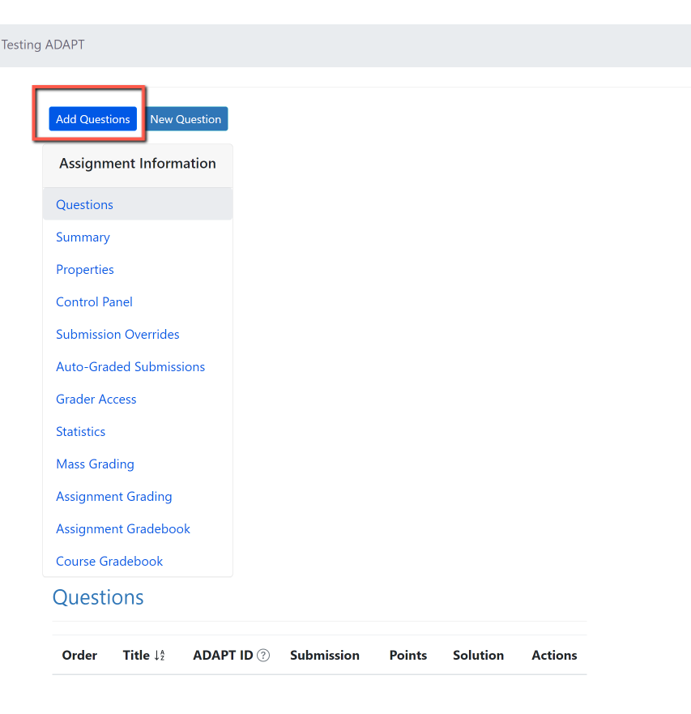
Add Questions

Slide 13
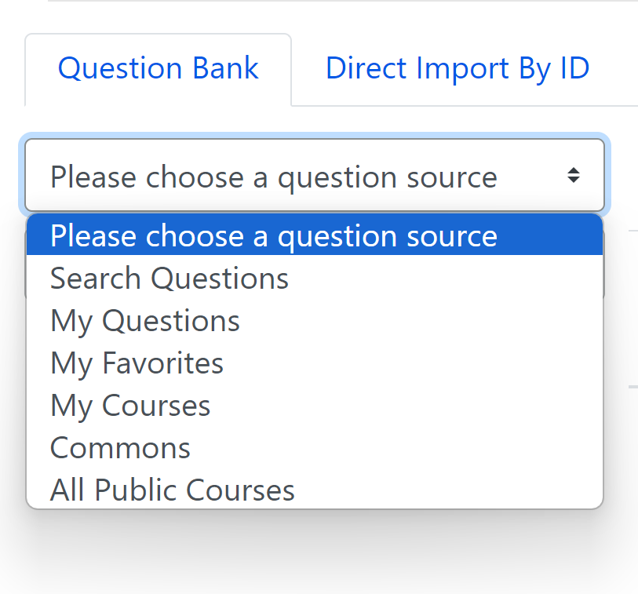
Choose a Question Source
You can search from:
Questions
Collections (OER projects)
Public Courses (open courses)

Slide 14
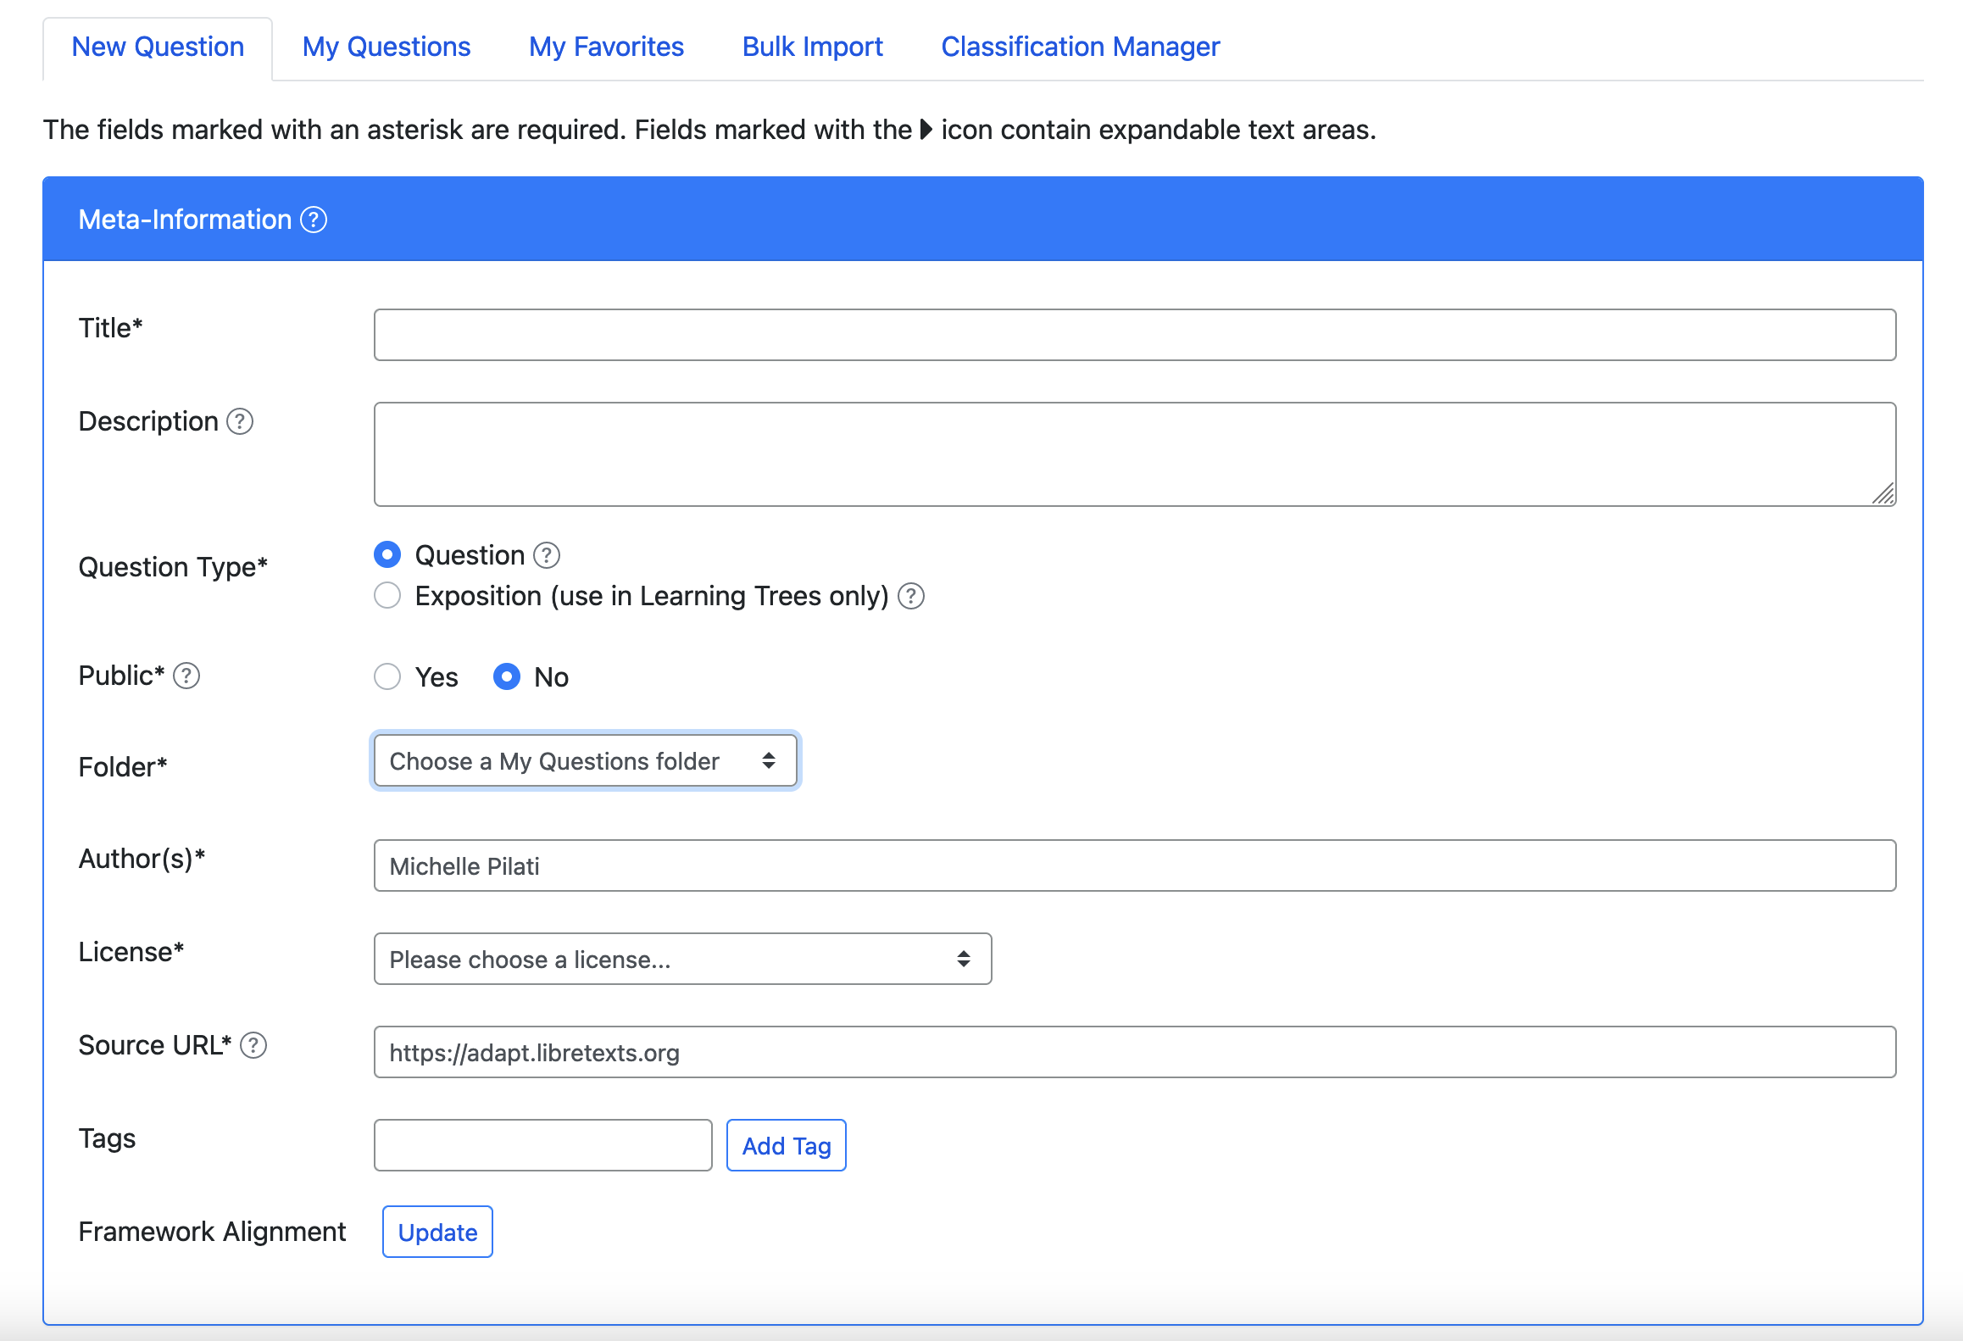
Create New Question
My Questions > New Question

Slide 15
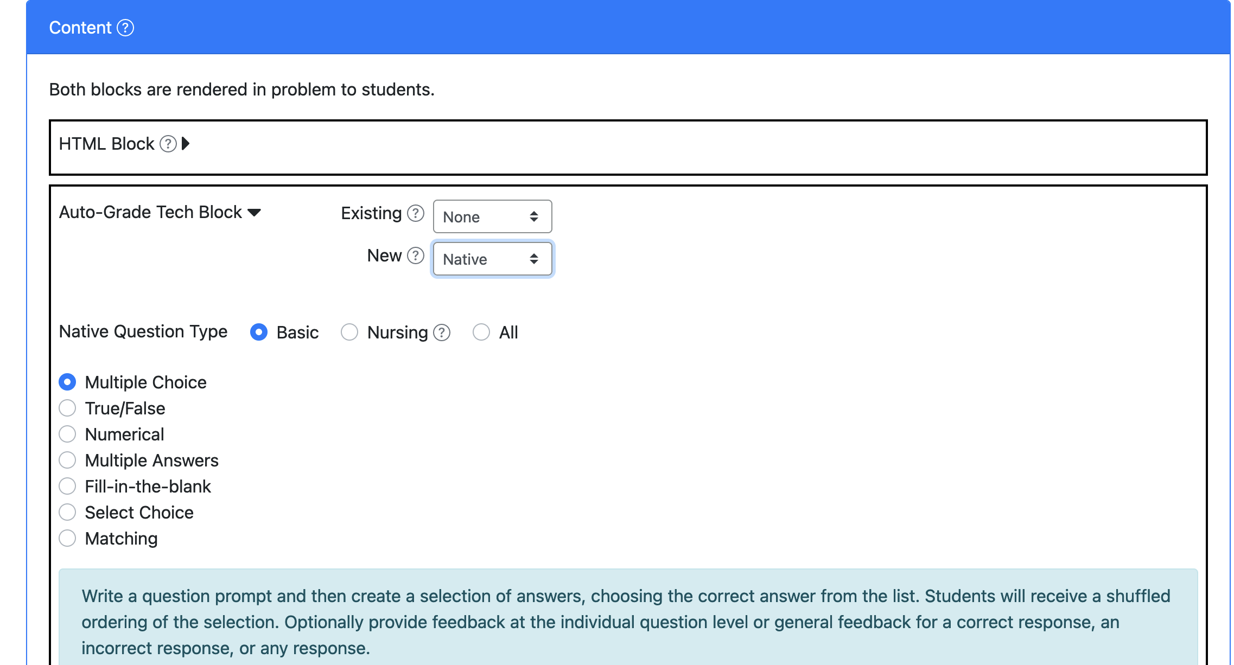
Selecting Content Type
New > Auto-Grade Tech Block > Native

Slide 16
Fill-in the Blanks
Create a question with fill in the blanks by underlining the correct responses.
Example: A stitch in time saves nine.
If you would like to accept multiple answers, separate them with a vertical bar: "|".
Example: January|February is a month that comes before March.

Slide 17
Select Choice (drop-down)
Use brackets for answers.
Example:
The [planet] is the closest planet to the sun; there are [number-of-planets] planets.
Then, add the choices below with your first choice being the correct response.
Add distractors. Each student will receive a randomized ordering of the choices.

Slide 18
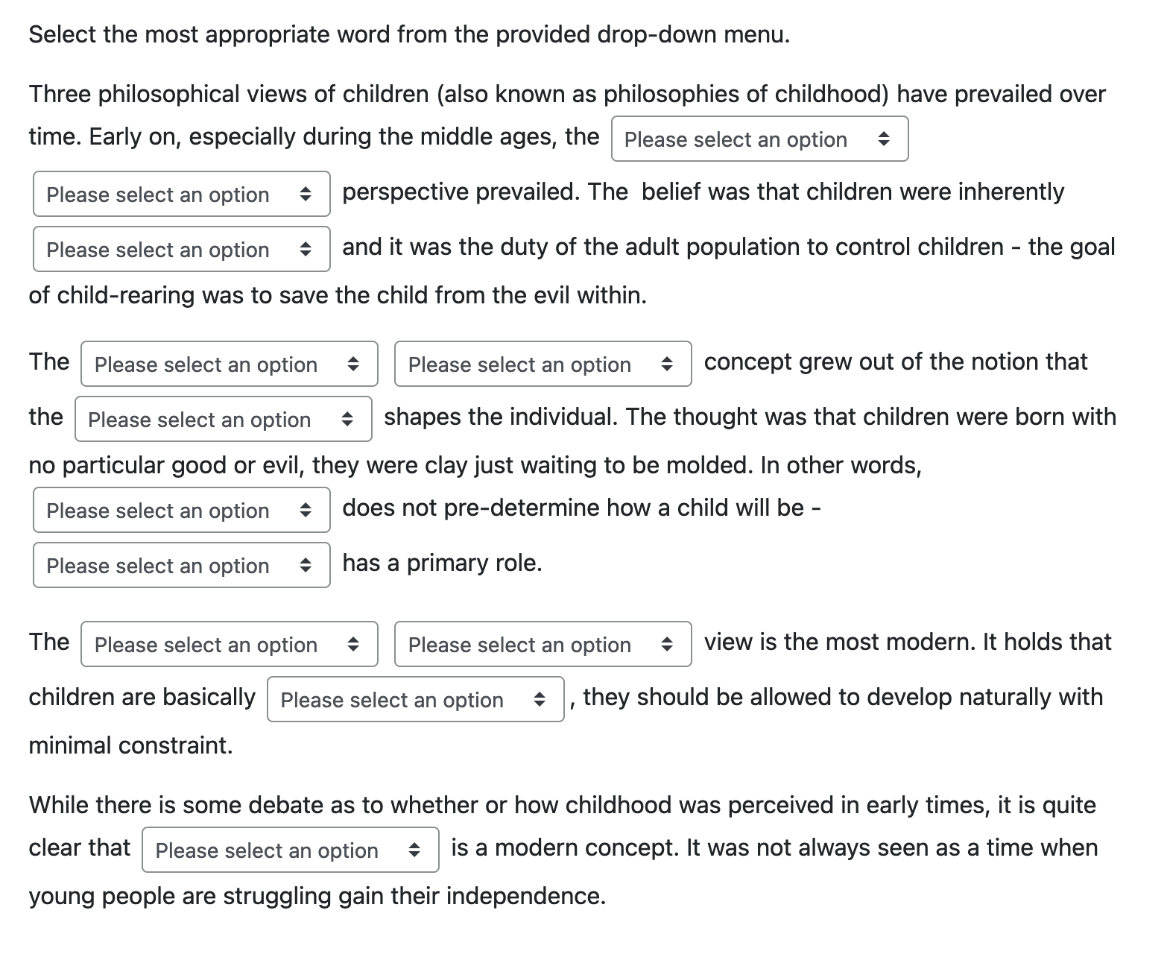
Select Choice Example

Slide 19
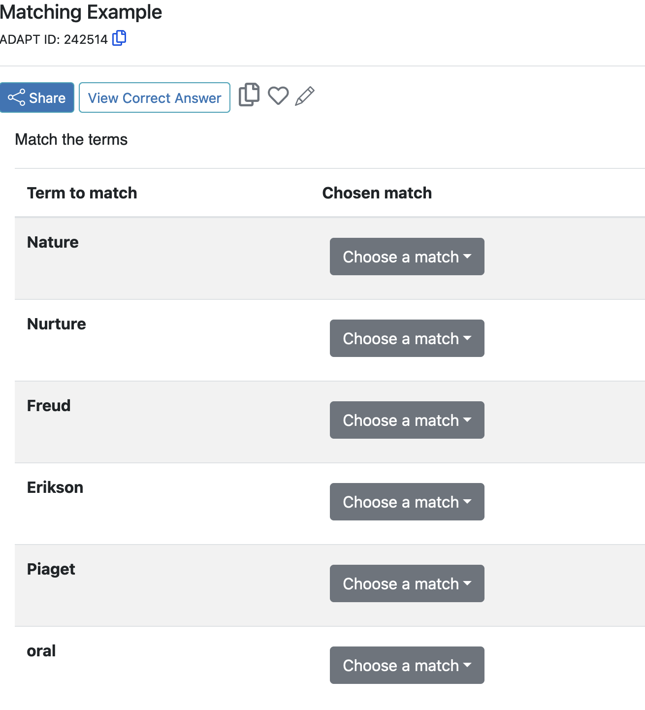
Matching
Create a list of terms to match along with their matching terms. Matching terms can include media such as images. Optionally, add distractors which do not satisfy any of the matches.

Slide 20
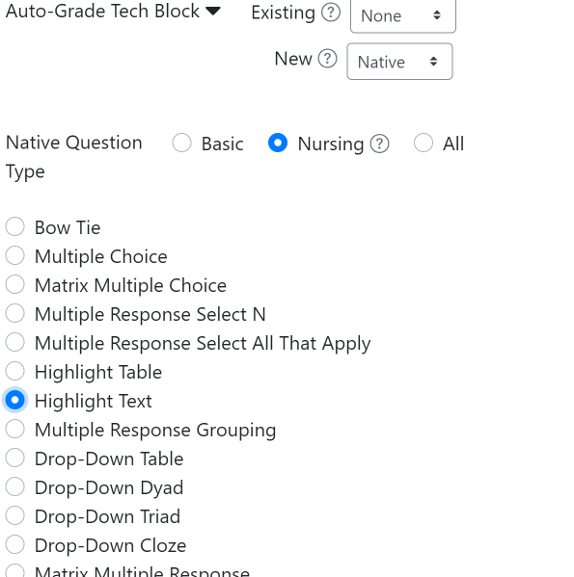
Highlight Text
You will find highlight text under the Nursing area.

Slide 21
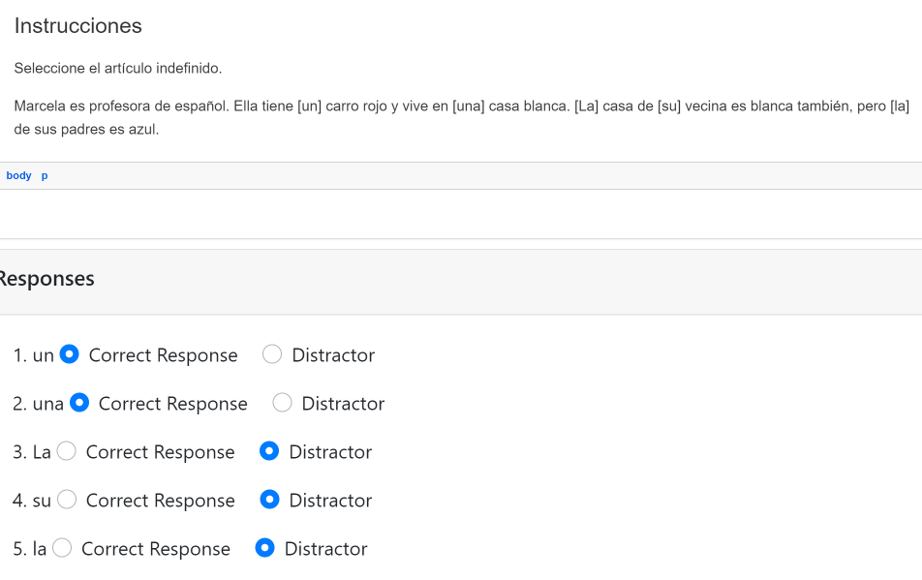
Highlight Text
Write out a prompt, where text within brackets [ ] will automatically become your highlighted text. Once the text is added, determine it is a correct answer or a distractor.

Slide 22
NEW!
Adding Audio/Video to Questions
You can add audio or video files to questions.
Once uploaded, it will create auto-create the captions and transcript.
Once you choose the type of question:
Click on Select Audio or Video File.
Upload the file.
Copy the link.
Create a link with the URL and add it to your question.
Note: You will receive an email notification when the captions are ready.

Slide 23
Edit Captions and Transcripts
The AI generated auto-captions are pretty accurate but if you need to edit, you can simply click on the pencil tool and edit.

Slide 24
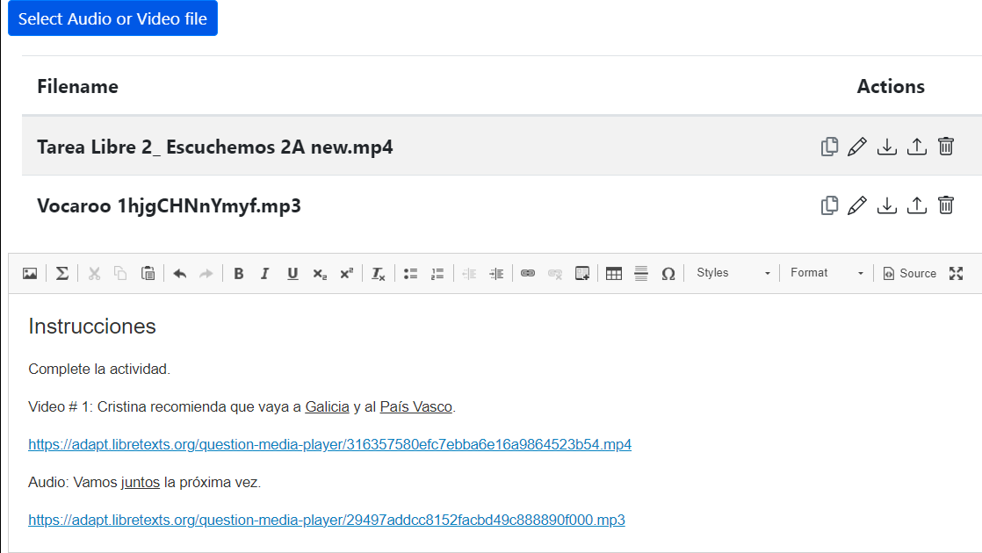
Sample of Video File (backend view)

Slide 25
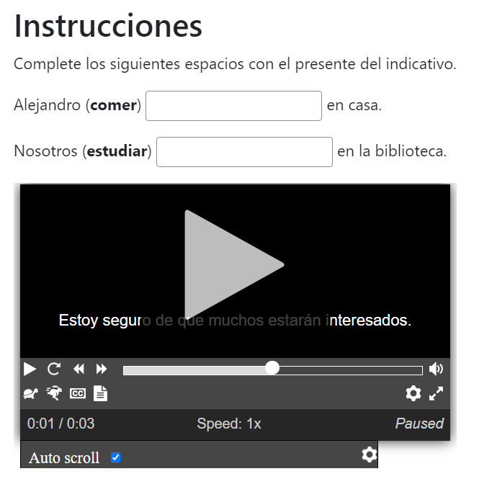
Sample of Audio File

Slide 26
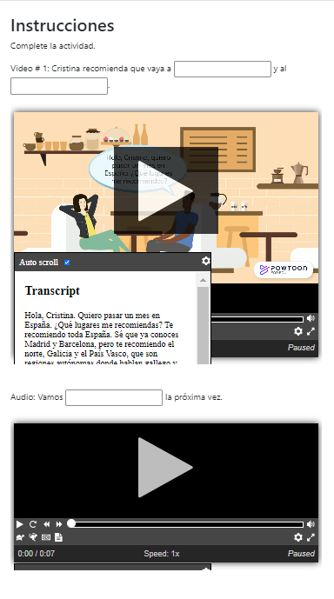
Sample of Video and Audio Files
Within the same question, you can include more than one file.

Slide 27
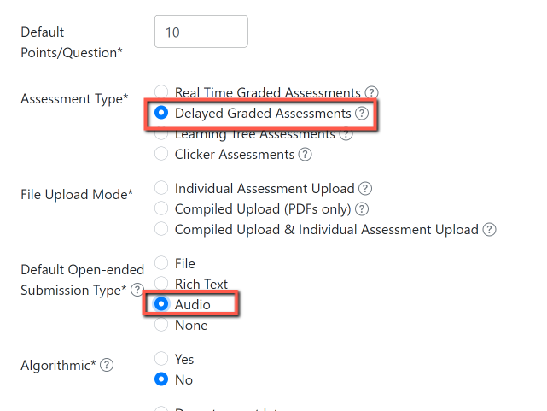
Non-auto graded/open-ended question
Are you interested in creating a speaking test type of question where students will have to record their answers?
Create a delayed graded assessment and select audio as the type of submission.
You can choose the type of open-ended submission.

Slide 28
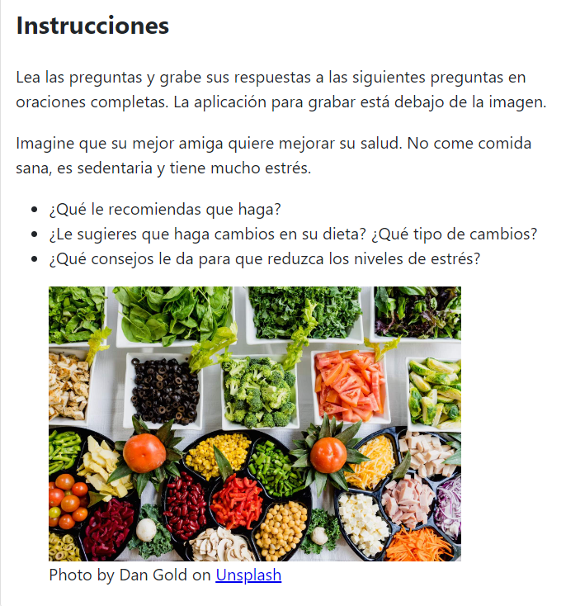
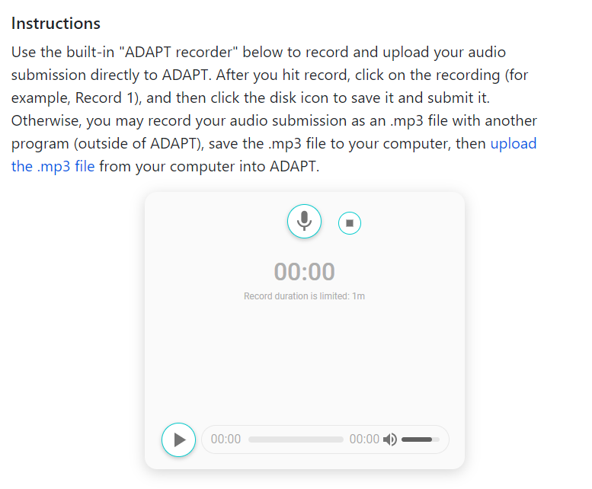
Speaking Test (non-auto graded)

Slide 29
Let’s Integrate ADAPT with Canvas

Slide 30
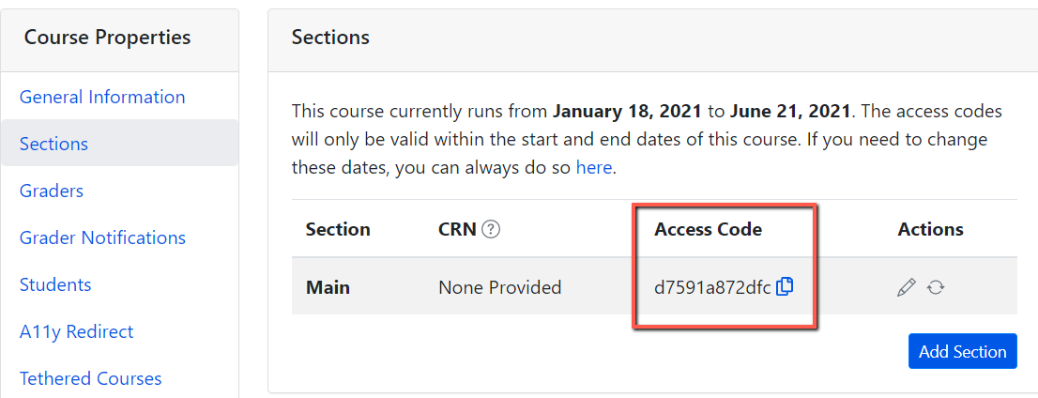
Important: ADAPT Access Code for Students
Go to your ADAPT course > course properties > sections > and get the “Access code”
Share this access code with your students. They will need to enter this code once when accessing ADAPT in Canvas.
Done.

Slide 31
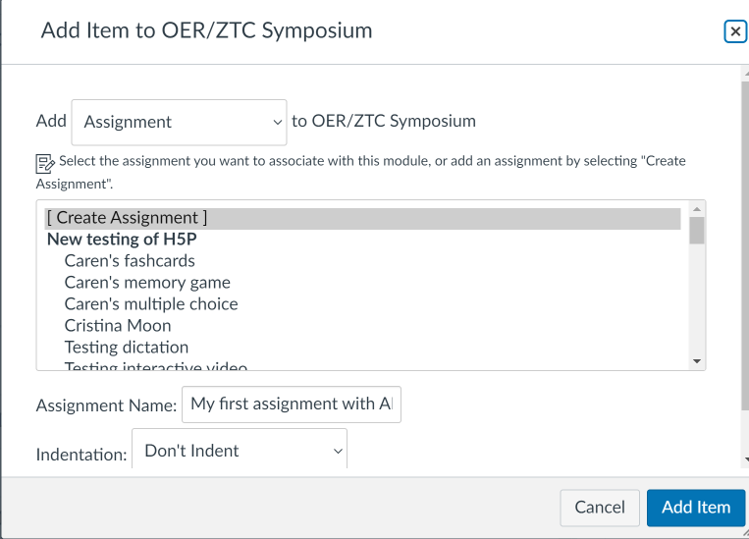
Link ADAPT in Canvas
Create an assignment in Canvas. Then edit.

Slide 32
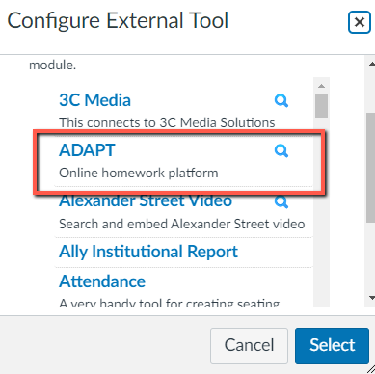
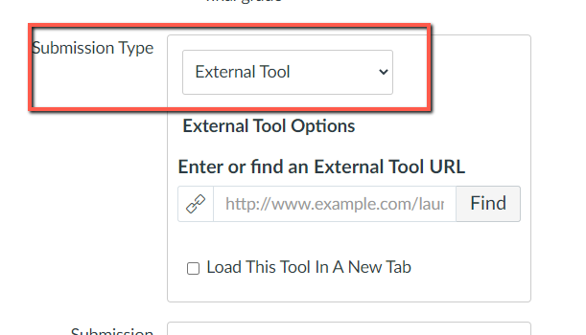
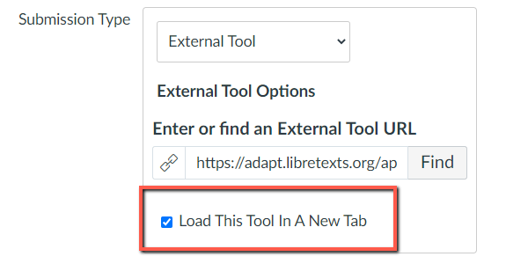
Select ADAPT in External Tool
Step 1: Edit the assignment and choose “external tool” under submission type.
Step 2: Click on “find” and look for ADAPT and “select”.
Step 3: Click on “Load This Tool in A New Tab”
Notes:
This is where you can confirm that you do – or do not – have the ADAPT LTI.

Slide 33
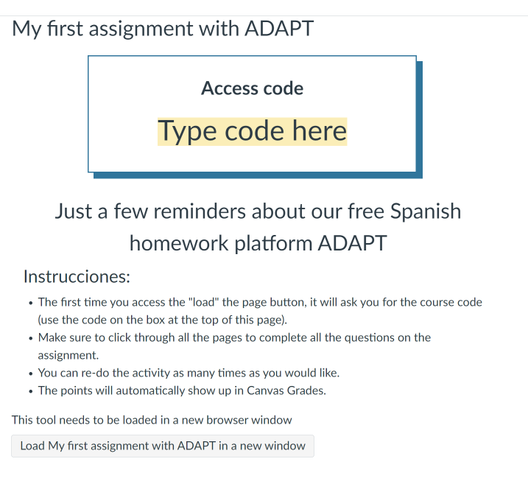
Example of an Assignment Description
This is an example of the description you can include on the assignment.
It is important to let the students know:
ADAPT Access code
Instructions about the assignment settings such as unlimited attempts

Slide 34
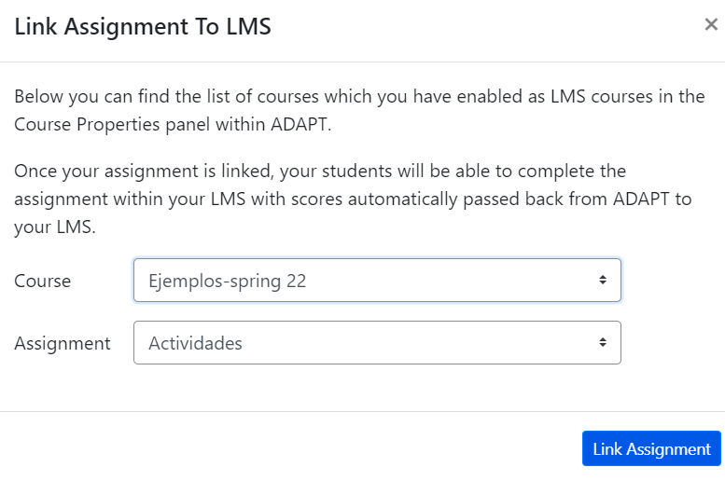
Select the Assignment in Canvas
In Canvas:
Click on “Load”
You will be able to see “Course” and “Assignment” you want to link to Canvas.
Click “Link Assignment”.
Done
This assignment is created and a column will appear in “Grades”.

Slide 35
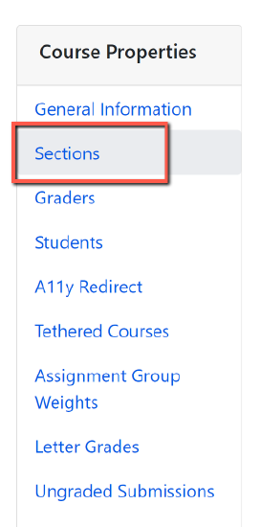
If Canvas/ADAPT LTI is not Available
If LTI is not an option for your institution, you and your students can access ADAPT directly by creating an ADAPT account.
Students will need to create a student account.
The instructor will need to provide the Course Access Code.
To find the code:
Go to the ADAPT course.
Click on Course Properties (the gear symbol).
Then, click on Sections.
You will find the Course Access Code here.

Slide 36
Looking for more ADAPT Training and Resources?

Slide 37
ADAPT Level 4:
Creating and Using Question Banks in ADAPT
Monday, July 22, 1:30 pm – 2:30 pm
After you’ve learned to create activities in ADAPT, how do you deploy those activities within a course so that each student receives a randomized selection of activities? In other words, how do you organize your ADAPT activities into questions banks that can then populate your assessments? Join us to learn how to do this in ADAPT.
Register for ADAPT Level 4 – Creating and Using Question Banks in ADAPT
Notes:
https://cccconfer.zoom.us/meeting/register/tZMrcu-qqD0iHtPf7Tvf5H5gevWjo79q0INF#/registration

Slide 38
Need more ADAPT Training?
Pre-Cal OER Conference ADAPT virtual training
August 6, 2024, 9:00-3:00 pm
Registration (a LibreTexts account is required)
This workshop will introduce educators to ADAPT, LibreTexts open homework and assessment platform. During this workshop LibreTexts Founder and Executive Director, Delmar Larsen, will demonstrate how instructors can use ADAPT to augment existing and newly constructed OER textbooks with summative exercises and embed them in LMSs, LibreTexts textbooks, in a standalone application, and in-class clickers. Discussions will demonstrate how the ADAPT homework system empowers faculty to build and use existing questions in multiple modalities. Participants will learn how to build auto graded questions based on four technologies – H5P, WebWork, IMathAS, and native (QTI) – that can be used interchangeably to allow for maximal impact.

Slide 39
ADAPT Resources
Accessibility reports
ADAPT construction guide
Canvas LTI for ADAPT instructions
LibreTexts weekly office hours in Zoom:
Tuesdays at 9:00-10:00 PST
Thursdays at 9:00-10:00 PST

Slide 40
ASCCC OERI Recorded Webinars on ADAPT
Continuing the Path to Zero in Spanish Open Educational Resources (OER): Tarea Libre 2 | 2024/05/03
Getting Spanish Homework to Zero Textbook Cost (ZTC) with LibreTexts ADAPT | 2024/04/26
Beyond Traditional Spanish Homework: Adding Project Based Learning to your Open Educational Practices | 2024/04/12
Spanish Open Educational Resources (OER) Hackathon: Let’s create a HW Collection | 2023/10/27
Getting Spanish to Zero – An Openly-Licensed Homework Option for Spanish | 2023/10/20
What’s new in Spanish OER: Tarea Libre | 2023/05/05
Remixing Spanish OERs in LibreTexts and importing to Canvas | 2023/04/28
What’s new in Spanish Open Educational Resources (OER) | 2022/11/04
What’s New in Spanish OER? | 2022/03/25
Remixing Spanish OER | 2021/10/15
Spanish, LibreTexts, and Adapt – Using OER to Customize Your Spanish Text and Integrate a Homework System | 2021/05/07
OER and Spanish | 2021/05/03

Slide 41
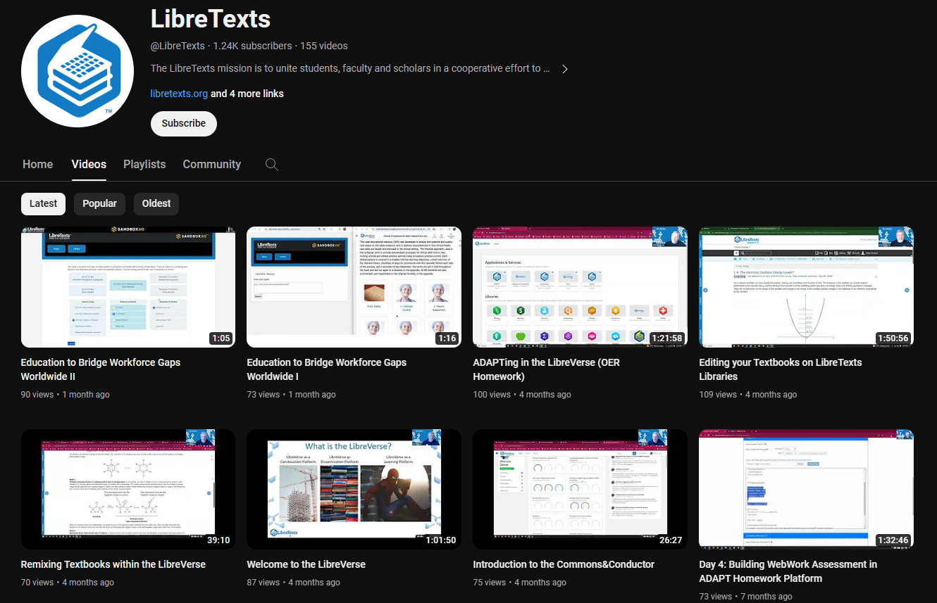
LibreTexts Workshops Recordings
LibreTexts News and Events page has more information.

Slide 42
More Information
ASCCC OERI Website (asccc-oeri.org)
Resources
Webinars and Events
ASCCC OER E-Mail (oeri@asccc.org)

Slide 43
Questions about ADAPT?
Cristina Moon
Spanish Faculty
OER/ZTC Coordinator at Chabot College
ASCCC OERI Spanish Lead, H5P/ADAPT Lead, and OERI Liaison
E-Mail Cristina Moon

