Slide 1
ADAPT Level 4
Creating and Using Question Banks in ADAPT
July 22, 2024. This work is licensed under a Creative Commons Attribution 4.0 International License.
Attribute this slide deck as: “ADAPT Level 4” by ASCCC OERI is licensed under CC BY 4.0.

Slide 2
Session Description
After you’ve learned to create activities in ADAPT, how do you deploy those activities within a course so that each student receives a randomized selection of activities? In other words, how do you organize your ADAPT activities into questions banks that can then populate your assessments? Join us to learn how to do this in ADAPT.

Slide 3
Presenters
Ying Liu
Biology Lead, ASCCC Open Educational Resources Initiative, OERI
Biology, City College of San Francisco
Ying.liu@mail.ccsf.edu
Michelle Pilati
Project Director, ASCCC OERI
Psychology, Rio Hondo
mpilati@asccc.org

Slide 4
Agenda
ADAPT - What and Why
ADAPT level 1, level 2 and level 3 webinars:
Create a course and an assignment
Add questions
Integrate ADAPT with Canvas
Creating and Using Question Banks

Slide 5
What is ADAPT?
ADAPT is a comprehensive online assessment/homework infrastructure that provides faculty the ability to include auto-graded and non-auto-graded activities from different platforms such as H5P, MyOpenMath, WeBWork, and its own native ADAPT questions.
ADAPT can be integrated into an LMS such as Canvas with full grade integration or it could be run independently.
Integration via LTI – required action by your Canvas Administrator
Instructions for LTI integration with Canvas.

Slide 6
Why ADAPT?
ADAPT, part of the LibreTexts platform, provides a repository of openly licensed activities/assessments within an environment focused on increasing the availability of OER.
Activities/assessments can be created in ADAPT, a creation tool that has focused on addressing the issues associated with other homework systems (e.g., accessibility).
ADAPT is a tool to connect your openly-licensed homework resources into the Canvas gradebook via LTI/API.
While ADAPT may not already do all that you want it to, like the LIbreTexts platform, it is ever-evolving.

Slide 7
Who has the ADAPT Canvas LTI?
Allan Hancock
Chabot Las Positas CCD
Chaffey College
City College of San Francisco
Coast CCD Office
College of the Canyons
College of the Desert
Contra Costa CCD Office
Cuesta College
Cuyamaca College
De Anza
Feather River College
Glendale Community College
Imperial Valley
Kern CCD
Lake Tahoe Community College
Los Angeles CCD
Los Rios CCD Office
Modesto Junior College
Mt San Antonio College
Mt San Jacinto College
North Orange CCD
Ohlone College
Peralta CCD
San Diego CCD
San Joaquin Delta College
San Jose-Evergreen CCD
San Mateo CCD
Santa Monica College
Santa Rosa Junior College
Shasta College
Sierra College
Solano Community College
Southwestern Community College
State Center CCD
Ventura College
Victor Valley College
Yuba CCD
Data current as of 6/27/24

Slide 8
Workflow
Import an ADAPT Course
Create an ADAPT Course
ADAPT Question Banks
Creating an Assignment to Draw from Question Banks
Add Questions to an Assignment
Import Question Banks / Assignments
Support Tickets for ADAPT
Ideas to make ADAPT better than Canvas?

Slide 9
Import an ADAPT Course

Slide 10
Import an ADAPT Course

Slide 11
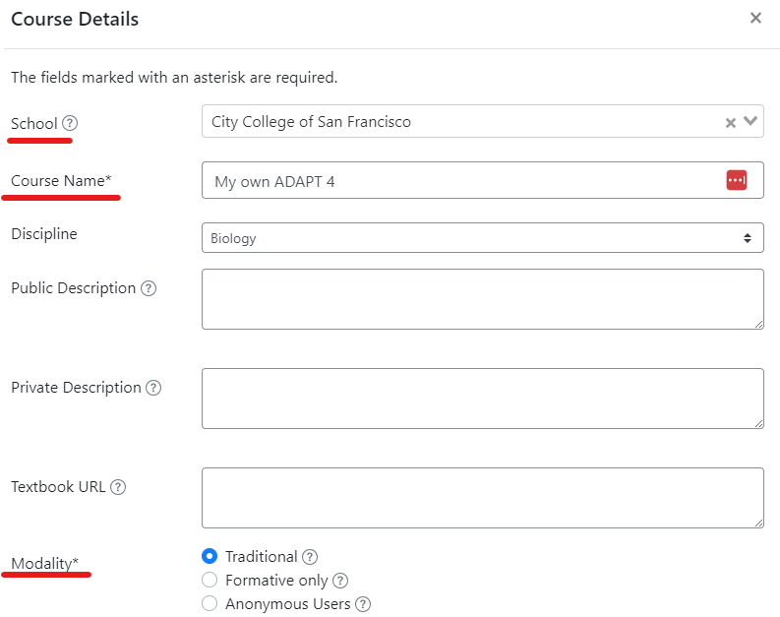
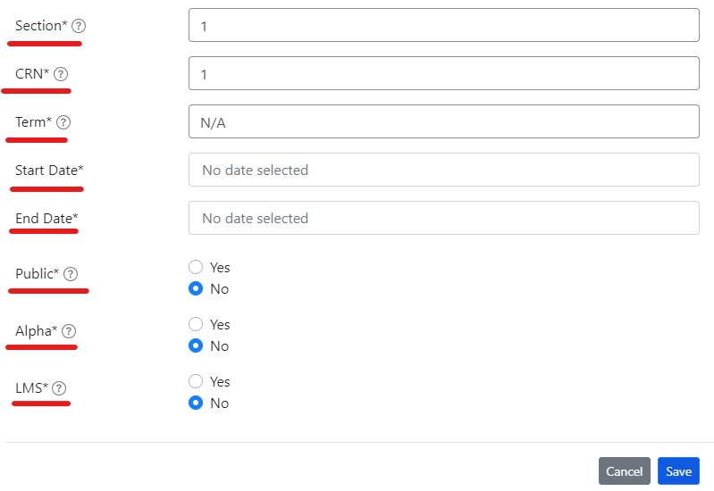
Create a Course in ADAPT

Slide 12
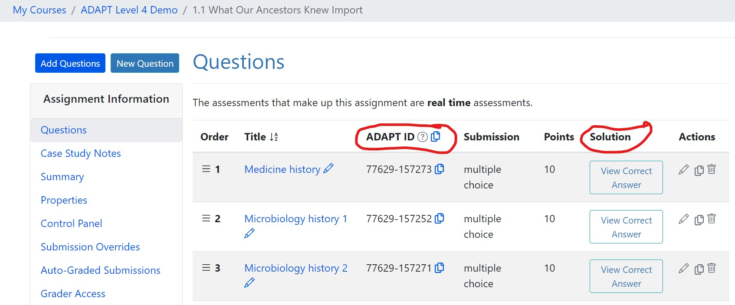
ADAPT Question Bank / Assignment

Slide 13
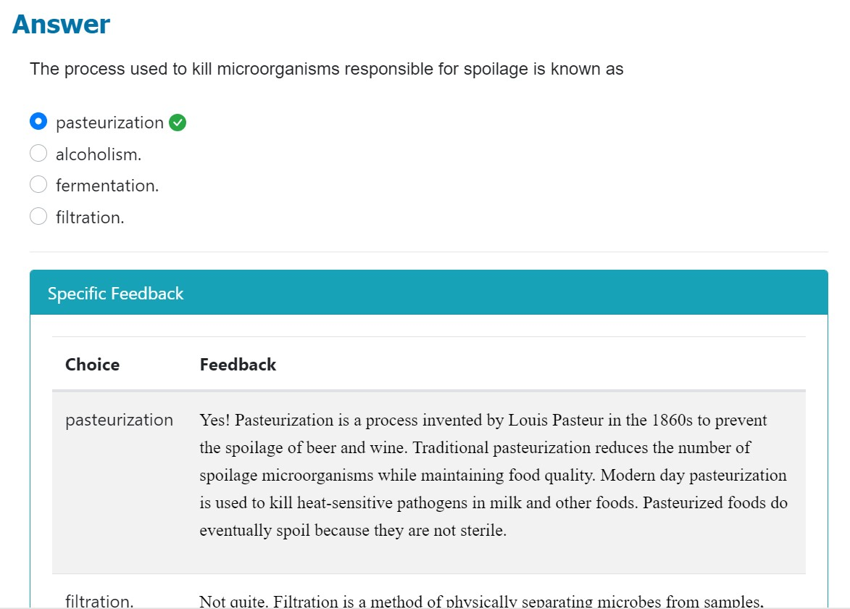
ADAPT Question Bank

Slide 14
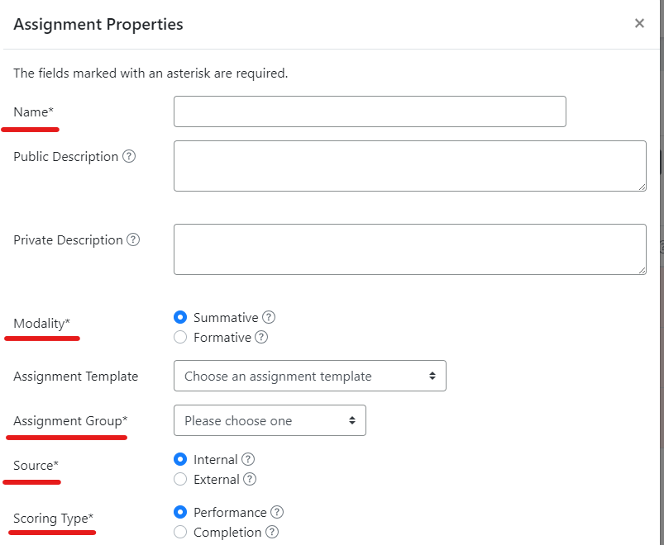
Create a New Assignment
Modality:
Summative: only enrolled students, grade recorded
Formative: anyone with the link or QR code, no grade recording
Source:
Internal: ADAPT questions
External: questions outside of ADAPT, manually input grade

Slide 15
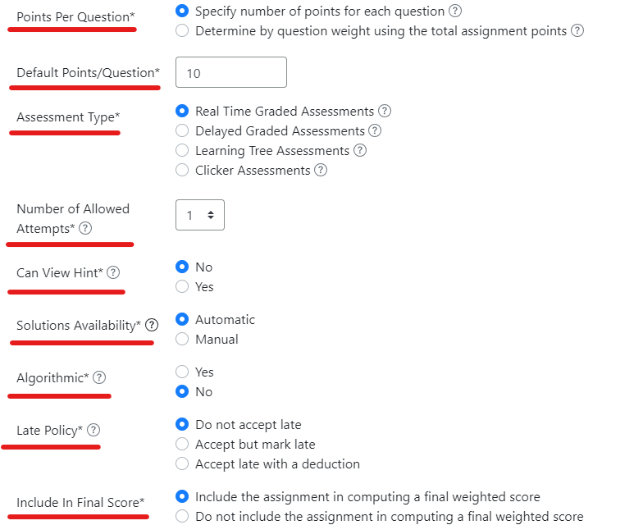
Create a New Assignment
Assessment Type:
Real Time Graded Assessments: work well with auto-graded questions
Delayed Graded Assessments: work well with open-ended questions
Solutions Availability:
Automatic:
Finite # attempts: students will see when they get the correct answer, or no more attempts left
Unlimited attempts: students will see when they get the correct answer, or request the solution
Manual: students will not see the solutions until you manually release them

Slide 16
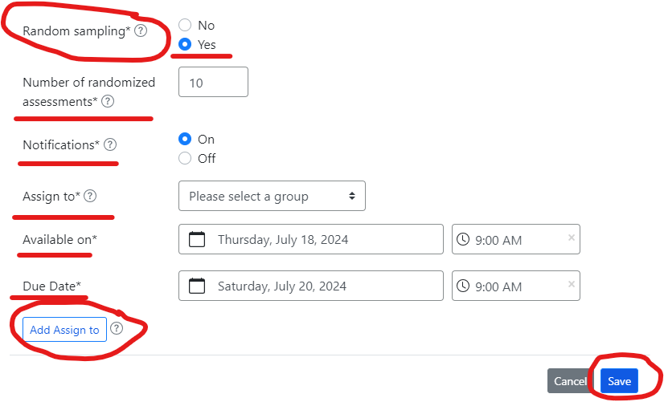
Random Draw from an Assignment
Notification:
Up to students whether they want to receive notification
For exams or clickers, turn it off
Add Assign to:
Assign different dates for some students
Can be useful for DSPS students

Slide 17
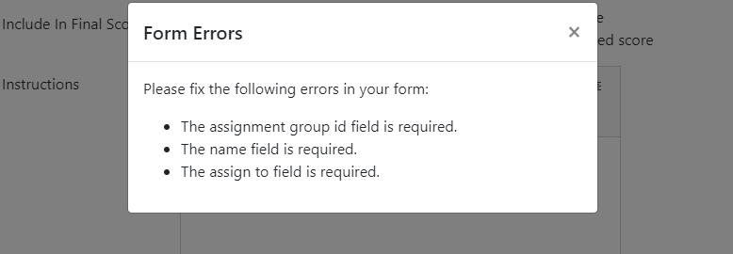
Random Draw from an Assignment
When you save the assignment, any field that you forgot to fill, you will get a reminder

Slide 18
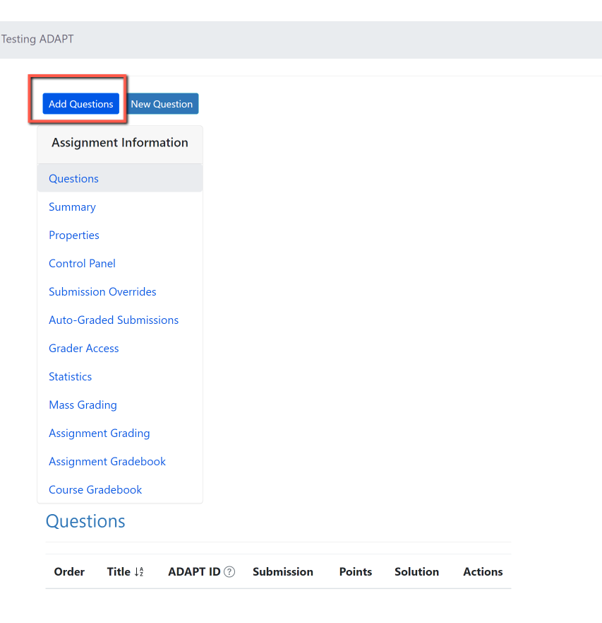
Add Questions

Slide 19
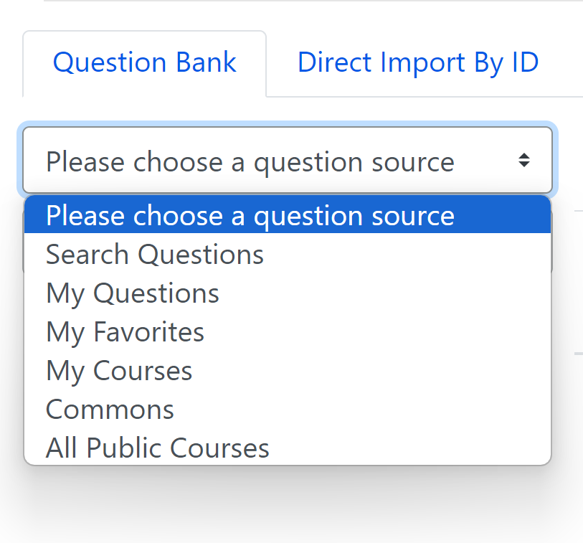
Choose a Question Source
You can search from:
Questions
Collections (OER projects)
Public Courses (open courses)

Slide 20
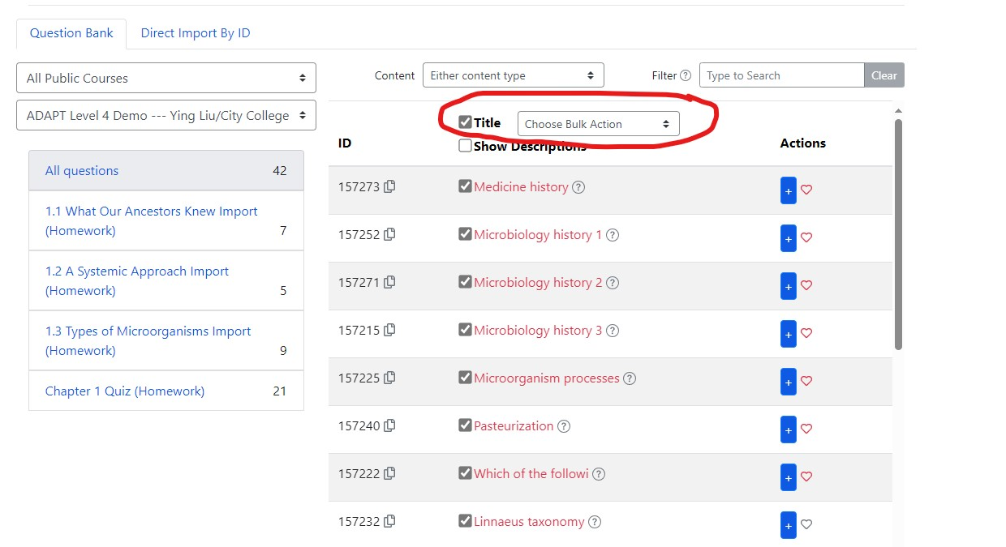
Import Questions

Slide 21
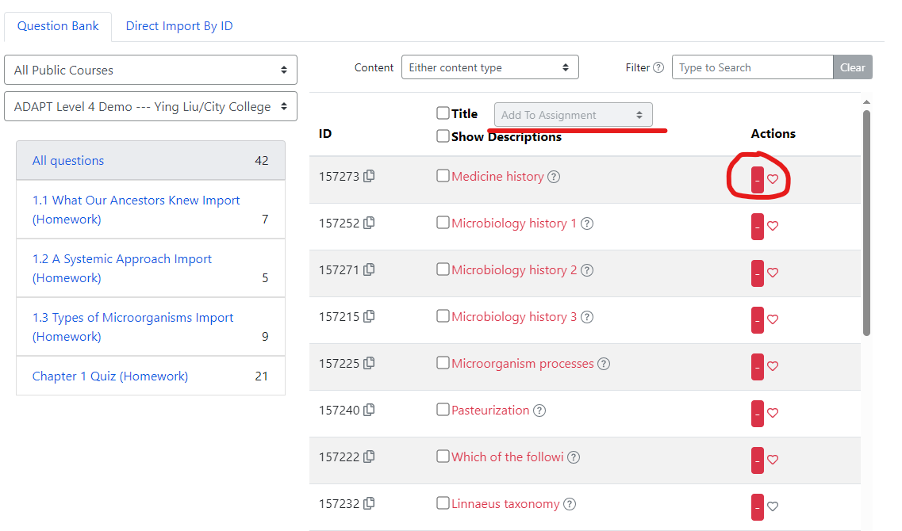
Import Questions

Slide 22
Import Questions

Slide 23
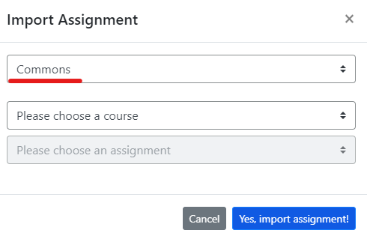
Import an Assignment
Import from LibreTexts Commons
Dropdown menu: alphabetical
Assignments in the Demo course are imported from “Microbiology (OpenStax) Ancillaries” course
All assignment groups: create different categories of assignments (Homework, Weekly Quiz, etc.)

Slide 24
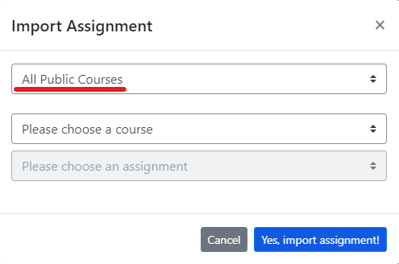
Import an Assignment
Import from “All Public Courses”
Dropdown menu: alphabetical
ADAPT Level 4 Demo
Chapter 1 Quiz (Homework)
Benefit of importing assignment: assignment properties are imported

Slide 25
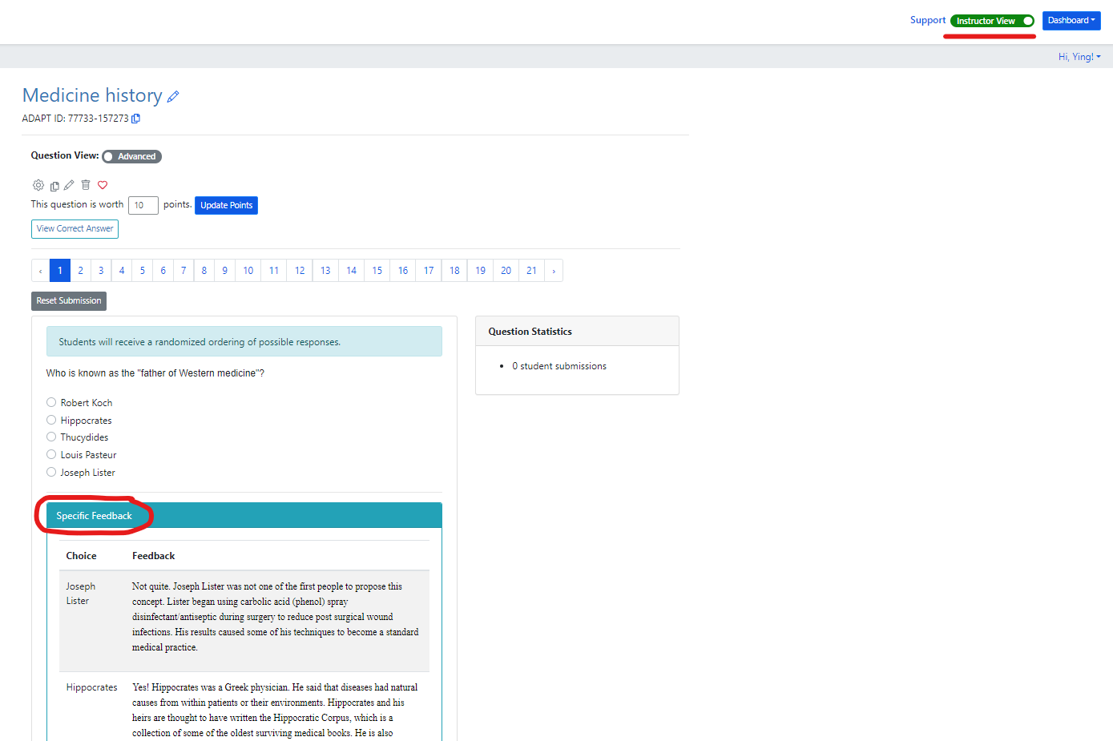
Testing Random Sampling

Slide 26
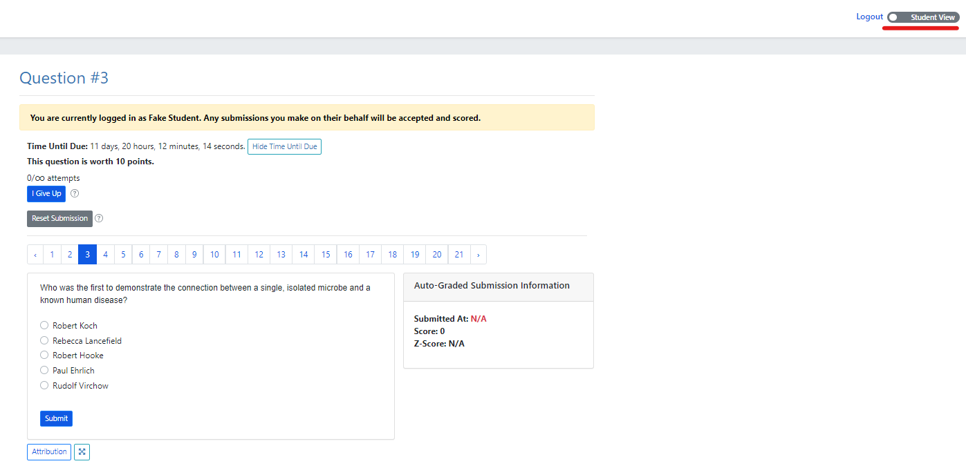
Testing Random Sampling
In the current ADAPT Student View, a faculty member does not get a true Student View
A change has been requested
How do you request changes?

Slide 27
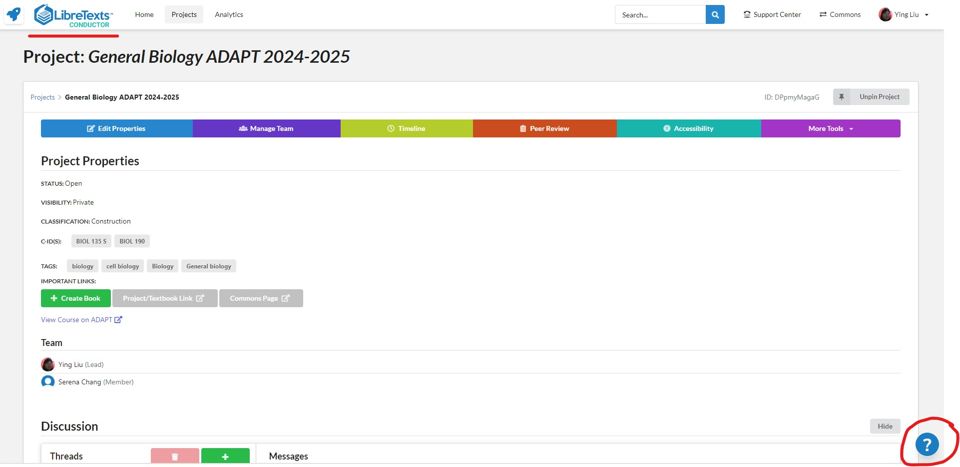
Support Tickets for ADAPT

Slide 28
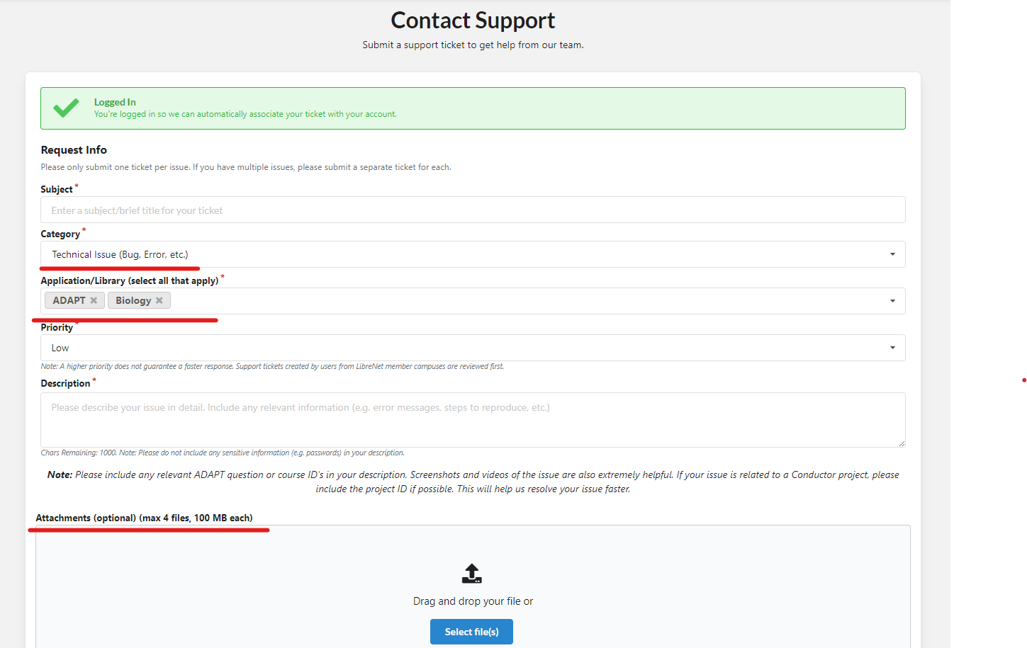
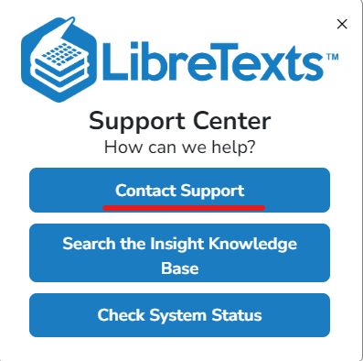
Support Tickets for ADAPT

Slide 29
What Other Features Are Helpful?
Allow a faculty member to specify the number of questions to pull from all the questions banks in use.
Anything else?

Slide 30
Ideas?
Allow the type of questions drawn from a bank to be specified.
What could make ADAPT better than Canvas?

Slide 31
ADAPT resources
ADAPT Accessibility reports
ADAPT Construction Guide
Canvas LTI for ADAPT Instructions
LibreTexts Weekly Office Hours in Zoom (https://zoom.libretexts.org/)
Tuesdays at 9:00-10:00 PST
Thursdays at 9:00-10:00 PST

Slide 32
ASCCC OERI Recorded Webinars on ADAPT
Continuing the Path to Zero in Spanish Open Educational Resources (OER): Tarea Libre 2 | 2024/05/03
Getting Spanish Homework to Zero Textbook Cost (ZTC) with LibreTexts ADAPT | 2024/04/26
Beyond Traditional Spanish Homework: Adding Project Based Learning to your Open Educational Practices | 2024/04/12
Spanish Open Educational Resources (OER) Hackathon: Let’s create a HW Collection | 2023/10/27
Getting Spanish to Zero – An Openly-Licensed Homework Option for Spanish | 2023/10/20
What’s new in Spanish OER: Tarea Libre | 2023/05/05
Remixing Spanish OERs in LibreTexts and importing to Canvas | 2023/04/28
What’s new in Spanish Open Educational Resources (OER) | 2022/11/04
What’s New in Spanish OER? | 2022/03/25
Remixing Spanish OER | 2021/10/15
Spanish, LibreTexts, and Adapt – Using OER to Customize Your Spanish Text and Integrate a Homework System | 2021/05/07
OER and Spanish | 2021/05/03

Slide 33
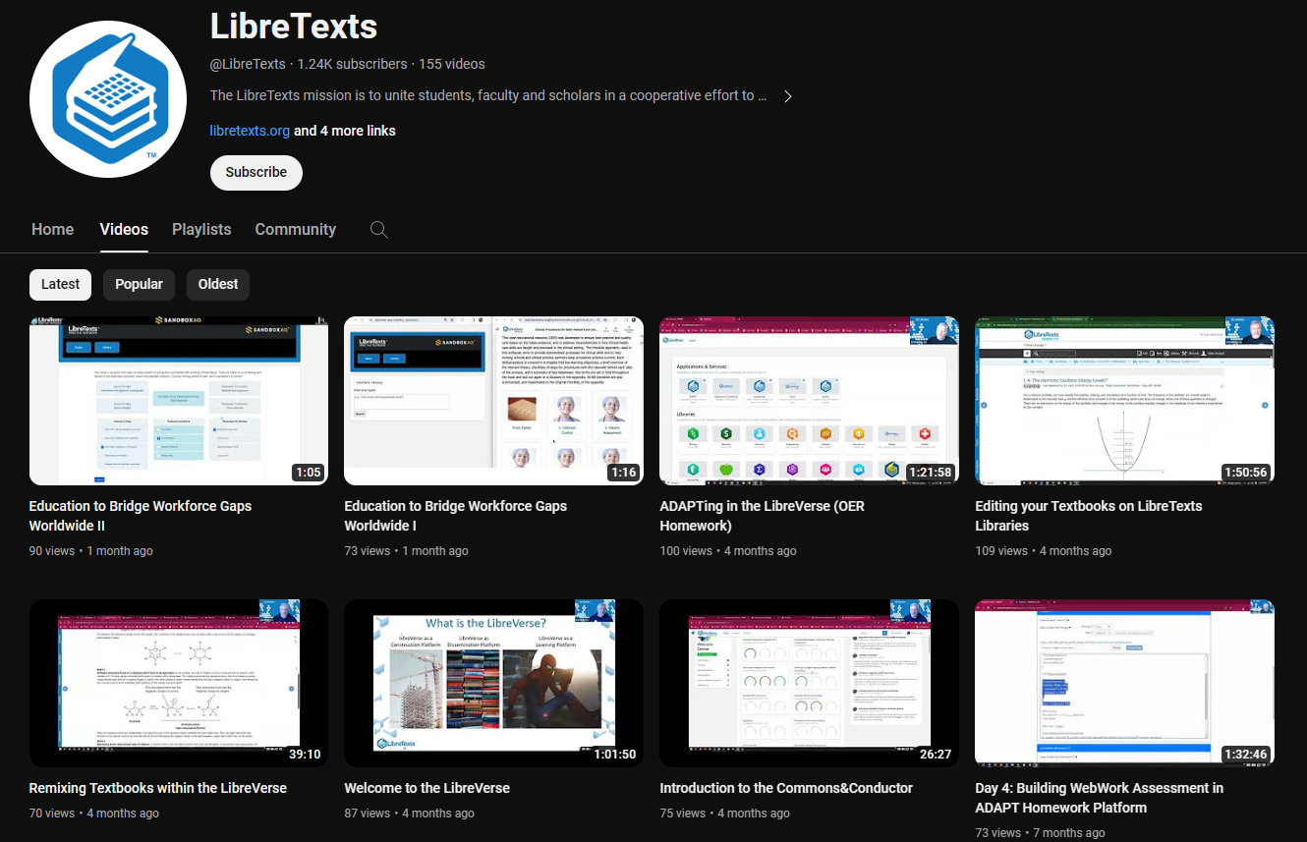
LibreTexts Workshops Recordings
LibreTexts News and Events page has more information.

Slide 34
More Information
ASCCC OERI Website (asccc-oeri.org)
Resources
Webinars and Events
ASCCC OER E-Mail (oeri@asccc.org)

