Slide 1
Welcome!
On behalf of the ASCCC OERI, we are pleased to have you here for our first Friday Forum of the new academic year, “Harnessing the Power of Artificial Intelligence (AI) and Open Educational Resources (OER) to Support Student Learning”.
If you are not already muted, please mute yourself upon arrival. As this is set up as a meeting, we will be able to have an actual discussion – but we need all those who are not speaking to be muted.
You are also encouraged to use the “chat” feature.

Slide 2
Webinar Description
Employing AI to create ancillary resources for OER is one of the many ways that generative AI can support both teaching and learning. While many faculty have experimented with free AI tools, many have not had the opportunity to investigate the more sophisticated tools that are not freely available. To maximize the potential of AI, what should you keep in mind when selecting such tools? Join us to explore the practical considerations for evaluating and selecting AI tools as well as view demonstrations on how to use AI to develop ancillary resources.

Slide 3
Harnessing the Power of Artificial Intelligence (AI) and Open Educational Resources (OER) to Support Student Learning
Revised September 6, 2024.
This work is licensed under a Creative Commons Attribution 4.0 International License.
Attribute this slide deck as: "Harnessing the Power of Artificial Intelligence (AI) and Open Educational Resources (OER) to Support Student Learning" by ASCCC OERI is licensed under CC BY 4.0.

Slide 4
Presenters
Michelle Kinzel
GIS Specialist, CSU San Marcos
GIS/Geography, San Diego Community College, Mount San Antonio College, and Southwestern College
Michelle Pilati
Psychology, Rio Hondo College
Project Director, ASCCC OERI
Fabiola Torres
Ethnic Studies, Glendale College
Faculty Innovators-in-Residence Strategy Team (FIRST) for the California Educational Learning Lab

Slide 5
Overview
AI Tools
Using AI to Create Assessments
Using AI Create Bots
Discussion/Q and A

Slide 6
What AI tools are teachers most commonly using?

Slide 7
According to ChatGPT, the most common AI tools in education:
Learning or Course Management Systems - Canvas
Adaptive Learning Platforms: Tools like DreamBox and Smart Sparrow adjust the difficulty of content based on individual student progress and needs.
Grading and Assessment Tools – TurnItIn
Virtual Assistants and Chatbots: AI chatbots, such as those used in tools like IBM Watson, assist with answering common student questions and providing support outside of regular class hours.
Content Creation and Enhancement - Grammarly and QuillBot
Speech-to-Text and Text-to-Speech Tools: Otter.ai and NaturalReader
Data Analytics Platforms - Tableau and Power BI
Interactive Learning Tools - Kahoot! and Duolingo
Personalized Learning Tools: Platforms like Squirrel AI and Knewton offer tailored learning experiences by adapting content to individual student needs and learning styles.

Slide 8
What generative AI tools are most commonly used by faculty?
ChatGPT (OpenAI)
Grammarly: Though not a generative AI per se, it leverages AI to improve writing quality…
Turnitin
Jasper (formerly Jarvis): Used for generating marketing content, course descriptions, and even academic articles. Its AI can help streamline content creation.
Quillbot: A tool for paraphrasing and summarizing text, which can assist faculty in revising and condensing information for lectures or publications.
Synthesia: Used for creating AI-generated videos.
Canva with AI tools: Canva has integrated AI features for designing visual aids, infographics, and presentations.
Google Bard: Similar to ChatGPT, it can be used for generating content, brainstorming, and providing insights on various topics.
DALL-E (OpenAI): For generating images from text descriptions…
DeepL: An advanced AI translation tool that helps faculty translate documents and research materials into different languages.
Notes:
Again, a ChatGPT query..

Slide 9
What AI tools that are commonly used in education are free?
*Grammarly, Kahoot!, Quizlet, ChatGPT, Edpuzzle
Google Classroom: Google Classroom integrates with various AI-driven features for grading, assignment management, and feedback.
Duolingo: Offers a free language learning platform with AI elements that adapt to the user’s proficiency and learning pace.
Notes:
*All offer free versions.

Slide 10
A few more free tools identified by ChatGPT
Otter.ai: Provides free transcription services that can be useful for turning spoken content into written text, aiding in note-taking and accessibility.
Microsoft OneNote: Includes AI-powered features for organizing notes and recognizing handwriting, and it's available for free.
Socratic by Google: A free app that uses AI to help students with homework by providing explanations and answers based on their queries.

Slide 11
Why emphasize free resources?
Faculty shouldn’t feel obligated to spend their money to try out any tool.
If faculty don’t all have access to the same tools, our faculty – and students – don’t benefit from equitable access to tools to support teaching and learning.
What should the availability of AI tools look like in the CCCs?

Slide 12
AI Tools
Faculty reviewed, piloted, and selected tools available to all.
Developed resources that can be shared and improved upon.
Ideally, developed resources that are truly open – allowing faculty to share and perfect resources to meet their needs.

Slide 13
Resources
OERI Website (asccc-oeri/org)
General OERI email (oeri@asccc.org)
OER by Discipline
NEW! – Searchable ASCCC OERI OER by C-ID Collection
OER by California State University General Education
OER by the California General Education Transfer Curriculum (Cal-GETC) – DRAFT
OER by Transfer Model Curriculum
OER by C-ID can be found on the COOL4Ed website – “C-ID” refers to the Course Identification Numbering System that establishes articulation among the California Community Colleges.
ASCCC OERI – Identified Gaps in OER Availability

Slide 14
Harnessing the Power of Artificial Intelligence (AI) and Open Educational Resources (OER) to Support Student Learning
Revised September 5, 2024.
This work is licensed under a Creative Commons Attribution 4.0 International License.
Attribute this slide deck as: "Harnessing the Power of Artificial Intelligence (AI) and Open Educational Resources (OER) to Support Student Learning" by ASCCC OERI is licensed under CC BY 4.0.

Slide 15
Using AI to Create Assessments

Slide 16
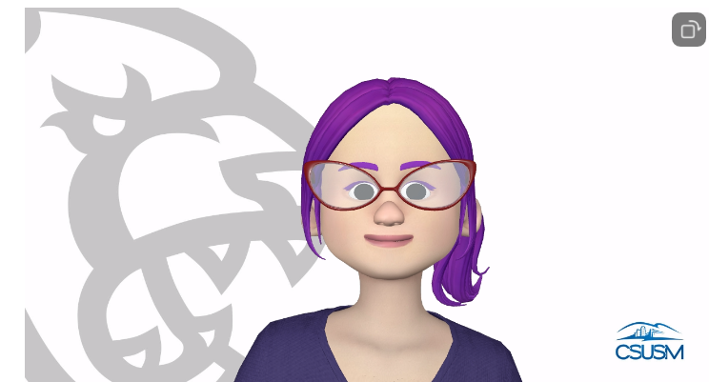
GIS and/or Instructional Design
California State University San Marcos
Make an Appointment with Michelle
mkinzel@csusm.edu

Slide 17
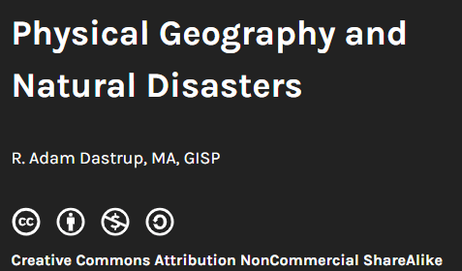
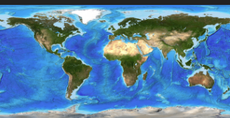
Sample Text Resources For This Presentation
Licenses and Attributions
Text adapted from : Physical Geography (Links to an external site.)Links to an external site.: Physical Geography by Lumen Learning is licensed Creative Commons.
License: Creative Commons AttributionLinks to an external site.
Text adapted from :Physical Geography and Natural Disasters;Links to an external site. (Links to an external site) by R. Adam Dastrup, MA, GISP is licensed under CC BY-NC-SA 4.0Links to an external site.
License: Creative Commons Attribution-ShareAlike 4.0

Slide 18
:
Process for Creating Canvas Quizzes on Textbooks Using AI Tools

Slide 19
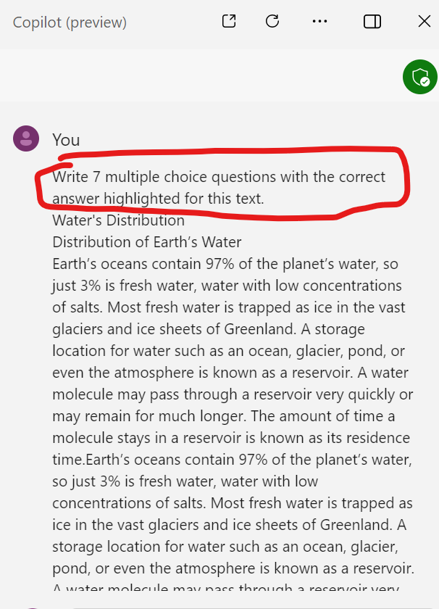
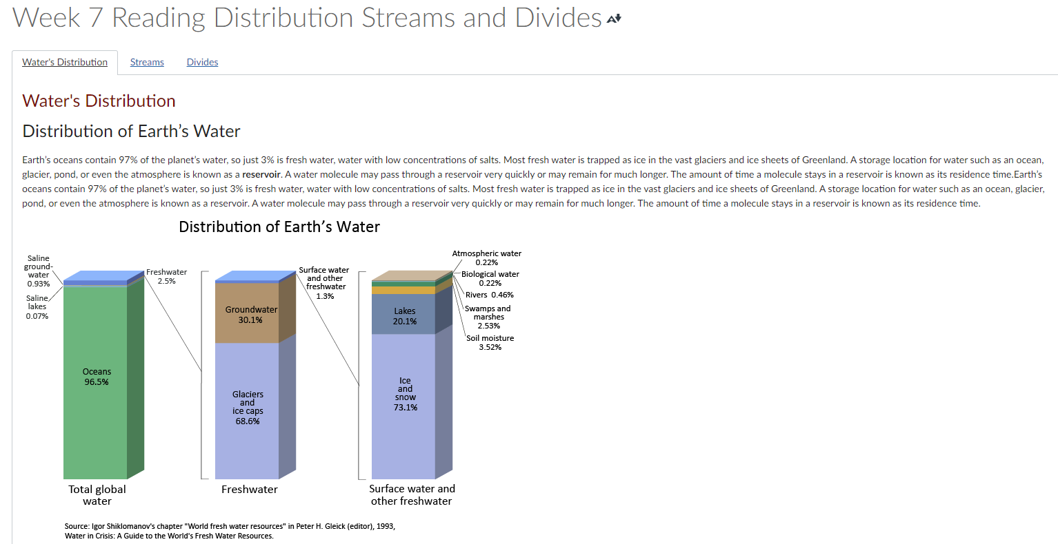
Using AI to create Quizzes
Creating Test Banks for Knowledge Checks
Copied text into AI – Microsoft CoPilot
Canvas Reading Page – OER Resources

Slide 20
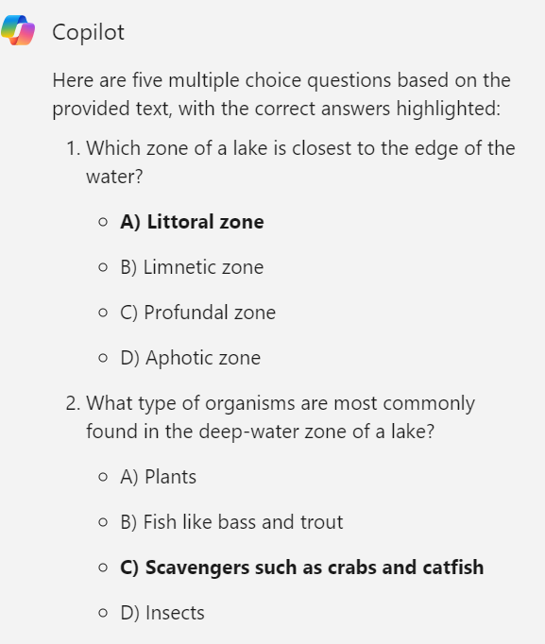
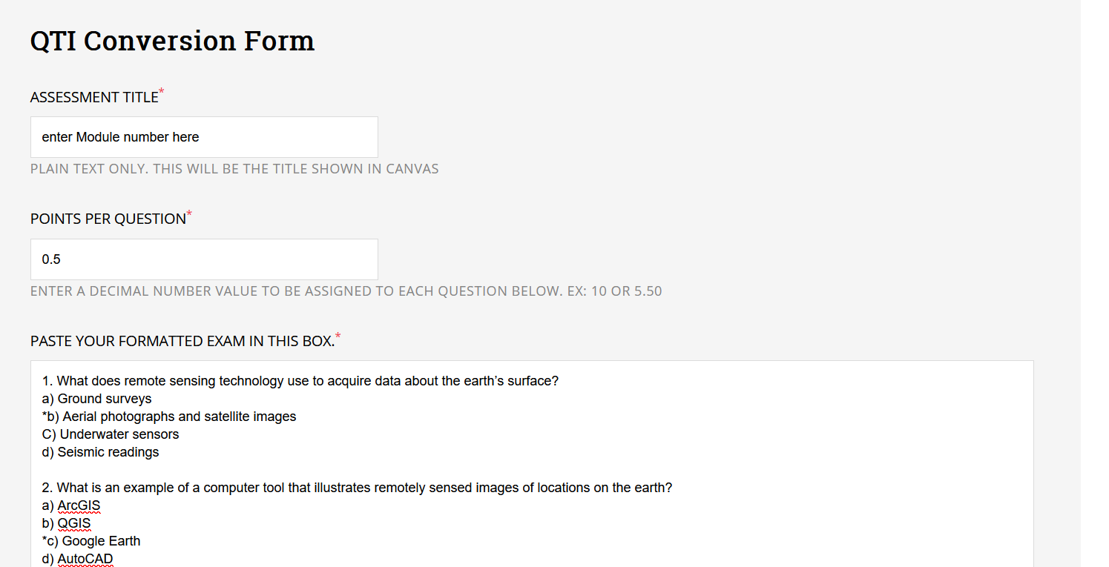
Using AI to create Quizzes
Creating Test Banks for Knowledge Checks
CoPilot Dialogue Box
QTI Conversion Form
https://www.nyit.edu/its/canvas_exam_converter

Slide 21
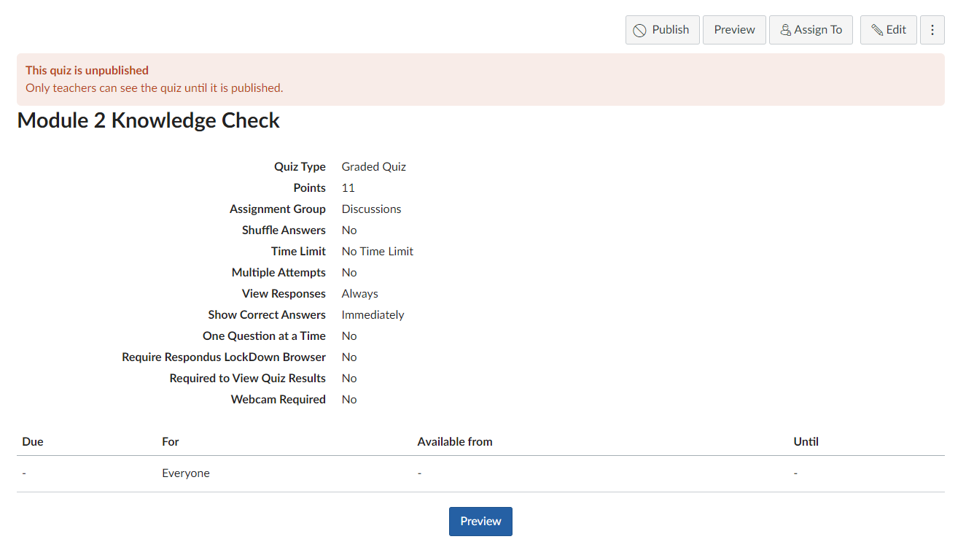
Using AI to create Quizzes
Creating Test Banks for Knowledge Checks
QTI File
QTI File Uploads to Canvas Quiz

Slide 22
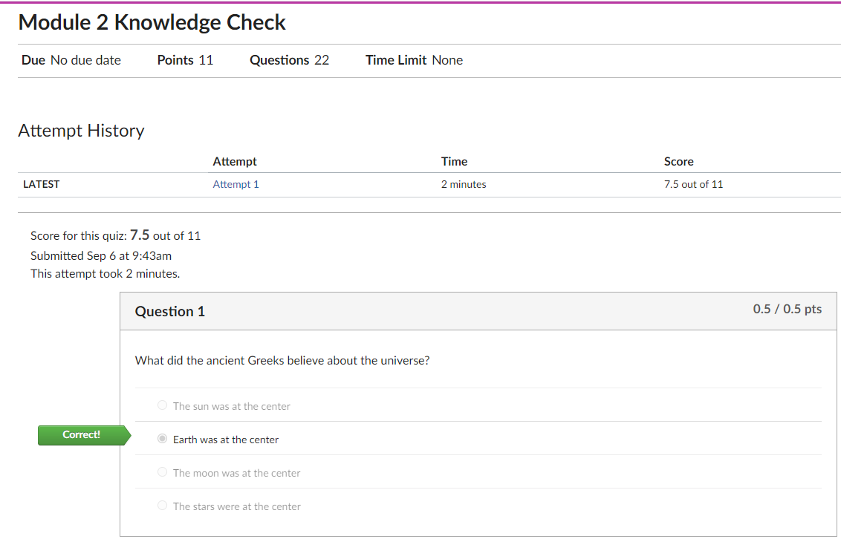
Using AI to create Quizzes
Great Time Savers and Formative Assessments
Creating Test Banks for Knowledge Checks
Auto Grading Quizzes
Unlimited Attempts for Self Learning
With Immediate Feedback

Slide 23
Using AI to create Quizzes
Creating Test Banks for Knowledge Checks – include incorrect answer explanations
! Here are five quiz questions about the Water Cycle, with the correct answers highlighted and explanations for the incorrect choices:
What is the process called when water vapor cools and changes back into liquid droplets?
A) Evaporation
Explanation: Evaporation is the process where liquid water turns into water vapor.
B) Condensation
C) Precipitation
Explanation: Precipitation is when water falls from the atmosphere as rain, snow, sleet, or hail.
D) Transpiration
Explanation: Transpiration is the release of water vapor from plants.

Slide 24
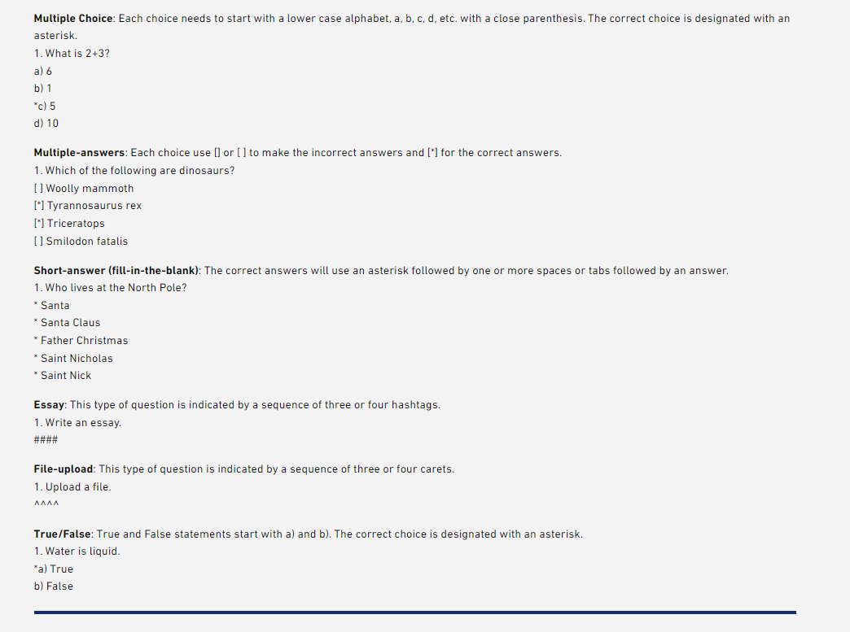
Using AI to create Quizzes
Creating Test Banks for Knowledge Checks – Other Formats
Multiple Answers, Fill in the Blank, Essay, File Upload, True/False

Slide 25
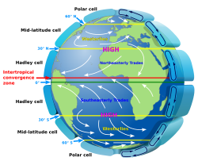
Using AI to create Quizzes
Analyze Images and Diagrams
What is the name of the circulation cell found at approximately 60° to 90° latitude in both hemispheres?
A) Hadley cell
B) Polar cell
C) Ferrel cell
D) Mid-latitude cell
Which zone is located near the equator where trade winds converge?
A) Polar convergence zone
B) Mid-latitude convergence zone
C) Intertropical Convergence Zone (ITCZ)
D) Subtropical convergence zone
What type of winds are found at approximately 30° latitude moving towards the equator?
A) Westerlies
B) Easterlies
C) Northeasterly trades in the Northern Hemisphere and Southeasterly trades in the Southern Hemisphere
D) High altitude jet streams

Slide 26
:
Process for Creating Canvas Quizzes on Textbooks Using AI Tools

Slide 27
Using AI to create Quizzes – You Tube Videos
Process for Creating Canvas Quizzes form You Tube Videos Using AI Tools
Just copy and paste the YouTube URL here
Returns a summary paragraph
summarize.tech: AI-powered video summaries

Slide 28
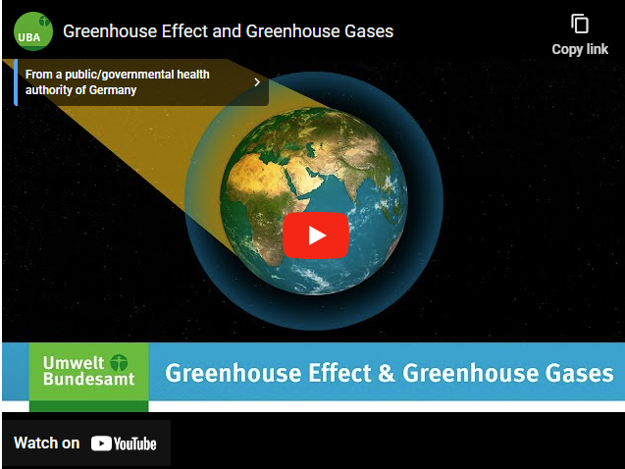
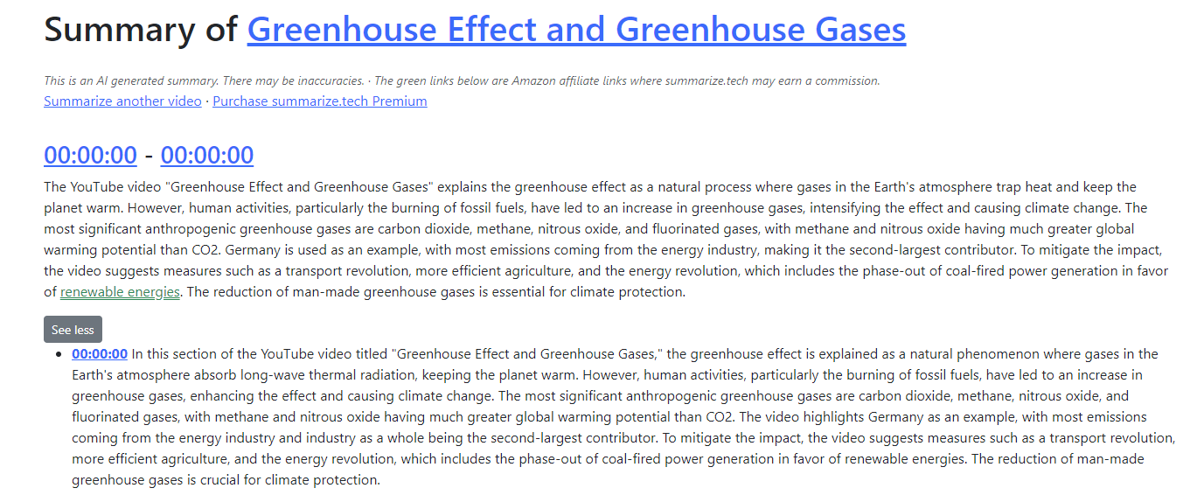
Using AI to create Quizzes
Process for Creating Canvas Quizzes from You Tube Videos Using AI Tools
https://youtu.be/XFCdxppTsu0
Use summary in AI, Microsoft Co-Pilot or ChatGPT to generate multiple choice questions
summarize.tech: AI-powered video summaries

Slide 29
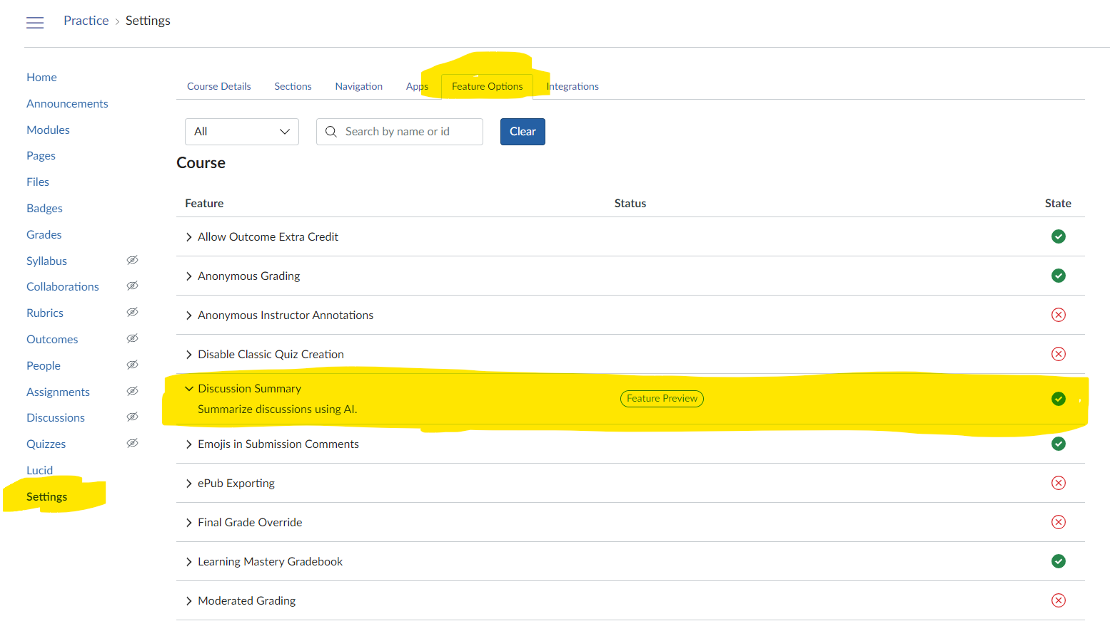
Using AI Within Canvas Summarize Discussion Board Assignment
This is the summary for my introduction discussion.
In the course discussion, students introduced themselves and shared their goals and expectations for the class. Many students expressed a desire to learn strategies for academic success, time management, and transitioning from high school to college. Common themes included a focus on developing better study habits, organization skills, and time management techniques to stay on top of coursework and avoid procrastination. Participants also want to learn how to effectively apply what they learn to their personal and professional lives, such as improving communication skills, critical thinking, and decision-making. Additionally, students see this class as an opportunity to familiarize themselves with campus resources and services that can support their academic and personal growth. Overall, the discussion indicates that the students are engaged, have clear learning objectives, and are eager to make the most of this course to facilitate a successful college experience.
summarize.tech: AI-powered video summaries

Slide 30
Look for Funding – Big pots of $$$ out there

Slide 31
THANK YOU
Michelle Kinzel
mkinzel@csusm.edu

