Slide 1
Open Outreach
OER Approaches Big and Small
Dr. Daniel Wilson, MLIS, PhD.
Open Education Librarian, Moreno Valley College

Slide 2
Today's Agenda
OER Landscape at MVC
Identifying Needs and Setting Goals
Pairing Goals and Costs
MVC's Efforts
Results

Slide 3
Does anyone have funding dedicated for OER/ZTC outreach?
Notes:
Siphoning off library funds, using implementation grant funds.

Slide 4
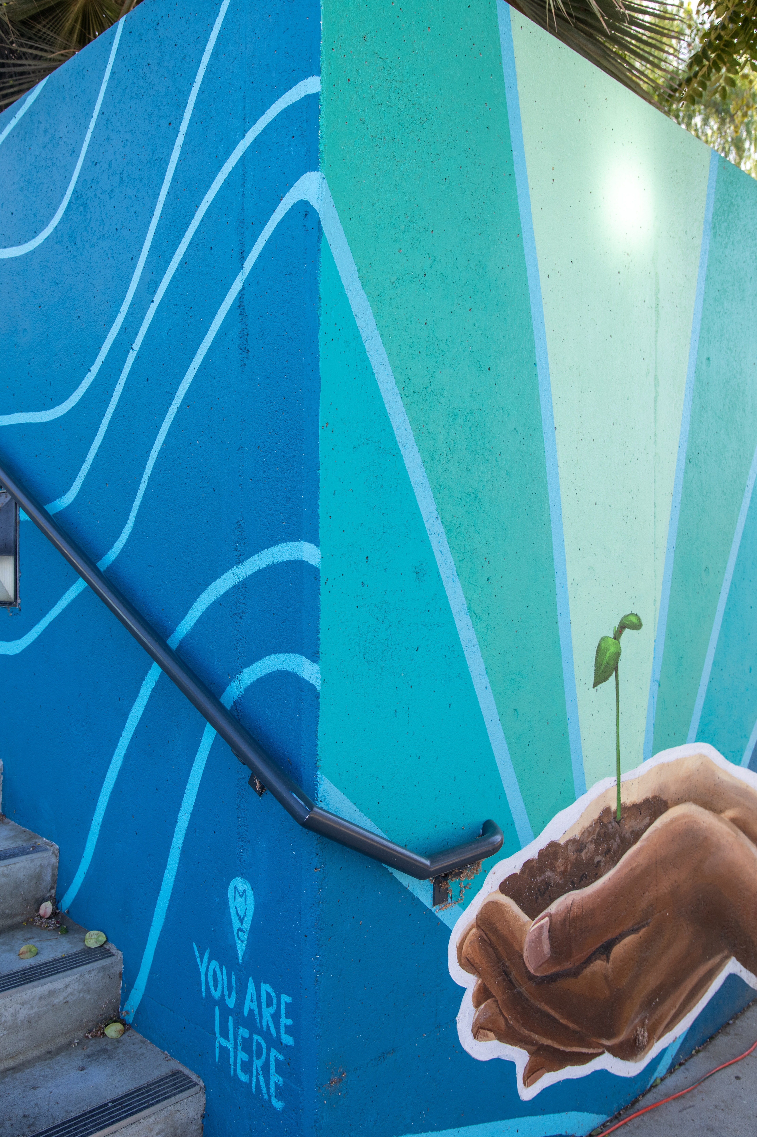
OER Landscape at MVC
More formal OER work began in 2019
Creation of the Course Materials Affordability Committee in 2020
Full-Time OER Librarian
ZTC Data this semester
44.1% ZTC courses
18.72% LTC courses
5 ADT pathways
Est. cost savings (Spring) $899,140

Slide 5
Challenges in Our Landscape
No standing budget for OER
No formal vetting process for ZTC courses
Faculty understanding of ZTC, LTC, and OER

Slide 6
Needs & Goals
Mapping pathway progress (discipline prioritization)
Successful outreach efforts must be directed towards meeting specific goals.
There are numerous approaches to identifying your institution's needs.
1
Speaking with stakeholders (faculty and students)
2
Reviewing the processes (bookstore, course schedule, grant approval)
3

Slide 7
MVC's Needs
Grant fulfillment – new ADT pathways
It took at least six months to figure out the landscape and college needs.
1
Improved learning penetration and retention; and student awareness
2
Improved processes: Course verification and consistency of reporting
3

Slide 8
What I learned Mapping the Pathways
Opportunities for 'easy win programs'
Which programs to approach
Which programs would be more challenging
Pace yourself with difficult conversations

Slide 9
What I learned Speaking with Stakeholders
Surveys demonstrated that students are increasingly comfortable with ebooks
Focus group showed that students do not overly rely on mobile devices for reading
Speaking with faculty identified misunderstandings in OER and book-buying processes

Slide 10
What goals have you set for OER/ZTC outreach?

Slide 11
Last Year's Goals
Secure additional grant funding
Initiate discipline grant projects
Improve awareness
Provide training on OER and LibreTexts

Slide 12
Available Resources?
Resources? What resources?
Budgets? Not in this town!
Grant funds for now...
Committee Support
FT Librarian
Implementation Grant

Slide 13
Resource Considerations
Create lasting value with limited funds
Re-usable promotional resources (signage)
Affordable bulk purchases (pamphlets, button-making, office posters)
OER self-paced training course
Free/Low-Cost Projects
Annual ZTC Faculty Champion Award Certificate
ZTC training workshops
ZTC Community of Practice
Reports to governing bodies (Student Senate, Academic Senate, President's Council, etc.)
Critical data collection (courses, surveys, focus group)
Notes:
Include button image here

Slide 14
MVC's Results in the past year
18 percentile increase in ZTC courses offered (26.07% ZTC to 44.1%)
500 views of student-facing ZTC/OER LibGuide
655 views of faculty-facing ZTC/OER LibGuide
OER Course Badges Awarded (21 of 28)
18 grant-funded ZTC projects over the past year
Identified 27 OER textbooks for our LibreTexts Commons

Slide 15
Questions?

