Slide 1
Course Cost Transparency in the California Community Colleges – The Past, the Present, and the Future
Revised October 7, 2024. This work is licensed under a Creative Commons Attribution 4.0 International License.
Attribute this slide deck as: ”Course Cost Transparency in the CCCs – The Past, the Present, and the Future" by ASCCC OERI is licensed under CC BY 4.0.

Slide 2
Event Description – The past
In 2010, a federal requirement that the costs of “college textbooks and supplemental materials” be made available to students at the time of registration took effect. This requirement was followed by regulatory changes that permitted the California Community Colleges to require students to purchase access to electronic resources and then by a new state law that required the marking of course sections with no textbook costs.

Slide 3
Event Description – The present and the future
In 2024, our colleges are grappling with implementing a section-level data element (XB12) that captures course cost data, a new transparency law that takes effect on January 1, 2025, and a proposed new regulation that pushes colleges to ensure students have the instructional materials they need to fully participate on the 1st day of class.
In this webinar, we will explore the history and interaction of these various requirements. Are there inconsistencies or contradictions? Or are the CCCs demonstrating how to truly make college affordable?

Slide 4
Overview
Definitions
XB12
Cost Transparency Timeline
Title 5 § 54221. Burden-Free Access to Instructional Materials. (AKA Day One Access to Course Materials)
What changes January 1, 2025?
Are there inconsistencies or contradictions? Or are the CCCs demonstrating how to truly make college affordable?

Slide 5
Why do we need to begin with definitions?

Slide 6
Because….
… a common understanding of what must be zero – what “counts” - in the context of XB12 and the Zero Textbook Cost (ZTC) Degree Program is needed.
… the costs that must be included in course schedules are changing and the challenges associated with this change need to be acknowledged.
… there’s a lot of confusion.

Slide 7
“Instructional Materials”
“any materials which a student must procure or possess as a condition of registration, enrollment or entry into a class; or any such material which is necessary to achieve the required objectives of a course” (California Code of Regulations, title 5, §59402)
“Instructional Materials” is a broad term that includes supplies that would always have to be purchased by someone, such as brushes, goggles, and other resources.
Federal cost transparency requirements and California state law related to no-cost marking are focused on “college textbooks and supplemental materials.” (Not instructional materials.)

Slide 8
“College textbooks and supplemental materials”
“College textbooks and supplemental materials” is a subset of “instructional materials” and the focus of:
the Higher Education Opportunity Act (federal cost transparency),
the course-marking requirement of California Education Code §66406.9 (AKA SB 3509), and
California Education Code §78052 (ZTC Degree Program)
Translation?

Slide 9
ZTC and No-Cost Marking
For the purposes of ZTC and no-cost marking, the section costs that need to be zero are limited to the costs of “textbooks and supplemental materials.”
In other words, the resources that will always have a cost are excluded.
This is also the focus of XB12.
Why might you question this conclusion when it comes to XB12?

Slide 10
XB12, “INSTRUCTIONAL-MATERIAL-COST”
“This element indicates the cost of course materials for the section. The instructional material definition in Title 5 is more broadly defined; however, for the purpose of this data element, only the cost of course textbooks (including lab manuals) and supplementary materials (including software and homework systems) are to be reported.”
XB12 was originally introduced for implementation in Summer 2022.
Revision: Summer 2024
Added clarifying language distinguishing “course materials” from instructional materials as defined in Title 5.
Removed “B - Section uses only no-cost digital instructional material”
Added E, F, G to better distinguish between different types of no-cost instructional materials and to add a category where the section may use a mix of no-cost OER and other course materials.
Notes:
Find the most current version of XB12 at https://webdata.cccco.edu/ded/xb/xb12.pdf.

Slide 11
XB12 – Current Definitions – Effective Summer 2024
Section has no associated course material
Section uses only no-cost digital instructional material
Section has course material costs none of which are passed on to students
Section has low course material costs (as defined locally)
Section uses only no-cost, OER course material
Section uses only no-cost digital course material that does not meet OER guidelines
Section uses a mix of no-cost OER and other cost bearing resources, but no costs are passed to the student
Y. Section does not meet no-cost or low-cost course material criteria

Slide 12
XB12 – Current Definitions and Examples
Section has no associated course material – studio art course that does not use a text, but might require the purchase of supplies
Section uses only no-cost digital instructional material
Section has course material costs none of which are passed on to students – an English course for which the college has purchased a course set or a humanities course that uses library resources
Section has low course material costs (as defined locally)
Section uses only no-cost, OER course material
Section uses only no-cost digital course material that does not meet OER guidelines – physical geography course that uses physicalgeography.net
Section uses a mix of no-cost OER and other cost bearing resources, but no costs are passed to the student – a history course that uses an OER and a specific library resource purchased for the course
Y. Section does not meet no-cost or low-cost course material criteria

Slide 13
The XB12 Challenge
How do you get the data?
When do you get the data?
What do we want to avoid?
Creating yet another stand-alone process.
Notes:
Regardless of how, when, what, or the process, step 1 is ensuring understanding of the codes.

Slide 14
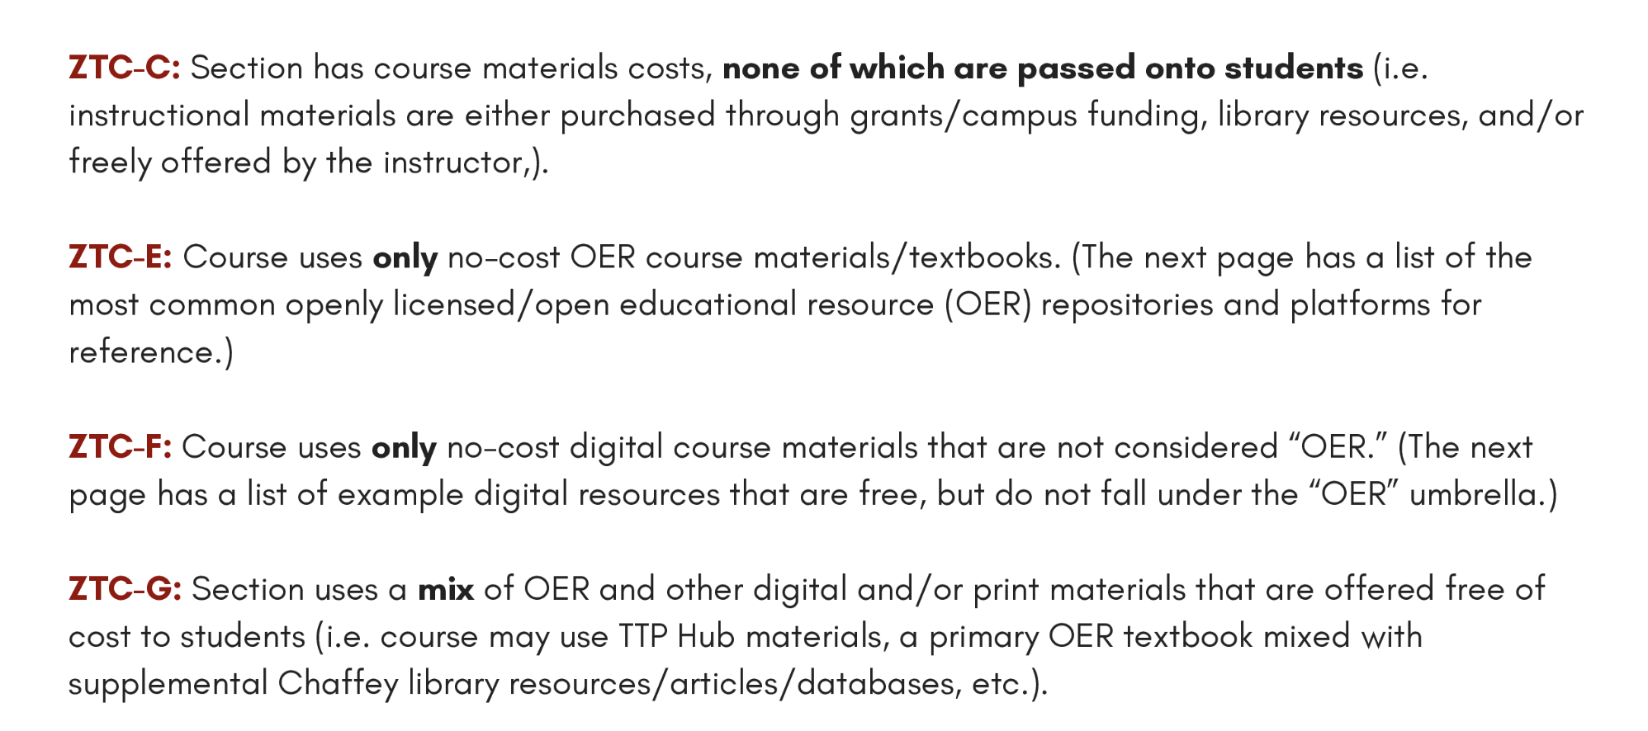
Chaffey College – Textbook Transformation Project (TTP)

Slide 15
XB12 Infographic – Glendale
Horizontal infographic
Attribution: XB12 Codes Infographic by Caroline Hallam, Glendale Community College (CC BY 4.0)
Notes:
https://campusguides.glendale.edu/oer/xb12

Slide 16
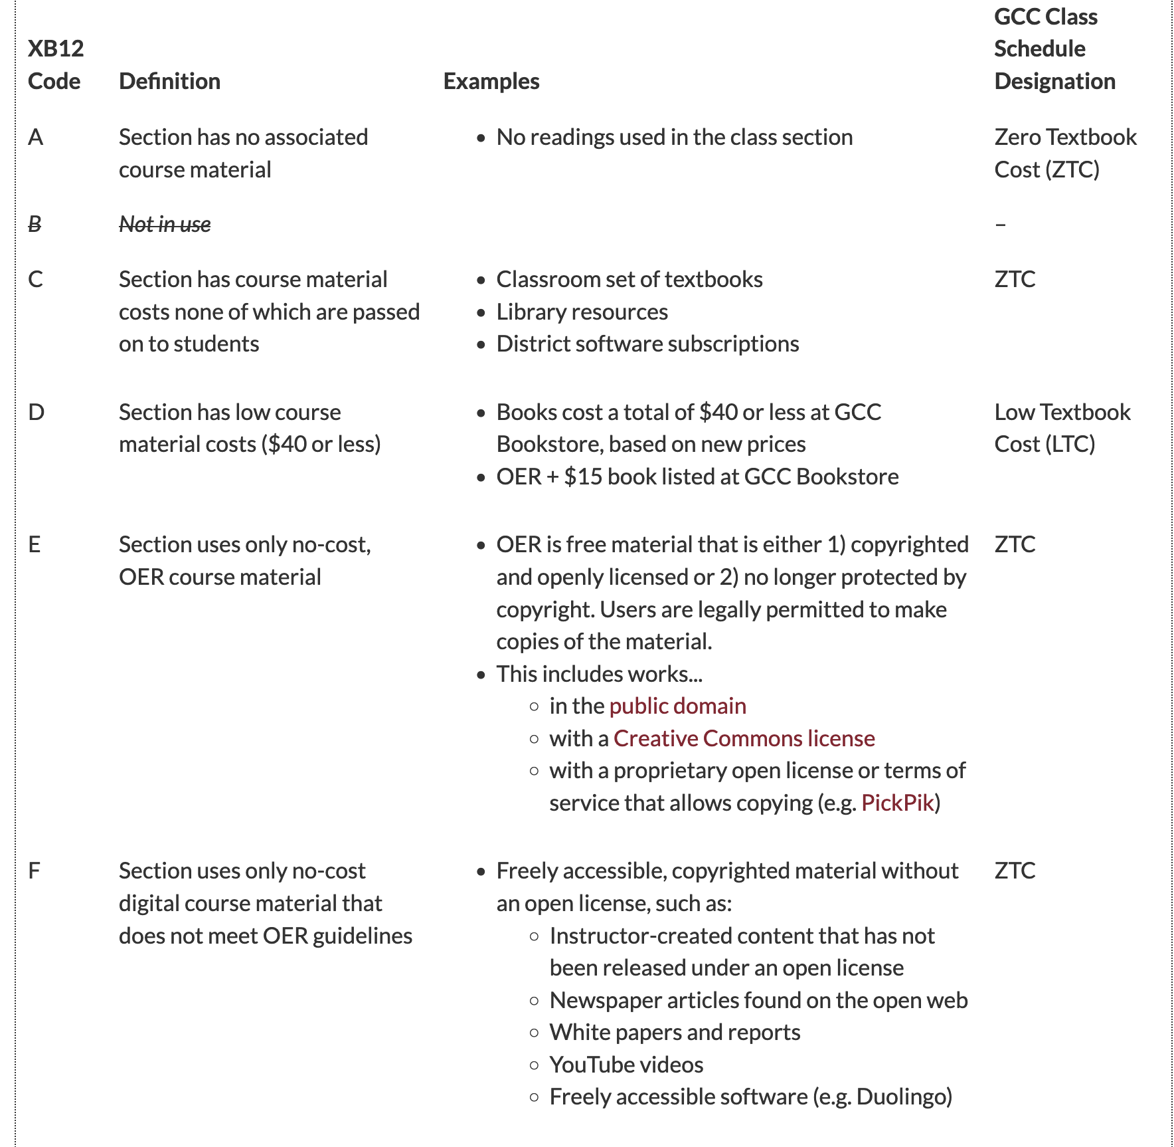
Definitions and Examples - Glendale
Notes:
https://campusguides.glendale.edu/oer/xb12

Slide 17
XB12 – When do you gather the data?
When the text is ordered/resource to be used is reported?
Can you integrate into the text ordering process?
When the course is assigned?
When no-cost sections are identified?
Notes:
What is XB12?

Slide 18
Glendale’s XB12 Implementation
To help students find classes, GCC will continue to list classes as Zero Textbook Cost (ZTC) and Low Textbook Cost (LTC) in the Online Class Schedule based on the XB12 codes used for each course section.
Changing XB12 codes post-registration
If, after registration begins, a course section is listed in the Online Class Schedule as zero textbook cost (ZTC; XB12 codes A, C, E, F, G) or low textbook cost (LTC; XB12 code D) and the instructor wants to change to a text that will cost more than originally advertised (i.e. going from ZTC-->LTC or removing ZTC/LTC completely), Curriculum will have to cancel the class and recreate it, as they do with day/time/modality/material fee changes.
On the other hand, if a class that was not listed as ZTC or LTC (XB12 code Y) is determined to be ZTC/LTC after registration begins, the notation can be added since it would only positively impact students.
If you're not sure whether a class will be ZTC or LTC before registration, list it using XB12 code Y.
Notes:
https://campusguides.glendale.edu/oer/xb12

Slide 19
Developing a Form to Gather XB12 Data
“I got some preliminary feedback from Deans and am making some changes but I feel like this it becoming a little monster of a form.”
OERI has gathered examples and will soon make them available at “Implementing XB12” (tinyurl.com/OERIXB12)
Presently has Chaffey and Glendale links

Slide 20
Cost Transparency Timeline (2010 – 2023)
2010 - (July 1, 2010) Textbook provisions of the HEOA took effect.
2012 – Title 5 § 59400, 59402, 59404, 59406, and 59408 were modified by the Board of Governors.
2018 - (January 1, 2018) No-cost marking legislation takes effect in California.
SB 1359 (Block, 2016) >> California Education Code (CEC) 66406.9.
2021 - Advocate for Development of a ZTC Data Element (Spring 2021; ASCCC Resolution Number: 11.02)
2022 – XB12 introduced
2022 - Clarify Components of XB12, the Instructional-Material-Cost Section-Level Data Element (Fall 2022; ASCCC Resolution Number 7.09)
Notes:
More about much of this is available at tinyurl.com/TextLeg. From Marking Open and Affordable Courses: Best Practices and Case Studies:
In 2007, Congress took up the reauthorization of the Higher Education Act of 1965, the law governing the nation’s college and university policies, which was ultimately achieved with the passage of the (HEOA) in 2008. Senator Dick Durbin of Illinois championed the issue of textbook affordability during the process, drafting a set of provisions that were ultimately codified into law under Section 133 (20 USC 1015b). Among the provisions was a requirement that colleges and universities eligible for funding must, to the maximum extent practicable, disclose the ISBN and retail price of college textbooks in the online course schedule students use for registration. The textbook information provisions took effect on July 1, 2010, and were evaluated by the Government Accountability Office (GAO) in 2013. The relevant portion of Section 133 reads:
To the maximum extent practicable, each institution of higher education receiving Federal financial assistance shall—
disclose, on the institution’s Internet course schedule and in a manner of the institution’s choosing, the International Standard Book Number and retail price information of required and recommended college textbooks and supplemental materials for each course listed in the institution’s course schedule used for preregistration and registration purposes, except that—
if the International Standard Book Number is not available for such college textbook or supplemental material, then the institution shall include in the Internet course schedule the author, title, publisher, and copyright date for such college textbook or supplemental material; and
if the institution determines that the disclosure of the information described in this subsection is not practicable for a college textbook or supplemental material, then the institution shall so indicate by placing the designation “To Be Determined” in lieu of the information required under this subsection; and
if applicable, include on the institution’s written course schedule a notice that textbook information is available on the institution’s Internet course schedule, and the Internet address for such schedule.
This provision instigated a shift in the responsibility of institutions for providing textbook information to students. Historically, textbook information was typically not available at the time students registered for courses (often several months in advance). Visiting the college bookstore prior to the start of the term was often the most reliable way to get information about book adoptions. Following the passage of HEOA, institutions had just under two years to update their systems to ensure that students had access to textbook information at the time of registration.
Source: Chapter 1, State and Federal Legislation, in Marking Open and Affordable Courses: Best Practices and Case Studies.

Slide 21
Title 5 § 59400, 59402, 59404, 59406, and 59408
Guidelines for Required Instructional Materials in the California Community Colleges, January 2013
“Tangible” removed as a requirement for what students can be asked to purchase.
Students can not be required to purchase “materials used or designed primarily for administrative purposes” prohibited.
Requirements associated with “access fees” established.
Notes:
Modifications made to title 5 sections relating to instructional materials. https://asccc-oeri.org/wp-content/uploads/2021/04/InstructionalMaterialsGuidelines12813pdf.pdf
The third subsection (c) is new and addresses instructional materials that are temporarily available to the
student through a license or “access fee.” This section recognizes that online materials do not have the
same permanent life as a textbook, and students should not be expected to pay for periodic updates or
improvements provided by an online publisher after the class has been completed. This situation creates
some complicated marketing issues for publishers. The solution provided by the regulation is a
requirement that students be given options of varying lengths of times they can have access to the
materials, presumably at varying prices.
At a minimum, students must be given the option to purchase or otherwise obtain the materials for the
length of the class. Also at a minimum, students must have the ability to purchase or to otherwise obtain
the materials for at least two (2) years. The number of points and the range of time in between those two
(2) points are not specified; that would be up to the publisher. Beyond two (2) years, there is no upper
limit of time the materials can be made available; again, that would be the publisher’s option. It is to be
expected that there will be varying costs associated with the varying lengths of time. These costs must be
detailed in a clear and understandable manner to the student prior to the purchase of the material by the
student.

Slide 22
§ 59402. Definitions. For the purposes of this subchapter the following definitions apply:
(a) “Required instructional materials” means any materials which a student must procure or possess as a condition of registration, enrollment or entry into a class; or any such material which is necessary to achieve the required objectives of a course.
(b) “Solely or exclusively available from the district” means that the instructional material is not available except through the district, or that the district requires that the instructional material be purchased or procured from it. A material shall not be considered to be solely or exclusively available from the district if it is provided to the student at the district's actual cost and:
(1) the instructional material is otherwise generally available, but is provided solely or exclusively by the district for health and safety reasons; or
(2) the instructional material is provided in lieu of other generally available but more expensive material which would otherwise be required.
Notes:
(a) “Required instructional materials” means any materials which a student must procure or possess as a condition of registration, enrollment or entry into a class; or any such material which is necessary to achieve the required objectives of a course.
(b) “Solely or exclusively available from the district” means that the instructional material is not available except through the district, or that the district requires that the instructional material be purchased or procured from it. A material shall not be considered to be solely or exclusively available from the district if it is provided to the student at the district's actual cost and:
(1) the instructional material is otherwise generally available, but is provided solely or exclusively by the district for health and safety reasons; or
(2) the instructional material is provided in lieu of other generally available but more expensive material which would otherwise be required.
(c) “Required instructional materials which are of continuing value outside of the classroom setting” are materials which can be taken from the classroom setting, and which are not wholly consumed, used up, or rendered valueless as they are applied in achieving the required objectives of a course which are to be accomplished under the supervision of an instructor during the class.

Slide 23
§ 59404. District Policies and Regulations for Instructional Materials.
(a) The governing board of a community college district which requires that students provide instructional materials for a course shall adopt policies or regulations, consistent with the provisions of this subchapter, which specify the conditions under which such materials will be required. These policies and regulations shall direct instructors to take reasonable steps to minimize the cost and ensure the necessity of instructional materials.
(b) The policies or regulations specified in subdivision (a) shall be published in each college catalog developed after the date of adoption.

Slide 24
Cost Transparency Timeline (2024 - 2025)
2024 – XB12 significantly modified
2024 – Title 5 § 54221. Burden-Free Access to Instructional Materials.
45-Day Notice published September 9, 2024
1st reading at the Board of Governors on September 23, 2024
Public comment period closes on October 24, 2024
2025 – (January 1, 2025) CEC 66406.9 modifications established by AB 607 (Kalra, 2023) take effect.
Notes:
More about much of this is available at tinyurl.com/TextLeg. From Marking Open and Affordable Courses: Best Practices and Case Studies:
In 2007, Congress took up the reauthorization of the Higher Education Act of 1965, the law governing the nation’s college and university policies, which was ultimately achieved with the passage of the (HEOA) in 2008. Senator Dick Durbin of Illinois championed the issue of textbook affordability during the process, drafting a set of provisions that were ultimately codified into law under Section 133 (20 USC 1015b). Among the provisions was a requirement that colleges and universities eligible for funding must, to the maximum extent practicable, disclose the ISBN and retail price of college textbooks in the online course schedule students use for registration. The textbook information provisions took effect on July 1, 2010, and were evaluated by the Government Accountability Office (GAO) in 2013. The relevant portion of Section 133 reads:
To the maximum extent practicable, each institution of higher education receiving Federal financial assistance shall—
disclose, on the institution’s Internet course schedule and in a manner of the institution’s choosing, the International Standard Book Number and retail price information of required and recommended college textbooks and supplemental materials for each course listed in the institution’s course schedule used for preregistration and registration purposes, except that—
if the International Standard Book Number is not available for such college textbook or supplemental material, then the institution shall include in the Internet course schedule the author, title, publisher, and copyright date for such college textbook or supplemental material; and
if the institution determines that the disclosure of the information described in this subsection is not practicable for a college textbook or supplemental material, then the institution shall so indicate by placing the designation “To Be Determined” in lieu of the information required under this subsection; and
if applicable, include on the institution’s written course schedule a notice that textbook information is available on the institution’s Internet course schedule, and the Internet address for such schedule.
This provision instigated a shift in the responsibility of institutions for providing textbook information to students. Historically, textbook information was typically not available at the time students registered for courses (often several months in advance). Visiting the college bookstore prior to the start of the term was often the most reliable way to get information about book adoptions. Following the passage of HEOA, institutions had just under two years to update their systems to ensure that students had access to textbook information at the time of registration.
Source: Chapter 1, State and Federal Legislation, in Marking Open and Affordable Courses: Best Practices and Case Studies.

Slide 25
Title 5 § 54221. Burden-Free Access to Instructional Materials.
(a) Governing boards shall adopt policies that ensure student access to textbooks and supplemental materials that are needed on the first day of class. Practices that enable first day access to zero-cost resources include, but are not limited to, the following:
(1) adapting or adopting OER for some or all textbook and ancillary material, when the option is available; and
(2) copying initial textbook chapters as permissible within copyright.
(b) Governing boards shall adopt policies that strengthen student access to other instructional materials before their required use in any course to minimize financial and administrative burdens to students.
Notes:
(a) Governing boards shall adopt policies that ensure student access to textbooks and
supplemental materials that are needed on the first day of class. Practices that enable
first day access to zero-cost resources include, but are not limited to, the following:
(1) adapting or adopting open educational resources for some or all textbook and
ancillary material, when the option is available; and
(2) copying initial textbook chapters as permissible within copyright.
(b) Governing boards shall adopt policies that strengthen student access to other
instructional materials before their required use in any course to minimize financial and
administrative burdens to students.
(c) District policies shall maintain an instructor’s responsibility to choose instructional
materials. District policies shall also support student-centered practices that encourage
the use of zero-cost instructional materials, and leverage available resources to the
maximum extent feasible, including, but not limited to, the following:
(1) developing and implementing sustainable zero-textbook-cost degrees, consistent with
Education Code Section 78052;
(2) adapting open educational resources to complete degrees and career technical
education certificates;
(3) adopting open educational resources for courses in which OER is commonly available
and prioritizing courses needed to satisfy general education requirements;
(4) establishing lending programs and maintaining college library resources to support
immediate access to course materials;
CFR 668.164(i);
(6) encouraging and supporting students to complete their financial aid files early to
receive timely disbursement; and
(7) deploying other forms of direct aid and support program resources to strengthen
student financial stability

Slide 26
Questions about § 54221…
What do compliant policies look like?
When would policies need to be in place?
What happens if a district does not adopt such a policy?
What’s the timeline – when would a college need to have a policy in place?
What usually happens when there is a new regulation such as this – where does guidance come from?

Slide 27
CCLC Templates
Community College League of California Statewide Policy & Procedure Services
The Policy & Procedure Service is provided to subscribing districts by the CCLC, in partnership with Liebert Cassidy Whitmore...
All 73 districts subscribe to the Service, which includes Board Policy and Administrative Procedure Templates.
There are over 400 board policy and administrative procedure templates that are vetted by the legal firm of Liebert Cassidy Whitmore. The language in the templates is indicated as legally required, legally advised, or suggested as good practice for boards and districts.
Notes:
https://www.ccleague.org/district-services/policy-procedure-services
Districts commonly rely on these templates to ensure compliance – but further guidance from the CCCCO is anticipated.

Slide 28
What does CEC 66406.9 require as of January 1, 2025?
Prominently display, by means that may include a link to a separate internet web page, the estimated costs for each course of all required course materials and fees directly related to those materials, for no less than 40 percent by January 1, 2025, 55 percent by January 1, 2026, 65 percent by January 1, 2027, and 75 percent by January 1, 2028, of the total number of courses on the online campus course schedule for which a faculty member or course instructor has been assigned.
“Course materials” as used in this paragraph includes digital or physical textbooks, devices such as calculators and remote attendance platforms, and software subscriptions.
CCCCO is interpreting this as being limited to the listed elements – but encouraging colleges to focus on everything – all instructional materials - in anticipation of needed clarification.

Slide 29
Are there inconsistencies or contradictions? Or are the CCCs demonstrating how to truly make college affordable?

Slide 30
Are there inconsistencies or contradictions?
Technically, yes.
Practically, no.
XB12 is misnamed – it is not capturing instructional material costs.
Where are instructional materials the focus?
Draft title 5 – “Governing boards shall adopt policies that strengthen student access to other instructional materials before their required use in any course to minimize financial and administrative burdens to students.”
New California cost transparency law effective January 1, 2025.

Slide 31
Are the CCCs demonstrating how to truly make college affordable?

Slide 32
More Information
ASCCC OERI Website (asccc-oeri.org)
Resources
Webinars and Events
ASCCC OER E-Mail (oeri@asccc.org)

