Slide 1
Challenging Ableism
Removing Ableist and Offensive Language from Your Vocabulary
Tiffany Lanoix, IDEA Faculty Lead
ASCCC
11/6/24

Slide 2
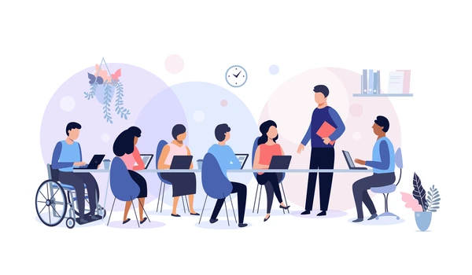
Agenda
Ableism & ableist language
Removing ableist language
Considerations
Dos and Don’ts
Notes:
Housekeeping:
Interactive, there are built in discussions but please participate throughout
To do so: raise hand, post in the chat, unmute yourself

Slide 3
What is the IDEA Framework?
A review framework to evaluate existing and assist in the creation of new ASCCC OERI-supported materials
Support faculty as they implement culturally responsive and anti-racist pedagogy
Assess OER for IDEA (inclusive, diverse, equitable, and anti-racist)

Slide 4
Assessment Categories
Are they inclusive, diverse, equity minded, and anti-racist?
1. Illustrations & Photos
2. Example Names
3. Gender Inclusive Language & Use of Pronouns
4. Diverse Authors, Researchers & Studies
5. Applications, Examples, and Problem Scenarios That Reflect Diverse Audiences
6. Appropriate Terminology
7. Keywords, Glossary & Metadata Representation
8. Incorporating Diverse Perspectives on Issues, Events, & Concepts Relevant to Diverse Pops

Slide 5
IDEA Framework Assessment Categories
6. Appropriate Terminology
Examine for derogatory, colloquial, inappropriate, or otherwise incorrect language
For historical uses, consider adding context, such as “a widely-used term at the time”
Strive to not use terminology that reduces a person to something that was done to them
E.g., Slave vs. enslaved, minority vs. marginalized
Be mindful of ableist language and identity preferences for specific disabled communities

Slide 6
Ableism
assigning value to people’s bodies and minds based on socially constructed ideas of normalcy, intelligence and physical ability
Privileged: individuals with bodies, minds and abilities that reflect what’s considered normal; people without disabilities
Disadvantaged: individuals with bodies, minds and abilities that fall outside what society considers normal; disabled people
Source: Talila Lewis

Slide 7
Ableism
Underlying message
Bodies and minds are supposed to operate in a specific way
People with disabilities are inferior and people without disabilities are superior
Reality
There are diverse ways for a mind and/or body to exist and operate
physical and neuro-diversity is part of the human experience

Slide 8
Sticks and Stones May Break My Bones…
The power of language and words
Words mean things
Negative words indicate what our society views as negative
Think of the power of the n-word, “that’s so gay”, and c*nt.
Words don’t just reflect meaning but can shape and influence the attitudes we have toward a subject
Language reflects power dynamics in society
Race: white is associated with good and black with bad
Gender: using the masculine as neutral
Ability: disabilities carry negative connotations

Slide 9
Ableist Language
Language that is offensive to people with disabilities
“retarded,” “psycho,” and “crazy” or phrases like “blind spot” or “falling on deaf ears”
expressing contempt
everyday conversation & omnipresent in culture
Impact >>>Intent
perpetuate negative stereotypes
justifies unequal treatment of people with disabilities
Notes:
Ableist language is built into our everyday conversation and is omnipresent in mainstream culture. Unless you’ve made an effort to remove ableist language from your vocabulary, you almost certainly use it. In many cases people use it without any intention of being harmful, yet, the impact remains. You are not responsible for the existence of ableist language but you are responsible for your use of it. Let’s start the process of moving toward ability inclusive language.

Slide 10
Removing ableist language
1) Be more precise
2) Considering person first vs. identity first language

Slide 11
Tools to Remove Ableist Language
Be more precise!
Replace ableist language with more precise options
Use other words or phrases to convey the same meaning
Below are examples of ableist language
Insane, crazy, “falling on deaf ears”, paralyzed, psycho, lame, crippled, OCD, “blind spot”
Pick at least one of the ableist examples above and:
Provide a specific example of how it gets used
Explain the underlying message behind the word or phrase
Offer more precise words or phrases to use instead
Notes:
We are often using ableist language to describe something as undesirable, problematic or as not going well. For example, if we are feeling overwhelmed with work we might say that we feel “crippled.” Or maybe we’ve been asked to complete a task that we don’t know how to start and say that we feel “paralyzed.” Instead of using ableist language there are other more precise options that we can use. However, because this type of language is so common, we often use it without much thought. So, if we want to avoid it, we have to be thoughtful about the language we use.

Slide 12
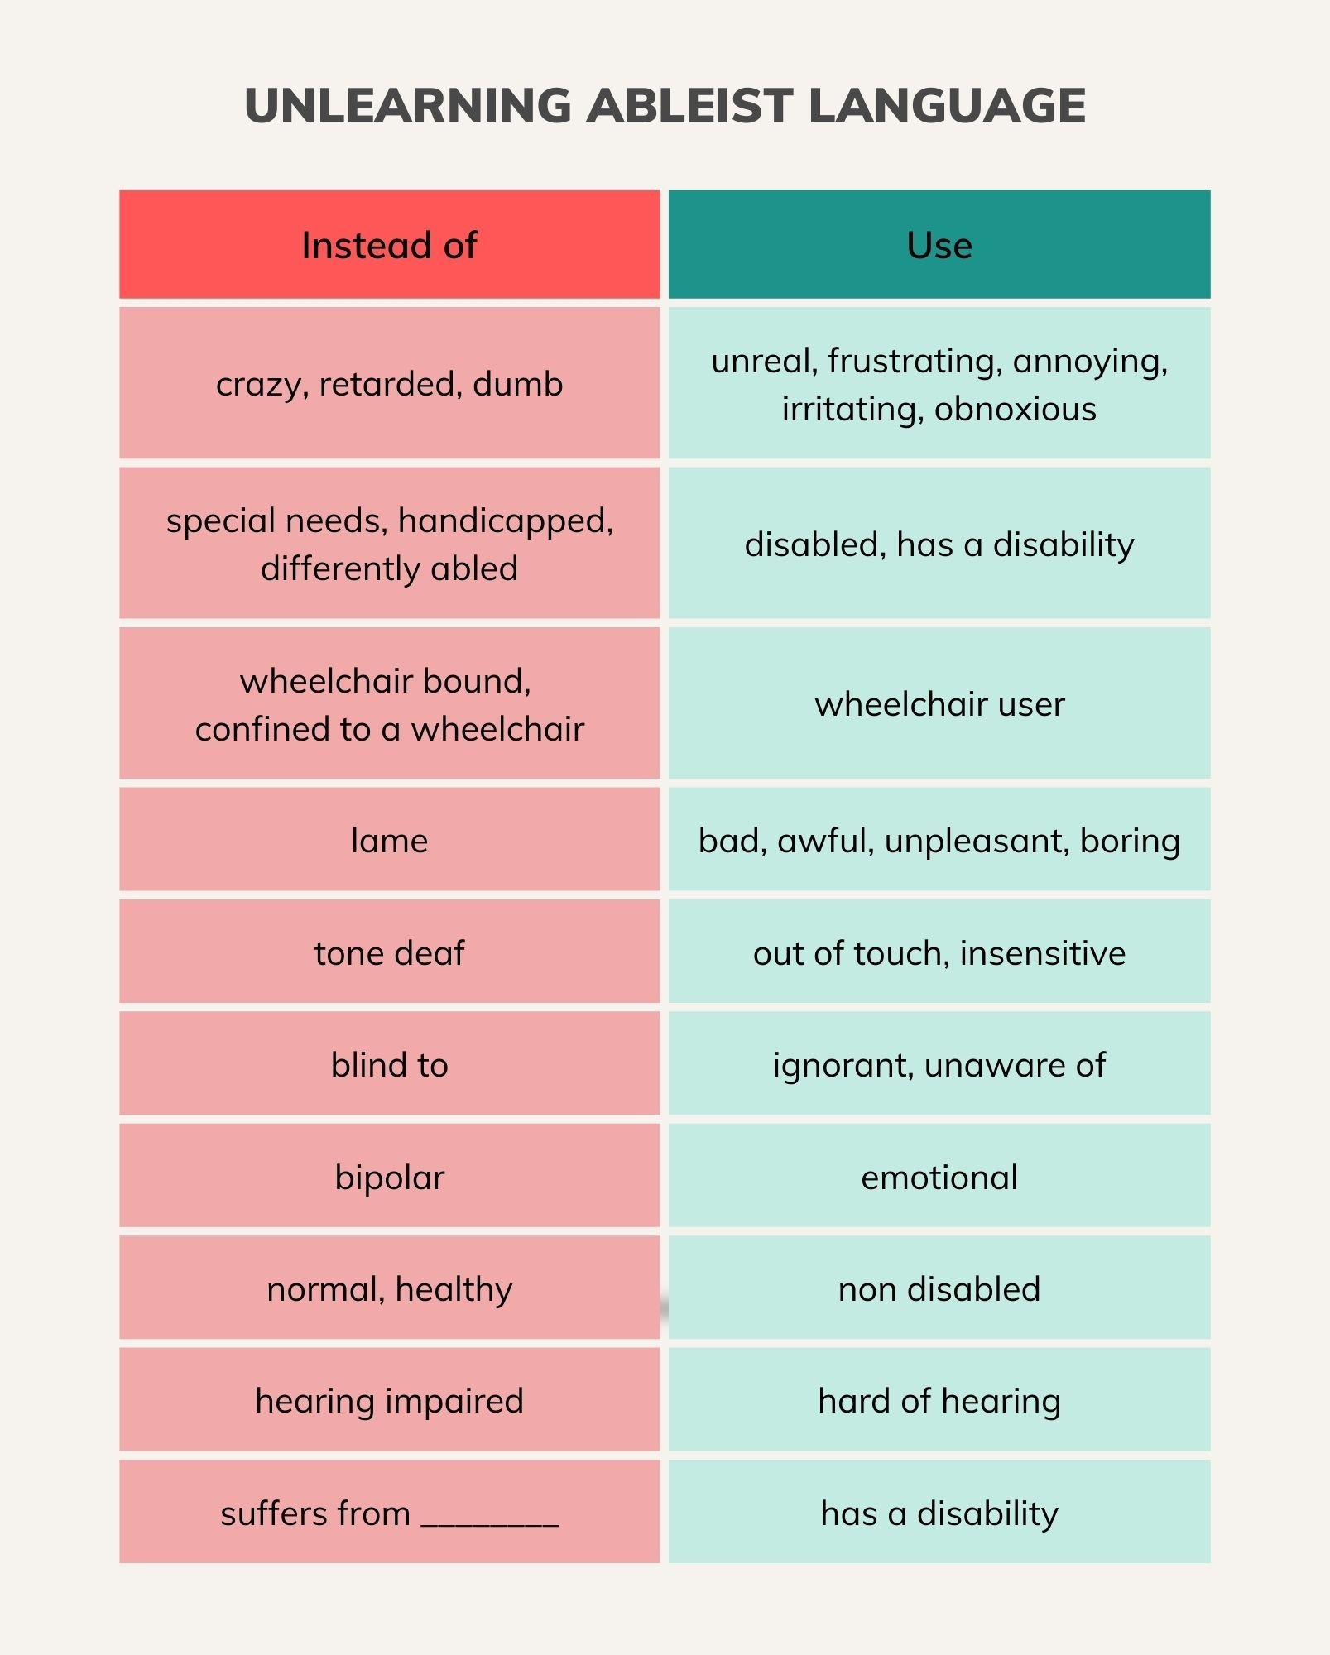
Unlearning Ableist Language
Source: Unlearning Ableism

Slide 13
Tools to Remove Ableist Language
Considering Person First Language vs. Identity First Language
Person-first language (PFL)
Personhood is the primary identity
a person that has a disability
Ex., “they have bipolar disorder”, “person with schizophrenia”, “person with autism”
Identity-first language (IFL)
Disability is the primary identity
a way of referring to individuals that emphasizes their disability as a core part of identity
Recognizes the role of the disability in shaping their experience and identity
Ex., “they are bipolar”, “schizophrenic”, “autistic”

Slide 14
Tools to Remove Ableist Language
Considering Person First vs. Identity First Language
Language is ever evolving
PFL was first promoted in the 1970s
Shift away from language perceived as derogatory
Currently, a shift toward IFL among some disabled communities
Critique of person first language
The need for a positive noun implies the disability is negative
Form of empowerment and positive identity
Similar to transformation of queer
Most important consideration: individual/community preference for identity
Source: An Evolving Mindset: Person-First vs. Identity-First Language

Slide 15
Autism & PFL vs. IFL
Preference for IFL
emphasizes the disability as a core part of their identity
“autistic” or “autistic person” instead of “person with autism”
Autism cannot be separated from the individual
dispels the notion of autism as an unfortunate affliction
Use of PFL driven by caregivers
Source: Autistic Self Advocacy Network & Disability Rights Texas

Slide 16
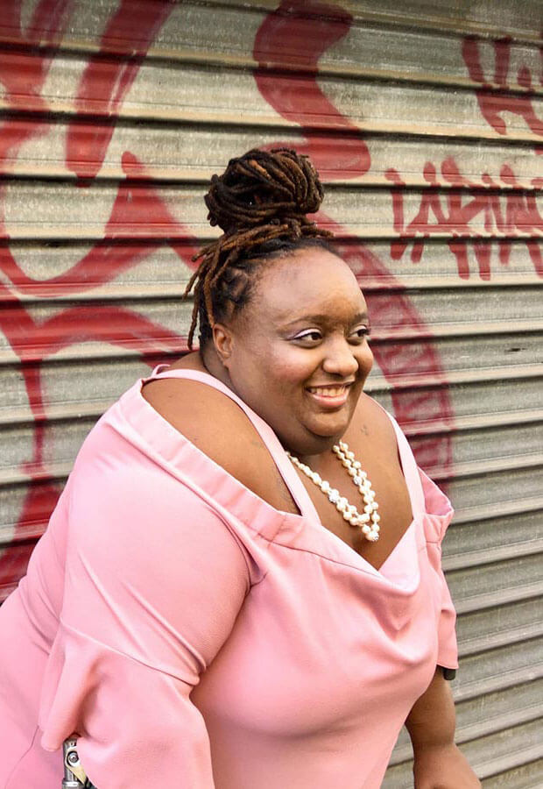
Quote Slide
“I don’t need to remind you that I’m a person first. You should already know.”-Imani Barbarin, Disability Blogger/Public Speaker/Model
Notes:
Switch slide and add photo

Slide 17
Video about ableist language

Slide 18
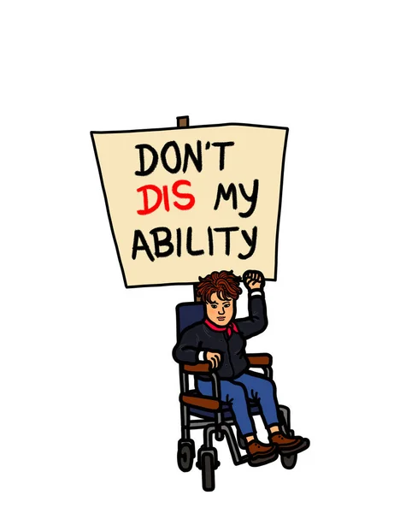
Dos and Don’ts
Dos
Practice in all contexts
Bring attention to ableist language when used
Respect individual preference for identity
Do your research
Don’ts
Treat disability as a dirty word
Get overwhelmed
Be afraid to make mistakes
Give up

Slide 19
Thank you!
Any questions?

