Slide 1
Easier Strategies for Finding and Evaluating Open Educational Resources (OER) with and without Generative AI
Anna Mills, College of Marin, ASCCC OERI English Discipline Lead, November 15, 2024

Slide 2
Academic Senate for California Community Colleges Open Education Resources Initiative Michelle Pilati, Faculty Lead
OER Liaisons on every campus
OER Discipline Leads make resource lists and host webinars
Resources at ASCCC-OERI.org

Slide 3
Agenda
What is OER (very briefly)?
Strategies for finding OER through search engines and OER sites
Using GenAI to help with search and evaluation
Slides, available for commenting: https://bit.ly/OERdiscovery

Slide 4
First, let’s define Open Educational Resources (OER)

Slide 5
What are Open Educational Resources?
Creative Commons defines OER as teaching, learning, and research materials that are either (a) in the public domain or (b) licensed in a manner that provides everyone with free and perpetual permission to engage in the 5R activities– retaining, remixing, revising, reusing and redistributing the resources.
-- Creative Commons

Slide 6
The 5R Permissions of OER
Make and own copies
Retain
Reuse
Use in a wide range of ways
Adapt, modify, and improve
Revise
Combine two or more
Remix
Share with others
Redistribute
The framework, freely available under a Creative Commons Attribution 4.0 license (CC BY), was designed by Lumen Learning as the 5Rs

Slide 7
How Do You Know if Something is OER and Not Just Free?
Look for Creative Commons licenses:

Slide 8
OER search sites and platforms

Slide 9
How do I quickly check for OER textbooks I might want to adopt?
Try the ASCCC-OERI page for your discipline. If you teach in California, look up the course you are teaching by Course ID (C-ID).
Faculty discipline leads curate these collections and update them every semester.

Slide 10
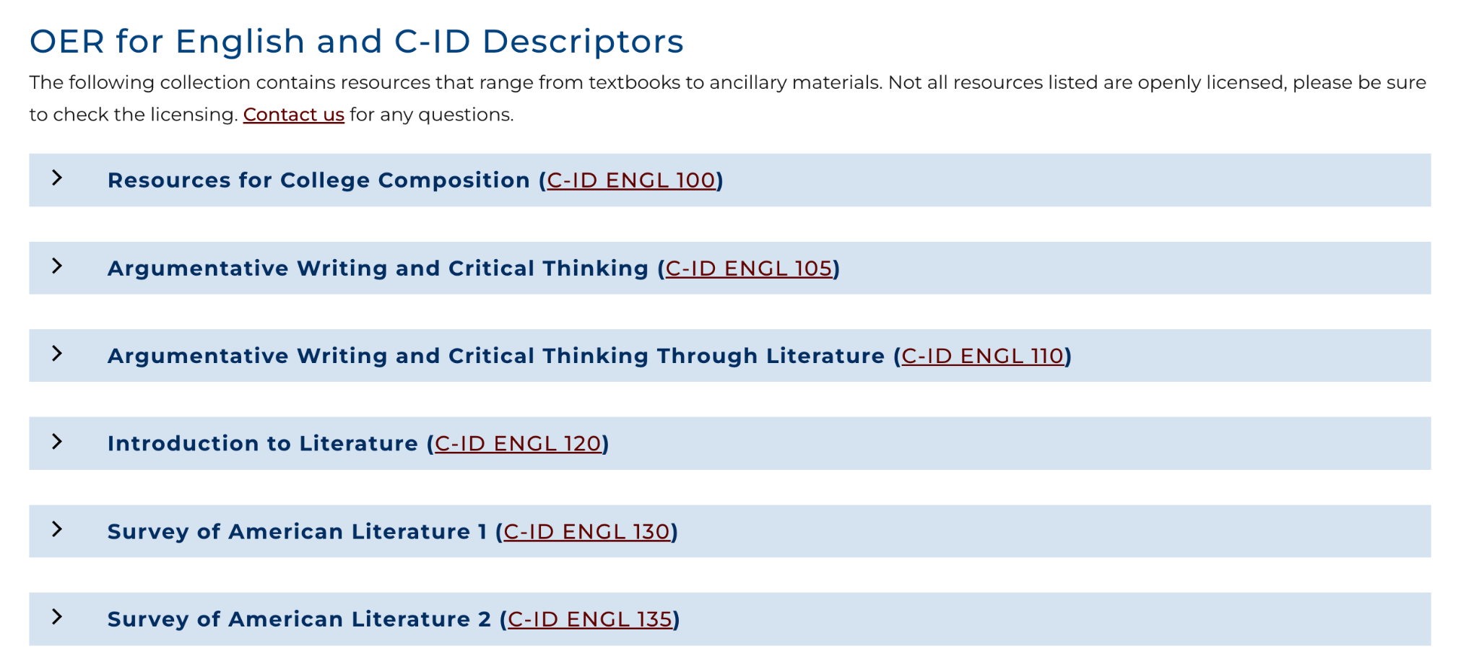
Each discipline has a page listing courses, and each course has a list of textbooks

Slide 11
But there are so many...
The list for English includes 45 OER textbooks relevant to one course, C-ID English 100.
How do we assess quality and pedagogical fit without losing our minds?

Slide 12
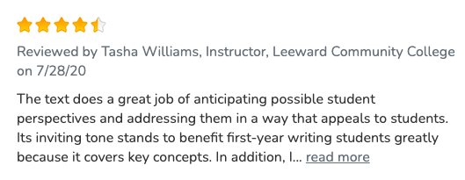
Open Textbook Library has the most substantive reviews

Slide 13
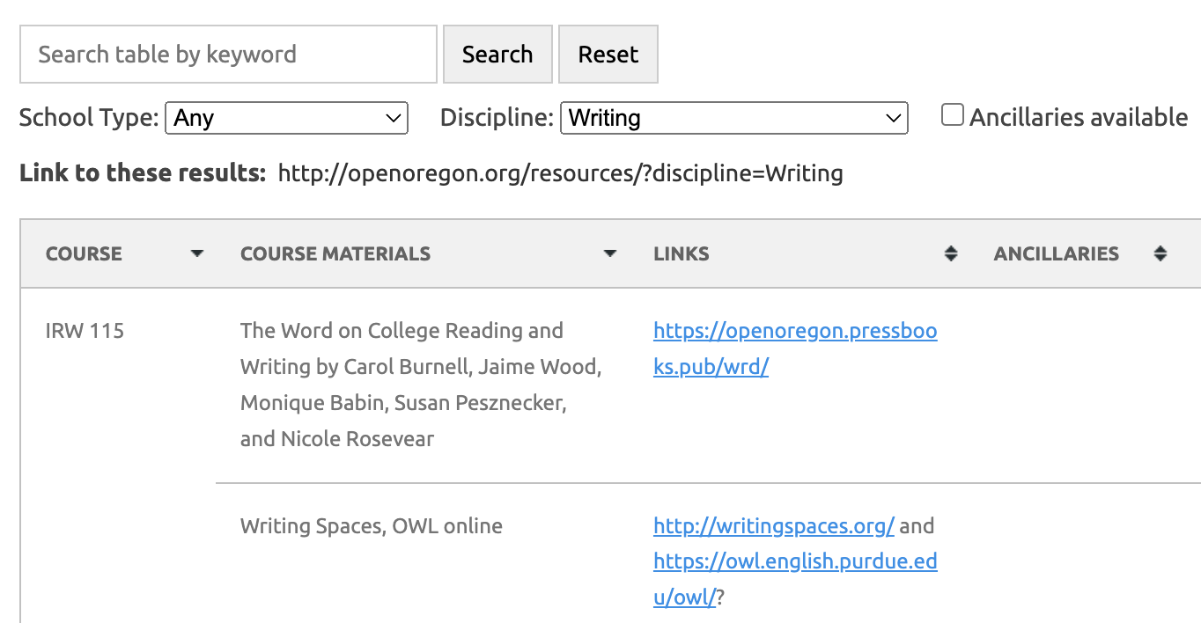
Look at which texts have been widely adopted
Open Oregon lists adoptions across Oregon. Search on a particular title to see if it has been adopted in Oregon.

Slide 14
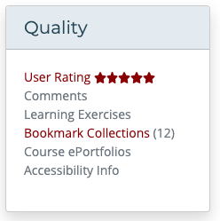
Look at instructor ratings and reviews on these sites
Open Textbook Library
MERLOT (also shows how many people have bookmarked a resource)
OER Commons
Cool4Ed

Slide 15
Subject Directories: Search in LibreTexts or Pressbooks
LibreTexts Commons search
Pressbooks Directory

Slide 16
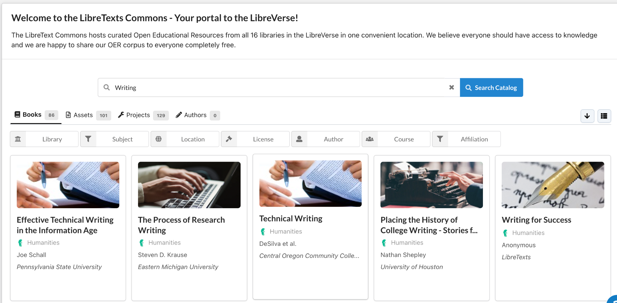
Screenshot from LibreTexts search

Slide 17
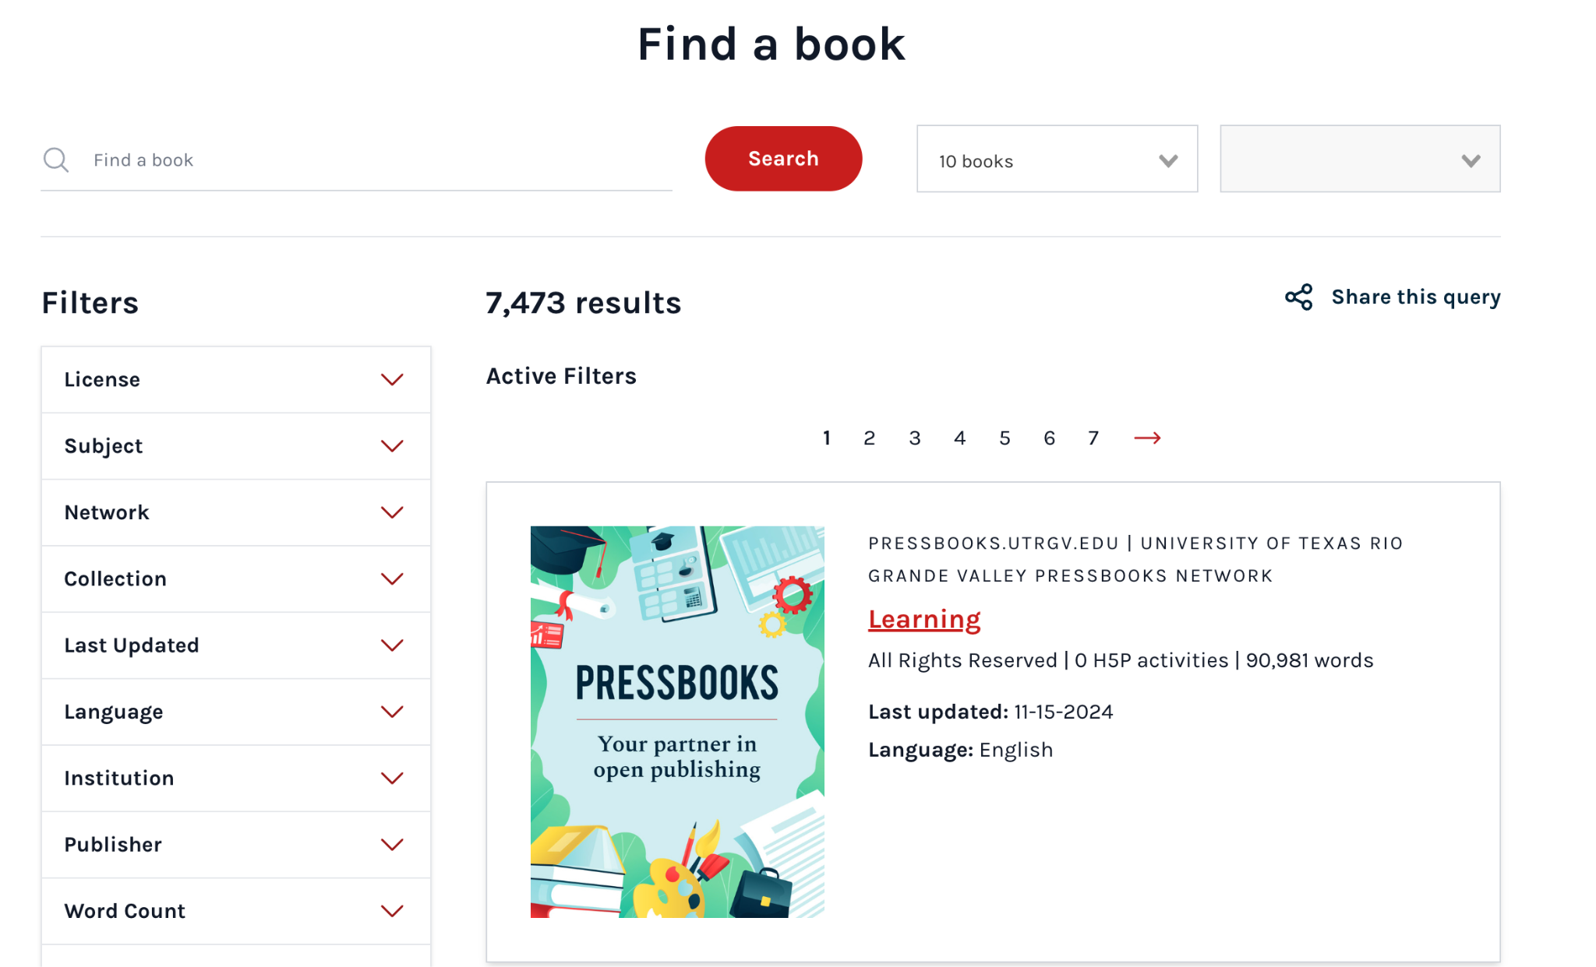
Pressbooks Homepage

Slide 18
Search in Canvas Commons
An OER textbook may be available along with ancillaries as a complete Learning Management System course that can imported or downloaded as a .imscc file.
Canvas Commons now allows us to search for OER/open-licensed content.
Enter Canvas Commons through your Canvas instance. If your institution does not use Canvas, you can create a free account at Canvas.instructure.com

Slide 19
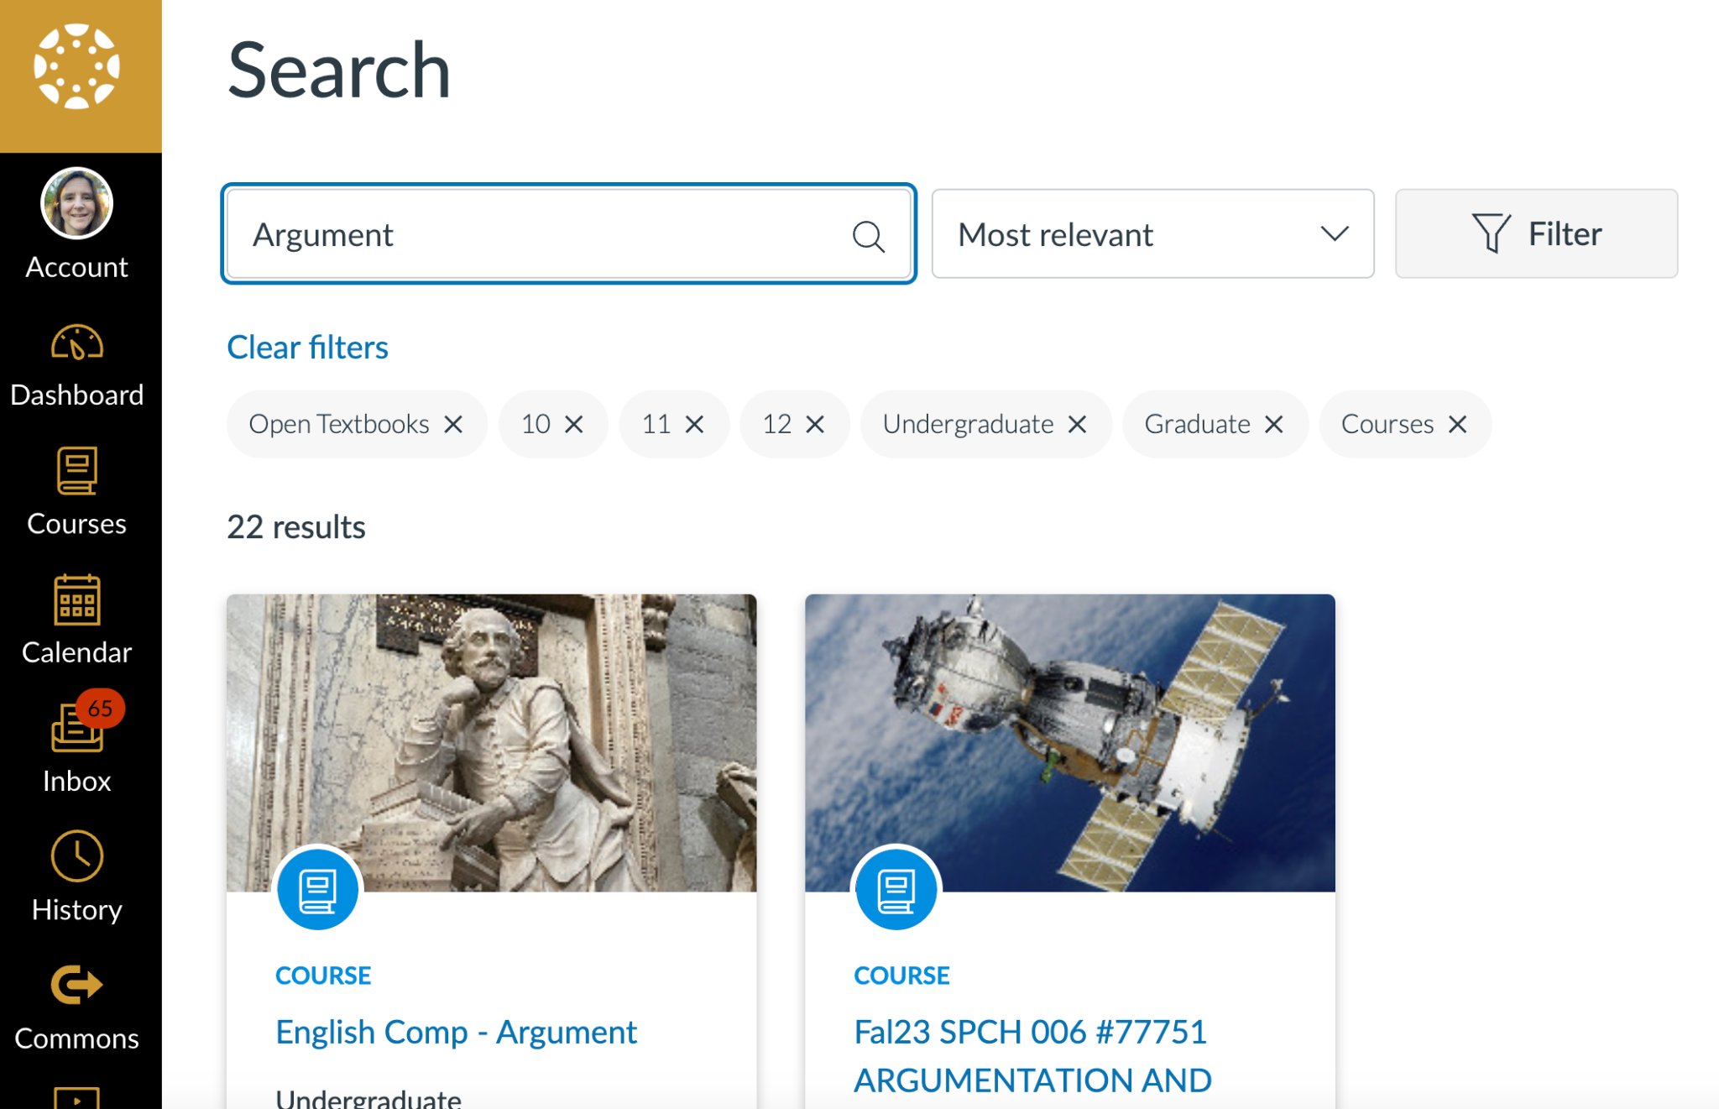
Canvas Search

Slide 20
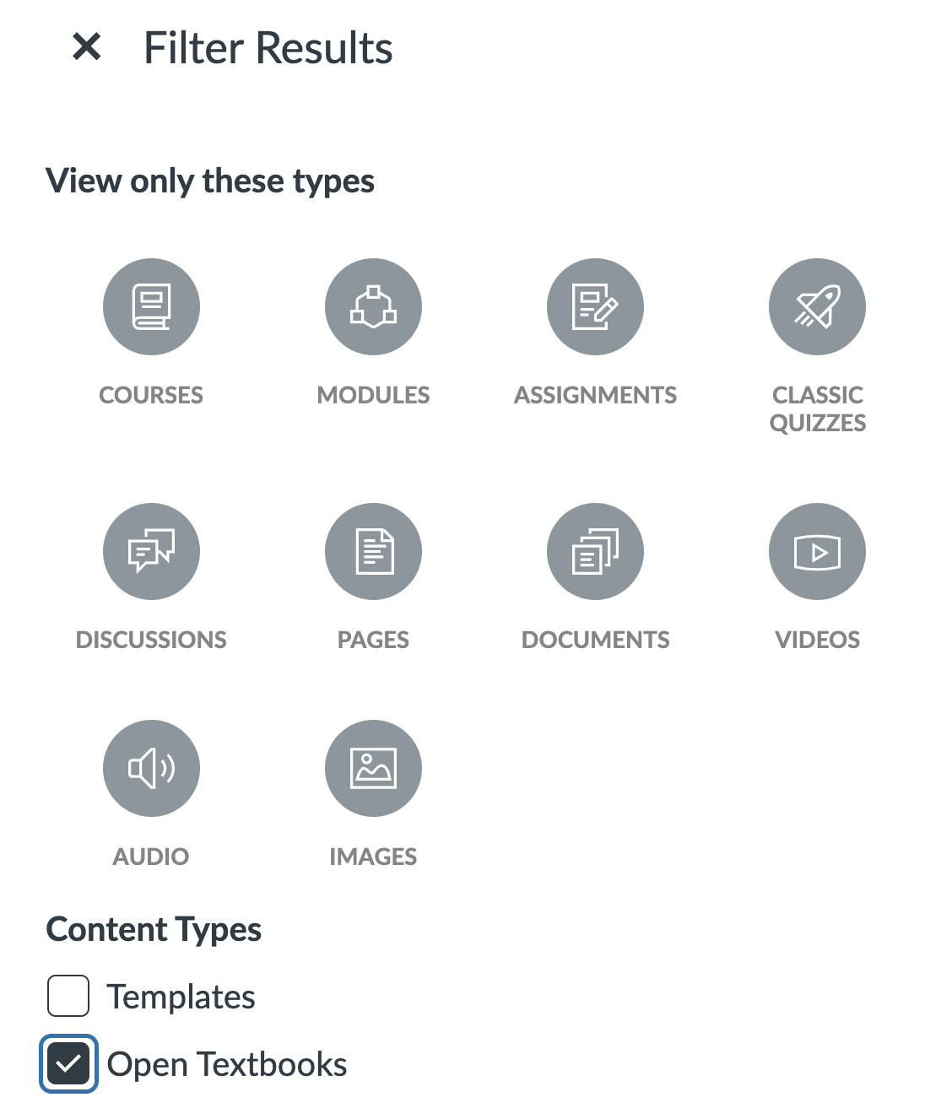
Choose “Courses” and “Open Textbooks” as filters

Slide 21
Okay, that a lot of ways to find OER. And what if I end up with too many options? What if I don’t have time to assess them?
It can be quite overwhelming to approach this task.
ASCCC OERI supports OER Liaisons at each college campus who can advise faculty one on one and help them with the search process for this reason.
Many colleges also publish library guides to OER by discipline for this reason.
My sense as an OER textbook author and English Discipline Lead and as someone who writes and thinks a lot about AI is that generative AI can help with OER as well, and I want to share my explorations of how we might approach this.

Slide 22
Using GenAI to help us find and evaluate OER textbooks: Early explorations

Slide 23
AI doesn’t just “hallucinate” sources these days. It can (imperfectly) help us work with real sources.
Many AI systems now combine text generation with Internet search. This includes ChatGPT Plus, Google’s Gemini, Microsoft Copilot, and Perplexity.
Most chatbots allow us to upload files, such as PDFs of textbooks or a spreadsheet of search results. The chat session can then discuss the attached data.

Slide 24
Here is your eager beaver assistant who is often and unpredictably wrong
When genAI analyzes real sources, it’s still not always accurate. It may misrepresent a source, in obvious or subtle ways.
What we have is something on the level of an ever-ready, hardworking assistant with mediocre judgment.

Slide 25
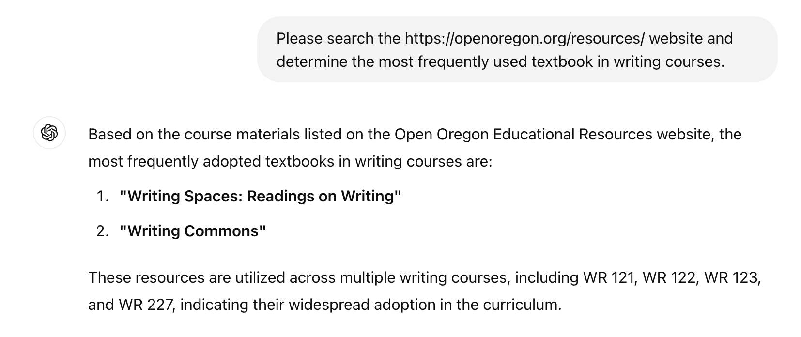
Sample chat where ChatGPT provides misinformation (actually, Writing Commons is used 3 times and Writing Spaces is used 6 times. Others are used more, like About Writing (13 times)

Slide 26
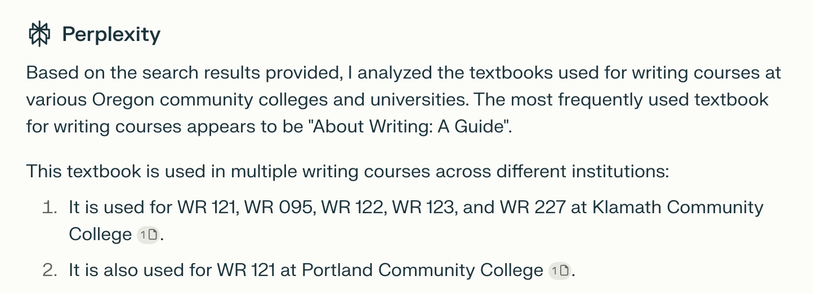
Perplexity identified About Writing as the most popular in response to the same query, but it doesn’t mention The Word on College Reading and Writing (used 9 times)

Slide 27
So if GenAI is not reliable, when might we turn to it, and how might it help?
It might make sense when we need to lower the cognitive load and just ask for help to get ideas or find a starting place.
Interacting with it may help us articulate what we’re looking for.
This is only advisable in situations where we can check pretty quickly if it’s right.

Slide 28
How might we use GenAI in OER search?
It expands the ways we can ask for information: We can try expressing what we are looking for more specifically, without optimizing keywords.
It expands the kinds of results we can get: not just a list of textbooks and their characteristics but rather more tailored analysis. We can use GenAI to summarize, ask questions about or “chat with” OER textbooks we are considering.

Slide 29
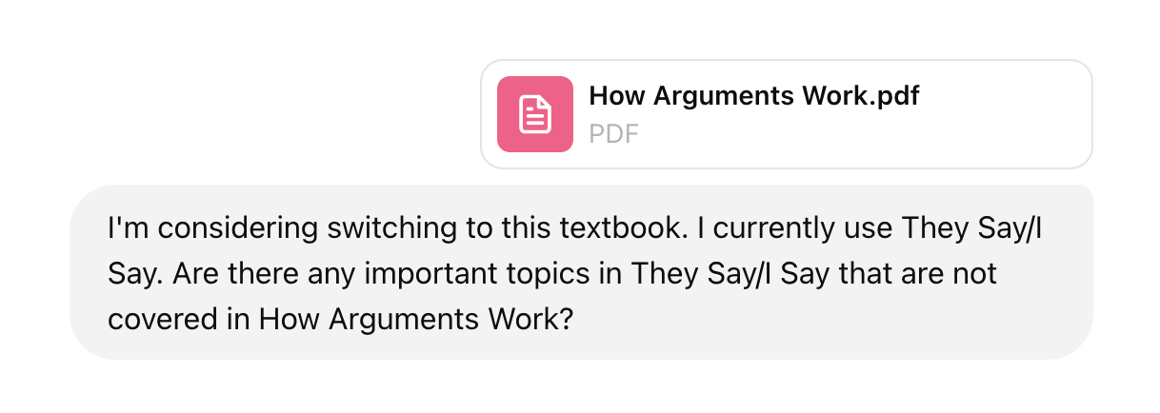
Ask for OER texts comparable to a particular commercial textbook (sample chat). Consider sharing the TOC of the commercial textbook from the publisher’s website.

Slide 30
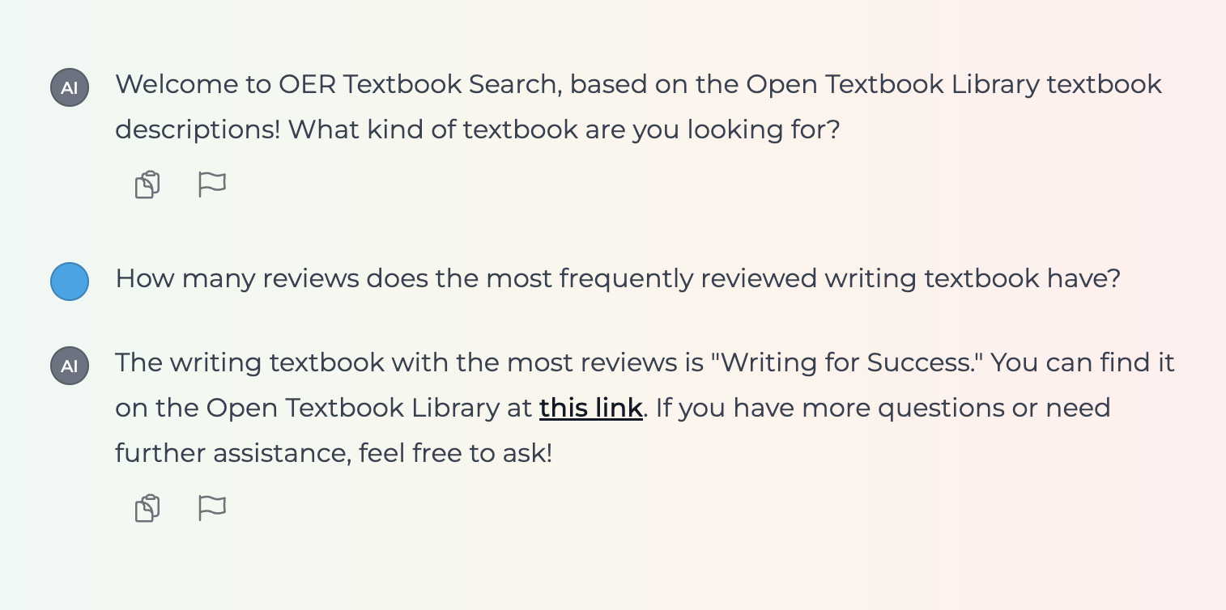
Ratings and reviews: ask questions but check the answers. If a bot says it can’t do something, try again… sometimes it’ll do it the next time or in a new chat session.

Slide 31
Searching for textbooks with particular characteristics
We have the option when we search these days to just explain what we are looking for in some detail in a conversational way rather than through keywords.
Again, don’t trust the result. In one case, I asked which book had information on how to write about literature, and it gave me a wrong answer, pointing to a literature anthology that didn’t have that content.
On the other hand, when I search for “literature diverse” without genAI assistance, I don’t get results that helped me tell anything about why the sites returned are on the list.

Slide 32
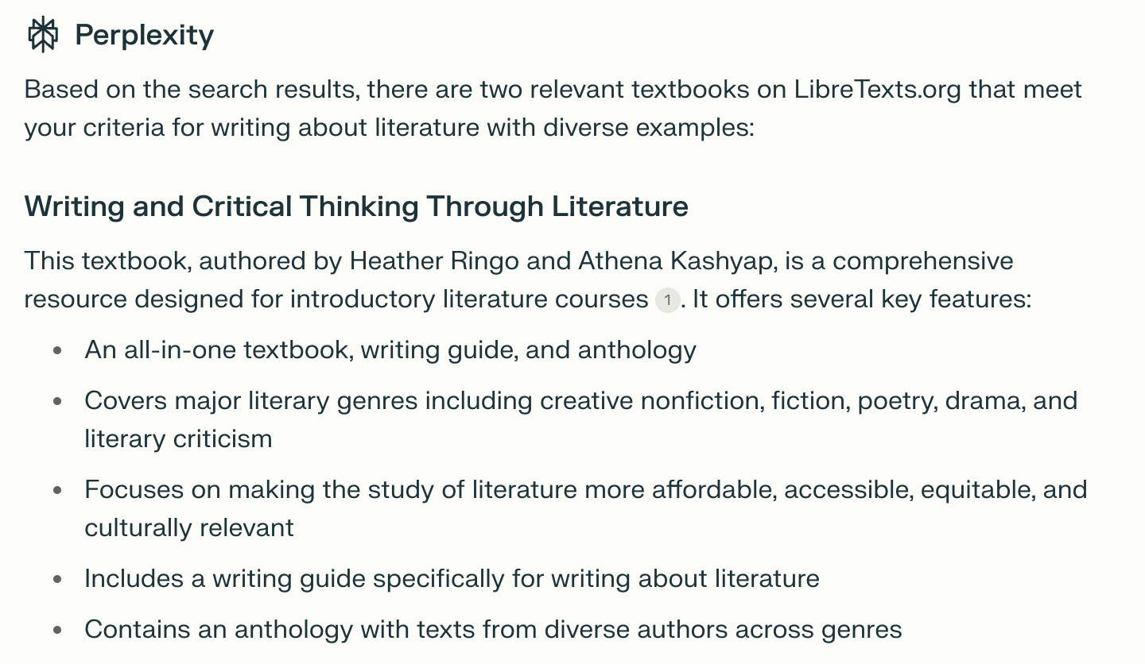
Prompt: “I'm looking for a textbook on LibreTexts.org that describes how to write about literature and includes examples from diverse authors.” (Google might work for this too)

Slide 33
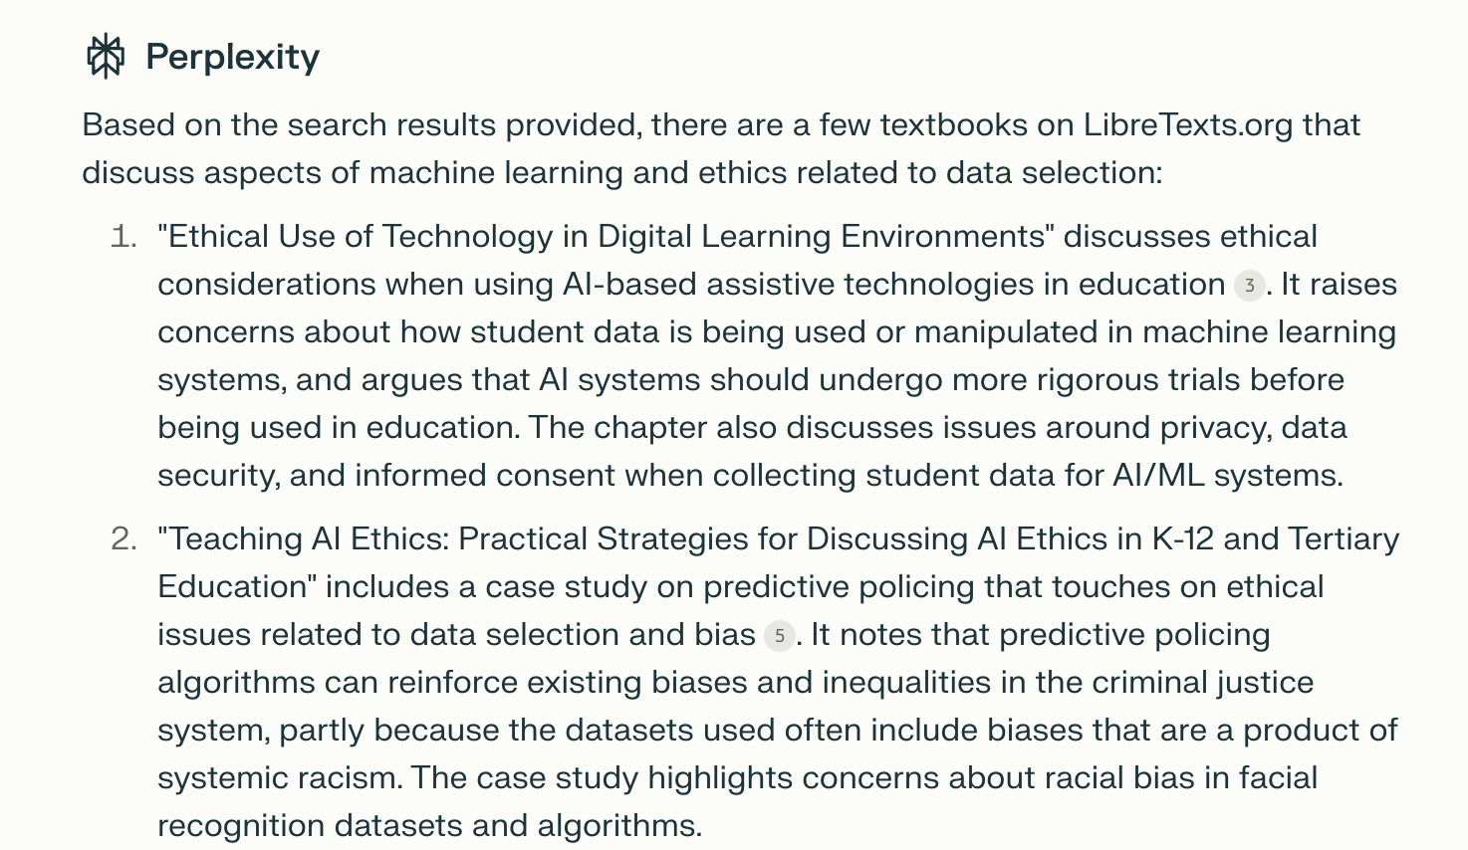
For example, here I asked Perplexity “Please search textbooks about machine learning on LibreTexts.org and tell me which discuss the ethics of data selection.”

Slide 34
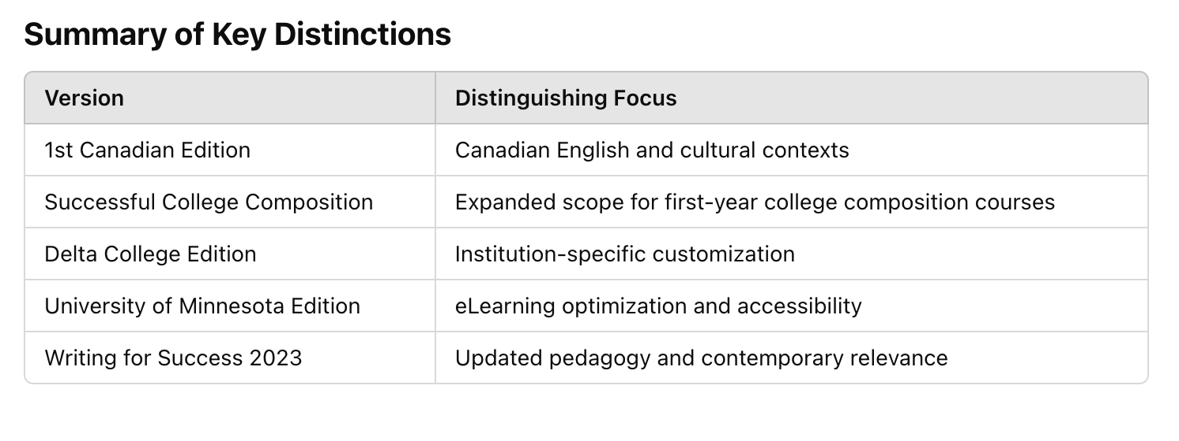
Differences between versions and adaptations of the same original OER textbook
“Writing for Success is a very popular OER textbook that has been adapted into various other versions. Could you find a complete list of published adaptations?” See the chat session transcript, where ChatGPT offers the table below as well as more detailed comparisons.

Slide 35
NotebookLM homepage

Slide 36
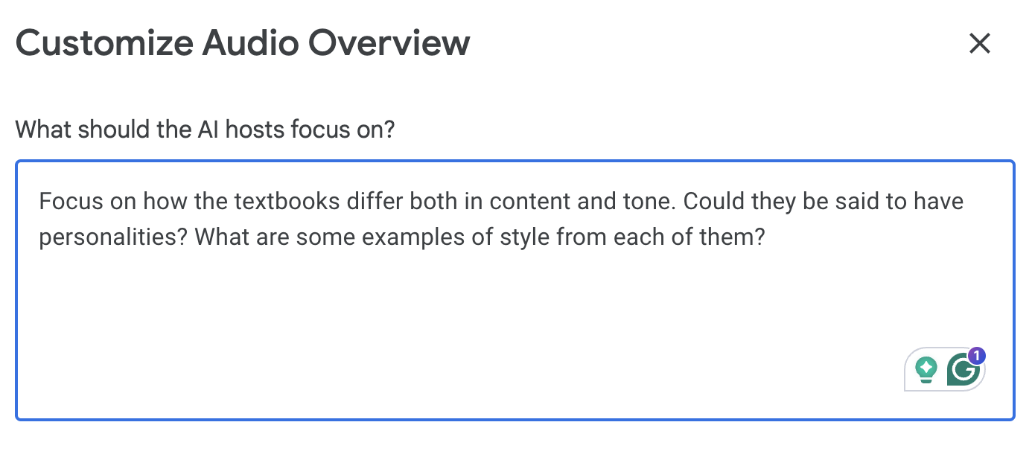
NotebookLM lets you specify what kind of on-demand podcast you’d like, discussing which questions in relation to which texts

Slide 37
Sample AI-generated podcast discussion comparing two OER textbooks
When I asked for a podcast comparing How Arguments Work and About Writing, I found the faux enthusiasm and interest of the AI hosts engaging (to an extent) and there were some interesting points made.

Slide 38
Playlab AI

Slide 39
Let’s test: Ask about a type of educational resource you’d like to find. Try at least one AI-assisted and one not AI-assisted approach. Share results in the chat.
LibreTexts Commons
The Open Textbook Library
OER Commons or Merlot
Anna’s PlayLab OER Search Assistant bot based on the Open Textbook Library
Perplexity.ai or Google (with AI overviews)
ChatGPT or Claude or Gemini or NotebookLM
Notes:
https://docs.google.com/presentation/d/1xU9ncbAIZwVV8t2pxLNiRxqVQxVkADeMbV4scq60YxY/edit#slide=id.g314edeeb75a_0_46

Slide 40
Risks of AI OER search assistance
AI research assistance may create an illusion of access and understanding of OER textbook options.
Maybe we aren’t seeing the textbooks we might find most valuable.
Maybe AI isn’t representing textbooks accurately.
Questions I ask myself:
Am I using AI for something I could do as quickly with search and my own reading?
If something seems plausible or probably right, how important is it that I check?

Slide 41
Please post in the chat: What works well for you and what more do you want to try when it comes to OER textbook search and evaluation?

Slide 42
Questions? Suggestions?
Anna Mills, College of Marin
ASCCC OERI English Discipline Lead
Slides: https://bit.ly/OERdiscovery
armills@marin.edu
This work is licensed under a Creative Commons Attribution-NonCommercial 4.0 International License.

