Slide 1
Unveiling Tarea Libre 2:
A New Open Educational Resource (OER) Homework Ancillary for Intermediate and Advanced Spanish
Hugo Díaz-Rodil, Sierra College and American River College
Alejandro Lee, Santa Monica College
Cristina Moon, Chabot College
OERI - 22 November 2024
“Unveiling Tarea Libre 2: A New Open Educational Resource (OER) Homework Ancillary for Intermediate and Advanced Spanish” is licensed CC-BY 4.0 by Prof. Hugo Díaz-Rodil, Dr. Sarah Harmon, Dr. Alejandro Lee, and Dr. Cristina Moon.
Notes:
CM (1-2); HDR (3-9); AL (10-15); CM (16-

Slide 2
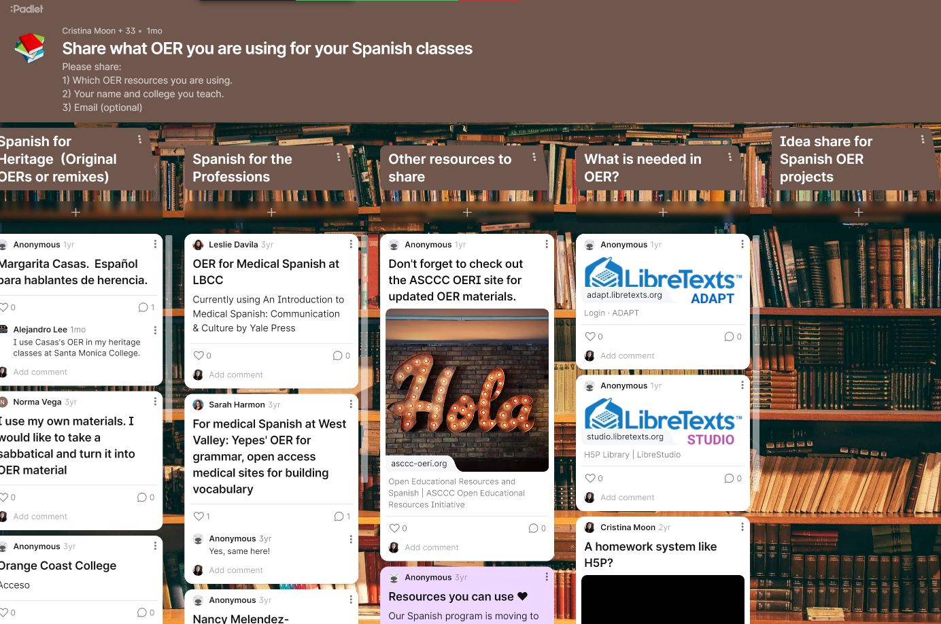
Conversation Starters!
Are you using OER?
Please share what you are using in our Padlet
Notes:
https://padlet.com/cmoon45/share-what-oer-you-are-using-for-your-spanish-classes-6aviwjzz3fwdilck

Slide 3
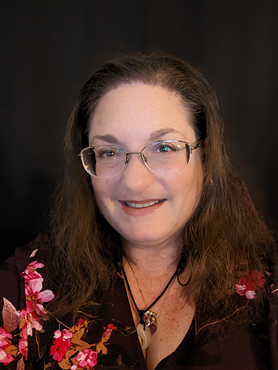
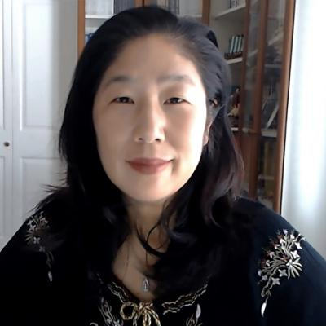
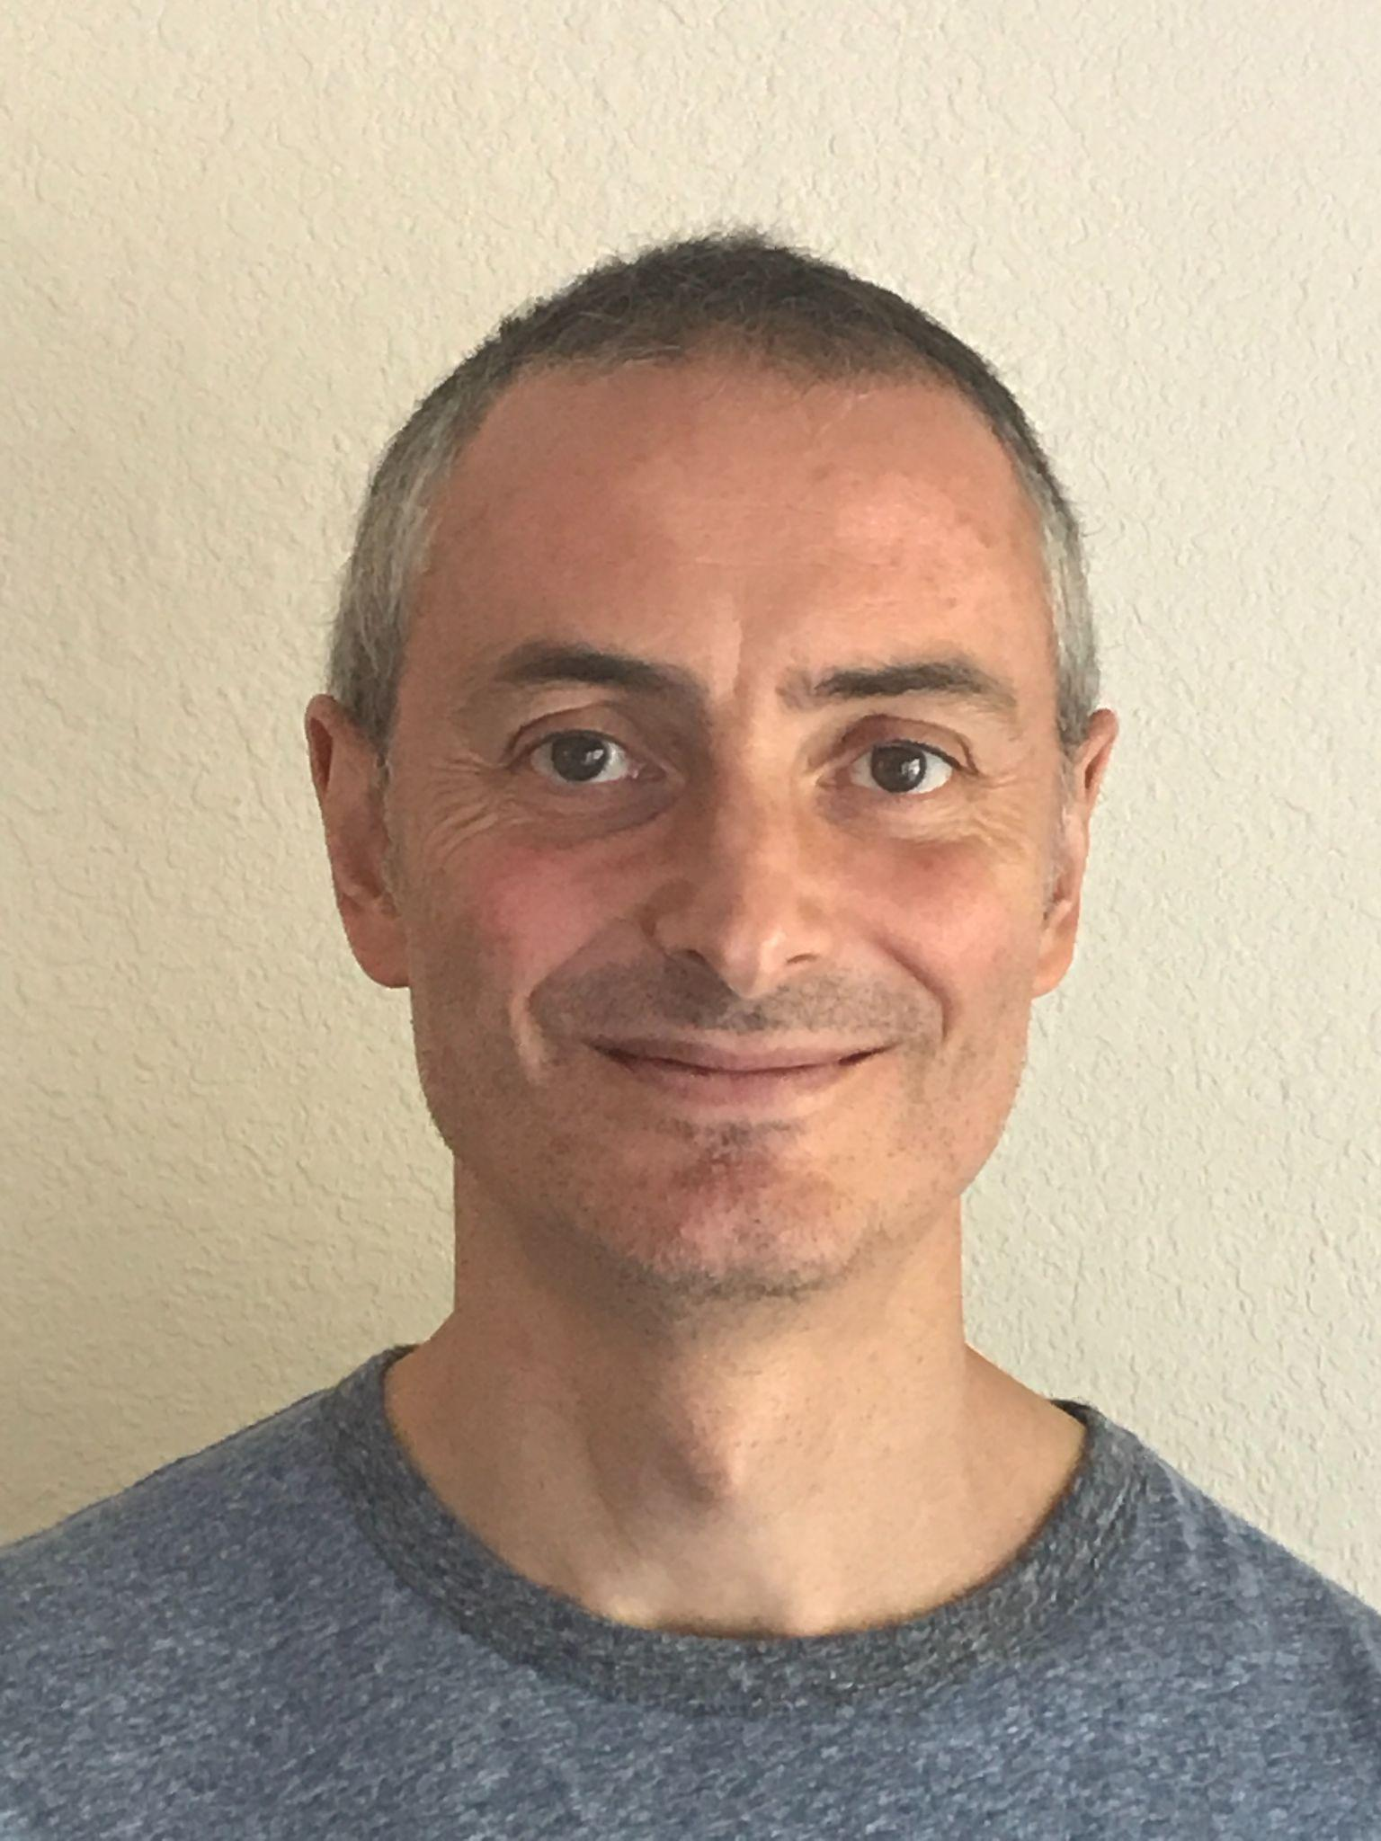
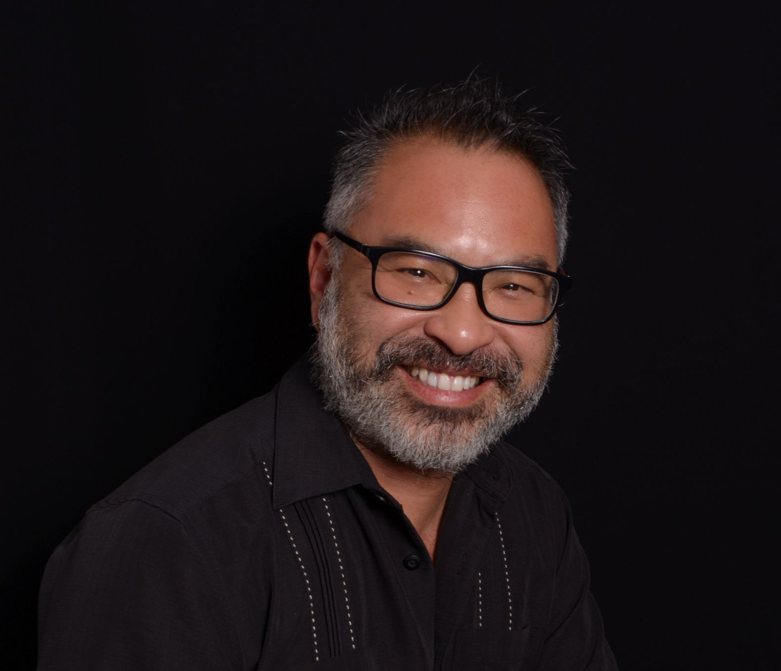
Meet the Team
Cristina Moon, Ph.D.
Sarah Harmon, Ph.D.
Professor of Spanish OER/ZTC Coordinator Chabot College
Adjunct Professor of Spanish and Linguistics OER/ZTC Coordinator Cañada College
Alejandro Lee, Ph.D., MLIS
Hugo Díaz-Rodil, MA
Professor of Spanish Santa Monica College
Instructor of Spanish at Sierra College and American River College
Notes:
1

Slide 4
The OER Journey
We began our OER journey in 2020 with the launch of our first OER Spanish grammar manual, Entrada Libre, to complement Acceso from U of Kansas.
We soon realized that lack of comprehensive and accessible OER homework was a roadblock to switching away from publisher materials, especially HW platforms such as MindTap, Connect, VHL Supersite, and MyLab.
In 2023, we released our second project, Tarea Libre, a homework collection of 1,400 activities for first-year Spanish courses.
In 2024, we continue with our third project, Tarea Libre 2, homework for second-year Spanish courses.

Slide 5
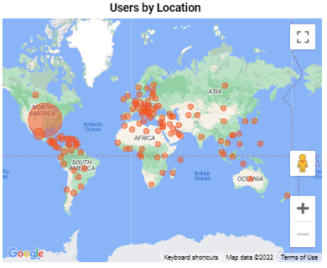
The Impacts of our First Two Projects
Entrada Libre
Tarea Libre
Web traffic exceeds 400,000 pageviews from 2020 and growing steadily.
833 days of confirmed student reading (likely more that cannot be tracked).
Numerous text remixes hosted on the LibreTexts Humanities library contain parts of Entrada Libre.
Through Spring 2024:
One-third (⅓) of the 500 active or past active courses on the platform were using Tarea Libre questions.
5,000 students and approximately 800,000 submitted answers.
Tarea Libre is the most active OER collection on the ADAPT homework system.

Slide 6
Tarea Libre 2
Homework set for Second-Year (collegiate) Spanish courses
Licensed as CC-BY-NC 4.0 (open license)
Written in accordance with California C-ID Transfer Model Curriculum for SPAN 200 and SPAN 210
Funding from LibreTexts and the CA ZTC Acceleration grants received for Chabot College and Santa Monica College
Technical support from LibreTexts, particularly with new technologies
Written Spring 2024-Fall 2024 terms
Media: either self-created or openly-licensed

Slide 7
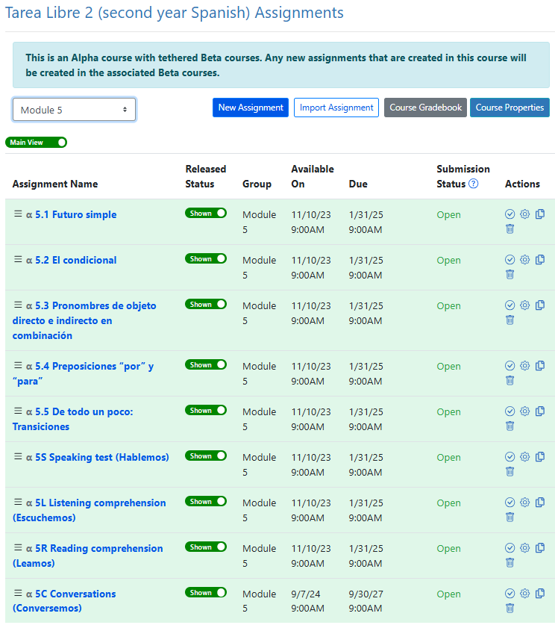
Tarea Libre 2 Modules
800 activities
8 modules (4 modules per semester) connected to Acceso
4-5 grammar sections per module
5 ‘pasos’ of grammar exercises per section
Empecemos
Continuemos
Practiquemos
Avancemos
De todo un poco
4 comprehensive assessments per module
Hablemos
Escuchemos
Leamos
Conversemos (new)

Slide 8
Grammar Content
1.1 Repaso: Números (ordinales, cardinales, romanos) 1.2 Comparativos y superlativos 1.3 Presente del indicativo 1.4 Ser y estar, presente progresivo 1.5 Usos del infinitivo y del gerundio 1.6 De todo un poco: Reglas de acentuación | 5.1 Futuro simple 5.2 Condicional 5.3 Pronombres de objeto directo e indirecto en combinación 5.4 Preposiciones “por” y “para” 5.5 De todo un poco: Transiciones y conectores, verbos con preposición
2.1 El imperfecto 2.2 El pretérito 2.3 Pretérito vs. imperfecto 2.4 Verbos como gustar 2.5 De todo un poco: Reglas de puntuación | 6.1 Cláusulas con “si” en situaciones reales 6.2 Imperfecto del subjuntivo 6.3 Cláusulas con “si” en situaciones hipotéticas 6.4 Mandatos formales e informales 6.5 De todo un poco: Más ortografía (J/G, C/K, LL/Y/I)
3.1 El presente del subjuntivo y sus usos 3.2 El subjuntivo con cláusulas adjetivales 3.3 El subjuntivo con cláusulas adverbiales 3.4 Pronombres relativos 3.5 De todo un poco: Reglas de los usos las mayúsculas/minúsculas, Ortografía (C/S/Z, B/V, H) | 7.1 Ser y estar 7.2 Pretérito perfecto del indicativo y pretérito perfecto del subjuntivo (futuro perfecto, secuencia de tiempo) 7.3 Pluscuamperfecto 7.4 Tiempos perfectos en situaciones hipotéticas 7.5 De todo un poco: Diferencias culturales
4.1 Pronombres de objeto directo 4.2 Pronombres de objeto indirecto 4.3 Pretérito perfecto del indicativo/ pretérito perfecto del subjuntivo 4.4 De todo un poco: Falsos cognados I, Participios adjetivales | 8.1 Pretérito vs. imperfecto 8.2 Usos impersonales de “hacer” 8.3 La voz pasiva 8.4 Usos comunes de “se” 8.5 De todo un poco: Falsos cognados II

Slide 9
New section in TL2:
De todo un poco
Module | Topics
Module 1 | Reglas de acentuación: Énfasis silábico, palabras bitónicas/tritónicas, división silábica, acentos diacríticos
Module 2 | Reglas de puntuación
Module 3 | Minúsculas/mayúsculas, ortografía (c/ s/ z, b/v, h)
Module 4 | Cognados falsos I, participios adjetivales
Module 5 | Transiciones y conectores, verbos con preposición
Module 6 | Ortografía (j/g, c/k, ll/y/l), mandatos informales, con vos/vosotros
Module 7 | Diferencias culturales, lingüísticas, léxicas, dialectales
Module 8 | Cognados falsos II (verbos)

Slide 10
Readings from Tarea Libre 2
The cultural readings follow Acceso’s thematic modules and explore other topics of interest.
1A Censo 2020
1B Las aventuras del chef José Andrés y sus hijas
2A Albert Espinosa
2B Ventajas e inconvenientes de vivir en España
3A Ponce de León
3B El son cubano y la Buena Vista Social Club
4A Tacos al pastor y la influencia levantina en México
4B Una nueva ola de inmigrantes: los coreanos en México
5A Los garífunas de América Central
5B Proyecto de desarrollo sostenible en la Moskitia
6A La lucha por la preservación: Los ngäbe-buglé de Panamá
6B Descubrimientos arqueológicos en el Caribe continental
7A El artista peruano Félix Espinosa
7B Nuevos descubrimientos en la selva amazónica en Ecuador
8A ¿Qué es el lunfardo?
8B El rongo rongo de Rapa Nui
8C El mapudungun, la lengua del pueblo mapuche

Slide 11
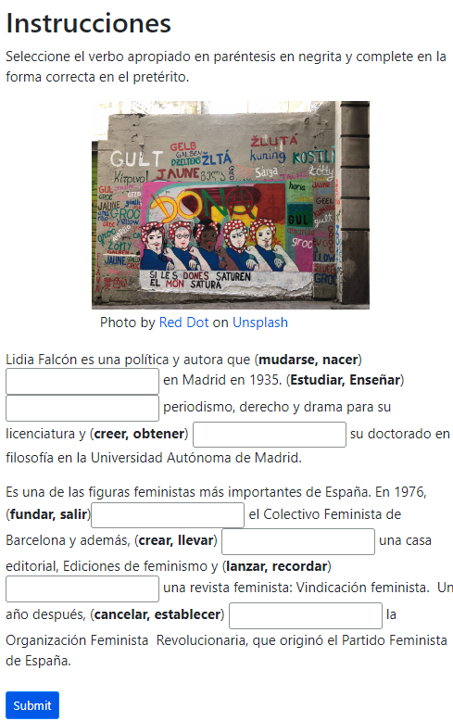
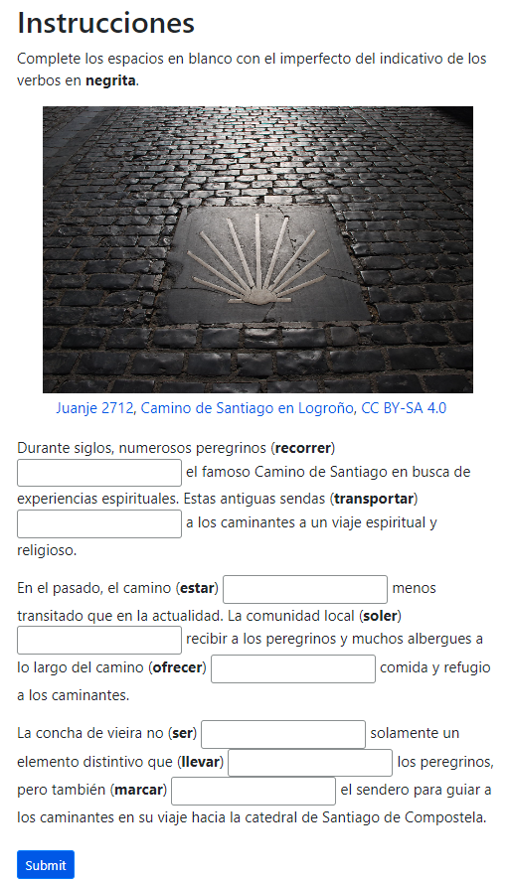
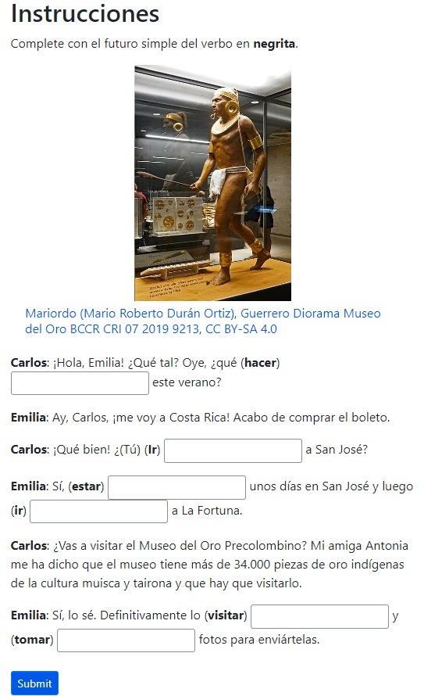
Connections to Acceso
For Tarea Libre 2, we paralleled our modules with the 8 thematic modules in Acceso.

Slide 12
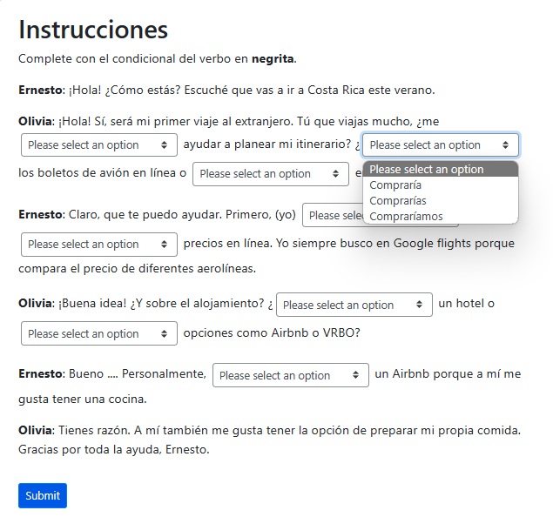
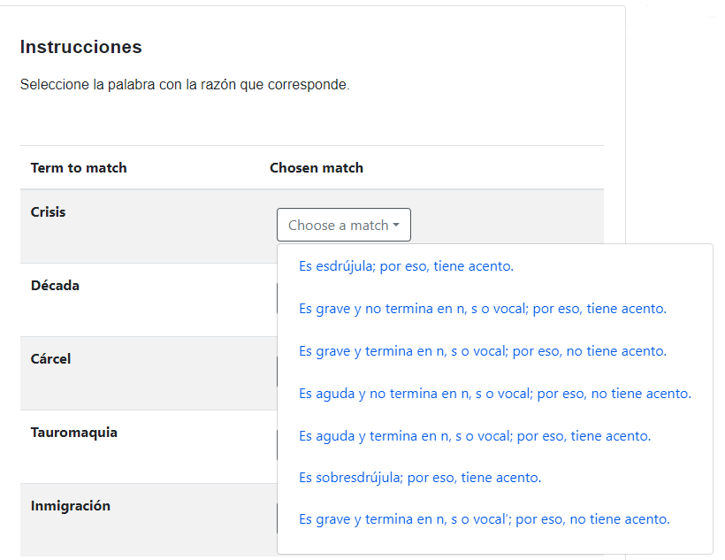
Tarea Libre 2 ADAPT Native Questions
ADAPT auto-graded native questions: fill in the blank, multiple choice, select choice, matching, highlight text
Select choice
Matching
Highlight Text
Notes:
Nancy

Slide 13
Cloning ADAPT native questions
Instructors can easily customize by copying (“cloning”) any ADAPT native question.

Slide 14
Accessibility in ADAPT
More accessible question types that are generally accessible, including matching, highlighting text (mark the word/text) and select choice (drop-down menu)
Note: Make sure to use UDL best practices when drafting
Easier to create alternative pathways (A11y)
Easier to clone, modify and share activities
Better insertion of audio and video media that integrates with the page (especially for those using adaptive technology)
Auto closed-captioning and transcription of audio and video recordings
Quicker response by ADAPT personnel to address issues and create solutions

Slide 15
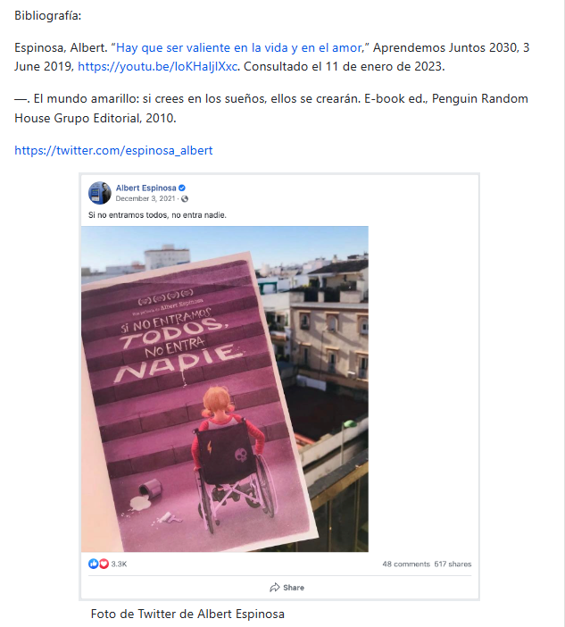
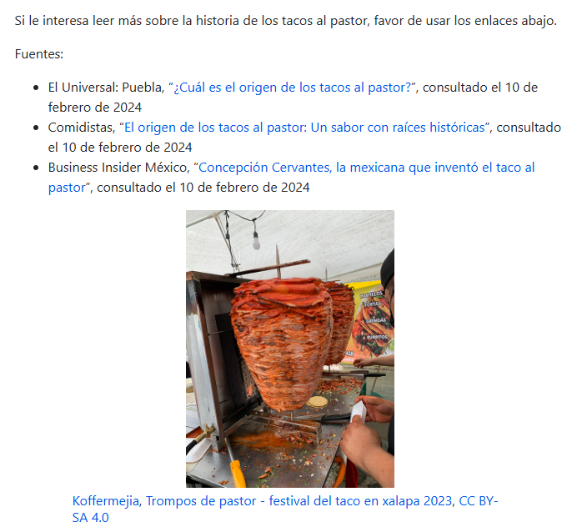
Cultural Diversity and Accessibility in Content
ASCCC OERI IDEA Framework (2022)
Culturally responsive education

Slide 16
Oral Assessments in
ADAPT Native Questions
Individual oral assessment
For non-auto graded activities, instructors can choose the type of student submission such as an oral recording.
Group oral activity
For the new Discuss-It question type, instructors can create threaded discussions of text, audio, or video student submissions.

Slide 17
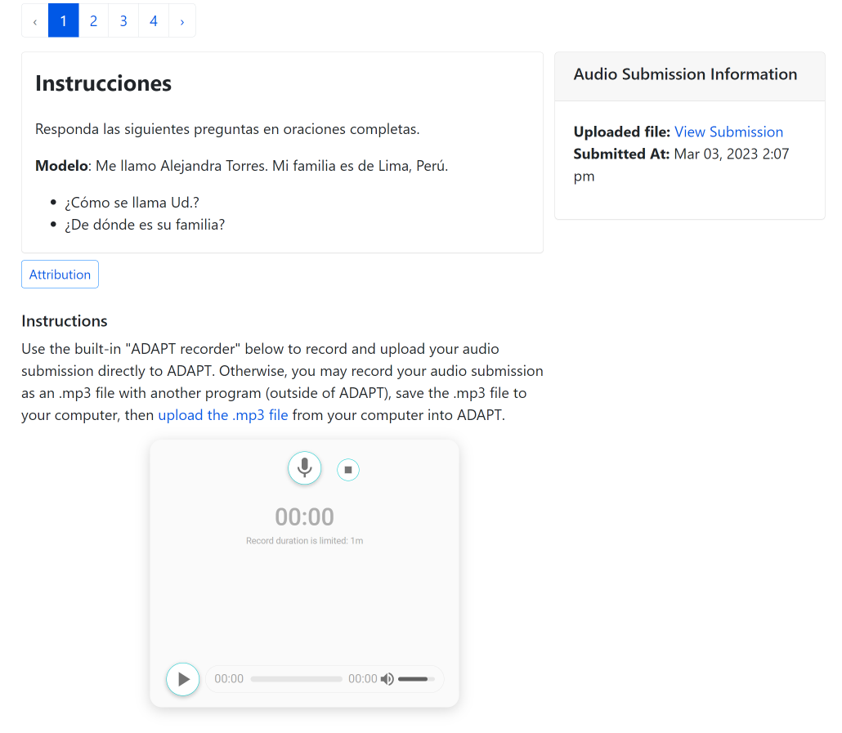
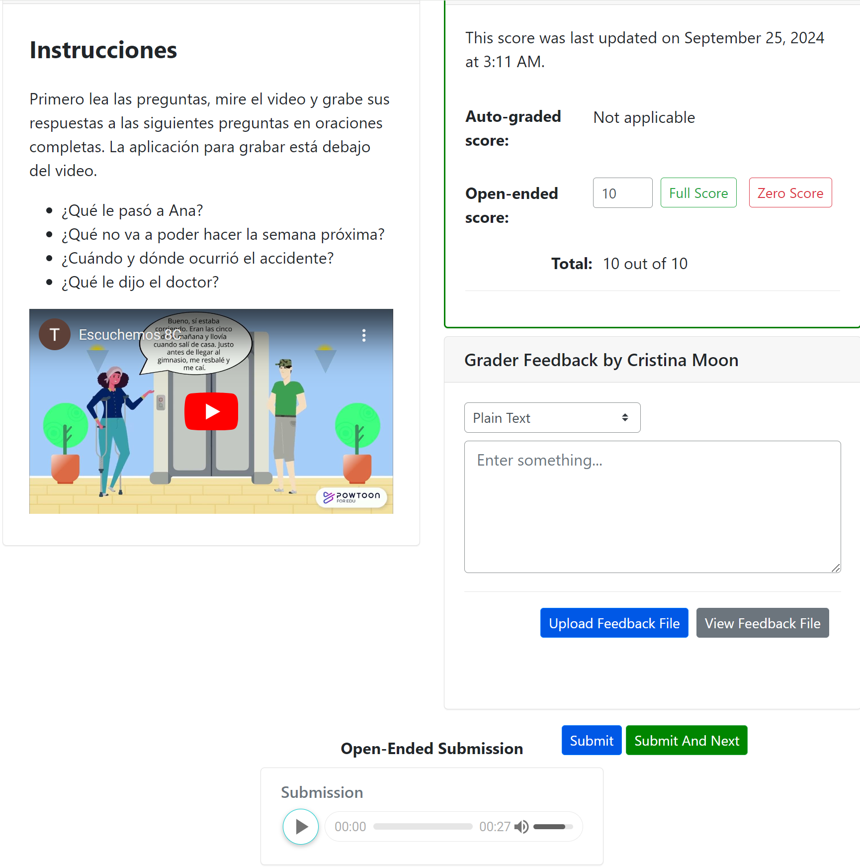
Audio Recording: Hablemos and Escuchemos
Non-auto-graded activities to assess oral and listening skills
Students record their responses using the recorder tool in the ADAPT assignment.
Instructors listen, grade, and provide feedback all in the same page.
Following Tarea Libre, TL2 include the Hablemos and Escuchemos sections based on topics presented on Acceso modules.

Slide 18
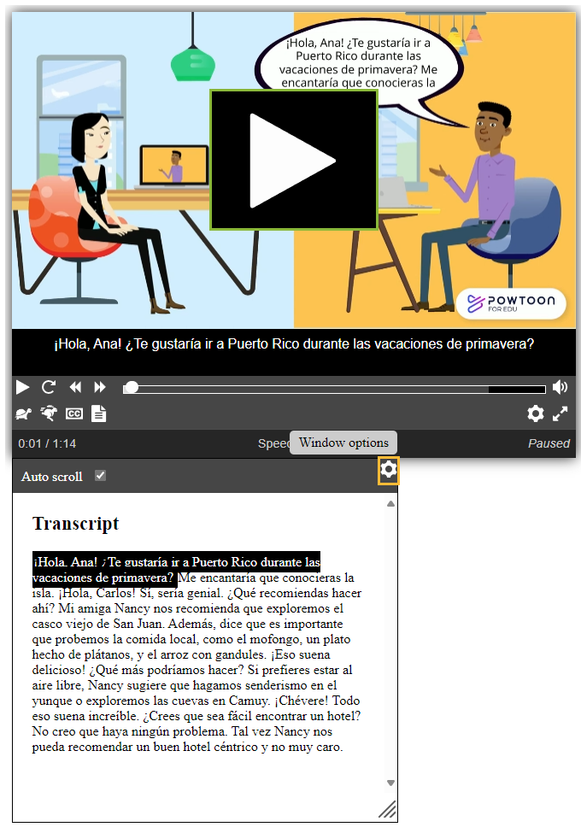
Auto-Captioning and Auto-Transcription
All media integrated into ADAPT is automatically captioned and transcribed with very high fidelity rates
Currently available for many languages (including English, Spanish, French, Mandarin, Japanese, German, Portuguese, Hindi)

Slide 19
Conversemos
TL2 team worked with LibreTexts to develop Discuss-It question type
Similar to a discussion board with audio, video and/or text inputs
Fosters the collaborative and student-to-student interaction that you can find with platforms such as Voicethread and Flip.
Addresses regular and substantive interaction requirements
TL2 used Discuss-It to create a new summative assessment: Conversemos.

Slide 20
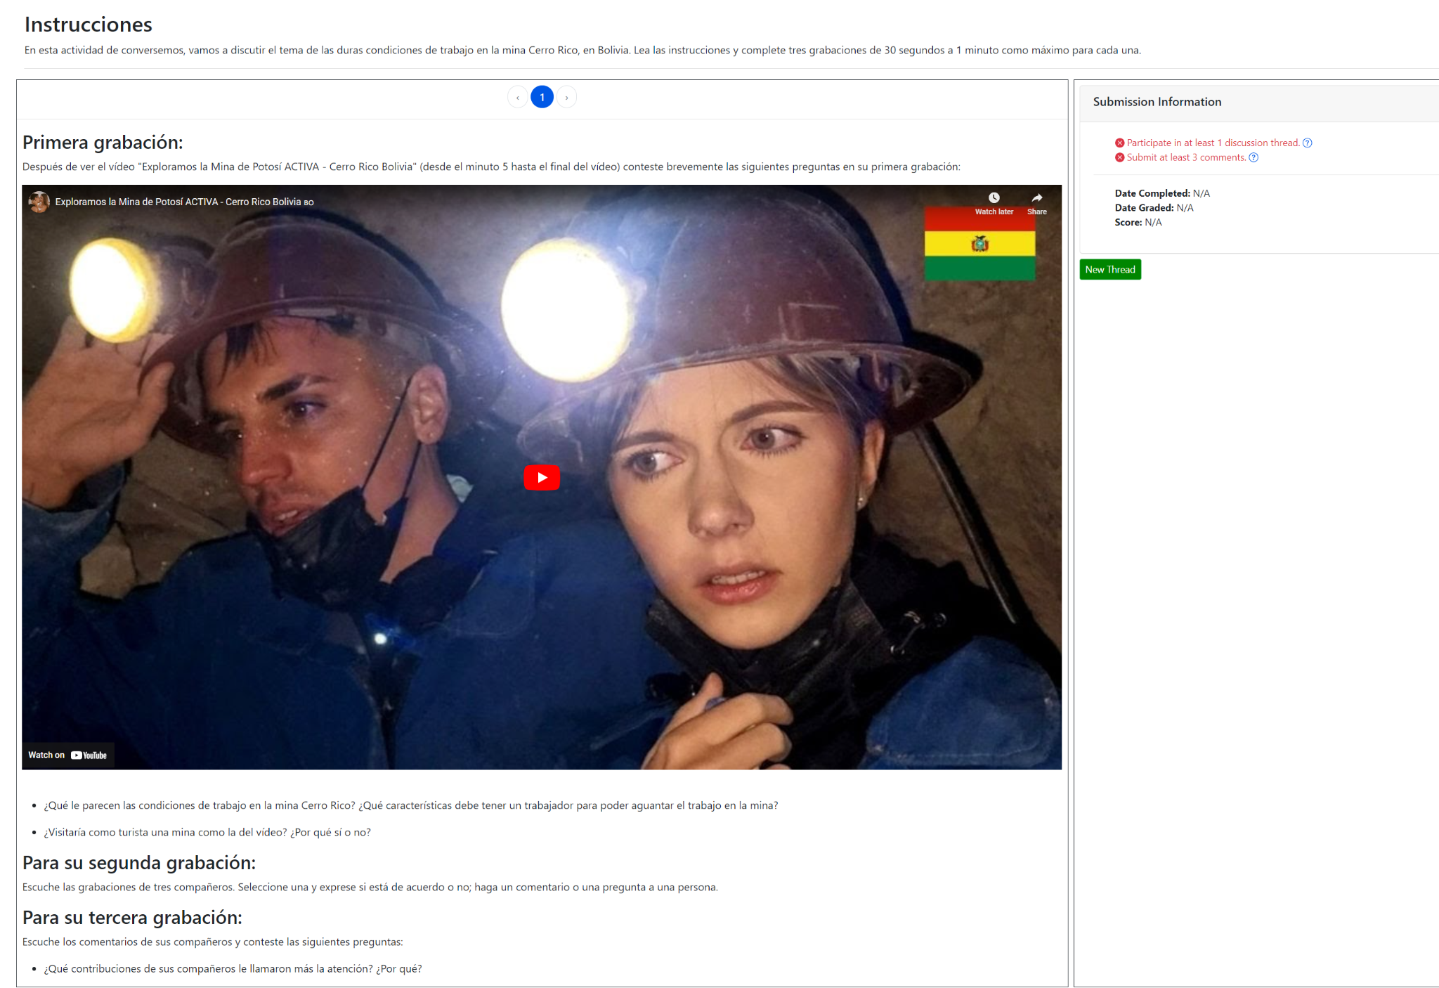
New for TL2: Conversemos

Slide 21
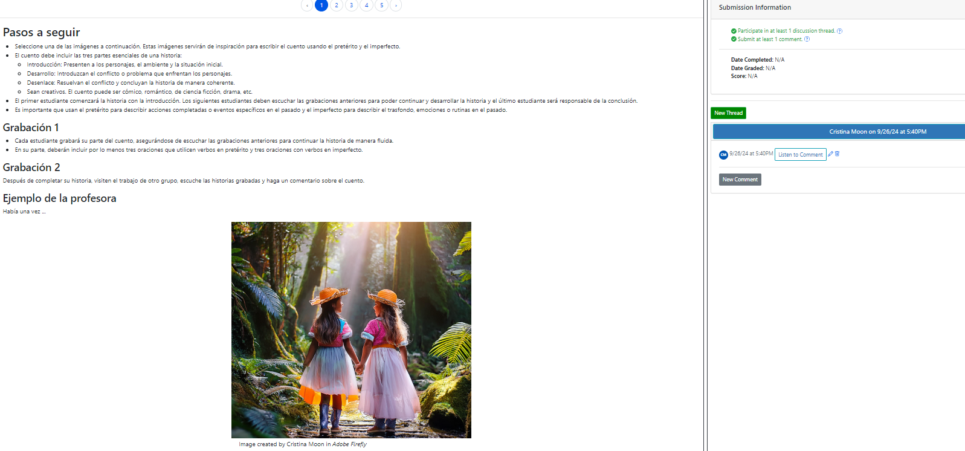
Fostering Collaborative Work
Notes:
“Seleccione una de las imágenes…” (en grupos)

Slide 22
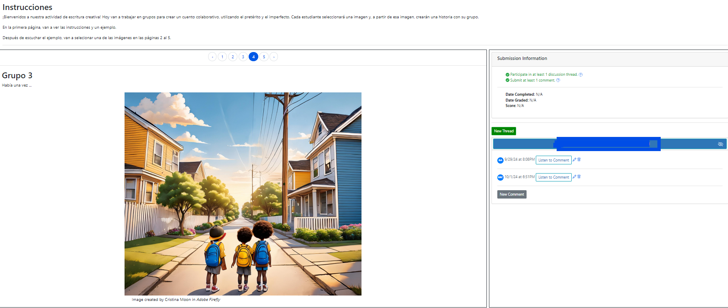
Chain Story
Students choose an image to narrate, continuing the story started by a peer.
Notes:
(en grupos)

Slide 23
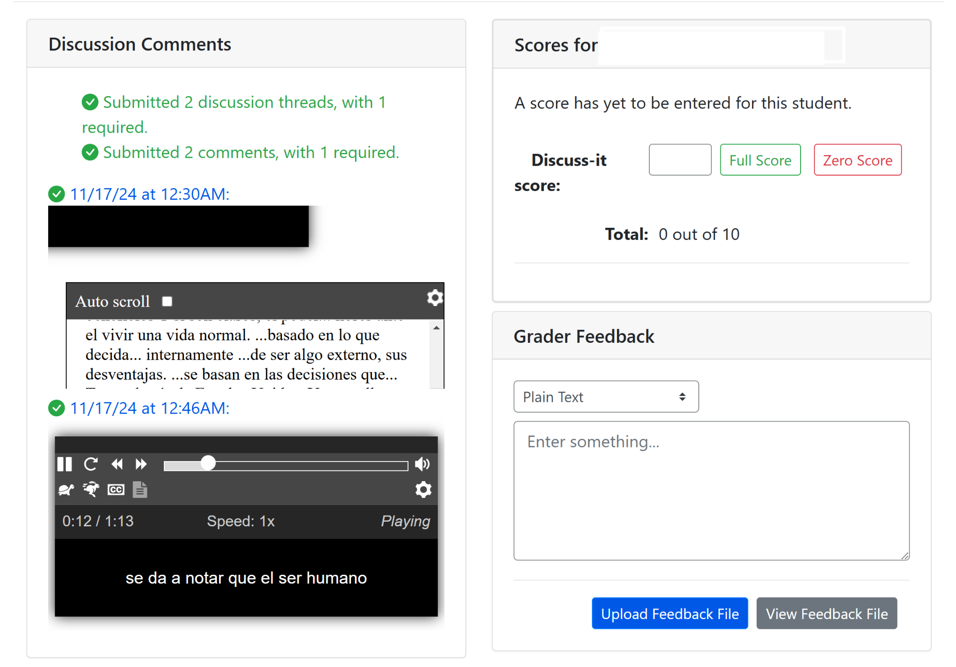
Grading Discuss-It Questions

Slide 24
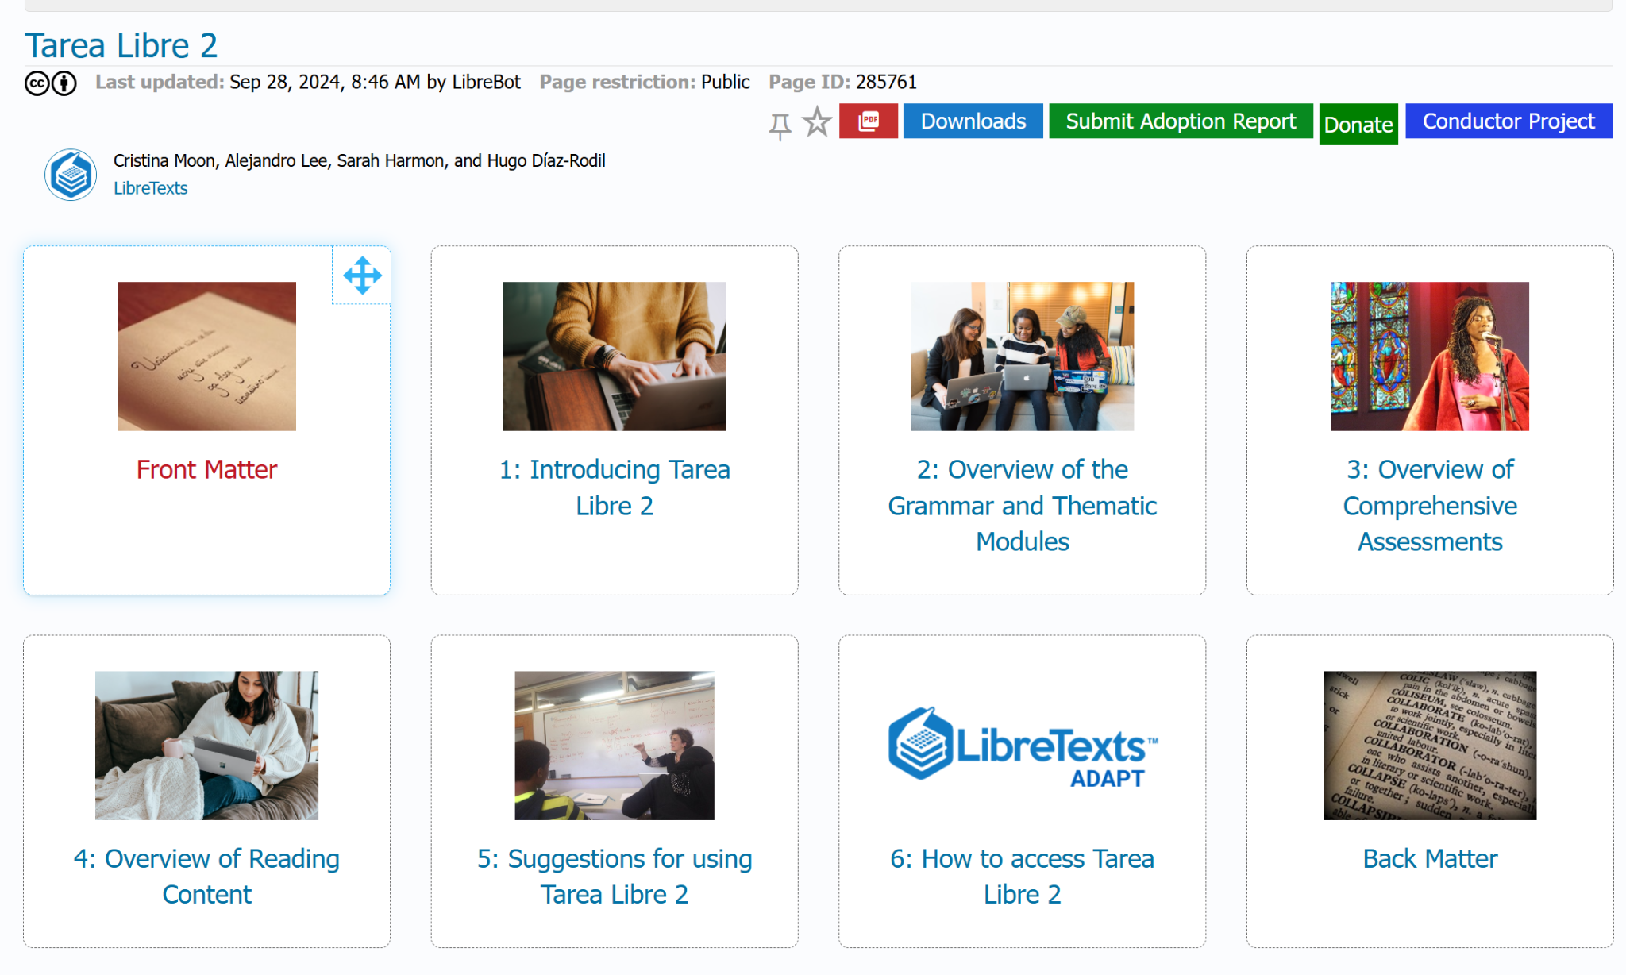
Where to Find Tarea Libre 2
Instructor Guide for Tarea Libre 2 is now available in the LibreTexts Commons.
And in ADAPT public courses.

Slide 25
Next Project
Entrada Libre 2
(expected summer 2025)
Will include the newly added grammar sections to align with Tarea Libre 2.

Slide 26
Interested in LibreTexts and ADAPT?
ASCCC OERI Regional Meeting – Introduction to Remixing and Open Homework Systems – South Friday, December 6, 2024, 8:30 am – 3:30 pm The OERI, in collaboration with Santa Ana College, is pleased to announce a professional development opportunity for faculty who intend to remix open educational resources in the LibreTexts platform and create openly-licensed assessments. Those who support this work at colleges are also invited to attend. Attendees of this in-person event at Santa Ana College will be introduced to – and actively interact with – LibreTexts, the LibreTexts Remixer, and the ADAPT Open Homework System.
Registration is now open for this December 6, 2024, 8:30 am – 3:30 pm in-person event. A light breakfast will be served and lunch will be provided. To defray costs, a registration fee of $25 will be charged. Space is limited.
Register for December 6 OERI Regional at Santa Ana College

Slide 27
Interested in Discuss-It?
Please check out the recorded webinar from November 15th:
Watch the “Boost Engagement with Discuss-It: Interactive Asynchronous Conversations in ADAPT” recording
Access the “Boost Engagement with Discuss-It: Interactive Asynchronous Conversations in ADAPT” slides
Bring asynchronous discussions to life and boost student engagement by using Discuss-It, the newest question type in ADAPT, the LibreTexts OER homework platform! Learn how Discuss-It fosters student interaction by using threaded text, audio, and video student responses. With seamless Canvas integration, ADAPT can be fully incorporated into your course with automatic gradebook syncing.

Slide 28
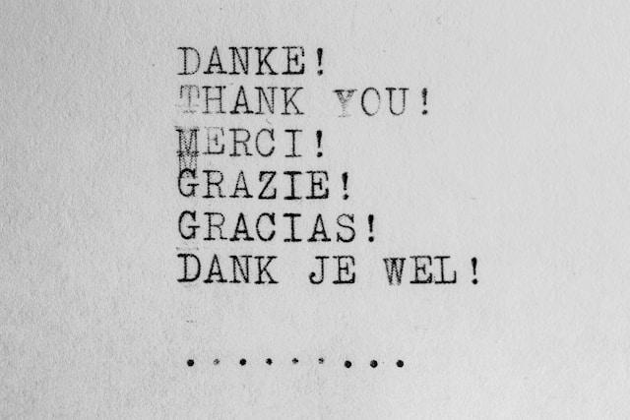
¡Gracias a nuestros colaboradores!
Nancy Meléndez-Ballesteros, Mount Saint Mary’s University-Los Angeles
María Datel, Boston University
José Luis Garrido Rivera, Mercer University
LibreTexts and ADAPT teams
ASCCC OERI
Colleagues as peer reviewers from various California Community Colleges
Photo by Wilhelm Gunkel on Unsplash

Slide 29
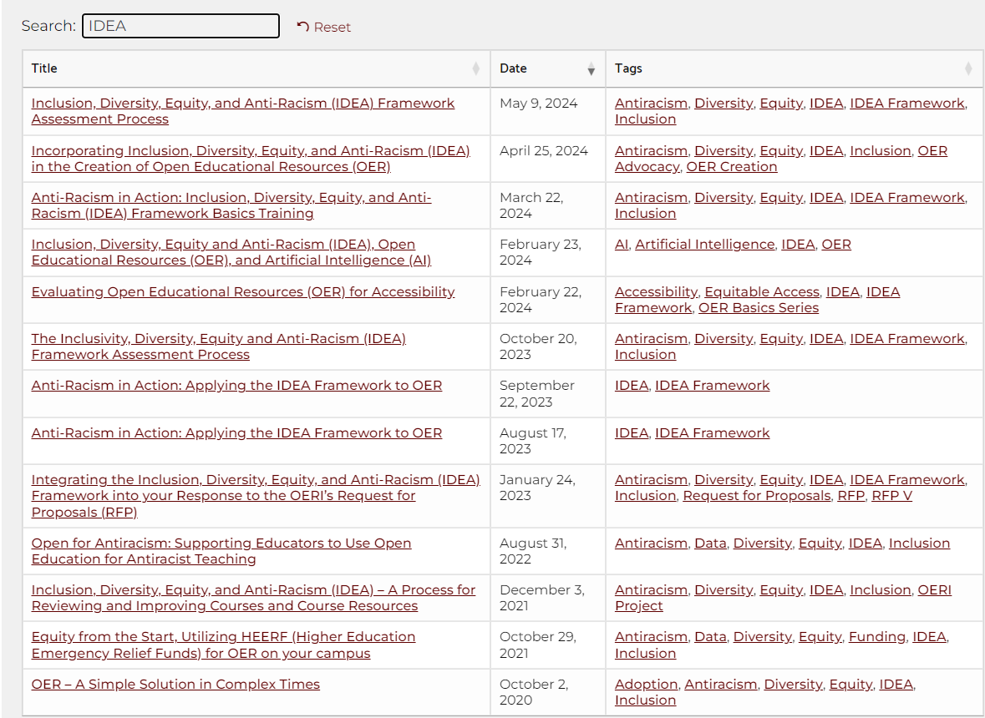
ASCCC OERI Webinars on IDEA
Archived webinars on the IDEA framework and how to use it on the ASCCC OERI website (use the search bar to aggregate videos on IDEA)

Slide 30
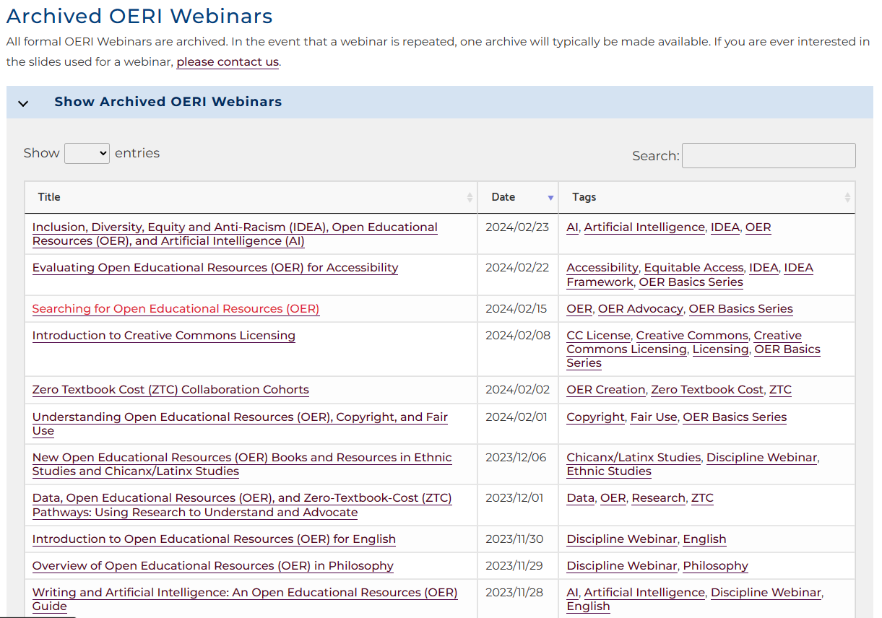
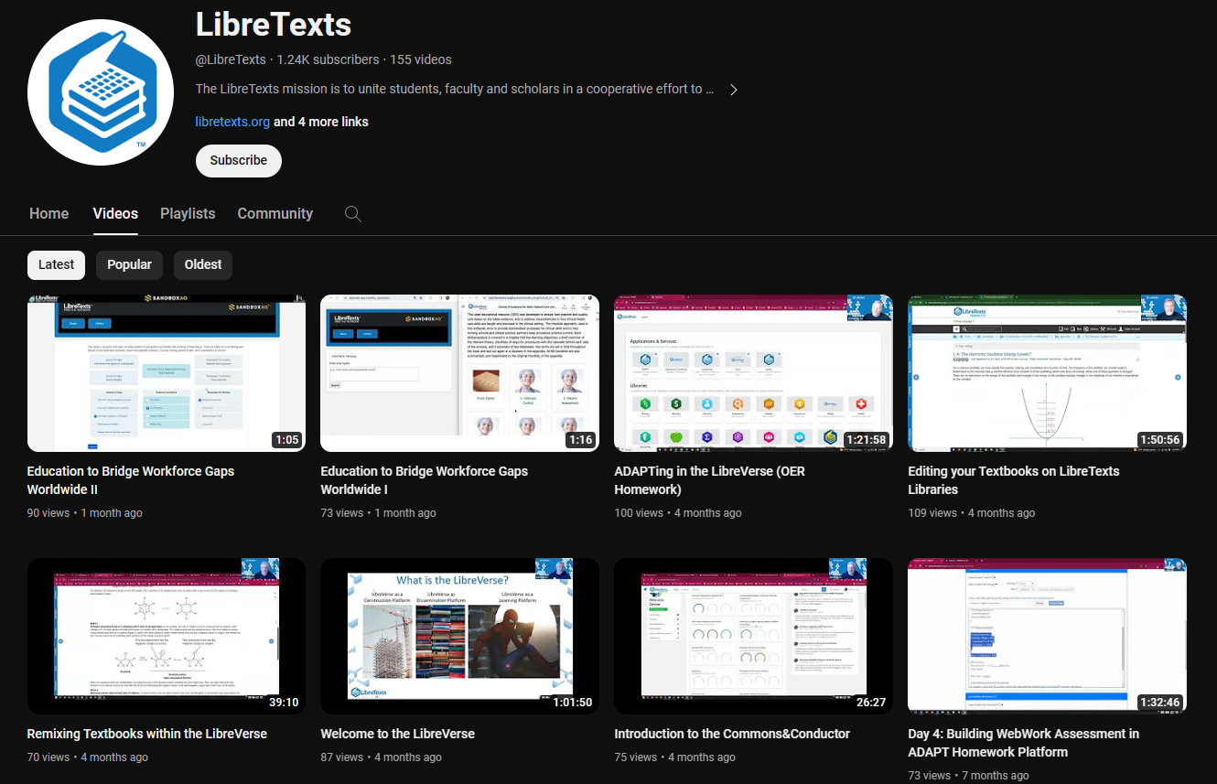
LibreTexts and ASCCC OERI Workshops
ASCCC OERI Webinars
LibreTexts Workshop Recordings
LibreTexts News and Events page has more information.
Notes:
Academic Senate for California Community Colleges (ASCCC); Open Educational Resources Initiative (OERI)

Slide 31
Let’s explore Tarea Libre 2
Please login to ADAPT: https://adapt.libretexts.org/
If you don’t have an account yet and need a code please type your name in the chat and one of our team members will give you a code.
Go to Dashboard and then select Public Courses
Under Title, type Tarea Libre 2

Slide 32
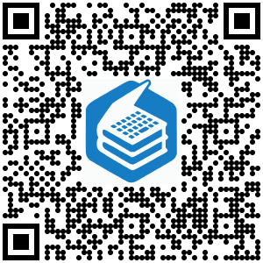
Tarea Libre 2 Demo Site
Let’s take a look at the types of activities in Tarea Libre 2 on our demo site.
Notes:
https://commons.libretexts.org/homework

Slide 33
ADAPT Resources
Accessibility reports
ADAPT construction guide
Canvas LTI for ADAPT instructions
LibreTexts weekly office hours in Zoom:
Tuesdays at 9:00-10:00 PST
Thursdays at 9:00-10:00 PST

Slide 34
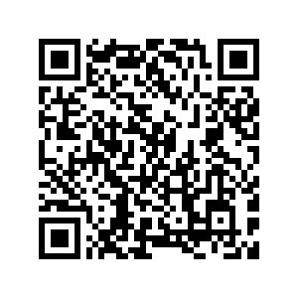
QR Code for These Slides

Slide 35
¿Preguntas?
Please keep this slide for attribution

Slide 36
LibreTexts ADAPT Codes
https://adapt.libretexts.org/
HUGO
d31a95125a0a 917adf429d46 Nora: 775bd4af4c88 9a659bde0833 7043eeeff665 b6b1ae41828b df428f0cafbf 4a289d673acb 39bceeff1ae3 e8bbc15e4e53
d6475af9eba9
ALEJANDRO
5d9bcc4fe40d = MIchelle Schewe
4730051ab5f1 = Janette
726648d855d4= Daysi Valle, Catherine Suarez
8df5ed10d7d8 = Megan a8168aea6dd4 f8d438242f95 400db01936ef
6b7f02b75978
203eddeca630 Diana
808720aa4965 Elena

