Slide 1
Boost Engagement with Discuss-It: Interactive Asynchronous Conversations in LibreTexts' ADAPT
“Boost Engagement with Discuss-It: Interactive Asynchronous Conversations in LibreTexts’ADAPT” is licensed CC-BY 4.0 by Cristina Moon and Sarah Harmon.

Slide 2
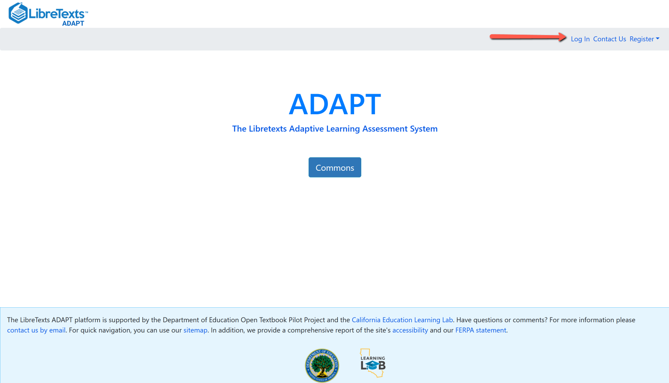
Login to your ADAPT account
Go to:
https://adapt.libretexts.org/login

Slide 3
Have you heard of and/or used any of these platforms?
VoiceThread
Flip or Flipgrid
Padlet
Extempore
Canvas Discussions with Studio

Slide 4
Discuss-It in ADAPT
Discuss-It is in LibreTexts’ ADAPT homework platform. LibreTexts is one of the largest repositories of Open Educational Resources (OER) and their ADAPT homework platform provides formative and summative assessments with more than 200,000 questions in a shared question bank.
Their newest question type, Discuss-It, boosts student engagement by enabling threaded text, audio, and video responses for meaningful interaction. With auto-captioning and auto-transcription functions, the platform ensures accessibility for all learners.
This tool fosters dynamic student-to-student interaction while offering seamless integration with a LMS, allowing for effortless course integration and automatic gradebook syncing. Discuss-It and ADAPT promote students' engagement with course material in an inclusive, interactive environment.

Slide 5
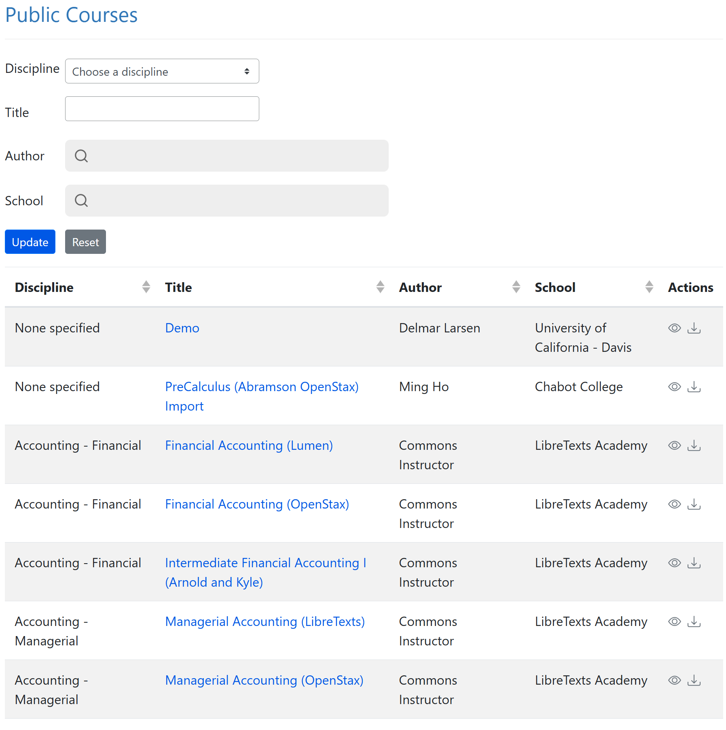
What is ADAPT?
ADAPT is a comprehensive online assessment/homework infrastructure that provides faculty the ability to include auto-graded and non-auto-graded activities from different platforms such as H5P, MyOpenMath, WeBWork, and its own native ADAPT questions.
ADAPT can be integrated into an LMS such as Canvas with full grade integration or it could be run independently.

Slide 6
Oral Assessments in ADAPT Native Questions
Individual oral assessment
For non-auto graded activities, instructors can choose the type of student submission such as an oral recording.
Group oral activity
For the new Discuss-It question type, instructors can create threaded discussions of text, audio, or video student submissions.

Slide 7
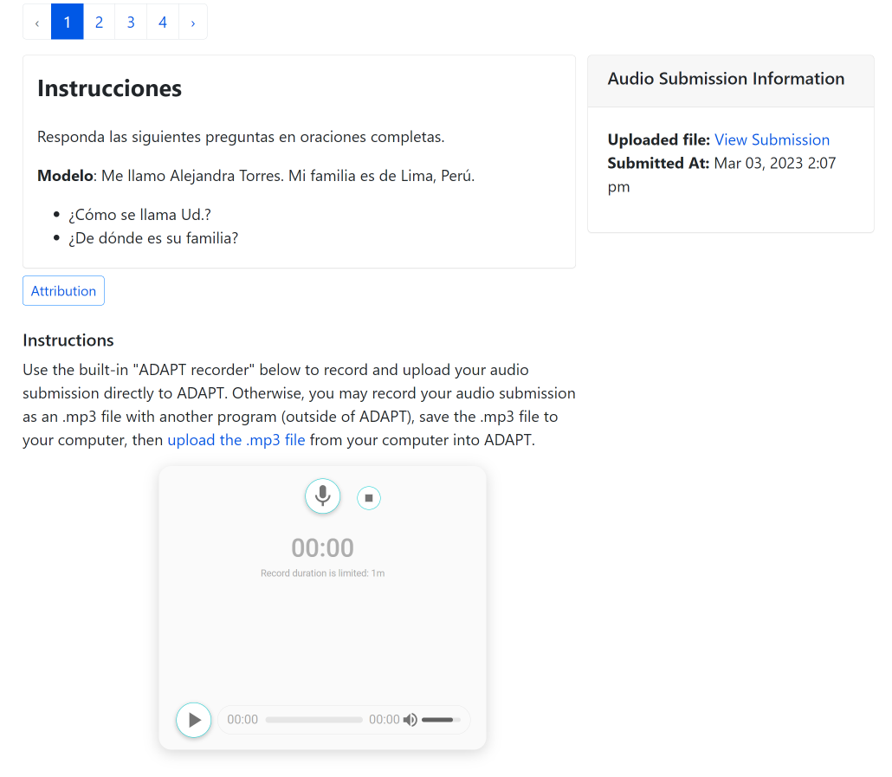
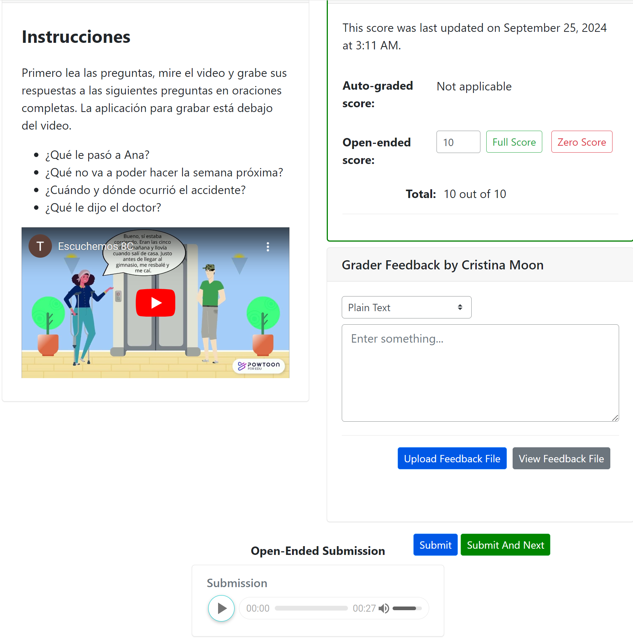
Audio Recording: Hablemos and Escuchemos
These are non auto-graded activities to assess oral and listening skills.
Students record their responses using the recorder tool in the ADAPT assignment.
Instructors listen, grade, and provide feedback all in the same page.

Slide 8
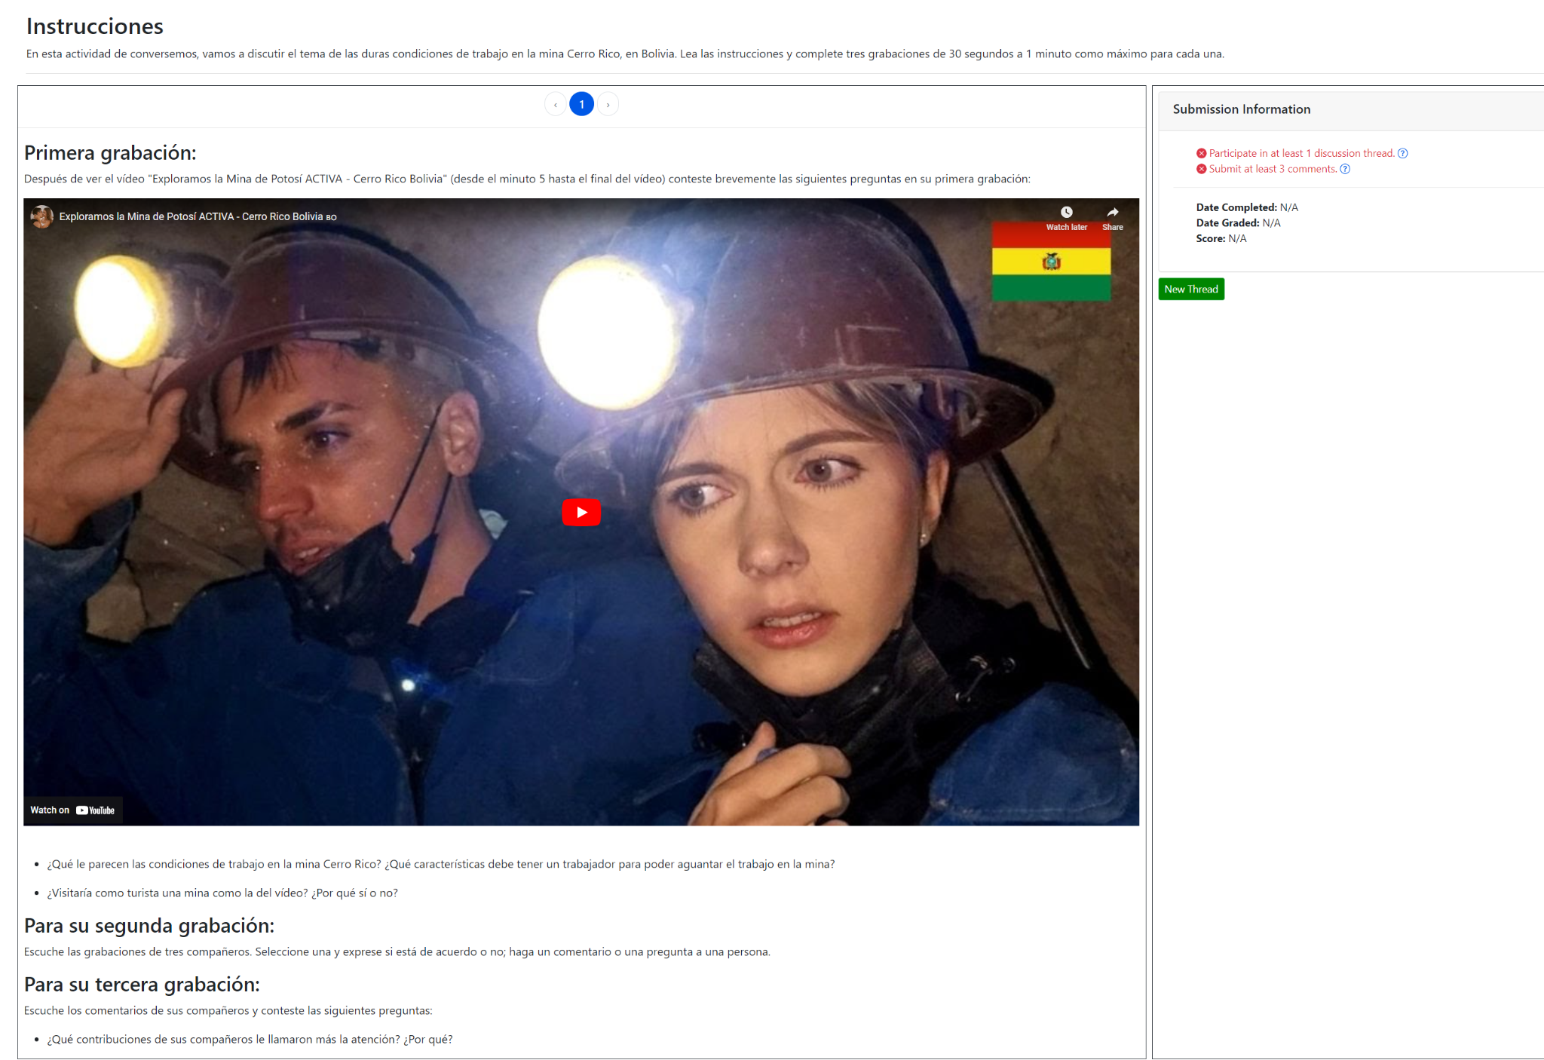
Discuss-IT
Question type for oral interaction
Similar to a discussion board with audio, video and/or text inputs
Uses new Discuss-It question type in ADAPT
Creates opportunities for student-to-student regular and substantive interaction in online modalities
Recordings are auto-captioned and transcribed

Slide 9
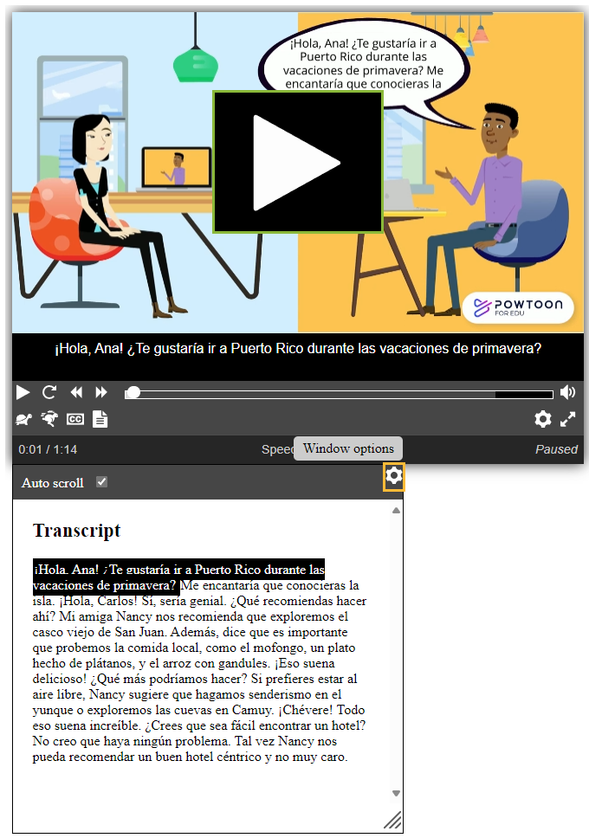
Auto-Captions and Auto-Transcript
All media integrated into ADAPT is automatically captioned and transcribed with very high fidelity rates
Currently available for many languages (including English, Spanish, French, Mandarin, Japanese, German, Portuguese, Hindi)

Slide 10
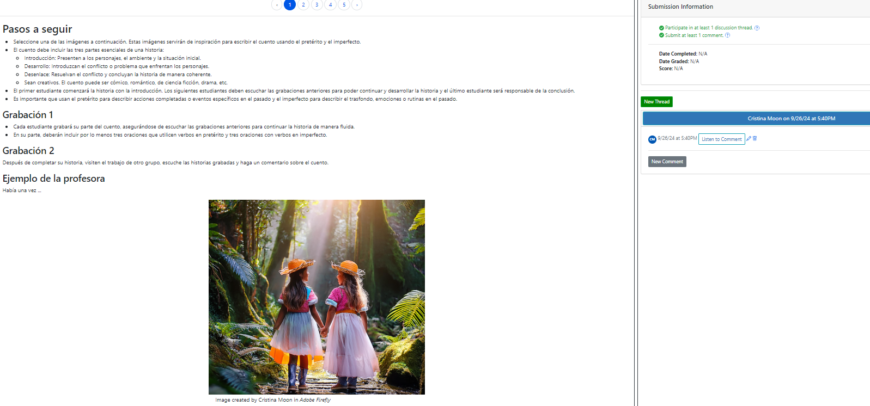
Fostering Collaborative Work

Slide 11
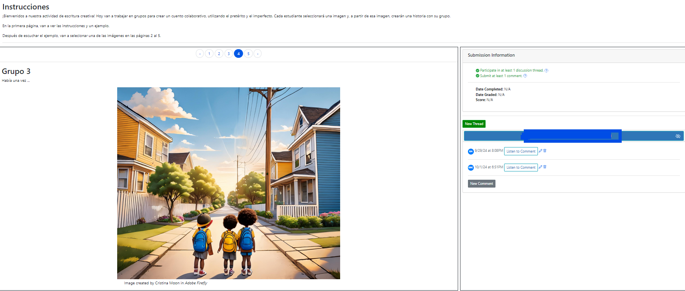
Chain Story
Students choose an image to narrate a story started by a peer.

Slide 12
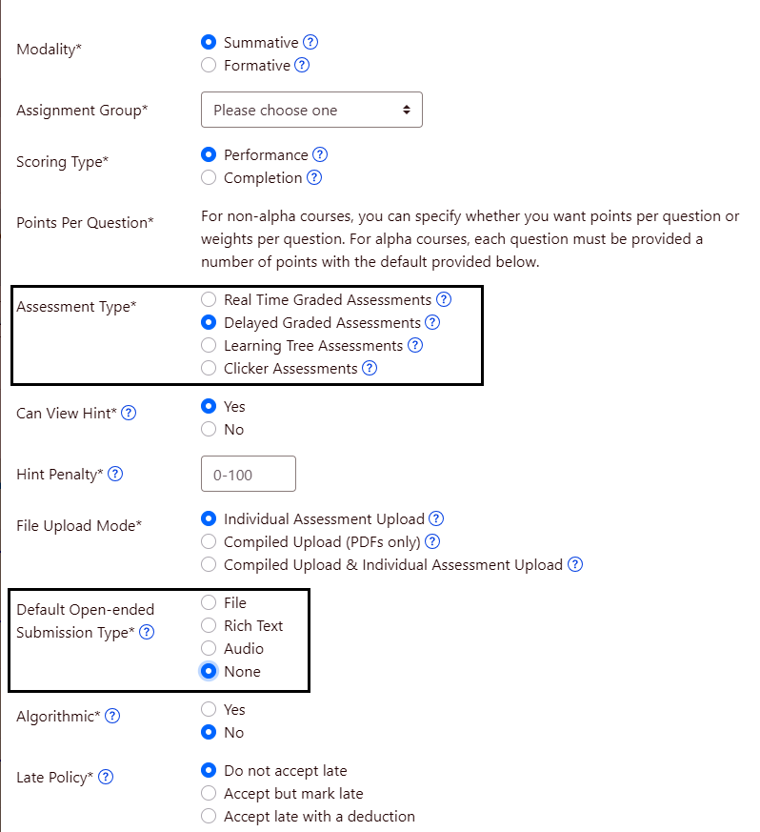
How do you create an assignment in ADAPT
Create a New Assignment
Under Assessment Type make sure to check “Delayed Graded Assessments”
For Submission type mark “None”

Slide 13
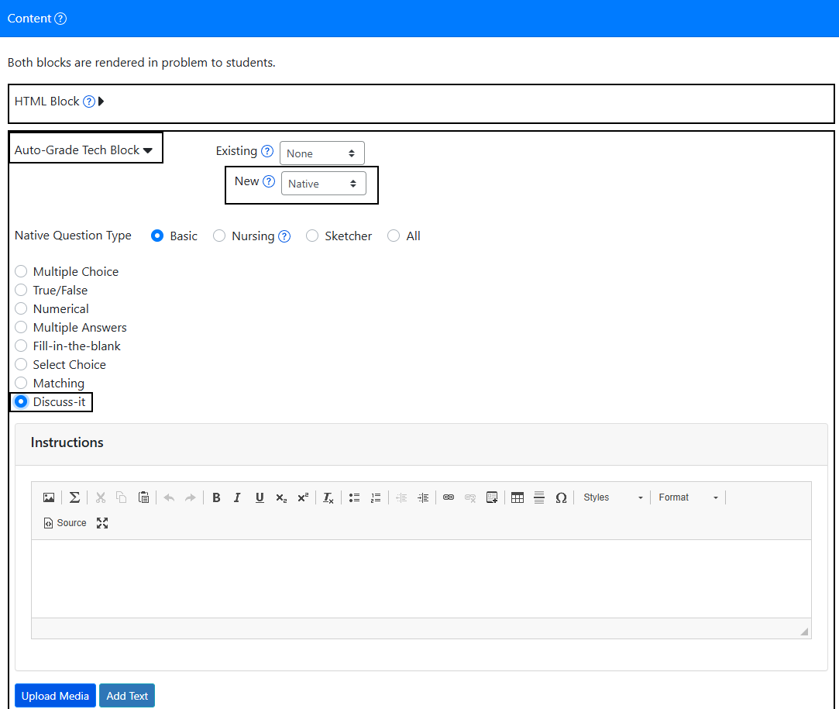
How do you create a Discuss-It Question, part 1
Add a New Question in the assignment
In the Auto-Grade Tech Block, in the New drop-down select “Native”
Select the Discuss-It native question type

Slide 14
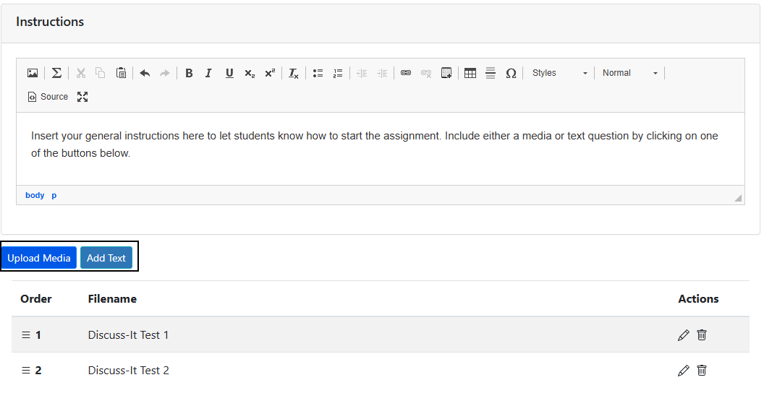
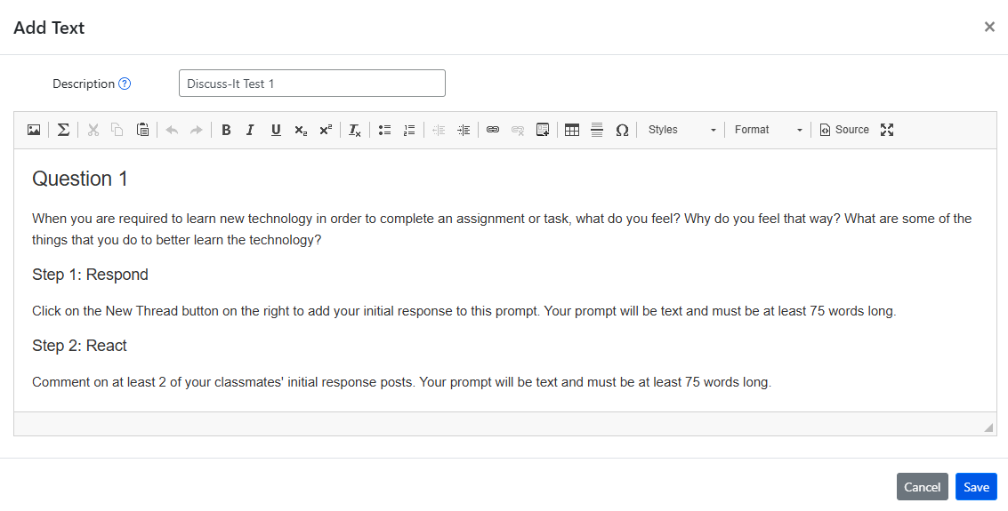
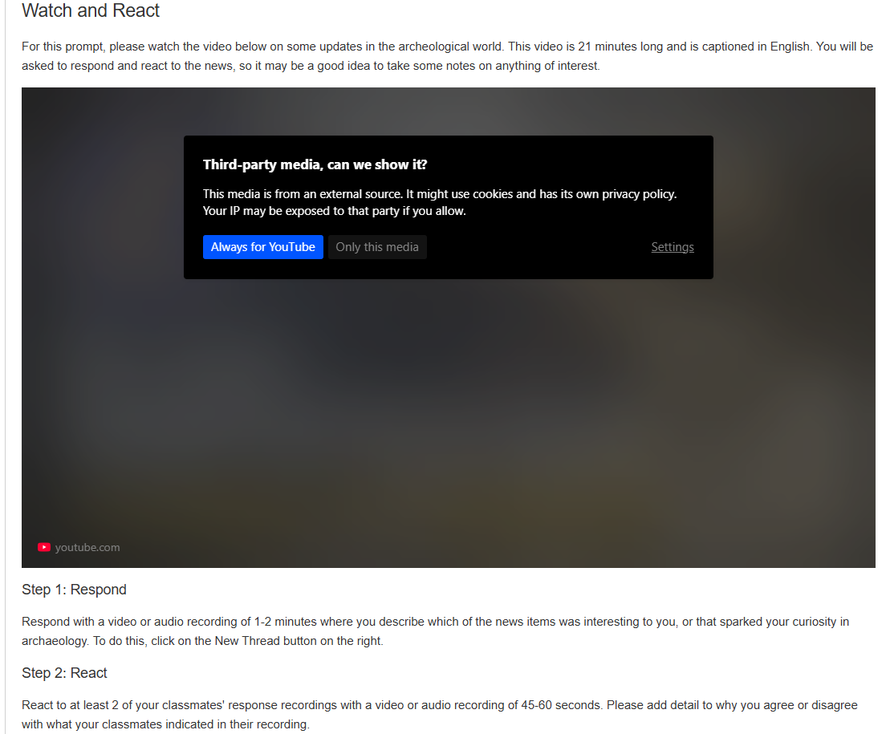
Creating a Discuss-It Question, part 2
In the Instructions box, add whatever information you want students to know to start working on it.
Add either a text or media prompt

Slide 15
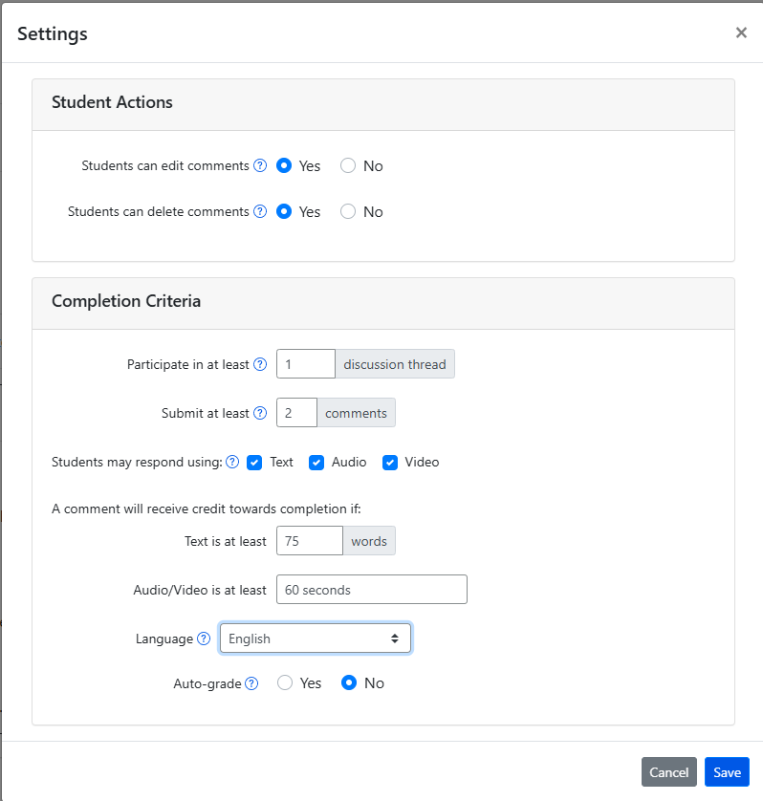
Discuss-It settings
Once the question is in the assignment, click on that question.
In the Settings box, set up the parameters of the student submissions.

Slide 16
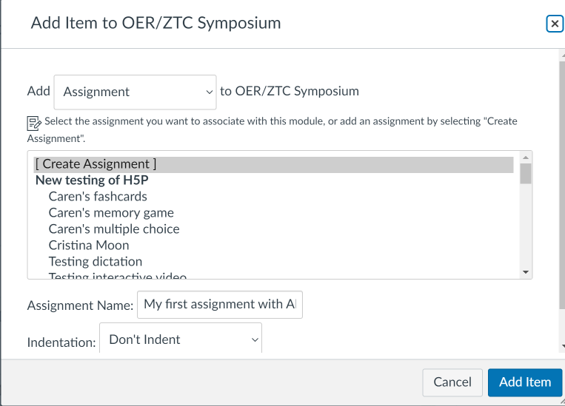
How to link ADAPT in Canvas
Step # 1: Create an assignment in Canvas. Then edit.
Notes:
1:25

Slide 17
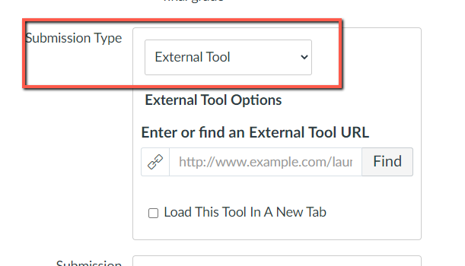
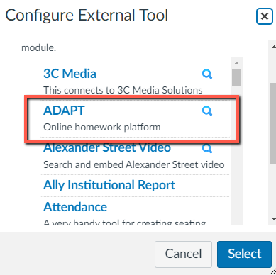
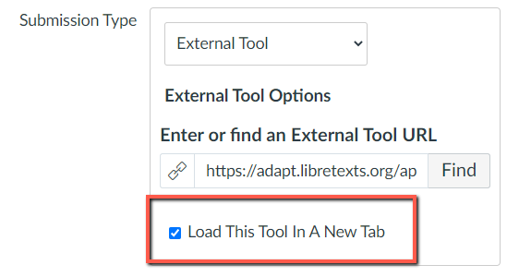
Select ADAPT in External Tool
Step # 2: Edit the assignment and choose “external tool” under submission type.
Step # 3: Click on “find” and look for ADAPT and “select”.
Step # 4: Click on “Load This Tool in A New Tab”

Slide 18
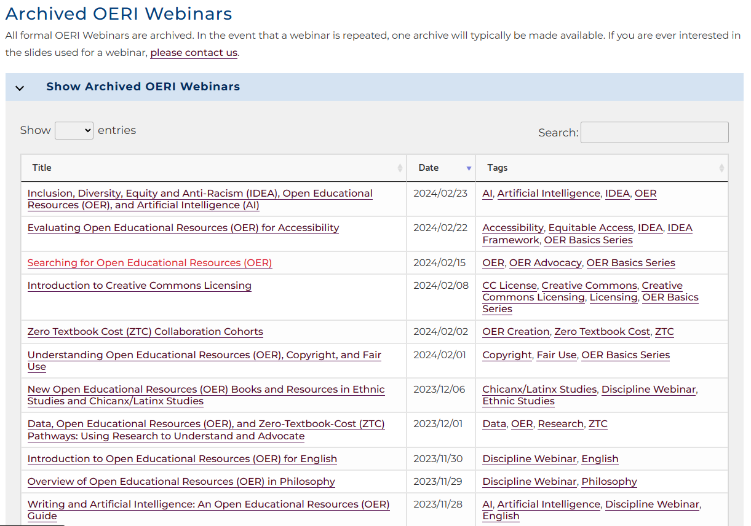
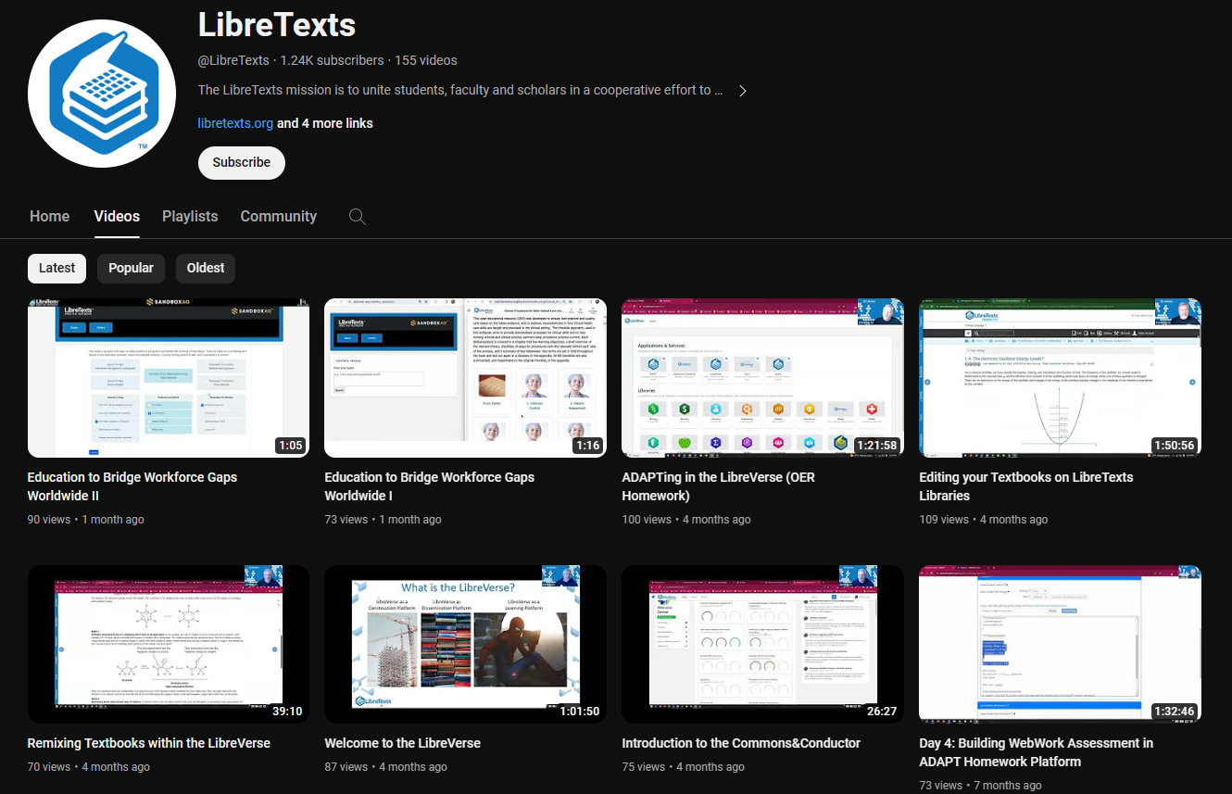
LibreTexts and ASCCC OERI Workshops
ASCCC OERI Webinars
LibreTexts Workshop Recordings
LibreTexts News and Events page has more information.
Notes:
Academic Senate for California Community Colleges (ASCCC); Open Educational Resources Initiative (OERI)

Slide 19
Demo Site for Discuss-It
Notes:
https://adapt.libretexts.org/students/assignments/94618/init-formative

Slide 20
Questions?
Cristina Moon, Ph. D.
Spanish Faculty and OER/ZTC Coordinator at Chabot College
ASCCC OERI Spanish and the H5P/ADAPT Lead
ASCCC OERI Liaison
cmoon@chabotcollege.edu
Please keep this slide for attribution

Slide 21
ADAPT codes
edc582b29360 (Leslie Hollowell)
6f364e147d0f (Kristine Wise)
4b9575ed6d92 (Rachael Tupper-Eoff)
a0c5f12c7100 (Nic Boushee)
906cf149355c (Youngmin Bae)
84e01f176547 (Teresa Lupe Grenot)
719044ea7125 8ac7b92c274f e9f9a0d2f091 70f57ab5a6a8
https://adapt.libretexts.org/
edc582b29360 6f364e147d0f 4b9575ed6d92 a0c5f12c7100 906cf149355c 84e01f176547 719044ea7125 8ac7b92c274f e9f9a0d2f091 70f57ab5a6a8
0ee991c05939 8dfd3028606f 7d77754ded76 e07620238741 e3e032317206 388029068f04 652dbce006f3 6bb600b54b5b a72452b422cb c2c9e9744592

