Slide 1
ASCCC OERI
Physics and Open Educational Resources (OER): Overview and Update
November 13, 2024
Emilie Hein, PhD
Physics Professor
Skyline College

Slide 2
What are Open Educational Resources?
Creative Commons defines OER as teaching, learning, and research materials that are either (a) in the public domain or (b) licensed in a manner that provides everyone with free and perpetual permission to engage in the 5R activities– retaining, remixing, revising, reusing and redistributing the resources.
-- Creative Commons

Slide 3
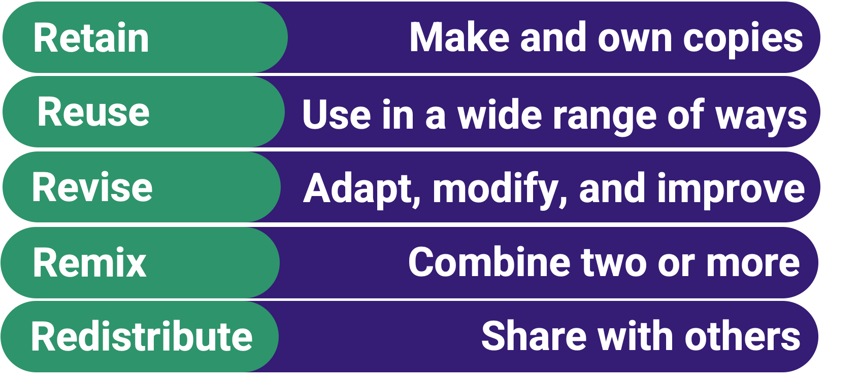
The 5R Permissions of OER
The framework, freely available under a Creative Commons Attribution 4.0 license (CC BY), was designed by Lumen Learning as the 5Rs

Slide 4
Traditional Textbook
OER
Publishing company owns copyright and sells book for profit
Cannot copy, scan, or share without permission
One student = one copy
Cannot change (revise or edit) material
No one making a profit
Freely and instantly available online
Copy, scan, share, as much as needed
Edit, revise, modify (depending on the license)

Slide 5
Why Use OER?
Free - students need extra financial help right now
Instant access - no waiting for books to arrive
Takes guessing game out of copyright and fair use
Perfect for online classes - many can be integrated into Canvas
Many have a print option

Slide 6
How do you know if something is OER and not just free?
Look for Creative Commons licenses:

Slide 7
OER and Physics: Where to start?
Start here: https://asccc-oeri.org
In particular: https://asccc-oeri.org/open-educational-resources-and-physics/
Also past webinars
Andrew Park: https://asccc-oeri.org/2020/04/16/webinar-oer-for-physics/
Emilie Hein: https://asccc-oeri.org/2021/04/05/oer-and-physics/

Slide 8
Example: OpenStax Physics + MyOpenMath + Canvas
Complete problem sets are available for
OpenStax College Physics (C-ID PHYS 105 and 110)
OpenStax University Physics, Volumes 1, 2 and 3 (C-ID 205, 210 and 215)
PHYS 105 – Course ID: 113568, Enrollment Key: CollegePHYS1.2
PHYS 110 – Course ID: 127338, Enrollment Key: CollegePHYS2.2
PHYS 205 – Course ID: 138465, Enrollment Key: cid.205.template
PHYS 210 – Course ID: 138466, Enrollment Key: cid.210.template
PHYS 215-OpenStax – Course ID: 138468, Enrollment Key: cid.215.template

Slide 9
Additional Resources
Join the Google Group: ASCCC OERI Physics
Cool4ED
MERLOT
OER Commons
LibreTexts
And more …
ComPADRE Resources and Services for Physics Education
Simulations
PhET
Videos
OpenStax's Concept Trailers
Khan Academy Physics Library

Slide 10
Questions?
Please feel free to contact me
Emilie Hein
heine@smccd.edu

Slide 11
What is MyOpenMath?
From https://www.myopenmath.com/info/classroom.php
“MyOpenMath is designed for mathematics, providing delivery of homework, quizzes, and tests with rich mathematical content. Students can receive immediate feedback on algorithmically generated questions with numerical or algebraic expression answers. And it can do so much more, providing a full course management system, including file posting, discussion forums, and a full gradebook, all designed with mathematics in mind.”
If it’s good for mathematics, it’s also great for other STEM disciplines!

Slide 12
Why use MyOpenMath?
It is free for you and your students to use!
LTI Integration - it can easily be integrated in your LMS
It is easy to share problems and courses with colleagues.
A large collection of course templates and problems is already available (depending on the discipline)
If you have already programmed problems in other platforms, it will be easy to do it in MOM
Well documented and supported: https://www.myopenmath.com/docs/docs.php
Additional support is available from the community

Slide 13
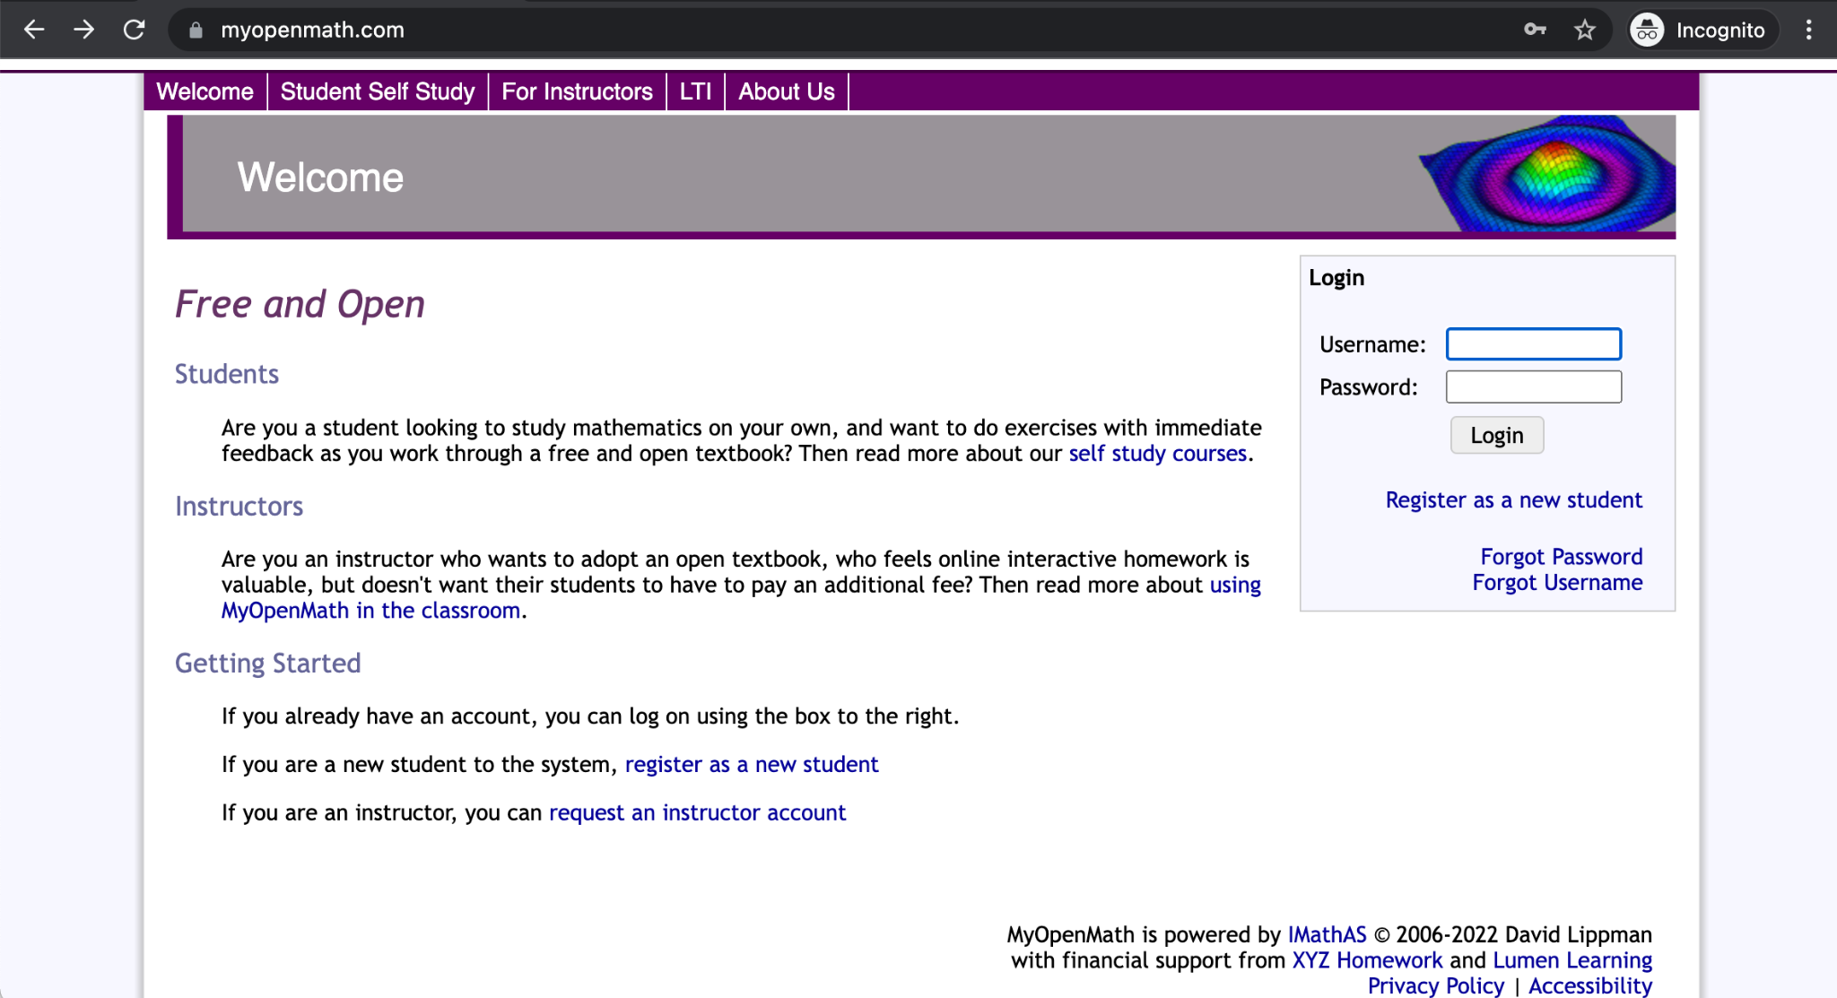
Getting started
If this is your first time using MyOpenMath, you will first need to request an account.
Go to https://www.myopenmath.com/
Request and Instructor account

Slide 14
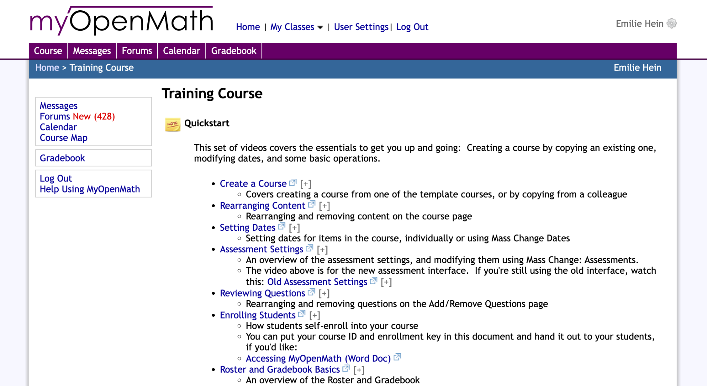
Training Course & Support Course
After logging in, you will land on the Home page.
You are automatically added to the Training and Support Courses.
Under “Courses you are taking”
Start there! Lots of resources and help from the MOM community

Slide 15
Integrating MyOpenMath into your Canvas shell
In Canvas, go to Settings, then click the Apps tab
Click on View App Configurations, then the +App button
For Configuration type, select "By URL"
For Name, enter MyOpenMath, or whatever you'd like
For Consumer Key, enter: LTIkey_####_1, where #### is your Course ID
For Shared Secret enter the secret shown in your MyOpenMath Course Settings
For the Config URL, enter https://www.myopenmath.com/canvas.php
Click Submit

Slide 16
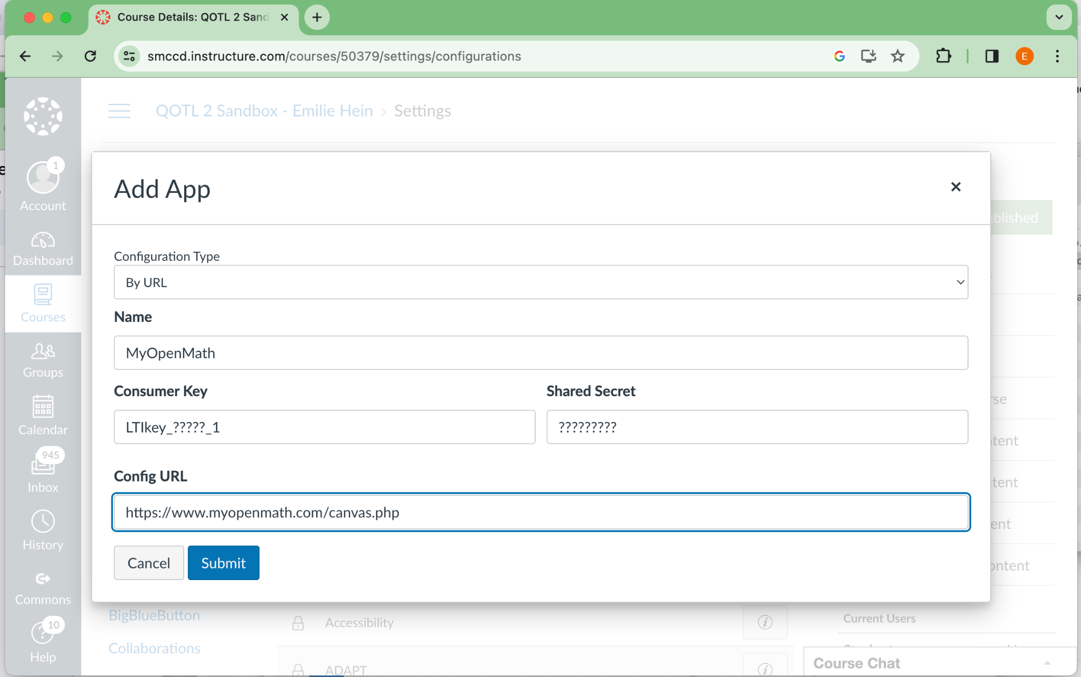
Screenshot of Canvas

Slide 17
How to create a link to an assignment in Canvas
Go to the Assignments page, and click +Assignment
Under Submission Type, select "External Tool"
Click on the "Find" button, then on the MyOpenMath tool (or whatever name you used when you created the tool)
If this is your first time using this key and secret, MyOpenMath will ask you, the teacher, to sign into your MyOpenMath account. This is necessary to establish a connection between your LMS account and your MyOpenMath account. You will not need to do this step again, and students will not be asked to sign in and will not need a MyOpenMath account.
If this is your first link from this course, MyOpenMath will ask you to select the MyOpenMath course you want to connect your LMS course with.
Select the assignment you want to link to, and click Make Placement.
Click the Select button
Finish setting up the assignment in Canvas
Assignments set up this way will receive grade return from MyOpenMath

Slide 18
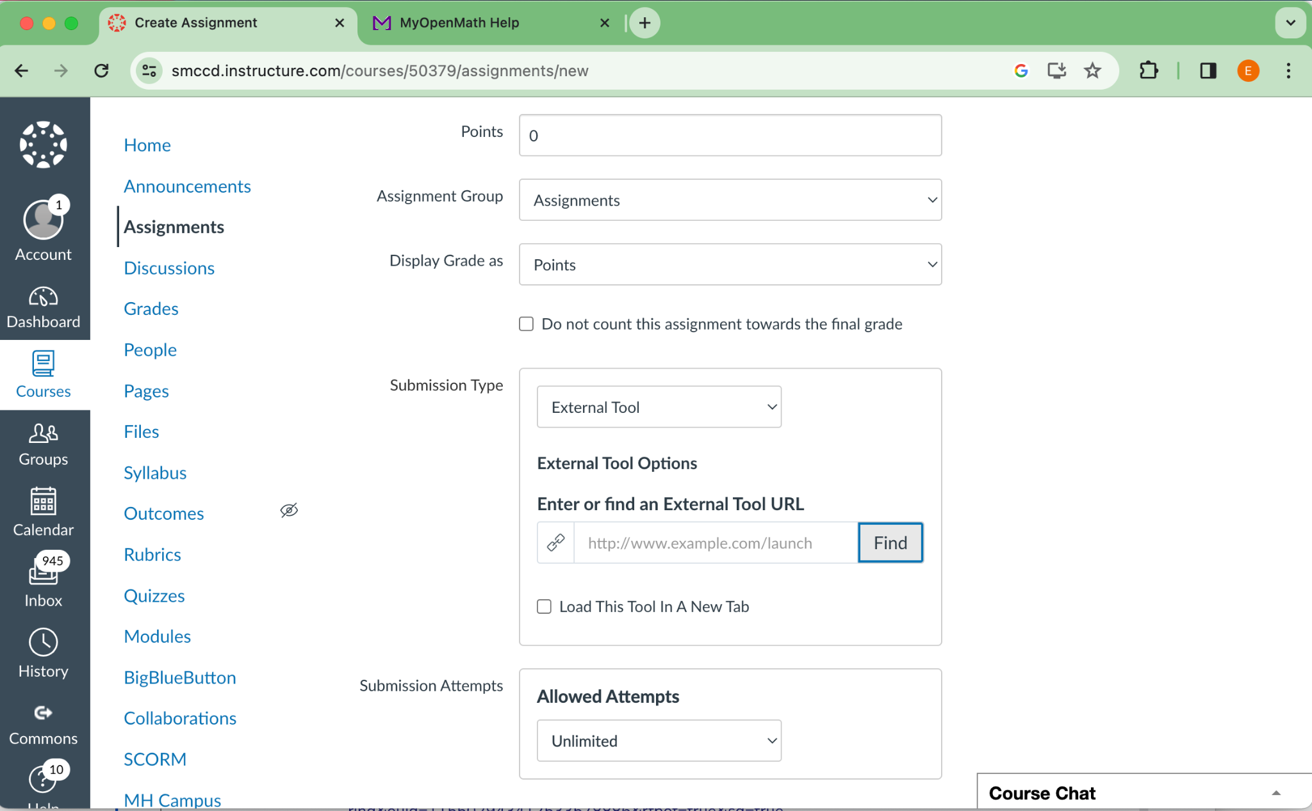
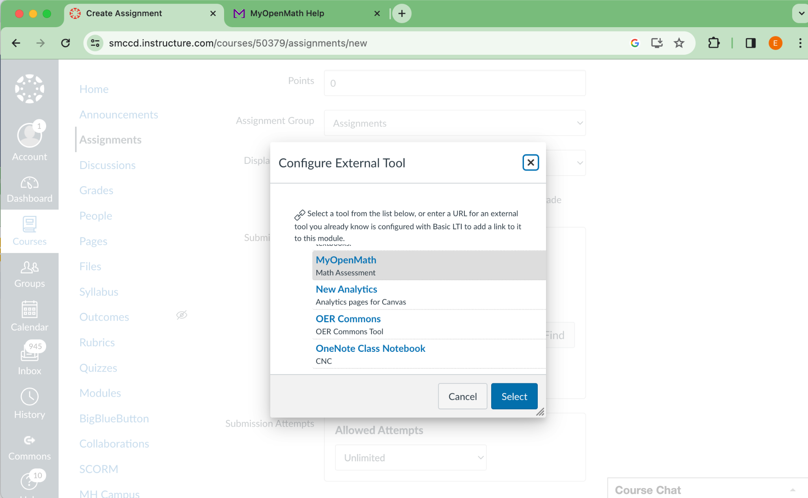
Screenshot of Canvas, Configuring External Tool

Slide 19
LTI Integration
For additional help, you can visit
https://www.myopenmath.com/help.php?section=lti
https://docs.google.com/document/d/19rF5SwoYlNz58hll63ExPLuZb-4GqlMH/edit?usp=sharing&ouid=115502943412533578886&rtpof=true&sd=true

Slide 20
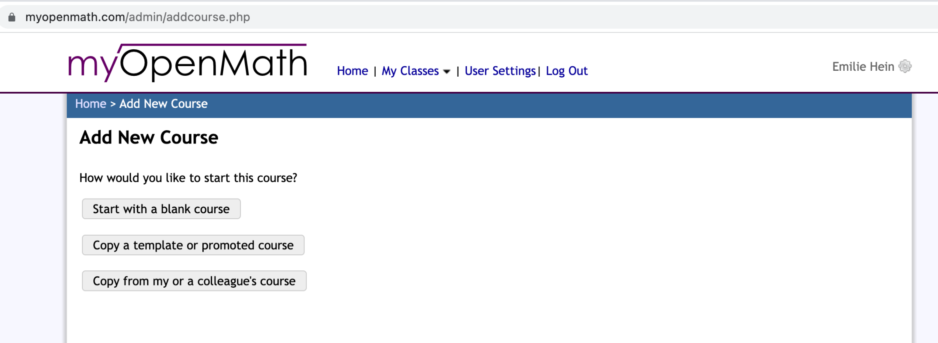
Explore existing content &
Create your own course
Select “Add New Course” from the Home page

Slide 21
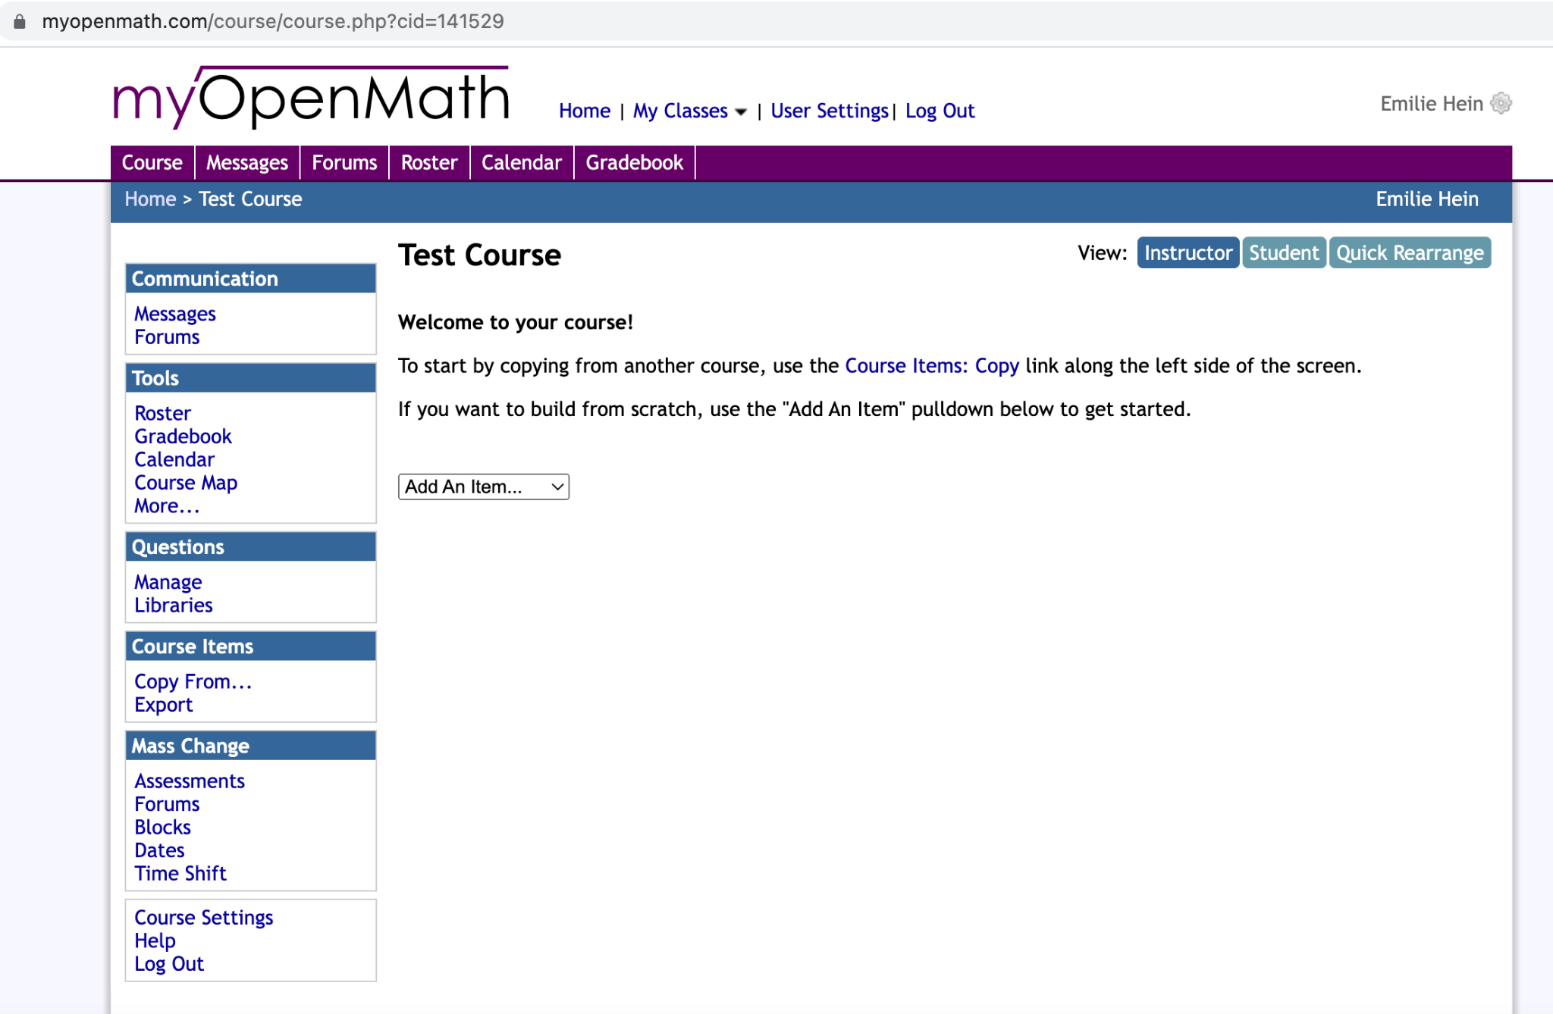
Exploring your new course

Slide 22
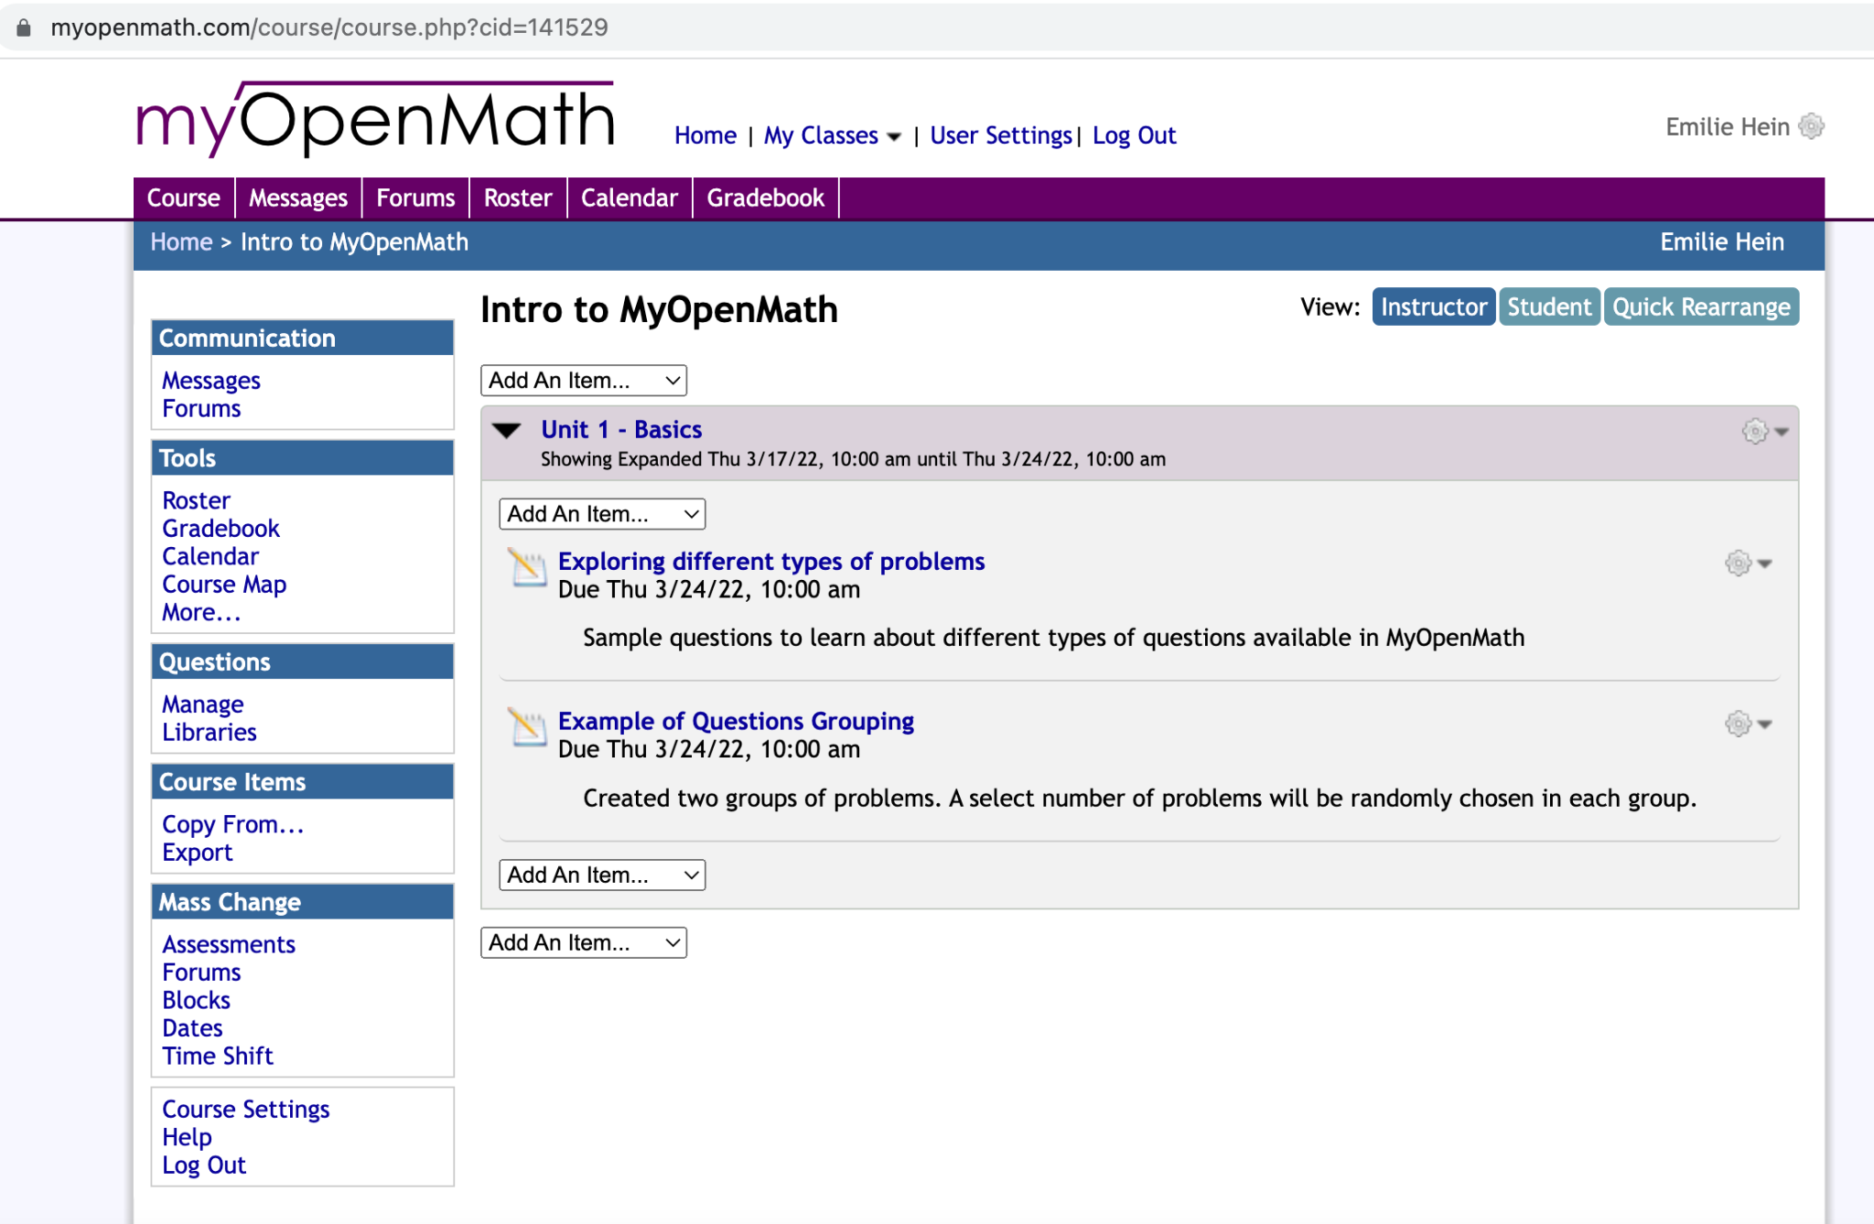
Let’s explore some examples…
Course ID: 141529
Course Name: Intro to MyOpenMath
Enrollment key: mom_intro

Slide 23
What now?
Explore existing content
Most users don’t need to learn how to code problems, they can use existing resources, as is.
A lot of content for physics was developed thanks to ASCCC OERI grants
If you don’t find what you are looking for
Ask the MOM community - a lot of people are developing content for various disciplines.
Ask the OER/ZTC community
https://asccc-oeri.org/
Talk to your colleagues, in your department and beyond. There may be funding available if you are interested in creating your own course templates

