Slide 1
Open Ethnic Studies Pedagogies
Dr. Mario Alberto Viveros Espinoza-Kulick, MA, PhD
Ethnic Studies OERI Discipline Lead

Slide 2
Acknowledgments
We recognize that the foundation of the United States was built by the uncompensated labor of enslaved Black and Native people. The contributions of people from the African diaspora were forcibly taken amidst violence and systemic injustice. Our social systems are also designed to exploit and ignore the work of undocumented workers and communities who make invaluable contributions to agriculture and care work.
We collectively acknowledge that Cuesta College occupies the ancestral, traditional, and contemporary lands of both the Salinan and the Northern Chumash who are the original, current, and future caretakers of the land upon we, as guests, work, teach, and learn.
As an online event, we further recognize that participants currently occupy distinct Native territories and Lands. If you are unfamiliar with whose lands you reside or work on, we encourage you to use the website https://native-land.ca to learn more and connect with local tribal communities.

Slide 3
Introductions
Please introduce yourself in the chat with the following:
Name
Pronouns
Affiliation(s)
Where you’re joining today’s conversation from
You are welcome to unmute yourself and share your introduction with the group.

Slide 4
Conversation Description
Join colleagues to explore how faculty can integrate open practices with Ethnic Studies pedagogical principles to create open resources and publish students’ projects, artwork, essays, and other creative works. This session invites faculty to reimagine the creation, adaptation, and sharing of culturally relevant materials to increase educational access and deepen student engagement.

Slide 5
What are Open Educational Resources?
Creative Commons defines OER as teaching, learning, and research materials that are either (a) in the public domain or (b) licensed in a manner that provides everyone with free and perpetual permission to engage in the 5R activities.
-- Creative Commons

Slide 6
The 5R Permissions of Open
Make and own copies
Retain
Use in a wide range of ways
Reuse
Adapt, modify, and improve
Revise
Combine two or more
Remix
Share with others
Redistribute
This framework (CC BY 4.0), was designed by Lumen Learning as the 5Rs

Slide 7
Open Ethnic Studies Pedagogy
Open Ethnic Studies Pedagogy uses OER to explore decolonization and anti-racism.
Decolonization is practiced by critically analyzing settler-colonialism and supporting the self-determination of Indigenous peoples.
Anti-racism involves critical thinking about intersecting social categories and taking action to address inequities.
Open Ethnic Studies Pedagogy
Decolonization
Anti-Racism
Open Educational Resources (OER)

Slide 8
Benefits of Open Ethnic Studies Pedagogy
Ethnic Studies courses have a range of benefits, such as academic achievement, cultural affirmation, critical thinking, and social responsibility.
Open Ethnic Studies Pedagogies build on the strength of Ethnic Studies teaching by utilizing free sharing of educational resources.
Accessibility
Knowledge Sharing
Critical Thinking

Slide 9
Open Ethnic Studies Pedagogy in Practice
Micro-Level Processes
Curate and assign open access materials in courses.
Share pedagogical tools and assessments.
Meso-Level Processes
Collaborate with campus and community groups to showcase open student work.
Integrate discussions of intellectual property and licensing into courses.
Macro-Level Processes
Produce open scholarship and text materials.
Inspire students to create open content, platforms, and processes.

Slide 10
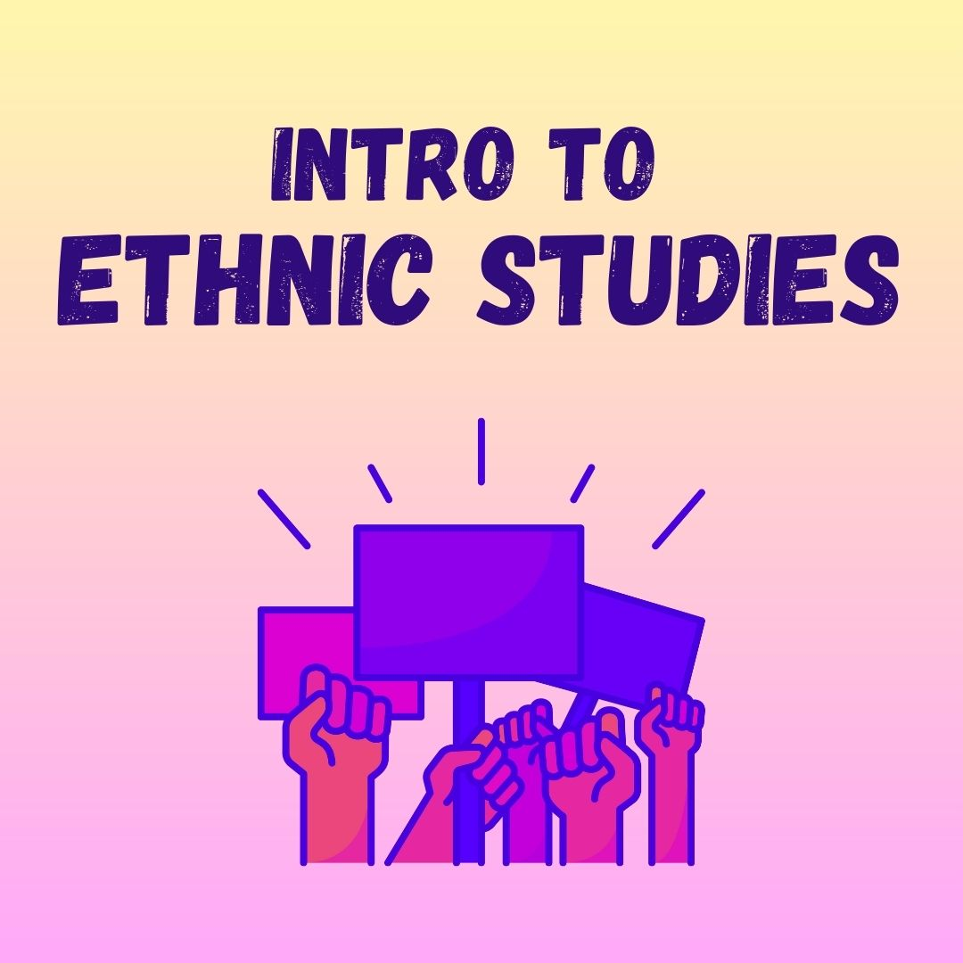
Example: Ethnic Studies OER Texts
Course textbooks are foundational for student learning and instructor pedagogy.
Ethnic Studies scholars and teachers are well suited to create, remix, and adapt OER text materials.
You can find existing Ethnic Studies OER and report adoptions on the Discipline Guide page: https://tinyurl.com/OER-ES-Resources

Slide 11
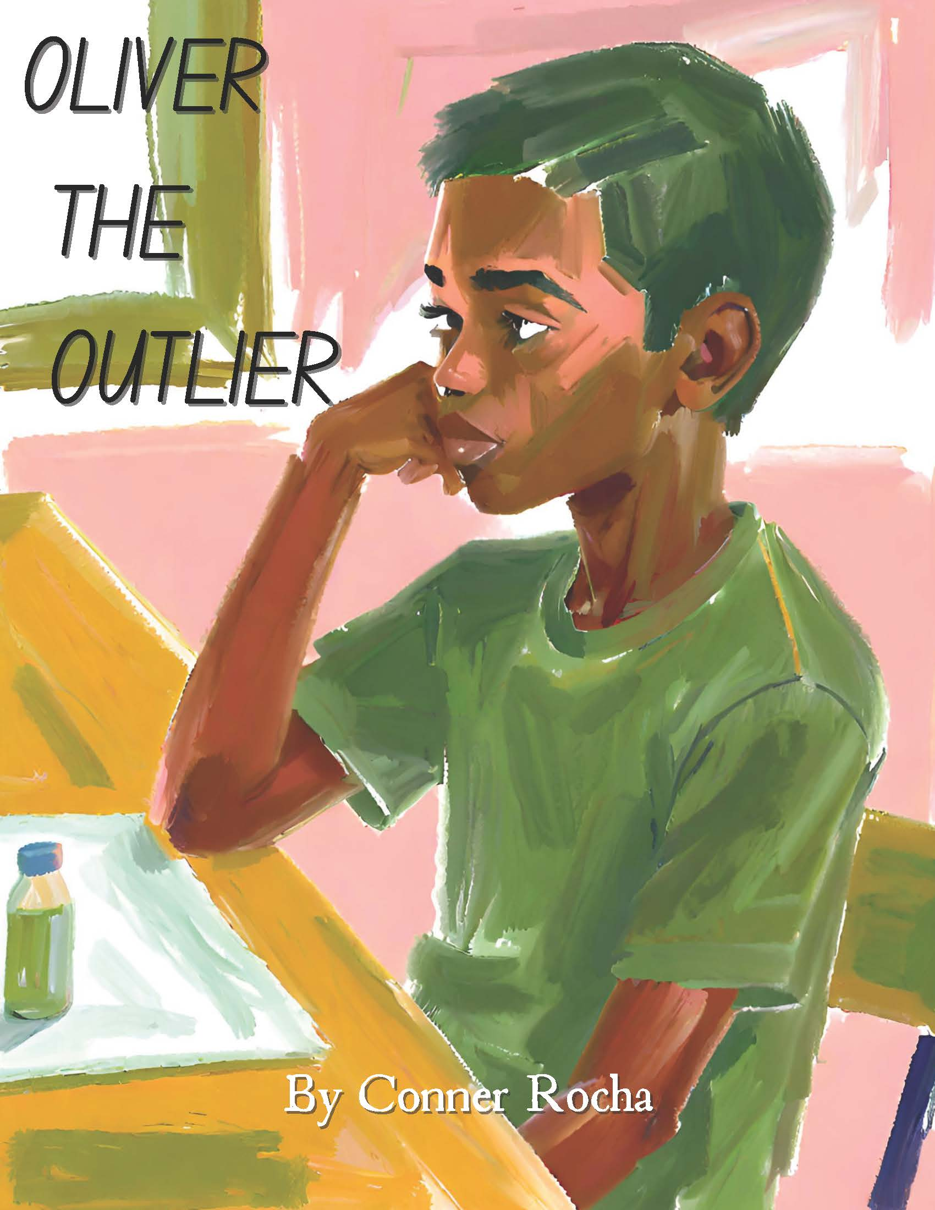
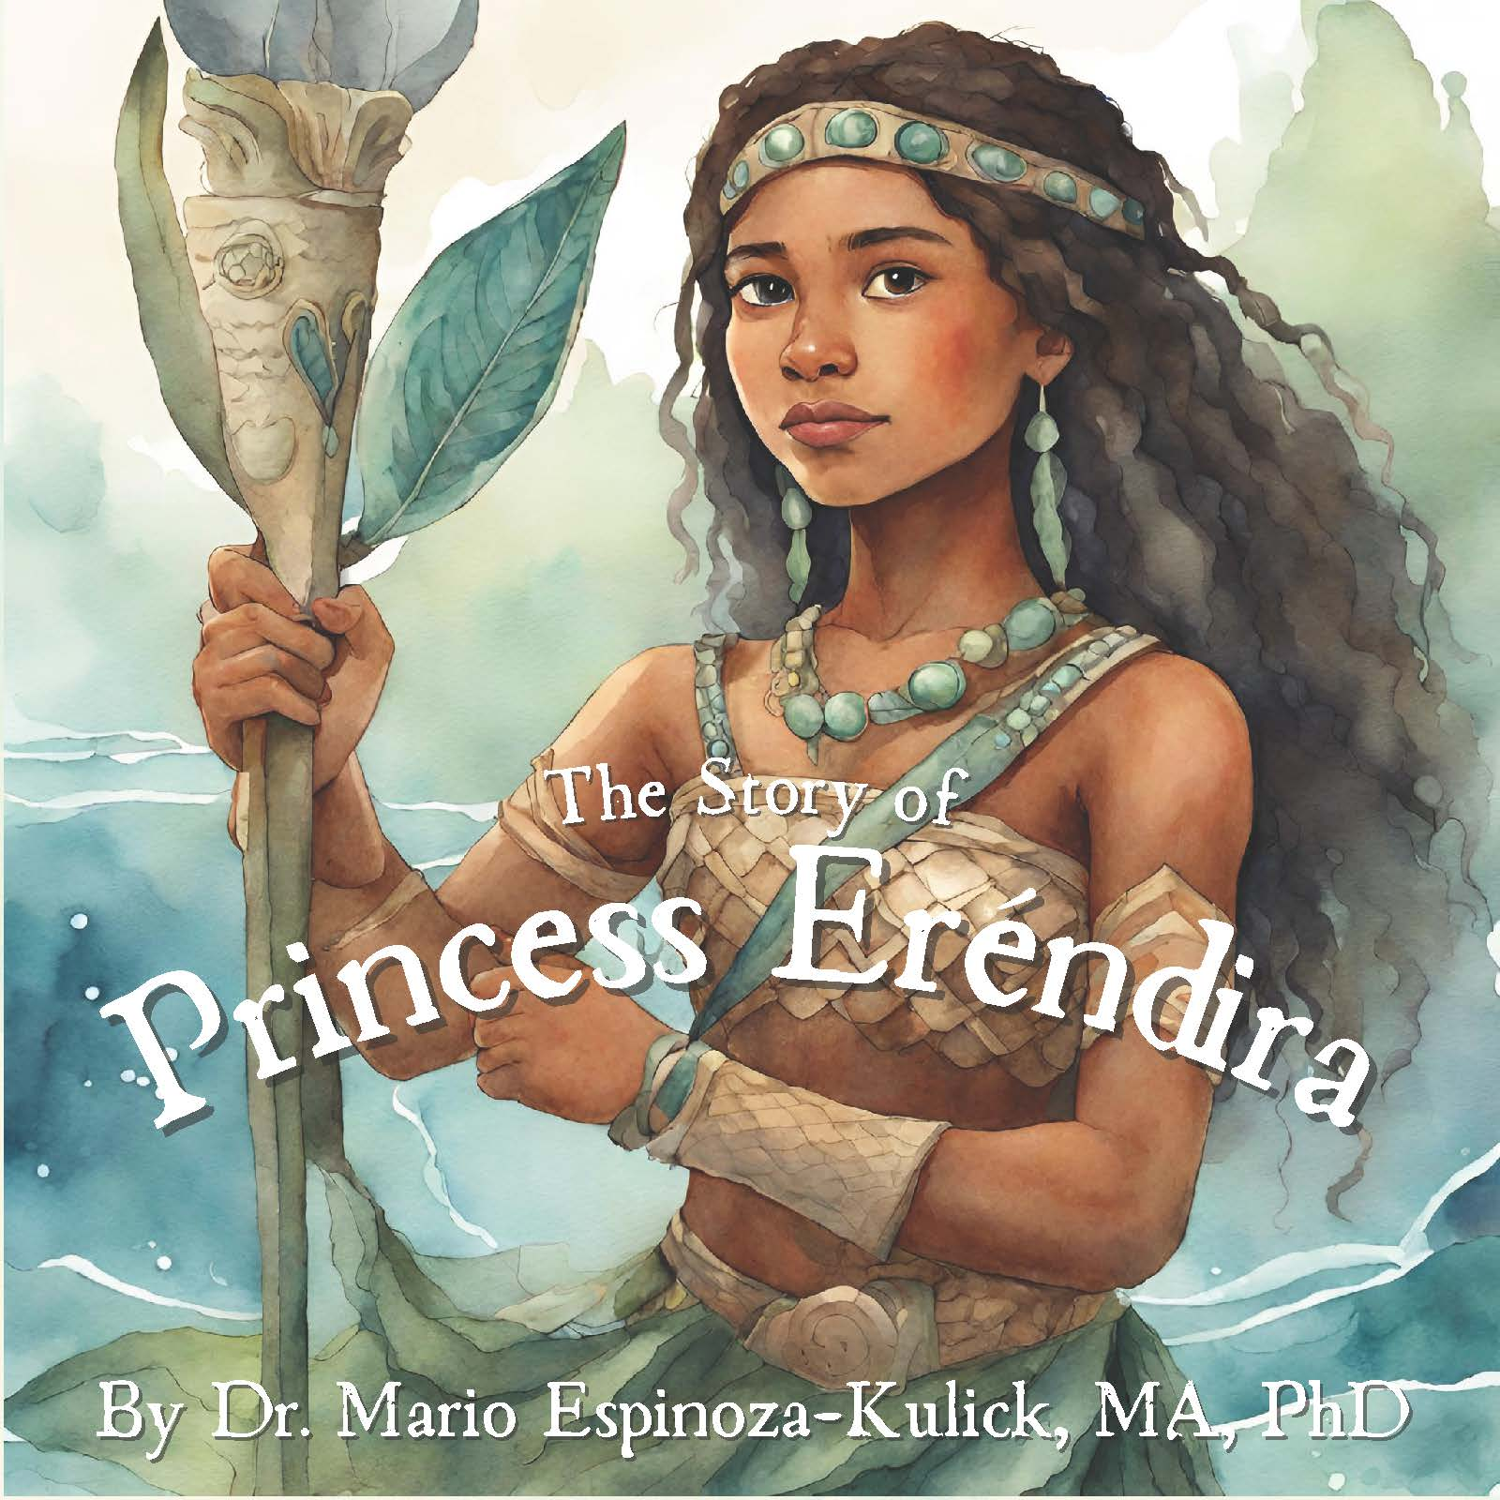
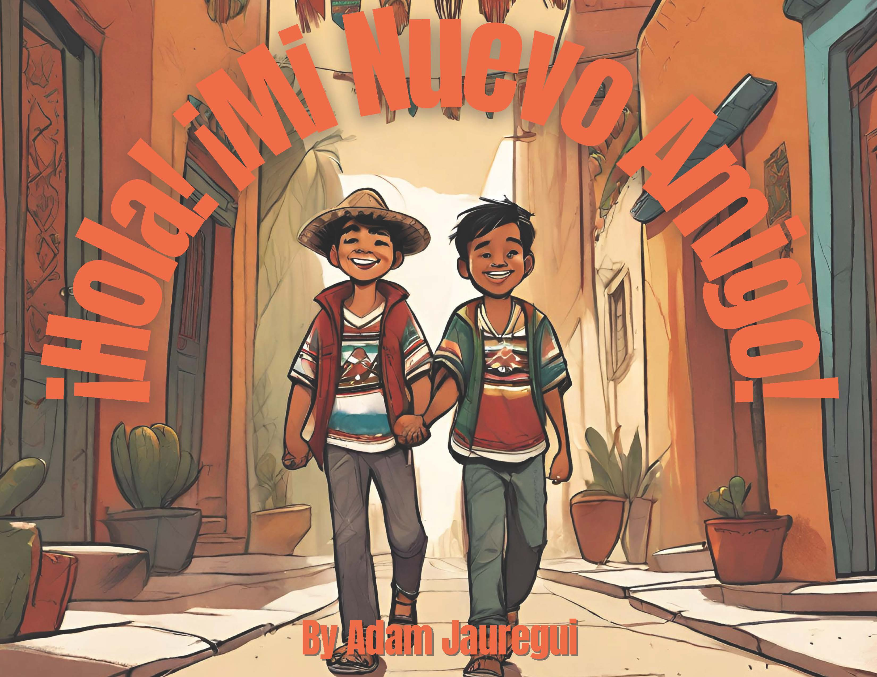
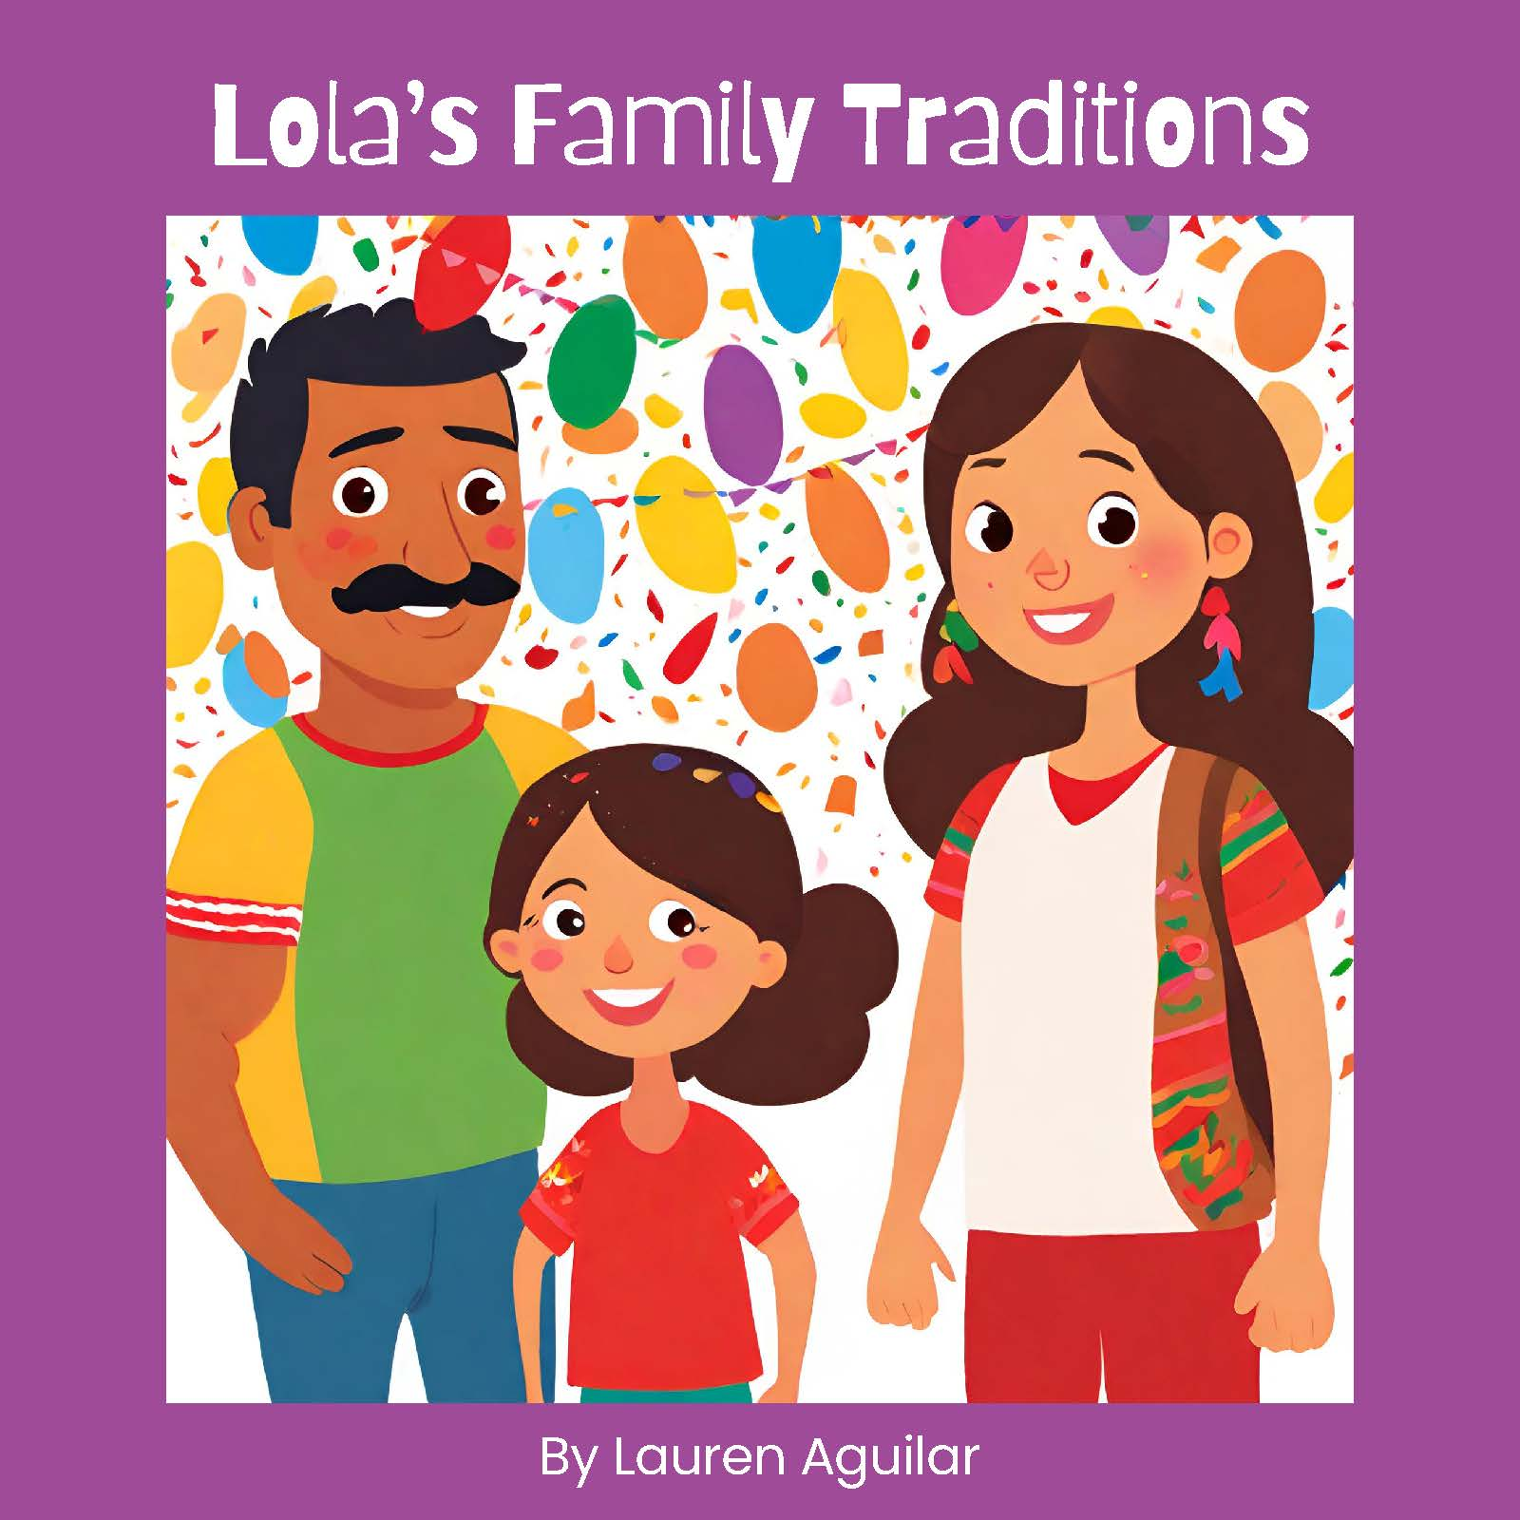
Example: Ethnic Studies Storybooks
Students in ETHN/EDUC 210 create original Ethnic Studies Storybooks as a term-long project.
They are trained in Ethnic Studies concepts, AI image generation, layout and design, and open licensing.
Completed books are available online and for check out in the campus library: https://libguides.cuesta.edu/ethnicstudies/storybooks

Slide 12
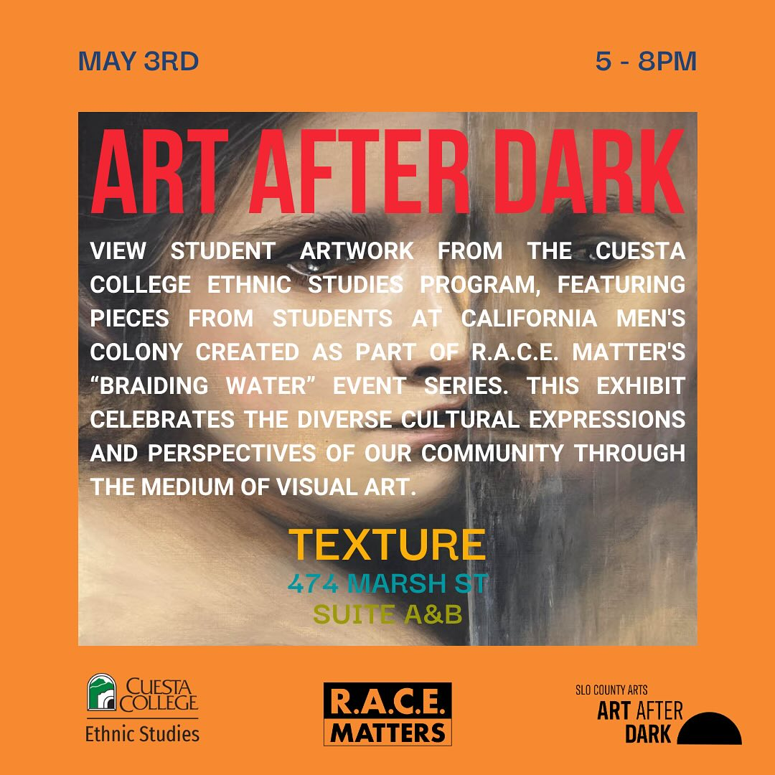
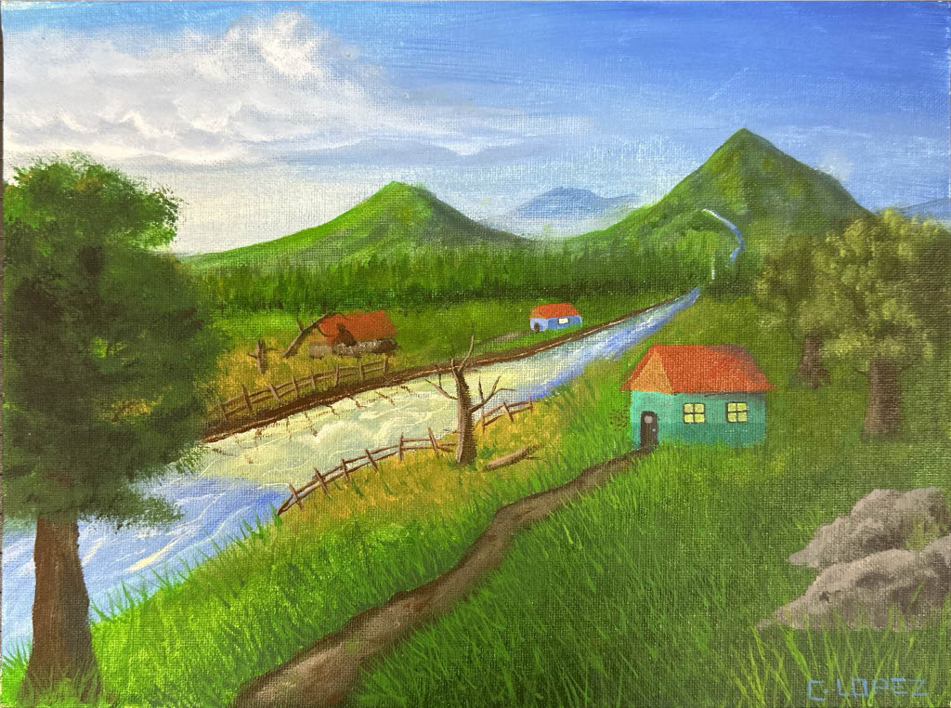
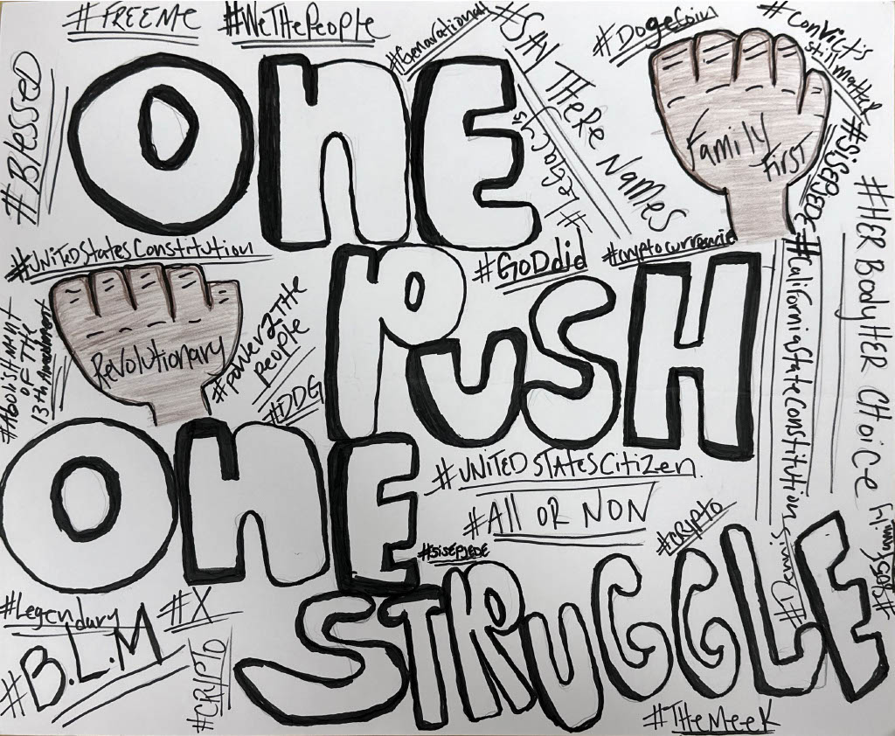
Example: Braiding Water Creative Projects
Rising Scholars students were invited to respond to the theme of “Braiding Water” in collaboration with R.A.C.E. Matters SLO
You can view and share the full slideshow: CMC Creative Projects: Braiding Water

Slide 13
Example: Palestine and Israel Q&A
Since Fall 2023, students have completed a K-L-W Activity (Knew, Learned, Want to Know) to help organize their understanding of the Israeli occupation of Palestine.
The questions and ideas that students “Want to Know” are compiled in an open access Q&A document, which grows each semester and is available at https://tinyurl.com/PIQA-Cuesta

Slide 14
Discussion
Please visit the Padlet at https://tinyurl.com/ESOER-120424 with Password: OESP
Share one example from your own teaching that you are considering adding a component of Open Ethnic Studies Pedagogy (OESP).
What is the title of the content, assignment, or other course material?
Briefly describe how you currently include this in your course.
Share an idea or question about incorporating OESP component(s).

Slide 15
Q&A
What questions do you have about OER in your courses?
Is there anything else you would like to share with the group?

Slide 16
Dr. Mario Alberto Viveros Espinoza-Kulick, PhD
Ethnic Studies Department
Cuesta College mario_espinozakulick@cuesta.edu
@cuestaethnicstudies ASCCC Ethnic Studies Listserv
OER and Ethnic Studies Sources

