Slide 1


Welcome!
On behalf of the ASCCC OERI, we are pleased to have you here for “Findings from the 2024 Open Educational Resources (OER) Liaison Survey”
If you are not already muted, please mute yourself upon arrival. As this is set up as a meeting, we will be able to have an actual discussion – but we need all those who are not speaking to be muted.
You are also encouraged to use the “chat” feature.
This event will be recorded and available to you on the OERI website (asccc-oeri.org).

Slide 2
Findings from the 2024 Open Educational Resources (OER) Liaison Survey
Revised February 11, 2025. OERI Friday Forum, February 21, 2025, 10:30 am – 11:30 am
This work is licensed under a Creative Commons Attribution 4.0 International License.
Attribute this slide deck as: "Findings from the 2024 OERL Survey" by ASCCC OERI is licensed under CC BY 4.0.

Slide 3
Your Presenters
Lara Braff
  OERI Area D Regional Lead
  Anthropology, Grossmont College
Amanda Taintor
  OERI Area A Regional Lead
  Early Childhood Education, Reedley College

Slide 4
Event Description
Since its inception, the Open Educational Resources Initiative (OERI) has gathered data from local OER Liaisons on a yearly basis. While the focus of the survey has shifted over time, many of the questions have been repeated in order to track changes. Join us to explore what has and hasn’t changed – and to learn about the various ways OER and cost-transparency efforts are being implemented across the state.

Slide 5

Overview
Survey respondents
  Roles
  Other OER/ZTC duties?
  Compensation
SB-1359
  Implementation
  Guidelines
  Identifying no-cost

Slide 6
Survey Respondents
The survey sought information from 117 colleges (including CalBright, North Orange Continuing Education, and San Diego College of Continuing Education)
At the time that the survey was conducted:
  7 colleges did not have an OERL (no survey response)
  10 OERLs did not provide responses.
  At 2 colleges, someone other than the OERL responded.
    Vice President of Instruction
    OER Coordinator
100 responding colleges

Slide 7
OERLs by Discipline (Top 4)
Library/Librarian 45
English 8
Mathematics 5
Art/Art History, Communication Studies,
Psychology 4

Slide 8
OERLs by Discipline (< 4)
Biology, Communication Studies, Kinesiology, Spanish (3)
Anthropology, CIS/Computer Science, ECE/CDEV, Economics (2)
Administration of Justice, Allied Health, American Sign Language, Business, Counseling, Ethnic Studies, History, Instructional Designer, Music, Online Education, Philosophy, Physics, Sociology (1)

Slide 9
Fall 2023 Data (97 respondents)
Has your college funded a position to guide your local OER, ZTC, and/or textbook affordability efforts?
  Yes – 29
  No – 68
Has your college identified a grant-funded lead(s) for your local ZTC efforts?
  Yes – 60
  No – 17
  I don’t know/other - 12

Slide 10
Fall 2024: Employment Status /Other Roles
84% employed at the college full-time
Does your OERL have additional OER/ZTC responsibilities in addition to the OERL expectations?
  Yes - 71
  No - 26
  I don’t know - 3

Slide 11
Fall 2024: Additional Duties?
Of the 71 that reported having additional duties, at least 49 indicated ZTC responsibilities.
At least 21 were the local ZTC Grant lead.
  ZTC Lead or Coordinator
  OER/ZTC Lead or Coordinator
Is additional compensation provided for these other duties?
  Yes - 59
  No – 31
Some respondents that reported having no additional OER/ZTC duties did report receiving additional compensation.
Notes:
In 2024, instead of asking “are you the ZTC lead?”, the question was open-ended – What are the additional duties…

Slide 12
Compensation?
Hourly pay – 12
  7 (2), 8, or 10 hours per week
  25 or 40 or 133.5 (shared) hours per term
  20% (2)
  Not stated or unclear (3)
Component of full-time position – 3 (all librarians)

Slide 13
Stipends, as reported by respondents
  $1500 funded by the ZTC funds.
  $500 compensation (unsure of funding/duration)
  Compensation is a stipend based on non-instructional pay rate; funded by ZTC Grant
  Grant funding, $15,000 / session
  I get approximately two hours of stipend pay from SEA funds.
  I receive $5000 per semester from ZTC/OER Impact grant
  Implementation Grant Funding: Annual amount: $57,500

Slide 14
Reassigned Time
10% (1)
20% (7)
25% (2)
30% (3)
40% (1)
50% (4)
100% (1)
1 LHE (1)
1.5 LHE (2)
3 LHE (2)
6 LHE (1)
9 hours (1)
Notes:
LHE = lecture hour equivalent

Slide 15
Has SB 1359 been implemented at your college?
Fall 2022
Fall 2023
Yes – 32
Yes, but not confident being done appropriately – 48
No – 7
Other – 5
Yes – 34
Yes, but not confident being done appropriately – 57
No – 3
Other – 3
Notes:
Fall 2022 Other Response Explanations:
links to bookstore where course is described as using OER
These courses should have a note in the course description, however, this is not uniform or searchable.
I wouldn't say "fully." We have a text note, probably not marked 100% appropriately. We are implementing (for spring 2023) new processes for marking ZTC/LTC sections with an icon, for course search limiting by ZTC, and for collecting more accurate data to comply with MIS requirements.
Our commercial bookstore provides the information on the course schedule for textbooks, and therefor, for OER, as well. It's very inconsistent
We have contacted our Dean about getting this changed along with the definition of ZTC materials in our online catalog

Slide 16
Fall 2024 - Has no-cost section marking been implemented at your college?
Notes:
Pretty similar to prior years – confidence in the process is lacking.

Slide 17
“Other” explanations
New software will improve accuracy via a mandatory drop-down menu.
Starting in January, you have to search for OER to find OER sections. In the past, we could see the whole schedule and see the ZTC symbol.
We are inviting all faculty to participate in self-reporting, which is entirely voluntary. Participation is not mandatory, and there is no obligation to provide this information.
We do label our classes that have the OER resources, however, we recently switched systems in our college, and we are working on updating the system so it will reflect that.
We only have OER and ZTC designations on the online schedule currently. Those materials may or may not be digital.
Yes, but I'm not confident. But we are creating new processes to clean this up.

Slide 18
Has your college established clear guidelines for what constitutes a no-cost section?
Fall 2022
Fall 2023
Yes – 57
No – 20
I don’t know – 9
Other – 6
Yes – 71
No – 13
I don’t know – 4
Other – 9
Notes:
Fall 2022 Other Response Explanations:
We are working on it
I am assuming the guidlines will reflect the MIS reporting definitions, but our newly formed task is looking at being sure faculty are aware of the guidelines, so we will clarify as necessary.
We follow the ASCCC guidelines for no-cost sections
Not quite. An awareness of OER and ZTC is growing
Faculty Senate approved definitions, but we have not implemented a system that ensures faculty are applying the definitions correctly and transferring their course info to admin. assts. who input this data for the online schedules. All divisions have their own process so we're trying to communicate with deans and other parties to develop a campus process.
Yes, but we are currently revising these criteria

Slide 19
Fall 2024 - Has your college established clear guidelines for what constitutes a no-cost section?
Notes:
ASK - We lost ground – why?
61% yes, 15% I don’t know or no, 9% other (chart is slightly off as one person chose other and then indicated, “yes but…”

Slide 20
Ten fewer colleges reported having clear guidelines. Why?
Confusion created by XB12?
Distracted by ZTC work?
On-going efforts to simplify/consolidate/perfect processes?
Greater scrutiny of practices and lack of confidence in the established reporting mechanisms?

Slide 21
Guidelines? “Other” responses
Better explanations and trainings are in progress. Training and explanations for faculty are currently in progress for self-reporting on the back-end.
Guidelines/practices are there, but need to be reviewed.
This is triggered by the bookstore so the "guidelines" are written into the script.
We are going by the language in the legislation. (Does this mean that different definitions are being used for course-marking and ZTC/XB12?)
Notes:
Lengthy responses edited – and responses that were not relevant?

Slide 22
Guidelines? More “Other” responses
We do, but it is not necessarily implemented correctly. Only courses when the instructor chooses "OER" or "No Textbook" get the ZTC marking. (Different definitions for course-marking and ZTC/XB12?)
We have a ZTC icon and have relied on faculty to identify those sections without a guideline, new software for fall 2025 schedule build will include descriptive drop-down options
We have guidelines on a PDF that we have to "sign" to be able to get the ZTC symbol next to the class.
We have guidelines, but they are not clear. Little to no training is offered beyond being asked to go to the state webinars.

Slide 23
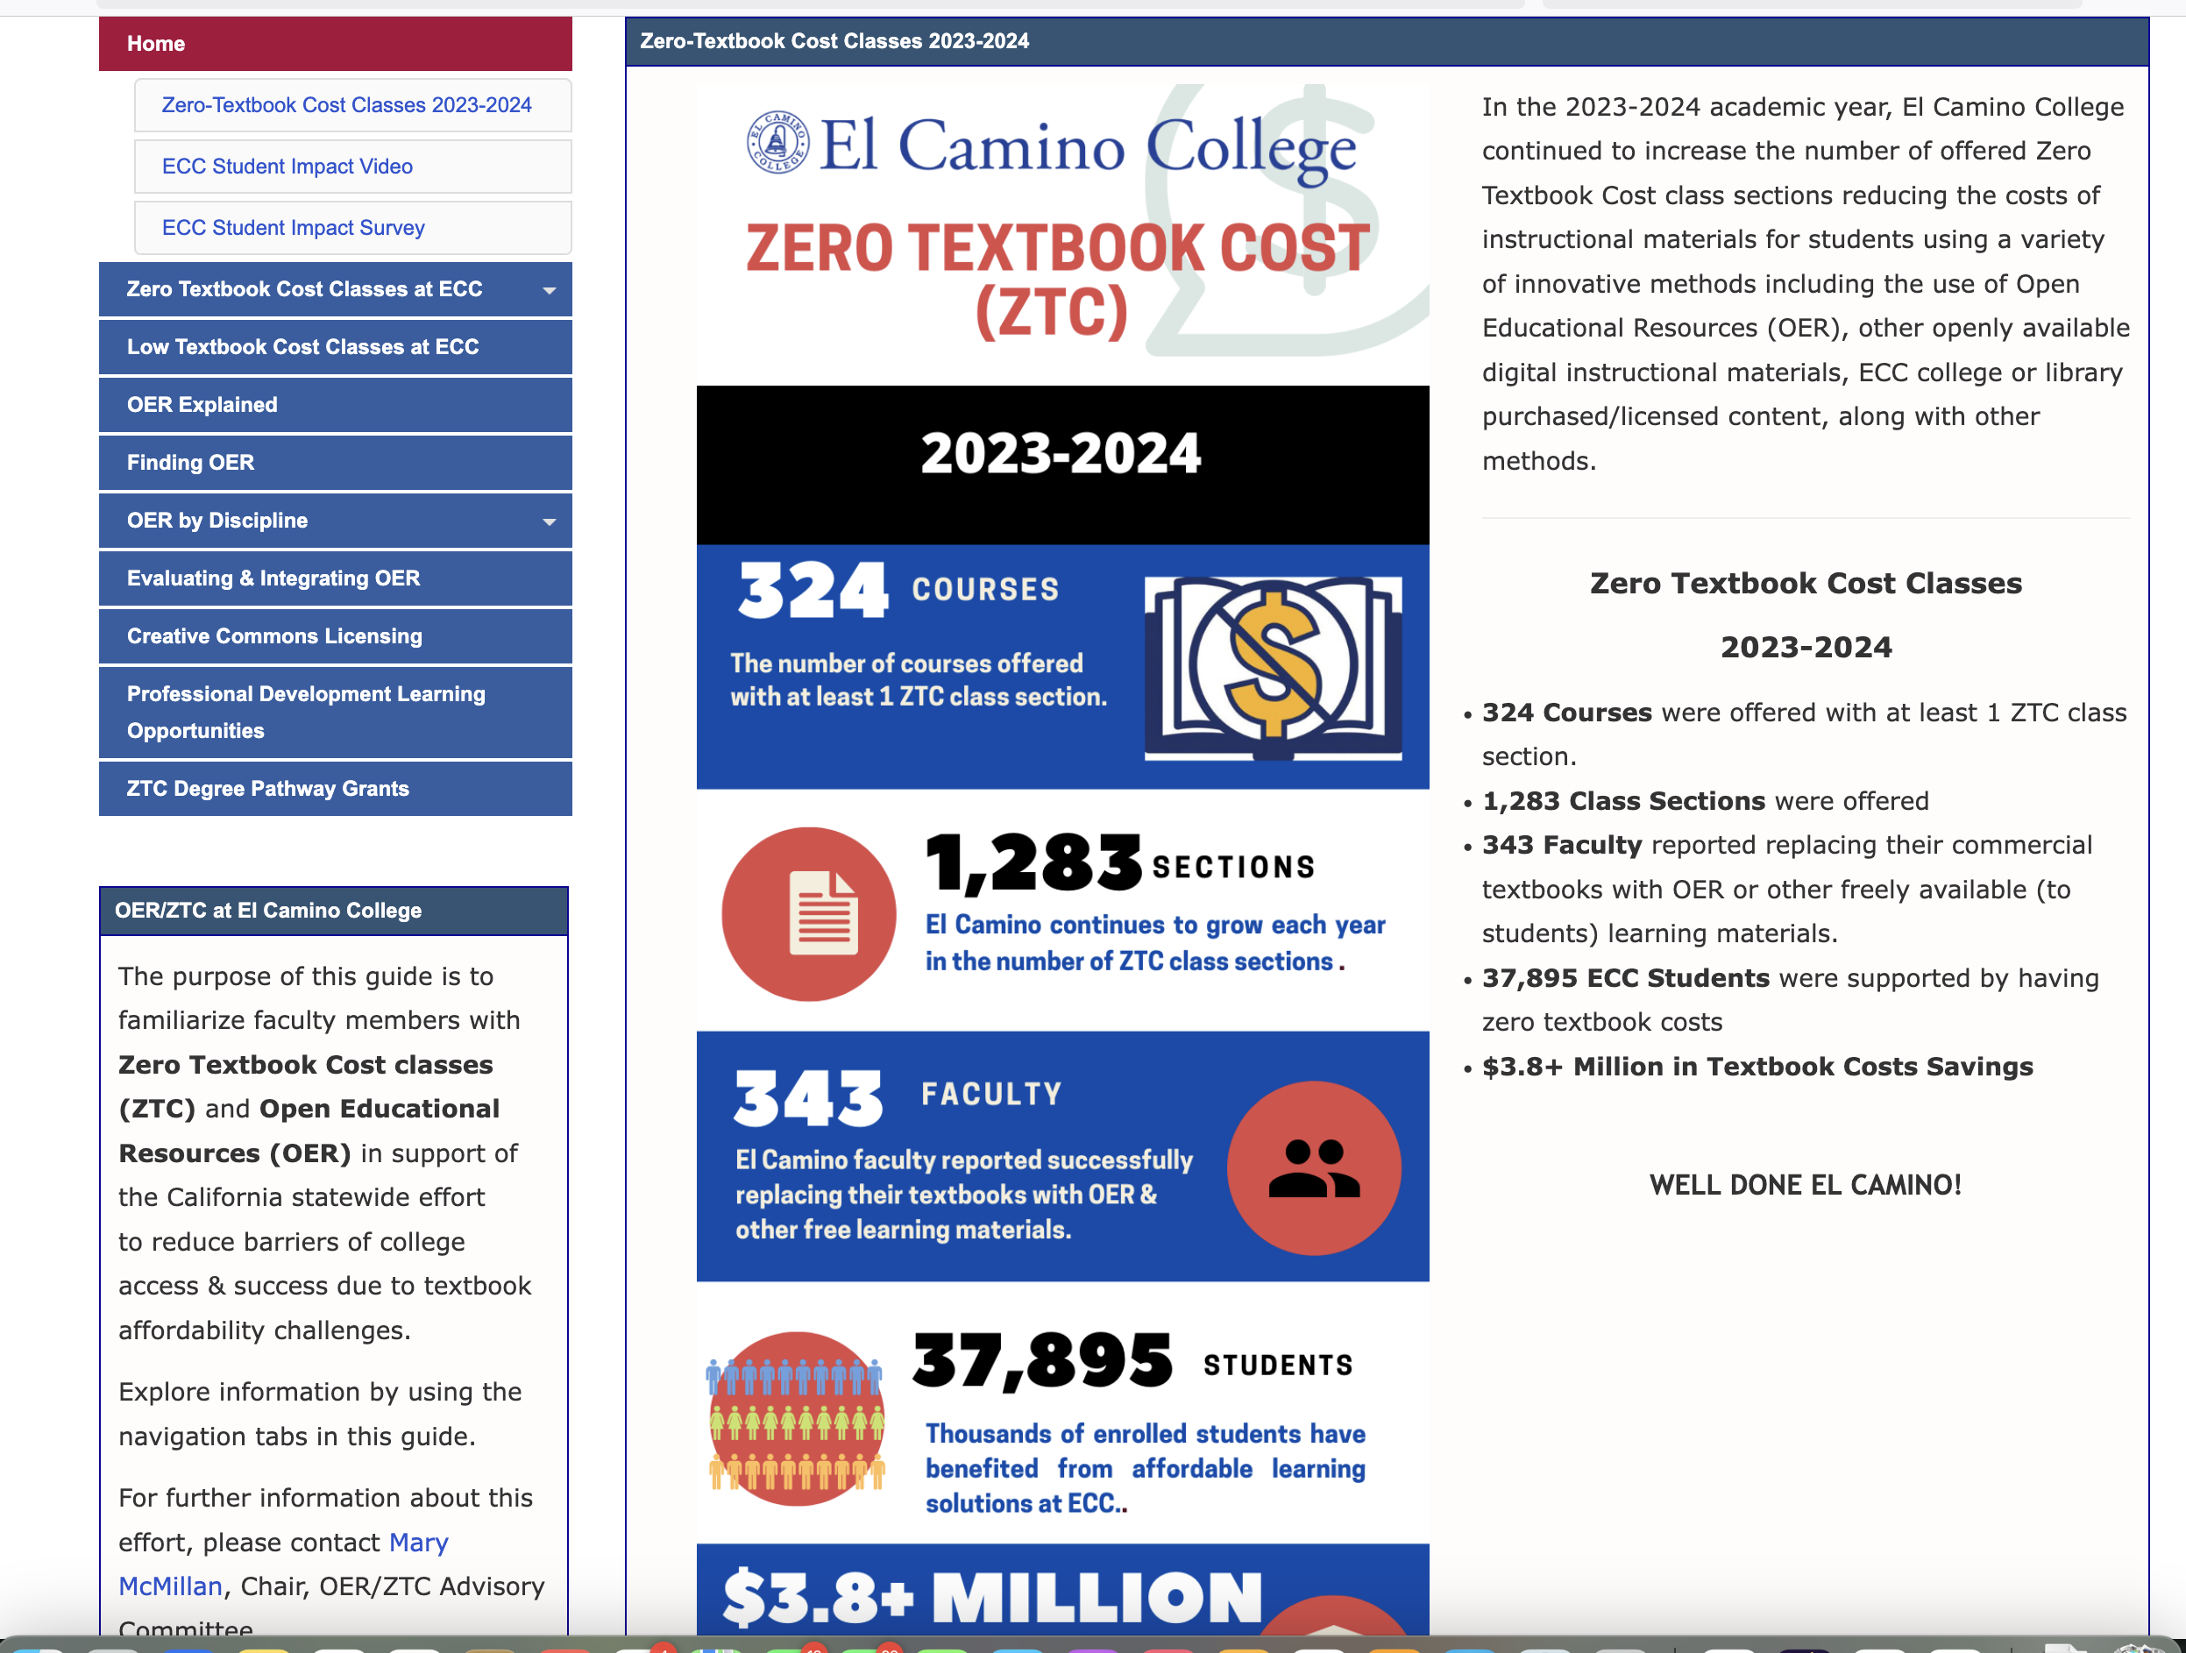
Public-Facing URLs for No-Cost Guidelines
49 colleges
provided a URL
Notes:
Despite fewer colleges having confidence in their guidelines, plenty are willing to share.
https://libguides.elcamino.edu/oer/zerotextbookcost
We are reviewing what was submitted and will determine how best to share… But here is one example…
Other examples:
https://laspositascollege.edu/ztc/index.php
https://mvc.edu/academics/schedule/zero-and-low-cost-textbooks.php
https://scc.losrios.edu/admissions/enroll-in-classes/zero-textbook-costs
https://sdmesa.libguides.com/ZTC

Slide 24
Marking Processes Over time
Fall 2022
Fall 2023
Fall 2024
By dept or division – 20
Integrated into textbook adoption process – 28
Call to be identified, but no existing process – 11
No process – 6
Other – 27
By dept or division – 13
Integrated into textbook adoption process – 28
Integrated into scheduling process – 25
Call to be identified, but no existing process – 9
No process – 4
Other – 18
By dept or division – 17
Integrated into textbook adoption process – 35
Call to be identified, but no existing process – 11
No process – 3
Other – 34
Notes:
Absent the option to report integration into the scheduling process, the numbers of “others” surged.
Fall 2022 Other Response Explanations:
this designation does not appear in the schedule of classes or course catalog
Textbook adoption includes includes OER data but not required for all course sections if there is no textbook typically associated with course.
I believe they are planning to have it intergrated into the text-adoption process.
Department chairs report when schedule is staffed and bookstore has process for marking book required (and to choose if OER is being used) during the textbook adoption process
We are in the process of drafting and implementing a process
Faculty are supposed to submit forms to the bookstore regarding their text adoption but this isn't required so things fall through the cracks
Newly formed ZTC task force is developing recommendation for process.
The no-cost sections are entered in the SIS when the class schedule is finalized. Some also are identified into the text-adoption process when textbook orders are submitted, but not consistently
VPAA office asks faculty to complete and sign a "ZTC checklist to acknowledge that their course materials meet the criteria set out by SB 1359. The bookstore is sent a list of faculty who submitted the signed checklist. Then the bookstore enters book information on the class schedule.
The process is connected to the call for the schedule build and textbook adoption process
Faculty submit an Outlook form requesting the symbols and specifying the XB12 code; requests are vetted by OER liaison and bookstore
Faculty submit a form & their no-cost course materials; OER coordinators verify that these materials qualify as ZTC. We maintain a database of ZTC courses, by instructors, and communicate this to IOPS.
OER flagging process through OER Coordinator
Every semester faculty let division secretaries know if their courses are ZTC or Low Cost, and the secretaries add the appropriate symbols to the class schedule.
Faculty self designate and inform their chair and admin support when they accept their teaching assignment. They also inform the bookstore and are integrated but that data wasn't always accurate.
Faculty notify the curriculum systems manager when they are running a non-cost section.
A mixture of "there is no process" and trying to tie it into the textbook adoption process. We are in a trial and error phase of figuring something out.
Instructors have two ways to indicate textbook cost: through the bookstore and/or include in section notes. Someone (proposed to be department chairs) will enter the data into the scheduling software.
Faculty self-select classes as ZTC or LTC in Banner once the schedule goes live
We have a form connected to PeopleSoft that pushes data directly to the online class schedule and the eServices schedule where students register. However, we still rely on faculty to self-report and some don't do this. We try to examine the schedule to catch classes that aren't tagged properly. Faculty must also report separately to the bookstore.
The process we have used for several years is the third option - a call is sent out by the scheduling dean for faculty to fill out a Google Sheet with their ZTC sections. However, recently we have *also* been trying to coordinate this data collection with the bookstore's adoption process. In addition, our entire district is working on a way for faculty to identify their ZTC sections within our backend software, PeopleSoft, which has the advantage of cutting out middlemen and updating the online schedule for students immediately (this is planned to roll out later this semester).
We have a master list of instructors and courses that are marked every semester, when someone new wants a course marked it is evaluated by our OER liaisons and then added to the master list going forward.
We had an official process in place that has since been (unofficially) changed, resulting in less accurate reporting.
Bookstore provides us with a list of courses and textbooks. The OER liaison along with the course scheduler go through the list to determine which should have the designations in our catalog.
faculty are supposed to notify dept chair; chair is supposed to indicate ZTC in schedule gallys (not a good process, IMO, but a process nonetheless)
We send out a Google form for instructors to self-identify their courses as ZTC
Once the online schedule is ready, each faculty uses an online site to mark their course sections as OER/ZTC

Slide 25
Identifying no-cost sections – “Other”
Survey/form/request is sent out to faculty – 8
Something happens at the time of scheduling – 5
Department chairs mark or report designations – 4
Comply with XB 12 - 1
Manual review of bookstore adoption data - 1
Instructor initiated. - 1
Notes:
35 report

Slide 26
“Other” - continued
Faculty are reminded to self-designate sections in our SIS. This occurs in conjunction with the bookstore's text adoption process, but also separately from that. - 1
Spring 2025 we are implementing a new form process during the time faculty are getting assignments. - 1
Faculty submit the designation along with their book orders at the online bookstore website AND through a college form. -1
It is a combination of both a department process and it’s integrated in the textbook adoption process. -1
OER Librarian tracks ZTC, LTC, and non-ZTC sections and communicates to the curriculum system manager. - 1

Slide 27
Observations
Many colleges are gathering data through various means.
  Is this improving accuracy?
  Are all faculty beginning with the same understanding of what needs to be marked?
Streamlining is a goal for many – but few are there yet.
Consistency may be lacking
“When textbook orders are submitted, no-cost sections are identified, but it is up to each department or each faculty member to determine if their course is ZTC. What constitutes a ZTC course is not the same across the board. For example, some science classes with labs, will not mark their course ZTC because they require the purchase of lab supplies. While many art classes will mark their courses ZTC because they do not require a textbook - but they do require the purchase of art supplies.”

Slide 28
Are courses that do not use a text marked with the no-cost designation?
Fall 2022
Fall 2023
Yes – 42
No – 8
It depends on the dept or division – 15
I don’t know – 18
Other – 9
Yes – 50
No – 6
It depends on the dept or division – 14
I don’t know – 15
Other – 12
Notes:
Fall 2022 Other Response Explanations
Since guidelines are not clear, it is up to each faculty member. Marking is not consistent.
So long as they're using instructional materials, they are marked as ZTC; in some cases, that means that instructional videos are used in lieu of text.
Historically NO, but FA2022 some sections were marked ZTC in compliance with XB12 as a pilot run of tracking that class section-level data
our software system fails if we don't select a text, so we are forced to select a text that includes a price
Not sure currently, but this will be part of our process going foward.
I am not sure, I have to double check. However, all courses must have some sort of course materials, that's why I am not sure if there are any courses with no materials.
OER and ZTC use the same designation
This should be described in the course description
Yet to be determined

Slide 29
Fall 2024 - Are courses that do not require a text marked as no-cost?

Slide 30
Do you mark courses with no-text as no-cost?
If there are other instructional materials that could be considered, then it is marked ZTC. If not, then it's marked as no-text.
It depends on the instructor’s self-reporting. (4)
Our local definition also includes zero cost for supplies, so they would not receive the designation if they had a supply cost. For example, our ceramics class has no textbook but students are required to purchase clay.
Yes, if the faculty member has indicated that the section is not using a textbook and there are no associated costs.
Notes:
1st response – no-text is not ZTC. Conflicts with the CO’s definition of ZTC. 3rd response – local definition is not aligned with ZTC or XB12. 4th is unclear.

Slide 31
Things to contemplate…
Inconsistencies exist within colleges and across colleges regarding everything.
Are there things that should be consistent across all colleges?
What kinds of guidance/direction would colleges benefit from?

Slide 32
Things to consider…
Clarify definitions to remove inconsistences between course-marking practices, XB12, and ZTC definitions – within and across colleges.
  No-cost per XB12 = no-cost marking and ZTC
Targeted survey to clarify local compensation for ZTC/OER work.
Effective practices for gathering no-cost marking data – highlighting approaches that appear to work.

Slide 33

Questions? Comments?

Slide 34

Photo of a Dog
Photo by Joe Caione on Unsplash

Slide 35
More Information
ASCCC OERI Website (asccc-oeri.org)
  Resources
  Webinars and Events
ASCCC OER E-Mail (oeri@asccc.org)
General OERI E-Mail: oeri@asccc.org

Slide 36

Thanks!
Photo by Thgusstavo Santana from Pexels

