Slide 1
The Open Educational Resources Initiative (OERI) and the Zero Textbook Cost (ZTC) Degree Program
Revised February 7, 2025. OERI Friday Forum, February 7, 2025, 10:30 am – 11:30 am
This work is licensed under a Creative Commons Attribution 4.0 International License.
Attribute this slide deck as: "The OERI and the ZTC Degree Program" by ASCCC OERI is licensed under CC BY 4.0.

Slide 2
Event Description
In light of the recent changes in the approach to the expenditure of the ZTC Degree Program funds, how will the work of the OERI change? Join us to discuss the OERI’s goals and plans – and to share your ideas and questions.

Slide 3
Overview
OER and ZTC
What happened?
What does this mean for:
OER Liaisons?
Discipline Leads?
the OERI
OER Platform
What’s next?

Slide 4
OER and ZTC
While not every course can achieve ZTC status with OER, ASCCC has identified OER as the preferred approach.
The ASCCC recognizes OER as the preferred and most sustainable mechanism for eliminating course costs but acknowledges that instances will arise in which eliminating costs is not possible;
The ASCCC asserts that while OER can reduce or eliminate instructional materials and textbook costs, resources should be dedicated to convening discipline faculty to determine the most sustainable mechanisms for reducing the costs of course resources; and
The ASCCC encourage the use of approaches that significantly reduce course resource costs such that course sections with a low-cost can obtain ZTC status by virtue of the cost being absorbed by the college, district, or the state.
Notes:
While OER is a subset of ZTC, it is an important subset – and has been formally recognized as such by the ASCCC.

Slide 5
OERI and the ZTC Degree Program
OERI’s work across the state established a network of OER advocates that were prepared to engage in OER work once the funds were available.
The OERI infrastructure also meant OERI was well-prepared to serve the ZTC Degree Program as needed.
Actively ensuring awareness of available OER and facilitating discipline conversations.
Notes:
These are all things that were true of the OERI before the ZTC Degree Program even existed.

Slide 6
Existing Curated OER Collections (tinyurl.com/ZTC4CCCs)
Searchable ASCCC OERI OER by C-ID Collection
Collaboration Cohort Reported OER Usage by C-ID
OER by Discipline
OER by California State University General Education
OER by the California General Education Transfer Curriculum (Cal-GETC)
OER by Transfer Model Curriculum
OER by C-ID can be found on the COOL4Ed website – “C-ID” refers to the Course Identification Numbering System that establishes articulation among the California Community Colleges.
ASCCC OERI – Identified Gaps in OER Availability

Slide 7
Disciplines Identified as Having No Gaps (Associate Degrees for Transfer)
Biology
Business Administration
Chemistry
Child and Adolescent Development
Computer Science
Early Childhood Education (ECE)
Economics
Environmental Science
Geography
Mathematics
Physics
Psychology
Social Work and Human Services
Sociology

Slide 8
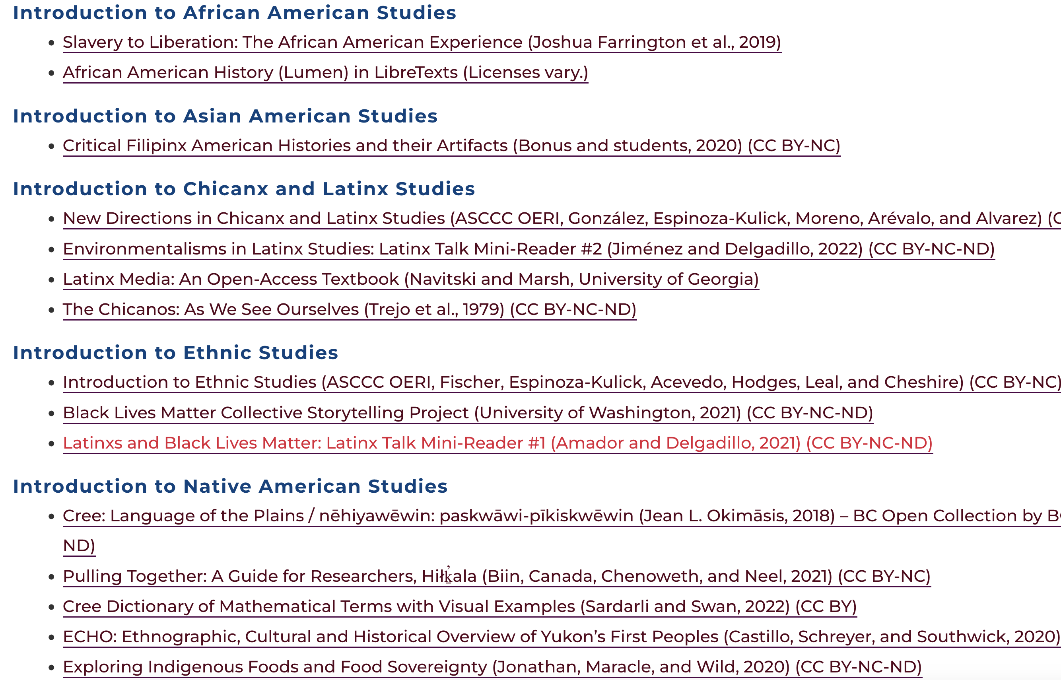
Cal-GETC – Area 6

Slide 9
On-Going Efforts
Improving Searchability
Facilitating Communication
Documenting Impact
Of OER
Of OERI
Ensuring faculty awareness and understanding of cost-related measures (regulation, law, coding)

Slide 10
What happened?
In December of 2024, while colleges were awaiting funding determinations for various ZTC grants, the California Community Colleges Chancellor’s Office (CCCCO) modified its approach, opting to disburse money to the colleges and routing funds to the OERI at the same time.
Additional funds have also been set aside to procure an OER platform for the system as recommended by the Burden-Free Instructional Materials Task Force. (2024 Report Advancing Equity in Access, Support and Success through Burden-Free Instructional Materials)
Notes:
URL for report - https://www.cccco.edu/-/media/CCCCO-Website/docs/report/2024-burden-free-instructional-materials-4-15-24-a11y.pdf

Slide 11
December 19 – ZTC 2025 Allocation
ZTC 2025 Allocation ESLEI-24-17
.. colleges will be allocated $400,000 ($400K) to implement at least two additional ZTC academic program pathways.
The OERI will provide lists of high-quality OER materials for multiple subject matter program pathways and courses that colleges can consider for adaptation and/or adoption.
The CCCCO will use 20% ($80K) of each allocation to support a contract with the OERI to assist local efforts and the sustainability of statewide ZTC efforts.
Each college will receive $320K through district apportionment at first principal allocation for the work of implementing a minimum of two ZTC pathways.
CCCCO ZTC Listserv Communications (https://tinyurl.com/ZTCList) The OERI archives all ZTC-related communications that are sent on the ZTC listserv. Subscribe to the ZTC listserv.

Slide 12
December 19 memo - continued
Colleges can use the funds to support ZTC/OER Coordinator positions, faculty stipends for OER implementation, professional development in ZTC/OER, and other related ZTC expenses that are reasonable and justifiable to produce ZTC Degree Grant Program outcomes.
Colleges will receive support under the ASCCC OERI contract for any further OER expansion efforts including curation, maintenance, and pathway development.
OERI will also assist the colleges with ZTC/OER by supporting the recruitment of college faculty across the system to create discipline-specific materials, resulting in more availability of high-quality OER materials, as well as a sustainable, collaborative OER collection.
OERI will work directly with participating colleges to target difficult to convert courses and under-resourced academic programs to build a robust OER collection that will support associate degree for Transfer (ADT) pathways and Cal-GETC general education courses.
OERI will update adopted resources to ensure they are current and relevant.

Slide 13
Wait a minute…
I was just informed that I didn’t get any or all of the funds my college requested – yet now I have to develop two additional ZTC pathways?
And you’re giving money to OERI to help me to do this?
What can OERI do for me?
Photo by Paolo Nicolello on Unsplash

Slide 14
January 13, 2025 – Update: ZTC/OER Grants
In order to support systemwide OER-based ZTC pathways, we prioritized the ZTC 2025 Allocation, ensuring all colleges will receive foundational funds to further develop and implement OER-supported ZTC program pathways. This allocation provides $320K for colleges to locally determine how to best use the funds to serve their ZTC implementation efforts.
For example, the funds may also be used to support costs associated with ZTC Acceleration efforts, and funds can be directed toward ZTC Acceleration II and Impact Grant program pathways that did not receive a recent grant award notification (*that were not funded or were underfunded). Colleges should aim to be as efficient and effective as possible with these funds to benefit the maximum number of students.

Slide 15
Flexibility
Webinar on January 29 attempted to address questions about the 2025 ZTC Allocation
The CCCCO has emphasized that we have flexibility with respect to how the $320K is spent.
Important things to note:
The cost of any pathway can’t exceed $200K
How you report what you are going to do depends on what you are doing to do (e.g., Email, NOVA)
“All colleges must declare how they will use the 2025 ZTC Allocation by May 2, 2025.

Slide 16
What does this mean for OER Liaisons?
No change in the OERI’s expectations or the role of OERLs as defined by the OERI.
Increased support from the OERI for all aspects of OER work.
And we need to know what you need.
Photo by Thomas Bormans on Unsplash

Slide 17
What does this mean for OERI Discipline Leads?
We’re seeking new leads – and asking many of our existing leads to do more.
New leads to curate collections for their discipline – and to support their discipline colleagues. And to identify discipline needs.
Existing leads – piloting processes for updating resources.

Slide 18
What does this mean for the OERI?
OERI will continue to exist for at least a decade.
OERI can plan to facilitate the updating of existing resources.
OERI needs to support the colleges in their ZTC-supported OER work.
Ideally, making the work of local ZTC Leads easier.
OERI can provide project management guidance to collaborative projects and engage in facilitated resource development (recruiting faculty and then supporting them).

Slide 19
What’s OERI doing now?
Instructor-facilitated courses.
Developing project management course and resources.
Working with the Accessibility Center to ensure awareness of resources/support – and identifying OER-specific training needs that need to be met.
Two-way OER and accessibility listserv anticipated.
Let the OERI know your accessibility needs.
Discussing collaboration with CVC-OEI.
Expanding availability of Canvas courses populated with OER texts and ancillaries (making OER more adoptable).

Slide 20
What’s next?
Providing discipline-specific ADAPT training.
Images
Expanding the OERI’s image repository in Flickr
Identifying needed images and determining how to meet the need
Reviewing funded and unfunded pathways to inform future work
Tracking new OER being developed and facilitating its review
Expanding Inclusivity, Diversity, Equity, and Anti-Racism (IDEA) work

Slide 21
OER Platform – What do we know?
Referenced in the Burden-Free Instructional Materials Task Force (IMTF) recommendations.
12. Incentivize the adoption of OER by establishing a systemwide OER platform and identifying resources to support it. Minimum requirements include:
a. Allows faculty to create, host, share and modify teaching and learning materials (e.g., textbooks, homework, presentations, question banks and worksheets) with an emphasis on interoperability, security, modification/customization, accessibility and scalability.
b. Allows users to print openly licensed materials at a low-cost. (presumably at cost)
c. Provides predictive analytics to enable effective teaching and learning.
d. Provides system-level data and transparent public-facing data dashboard about repository usage and OER adoptions.
Referenced in January 13, 2025 communication:
The CCCCO is also in the process of designing and releasing an RFP to provide a robust, statewide OER platform for system use – a necessary next step in supporting a statewide OER infrastructure as recommended by the IMTF.
Developing a Request for Proposals has been tasked to the group working on implementing the recommendations.

Slide 22
What’s next with the OERI?
The OERI will move forward with providing the resources and professional development that we believe are needed – but we need to hear from you.
Do you have a specific local need and you believe the OERI can help? Invite us to visit.
Stay tuned!

Slide 23
More Information
ASCCC OERI Website (asccc-oeri.org)
Resources
Webinars and Events
ASCCC OER E-Mail (oeri@asccc.org)
General OERI E-Mail: oeri@asccc.org

Slide 24
Thanks!
Photo by Thgusstavo Santana from Pexels

