Slide 1
OERL Webinar: Exploring the Fall 2023 OER Liaison Survey Data
While we are waiting to start, feel free to introduce yourself in the chat
Please stay muted when not speaking to reduce audio issues
If you have questions, please use the raise hand feature or type your question in the chat
Thank you!!

Slide 2
Exploring the Fall 2023 OER Liaison Survey Data December 7, 2023
This work is licensed under a Creative Commons Attribution 4.0 International License.
Attribute this slide deck as: "Exploring the Fall 2023 OER Liaison Survey Data" by ASCCC OERI is licensed under CC BY 4.0.

Slide 3
Webinar Description
With this year’s OERL survey, the OERI continued to gather data on both marking no-cost course sections and the implementation of the XB12 data element. In addition, the focus of the survey was expanded to include local Zero Textbook Cost (ZTC) efforts and compensation for ZTC and OER work. What has and has not changed over the last year? And how can these survey data inform your local work? Join us for an exploration of our findings.
Notes:
*New

Slide 4
Our Agenda
Look at what has changed and has not changed over the past year?
Marking no-cost course sections
Implementation of the XB12 data element
Local Zero Textbook Cost (ZTC) efforts
Compensation for ZTC and OER work
How can these survey data inform your local work?

Slide 5
Number of Responses to OERL Survey
Fall 2022
Fall 2023
92
97

Slide 6
SB 1359 & Local Course Marking Process
Notes: SB 1359 (California Education Code 66406.9) requires that all course sections “that exclusively use digital course materials that are free of charge to students” be noted as such in the online course schedule.

Slide 7
Fall 2022 OERL Survey Questions – SB 1359 & Local Course Marking Process
Has SB 1359 been fully implemented at your college?
Has your college established clear guidelines for what constitutes a no-cost section?
What process is used to determine which course sections will be marked with the no- cost designation?
Are courses that do not use a text marked with the no-cost designation?
If you have not yet implemented SB 1359, when do you anticipate doing so? Please explain your response.

Slide 8
Fall 2023 OERL Survey Questions - SB 1359 & Local Course Marking Process
Has SB 1359 been implemented at your college?
Has your college established clear guidelines for what constitutes a no-cost section?
What process is used to determine which course sections will be marked with the no- cost designation?
Are courses that do not use a text marked with the no-cost designation?
In your opinion, should courses that do not use a text be marked with the no-cost designation?
If you have not yet implemented SB 1359, when do you anticipate doing so? Please explain your response.

Slide 9
Has SB 1359 been implemented at your college?
Fall 2022
Fall 2023
Yes – 32
Yes, but not confident being done appropriately – 48
No – 7
Other – 5
Yes – 34
Yes, but not confident being done appropriately – 57
No – 3
Other – 3
Notes:
Fall 2022 Other Response Explanations:
links to bookstore where course is described as using OER
These courses should have a note in the course description, however, this is not uniform or searchable.
I wouldn't say "fully." We have a text note, probably not marked 100% appropriately. We are implementing (for spring 2023) new processes for marking ZTC/LTC sections with an icon, for course search limiting by ZTC, and for collecting more accurate data to comply with MIS requirements.
Our commercial bookstore provides the information on the course schedule for textbooks, and therefor, for OER, as well. It's very inconsistent
We have contacted our Dean about getting this changed along with the definition of ZTC materials in our online catalog

Slide 10
Has your college established clear guidelines for what constitutes a no-cost section?
Fall 2022
Fall 2023
Yes – 57
No – 20
I don’t know – 9
Other – 6
Yes – 71
No – 13
I don’t know – 4
Other – 9
Notes:
Fall 2022 Other Response Explanations:
We are working on it
I am assuming the guidlines will reflect the MIS reporting definitions, but our newly formed task is looking at being sure faculty are aware of the guidelines, so we will clarify as necessary.
We follow the ASCCC guidelines for no-cost sections
Not quite. An awareness of OER and ZTC is growing
Faculty Senate approved definitions, but we have not implemented a system that ensures faculty are applying the definitions correctly and transferring their course info to admin. assts. who input this data for the online schedules. All divisions have their own process so we're trying to communicate with deans and other parties to develop a campus process.
Yes, but we are currently revising these criteria

Slide 11
What process is used to determine which course sections will be marked with the no-cost designation?
Fall 2022
Fall 2023
By dept or division – 20
Integrated into textbook adoption process – 28
Call to be identified, but no existing process – 11
No process – 6
Other – 27
By dept or division – 13
Integrated into textbook adoption process – 28
Integrated into scheduling process – 25
Call to be identified, but no existing process – 9
No process – 4
Other – 18
Notes:
Fall 2022 Other Response Explanations:
this designation does not appear in the schedule of classes or course catalog
Textbook adoption includes includes OER data but not required for all course sections if there is no textbook typically associated with course.
I believe they are planning to have it intergrated into the text-adoption process.
Department chairs report when schedule is staffed and bookstore has process for marking book required (and to choose if OER is being used) during the textbook adoption process
We are in the process of drafting and implementing a process
Faculty are supposed to submit forms to the bookstore regarding their text adoption but this isn't required so things fall through the cracks
Newly formed ZTC task force is developing recommendation for process.
The no-cost sections are entered in the SIS when the class schedule is finalized. Some also are identified into the text-adoption process when textbook orders are submitted, but not consistently
VPAA office asks faculty to complete and sign a "ZTC checklist to acknowledge that their course materials meet the criteria set out by SB 1359. The bookstore is sent a list of faculty who submitted the signed checklist. Then the bookstore enters book information on the class schedule.
The process is connected to the call for the schedule build and textbook adoption process
Faculty submit an Outlook form requesting the symbols and specifying the XB12 code; requests are vetted by OER liaison and bookstore
Faculty submit a form & their no-cost course materials; OER coordinators verify that these materials qualify as ZTC. We maintain a database of ZTC courses, by instructors, and communicate this to IOPS.
OER flagging process through OER Coordinator
Every semester faculty let division secretaries know if their courses are ZTC or Low Cost, and the secretaries add the appropriate symbols to the class schedule.
Faculty self designate and inform their chair and admin support when they accept their teaching assignment. They also inform the bookstore and are integrated but that data wasn't always accurate.
Faculty notify the curriculum systems manager when they are running a non-cost section.
A mixture of "there is no process" and trying to tie it into the textbook adoption process. We are in a trial and error phase of figuring something out.
Instructors have two ways to indicate textbook cost: through the bookstore and/or include in section notes. Someone (proposed to be department chairs) will enter the data into the scheduling software.
Faculty self-select classes as ZTC or LTC in Banner once the schedule goes live
We have a form connected to PeopleSoft that pushes data directly to the online class schedule and the eServices schedule where students register. However, we still rely on faculty to self-report and some don't do this. We try to examine the schedule to catch classes that aren't tagged properly. Faculty must also report separately to the bookstore.
The process we have used for several years is the third option - a call is sent out by the scheduling dean for faculty to fill out a Google Sheet with their ZTC sections. However, recently we have *also* been trying to coordinate this data collection with the bookstore's adoption process. In addition, our entire district is working on a way for faculty to identify their ZTC sections within our backend software, PeopleSoft, which has the advantage of cutting out middlemen and updating the online schedule for students immediately (this is planned to roll out later this semester).
We have a master list of instructors and courses that are marked every semester, when someone new wants a course marked it is evaluated by our OER liaisons and then added to the master list going forward.
We had an official process in place that has since been (unofficially) changed, resulting in less accurate reporting.
Bookstore provides us with a list of courses and textbooks. The OER liaison along with the course scheduler go through the list to determine which should have the designations in our catalog.
faculty are supposed to notify dept chair; chair is supposed to indicate ZTC in schedule gallys (not a good process, IMO, but a process nonetheless)
We send out a Google form for instructors to self-identify their courses as ZTC
Once the online schedule is ready, each faculty uses an online site to mark their course sections as OER/ZTC

Slide 12
Are courses that do not use a text marked with the no-cost designation?
Fall 2022
Fall 2023
Yes – 42
No – 8
It depends on the dept or division – 15
I don’t know – 18
Other – 9
Yes – 50
No – 6
It depends on the dept or division – 14
I don’t know – 15
Other – 12
Notes:
Fall 2022 Other Response Explanations
Since guidelines are not clear, it is up to each faculty member. Marking is not consistent.
So long as they're using instructional materials, they are marked as ZTC; in some cases, that means that instructional videos are used in lieu of text.
Historically NO, but FA2022 some sections were marked ZTC in compliance with XB12 as a pilot run of tracking that class section-level data
our software system fails if we don't select a text, so we are forced to select a text that includes a price
Not sure currently, but this will be part of our process going foward.
I am not sure, I have to double check. However, all courses must have some sort of course materials, that's why I am not sure if there are any courses with no materials.
OER and ZTC use the same designation
This should be described in the course description
Yet to be determined

Slide 13
In your opinion, should courses that do not use a text be marked with the no-cost designation?
Fall 2023
Yes – 75
No – 5
Other – 17
Should be separate
Only if no cost at all
More codes would be helpful

Slide 14
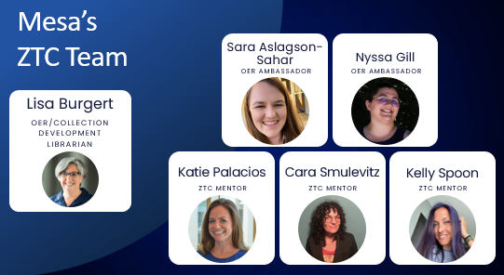
OER/ZTC at Local Colleges
Notes: Fall 2023’s focus was to gather information regarding your local permanent OER-related efforts and grant-funded temporary positions and committees or task forces.

Slide 15
Fall 2022 OERL Survey Questions – OER/ZTC at Local Colleges
Has your college established a committee or task force to guide your local OER, ZTC, and/or textbook affordability efforts?
Does your college support OER and/or ZTC efforts in other ways?
What barriers to the establishment of ZTC pathways at your college do you anticipate?
What questions, if any, about the ZTC Program do you have?

Slide 16
Fall 2023 OERL Survey Questions – OER/ZTC at Local Colleges
Has your college funded a position to guide your local OER, ZTC, and/or textbook affordability efforts? (not via grants
Has your college established a permanent standing committee to guide your local OER, ZTC, and/or textbook affordability efforts?
Has your college identified a grant-funded lead or leads for your local ZTC efforts?
What role, if any, does your OER Liaison play in your local ZTC efforts?
Does your college support OER and/or ZTC efforts in other ways?

Slide 17
Fall 2023 OERL Survey Questions – OER/ZTC at Local Colleges (cont.)
What barriers to establishing ZTC pathways at your college do you anticipate or have you encountered?
Which of the following Cal-GETC (Cal-GETC Standards) general education area or areas, if any, would benefit most from the availability of more OER options?
What was the basis for your selections and ranking in response to #19?
Is your college using library resources to get courses to zero?
What questions, if any, about the ZTC Degree Program established in 2021 do you have?
Which of the following providers for professional development regarding OER and ZTC have your faculty used?

Slide 18
Has your college funded a position to guide your local OER, ZTC, and/or textbook affordability efforts?
Fall 2023
Yes – 29
No – 68

Slide 19
Has your college established a committee or task force to guide your local OER, ZTC, and/or textbook affordability efforts?
Fall 2022
Fall 2023
Yes – 55
No – 16
In process – 16
Other – 5
32 are Senate committees
51 are chaired by faculty
Added “permanent”
Yes – 43
No – 29
In process – 13
Other – 12
35 are Senate committees
41 are chaired by faculty
Notes:
Fall 2022 Other Response Explanations:
It is being resurrected. I am co-chairing it.
it's an ad hoc task force
District wide committee for San Diego Community Colleges
Yes, but very recently so the committee will have it's first meeting this month.
Yes, but it was limited term and has since ceased meeting

Slide 20
Has your college identified a grant-funded lead or leads for your local ZTC efforts?
Fall 2023
Yes – 60
No – 17
I don’t know – 5
Other – 12

Slide 21
What role, if any, does your OER Liaison play in your local ZTC efforts?
Fall 2023
Is ZTC Lead – 58
On Committee Guiding ZTC Work – 35
Chairs Committee + 30
None – 2
Other – 17

Slide 22
Does your college support OER and/or ZTC efforts in other ways?
Fall 2022
Fall 2023
No, just OERL – 40
Yes, faculty with reassigned time – 21
Yes, staff or admin – 20
Yes, FT faculty – 7
Yes, student worker/s – 5
No one – 0
Other – 30
No, just OERL – 35
Yes, faculty with reassigned time – 25
Yes, staff or admin – 25
Yes, FT faculty – 5
Yes, student worker/s – 3
No one – 1
Other – 23
Notes:
Fall 2022 Other Response Explanations
A faculty member was recently given 20% overload to support these efforts
A part time faculty member get additional hours paid through SEA funds and with a stipend.
Based on the ZTC grant from the CO, the some of the faculty who will be doing work in OER will be receiving stipends. Largely the work is being done by the OER Liaison without any reassign time.
Faculty can take sabbaticals to do OER-/ZTC-related work.
Faculty take sabbaticals to work on OER, The ZTC Grant Work Group is supported by the admin. asst., director and faculty co-coordinator of the Guided Pathways Office. This partnership is working much better than the Faculty Senate OER Work group.
FT OER/Collection Development Librarian (40% OER), 2 Part-Time temporary staff support OER/ZTC
full-time librarian focused part-time on OER + reassigned time to one faculty member to support OER efforts
I am a full time faculty who in addition to my teaching duties, liaison on the OER/ZTC effort for the whole campus
I receive 20% release time from the Senate budget to be the OERC.
Librarian will serve as OER/ZTC Librarian
Library works with faculty to find OER
new full-time Equity Librarian who will be desgnated to support
Our college currently has a faculty member with reassigned time to support OER and ZTC, but this is temporary and funded by HEERF funds.
Our college is currently in a limbo period with our Distance Education Coordinator position being unfilled for the time being due to a recent retirement. This coordinator position also oversees OER/ZTC initiatives for the campus.
Our college somewhat provides reassigned time to a faculty member to support OER/ZTC: one classroom faculty has reassigned time, and the library faculty member has "dedicated OER time" in name only
Our DE coordinator has been tasked to spend part of her time on OER/ZTC efforts
Really mostly just a liaison, but our task force is co-chaired by helpful executive dean.
Stipends for faculty developing OER course shells. Admin is also supportive.
The liaison supports OER. We did get some special project funds for OER efforts starting Summer 2022. This was for several faculty. And we received more for Fall. College money, not grant funded.
The library has assisted. Funds have been used to purchase textbooks for some courses. Conversion to OER is mostly a faculty labor of love.
The Library is unofficially in charge of OER/ZTC, although there is no dedicated librarian (I do the work whenever I can)
The library priorities OER efforts as part of their workload.
the reassigned time for faculty is temporary, only for this academic year; there is no promise of ongoing support
We are continuing to use HERRF funds to facilitate faculty moving their courses to OER
We have a cadre of Liaison, FT & PT faculty, Dean of Instruction, and librarians with dedicated hours.
We have an OER Liaison because ASCCC OERI supports this.
We have grass-roots support and activities are being planned and implemented, but not one has an official role tied into OER/ZTC, yet!
We have librarian who has OER ZTC as one of their responsibilities and another librarian is working on ZTC pathways as one of their responsibilities. We work together on all aspects.
While none of these apply, faculty and classified are being paid a stipend to coordinate Phase 1 of the CCCCO ZTC grant and we expect at least a .2 assignment for Phase 3. That said, it will not be reassigned time
Yes, our college has a full-time faculty member with the OER Workgroup as part of their committee assignment.

Slide 23
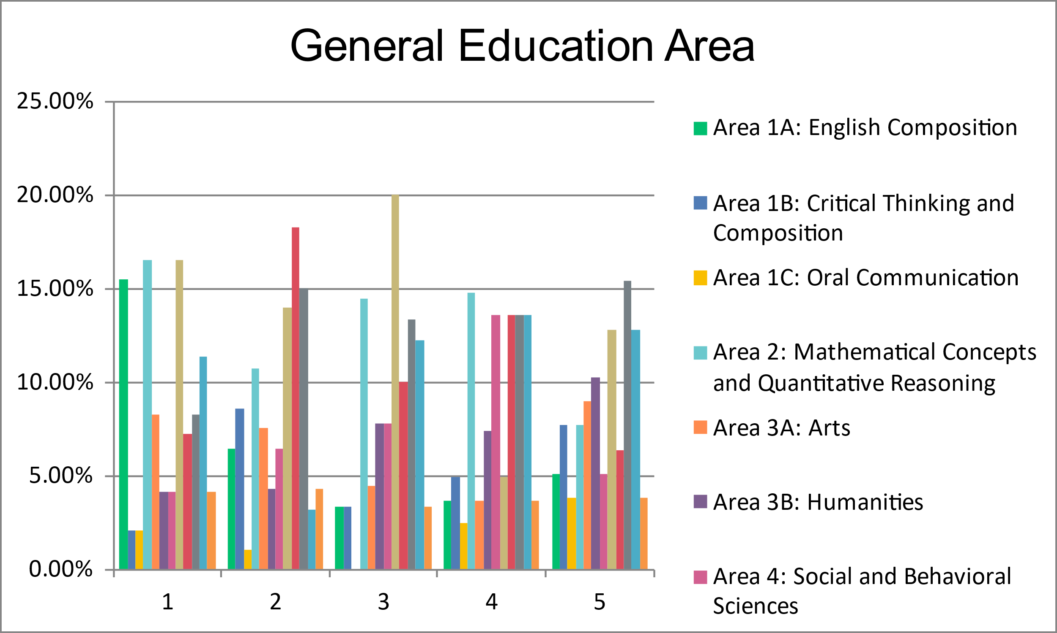
Which of the following Cal-GETC GE area/s, if any, would benefit most from the availability of more OER options?
Fall 2023

Slide 24
What was the basis for your selections and ranking of GE Area/s that would benefit most from more OER?
Fall 2023
Mapping data – 42
Intuition – 8
Discussed with or surveyed area faculty – 25
I don't believe that any particular areas are in need of resources – 1
I don't have sufficient information to answer the prior question - 5
Other – 16
Different methods for different areas
Multiple methods
Reviewed schedule of classes

Slide 25
Is your college using library resources to get courses to zero?
Fall 2023
Yes – 68
No – 7
I don’t know – 12
Other – 10
Working on this with grant funds
Databases
In process
Will not be adequate
Sustainability

Slide 26
Which of the following providers for professional development regarding OER and ZTC have your faculty used?
Fall 2023
ASCCC OERI Events – 91
OERI Discipline Lead webinars – 75
ASCCC OERI Courses – 55
@ONE Courses – 46
CCCOER Webinars – 53
ZTC Technical Assistance Provider – 32
Other – 19
OERL, ZTC Lead/Coordinator, Local
OFAR
LibreTexts
Conferences

Slide 27
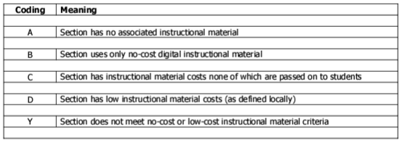
XB12 Implementation
Notes:
XB12 Instructional-Material-Cost
Includes the option of identifying course sections that have low instructional material costs (as defined locally).

Slide 28
Fall 2022 OERL Survey Questions – XB12 Implementation
Has the XB12 data element been implemented at your college?
Has your college adopted a definition for low instructional material cost?
If so, what is that definition (cost)?

Slide 29
Fall 2023 OERL Survey Questions – XB12 Implementation
Has the XB12 data element been implemented at your college?
Has your college adopted a definition for low textbook cost?
If so, what is that definition (cost)?

Slide 30
Has the XB12 data element been implemented at your college?
Fall 2022
Fall 2023
Yes – 24
No – 24
I have no idea – 24
Other – 20
Yes – 45
No – 15
I have no idea – 19
Other – 18
In Process

Slide 31
Has your college adopted a definition for low instructional material cost?
Fall 2022
Fall 2023
Yes – 60
No – 30
Yes – 81
No – 16

Slide 32
Definition (cost) of Low Textbook Cost
Fall 2022
Fall 2023
Equal to or less than
$20 – 3
$30 – 5
$35 – 1
$40 – 32
$50 – 21
Equal to or less than
$30 – 13 (+4)
$35 – 2
$40 – 35
$50 – 27
Other – 4
Changing

Slide 33
How can these survey data inform your local work?
How have you used these data?
How might you use these data moving forward?

Slide 34
Thank You!
For more information
Survey Information: https://asccc-oeri.org/oer-liaison/
OER, ZTC, and XB12: https://asccc-oeri.org/oer-and-ztc/
Contact us: oeri@asccc.org

