Slide 1


Welcome OER Liaisons!
On behalf of the ASCCC OERI, we are pleased to have you here for one of our term “kick-offs”.
If you are not already muted, please mute yourself upon arrival. As this is set up as a meeting, we will be able to have an actual discussion – but we need all those who are not speaking to be muted.
You are also encouraged to use the “chat” feature.

Slide 2
ASCCC OERI Spring 2025 OER Liaison Kick-Off
Revised January 28, 2025.
This work is licensed under a Creative Commons Attribution 4.0 International License.
Attribute this slide deck as: "ASCCC OERI Spring 2025 OERL Kick-Off" by ASCCC OERI is licensed under CC BY 4.0.

Slide 3
Overview
OER Liaison Basics
ZTC Developments
Course Cost Transparency
OER Adoption Data
Local Senate Visits

Slide 4

OERI’s Goal?
Increase the use of open educational resources in lieu of commercial texts by all reasonable means available.
Photo by Markus Winkler on Unsplash

Slide 5
Increase OER Use By…
Increasing awareness
Increasing the availability of high-quality OER
Making the adoption of OER easier
Supporting you to help your faculty join us…

Slide 6
OERI Regional Leads
Amanda Taintor (Area A)
  Early Childhood Education, Reedley
Heather Dodge (Area B)
  Library, Berkeley City
Jennifer Paris (Area C)
  ECE/CD, College of the Canyons
Lara Braff (Area D)
  Anthropology, Grossmont

Slide 7
Other OERI Personnel
Project Director
  Michelle Pilati – Psychology, Rio Hondo
OERI Project Facilitators
  Shagun Kaur - Communication Studies, De Anza
  Suzanne Wakim - Biology, Butte
Communication Lead
  Julie Bruno – Communication Studies, Sierra
IDEA Framework Lead
  Tiffany Lanoix – Sociology, West Los Angeles

Slide 8
OERI Anticipated Structural Changes
More discipline leads
  Please encourage interested faculty in all disciplines to submit an application (tinyurl.com/DL4OERI)
More responsibilities for some existing discipline leads
Additional OERI personnel to be identified and recruited, as needed

Slide 9
Stay Informed
As an OER Liaison, you will receive the OERI and the OER Liaison Newsletters. You may wish to forward the OERI Newsletter to your college community. The OERL Newsletter:
  Contains information intended just for OERLs (and general information)
  Typically distributed before the OERI Newsletter
Discipline Listservs – encourage your colleagues to sign up
Canvas Course

Slide 10
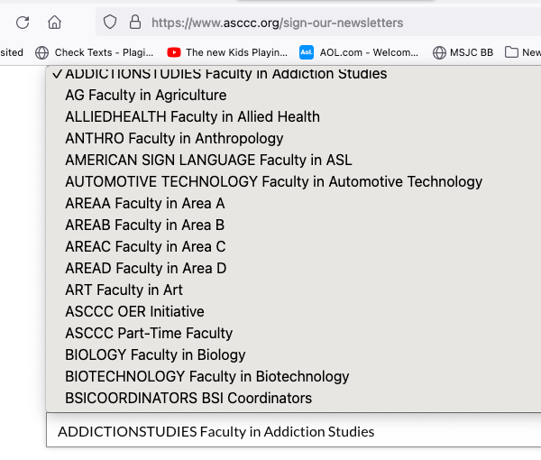
ASCCC.org > Resources
https://www.asccc.org/resources > Subscribe to Listservs
Notes:
Discipline list-servs are used for discipline-specific communications – recruiting Discipline Leads, sharing new resources, matchmaking for projects, etc.

Slide 11
Canvas Course
Although we are no longer adding content to the course, we do use it for communication – and we populate its calendar with our events.
Self-enroll at: https://ccconlineed.instructure.com/enroll/7RJL33.
"Enrollment" is necessary to receive communications.
Direct access via: tinyurl.com/ASCCC-OpenEd

Slide 12
ASCCC-OERI.org
  Your go-to for everything (we hope)
  Updated regularly
  Archives of webinars and newsletters
  Curated Collections – by discipline, TMC, GE
  OER and ZTC – (tinyurl.com/OER4ZTC)
    Everything available can be found under “The ZTC Degree Program”
    Scroll to the bottom of the main page for information on existing ZTC pathways
    Archived ZTC list-serv messages (https://tinyurl.com/ZTCList)
Notes:
ZTC list-serv archives - https://asccc-oeri.org/ztc-listserv-communications/

Slide 13
Spring 2025 OERL Expectations
Complete – and document – your Spring 2025 OER Liaison activities by Friday, May 9, 2025. Activities should be tracked throughout the term via the Spring 2025 Liaison Tracking Spreadsheet (tinyurl.com/OERL-2025S )
Attend an OER Liaison Fall 2024 Kick-Off. ✔️
Notes:
Spring 2025 Expectations: https://asccc-oeri.org/wp-content/uploads/2024/12/OER-Liaisons-Spring-2025-Expectations-Final.pdf
Tracking sheet:
https://docs.google.com/spreadsheets/d/1csVLaWbHftIwfUDcl7MjWgMJeytd5DmHTvg8FSZAdZI/edit?gid=52749986#gid=52749986

Slide 14
Expectations (continued)
Attend two additional OERI or OERL Events (Webinars or Conversations) during the term, or host one.
Communicate with your local senate and faculty regarding the work of the OERI by forwarding the OERI Newsletter broadly and reaching out to specific faculty and departments as warranted.
Check-in at least twice with an OERI representative to share local needs and issues.

Slide 15

Important
You are our connection to your college.
If you are not able to push communications to your college community as needed, please contact your Regional Representative for assistance.
Photo by Will O on Unsplash

Slide 16
ZTC Developments
Many colleges did not receive the funding they sought. (this is a simplification and an understatement)
2025 ZTC Allocation to Colleges
  $320,000 to all degree-granting colleges. If a college has previously received all the funds it sought, these funds are to be used to establish two new pathways.
  If a college has not been ”fully funded”, these funds can be used to compensate.
2025 ZTC Allocation to OERI
  OERI funded for the foreseeable future
Notes:
The OERI’s role is not to explain or justify the actions of the CCCCO. Regarding #1 – many, if not most, colleges did not receive the funds they requested following the Collaboration Cohort process and the same is true of those trying to access Acceleration II funds. The CCCCO has emphasized the flexibility associated with the new allocation.

Slide 17
OERI and ZTC
OERI now has resources to address known needs using a systemwide approach
  Homework systems
  Increasing the adoptability of available OER
  Sustainability
Ideally, we find ways to take burdens off of local OERLs and ZTC leads
  Increasing available training
  “Train-the-trainer” approach to project management
What can OERI do for you?
Notes:
What can OERI do for you? This is the most important part of this slide – we have a sense of the systemwide needs – but we need to hear from the colleges.

Slide 18
Course Cost Transparency
(Burden-Free) Instructional Materials Task Force (IMTF) Implementation Committee/Workgroup/Task Force convened
  IMTF Recommendations
  Establishing workgroup to focus on a request for proposals for an OER platform
  Other workgroups focusing on other recommendations – funding/reducing costs, legislation/regulations, systemwide solutions
Timeline of Title 5 § 54221. Burden-Free Access to Instructional Materials. (AKA Day One Access to Course Materials) unknown
California Education Code 66406.9 – Is your college compliant?
Notes:
IMTF is about all costs – getting course materials to zero is just one element. The OER platform work is supposed to move quickly. As elements of the discussion are made public, the OERI will work get your input and ideas.
IMTF Recommendations - https://www.cccco.edu/About-Us/Chancellors-Office/Divisions/Educational-Services-and-Support/burden-free-instructional-materials/bfim-taskforce

Slide 19
What does California Education Code 66406.9 require as of January 1, 2025?
Prominently display, by means that may include a link to a separate internet web page, the estimated costs for each course of all required course materials and fees directly related to those materials, for no less than 40 percent by January 1, 2025, 55 percent by January 1, 2026, 65 percent by January 1, 2027, and 75 percent by January 1, 2028, of the total number of courses on the online campus course schedule for which a faculty member or course instructor has been assigned.
“Course materials” as used in this paragraph includes digital or physical textbooks, devices such as calculators and remote attendance platforms, and software subscriptions.
CCCCO is interpreting this as being limited to the listed elements – but encouraging colleges to focus on everything – all instructional materials - in anticipation of needed clarification.
Notes:
This is a slide from the fall – none of this has changed. https://leginfo.legislature.ca.gov/faces/codes_displaySection.xhtml?sectionNum=66406.9.&lawCode=EDC

Slide 20
OER Adoption Data
We need your help! The OERI has established a simple mechanism for any faculty member to report an OER adoption so that we may gather adoption and minor adaptation data as a component of the ZTC reporting. To report the adoption of a specific resource, please navigate to the relevant discipline collection or search for the resource in our OER by C-ID table. Each textbook equivalent will have a button that leads to a brief form.
Please share this information widely to help us in our data collection efforts.
Is there a better way to gather these data?

Slide 21
Local Senate Visits
The ASCCC – and OERI – are available to do visits to colleges to present on topics of interest.
These visits can be virtual – or in-person.
Interested? Just let the OERI know. (oeri@asccc.org)
No-cost to the hosting college

Slide 22
How can OERI help you?

Slide 23
More Information
ASCCC OERI Website (asccc-oeri.org)
  Resources
  Webinars and Events
ASCCC OER E-Mail (oeri@asccc.org)

Slide 24
And to contact us…
General OERI E-Mail: oeri@asccc.org
Find everyone’s e-mail at: https://asccc-oeri.org/about-us/

Slide 25

Thanks!
Photo by Thgusstavo Santana from Pexels

