Slide 1
Anatomy and Physiology Courses: Identifying and Addressing Barriers to Getting to Zero
March 14, 2025
This work is licensed under a Creative Commons Attribution 4.0 International License.
Notes:
The Open Washington Open Attribution Builder is a handy tool for creating your attributions, if you’d like to indicate how your work should be attributed or if you are using resources that require attribution. https://www.openwa.org/attrib-builder/ Including how your presentation is licensed on your title slide is an effective way of making this clear. OERI resources are most commonly licensed CC BY, allowing others to use and modify them – but requiring that they be properly attributed.

Slide 2
Welcome!
On behalf of the ASCCC OERI, we are pleased to have you here with us for “Anatomy and Physiology Courses: Identifying and Addressing Barriers to Getting to Zero”
If you are not already muted, please mute yourself upon arrival.
You’re invited to introduce yourself in the chat – please provide your name, college, discipline/role
This event will be recorded. Archives of all ASCCC OERI events are available at asccc-oeri.org > Webinars and Events

Slide 3
Description
During the 2020-2021 academic year, OpenStax indicated that at least one faculty member at 61 California community colleges reported adopting OpenStax Anatomy and Physiology. At about the same time, the OERI funded a team of faculty to separate out the anatomy components of the text to better meet the needs of discipline faculty [Human Anatomy (OERI)]. More recently, a team of faculty made additional updates to this text with a focus on creating or modifying images to better align to their courses [General Human Anatomy (Lange et al.)]. What further modifications would support the faculty at your college who are teaching anatomy and/or physiology? Join us to learn about the work in progress and potential solutions to collective challenges and, more importantly, to share your needs.
Notes:
A description of the presentation is included in the slide deck so that the purpose of the slide deck is established – and to inform anyone viewing the presentation as to what was planned.

Slide 4
Presenters
Suzanne Wakim, Project Facilitator, ASCCC OERI
Distance Education and Accessible Learning Resources Coordinator, Butte College
Ying Liu, Biology Lead, ASCCC OERI
Biology Instructor, City College of San Francisco
Visiting Scholar, University of Dundee
Jennifer Lange
Life Science Faculty, Chabot College
Harmony Folse
Life Science Faculty, Chabot College
Notes:
Presenters can be included following the description or the overview. Where images are used, they should include an attribution (Photo by…) and appropriate alternative text should be used (or the image marked decorative).

Slide 5
Anatomy Textbook - Versions and Upgrades
Human Anatomy (OERI) by Whitney Menefee, Julie Jenks, Chiara Mazzasette, & Kim-Leiloni Nguyen (CC BY)
separated anatomy content from OpenStax A&P
added anatomy content
updates to improve accessibility
added images
General Human Anatomy (Lange et. al) by Jennifer Lange, John Polos, Yancy Aquino, and Cheri Calcagno with illustrations by Justin Greene, Mark Schaeffer, Sophia Elizondo, Gabrielle Spurlock, and Claire McGuire (CC BY-NC-SA)
removed more physiology content
adjusted anatomy content to lower division course level
added/revised/changed hundreds of images
added an atlas with histology, models, and cadavers
added practical
original OpenStax questions were put into Adapt by Libretext

Slide 6
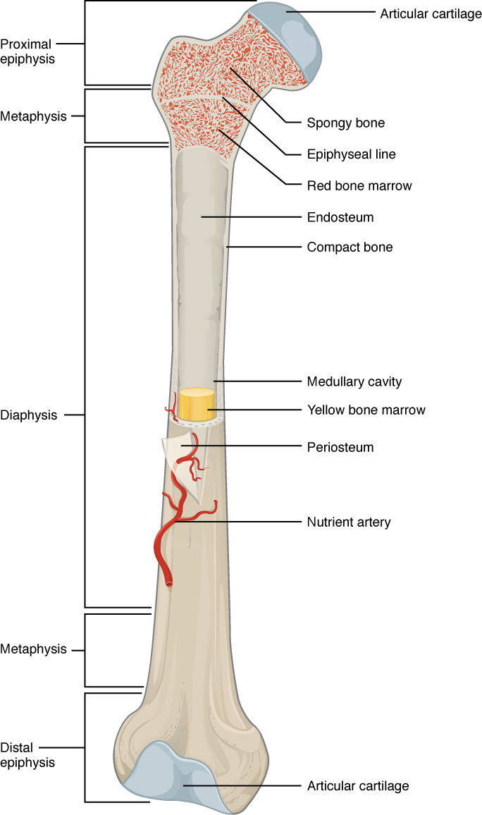
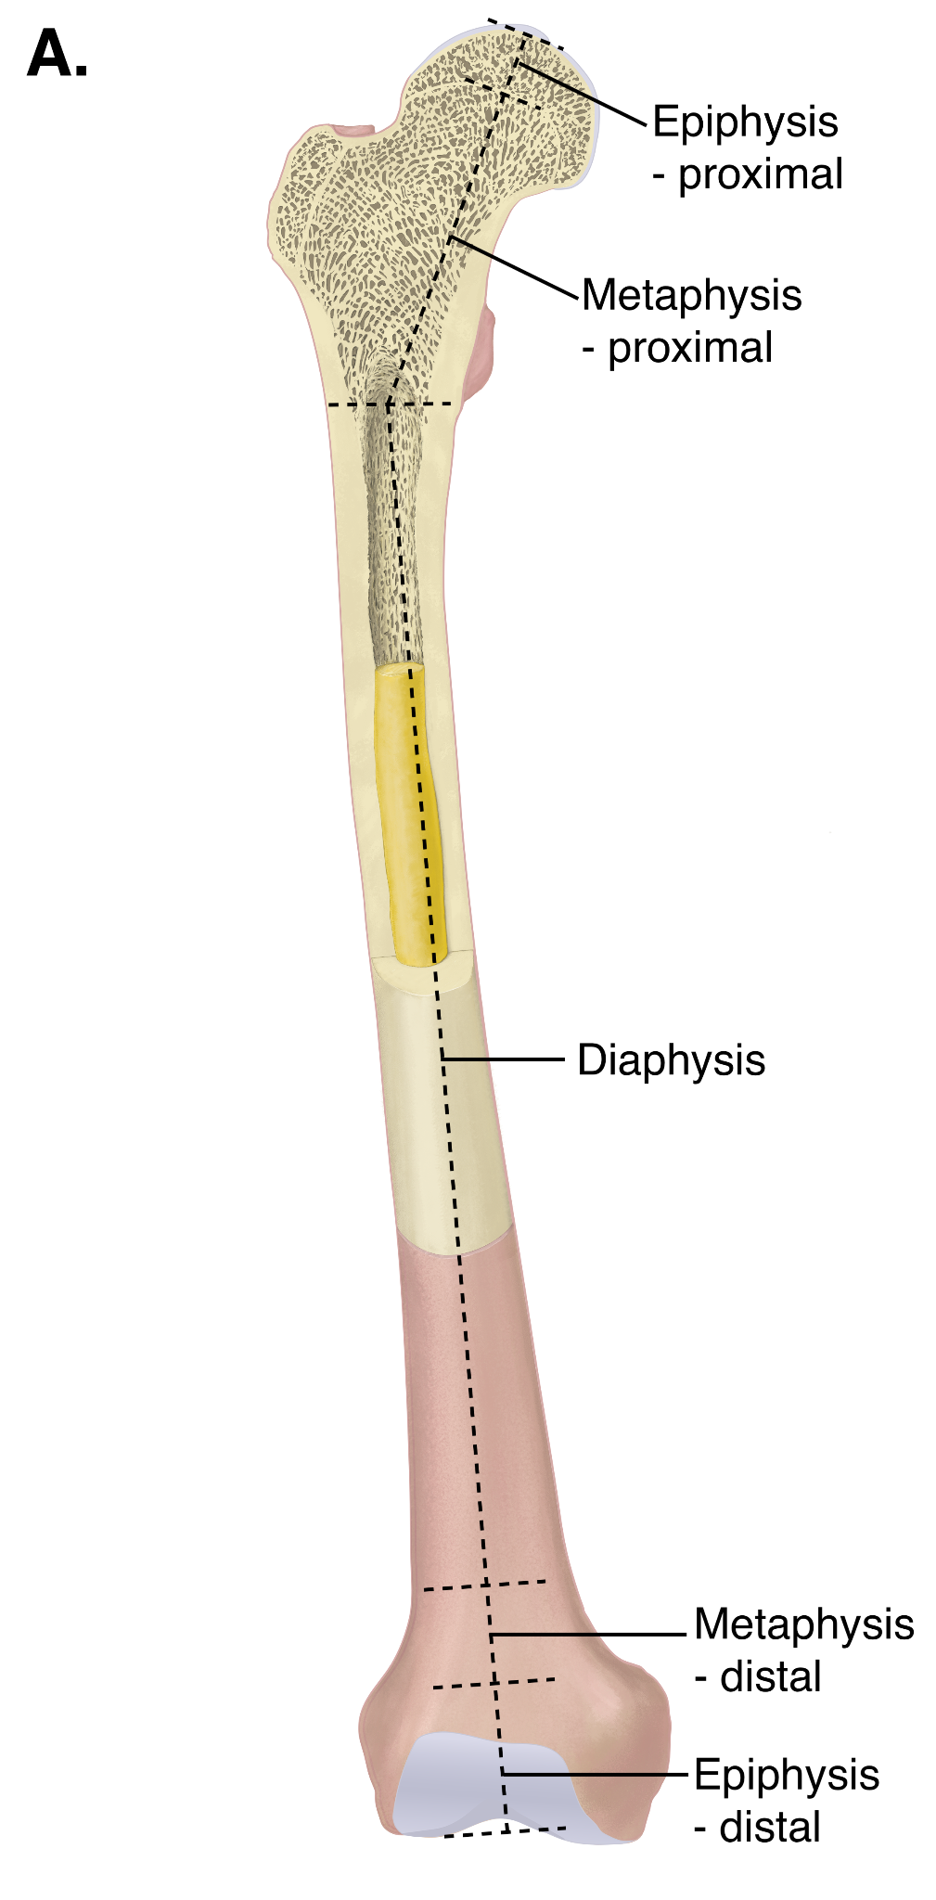
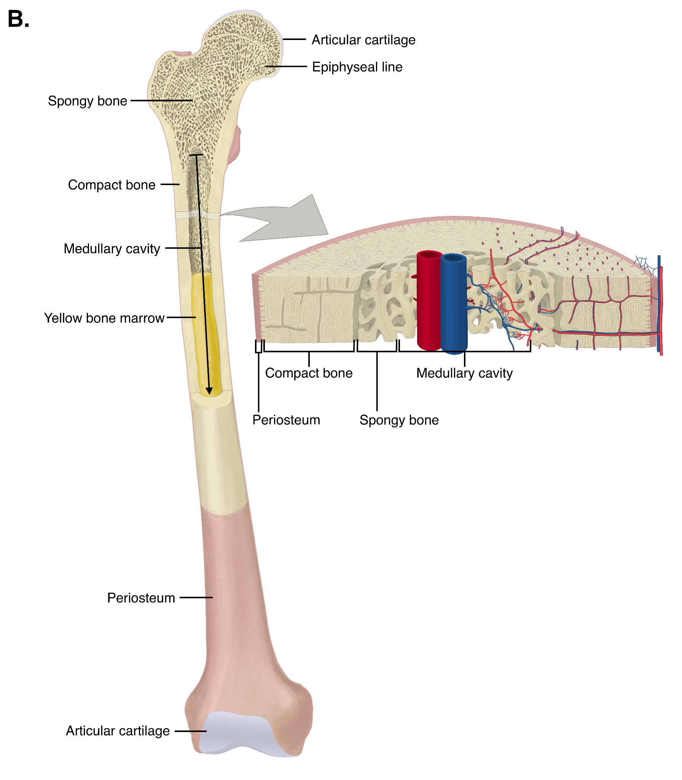
General Human Anatomy (Lange et. al)

Slide 7
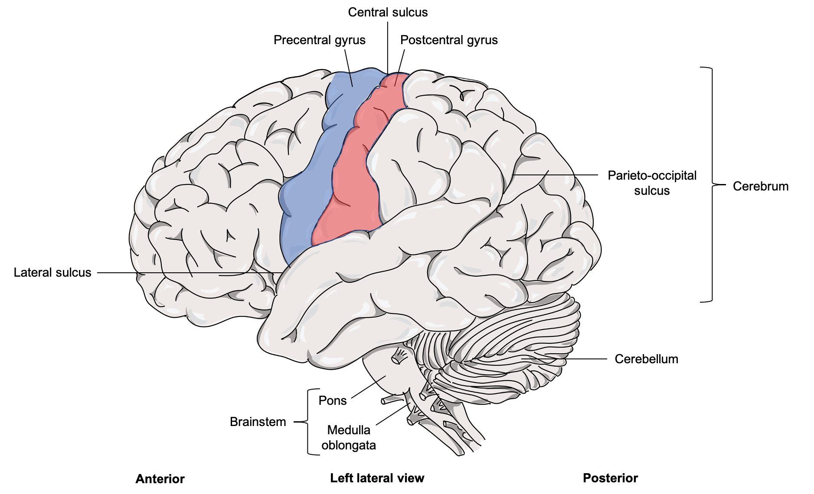
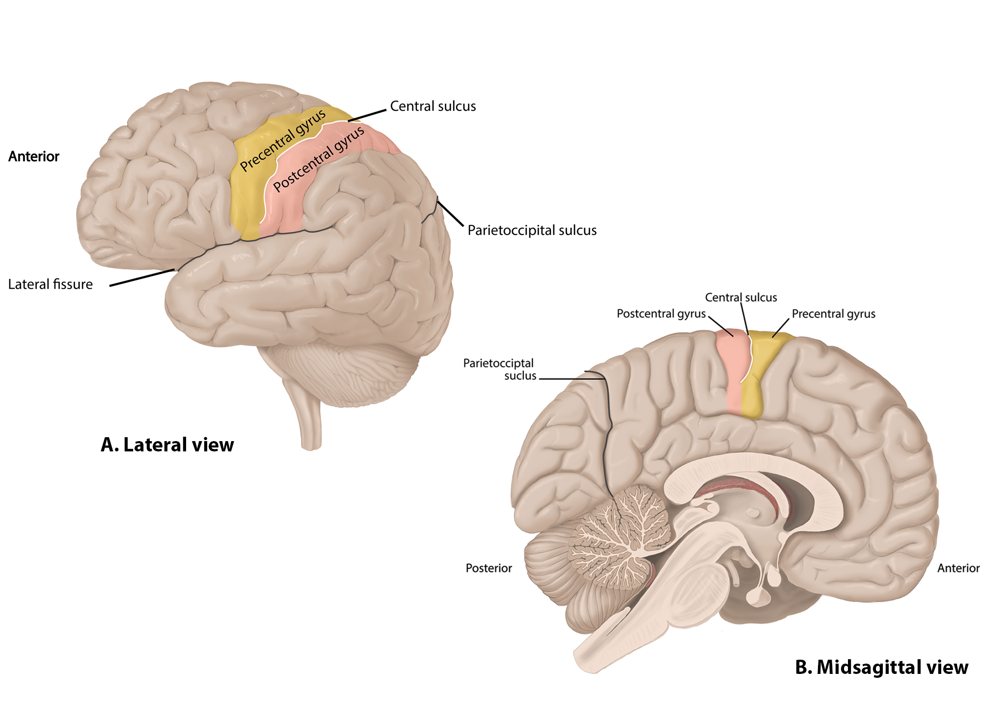
General Human Anatomy (Lange et. al),

Slide 8
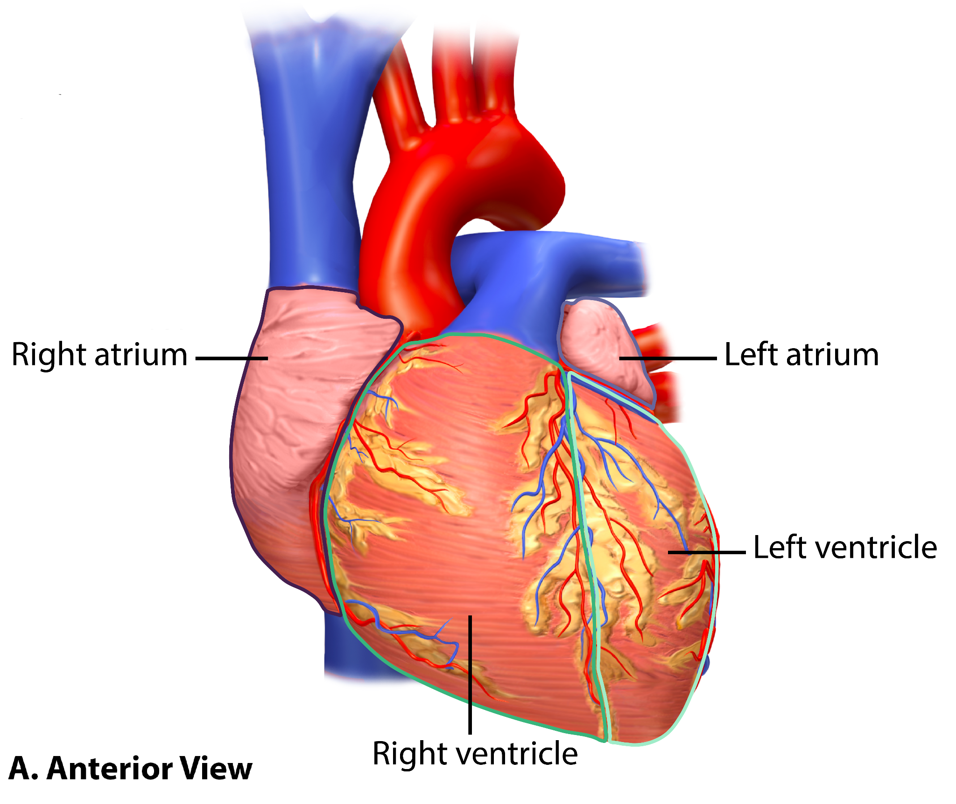
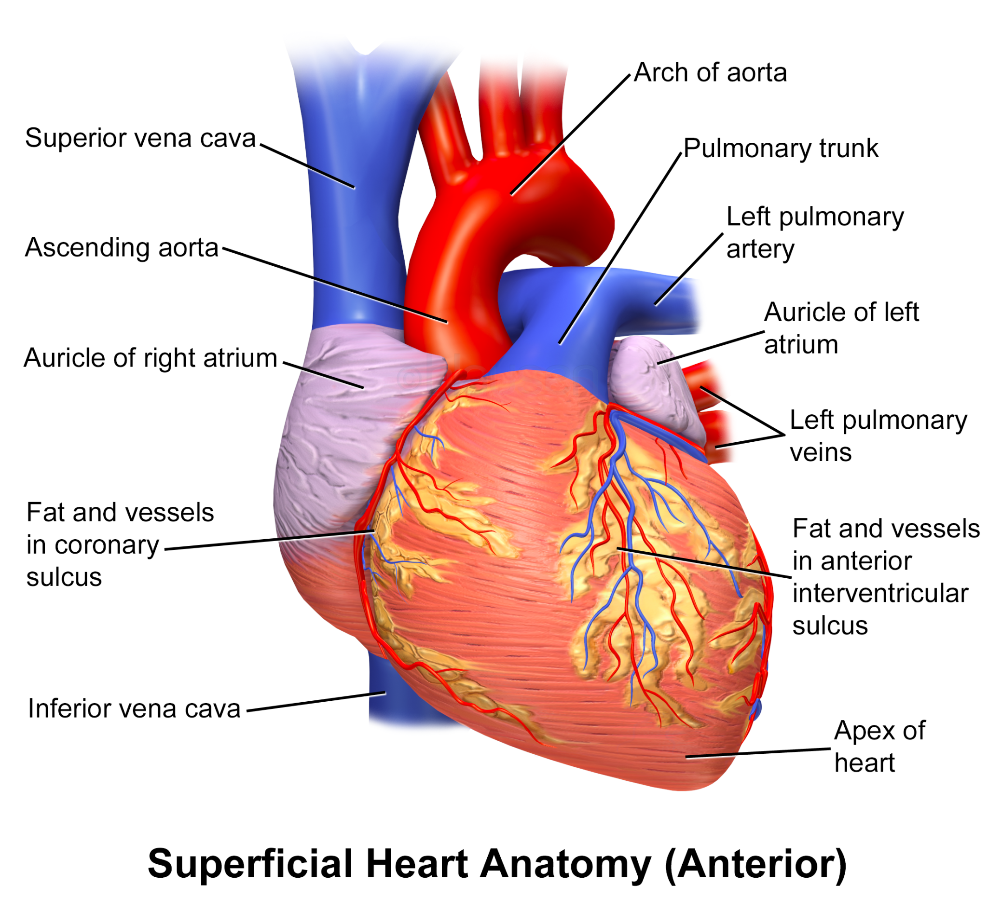
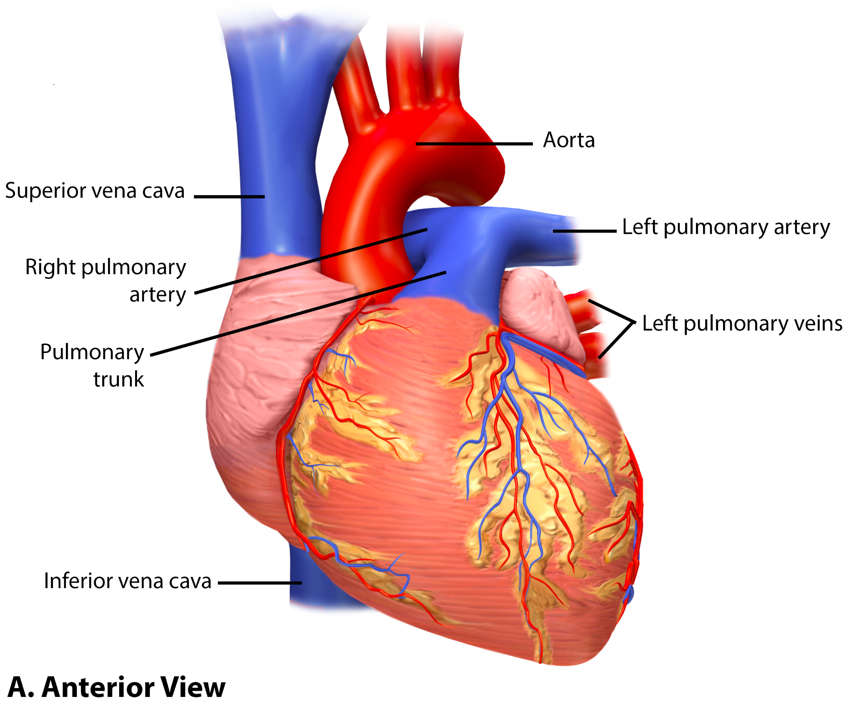
Images of the heart

Slide 9
Images
Text is easy to edit; images less so
Adding to a Flickr album
Adding Photoshop and Illustrator version for new files
What are the main image gaps?
Google Doc to help us identify A&P needs

Slide 10
Physiology
Most OER content at the moment is Anatomy & Physiology combined, or Anatomy only
Lack of Physiology focused material
Especially lab manuals
Chabot College OER project
Creating an OER lab manual to replace web-based simulation program
Convert Physiology at Chabot from LTC to ZTC

Slide 11
OERI Resources
Are you using OER?
Currently available for Anatomy:
OpenStax Anatomy and Physiology - used by aprox. 61 colleges
Human Anatomy (OERI) - used by at least 4 colleges
General Human Anatomy (Lange et al.)
Biology OER list
What books are you using?
Have you created adaptations?
If you are not using OER, why not?
How can we help with collaborations?

Slide 12
OERI Resources Feedback
OER and Biology
OERI is collecting book adoption information
Submit an adoption report
Does the organization of the website make sense?
Human Anatomy and Physiology
Biology Sequence for Majors
Zoology and Botany
Cell and Molecular Biology
General Biology
Human Biology
Microbiology
Introduction to Environmental Science
Genetics

