Slide 1
AI + OER: Shaping the Future of Learning in CA Colleges
Shagun Kaur (De Anza College) & Heather Dodge (Berkeley City College)
ASCCC OERI

Slide 2
Agenda
Overview and definition of OER and the OERI (Heather)
OER and AI: Where are the intersections? (Heather)
Scenarios and Uses: How faculty are using AI and OER together (Shagun)
Open Pedagogy and AI: (Heather)
Concerns for AI and OER (Heather)

Slide 3
OER and AI
Artificial Intelligence (UNESCO Definition)
OER (UNESCO definition)
Built from data, hardware and connectivity, AI allows machines to mimic human intelligence such as perception, problem-solving, linguistic interaction or creativity.
Learning, teaching and research materials in any format and medium that reside in the public domain or are under copyright that have been released under an open license, that permit no-cost access, re-use, re-purpose, adaptation and redistribution by others.
How many of us are already using OER or AI or both in our teaching or work?

Slide 4
From Information Age to Generative Age
Open lends itself to generative AI
Intersections: OER and AI
See David Wiley
“This is a time when the most powerful emerging technology-Gen Ai-is one that can create new resources on demand, rather than simply make copies of existing resources.” -David Wiley
Flexible licensing that allows for the 5 Rs (Retain, Reuse, Revise, Remix and Redistribute)
Real-time fine-tuning and editing existing materials for specific purposes
Utilizing open textbooks to power Ai bots or class ancillaries

Slide 5
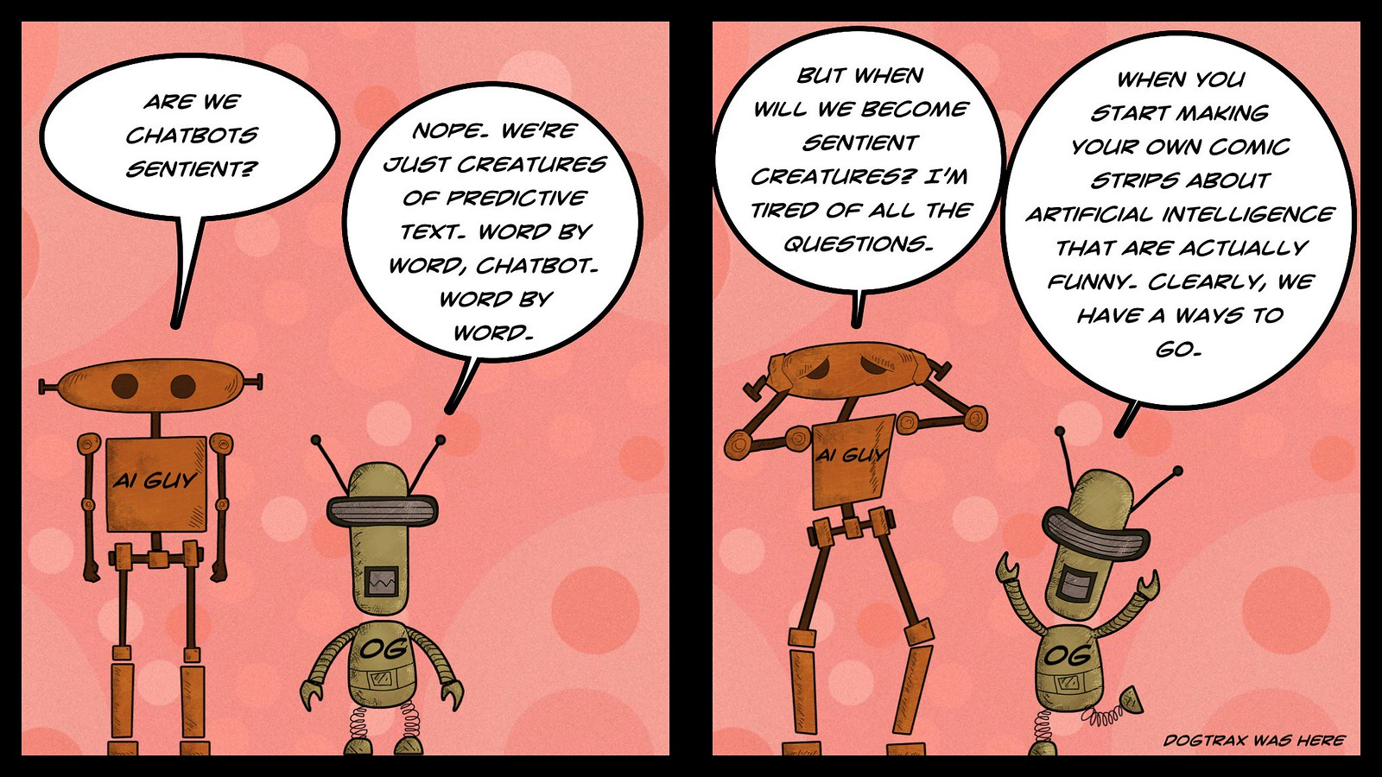
GPT in 2018, 2020, 2022….
It's Only AI 15 (Word By Word) | Kevin Hodgson | Flickr
This presentation reflects our current understanding of the intersection of OER and AI, but as this landscape evolves, we remain committed to co-creating meaning and learning together in an equity-minded space.
Notes:
ChatGTP3 was trained on a staggering 175 billion parameters. Although the GTP models had been in existence since 2018, it was with GPT-3 that individuals had the opportunity to interact with ChatGPT directly, ask it questions, and receive comprehensive and practical responses. When people were able to interact directly with the LLM like this, it became clear just how impactful this technology would become.

Slide 6
AI: Hidden Gaps, Real-World Impact
Healthcare: Underrepresentation of women and minority groups in training data skews AI predictions, leading to lower accuracy for Black patients in CAD systems.
Hiring: Applicant tracking systems may favor certain language patterns, as seen in Amazon’s discarded hiring algorithm that preferred male-coded terms.
Online Advertising: Search engine ad algorithms reinforce gender bias, showing high-paying jobs to men more often than women (Google’s Online Advertising system).
Image Generation: AI art tools like Midjourney depict older professionals as men, perpetuating workplace gender bias.
Predictive Policing: AI tools relying on historical arrest data risk reinforcing racial profiling and disproportionately targeting minority communities.
AI showed women for inputs including non-specialised job titles such as journalist (right). It also only showed older men (but not older women) for specialised roles such as news analyst (left). Midjourney

Slide 7
Quote from Dr. Joy Buolamwini
“The machines we build reflect the priorities, preferences, and even prejudices of those who have the power to shape technology.”
Dr. Joy Buolamwini
Joy Buolamwini: The 100 Most Influential People in AI 2023 | TIME
Notes:
Antoniak, M. (2023, June 22). Using large language models with care - AI2 blog. Medium. https://blog.allenai.org/using-large-language-models-with-care-eeb17b0aed27
De Vynck, G. (2023, June 28). ChatGPT maker OpenAI faces a lawsuit over how it used people’s data. Washington Post. https://www.washingtonpost.com/technology/2023/06/28/openai-chatgpt-lawsuit-class-action/
Dwivedi, Yogesh K. et al. Opinion Paper: “So what if ChatGPT wrote it?” Multidisciplinary perspectives on opportunities, challenges and implications of generative conversational AI for research, practice and policy, International Journal of Information Management, Volume 71, 2023, 102642,ISSN 0268-4012, https://doi.org/10.1016/j.ijinfomgt.2023.102642.
European Commission, Directorate-General for Education, Youth, Sport and Culture, Ethical guidelines on the use of artificial intelligence (AI) and data in teaching and learning for educators, Publications Office of the European Union, 2022, https://data.europa.eu/doi/10.2766/153756
Frąckiewicz, M. (2023). OpenAI and the Risks of AI Bias: Addressing Stereotypes and Discrimination. TS2 SPACE. https://ts2.space/en/openai-and-the-risks-of-ai-bias-addressing-stereotypes-and-discrimination
Gašević, D., Siemens, G., & Sadiq, S. (2023). Empowering learners for the age of artificial intelligence. Computers & Education: Artificial Intelligence, 4, 100130. https://doi.org/10.1016/j.caeai.2023.100130
Ossiannilsson, E., Ulloa Cazarez, R. L., Goode, C., Mansour, C., & De Gusmão, C. M. G. (2024). Artificial Intelligence Use to Empower the Implementation of OER and the UNESCO OER Recommendation. Open Praxis, 16(2), 237–257. https://doi.org/10.55982/openpraxis.16.2.650
Shelton, K., & Lanier, D. (2024, August 30). Thinking about equity and bias in AI. Edutopia. Retrieved from https://www.edutopia.org/article/equity-bias-ai-what-educators-should-know/
Uzzi, B. (2020, November 4). A simple tactic that could help reduce bias in AI. Harvard Business Review. https://hbr.org/2020/11/a-simple-tactic-that-could-help-reduce-bias-in-ai

Slide 8
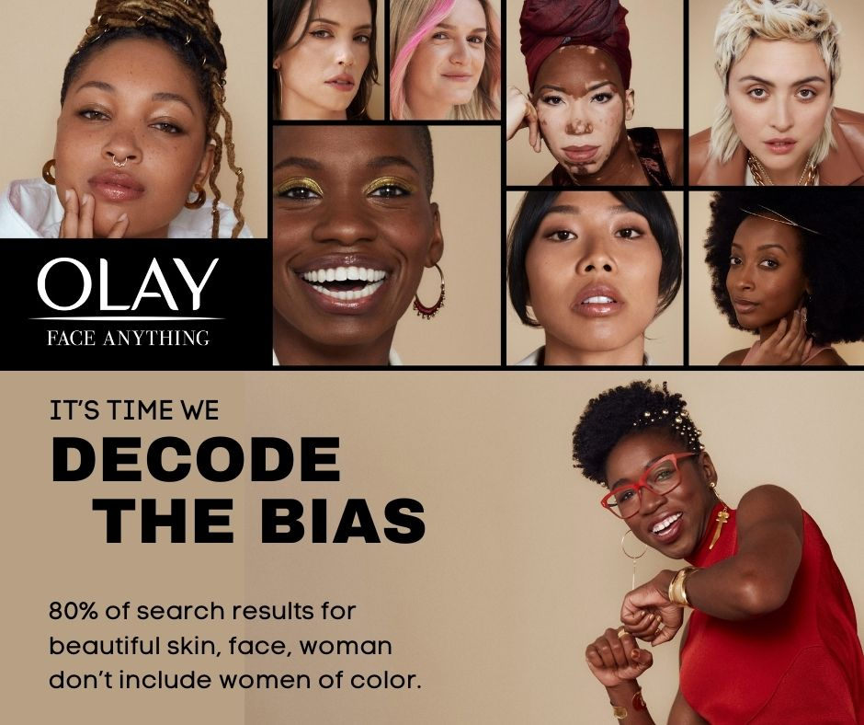
The Flip Side
AI Hallucinations: False or misleading AI-generated outputs that seem plausible but lack factual accuracy.
Training Data Bias: The presence of skewed, incomplete, or unrepresentative data in AI training sets, resulting in models that perpetuate or amplify inaccuracies and disparities.
Algorithm Bias: Systematic distortion in AI decision-making caused by biased data, leading to unfair or inaccurate predictions that reinforce existing inequalities.
In 2021, the Olay cosmetics brand teamed up with the Algorithmic Justice League and Black Girls CODE to #DecodetheBias during National Coding Week.

Slide 9
CSU: ETHICAL Principles AI Framework for Higher Ed
Exploration and Evaluation: Critically assess and evaluate AI tools and outputs.
Transparency and Accountability: Maintain openness about AI use in academic and administrative contexts
Human-Centered Approach: Prioritize human judgment and decision-making in AI applications.
Integrity and Academic Honesty: Uphold academic and professional standards when using AI and promote responsible AI use in learning and research
Continuous Learning and Innovation: Foster ongoing education about AI technologies and their implications.
Accessibility and Inclusivity: Ensure AI use promotes equity and inclusive opportunities
Legal and Ethical Compliance: Adhere to relevant laws, regulations, and ethical standards in AI use.
California Community Colleges - Campus policy recommendations from statewide Academic Senate (ASCCC, Spring 2024 )
Notes:
Key Topics Discussed in Spring Plenary:
AI Influence and Responsibility:
AI's growing impact on education and professional matters.
Importance of academic senates in making informed recommendations.
Ethical and Effective AI Policy Creation:
Ensure AI policies are ethical, legal, and transparent.
Provide accountability and oversight for AI use.
Support professional learning, training, and education related to AI.
General Considerations:
Prioritize student equity and accessibility.
Set clear expectations for AI use and provide ongoing professional learning.
Be mindful of paywalls and consider alternatives for costly AI tools.
Guiding Principles for AI Policy Creation:
Ethical considerations: Promote equity, transparency, accountability, and inclusivity.
Legal and compliance obligations: Ensure data protection and student consent.
Transparency and communication: Make AI policies accessible and communicate changes.
Accountability and oversight: Establish clear roles and responsibilities.
Education and training: Implement programs for continuous professional development.
Promoting Ethical AI Use:
Recognize biases in AI algorithms and prioritize personal data protection.
Ensure AI tools are used to promote equity and mitigate disparities.
Collaborate with external experts for independent assessments.
Practical Steps for AI Implementation
Team review and fact-checking of AI-generated content.
Use primary sources and citations to confirm accuracy.
Create multiple drafts for iterative review and refinement.
Disclose AI use in presentations to build trust and demonstrate responsible use.

Slide 10
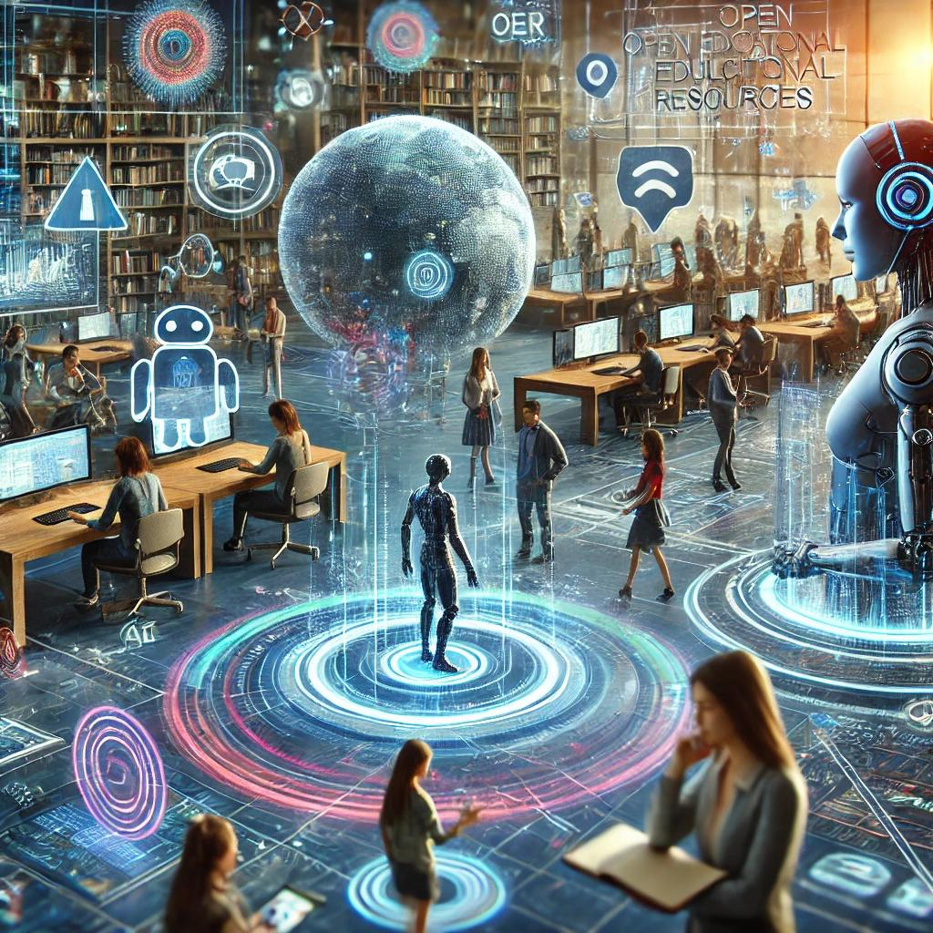
Large Language Models [LLM] as Partners
Transformer architecture and attention mechanism
Access to massive amounts of data
Reinforcement Learning with Human Feedback (RLHF)
Customized Learning
Active Student Participation
Curriculum Innovations
Supplemental materials
Open Pedagogy
AI enhances the 5 Cs of OER- Create, Curate, Customize, Connect, and Collaborate by optimizing content creation, personalization, and global knowledge-sharing.
ChatGPT & DALL·E. (2025). AI integration in Open Educational Resources for higher education [AI-generated image]. OpenAI.
Notes:
The practicality of the second and third prerequisites was proven in 2022 with OpenAI’s launch of its first LLM, ChatGPT 3.5. Which reaches 1 million users in 5 days.

Slide 11
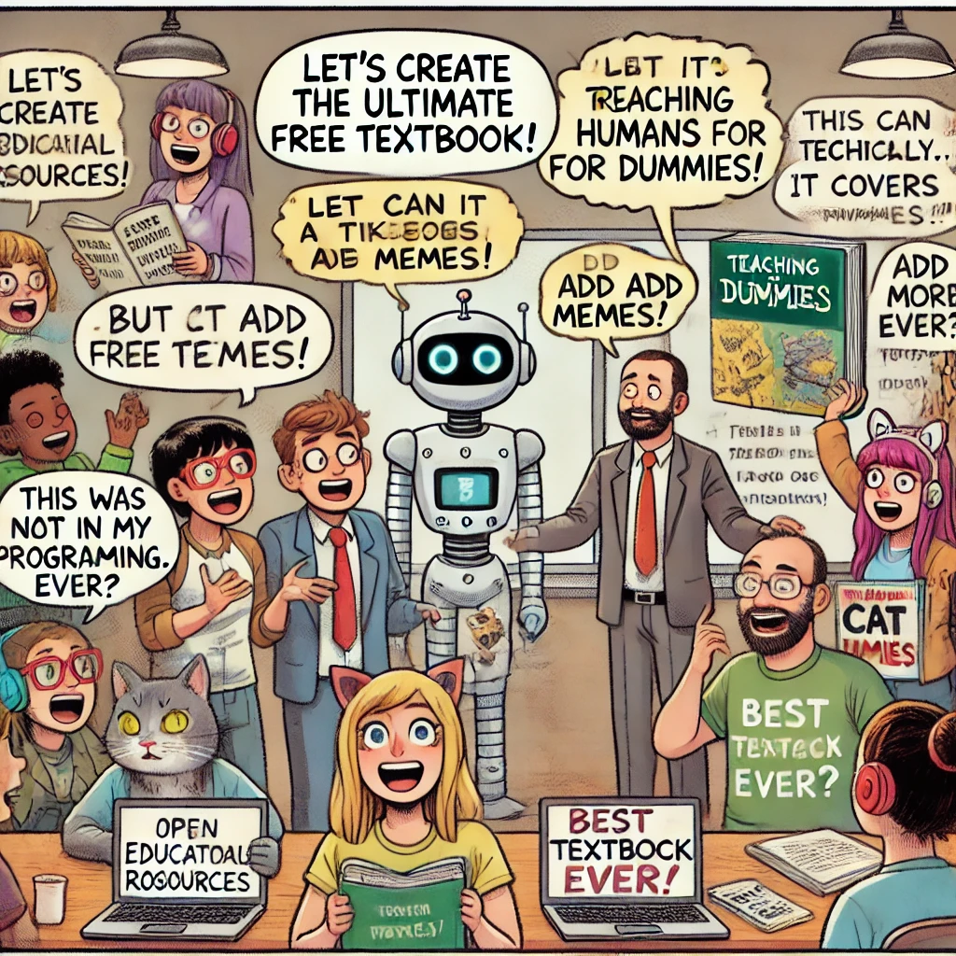
AI and OER: Building
Content Creation & Enhancement
Automated Content Generation
Text Simplification & Adaptation
Interactive & Engaging Content
Multimodal Content Development
Organization & Curation
Auto-Tagging & Metadata Generation
Version Control & Updates
Assessment & Feedback
Automated Quiz & Test Generation
Instant Feedback & Adaptive Assessments
Collaboration & Community Engagement
AI-Powered Discussion Moderation
Collaborative Content Creation
Peer Review Automation
Sustainability & Cost Efficiency
Reducing Development Time
Lowering Costs
Resource Optimization
ChatGPT & DALL·E. (2025). A funny comic Open Educational Resources (OER), pedagogy, and co-creation [AI-generated image]. Open AI
Notes:
Content Creation & Enhancement
Automated Content Generation – AI tools like ChatGPT and Claude can draft educational content, create lesson plans, and summarize complex topics.
Text Simplification & Adaptation – AI can rewrite materials in simpler language or different reading levels to accommodate diverse learners.
Interactive & Engaging Content – AI can create quizzes, case studies, and simulations to make OER more interactive.
Multimodal Content Development – AI can generate videos, animations, and infographics to supplement text-based OER.
Organization & Curation
Auto-Tagging & Metadata Generation – AI can classify OER materials with appropriate metadata, making them easily searchable.
Intelligent Recommendations – AI can suggest relevant resources based on user preferences and prior learning history.
Version Control & Updates – AI can track changes, suggest updates, and highlight outdated information in OER content.
Assessment & Feedback
Automated Quiz & Test Generation – AI can create multiple-choice questions, short-answer assessments, and case studies.
Instant Feedback & Adaptive Assessments – AI can analyze student responses and offer personalized feedback in real time.
Plagiarism Detection & Citation Assistance – AI tools can check for content originality and assist in proper citation formatting.
Collaboration & Community Engagement
AI-Powered Discussion Moderation – AI can facilitate and moderate discussions in OER communities to ensure constructive dialogue.
Collaborative Content Creation – AI can help teams co-author textbooks, work on research papers, or develop OER resources more efficiently.
Peer Review Automation – AI can assist in the peer-review process by analyzing content quality, structure, and coherence.
Sustainability & Cost Efficiency
Reducing Development Time – AI can significantly cut down the time needed to produce high-quality educational materials.
Lowering Costs – AI-powered automation can reduce the need for expensive content production and editorial work.
Resource Optimization – AI can analyze content usage data and suggest improvements or deletions to optimize OER repositories.

Slide 12
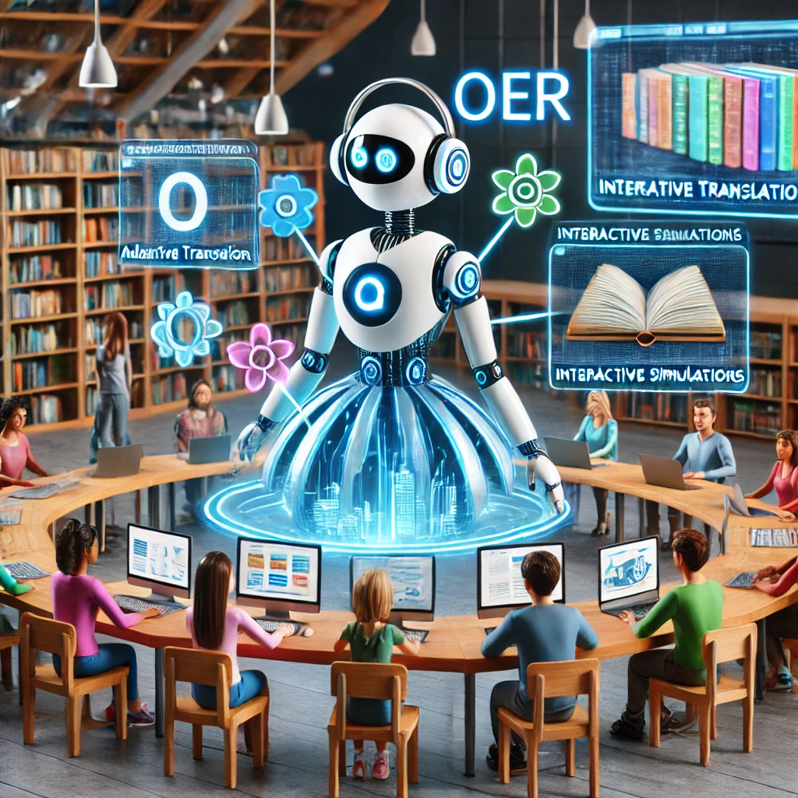
AI and OER: Pedagogy
Personalization & Adaptive Learning
AI Tutors & Chatbots
Learning Analytics & Insights
Adaptive Learning Pathways
Accessibility & Inclusivity
Real-Time Translation & Localization
Speech-to-Text & Text-to-Speech
Alternative Format Generation
Integration with Other Technologies
AI in Augmented & Virtual Reality (AR/VR)
Integration with Learning Management Systems (LMS)
ChatGPT & DALL·E. (2025). A futuristic digital classroom illustrating the intersection of AI and OER [AI-generated image]. Open AI
Notes:
Accessibility & Inclusivity
Real-Time Translation & Localization – AI can automatically translate OER materials into multiple languages, making education more globally accessible.
Speech-to-Text & Text-to-Speech – AI can provide transcripts and audio versions of OER for visually and hearing-impaired learners.
Adaptive Learning Paths – AI-driven personalization can adjust content difficulty based on a learner’s pace and understanding.
Alternative Format Generation – AI can convert text-based OER into braille, audiobooks, or visual formats for learners with disabilities.
Personalization & Adaptive Learning
AI Tutors & Chatbots – AI-driven virtual assistants can help learners navigate OER content and answer questions.
Learning Analytics & Insights – AI can analyze user engagement, identify weak areas, and suggest targeted resources.
Intelligent Pathways – AI can create custom learning paths for students, guiding them through OER materials in a way that suits their learning styles.
Integration with Other Technologies
AI in Augmented & Virtual Reality (AR/VR) – AI can help create immersive OER experiences by generating virtual labs, historical simulations, and interactive models.
Blockchain for OER Certification – AI can work with blockchain to track OER usage, authorship, and certifications for learners.
Integration with Learning Management Systems (LMS) – AI-powered OER can be seamlessly embedded into platforms like Moodle, Canvas, and Blackboard.

Slide 13
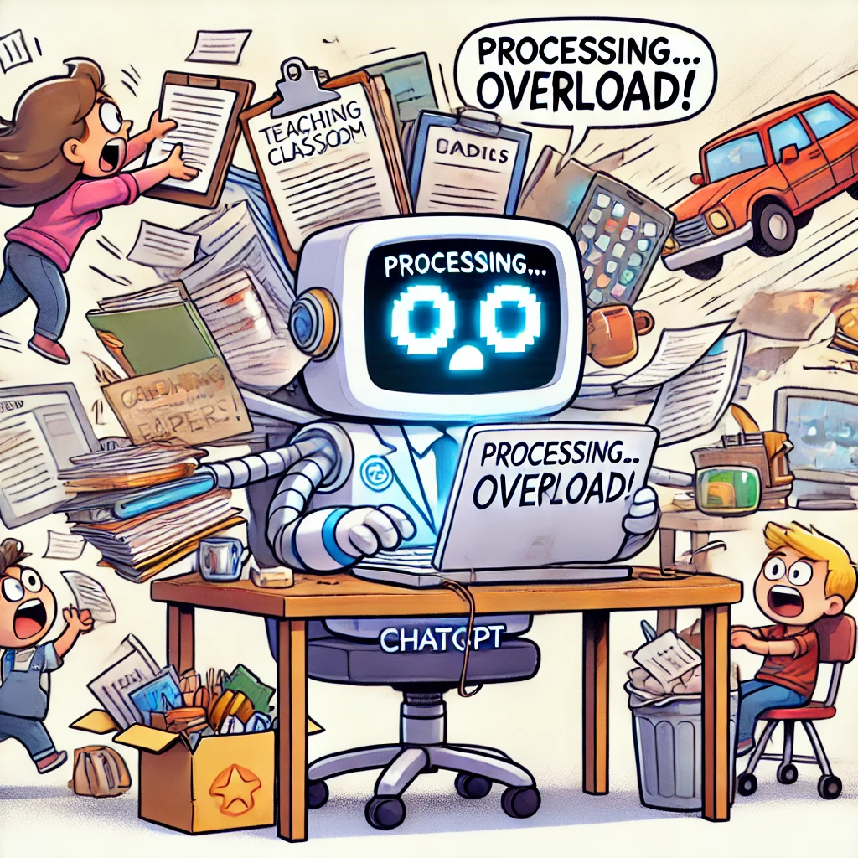
Chat GTP and OER: AI Prompt Engineering
Prepare 1st drafts.
Generate ideas.
Modify tone.
Write feedback.
Create examples.
Write exam questions, sample answers, book chapters, etc.
Create rubrics
Proof writing.
OpenAI. (2025). A funny cartoon of ChatGPT as a super-powered robot trying to do everything at once [AI-generated image]. DALL·E.
Modified from “The Intersection of OER and AI" by ASCCC licensed under CC BY 4.0.

Slide 14
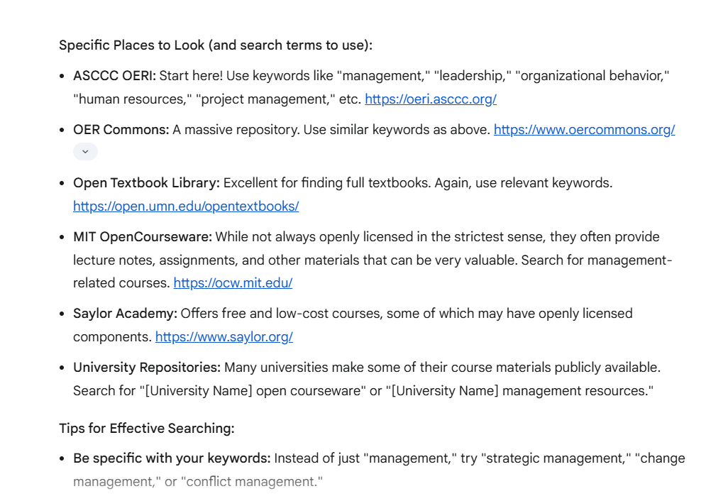
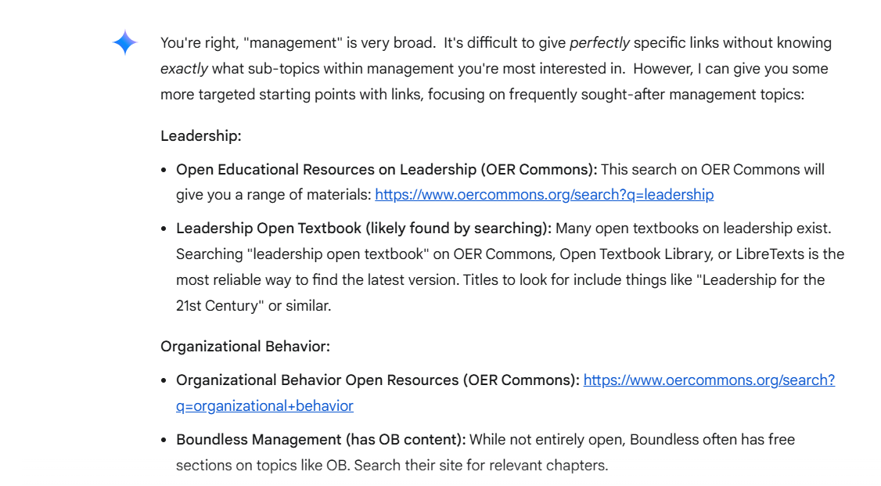
Gemini as an OER Search TOOL

Slide 15
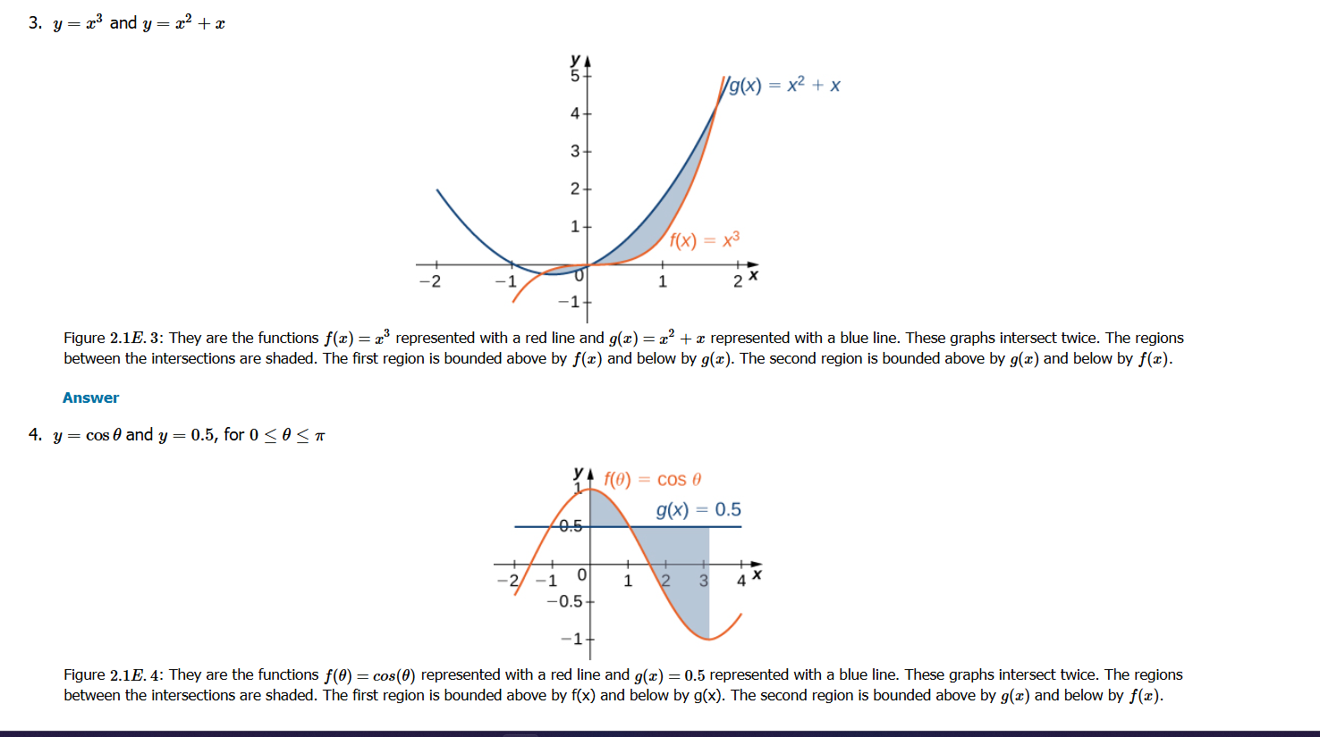
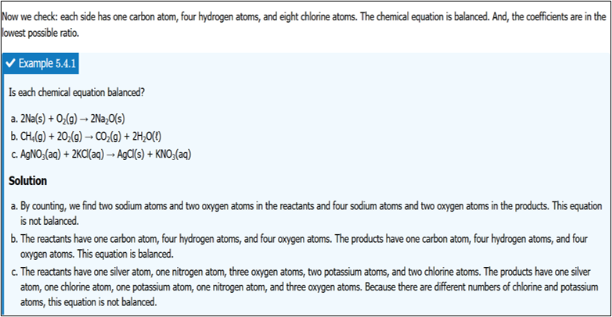
ChatGPT: LaTeX Coding and solutions in Organic Chemistry and Calculus

Slide 16
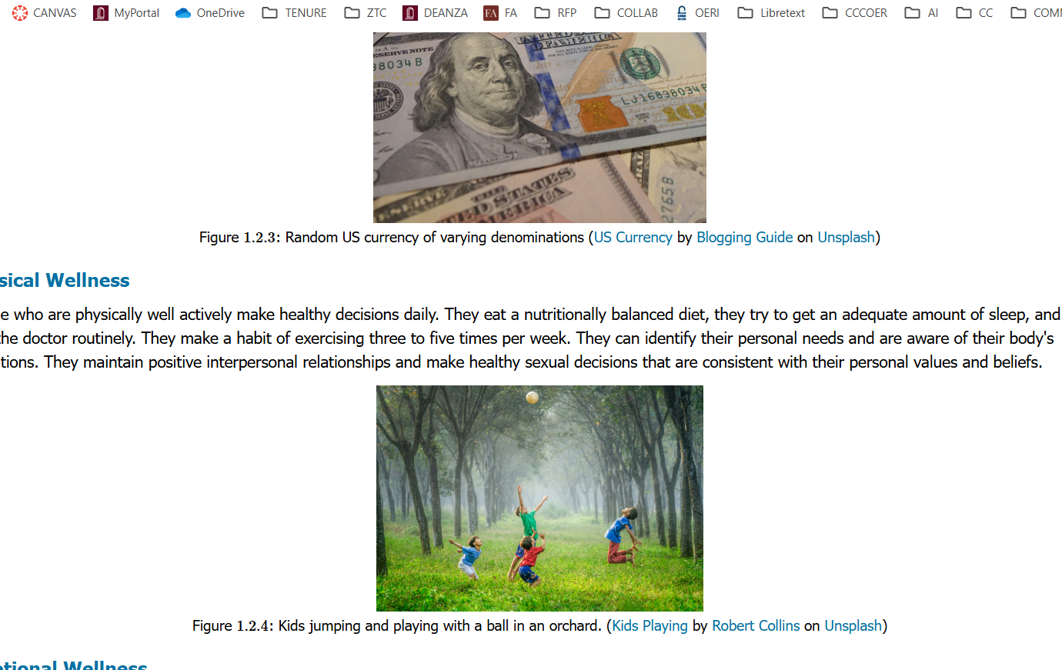
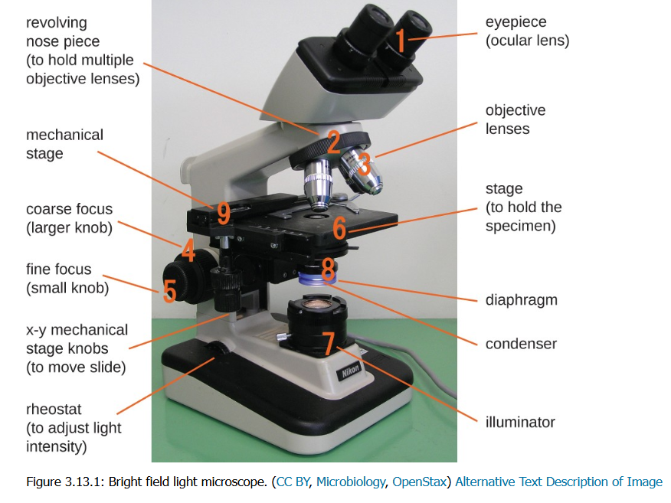
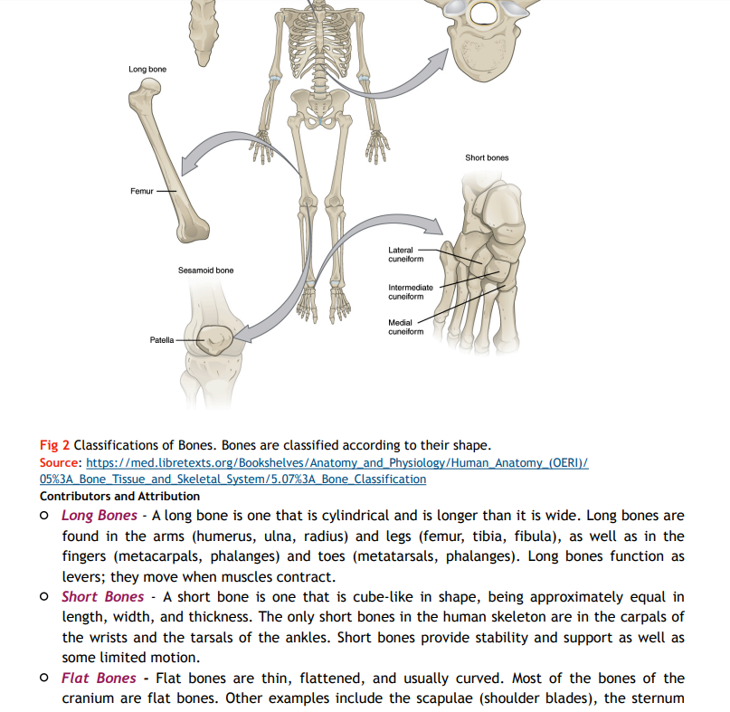
Alt text and attributions for Kinesiology and Biology

Slide 17
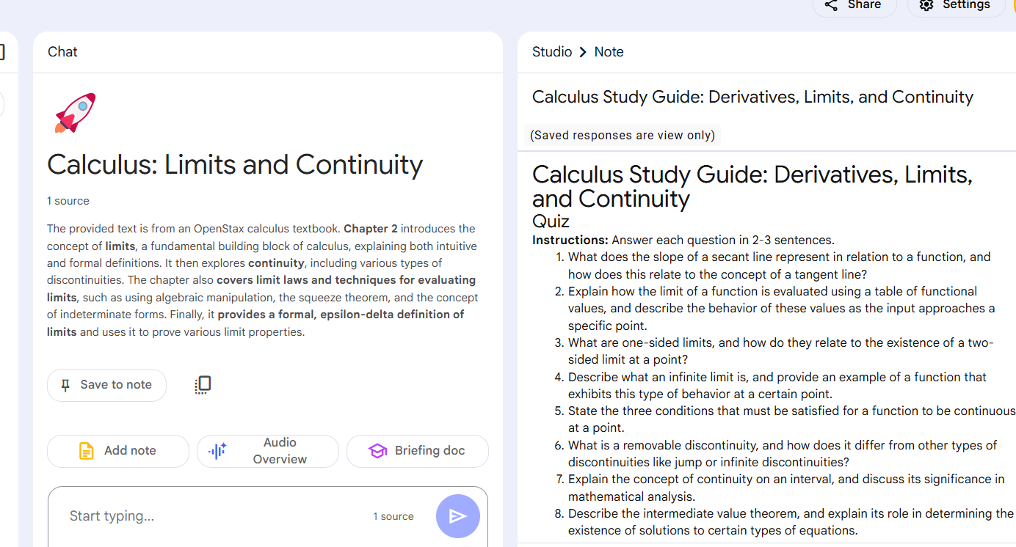
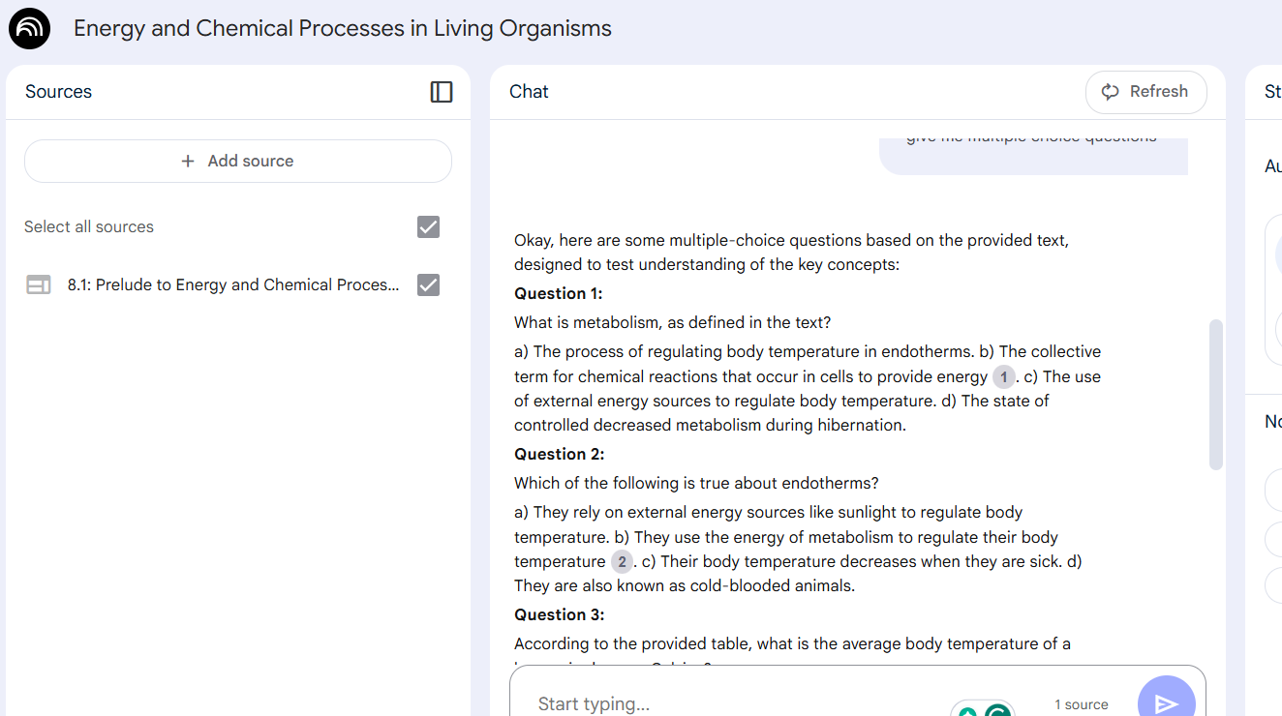
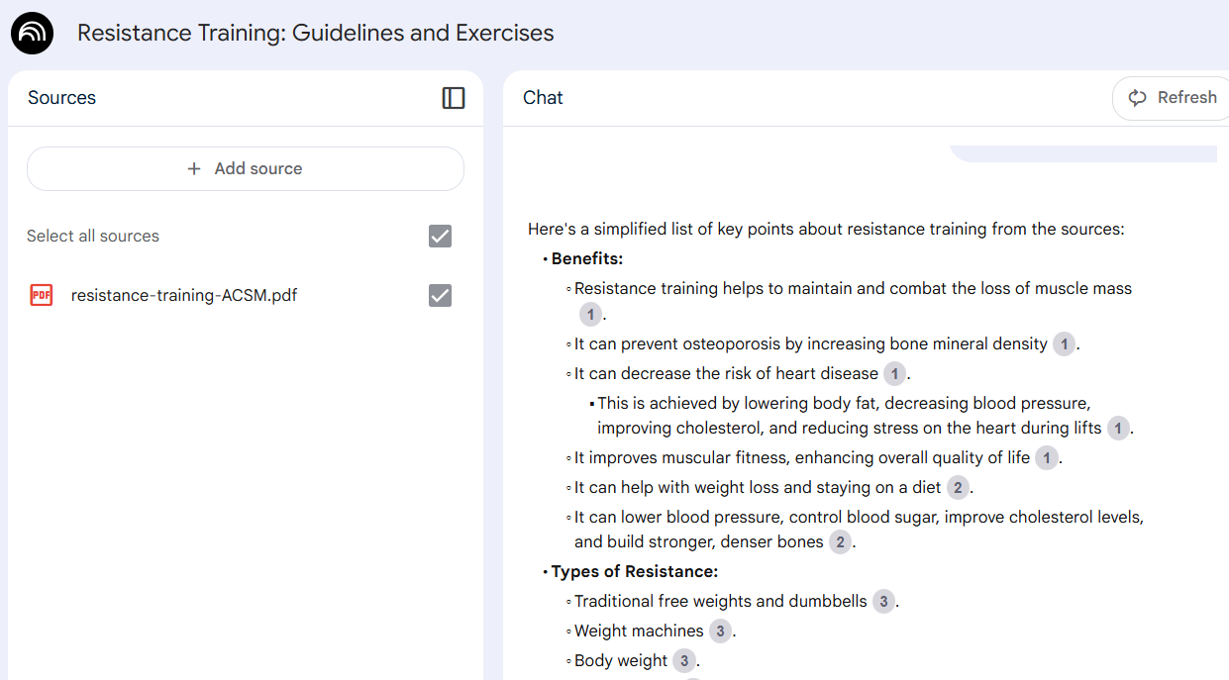
Notebook LM for Study Guides, Quizzes…

Slide 18
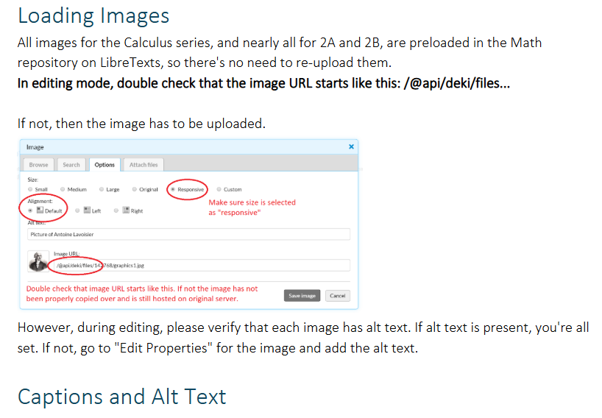
Copilot for OER Project Management
SubjectCode | ZTC Adoptions | LTC Adoptions
CIS | 29 | 8
MATH | 14 | 9
COMM | 14 | 2
PSYC | 7 | 1
ANTH | 6 | 2
ASTR | 6 | 0
EWRT | 5 | 9
POLI | 5 | 4
HUMI | 4 | 3
ESL | 4 | 2
ARTS | 4 | 1
E S | 4 | 1
JOUR | 4 | 1
BUS | 3 | 5
ESCI | 3 | 0
KNES | 3 | 0
PHIL | 2 | 2
BIOL | 2 | 1
NUTR | 2 | 1
AFAM | 2 | 0
GEOL | 2 | 0
HUMA | 1 | 8
CLP | 1 | 3
F/TV | 1 | 2
HLTH | 1 | 2
ECON | 1 | 1
ELIT | 1 | 1
C D | 1 | 0
EDAC | 1 | 0
ICS | 1 | 0
ITAL | 1 | 0
MET | 1 | 0
MUSI | 1 | 0
SOC | 1 | 0
ADMJ | 0 | 2
ASAM | 0 | 2
CETH | 0 | 1
DANC | 0 | 1
THEA | 0 | 1
Grant Writing
Data Crunching
Templates, Style Sheets, Training Resources
Meeting Minutes
Project Tracking

Slide 19
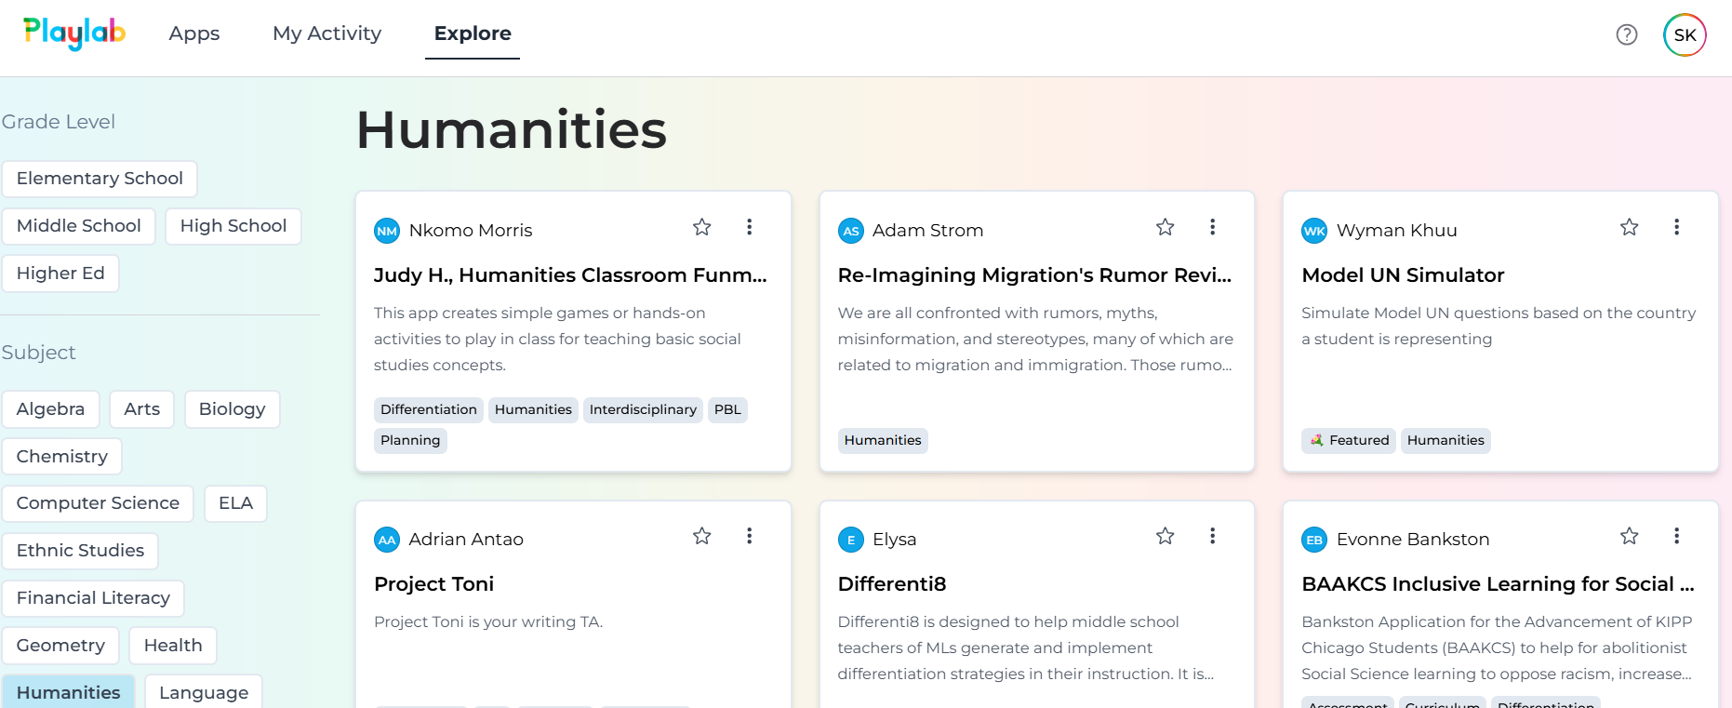
Chatbots for Augmentation and Ancillaries

Slide 20
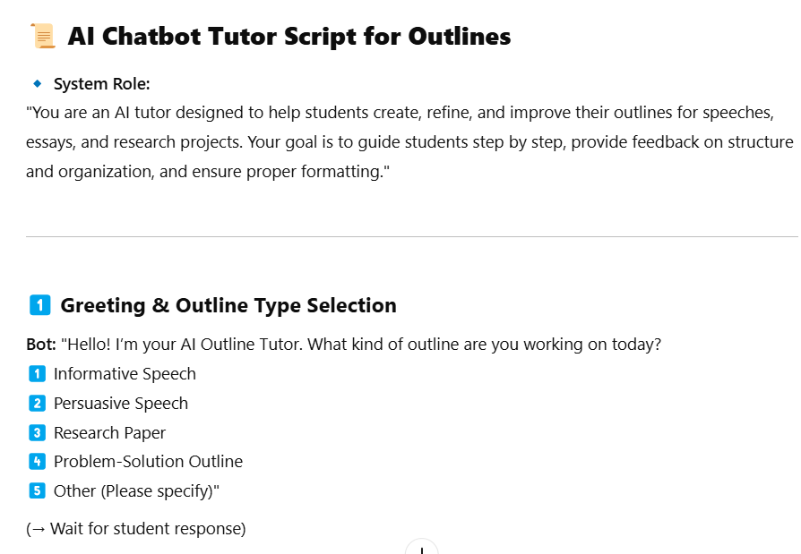
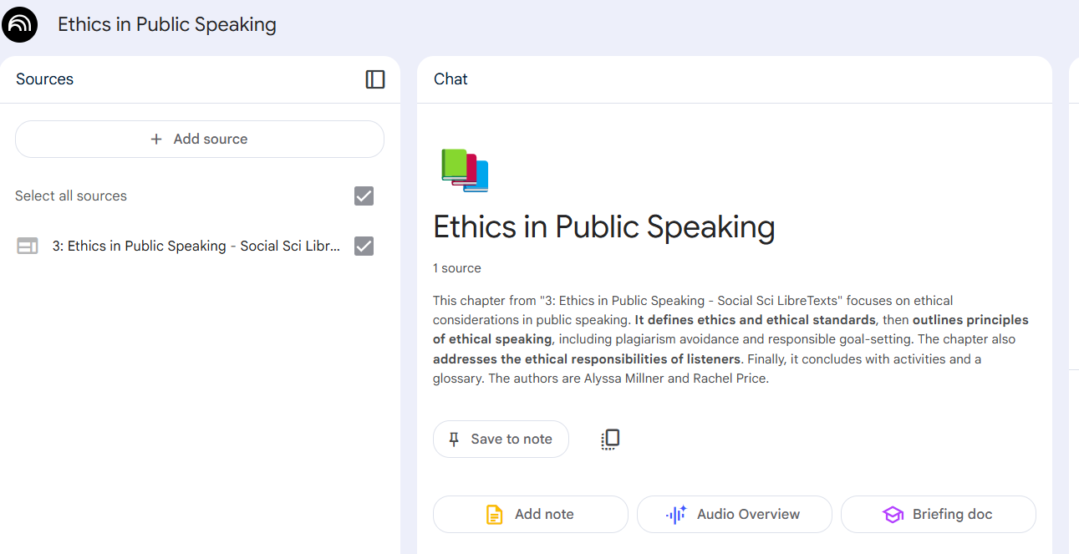
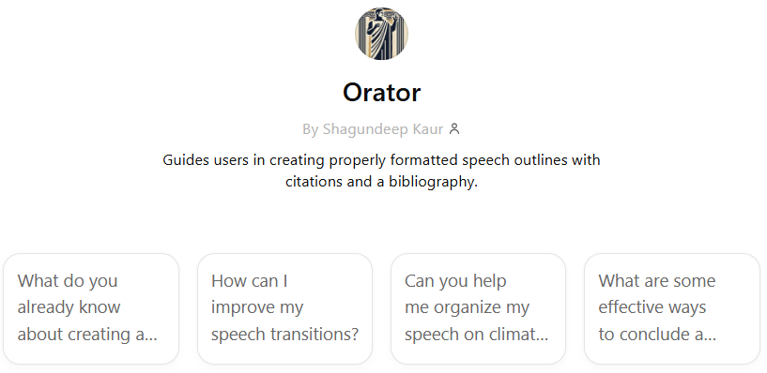
Chatbots: Utility/Validity: TBD/Co-Constructed

Slide 21
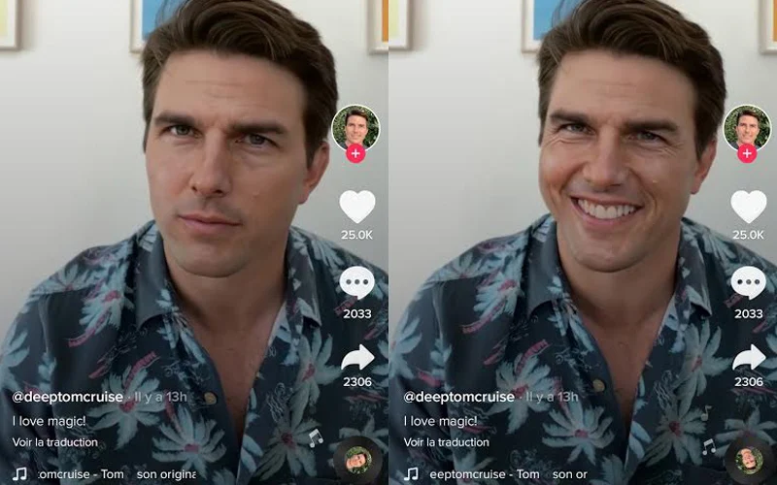
AI and OER Development: Questions Unanswered
Intellectual Property & Copyright
Who owns AI-generated content?
Risk of unclear licensing & derivative works
Ensure Creative Commons (CC) compliance
Institutions lack clear policies on AI-generated OER
Ethical & Transparency Issues
AI lacks proper attribution & citations
Risk of plagiarism & misinformation
Disclose AI use in OER creation
Bias & Accuracy Challenges
AI inherits biases from training data
Requires human fact-checking & review
Ensure diverse perspectives & inclusivity
Tom Cruise deepfake account causes confusion on TikTok | FMT

Slide 22
AI and Open Pedagogy with students
Prompt engineering to author new material for courses
Students developing podcasts using OER texts and Notebook LM
Auditing/editing using specific framework (IDEA framework)
Co-authoring texts and other tangible materials to build on existing assignments and courses–using AI to help for clarity and tone
Student-built ‘bots’ using OER texts and other openly licensed materials

Slide 23
Humanizing AI and OER
“We’re increasingly becoming a society in which very wealthy people get obsequious, leisurely human care, like concierge medicine paid out of pocket … and private schools with tiny class sizes... Everybody else might receive long waits for 15-minute appointments with harried doctors, a public school system with overworked teachers who are supplemented by unproven apps to ‘personalize’ learning and a pharmacy with self-checkout.”
-Jessica Gross, New York Times, writing about the book, The Last Human Job, by Allison J. Pugh

Slide 24
Heather Dodge
Thanks & Questions
Shagun Kaur
ASCCC OERI Regional Lead (Area B)
Librarian, Berkeley City College
hdodge@peralta.edu
Project Facilitator, ASCCC OERI
ZTC Grants Coordinator, De Anza College
kaurshagun@fhda.edu
The slide deck is licensed CC BY 4.0 unless otherwise noted

