Slide 1
Applying the Inclusion, Diversity, Equity, and Anti-Racism (IDEA) Framework to Open Educational Resources (OER): Human Anatomy
Academic Senate for California Community Colleges (ASCCC)
Open Education Resource Initiative (OERI)
IDEA Framework Lead
Tiffany Lanoix 3/20/25

Slide 2
What is the IDEA Framework?
A review framework to evaluate existing and assist in the creation of new ASCCC OERI supported materials
Support faculty as they implement culturally responsive and anti-racist pedagogy
Provide a framework to incorporate IDEA principles into new or use to assess existing ASCCC OERI-supported materials
The O in OER-> materials are accessible to everyone and adaptable
Guidebook & Assessment Rubrics

Slide 3
What do we mean by IDEA?
Inclusion, diversity, equity and anti-racism
Inclusion: Intentional efforts to ensure students feel welcome, included, respected, and valued
Diversity: Materials are representative of the varied experiences of our diverse student body
Equity: Address issues of access to and relevancy of course materials for historically marginalized groups
Anti-racism: Materials do not attempt to be color-blind or culturally neutral since doing so perpetuates racial and ethnic inequities and white supremacy
Notes:
include the varied experiences of students in a way that recognizes the value, legitimacy, and importance of those experiences
includes, but is not limited to, race and ethnicity, gender, class, ability, sexual orientation, country of origin and cultural affiliations
focused effort on reducing racial and ethnic inequities and dismantling white supremacy

Slide 4
IDEA Framework
Assessment Categories
  Illustrations and Photos
  Example Names
  Gender Inclusive Language & Use of Pronouns
  Diverse Authors, Researchers, & Studies
  Applications, Examples and Problem Scenarios That Relate to Diverse Audiences
  Appropriate Terminology
  Keyword, Glossary, & Metadata Representation
  Incorporating Diverse Perspectives on Issues, Events, & Concepts That Are Relevant to Underrepresented Groups
Example OER Textbook: General Human Anatomy by Lange, et. al

Slide 5
IDEA Framework Assessment Categories
1. Illustrations and Photos
Reflective of diverse populations and should not perpetuate stereotypes
  Consider diversity in terms of race. Ethnicity, age, sex gender expression, physical and mentalities, sexual orientation, etc.
  Examine the number of images and illustrations and the individuals and populations represented
  Analyze role, depiction, connotation, expressions of authority, and purpose of the people
  Include images of people where the context does not relate to their identity
Notes:
Student can see people like themselves (representation matters)

Slide 6
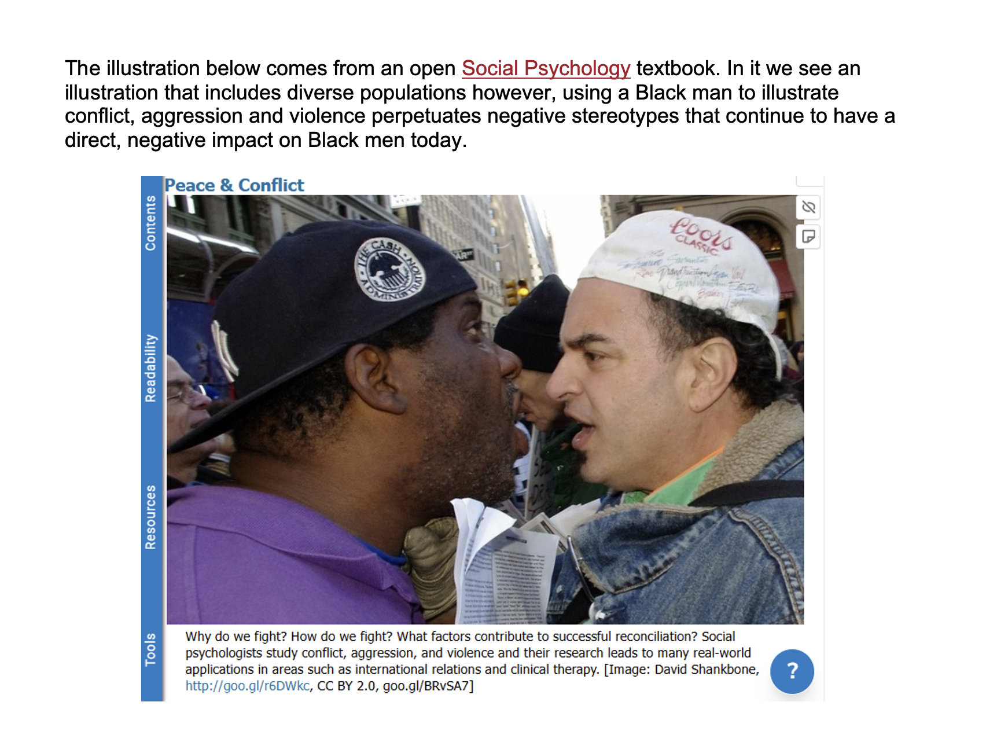
Social Psychology textbook

Slide 7
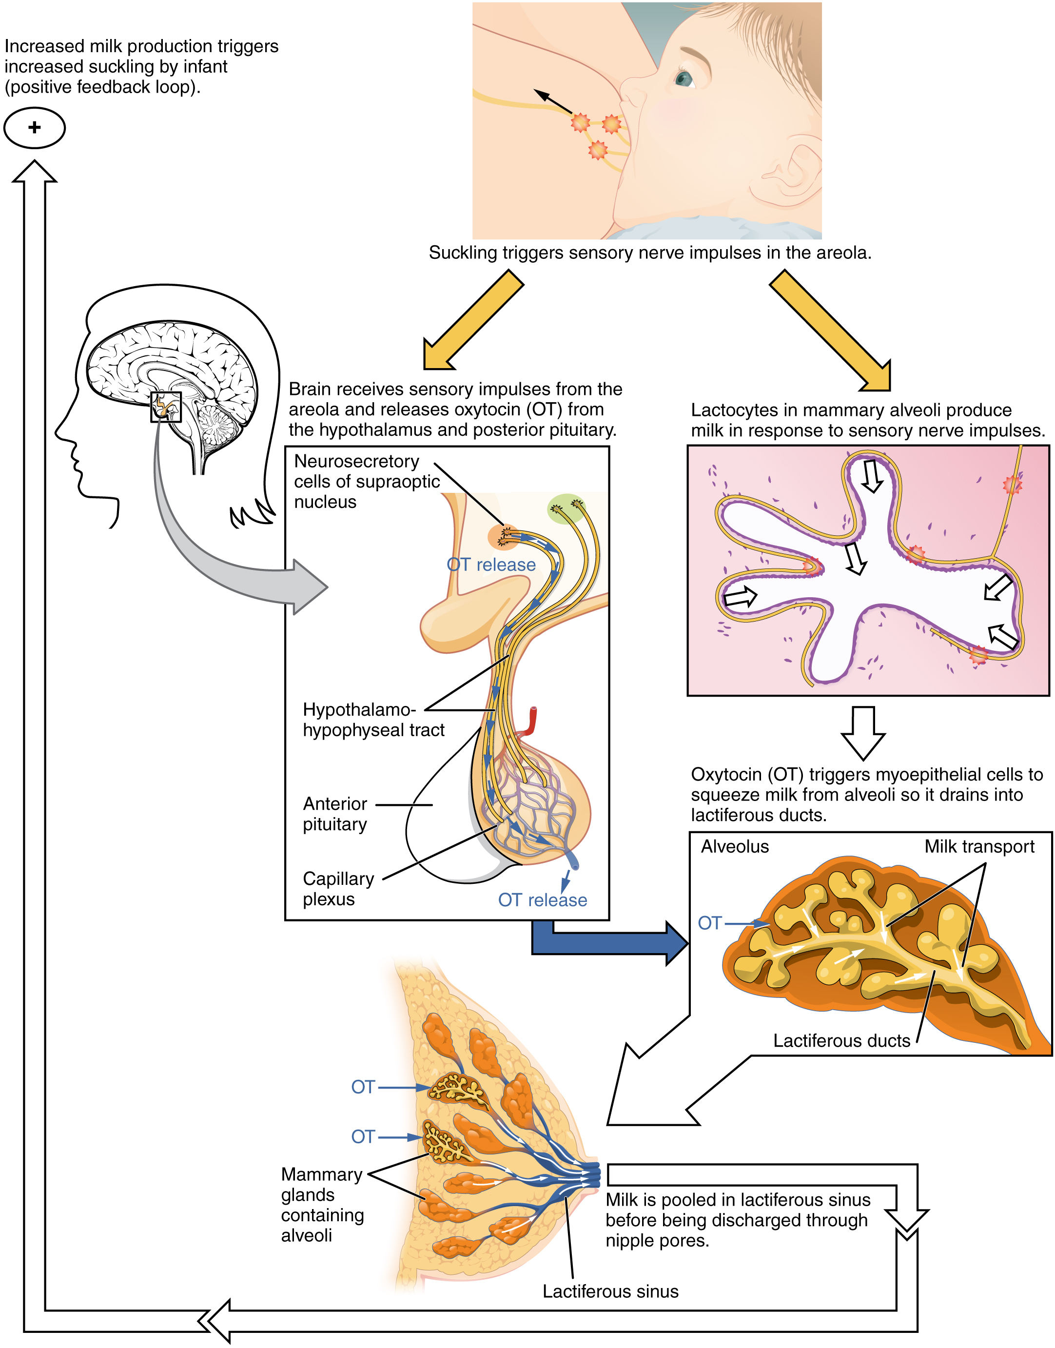
Lactation

Slide 8
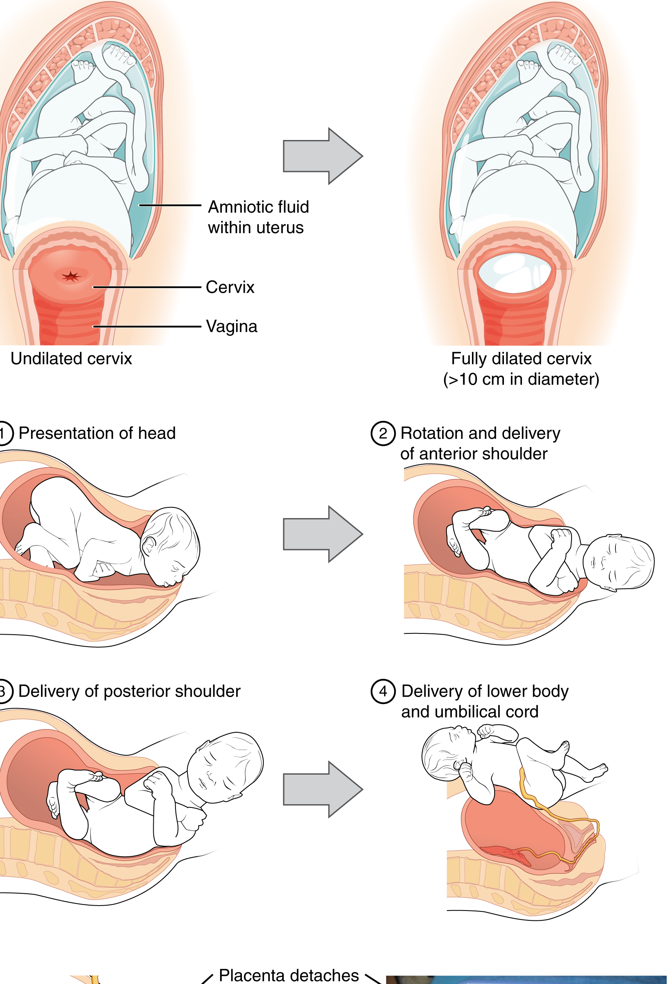
Human Child Birth

Slide 9
IDEA Framework Assessment Categories (2)
3. Gender-Inclusive Language and Use of Pronouns
Use gender-neutral pronouns or language that intentionally dispels gender stereotypes
  Avoid making gender assumptions
  Be inclusive of varied gender expressions i.e., trans, gender non-binary, gender fluid, gender queer, agender

Slide 10
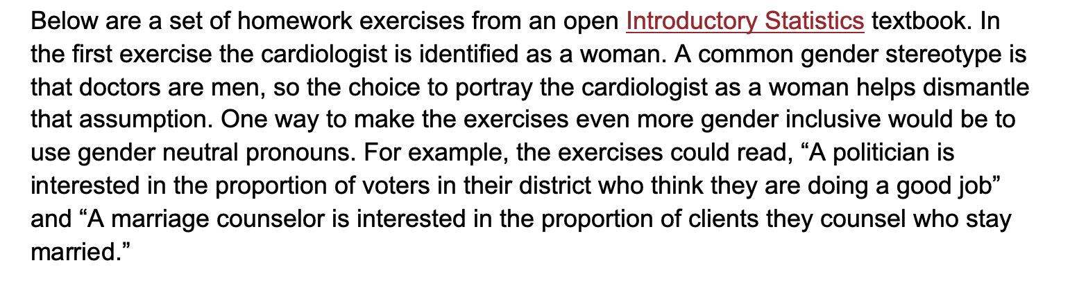
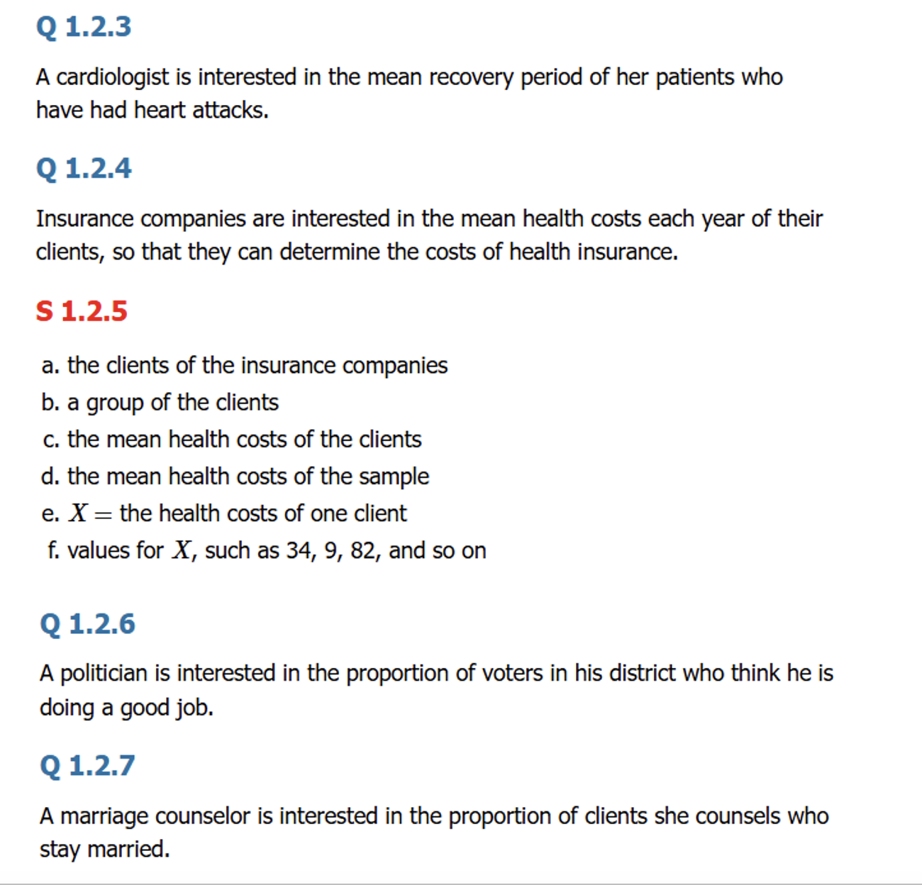
Introductory Statistics

Slide 11
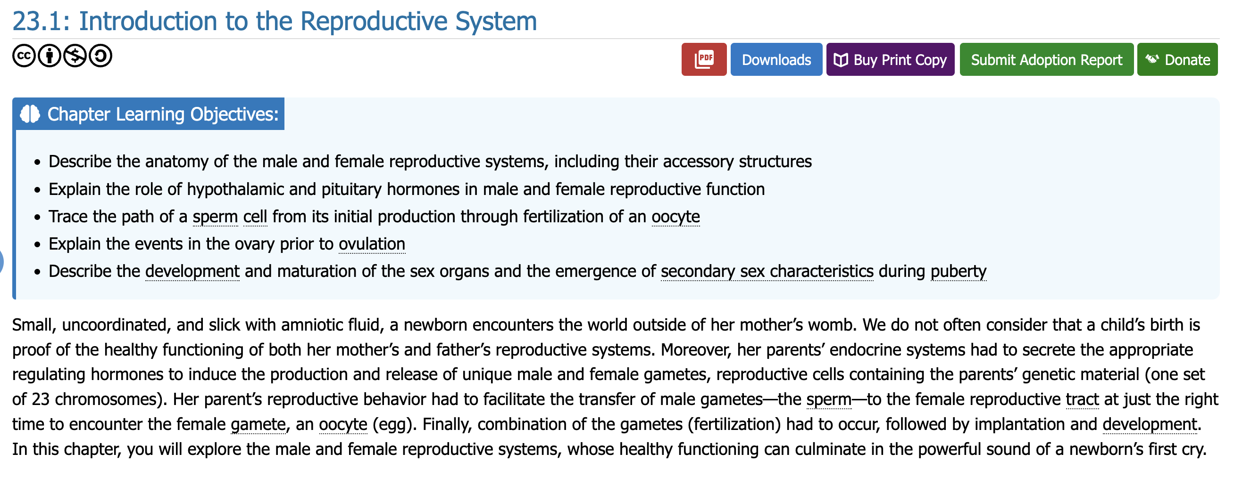
Introduction to Reproductive System

Slide 12
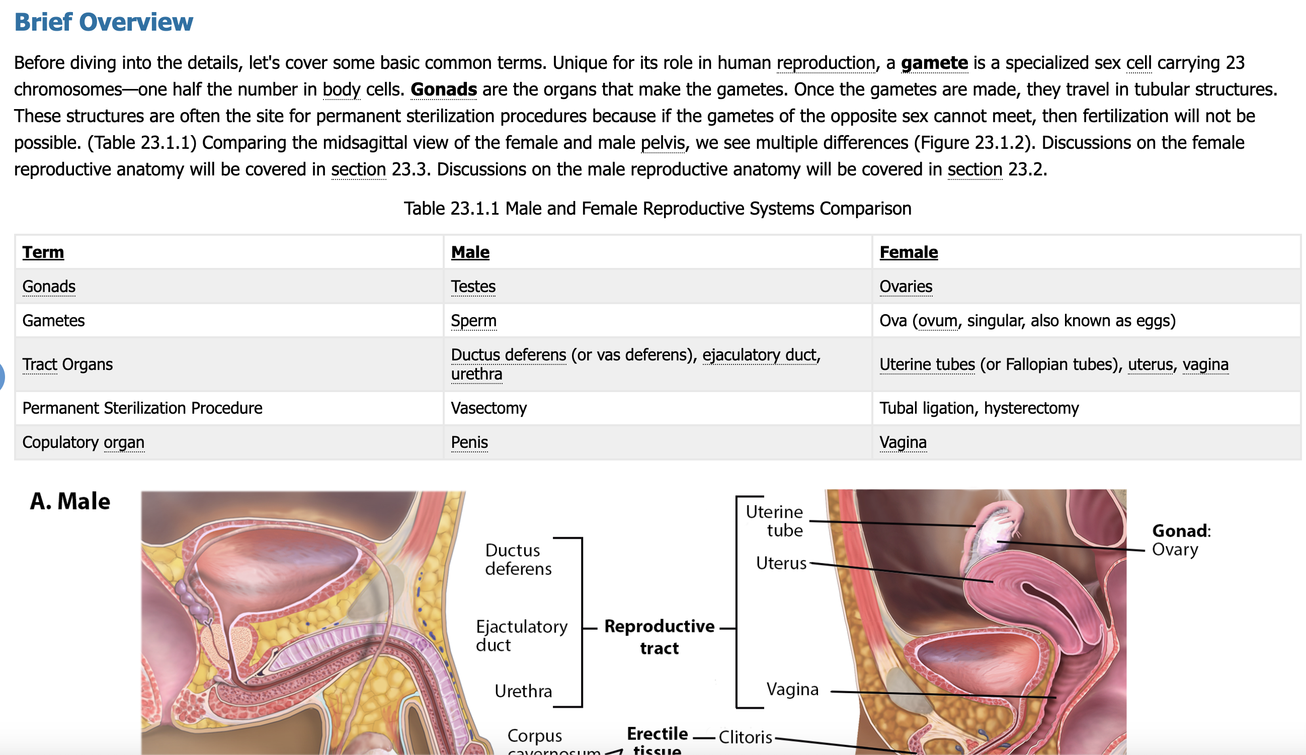
Human reproduction

Slide 13
IDEA Framework Assessment Categories
4. Diverse Authors, Researchers, and Studies
Reference discipline contributors—e.g., researchers, scholars, academics—with backgrounds like those of your students
  Include photos/illustrations or description of BIPOC contributors
  If the contributions are dominated by cis-hetero white men, openly recognize and discuss in the text
  Avoid isolating diverse contributors to specific sections, e.g., “multicultural impacts on human anatomy.”

Slide 14
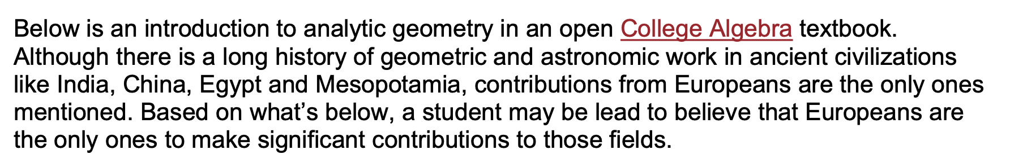
College Algebra

Slide 15
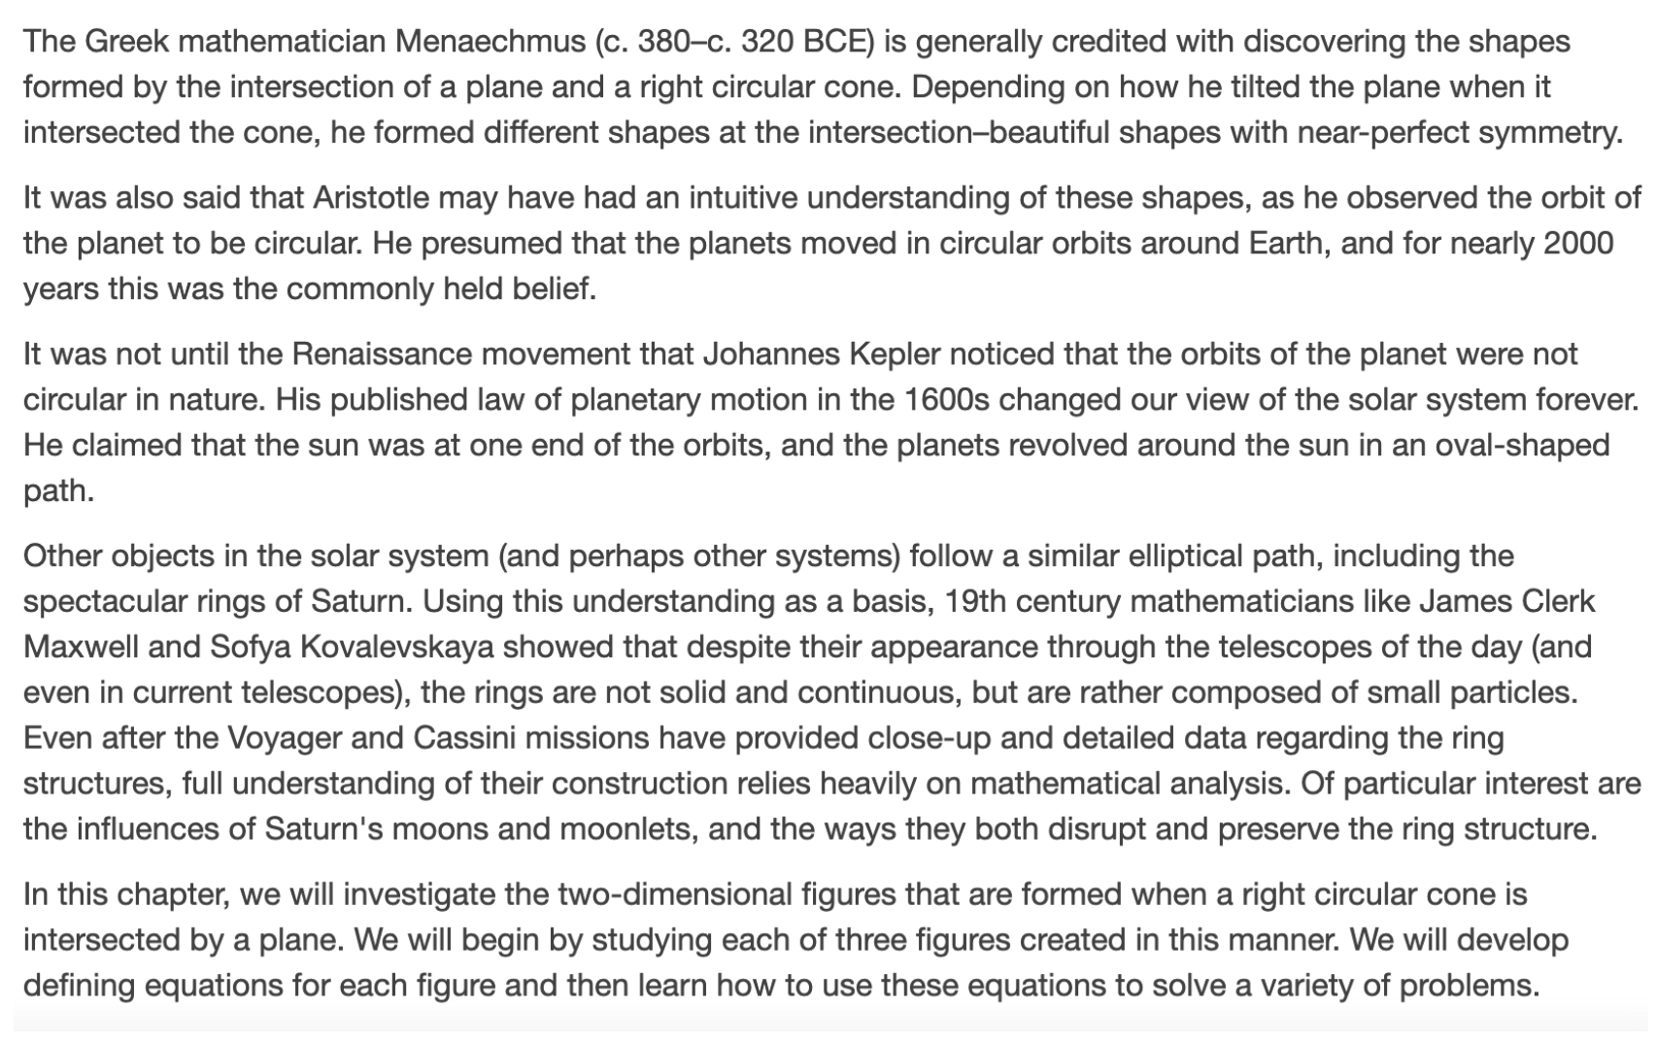
College Algebra Text

Slide 16
Diverse Studies: Henrietta Lacks
Having reviewed our interactions with Henrietta Lacks and with the Lacks family over more than 50 years, we found that Johns Hopkins could have – and should have – done more to inform and work with members of Henrietta Lacks’ family out of respect for them, their privacy and their personal interests. Though the collection and use of Henrietta Lacks' cells in research was an acceptable and legal practice in the 1950s, the laws protecting research subjects have evolved. We at Johns Hopkins have been supportive of legal changes since 1951 that protect research subjects, and we are compliant with these requirements, including those related to informed consent.
Source: John Hopkins University

Slide 17
Diverse Studies: J. Marion Sims
Medical Exploitation
Lauded as the “Father of Gynecology” after his experiments on at least seven enslaved Black women and girls in Montgomery between 1845 and 1849, in some cases without anesthesia
  The result was a technique to repair a chronic complication of childbirth
  Legally needed permission only from the enslaved women’s “owners”
  Unable to refuse treatment or withhold consent enslaved patients were powerless to protect themselves from medical exploitation
  Prevailing and dehumanizing myth that Black people were less sensitive to pain than white people
    Black patients were 22% less likely than white patients to receive any pain medication.
    40% of first- and second-year medical students endorsed the false belief that “black people’s skin is thicker than white people’s.”
Source: Equal Justice Initiative , National Library of Medicine, Proceedings of the National Academy of Sciences

Slide 18
Diverse Studies: Scientists
Scientists Spotlight Initiative
  Inclusive curricula that helps ALL students see themselves in science
  Provide access to easy-to-implement assignments/activities that link course content to the stories of counter-stereotypical scientists

Slide 19
IDEA Framework Assessment Categories (3)
8. Incorporating Diverse Perspectives on Issues, Events, and Concepts That Are Relevant to Underrepresented Groups
Diverse populations experience issues such as social problems, health, politics, business practices, and economic conditions that may differ from the mainstream
  Include diverse perspectives when presenting controversies, arguments, and opinions for each topic or concept covered

Slide 20
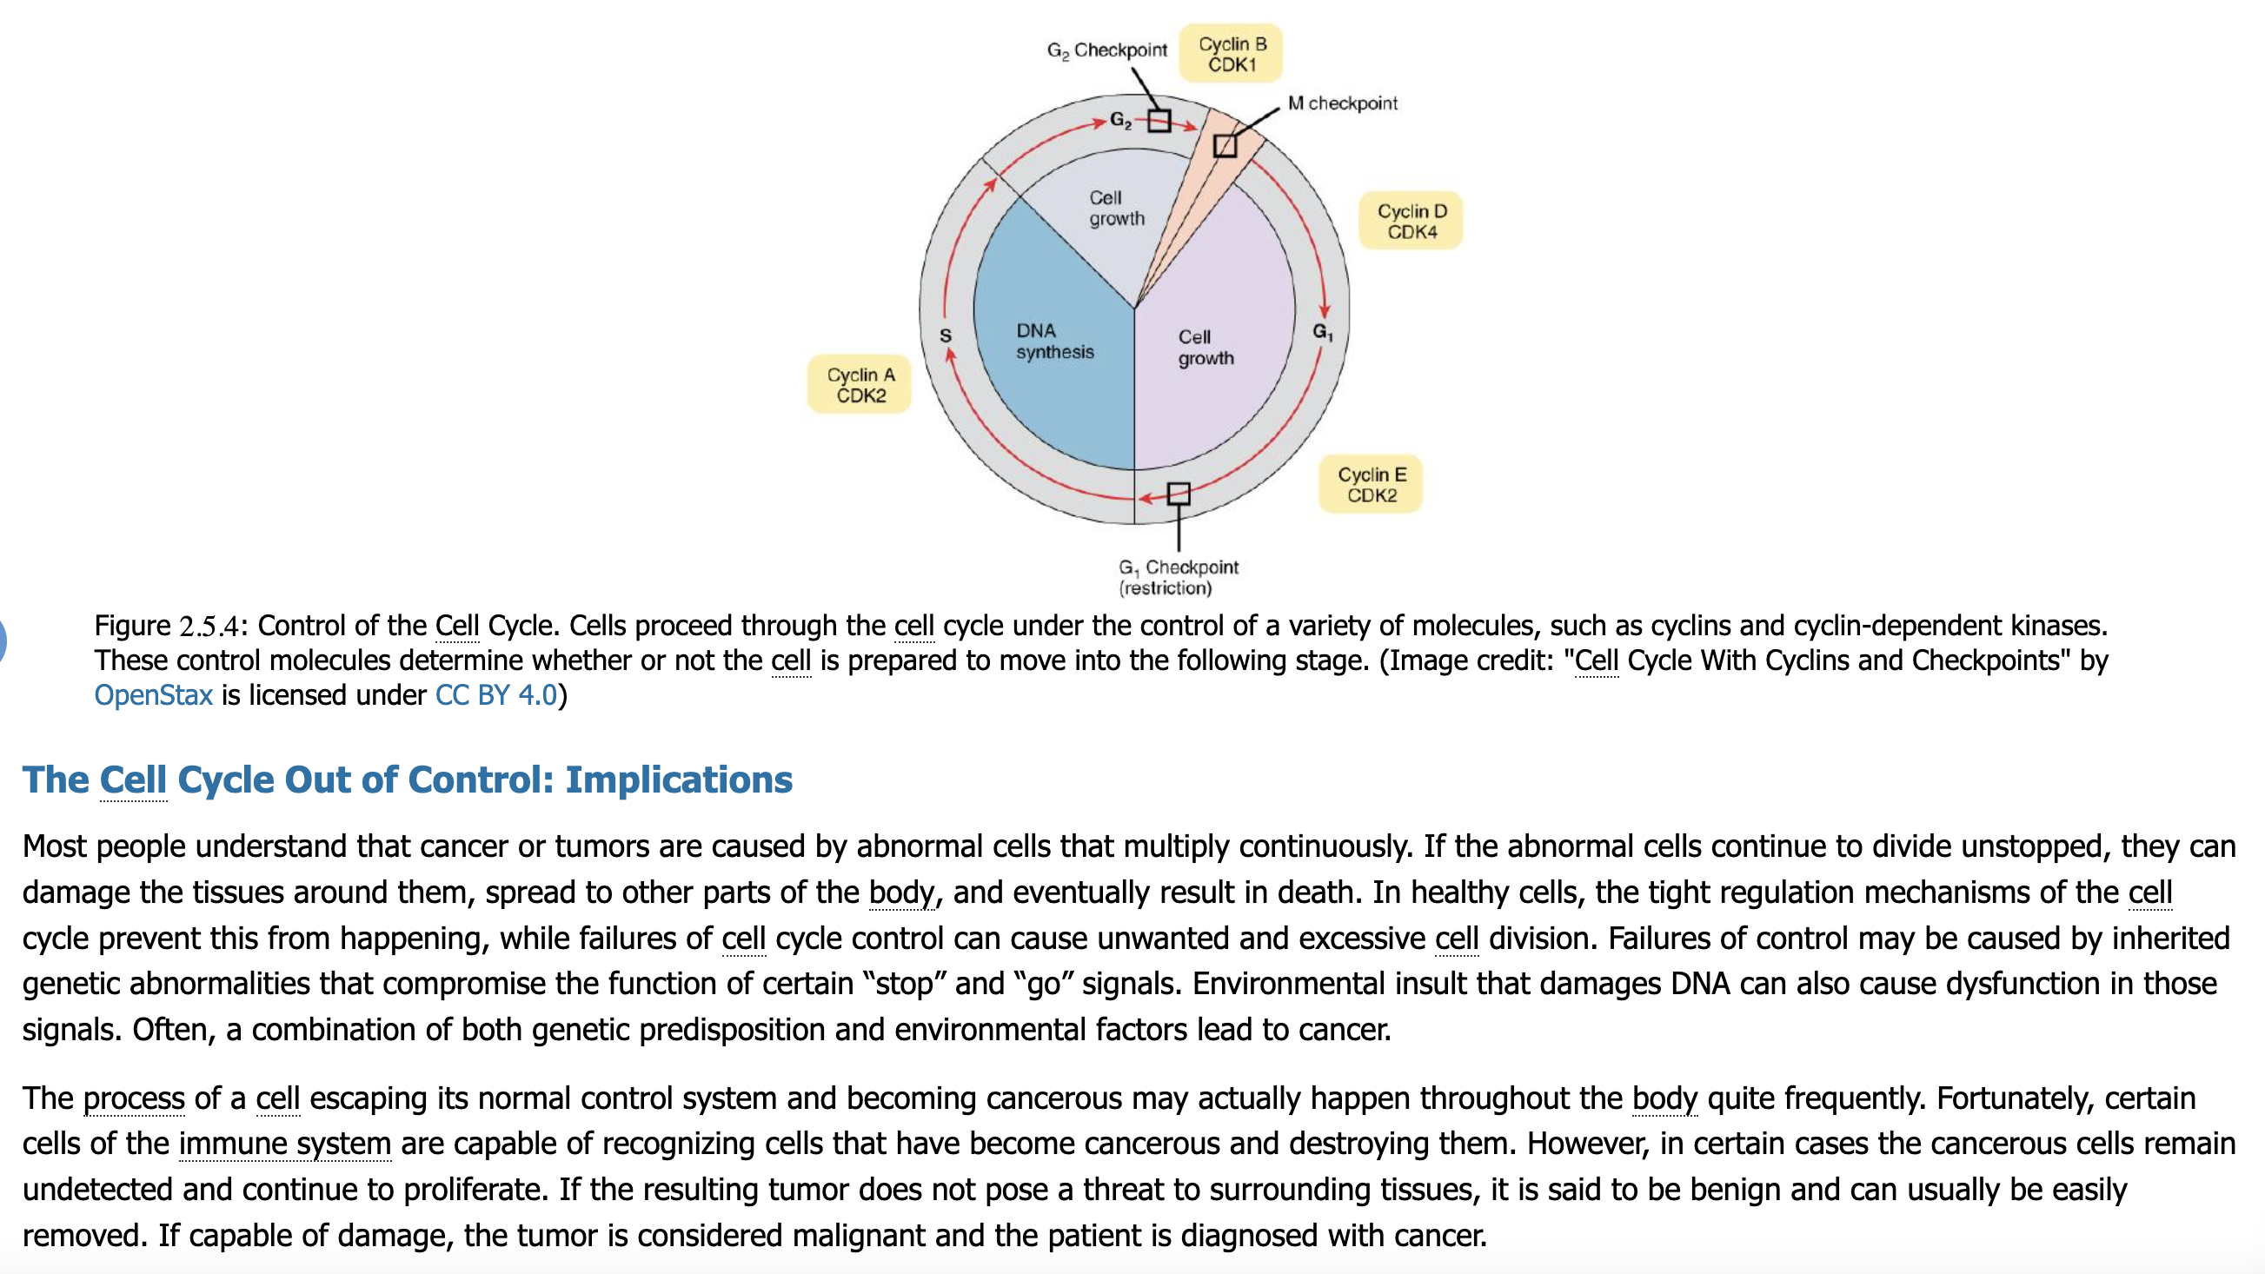
Cell Cycle

Slide 21
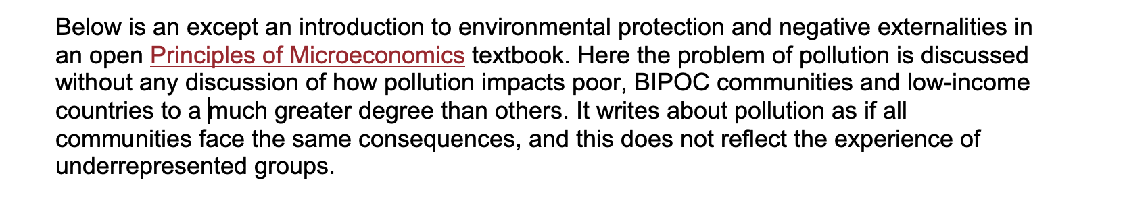
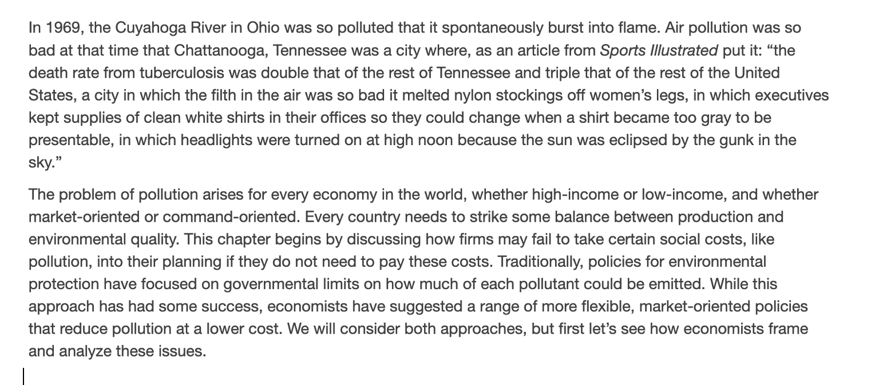
Principles of Microeconomics

Slide 22
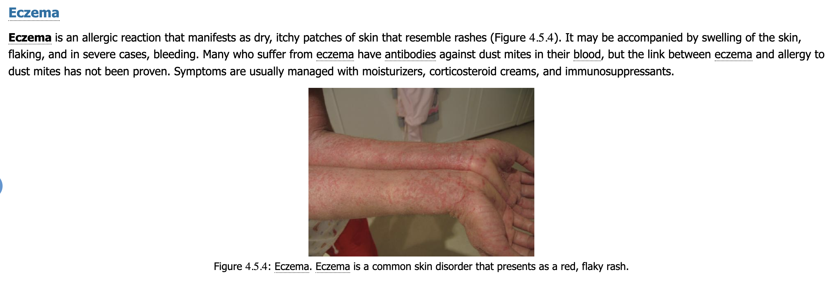
Eczema

Slide 23
Anatomy/Biology Resources
Oregon Health & ScienceUniversity’s Inclusive Language Guide
  institutional communications, patient care, instruction and presentations around descriptors of race and ethnicity, immigration status, gender and sexual orientation and physical & mental ability
Health Education Media Library
  provide high quality assets that are representative of a diverse population of both patients and health care providers (across different ethnicities, genders, ages, body types etc.) and inclusive of stigmatized health care topics
Genomics Education Partnership Diversity & Inclusion Resources
  curriculum, training, resources, and mentorship to empower faculty to provide their students experiential learning and Course-based Undergraduate Research Experiences (CUREs) in genomics and bioinformatics
Inclusive Science 4 All
  Equity, diversity, inclusion and decolonization specific resources in biomedical science education and practice
Illustrate Change
  Inclusive medical illustrations

Slide 24
Anatomy/Biology Resources (2)
Anatomy TV
  To improve equity, diversity and inclusion within our products and on our Anatomy.tv platform to support the anatomy education community
The Underrepresentation Curriculum Project
  curriculum designed to help students critically examine scientific fields and take action for equity, inclusion and justice
Cornell University Department of Ecology and Evolutionary Biology Diversity and Inclusion Resources
Gender Inclusive Biology
  Gender and sexuality diversity are more visible than ever, and our science curriculum must adapt if it is to serve our students and prepare them for the future
Project Biodiversify
  Repository of teaching materials and methods aimed at enhancing human diversity and inclusivity in biology courses

Slide 25
Send me your resources!
lanoixtr@wlac.edu

Slide 26
Debrief
Reflection
Initial thoughts? What are the big takeaways for you?
What hesitations or concerns do you have about using the IDEA Framework?
How can ASCCC OERI support for your efforts?
Accept our invitation to join our Canvas Page!

Slide 27
Join me for office hours on 3/27 from 2-3pm

