Slide 1
Art and Art History OER: Finding, Adopting, and Tracking Confirmation
Please feel free to introduce yourself in the chat!
Wednesday, March 12, 10:00-11:00am
Cerise Myers, Art & Art History Discipline Lead
Notes:
Today is geared toward OER beginners, rather than experts—although if you are an expert, I’d love it if you’d stick around and share your wisdom and knowledge!

Slide 2
Housekeeping
Drop questions/comments into the chat, raise your hand, or just speak up!
Session recording will be available at the ASCCC-OERI website
Sign up for the Art & Art History OER Google Group
Notes:
Link: https://forms.gle/ZFZ4FAPYN8YGPxEFA

Slide 3
Today
Defining OER
Finding OER in Art & Art History
Adopting OER
Tracking Adoptions
Today’s
slides:
Notes:
Short & sweet agenda today
Conversation, answer questions
Slides: https://docs.google.com/presentation/d/1v-6Dx7zpeBfK91OyXxzOa0KneoZM4pS5vON9si7nTFY/present

Slide 4
OER Definition
“
“OER” refers to teaching and learning materials that are freely available online for everyone to use and includes course modules, lectures, homework assignments, lab and classroom activities, pedagogical materials, games, simulations, and many more resources contained in digital media collections from around the world… OER most often refers to openly-licensed textbooks and ancillary materials that are available at little or no cost to students. ​–ASCCC-OERI
”

Slide 5
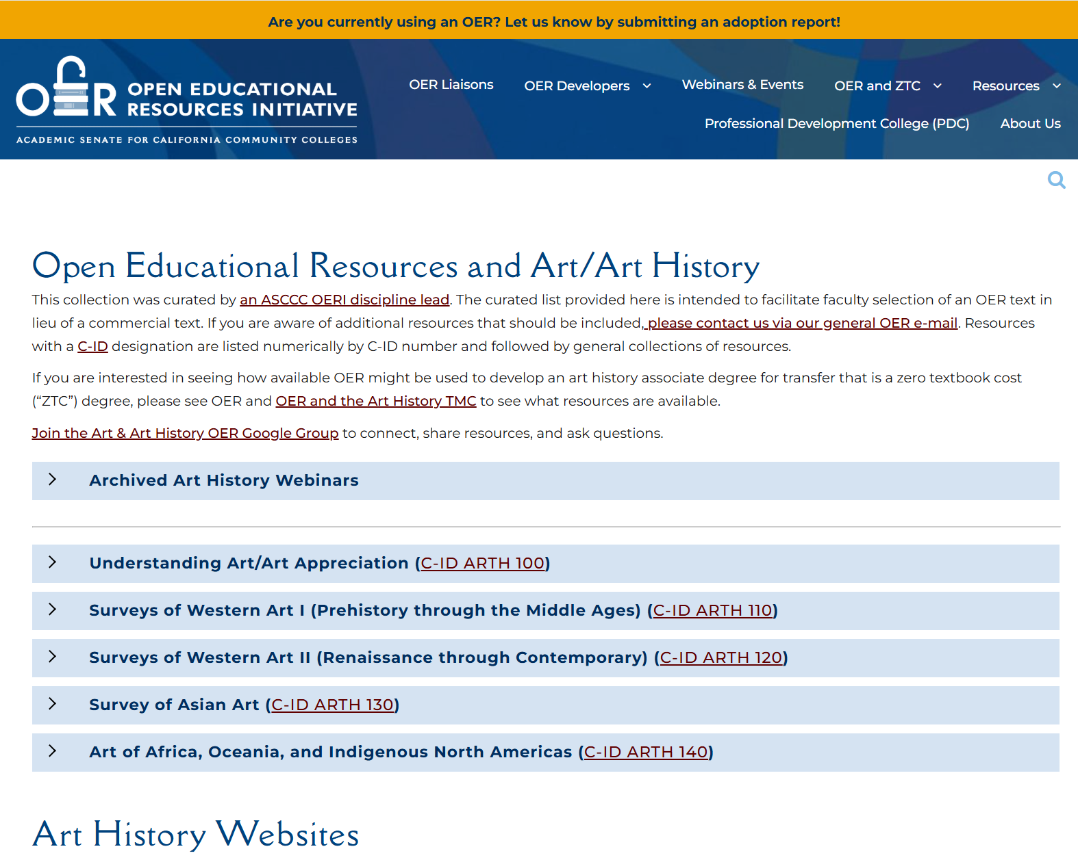
Finding OER in Art & Art History
Discipline curated list at the OERI’s website, https://asccc-oeri.org/
Is something missing from the list? Please let me know!

Slide 6
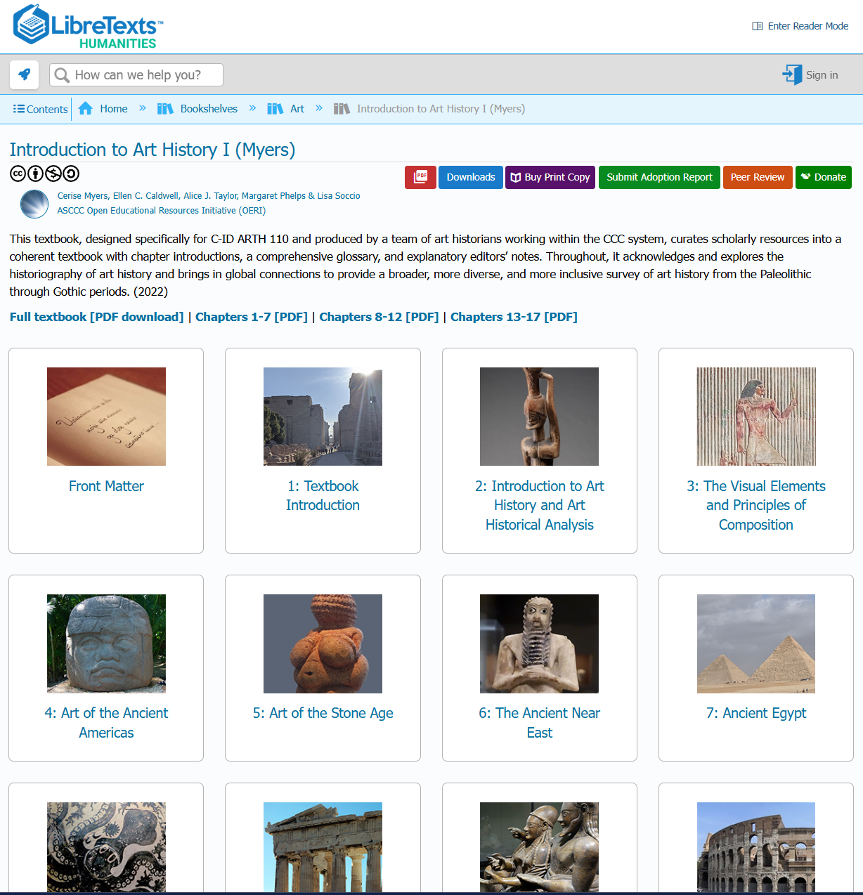
Adopting OERs
Consideration: use as-is or remix?
Sharing: link (and/)or frame?
If you can, get it on the COR!

Slide 7
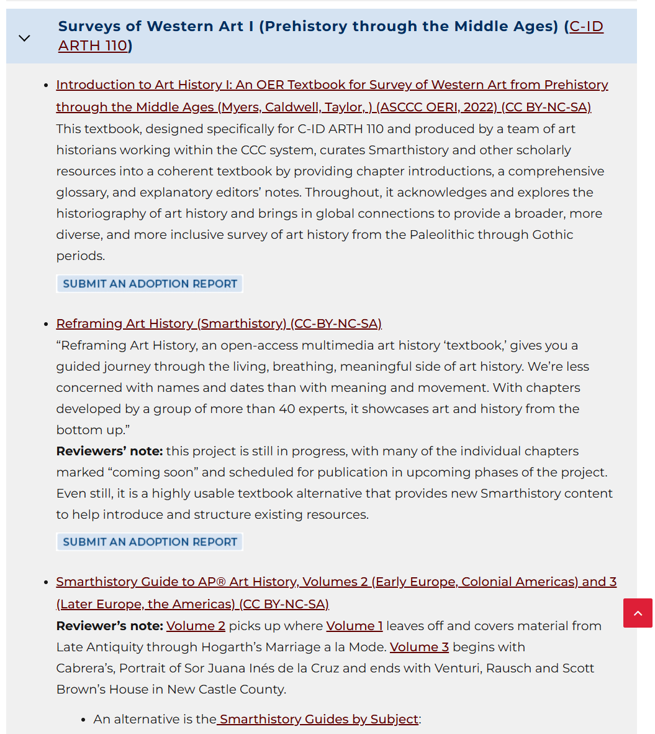
Tracking OER Adoption
New feature at ASCCC-OERI.org: “Submit an Adoption Report” button
Curated discipline lists
Table searchable by C-ID

Slide 8
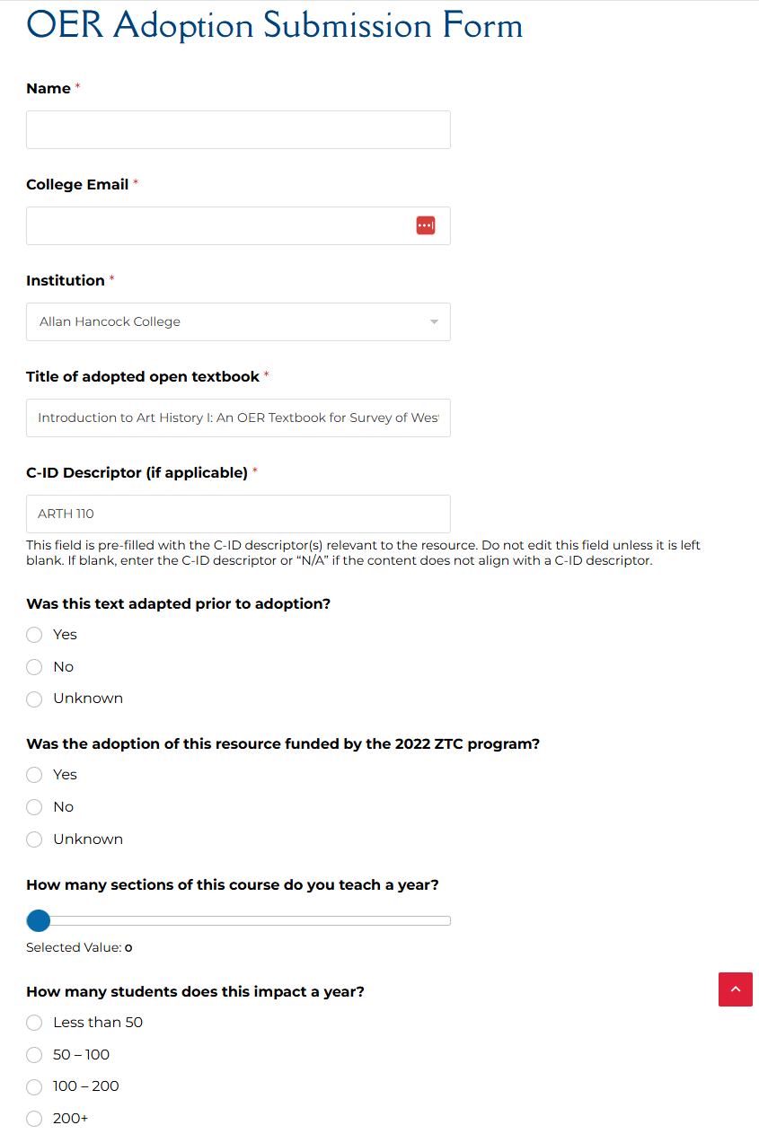
Tracking OER Adoption (2)
Only nine questions—and two will auto-populate!
Notes:
Some of our textbooks are approved for multiple C-IDs, like Reframing Art History. When I submitted for ARTH 120, I removed the “ARTH 110” ((Heather, was this correct?))
Gives us useful data and helps us improve our lists

Slide 9
Thank you! Questions?
Please don’t hesitate to reach out:
Cerise Myers (cerise.myers@imperial.edu)
Today’s
slides:

