Slide 1

Spring 2025 ECE OER Update
Welcome to our Spring 2025 Early Childhood Education Open Educational Resources update. This presentation highlights the latest OER materials available across key ECE subject areas.
by Amanda Taintor

Slide 2

Child Growth and Development Resources
1
The Whole Child
2
Infant and Child Development
3
Canvas Course
Lecture slides and transcripts by Buckley and Budzyna available on OER Commons.
POCR ZTC Child Growth and Development by Dr. Susie Valdez.
Comprehensive textbook by Drs. Parnes and Pagano with embedded H5P activities.

Slide 3
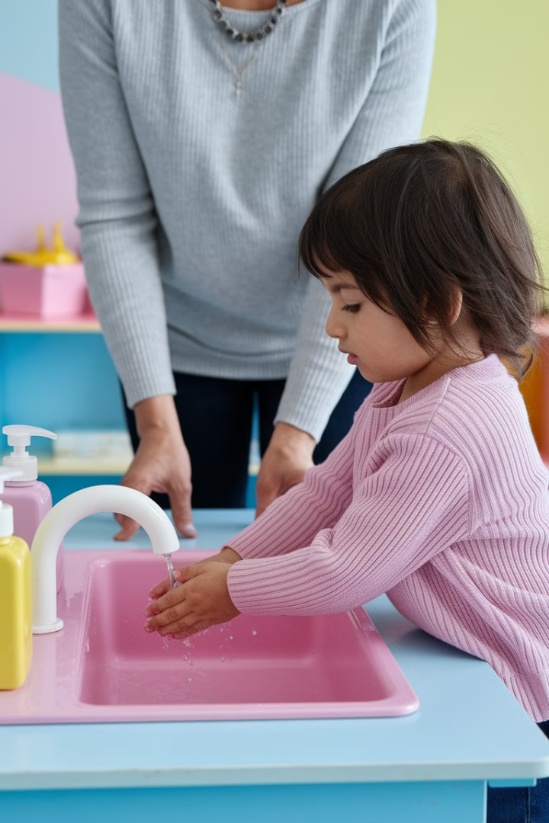
Health, Safety and Nutrition
Safety, Health and Nutrition in Early Childhood Education
Jennifer Paris. Updated H5p
Interactive Content
Includes 32 H5P activities across 115,732 words of content.

Slide 4
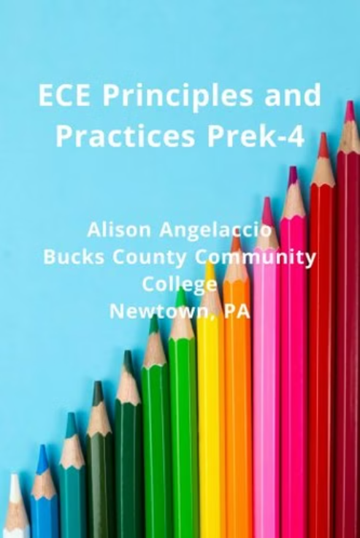

Principles and Practice
ECE Principles and Practices
Introduction to ECE
Comprehensive textbook by Alison Angelaccio covering PreK-4 education principles.
Introduction to Early Childhood Education is designed for ECED 105, one of the initial courses in the ECE Initial Certificate program in Washington State. This book serves as an essential guide, exploring the principles, practices, and foundational knowledge of early childhood education.

Slide 5





Practicum and Field Experience
Field Experience Skill Evaluations
Field Experience Documents
Fanshawe College Early Childhood Education Field Practicum HUB
A set of rubrics used to evaluate students in early childhood education teacher preparation field experiences.
A collection of field experience documents created to provide information and support to students, faculty, and community partners.
Comprehensive resource with 17,707 words and H5P activities by Kim Woods.

Slide 6
Introduction to Curriculum
Canvas Shell: ECED80: Introduction to Curriculum (Kari Galer)
Welcome to this course on the learning journey, where we explore the process of growth as a continuous cycle of successes, challenges, and discoveries. Throughout this course, we will examine what it means to truly understand something, both as a parent and a child, while recognizing how setbacks can become valuable learning experiences. You will learn to identify signs of frustration in children, explore strategies to support their learning, and build a strong network of support for both parents and caregivers. We will also dive into the concept of lifelong learning, reflecting on personal growth, future learning opportunities, and the role of virtual technology in education. By the end of this course, you will have developed actionable strategies and a clear plan to foster a positive, resilient, and sustainable learning environment for yourself and the children you support.

Slide 7

Parenting Course
Canvas Course: TLSS: Parents & Care Givers
Welcome to this course on the learning journey, where we explore the process of growth as a continuous cycle of successes, challenges, and discoveries. Throughout this course, we will examine what it means to truly understand something, both as a parent and a child, while recognizing how setbacks can become valuable learning experiences. You will learn to identify signs of frustration in children, explore strategies to support their learning, and build a strong network of support for both parents and caregivers. We will also dive into the concept of lifelong learning, reflecting on personal growth, future learning opportunities, and the role of virtual technology in education. By the end of this course, you will have developed actionable strategies and a clear plan to foster a positive, resilient, and sustainable learning environment for yourself and the children you support.

Slide 8
Child, Family, Community
Sample assignments from "Teaching Children, Families, Schools, and Communities" available on OER Commons provide practical applications of these interconnected relationships.
Sample Assignments for Teaching Children, Families, Schools, and Communities

Slide 9





Child Guidance Resources
Canvas Shell
Comprehensive resource for positive guidance strategies.
Canvas Shell
Canvas shell: positive child guidance Kari Galer
Shasta College Chapters: Lorraine Haas
LHaas@ShastaCollege.edu
Historical Perspectives on Child Guidance
Developmental Theories in Child Guidance
Analyzing Child Behavior: Typical and Atypical Development
Environmental Influences on Child Behavior
Role of the Educator in Child Development
Implementing Effective Guidance Strategies
Behavior Management and Intervention Techniques
Observational Techniques for Assessing Behavior

Slide 10
Infant/Toddler Safety: Canvas Course
Infant Safety- Canvas Course The Infant Safety Canvas Course provides comprehensive guidance on creating and maintaining safe environments for our youngest learners.

Slide 11
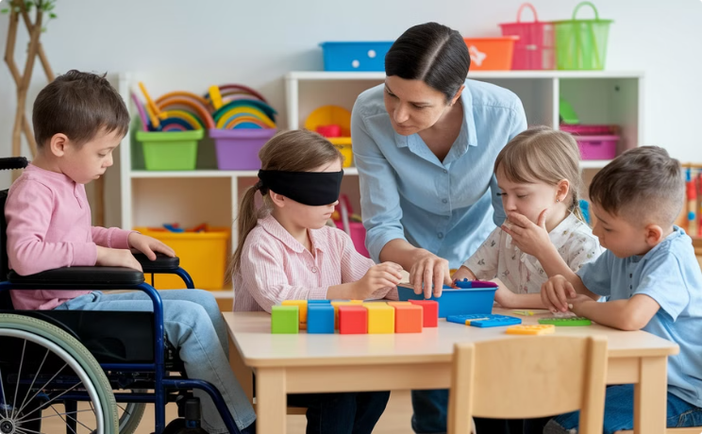
Diversity in Early Childhood
"Opening Eyes onto Inclusion and Diversity" by Carter et al. provides comprehensive guidance.

Slide 12
Early Intervention
Harmony Negrete's robust Canvas shell "Introduction to Early Intervention" from Fresno City College offers comprehensive resources for early intervention professionals.

Slide 13

Administration Resources
"Childcare Programming, Administration, and Supervision, Birth-PreK" by Dr. Susan K. Eliason explores essential skills for operating high-quality early childhood programs.

Slide 14
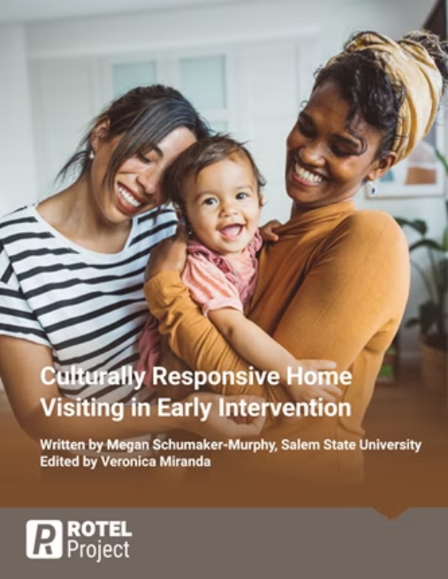
Misc.
Book Description: Written by a former early intervention developmental therapist in consultation with EI parents, this text provides an updated and easily accessible framework for providing culturally responsive early intervention services. Each component of the updated framework is presented in its own chapter that includes an introduction to new concepts, necessary background information, recommendations for future practice, case studies and/or reflective tools, next steps, and linked resources. Written in practitioner friendly language with concepts and strategies that are immediately relevant to working with families with children with disabilities, this text is appropriate for pre- and in-service EI providers at all levels.
Culturally Responsive Home Visiting in Early Intervention
Authors: Megan Schumaker Murphy and Veronica Miranda

Slide 15

Addressing the Gaps:
What's happening around the state (that I know of….)

Slide 16




Administration/ Supervision and Mentoring
Colleges open for collaboration on administration, supervision, and mentoring resources:
Chabot College
Shasta College
Cerro Coso
ELAC
Alice Hale
Jeanne Veich
Julia Faumuinajulia.faumuina@cerrocoso.edu
Ancelma Sanchez
ahale@Chabotcollege.edu
jveich@ShastaCollege.edu
Ydania Garcia
Elizabeth Blackwell

Slide 17
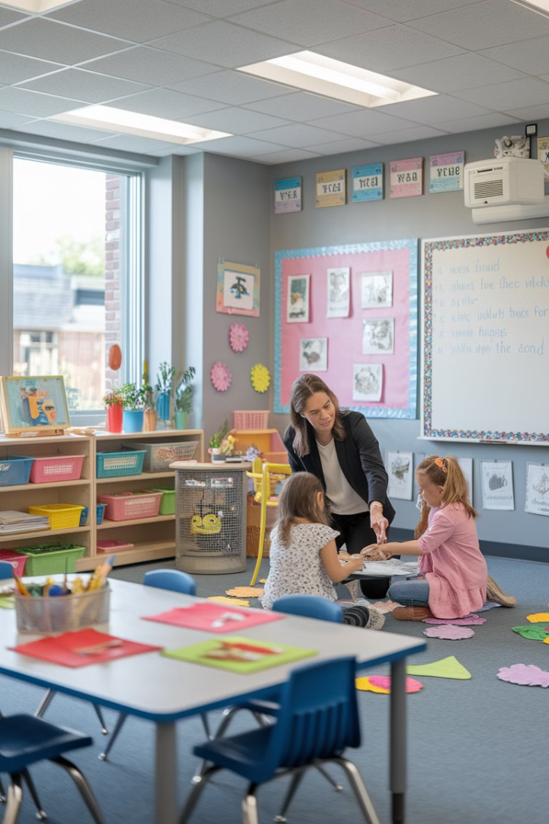
Special Needs
Chabot College
Alice Hale at ahale@Chabotcollege.edu

Slide 18
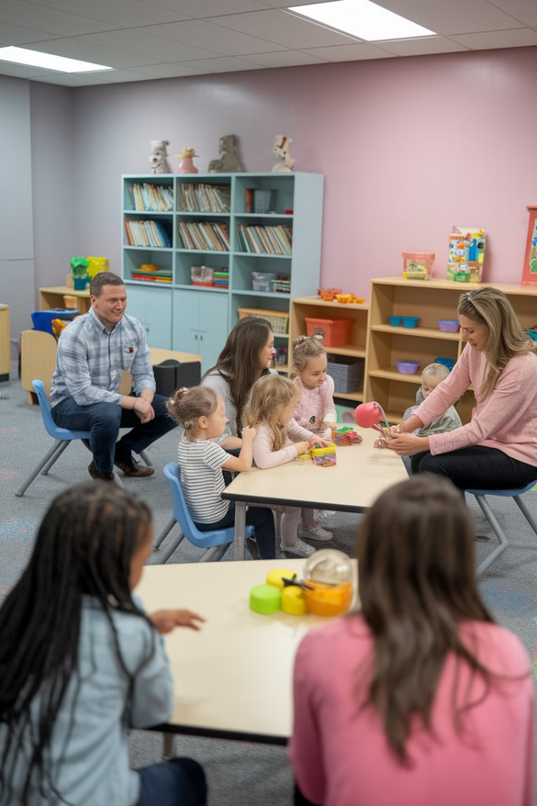
Practicum
Shasta College
Jeanne Veich jveich@ShastaCollege.edu

Slide 19
Guidance
Colleges collaborating on guidance resources:
Palomar College
Amanda Hill – ahill2@palomar.edu
Lorraine Hass
Ken Breeding – kbreeding@palomar.edu
See above links: First 9 chapters completed
Completed a first partial draft for the chapter on Communication

Slide 20
Working with Parents and Families
Palomar
Heather Elliot Pham - helliottpham@palomar.edu
Gina Wilson – gwilson2@palomar.edu

Slide 21

School Age Development
Palomar College
Kerry Diaz - kdiaz@palomar.edu
Tanessa Sanchez – tsanchez@palomar.edu

Slide 22

School Age Curriculum
Palomar
Kerry Diaz - kdiaz@palomar.edu
Tanessa Sanchez – tsanchez@palomar.edu

Slide 23

Child Abuse
Palo Verde
Dana Rethwisch<dana.rethwisch@paloverde.edu

