Slide 1
Terms of Use
Except where otherwise indicated, the contents of this slide presentation are available for use under the Creative Commons Attribution 4.0 license.
You are free to adapt and share the work, but you must give appropriate credit, provide a link to the license, and indicate if changes were made.
Sample attribution: [Title of work] by C-MOOR. CC-BY 4.0
This Google Slides template is modified
from original work by Jimena Catalina,
provided as free to use from SlidesCarnival
under Creative Commons License
Attribution 4.0 International.
Notes:
Except where otherwise indicated, this content is available for use under CC B Y 4.0.

Slide 2
Integrating RNA-seq Research into Biology for Majors Course
Rosa Alcazar, Ph.D.
Stephanie Coffman, Ph.D.
Clovis Community College

Slide 3
Outline
The Mission – Preparing Our Students
Our Method – Teaching Through Research
Future Directions – Where We’re Headed

Slide 4
1.
The Mission
Preparing Our Students
Notes:
One

Slide 5
Our Vision
Every biology student should participate in an authentic research experience before transfer
www.c-moor.org

Slide 6
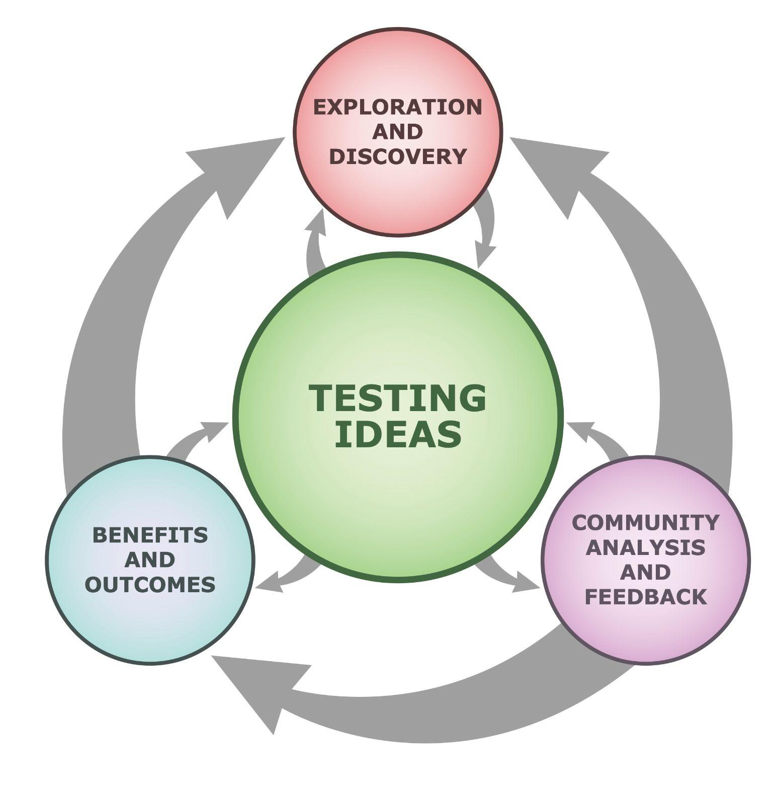
What is an Authentic Research Experience? Discovery, Collaboration, Iteration
undsci.berkeley.edu/understanding-science-101/how-science-works/the-real-process-of-science
Notes:
Every student before they transfer has had an authentic research experience
Develop own hypothesis (ownership)
Test own ideas
Communicate results
Incorporate feedback

Slide 7
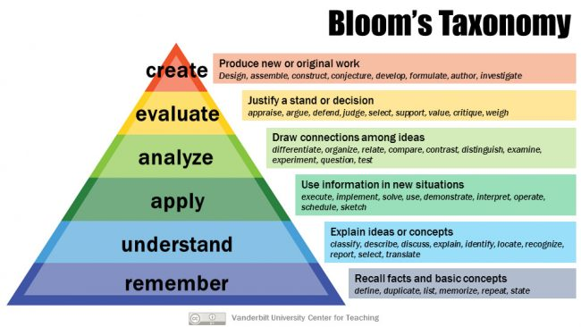
Benefits of a Course-Based Undergraduate Research Experience (CURE)
Opportunity to engage with higher level skills
vanderbilt.edu/advanced-institute

Slide 8
What are you nuts?
“We don’t have resources for research”
“Instructors don’t have time for this”
“Students need to focus on the basic concepts”
“Students don’t have time for this”
“Students aren’t ready the first-second year”
“You’re setting up students for failure”
“Research shouldn’t be required”

Slide 9
Doing this with Genomic Data Science
Highly relevant in today’s biology
Lots of freely accessible data
Tools more available
Doesn’t require expensive equipment
Cloud Computing allows students to use any device
Training can transfer to other data intensive fields

Slide 10
Sequencing Data is Ubiquitous, Cloud Computing Makes Data Analysis Accessible
galaxyproject.org // sciserver.org // bioconductor.org

Slide 11
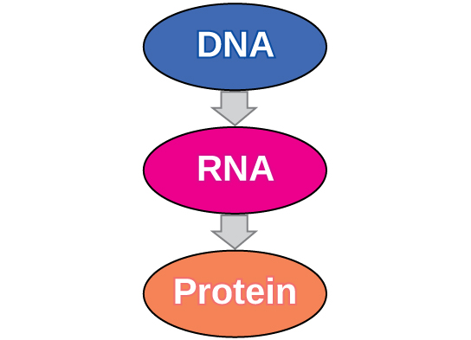
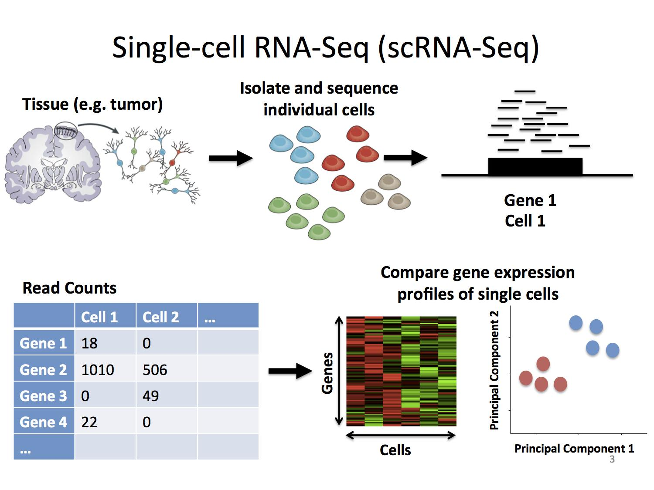
BIOL11A “Biology for Majors”
Transcription
Translation
Image Credit: Concepts of Biology, OpenStax. CC-BY 4.0.
speakerdeck.com/stephaniehicks/welcome-to-the-world-of-single-cell-rna-sequencing

Slide 12
Access to Research in the lab: miniCURE
Earlier research experiences
See instructor as mentor
Increase self-efficacy, skills, and persistence in STEM
Embedded multi-week Course-based Undergraduate Research Experiences (miniCUREs) in a required course for biology
hhmi.org/science-education/programs/model-programs-course-based-undergraduate-research-experience-cre-or-cure

Slide 13
We’re not crazy
Introduced students to research projects for 7 years
600+ students completing the project
No coding experience
First scientific poster presentation
Established a research symposium
Collaborating across institutions
College of the Desert running CURE and miniCURE
Dine College implemented a module
Funded by NSF and NIH to expand

Slide 14
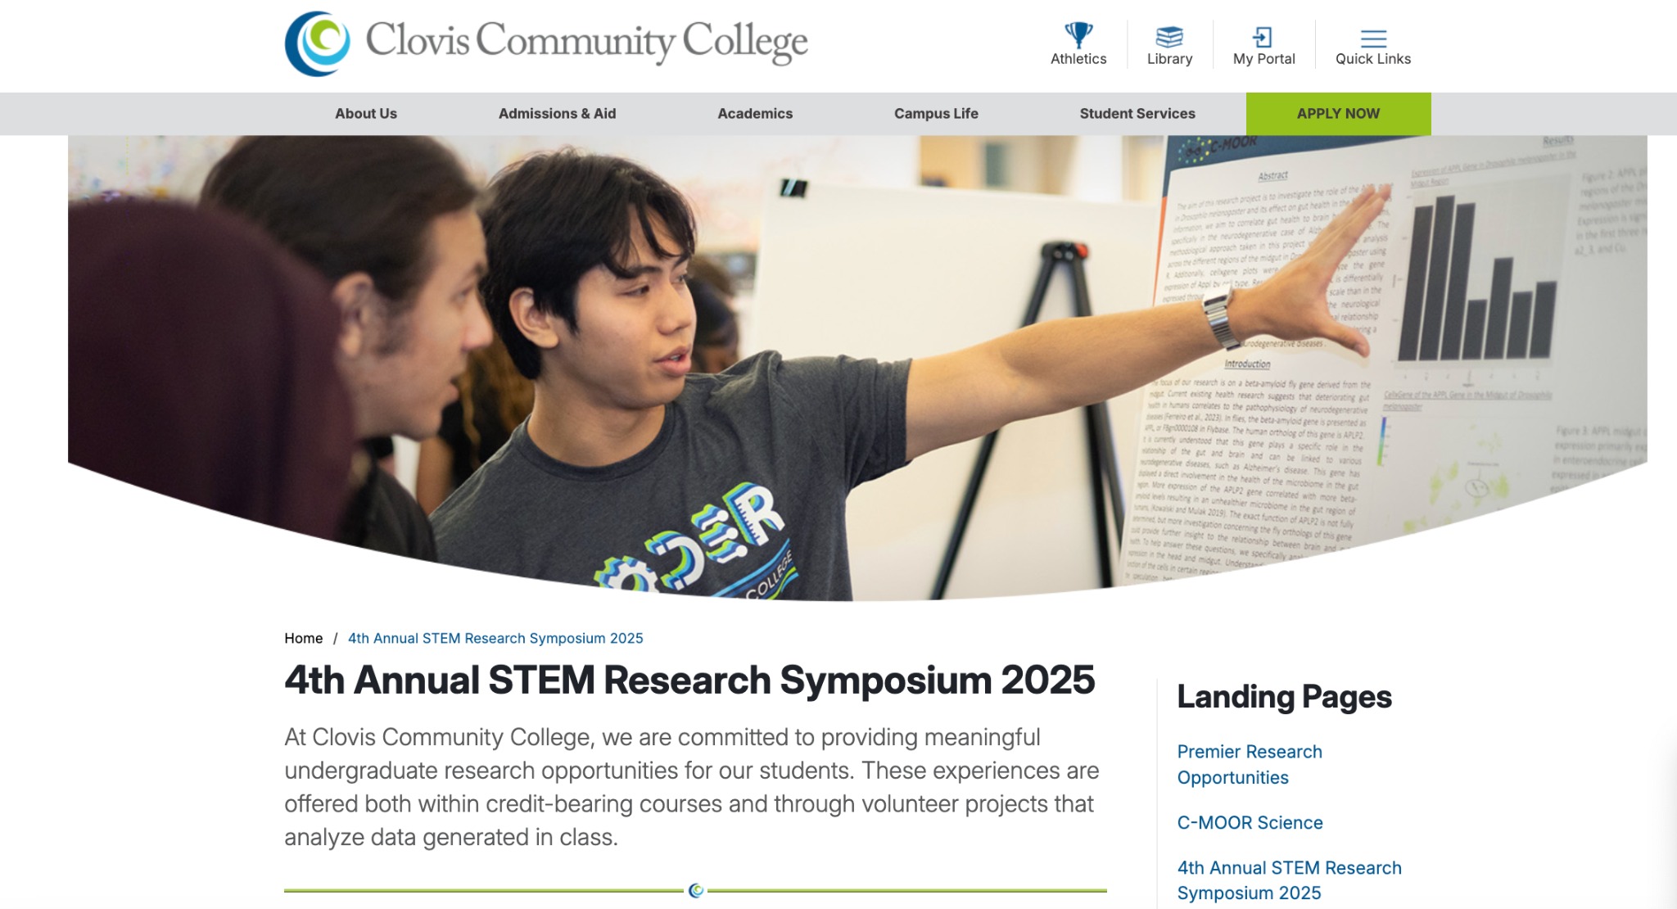
Research Symposium at Clovis

Slide 15
Student Video

Slide 16
2.
Our Method
Teaching Through Research
Notes:
One

Slide 17
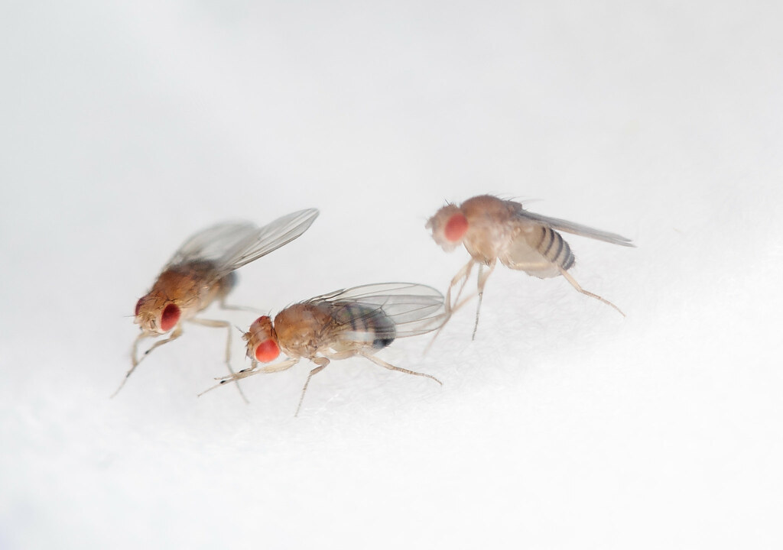
C-MOOR Science Project
Incorporated into the first semester of Biology for Majors series
Students analyze existing RNA-seq data sets
Four modules are integrated into the lab, followed by independent research
The Fruit Fly by NASA's Marshall Space Flight Center, CC-BY-NC 2.0.

Slide 18
Project Goals and Specifics
Navigate biological databases to access the wealth of available scientific knowledge and data.
Analyze data (i.e. create and interpret plots) to generate novel conclusions.
Cultivate an “-omics” perspective, integrating multiple sources of information and wielding computational tools to enable a holistic approach
Practice the scientific process, identifying avenues for research, designing experiments, analyzing data, and integrating results into the broader scientific discourse.
Aligned Course Learning Outcomes:
Apply the scientific process, to explore biological data, formulate a hypothesis and design an experiment using appropriate controls based on an analysis of scientific literature.
Analyze the impact of Biotechnology in basic and applied research.
Other SLOs projects often touch on:
Explain the structural-functional relationship in the components and regulation of eukaryotic and prokaryotic cells.
Explain how living organisms convert light and chemical energy to produce and utilize ATP.

Slide 19
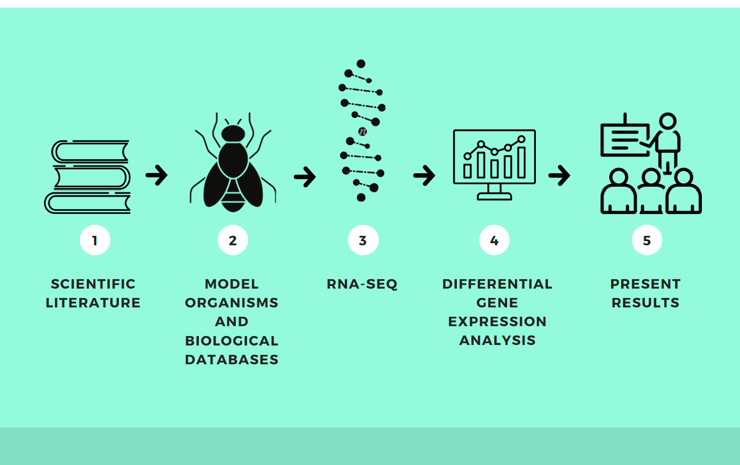
Available Content
Modules may include:
LearnR Tutorial(s)
Pre-Lab Assignment
Lab Assignment
Introduction Slides
Readings
Modular and Flexible
RNA-seq mini-CURE
Notes:
DEMO?
Walk through miniCURE curriculum online
LearnR tutorial?
Gene expression spreadsheet?

Slide 20
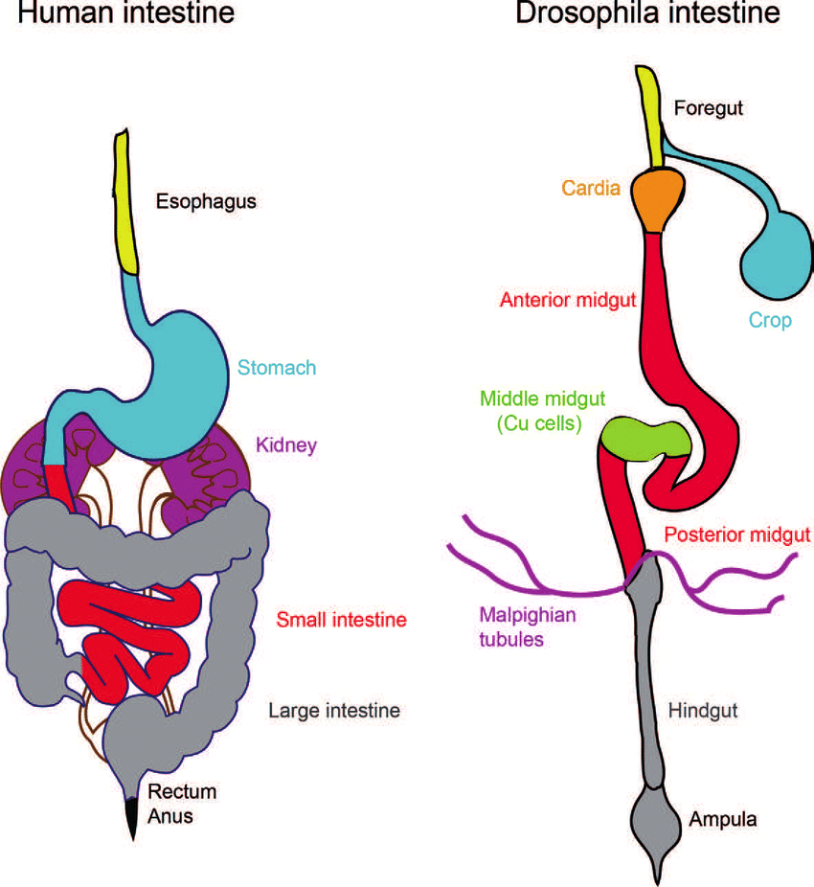
Data Set
Currently, students have access to an RNA-seq dataset from the midgut of Drosophila melanogaster from Marianes and Spradling 2013.
CC-BY 3.0

Slide 21
Demo
Notes:
Databases, Coding Demo, Example: Trypsin

Slide 22
Student Poster Presentation
As a summative assessment, students develop a digital poster with their group
Poster mirrors the sections of a traditional scientific journal article

Slide 23
STEM Research Symposium

Slide 24
3.
Future Directions
Where We’re Headed
Notes:
One

Slide 25
Lessons Learned
Teaching science vs teaching coding
Key word in ‘Data Science’ is not Data, it’s Science (Leek)
Scaffolding the scientific process
Novice scientists need goal posts for progress
Negative results are not failures
Can be evidence of their development as scientists
Ownership makes a difference in motivation
Students are surprised by the free available resources

Slide 26
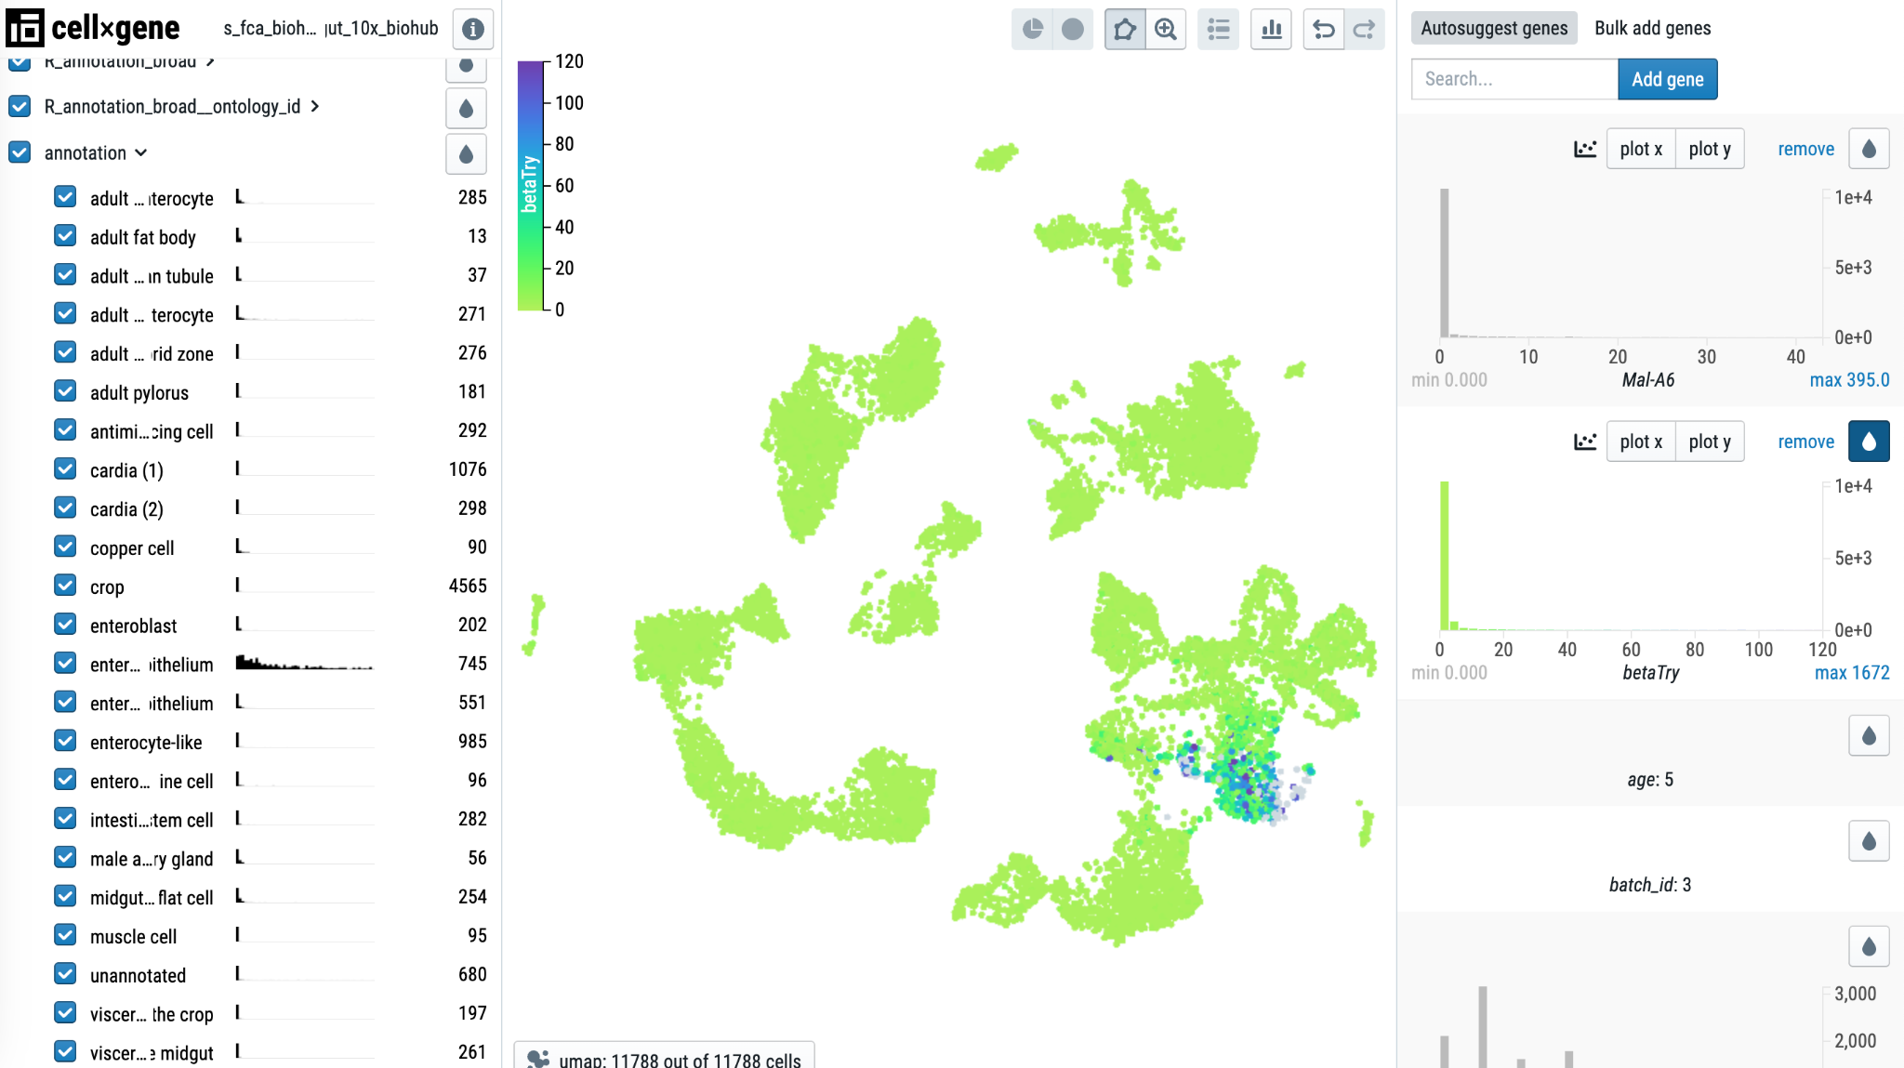
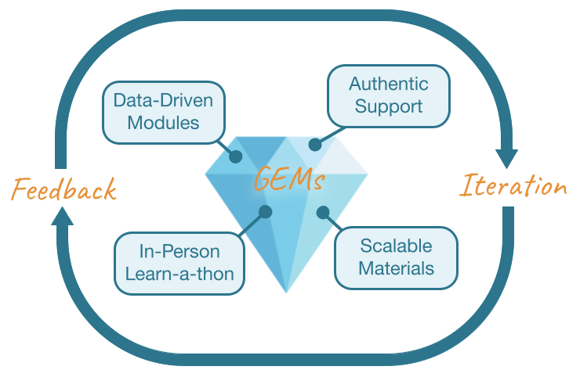
Expand datasets for RNA-seq miniCURE
Expression color scale
Anterior midgut epithelium
betaTry gene expression
More RNA-seq
Single Cell
genomicseducation.org // science.c-moor.org/miniCURE-RNA-seq/single-cell-rna-seq-analysis.html
Notes:
Let's now take a look at the expression of the beta trypsin gene, which is a gene involved in protein breakdown.
Enter the gene name, shown in italics in the slide, to the quick gene search and add the gene to the panel.
Click the droplet icon and clipp the expression values to create a better color scale for expression.
After performing these operations we also observe that the beta trypsin gene also expresses almost exclusively on the anterior mid-gut epithelium.

Slide 27
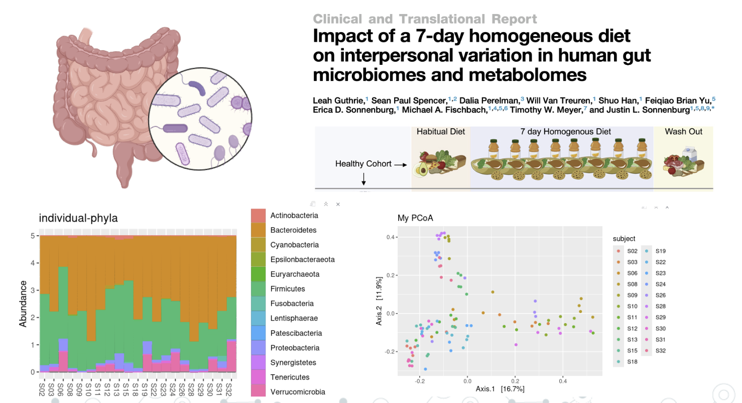
Expand miniCURE to Human Gut 16S rRNA
reporter.nih.gov/project-details/10983250 // pubmed.gov/35643079

Slide 28
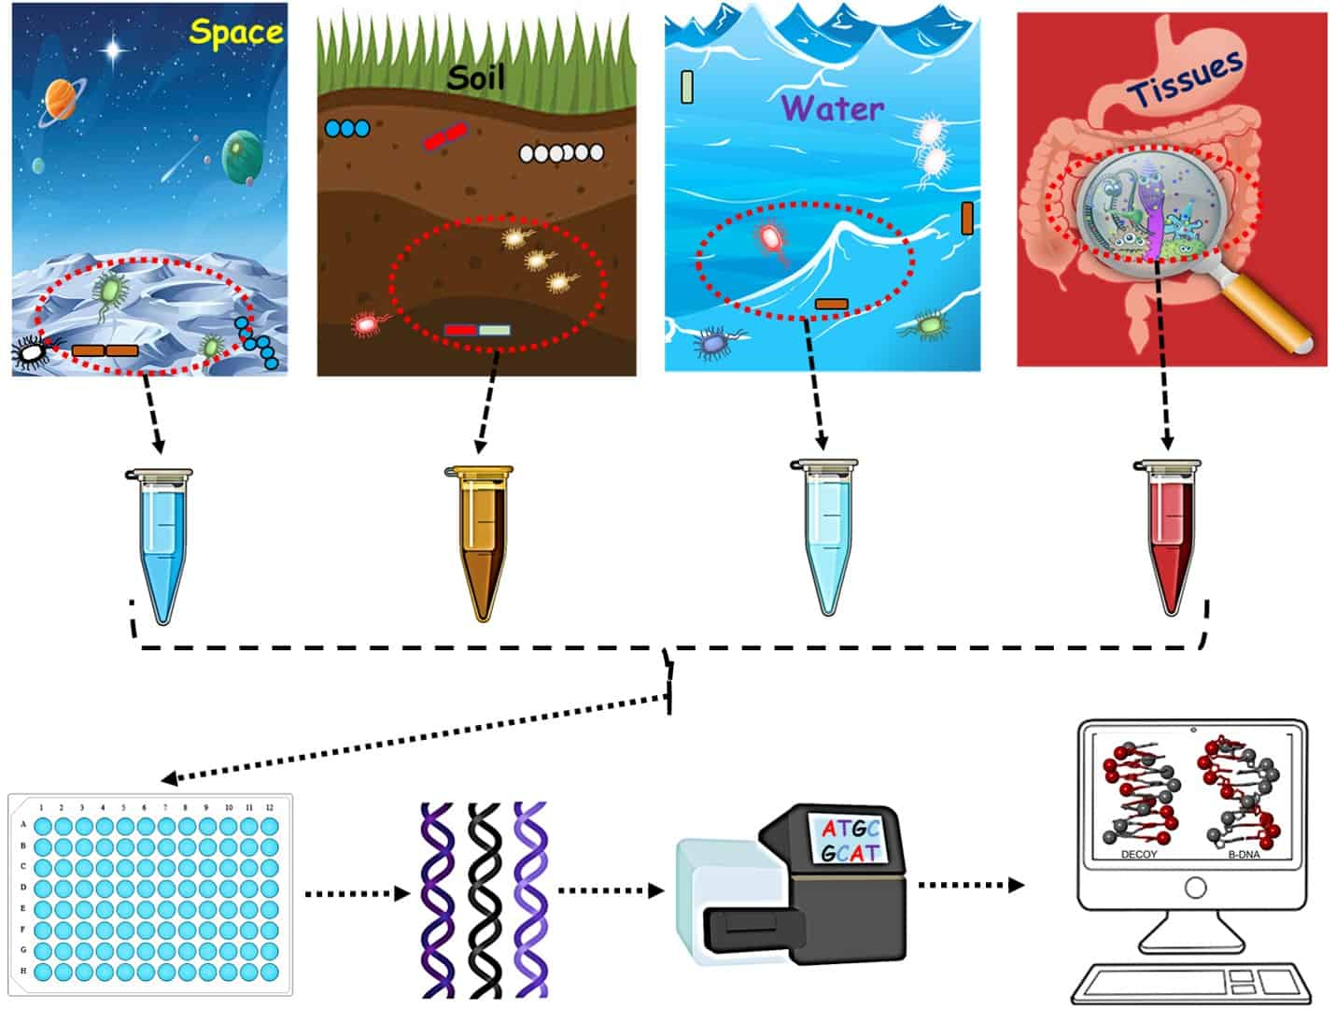
Expand content to a semester long CURE
% | Type
20% | Assignments
20% | Class Discussions
20% | Written Check-ins
10% | Advisory Meetings
10% | Peer Reviews
10% | Final Presentation
10% | Portfolio Development
sciwri.club/archives/7530

Slide 29
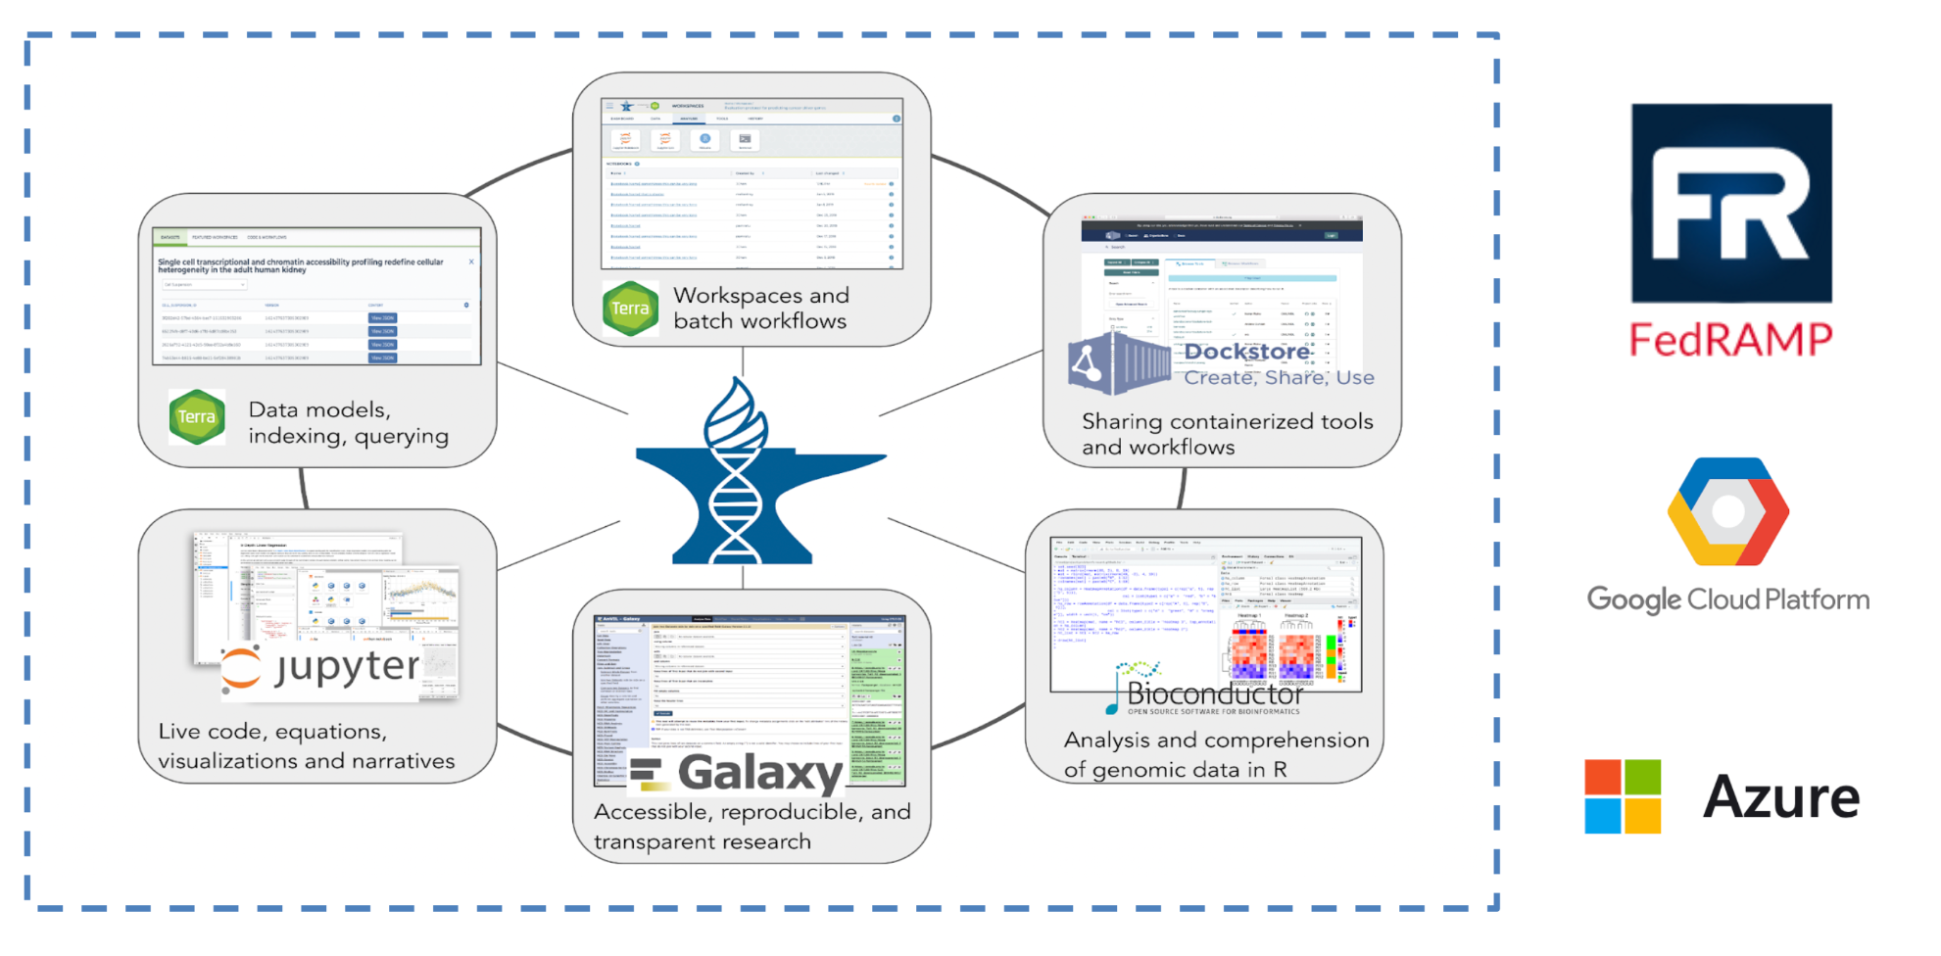
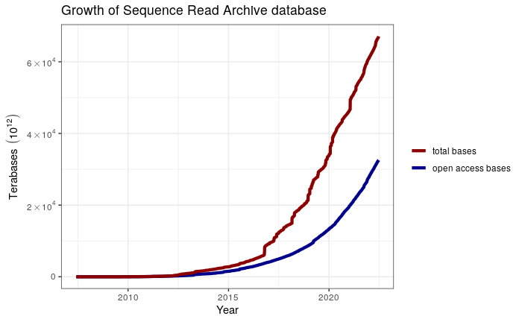
Expand to the secure AnVIL platform
Total bases
Open access bases
Latest tools
Human datasets
anvilproject.org // pascal-martin.netlify.app/post/plotting-sra-database-growth

Slide 30
Expand from just analysis to data generation

Slide 31
How to get involved
Try out the RNA-seq miniCURE
https://science.c-moor.org/miniCURE-RNA-seq
Check out student work at the Discussion Forum
https://help.c-moor.org
Fill out the Contact Us form
https://www.c-moor.org
Email us!
rosa.alcazar@cloviscollege.edu and stephanie.coffman@cloviscollege.edu

Slide 32
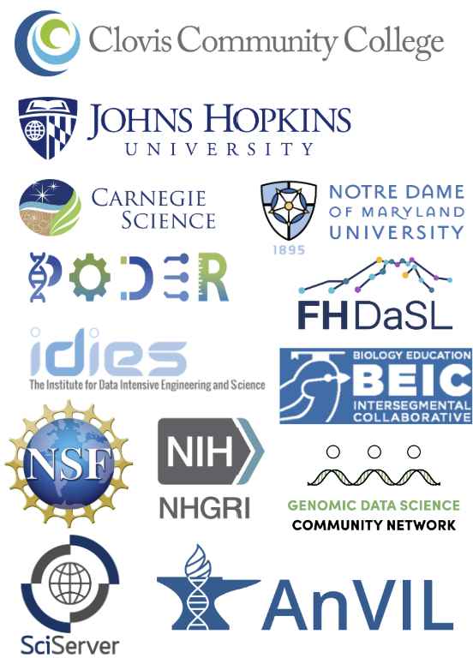
C-MOOR project at Clovis has wide support
C-MOOR
Frederick Tan, Katie Cox, Jai Won Kim,
and Valeriya Gaysinskaya, JHU
Jennifer Kerr and Sayumi York, NDMU
Javier Carpinteyro-Ponce, Carnegie Institution
GDSCN BioDIGS, GEMS
Mike Schatz, JHU and Jeff Leek, Hutch
Shurjo Sen and Christina Daulton, NHGRI
Ava Hoffman and Elizabeth Humphries, Hutch
Clovis / SCCCD
Laura Hill, Monica Chahal, Kim Armstrong
Stephanie Briones, James Ortez
Michelle Johnson, Ryan Feyk-Miney
Robert Frost, Nickolas Trujillo
Gauri Paul

