Slide 1
LibreTexts’ ADAPT Homework Platform and the New Discuss-It
April 16, 2025
This work is licensed under a Creative Commons Attribution 4.0 International License.
Attribute this slide deck as: “LibreTexts’ ADAPT Homework Platform and the new Discuss-It by ASCCC OERI is licensed under CC BY 4.0.

Slide 2

Discuss-It Demo Site
Notes:
https://adapt.libretexts.org/students/assignments/94618/init-formative

Slide 3
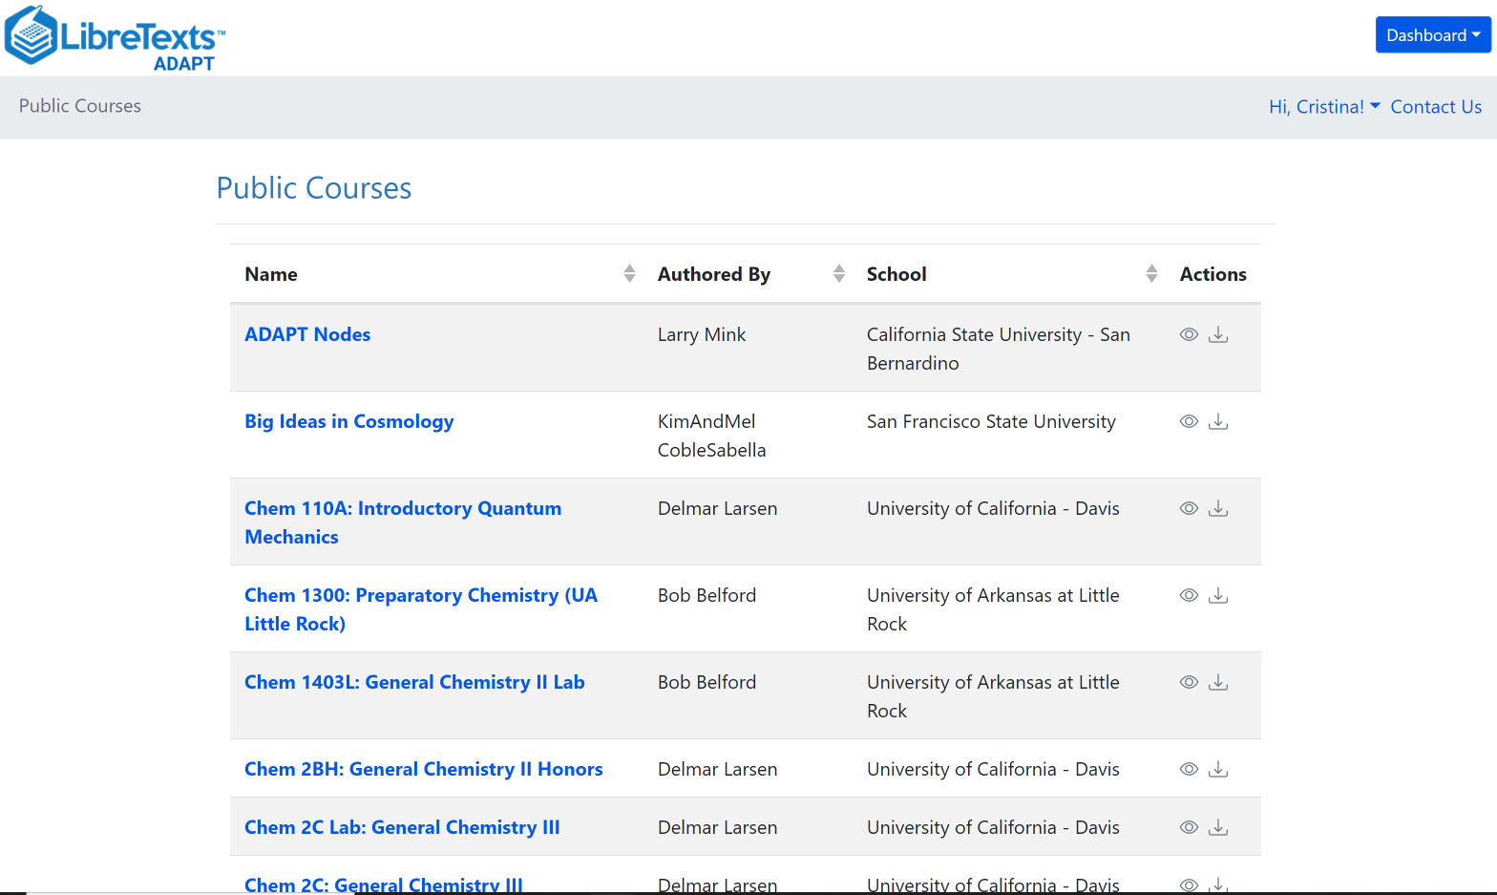
What is ADAPT?
ADAPT is a comprehensive online assessment/homework infrastructure that provides faculty the ability to include auto-graded and non-auto-graded activities from different platforms such as H5P, MyOpenMath, WeBWork, and its own native ADAPT questions.
ADAPT can be integrated into an LMS such as Canvas with full grade integration or it could be run independently.

Slide 4
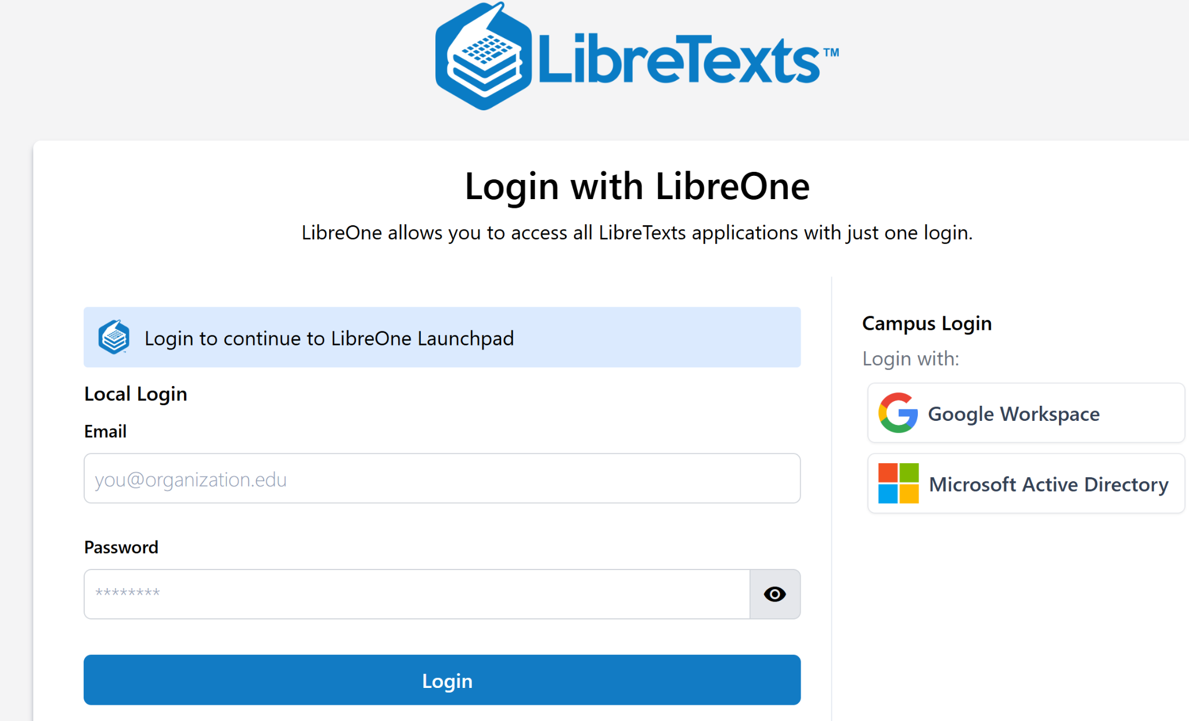
Create an account and
Login to LibreOne
https://one.libretexts.org/
Notes:
https://one.libretexts.org/

Slide 5
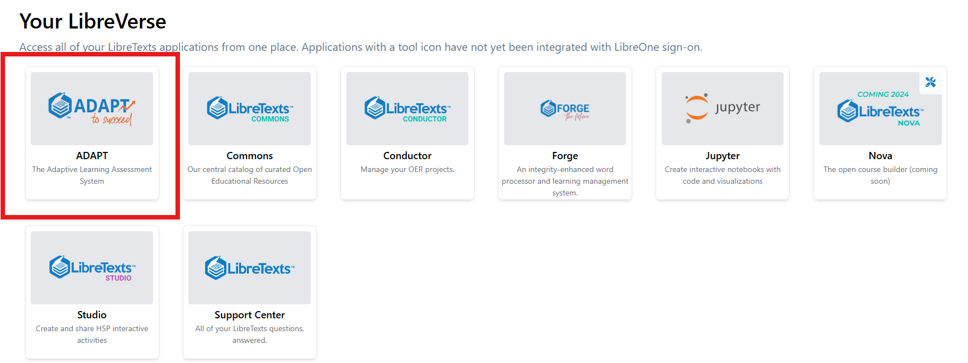
Finding ADAPTT

Slide 6
Have you heard of and/or used any of these platforms?
VoiceThread
Flip or Flipgrid
Padlet
Extempore
Canvas Discussions with Studio
Notes:
Article: “Assessing Replacements for Flip for Student Speaking”https://fltmag.com/replacements-for-flip/

Slide 7
Discuss-It in ADAPT
It’s the newest native question type in LibreTexts’ ADAPT homework platform.
Fosters dynamic student-to-student regular and substantive interaction.
Boosts student engagement by enabling threaded text, audio, and video responses for meaningful interaction.
With auto-captioning and auto-transcription functions, the platform ensures accessibility for all learners.
Offers seamless LTI/API integration with Canvas, allowing for effortless course integration and automatic gradebook syncing.
Coming soon: Rubric for grading

Slide 8
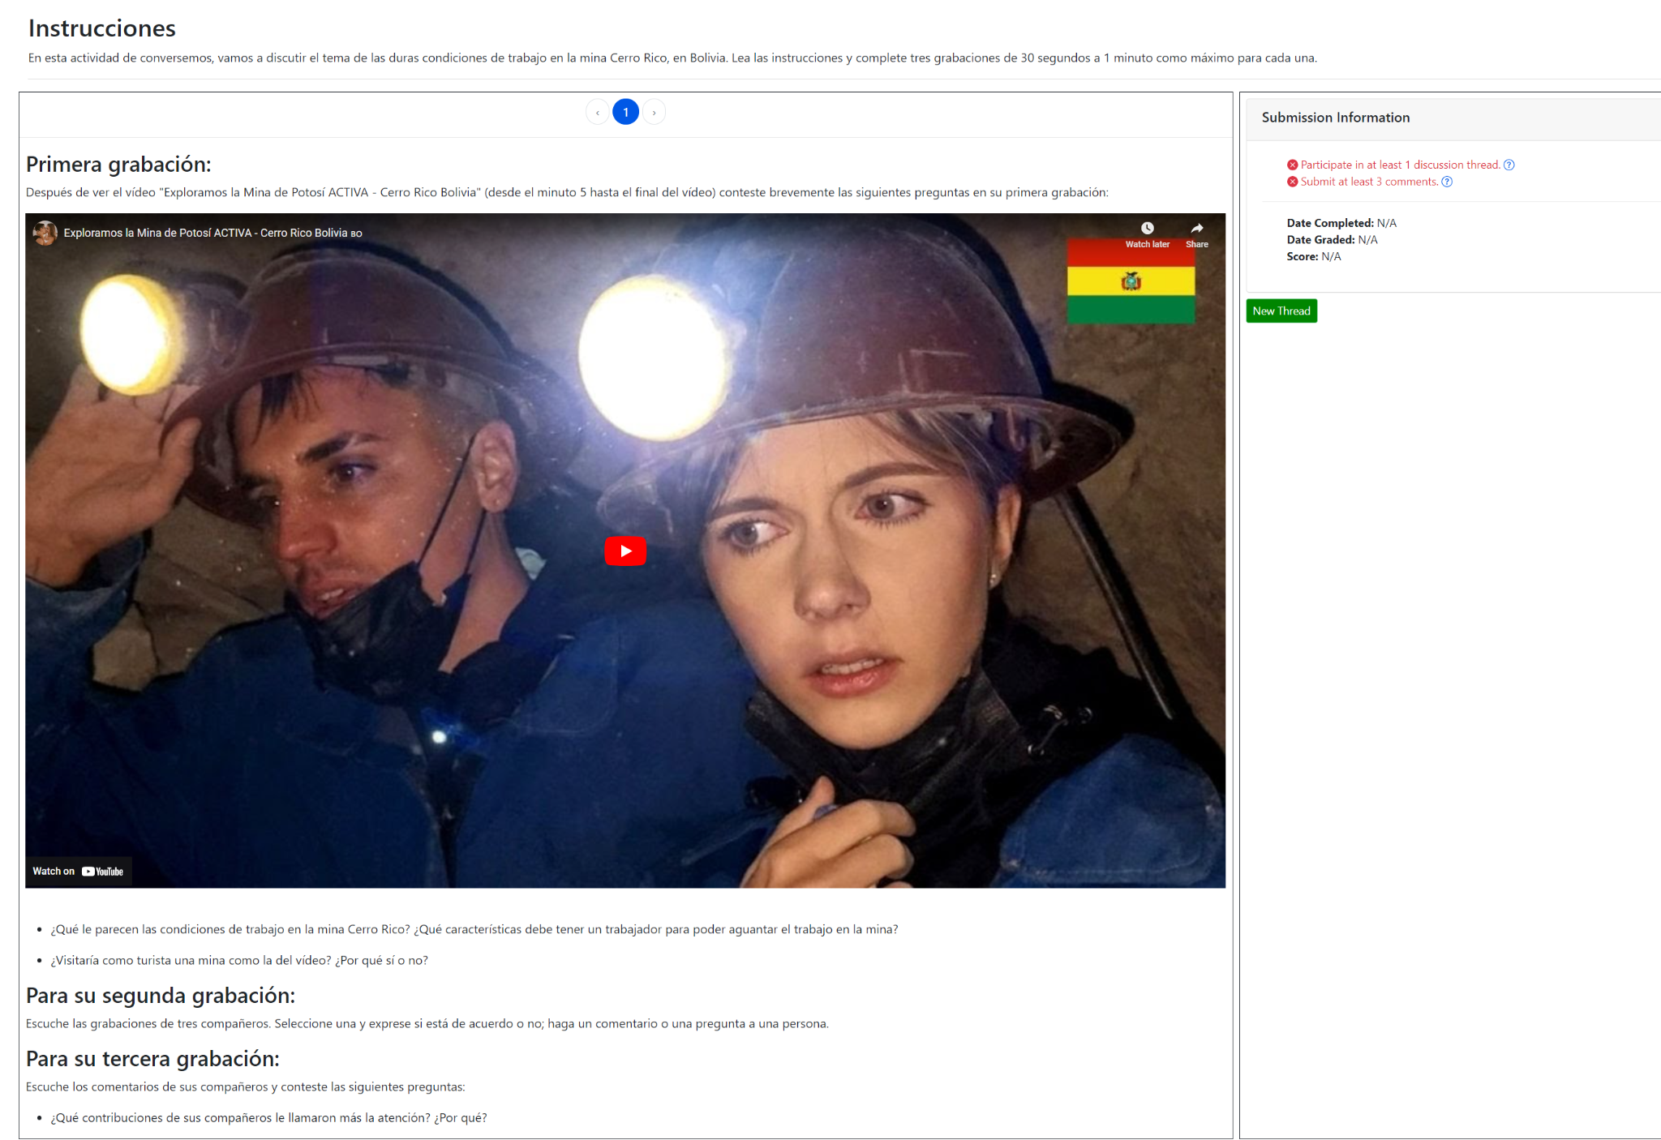
Discuss-It
Discuss-IT
Question type for oral interaction
Similar to a discussion board with audio, video and/or text inputs
Recordings are auto-captioned and transcribed

Slide 9
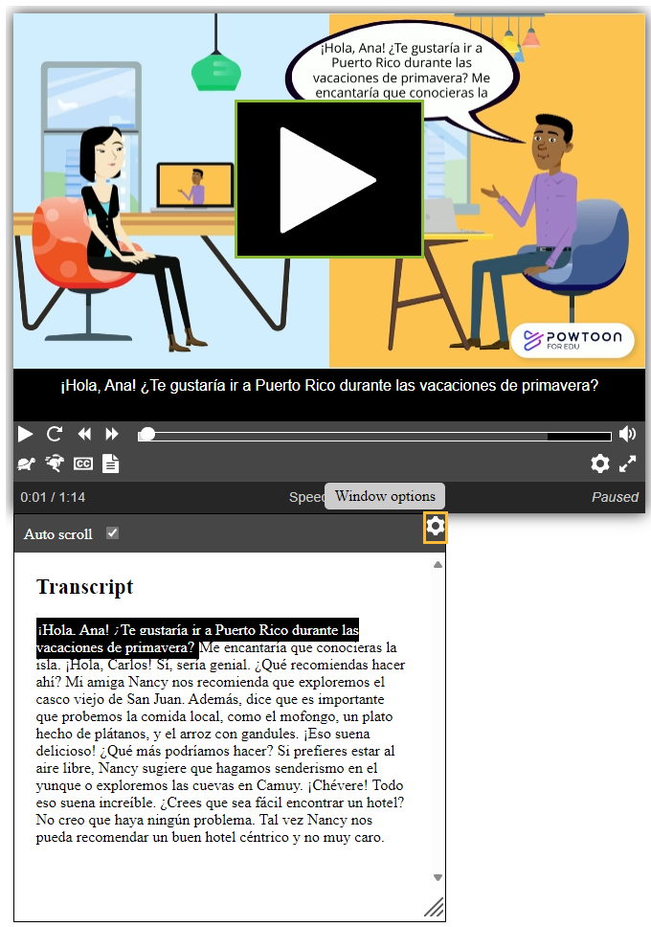
Auto-Captions and Auto-Transcript
All media integrated into ADAPT is automatically captioned and transcribed with very high fidelity rates
Currently available for many languages (including English, Spanish, French, Mandarin, Japanese, German, Portuguese, Hindi)

Slide 10
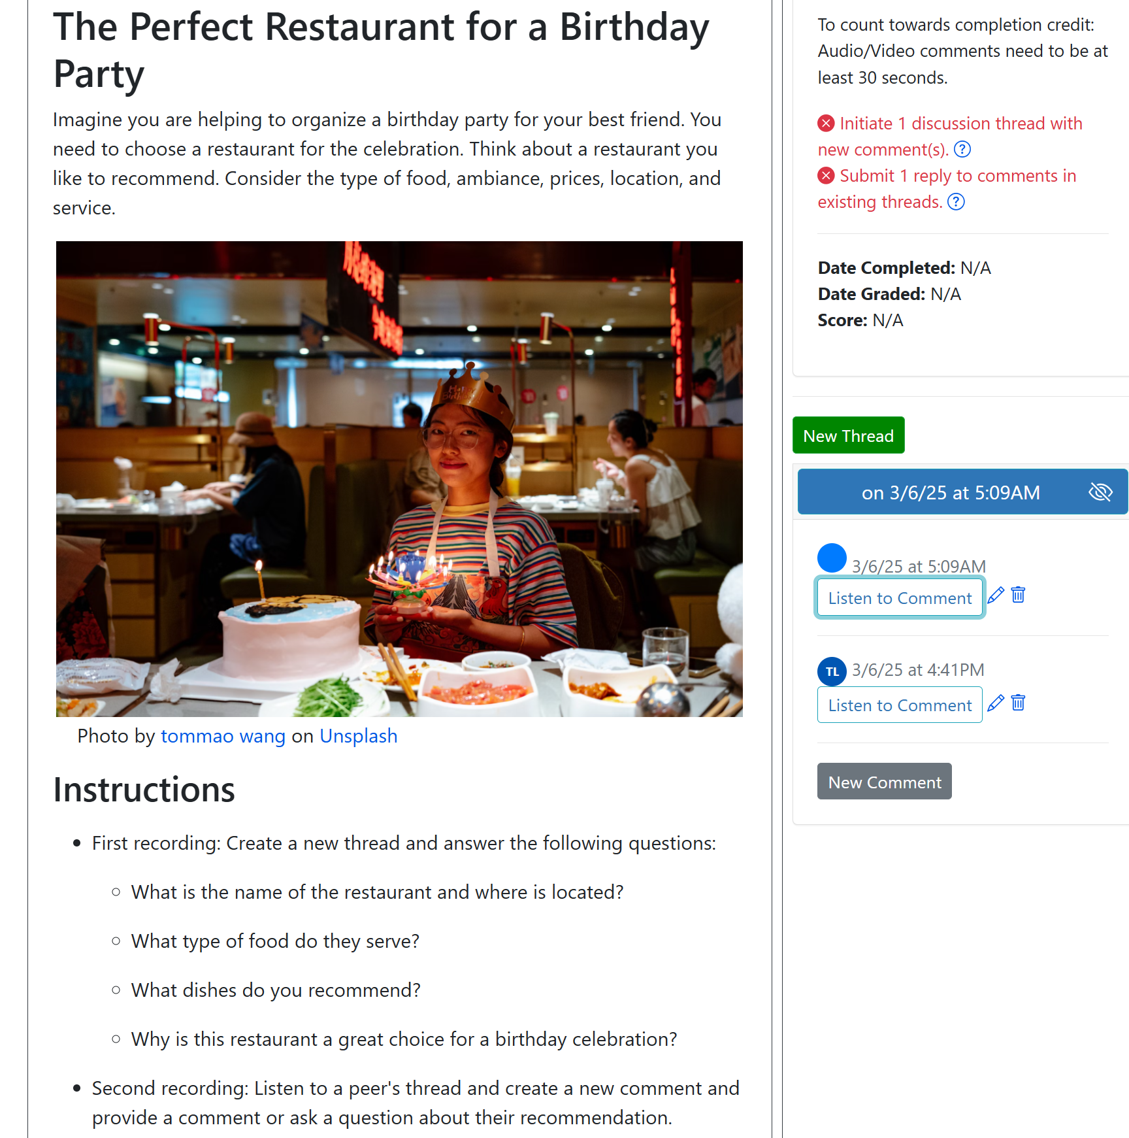
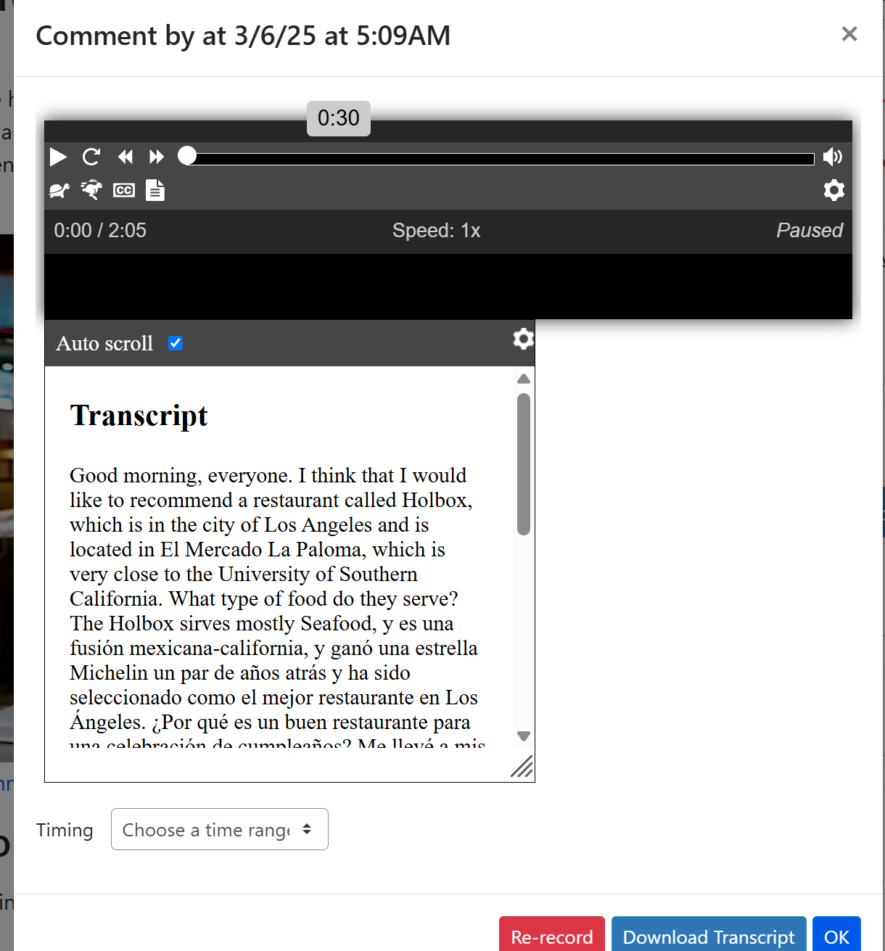
Icebreaker Activity Example 1:
The Perfect Restaurant

Slide 11
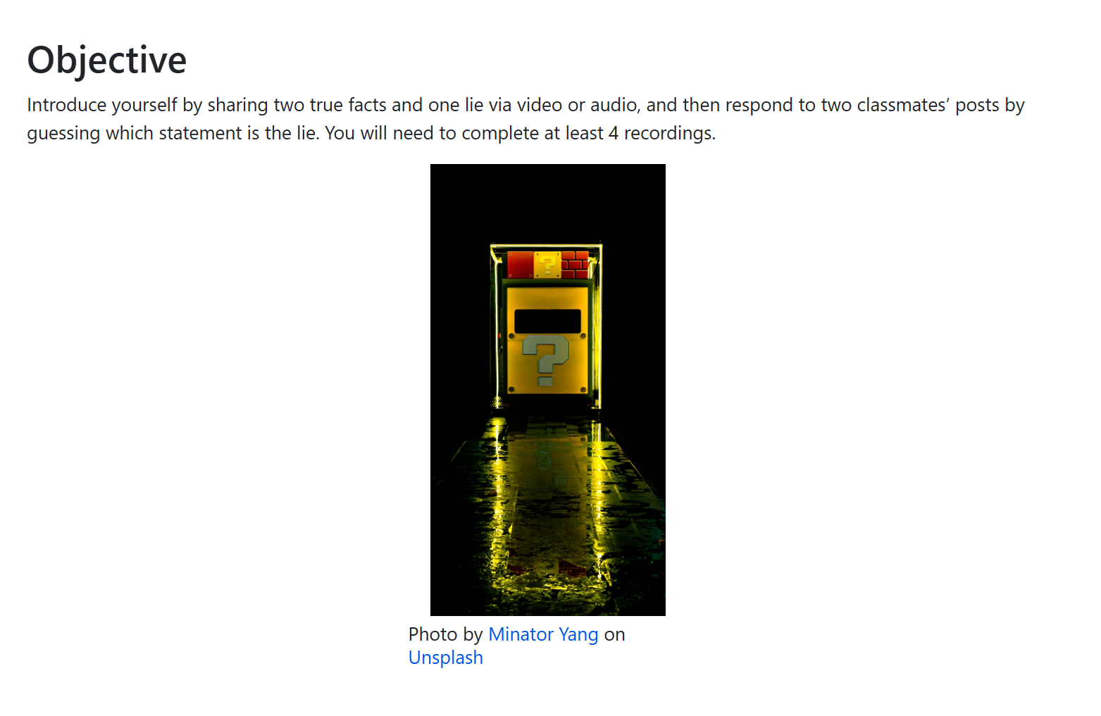
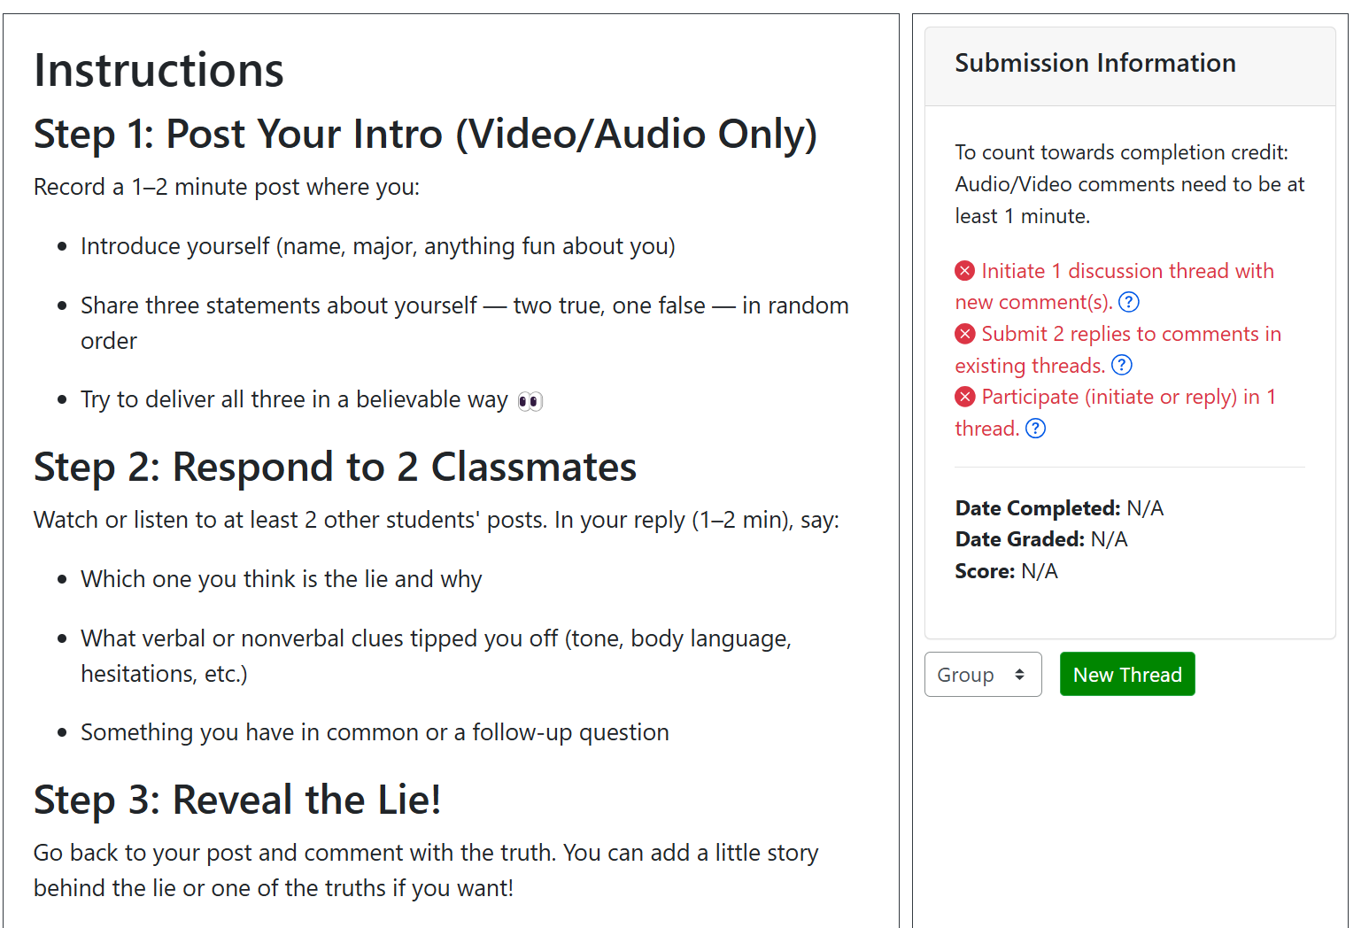
Icebreaker Activity Example 2:
Two Truths and One Lie

Slide 12
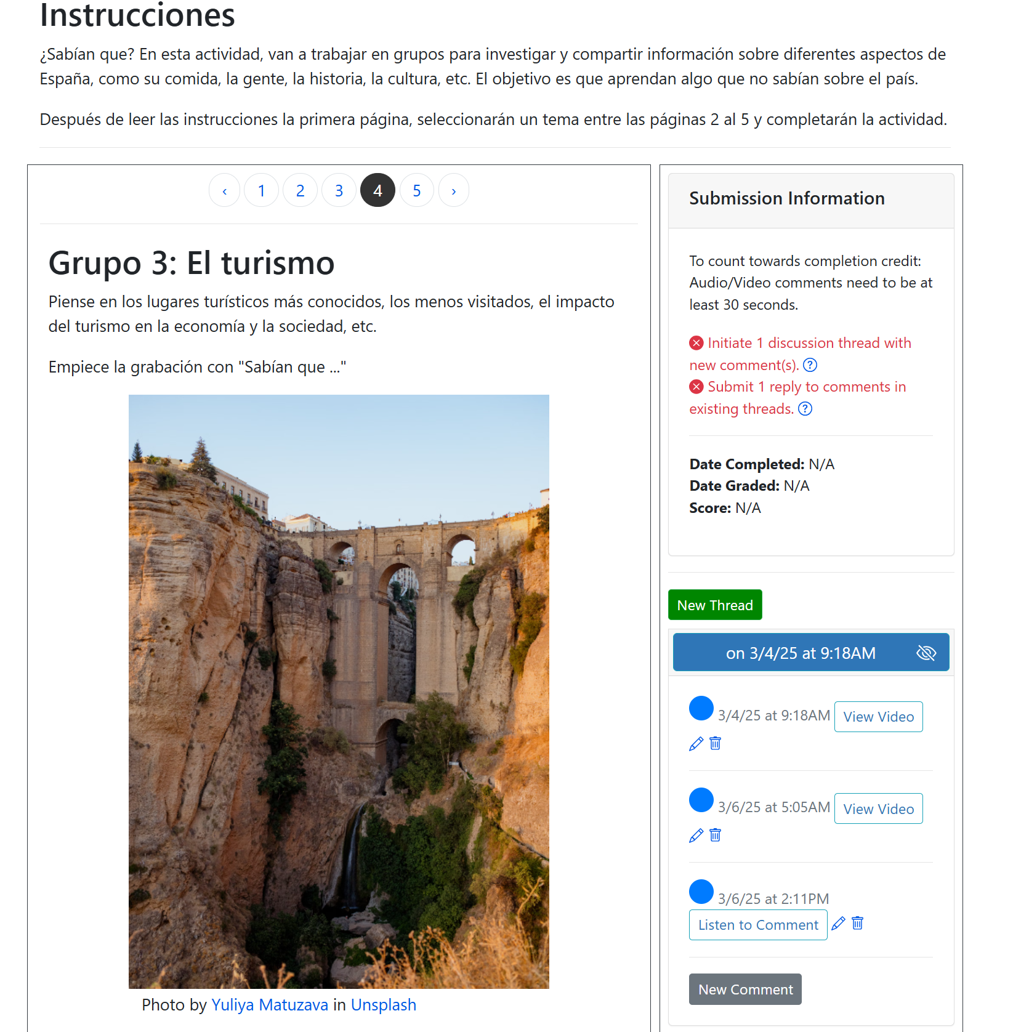
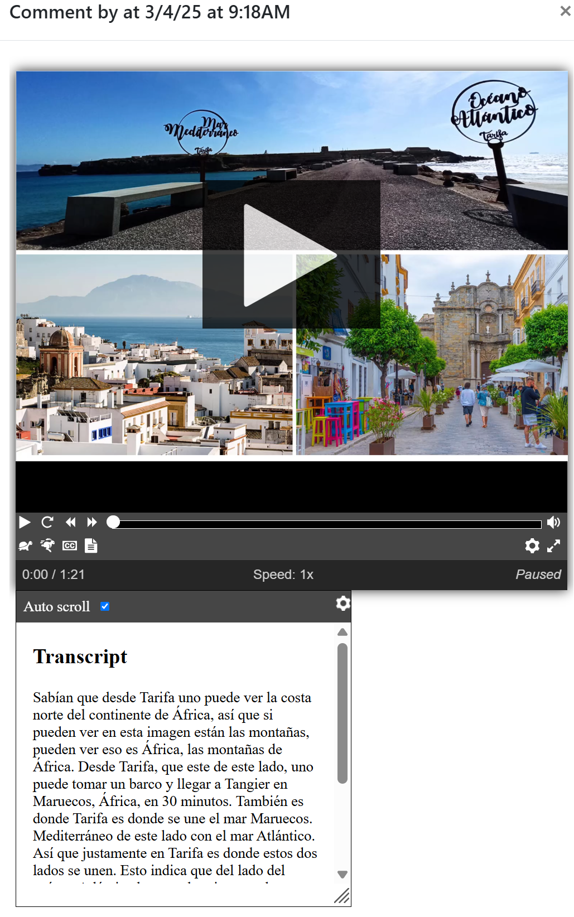
Spanish Example 1:
Did you know?
Fostering Collaborative Work

Slide 13
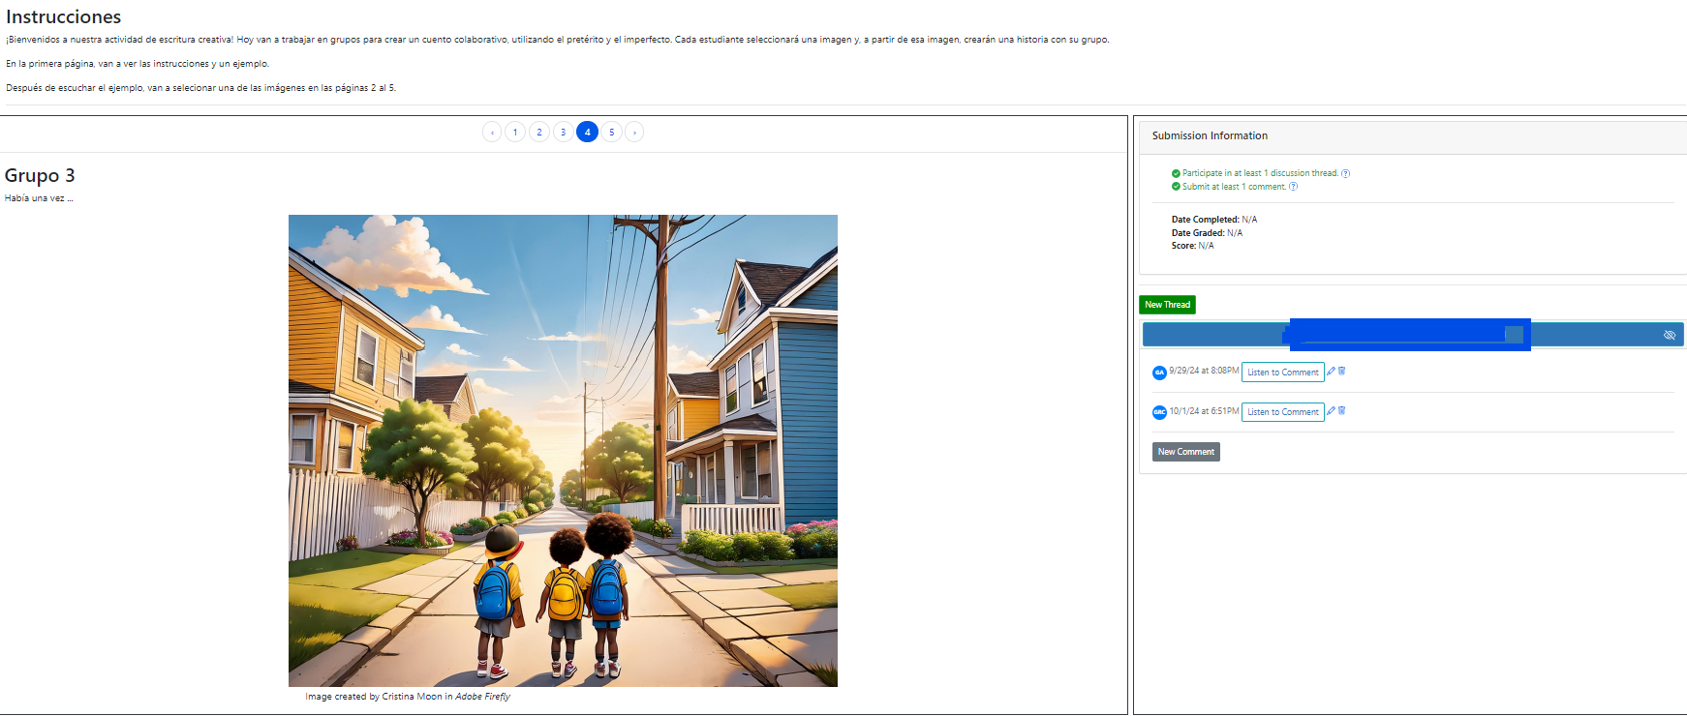
Spanish Example 2:
Chain Story
Students choose an image to narrate a story started by a peer.

Slide 14
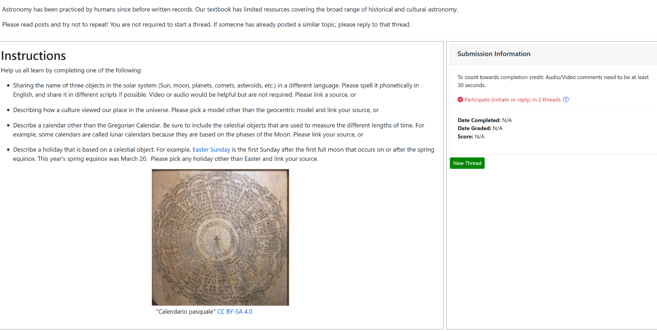
Astronomy Example
Assignment was authored by Rachel Mastrapa

Slide 15
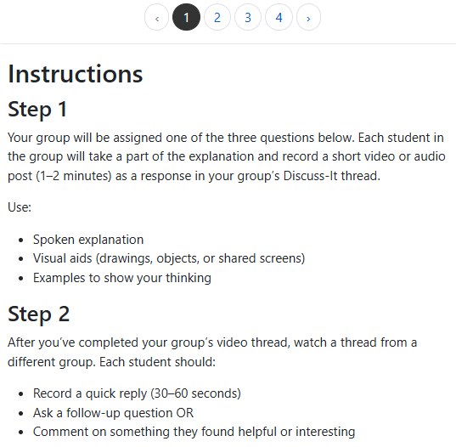
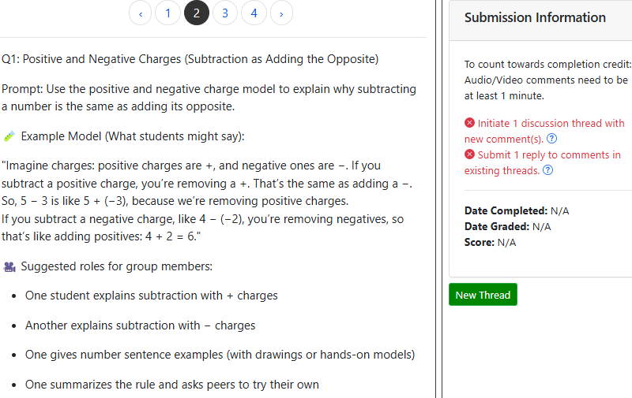
Math Example

Slide 16
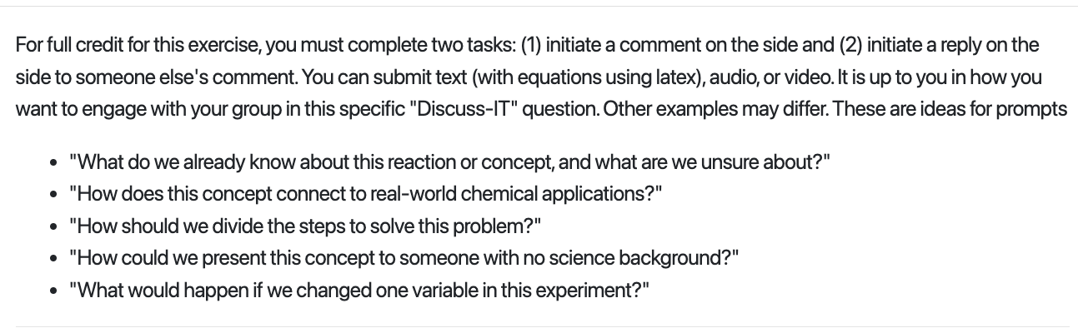
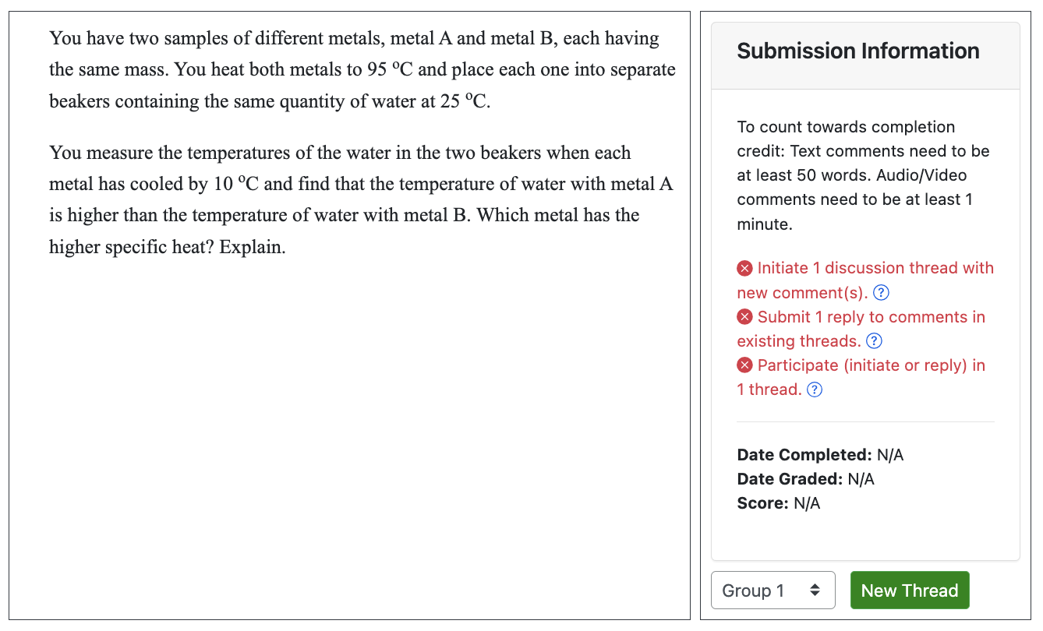
Chemistry Example

Slide 17
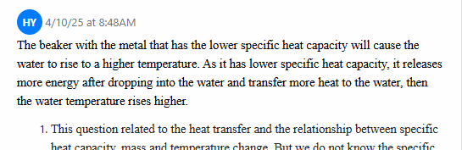
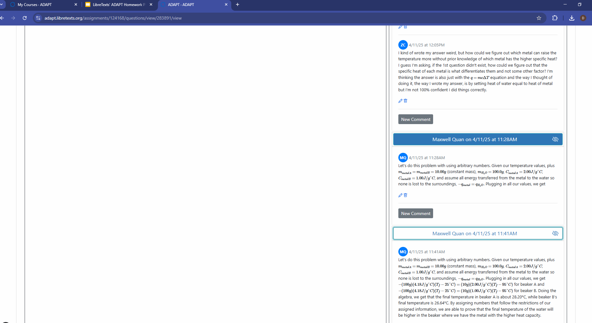
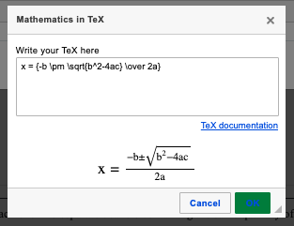
Chemistry Example part 2
B
B
A
Continued Editing
B
Student initiated a comment thread on 4/10 and
then commented on another student’s comment thread on 4/11, followed by revisiting and editing.
B
Notes:
From Delmar

Slide 18
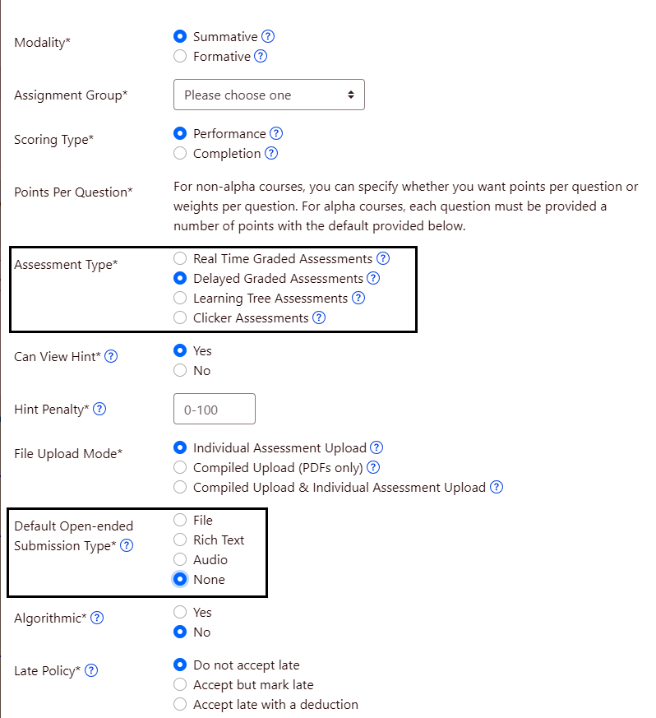
How do you create an assignment in ADAPT
Create a New Assignment
Under Assessment Type make sure to check “Delayed Graded Assessments”
For Submission type mark “None”

Slide 19
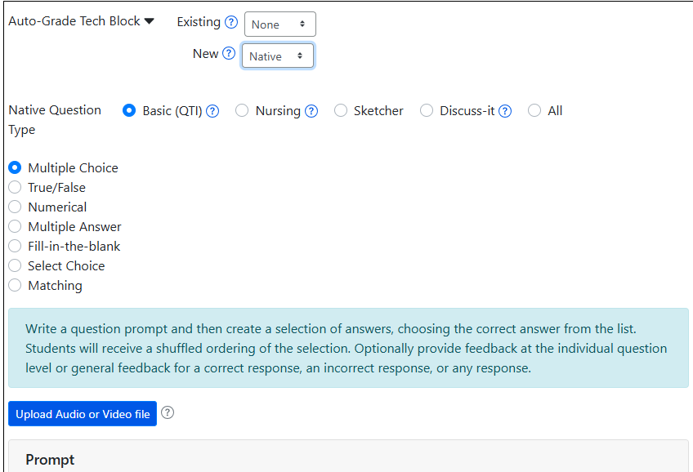
Discuss-It Question
Create a New Assignment
Under Assessment Type make sure to check “Delayed Graded Assessments”
For Submission type mark “None”
Add a New Question in the assignment
In the Auto-Grade Tech Block, in the New drop-down select “Native”
Select the Discuss-It native question type

Slide 20
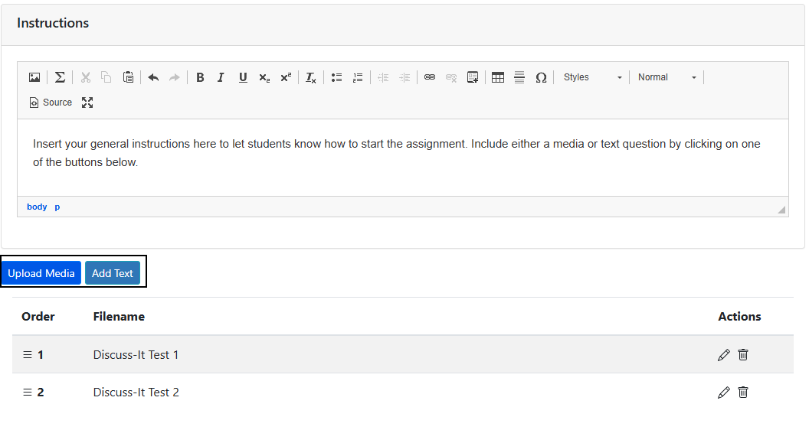
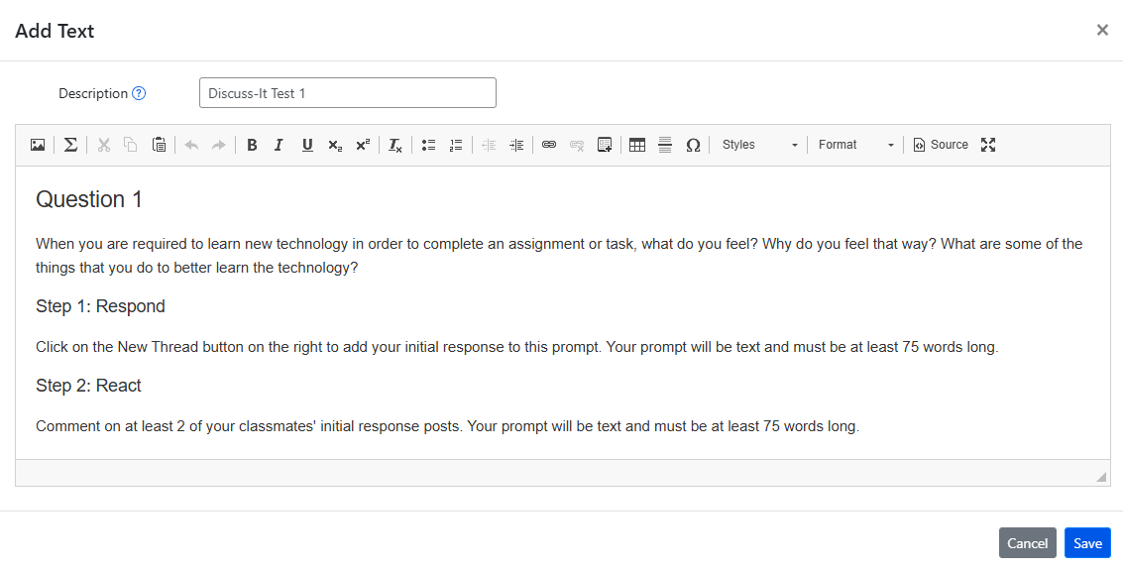
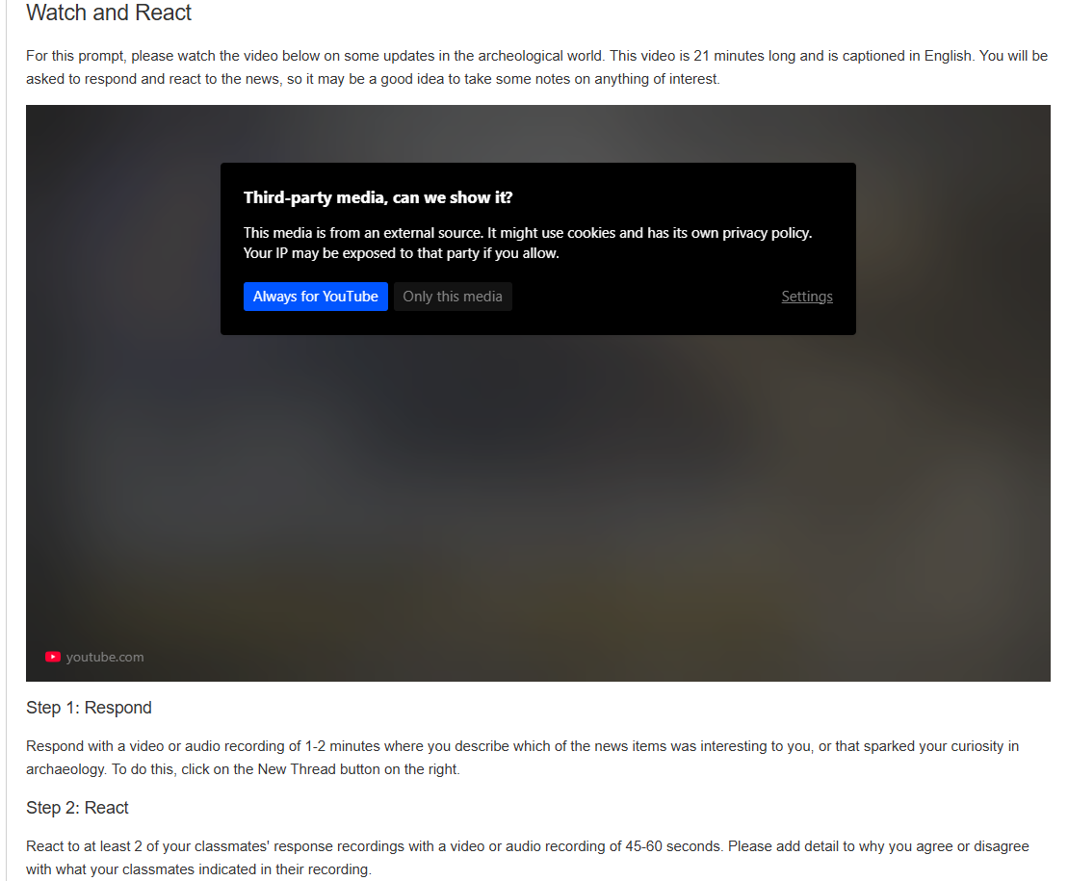
Creating a Discuss-It Question
In the Instructions box, add whatever information you want students to know to start working on it.
Add either a text or media prompt

Slide 21
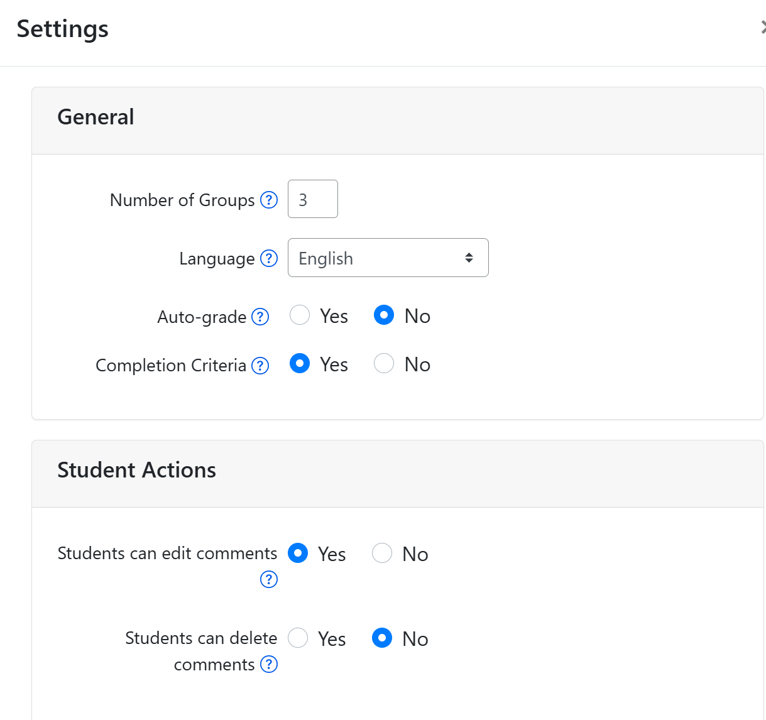
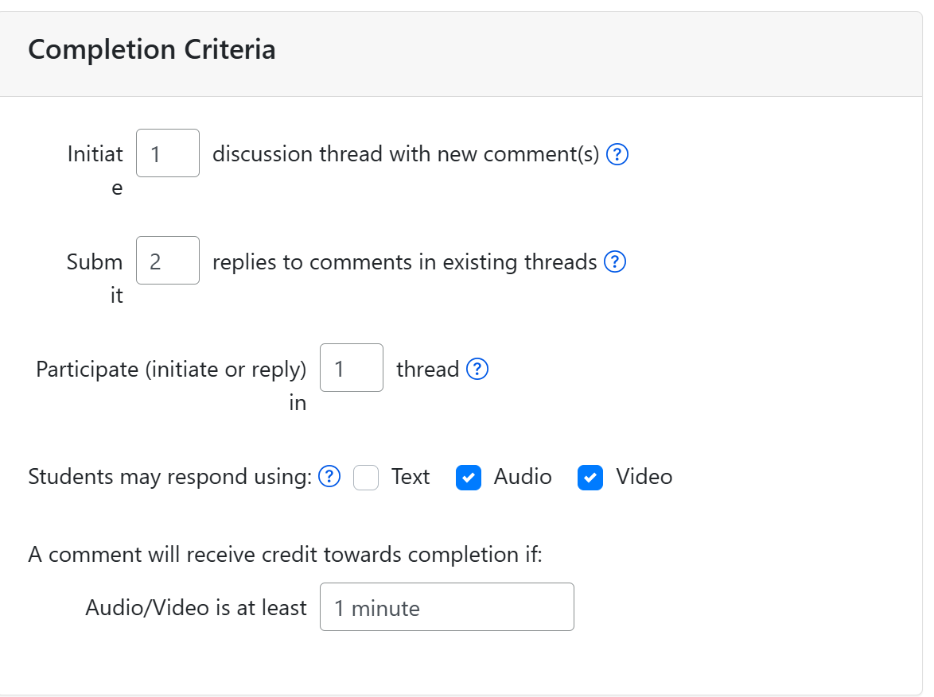
Discuss-It settings

Slide 22
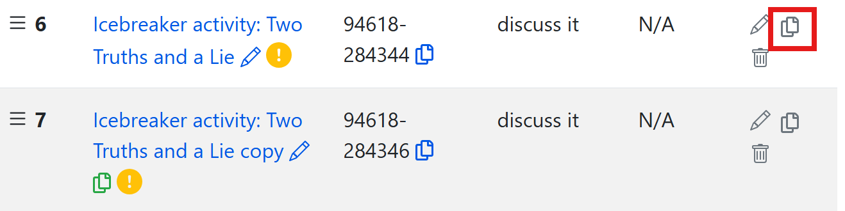
Clone an ADAPT activity and edit
Once you clone an activity, you will be able to edit

Slide 23
Looking for more Resources?

Slide 24
OERI in-person Regional Meetings:
Introduction to Remixing and Open Homework Systems
Friday, May 16, 2025 from 8:30 am – 3:30 pm at De Anza College
Saturday, May 17, 2025 from 8:30 am – 3:30 pm at East Los Angeles College
The OERI, in collaboration with De Anza College and East Los Angeles College is pleased to announce regional professional development opportunities for those who intend to remix open educational resources in the LibreTexts platform and create openly-licensed assessments. Those who support this work are also invited to attend.
Attendees of these in-person events will be introduced to – and actively interact with – LibreTexts, the LibreTexts Remixer, and the ADAPT Open Homework System.
Registration is now open. A light breakfast will be served and lunch will be provided. To defray costs, a registration fee of $25 will be charged. Space is limited.
Register for Friday, May 16, 8:30 am – 3:30 pm OERI Regional at De Anza College
Register for Saturday, May 17, 8:30 am – 3:30 pm OERI Regional at East Los Angeles College

Slide 25
LibreTexts Training
Visit the LibreTexts Academy for more professional development services.
General Introduction to ADAPT hosted by LibreTexts Academy is this Friday, April 18, at noon: designed for complete new users to LibreTexts.

Slide 26
LibreTexts Workshop Recordings
ASCCC OERI Webinars
Title | Date | Tags
Boost Engagement with Discuss-It: Interactive Asynchronous Conversations in ADAPT | November 15, 2024 | ADAPT, Discipline Webinar, Spanish
ADAPT Level 4 – Creating and Using Question Banks in ADAPT | July 22, 2024 | ADAPT, ADAPT Series, Canvas
ADAPT Level 3 – Using ADAPT in Canvas | July 15, 2024 | ADAPT, ADAPT Series, Canvas
ADAPT Level 2 – Creating in ADAPT | June 21, 2024 | ADAPT, ADAPT Series
ADAPT Level 1 – Accessing ADAPT and Finding Existing Assessments | June 14, 2024 | ADAPT, ADAPT Series
Spanish Open Educational Resources (OER) Homework Hackathon 2: Let’s have fun with ADAPT | May 10, 2024 | ADAPT, Discipline Webinar, LibreTexts ADAPT, Spanish
Notes:
Academic Senate for California Community Colleges (ASCCC); Open Educational Resources Initiative (OERI)

Slide 27
More Information
ASCCC OERI Website (asccc-oeri.org)
  Resources
  Webinars and Events
ASCCC OER E-Mail (oeri@asccc.org)

Slide 28
And to Contact Us…
General OERI E-Mail:
oeri@asccc.org
Find everyone’s email at: https://asccc-oeri.org/about-us/

Slide 29
Questions?
Cristina Moon
Spanish Faculty
OER/ZTC Coordinator at Chabot College
ASCCC OERI Spanish Lead, H5P/ADAPT Lead, and OERI Liaison
cmoon@chabotcollege.edu

Slide 30

Thanks!
Photo by Thgusstavo Santana from Pexels

