Slide 1
Using AI to Enhance Open Educational Resources in Canvas
Discover how artificial intelligence can transform your educational materials, making them more engaging, accessible, and effective for diverse learners.
by Amanda Taintor

Slide 2
Introduction to AI in Education
Transforming Learning
Creative Potential
Ethical Considerations
AI tools automate routine tasks. They analyze learning patterns. They create personalized experiences.
Generate custom visuals. Craft engaging narratives. Develop interactive assessments.
Maintain academic integrity. Consider data privacy. Address AI bias and accessibility.

Slide 3
AI Tools for OER Enhancement
Content Creation Tools
Canvas Integration
Tools are ever changing. Find one you like and learn it.
Look for embed codes (padlet, H5p)
Don't forget about the tried and true cut and paste

Slide 4
AI-Assisted Content Generation
Create Outlines & Drafts
Generate module, lesson, etc structures. Develop initial content drafts. Create learning objectives.
Build Assessments
Generate diverse quiz questions. Create discussion prompts. Develop critical thinking exercises.
Simplify Complex Topics
Generate explanatory analogies. Create simplified summaries. Develop step-by-step explanations.
Review & Refine
Check for accuracy. Verify educational soundness. Make necessary adjustments.

Slide 5
Personalizing Learning with AI
Analyze Needs
Adapt Content
Identify diverse learning preferences and requirements
Create multiple versions at varying difficulty levels
Track Progress
Recommend Resources
Monitor engagement and adjust recommendations accordingly
Suggest supplemental materials for deeper understanding
AI enables truly personalized learning experiences that adapt to each student's unique needs and preferences.

Slide 6
Implementing AI-Enhanced OER in Canvas
Select appropriate AI tools
1
Choose tools that integrate well with Canvas
Create enhanced content
2
Generate and refine materials with AI assistance
Embed in Canvas modules
3
Integrate seamlessly using Canvas embed options
Test and iterate
4
Gather feedback and make continuous improvements
Start small with one module. Check for technical issues. Expand gradually to more content areas.

Slide 7
Improving Visual Appeal with AI
AI-Generated Imagery
Automated Design
Accessibility Enhancements
Create custom illustrations. Design relevant infographics. Develop engaging diagrams.
Get layout suggestions. Balance text and visuals. Optimize color schemes.
Generate alt text automatically. Check color contrast. Simplify complex visuals.
Tools like DALL-E and Midjourney generate visuals matching your exact specifications.
AI tools analyze content and recommend design improvements for maximum engagement.
AI ensures materials meet accessibility standards for all learners.

Slide 8
Improved Scores
Case Studies: Successful AI-OER Integration
42%
28%
Engagement Increase
Time Saved
Arizona State University saw higher student interaction with AI-enhanced content
Faculty at MIT reported reduced content creation time
35%
Georgia Tech students showed better assessment performance
Success factors include faculty training, starting with small projects, and gathering regular student feedback.

Slide 9
Things to be aware of when using AI
Always review AI outputs
Verify accuracy and educational soundness
Watch for bias
Check for cultural, gender, or other biases
Understand copyright implications
Know the rules for AI-generated content
Prioritize data privacy
Never share sensitive student information with AI tools

Slide 10
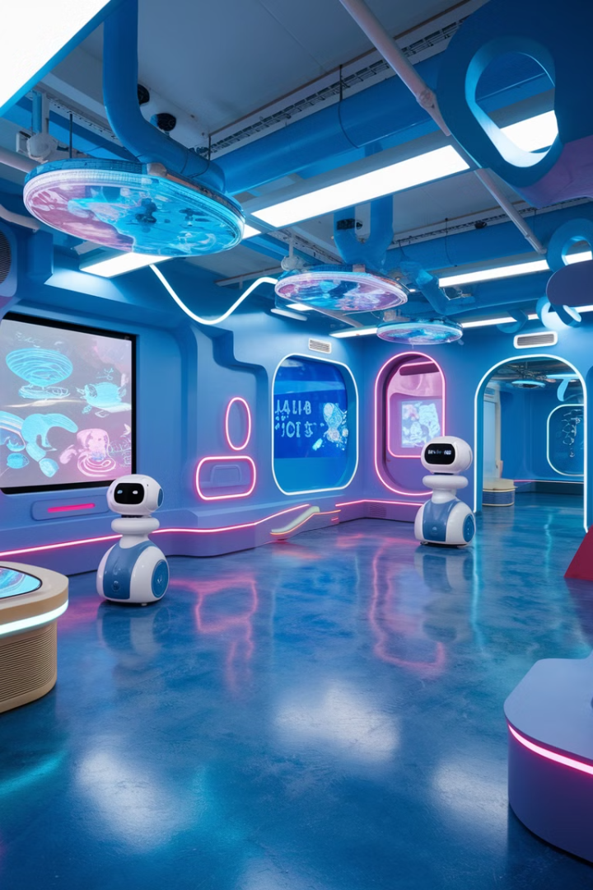
Future of AI in OER and Canvas
Adaptive Learning
Immersive Experiences
Natural Interfaces
AI systems that automatically adjust to individual learning patterns in real-time.
AI-generated virtual environments for experiential learning within Canvas.
Conversational AI tutors embedded directly in educational modules.
Canvas Integration
Native AI tools built directly into the Canvas platform.

