Slide 1
Administrative Procedures (APs) and Board Policies (BPs): Creating and Implementing APs and BPs for Open Educational Resources (OER) Sustainability
Presenters:
Lisa Storm, Hartnell College & Ron Oxford, College of Marin
Moderator: Heather Dodge, OERI Regional Lead (Area B)

Slide 2
Agenda
Introductions
Definitions
Hartnell’s AP & BP story
College of Marin and West Hills: two different stories
Questions and discussion

Slide 3
What are APs and BPs?
Board Policy (BP)
Board Policies are statements or intents/guidelines that are adopted by the Board of Trustees to be used by the administration in the development and implementation of regulations and procedures for operating the District. The Board is the ultimate decision-maker in those areas assigned to it by state and federal laws and regulations.
Administrative Procedures (AP)
Administrative procedures reflect how board policy should be implemented. They address how the general goals of the District are achieved and define operations of the District or college. They include details of policy implementation, responsibility, accountability, and standards of practice.
*Adapted from the Peralta CCD Board Policy and SDCCD webpages on BP & AP

Slide 4
Hartnell College Board Policy and Administrative Procedure 4042

Slide 5
Presentation objectives:
Provide a step-by-step guide to drafting and gaining approval for BPs/APs that support OER/ZTC/LCT
Highlight additional College documents/plans that can support OER/ZTC/LCT
Discuss naysayers/potential pitfalls
Answer questions

Slide 6
Goals of BP and AP 4042:
Institutionalize OER, ZTC, and Low-Cost
Emphasize academic freedom to adopt textbook of choice
Memorialize Low-Cost textbook price ($40)
Comply with relevant state and federal legislation
Promote and ensure visibility of ZTC course sections and course sections that have adopted OER or Low-Cost
Ensure District support of OER and Low-Cost adoption, development of ZTC/LCT course sections, and ZTC/LCT pathways to credentials

Slide 7
BP 4042-approved December 2022
Process: vetting and approval from the Academic Senate and Hartnell College Council
Very little feedback
Approved by the College President and the Board of Trustees

Slide 8
BP 4042:
Goals:
Institutionalize OER, ZTC, and Low-Cost
Emphasize academic freedom to adopt textbook of choice

Slide 9
Continued description of BP 4042
Goals:
Memorialize Low-Cost textbook price ($40)
Comply with state and federal legislation
Promote and ensure visibility of ZTC course sections and course sections that have adopted OER or Low-Cost
Ensure District support of OER and Low-Cost adoption, development of ZTC/LCT course sections, and ZTC/LCT pathways to credentials

Slide 10
Next step: embed ZTC support into the Strategic Enrollment Management Plan 2024-2027
Increase,promote, and schedule ZTC pathways
Annually review student achievement data in ZTC pathways

Slide 11
AP 4042 approved in April, 2024
New VPAA that supports OER/ZTC/LCT suggested that I draft a roadmap that justifies each section
Same process of Academic Senate and Hartnell College Council approval
Does not require Board approval
Very little feedback

Slide 12
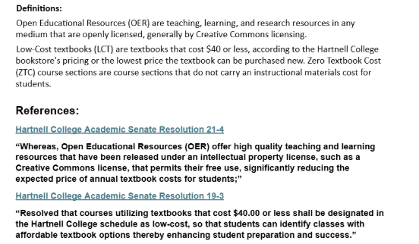
Definitions:
The definitions for OER and Low-Cost textbooks are supported by our local Academic Senate resolutions 21-4 (OER) and 19-3 (Low-Cost)

Slide 13
Philosophy:
The philosophy is supported by Hartnell College Academic Senate Resolution 21-4 and the Strategic Enrollment Management Plan
RESOLVED, That the Hartnell College Academic Senate support faculty efforts to increase student access to lower-cost high-quality textbooks and other instructional materials;
RESOLVED, That the Hartnell College Academic Senate support the development of Zero-Cost and Low-Cost Degrees and Certificates.

Slide 14
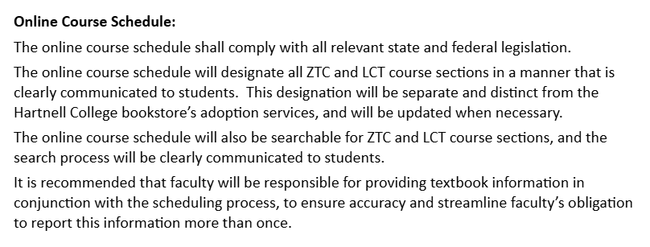
Online course schedule:
Publication of ZTC/LCT course sections in the online course schedule is supported by:
20 U.S.C. Ch. 28 s. 1015(b)
Cal Ed Code 66406.9
AB 607
ASCCC Resolution 13.06 spring 22
Strategic Enrollment Management Plan
Hartnell College Academic Senate Resolution 21-4

Slide 15
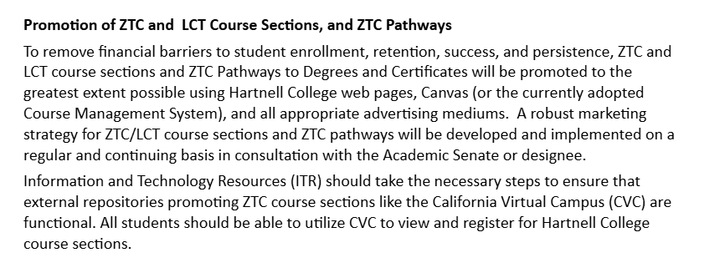
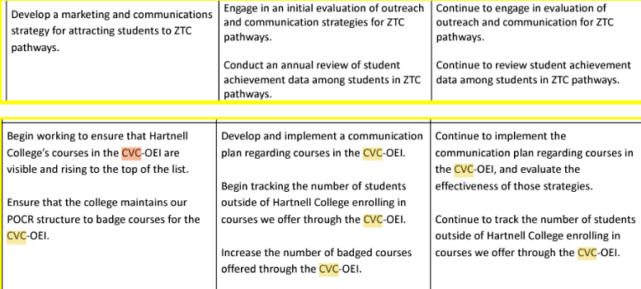
Promotion:
Promotion of ZTC/LCT course sections and ZTC pathways to credentials is supported by: Strategic Enrollment Management Plan

Slide 16
Disfavoring Inclusive Access:
Disfavoring Inclusive Access is supported by:
Department of Education Inclusive Access response:
“Eliminate the provision allowing institutions to include the cost of books and supplies as part of tuition and fees (§ 668.164(c) and (m)). Current regulations permit schools to automatically charge students for books and supplies as part of tuition and fees, without student authorization, even when the materials can be obtained from a source other than the institution. The regulations permit these charges if the school has a contract with a third-party publisher or retailer, offers the books “below competitive market rates,” and gives students a way to opt out, so long as the student can obtain the books and supplies by the seventh day of the payment period. The Department is concerned that lack of disclosure and transparency limits students' ability to find less expensive materials or assess if their school is offering the most affordable arrangement. Under the proposal, we would maintain the allowance for including books and supplies in tuition and fees when institutions demonstrate there is a compelling health or safety reason, or if the institution is the only option for students to access the books or supplies.

Slide 17
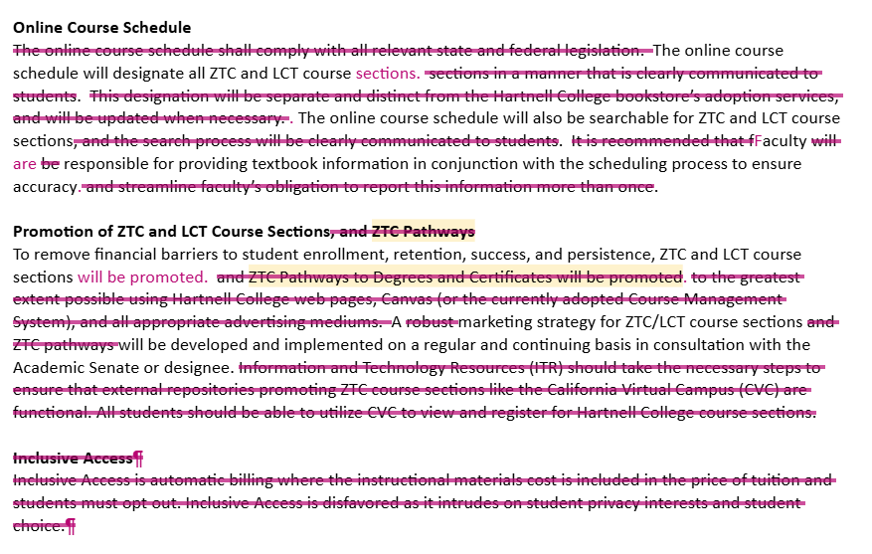
First pitfall: a few months after approval of AP 4042. . .
VPITR attempted to “modify”the AP
Justification: Hartnell doesn’t have ZTC pathways currently
Hartnell does (ECE AS-T) and is striving to increase ZTC pathways with the Chancellor’s Office grant funding
Several credentials are one-two classes away from a complete ZTC pathway

Slide 18
ZTC added to Strategic Plan ‘25-’28
ZTC pathways are strategies/initiatives; Key Performance Indicators are increased ZTC course sections and fully ZTC pathways

Slide 19
ZTC apparent in new Mission Statement
Advancement of economic justice!
$$$$$$$

Slide 20
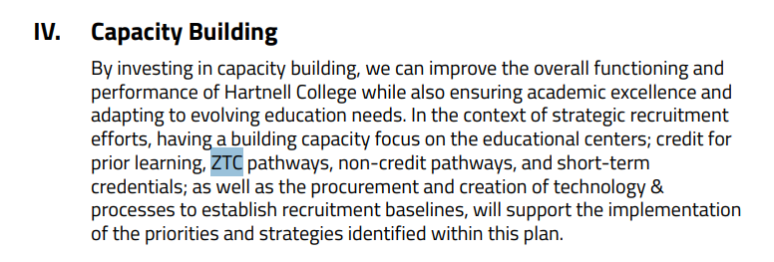
ZTC embedded in Strategic Recruitment Task Force Plan (in progress)
All references increase ZTC courses and pathways

Slide 21
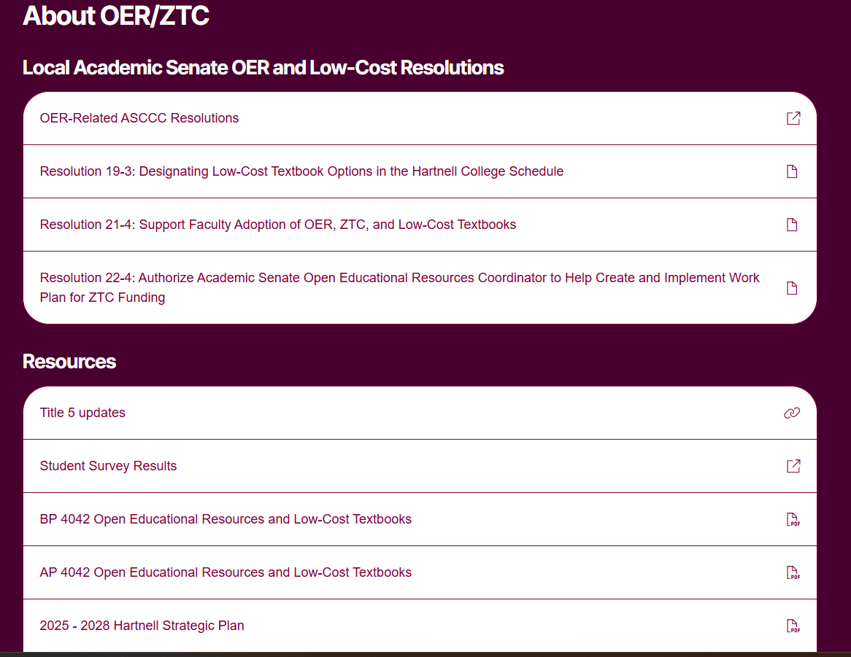
Newly designed ZTC webpage features OER repository, faculty resources, link to an OER/LCT Canvas shell, and AP/BP 4042

Slide 22
Moving forward. . .
Playing the long game, and institutionalizing ZTC/OER/LCT is tedious and time consuming, but it produces results!
Questions?

Slide 23
BP at West Hills Community College District (WHCCD) and BP/AP at College of Marin (CoM)
AB798 – College Textbook Affordability Act 2015 (CSU Affordable Learning Solutions)
25 CCs with requirement that you have a Senate Resolution in support.
OERI lists 49 Senate Resolutions going back to 2010
Achieving the Dream Open Educational Resources (OER) Degree Initiative Questions
“The Governing Board has voiced its support for creating OER degrees” worth 10 points on the application.
“Please describe the support this initiative will receive from the Governing Board”
Application was due 4/8/2016 and BP 4042 was approved 3/8/2016

Slide 24
Zero-Textbook Cost Degree Grant Program by CCCCO
$5 Million for 23 California Community Colleges (2016)
In a Letter of Support the President cited OER being listed in the District Strategic Plan, College Strategic Plan, Board Policy and Academic Senate Resolution.
WHCL became Technical Assistance Provider for those 23 grants along with College of the Canyons
September 2017 College of Marin - The California Community Colleges, OER, and You
CoM adopted AP 5160 11/14/2017 and BP 5160 12/5/2017

Slide 25
Lemoore College (WHCL at the time) went all-in
2014/2015 there were only 6 OER at WHCL but it was still in the next Strategic Plan Goals to increase with benchmarks for increase listed by year.
Student Equity and Achievement Program OER is mentioned 10 times and ZTC mentioned 7 in a 21-page document
Strategic Plan Goal #1
Increase the number of course sections, certificates, and degrees identified as Zero Textbook Cost (ZTC) or Low Textbook Cost (LTC) with Open Educational Resources across all disciplines.

Slide 26
Regaining Momentum at CoM
Bring Forward Easier Lifts first
Student Senate Resolution - Two listed on OERI Site
AP is the how the BP is addressed. Details of implementation, responsibility, accountability, etc.
Academic Senate purview of 10+1
#1 Curriculum including establishing prerequisite and placing courses within disciplines
#5 Standards or policies regarding student preparation and success
#8 Policies for faculty professional development activities

Slide 27
Getting to a BP should be a priority.
How will the Board approve plans if they are not even aware of what it is!!!
Burden-Free Instructional Materials (BFIM) Taskforce Recommendations 4/16/2024
The California Community College Chancellor’s Office, in partnership with key State-wide stakeholders, should develop new regulations, or revise current regulations, to address the following:
mandate colleges to provide annual updates to their respective Board of Trustees on the local level with progress towards zero instructional materials costs;

Slide 28
Back to what Lisa said earlier
“Ensure District support for OER...but also awareness
Playing the long game, and institutionalizing ZTC/OER/LCT is tedious and time consuming, but it produces results!
OER IS ON THE RIGHT SIDE OF HISTORY
"I am committed... in addressing, I’ll say it, the racket that is textbooks in this country – usurious costs associated with textbooks – and so we will do more this year... because we in California have an obligation to disrupt that entire system nationwide." — Governor Newsom
Board Resolution on Burden Free Instructional Materials Resolution of the Board of Governors California Community Colleges Number 2023-18

