Slide 1
Approaches to Integrating No-Cost Marking and XB12 (Instructional-Material-Cost) Coding into the Textbook Adoption Process
Revised April 9, 2025. OERI Friday Forum, April 18, 2025, 10:30 am – 11:30 am. This work is licensed under a Creative Commons Attribution 4.0 International License. Attribute this slide deck as: "Approaches to Integrating No-Cost Marking and XB12 Coding into the Textbook Adoption Process" by ASCCC OERI is licensed under CC BY 4.0.

Slide 2
Event Description
In January of 2018, the requirement that California community colleges mark their no-cost course sections went into effect [Senate Bill 1359 (Block, 2016)]. In the summer of 2022, all colleges were to have implemented the initial iteration of XB12, a section level data element that was intended to identify course sections that achieved no-cost by using Open Educational Resources (OER). Effective summer 2024, XB12 was modified to more effectively capture course costs and to identify how a section became no-cost. Unfortunately, most colleges have not designated a person(s) responsible for ensuring the effective implementation of no-cost marking and XB12 coding. Further, obtaining the information for both often require faculty to provide the data in addition to reporting standard textbook adoption information. Can a process be created to ensure that accurate course material information is available to students at the time of registration and all required coding and marking happen in a streamlined fashion? Join us for a discussion of the challenges and an array of approaches to inform your integrated – or more integrated – approach to the collection of these data.

Slide 3
Your Presenters – Representatives From
Chabot
Chaffey
Grossmont
MiraCosta
Rio Hondo

Slide 4
Overview
XB12 and No-Cost Marking
Integration?
What not to do..

Slide 5
XB12 and No-Cost Marking
XB12 – Section-level data element that indicates whether a course section is no-cost, low-cost (if locally established), or has a cost that is greater than low-cost.
How a course became no-cost must also be reported.
No-cost marking – “Clearly highlight, by means that may include a symbol or logo in a conspicuous place on the online campus course schedule, the courses that exclusively use digital course materials that are free of charge to students and may have a low-cost option for print versions.”

Slide 6
Ideally….
XB12 informs no-cost marking and/or no-cost marking informs XB12
Zero-cost XB12 code > no-cost marking
No-cost marking > identify the appropriate XB12 code
The gathering of XB12 and no-cost marking data are integrated into the textbook adoption process.
In integration happening?

Slide 7
Fall 2024 - What process is used to identify no-cost sections?
Notes:
35 reported integration into the text-adoption process – 34 said “other.”

Slide 8
Marking Processes Over time
Fall 2022
Fall 2023
Fall 2024
By dept or division – 20
Integrated into textbook adoption process – 28
Call to be identified, but no existing process – 11
No process – 6
Other – 27
By dept or division – 13
Integrated into textbook adoption process – 28
Integrated into scheduling process – 25
Call to be identified, but no existing process – 9
No process – 4
Other – 18
By dept or division – 17
Integrated into textbook adoption process – 35
Call to be identified, but no existing process – 11
No process – 3
Other – 34
Notes:
Absent the option to report integration into the scheduling process, the numbers of “others” surged.

Slide 9
What shouldn’t you do?

Slide 10
What not to do?
XB12, no-cost marking, and textbook ordering are three independent processes.
”How-to” information is not provided.
No-cost sections are not marked.
XB12 data is not gathered.
Inconsistencies between XB12 coding and no-cost marking.

Slide 11
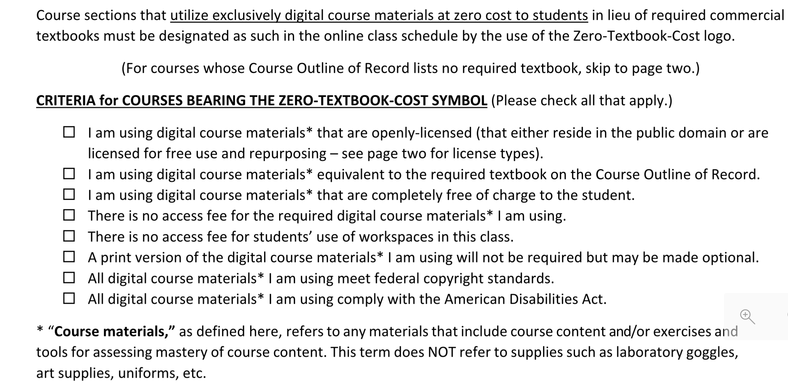
Any issues?

Slide 12
What would a more effective form look like?
Grossmont

Slide 13
Cont.
Cosumnes

Slide 14
Self-Reporting
MiraCost

Slide 15
Integration
Chaffey

Slide 16
Determining Appropriate XB12 Code
Chabot

Slide 17
Universal Challenges
Getting the data.
Ensuring data accuracy.
Developing a process that really works.
Ensuring the process is not overly cumbersome.

Slide 18
More Information
ASCCC OERI Website (asccc-oeri.org)
Resources
Webinars and Events
ASCCC OER E-Mail (oeri@asccc.org)
General OERI E-Mail: oeri@asccc.org

