Slide 1
Summer
ADAPT Training
Part 1
Accessing ADAPT and Finding Existing Assessments
This work is licensed under a Creative Commons Attribution 4.0 International License. Attribute this slide deck as: “ADAPT Training Part 1 by ASCCC OERI is licensed under CC BY 4.0.

Slide 2
QR Codes for ADAPT Spanish Demo and STEM Demo
ADAPT Spanish
Demo
STEM
Demo
Notes:
Spanish Demo: https://adapt.libretexts.org/students/assignments/73560/init-formative
STEM Demo: https://adapt.libretexts.org/students/assignments/73558/init-formative

Slide 3
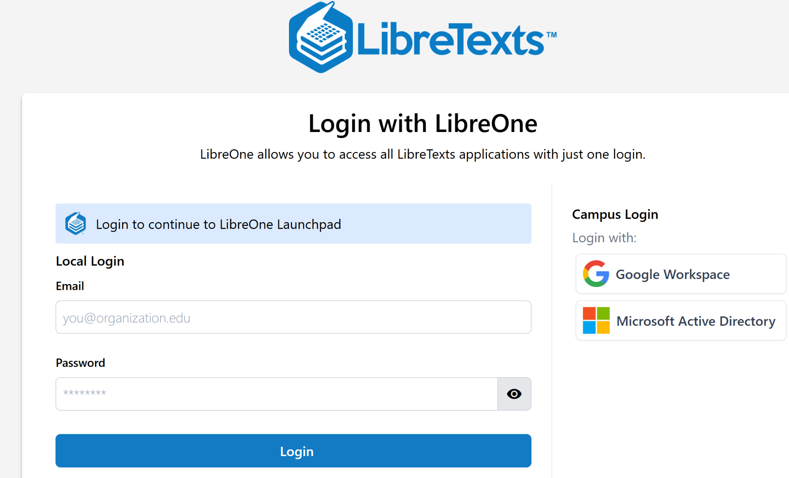
Login to LibreOne
https://one.libretexts.org/
Notes:
https://one.libretexts.org/

Slide 4
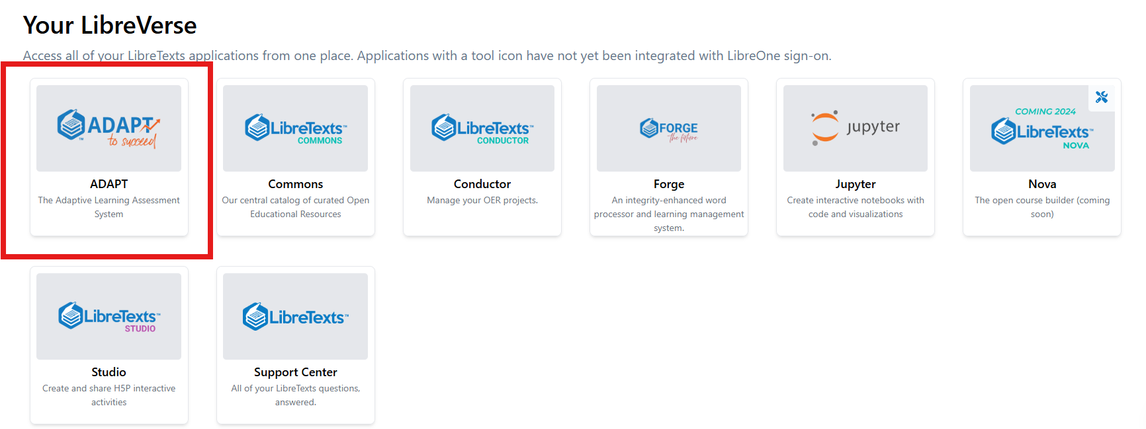
Finding ADAPT

Slide 5
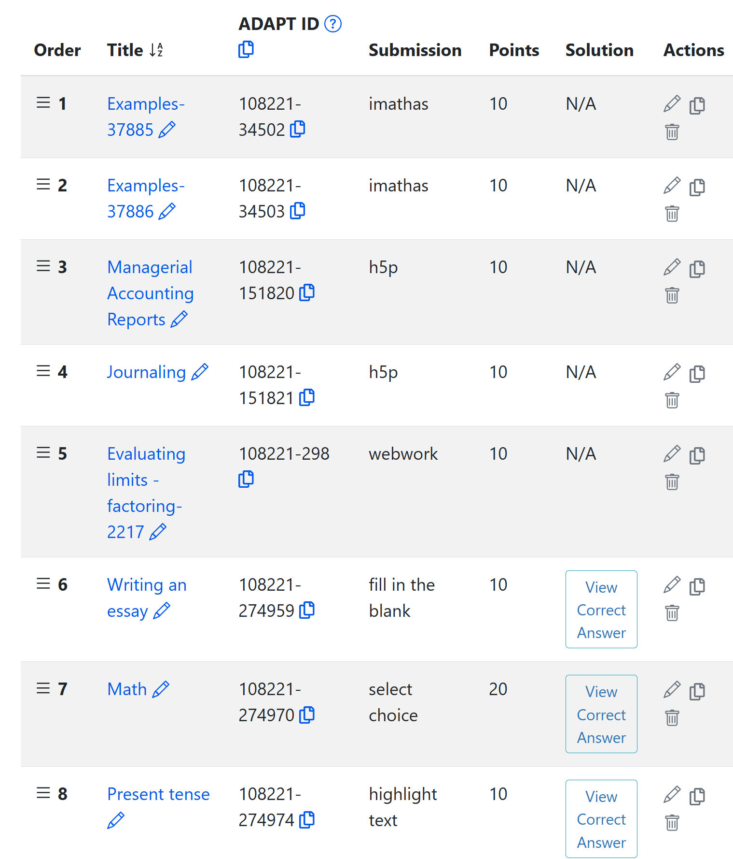
What is ADAPT?
ADAPT is a comprehensive online assessment/homework infrastructure that provides faculty the ability to include auto-graded and non-auto-graded activities from different platforms such as H5P, MyOpenMath, WeBWork, and its own native ADAPT questions.
Coming soon to ADAPT: Forge
ADAPT can be integrated into an LMS such as Canvas with full grade integration or it could be run independently.

Slide 6
ADAPT Library has 262,486 questions
H5P: +25,000 questions
WebWork: +54,000 questions
MOM/iMathAS: 73,000 questions
Open-Ended: +70,000 questions
ADAPT Native: +37,000 questions
Basics QTI: +19,000 questions
Nursing (NCLEX prep): +17,000 questions
Sketcher (molecular structures): 438 questions
Discuss-It: 215 questions

Slide 7
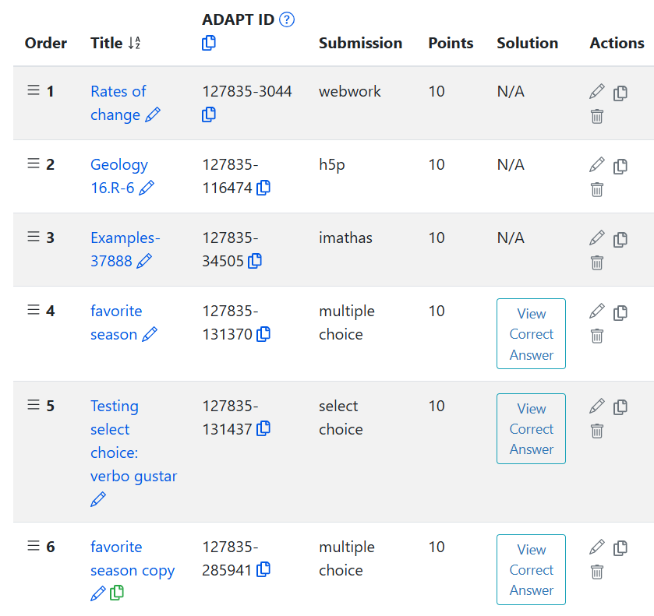
ADAPT is Built for Multi-Modal Use
No single technology can handle all use cases. Our solution is to build ADAPT with multiple technologies capable of handling numerous use cases.
AutoGraded Questioning
WebWork
IMathAS (MyOpenMath
& Ohm)
Native
(LMS QTI)
H5P

Slide 8
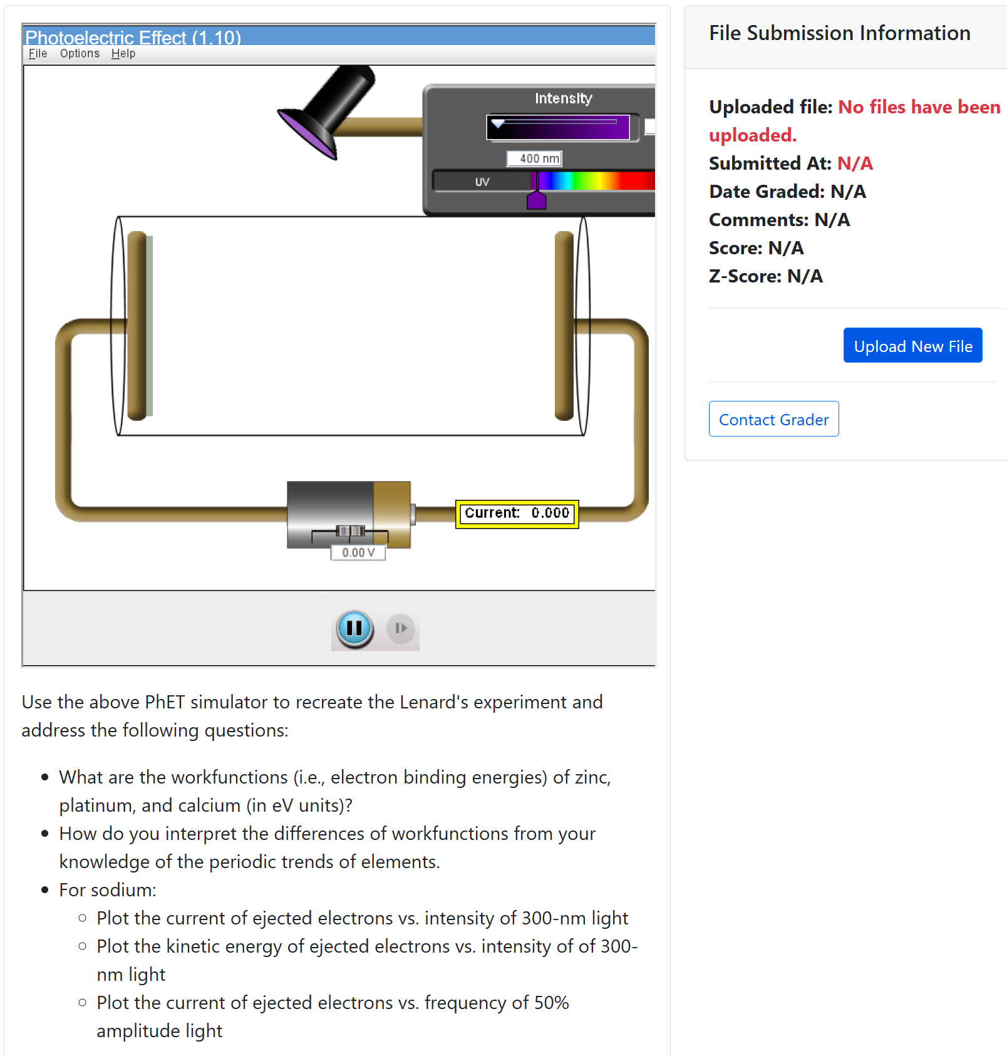
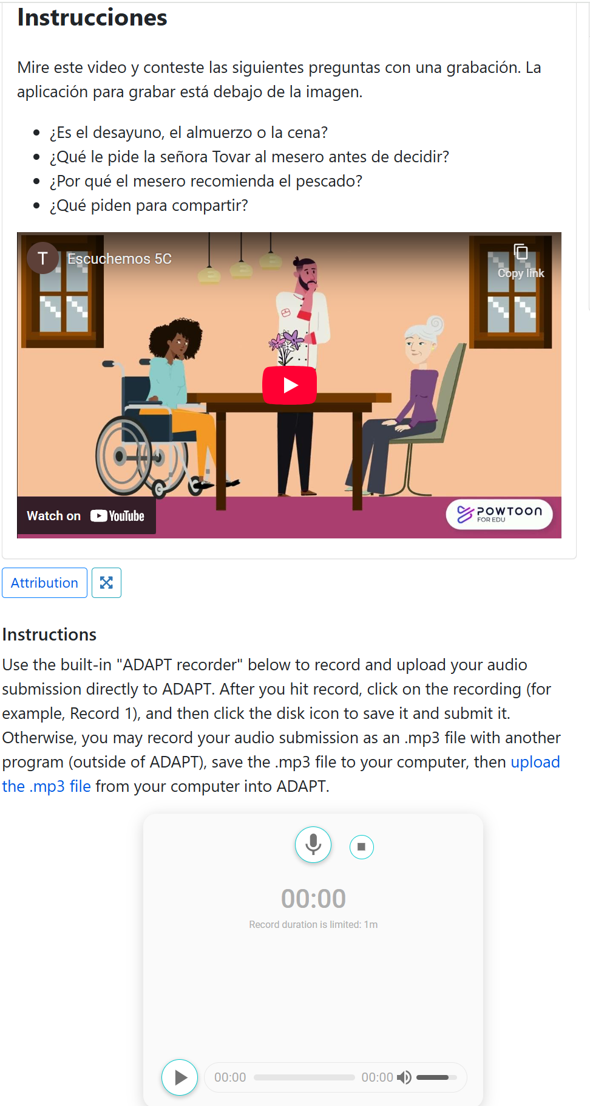
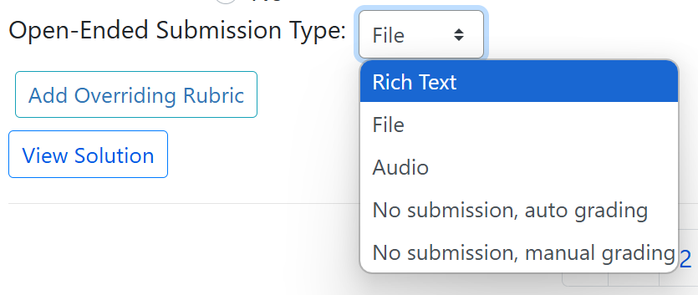
Open-Ended Questions in ADAPT
Open-Ended Questioning
Rich Text
Plain Text
Audio
File
(PDF, Excel …)

Slide 9
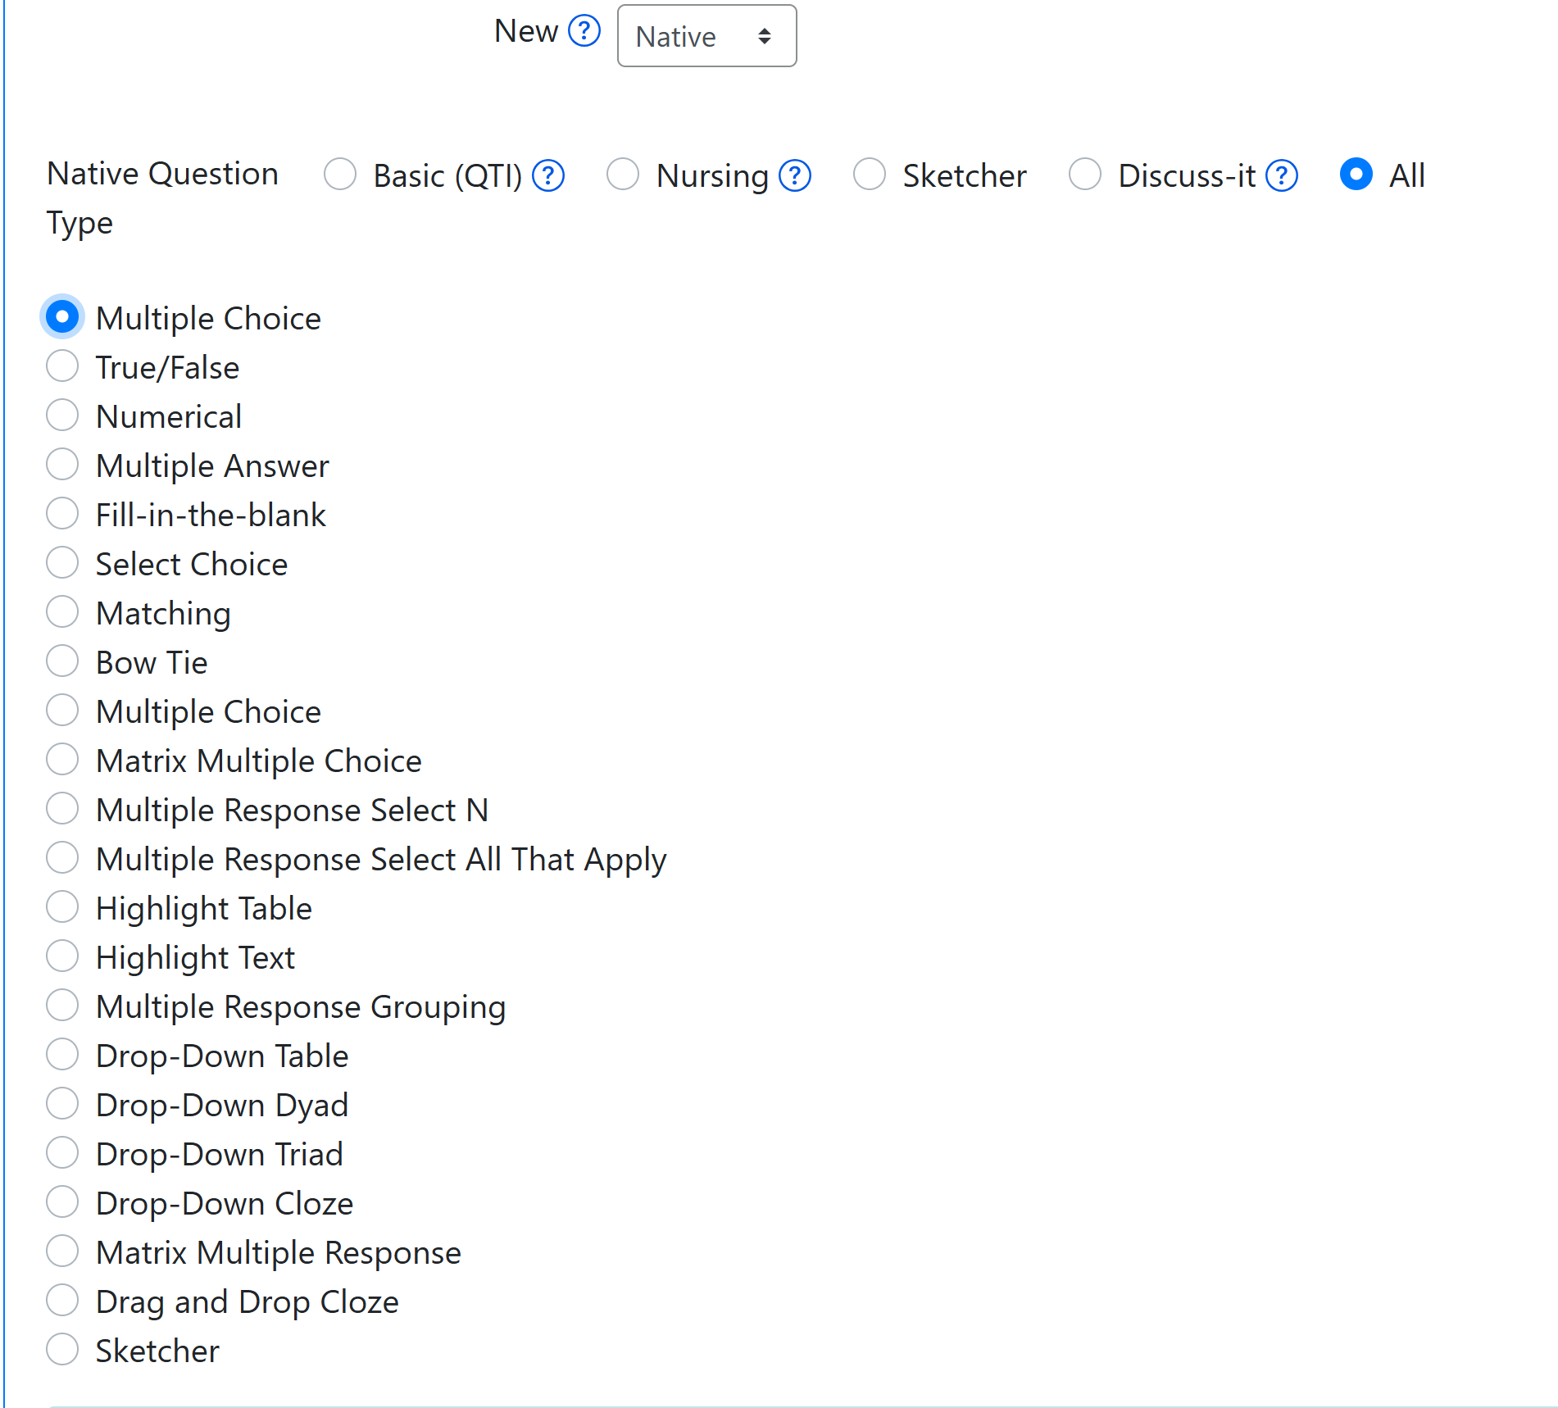
ADAPT Native Questions
Basic Questions (QTI)
Multiple Choice
True/False
Numerical
Multiple Answer
Fill-in-the-blank
Select Choice
Matching

Slide 10
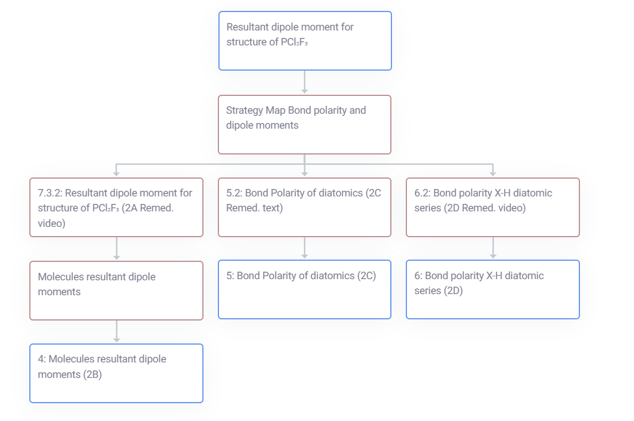
ADAPT Learning Trees
Adaptive Learning Tree approach enables individualized assessment and learning.
Tree #430
Notes:
Student view of learning tree: https://commons.libretexts.org/insight/student-view-of-learning-trees

Slide 11
Coming to ADAPT: Forge
Notes:
https://libretexts.org/blog/introducing-forge-new-innovation-open-pedagogy

Slide 12
Cool Features in ADAPT

Slide 13
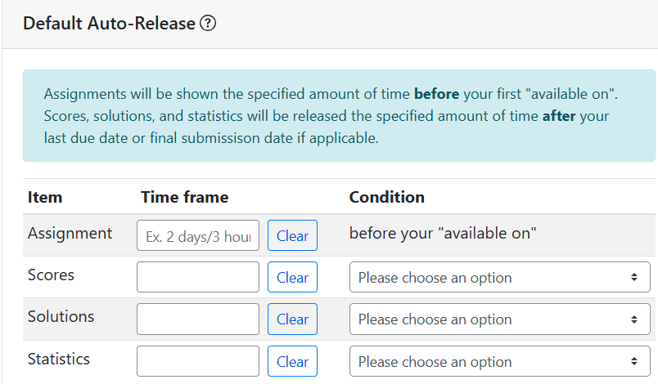
Auto-Release Settings for Assignments

Slide 14
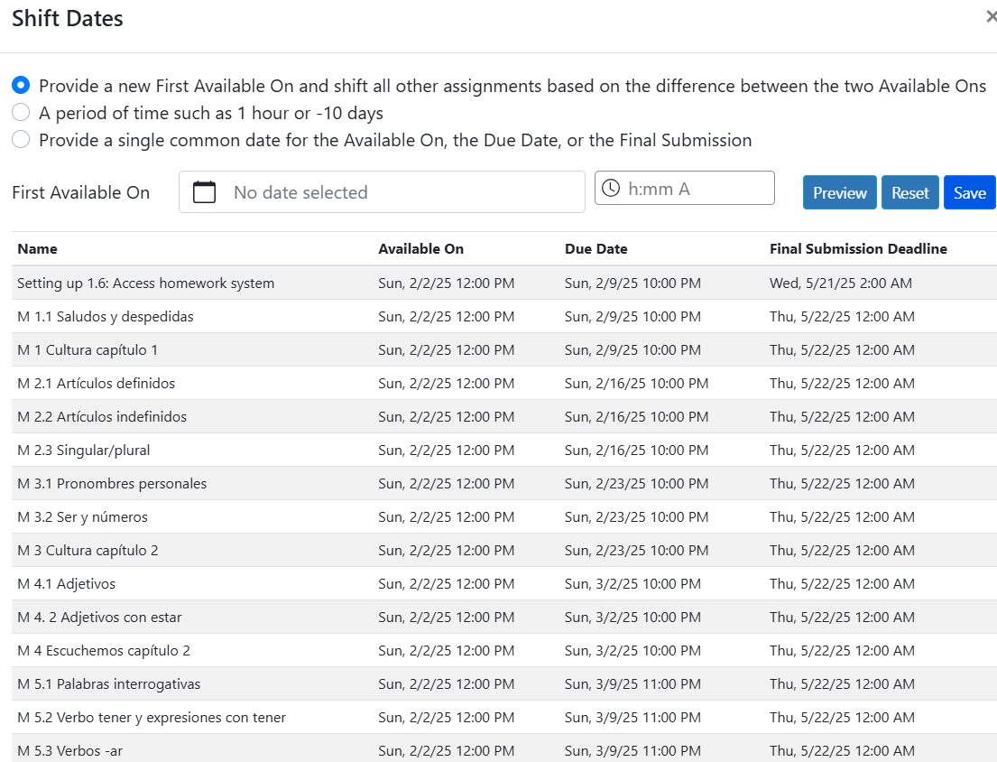
Shifting Dates after the end of a term

Slide 15
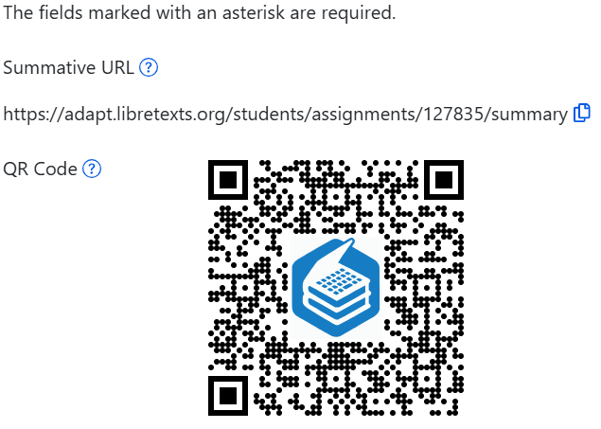
Sharing QR Codes of Assignments

Slide 16
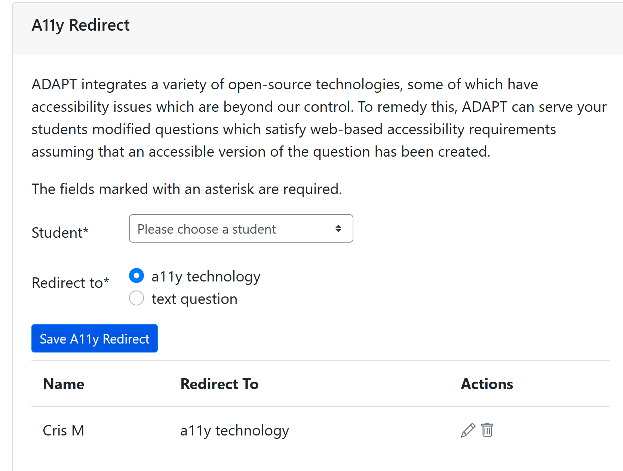
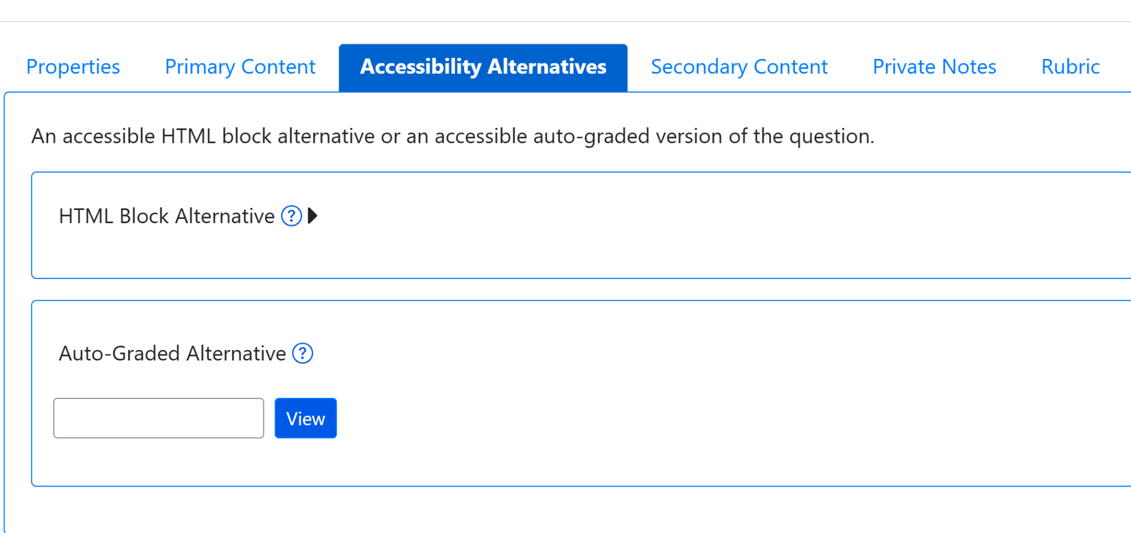
A11y Redirect for non-accessible activities
This tool in ADAPT lets you identify the student that needs accommodations and deploy the accessible activities to only those that need them.

Slide 17
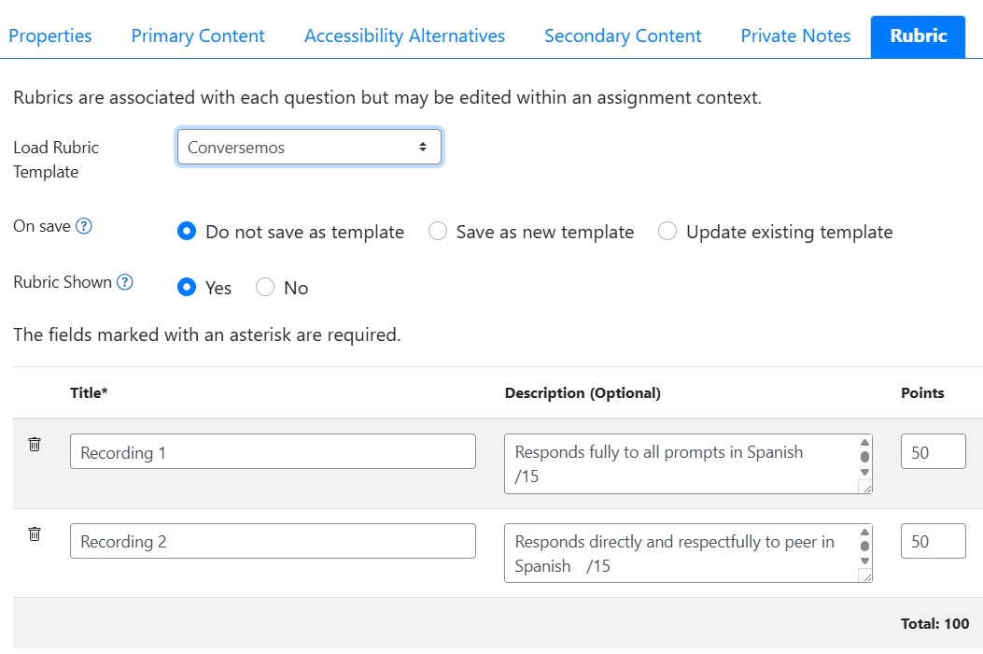
New: Rubric

Slide 18
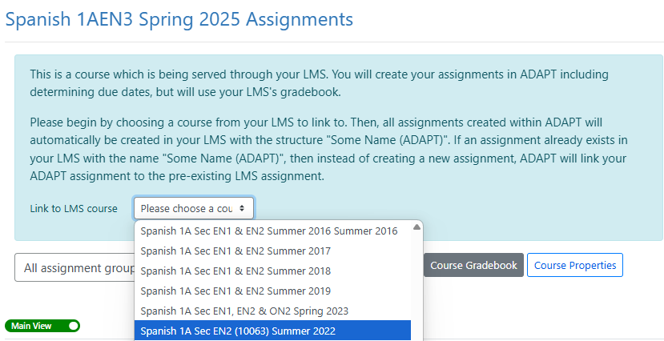
Linking Canvas Course to ADAPT Course via API/LTI
The API link to Canvas will automatically create individual Canvas assignments and gradebook entries.
Notes:
More info on API: https://docs.google.com/document/d/1ItwdvFXi6fqy-OilptSjTaxGZ7LeCPEZMDQtYElBsQg/edit?tab=t.0#heading=h.1f9oybosc2xn

Slide 19
Goals for ADAPT-Part I Webinar
Access ADAPT
Create an ADAPT course
Create an assignment and add existing questions
Find ADAPT questions, collections, and public courses
Clone and edit ADAPT native questions

Slide 20
Let’s get to work
Create an ADAPT course and add assignments

Slide 21
Let’s get to work (1)
Find ADAPT
Questions
Collections
Public courses
Notes:
12:40

Slide 22
Let’s get to work (2)
Create an assignment and add existing questions

Slide 23
Find ADAPT

Slide 24
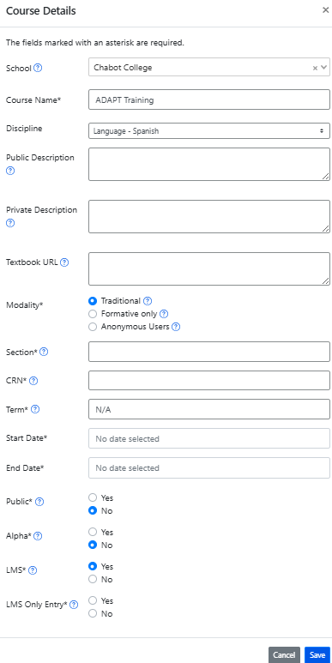
Create an ADAPT course and set the Gradebook integration with Canvas
Enter:
School
Course Name
Discipline
Section/CRN
Term
Start/end date
Public: Yes >if you want to share your course with other instructors
LMS: select “Yes” for Canvas integration. If you select yes. Then you will need to choose:
If yes, student can only enter via Canvas.
If no, student can enter via Canvas or directly via ADAPT.

Slide 25
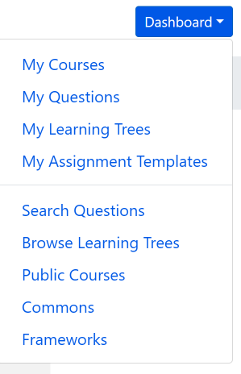
Search for ADAPT questions, collections, and public courses
Questions: Search among ADAPT questions.
Public Courses: Search among shared public courses.
Commons: Search from collections.

Slide 26
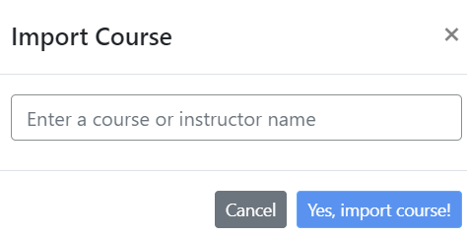
Import an existing course
You can look for public courses that other instructors have shared by going to “Public Courses”.
If you like what you see, you can import the course to your account:
Click on “Import course”
Search for course name or instructor name
Then, import.

Slide 27
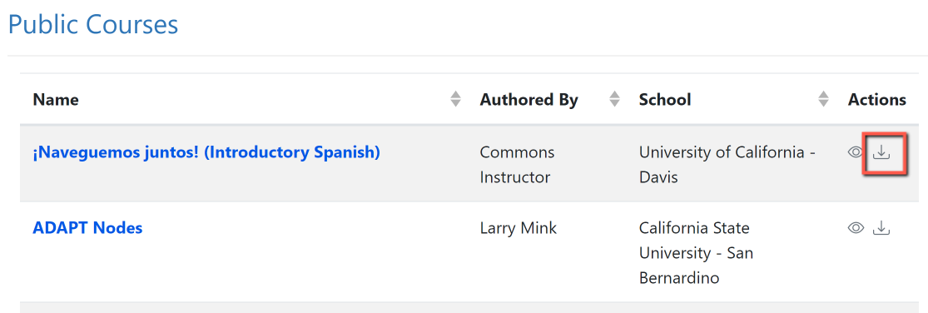
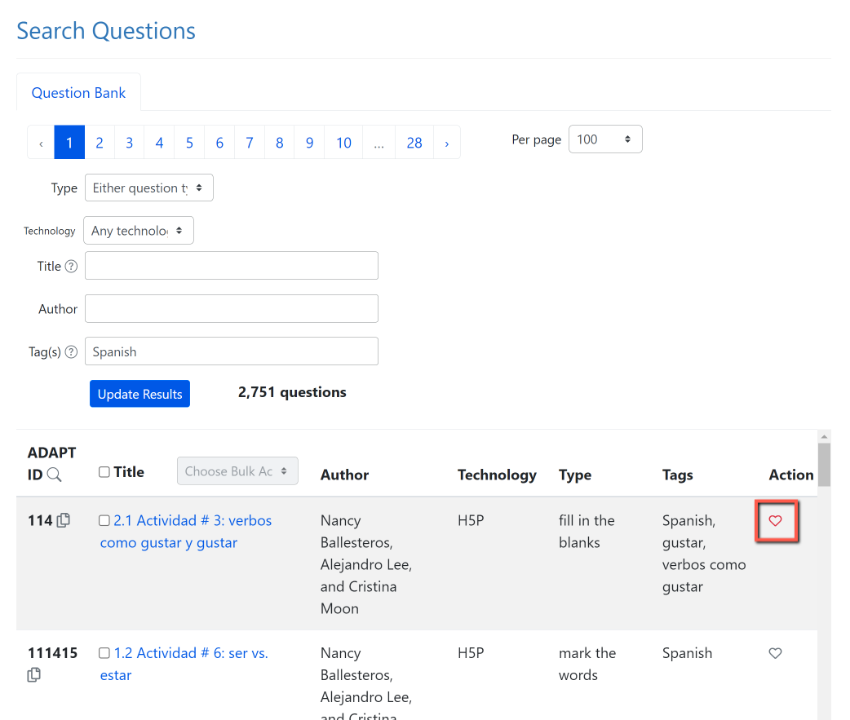
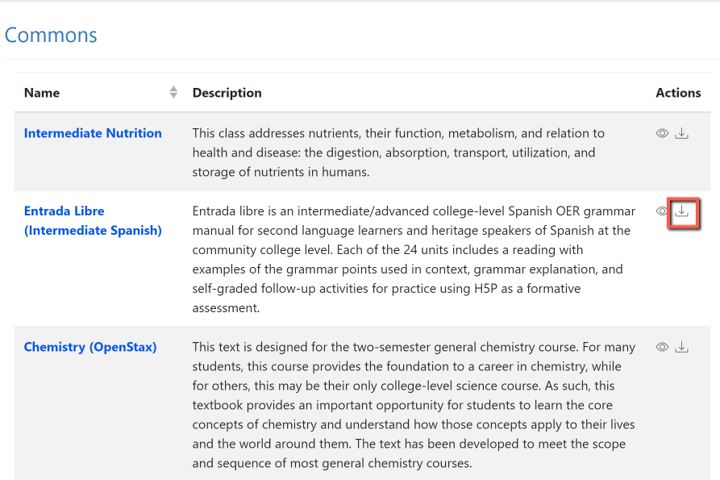
Now, You Do It …
Search and import a Public Course or a collection from Commons
2. Search for questions and save to favorites.
Notes:
12:45

Slide 28
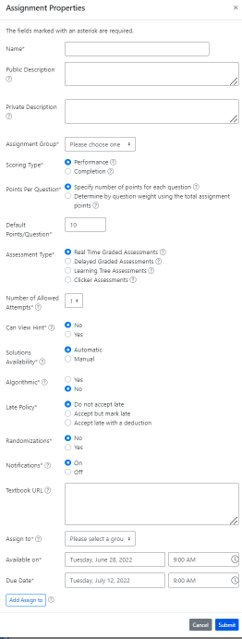
Create a new assignment
Enter:
Name of the assignment
Assignment group
Points (default is 10)
Assessment type
# of allowed attempts
Late policy
Assign to
Available on
Due date

Slide 29
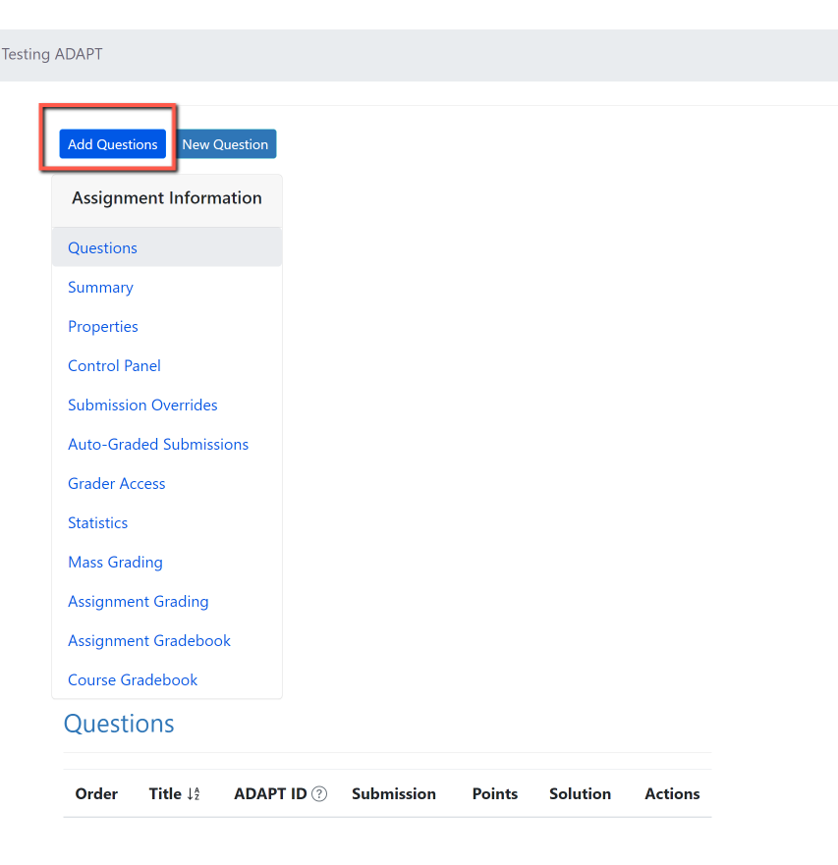
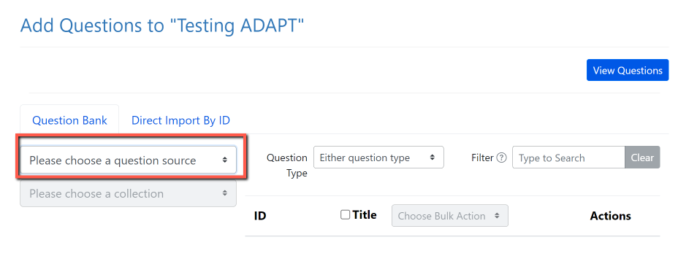
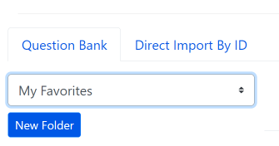
Add Questions
Step 1: Add Questions
Step 2: Click on “Please choose a question source”
Step 3: Go to “My Favorites” and find the question you saved on activity # 1.
Notes:
12:55

Slide 30
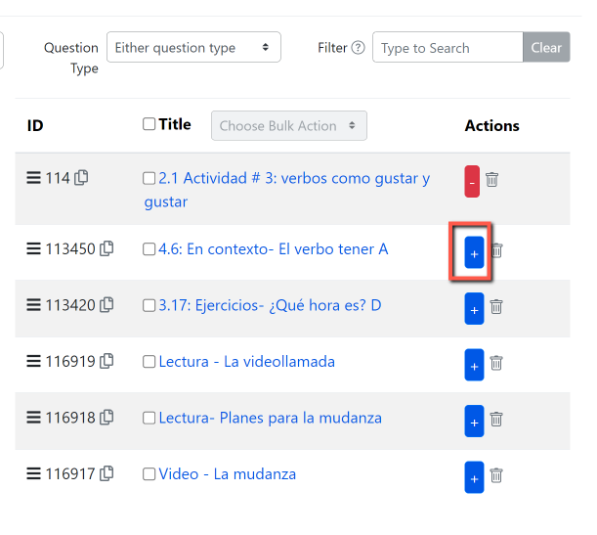
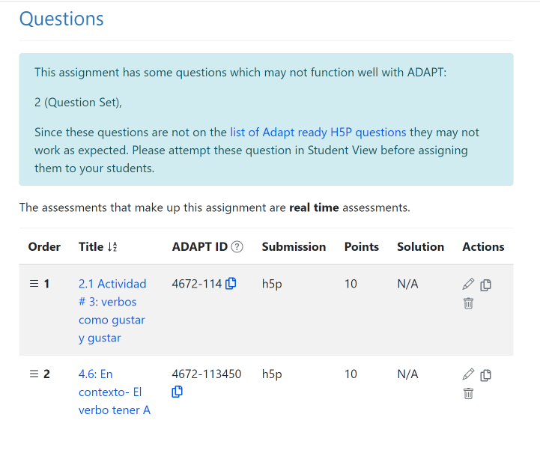
Step 4: Click on the + sign to add the activity to the assignment.

Slide 31
Once you clone an activity, you will be able to edit

Slide 32
Looking for more ADAPT resources?

Slide 33
OERI Summer ADAPT Webinar Series
ADAPT Level 2 – Creating in ADAPT Friday, June 20, 2025 from 1:30 pm – 3:00 pm In this webinar, you will learn how to create auto-graded activities in ADAPT, featuring various question types like fill-in-the-blank, multiple choice, select choice, highlight text, and matching that are accessible and adaptable.
ADAPT Level 3 – Fostering Oral Interaction with ADAPT’s Discuss-It Question Type
Monday, June 30, 2025 from 3:00 pm – 4:30 pm
In this webinar, you will learn how to create oral and listening assessments through threaded student-to-student interaction using text, audio, and video. The Discuss-It question type also offers auto-captioning, transcription, rubric-based grading, and seamless Canvas integration. Discover how Discuss-It fosters accessibility, engagement, and meaningful communication in multiple languages.
ADAPT Level 4 – Question Banks and ADAPT Canvas Integration
Monday, July 7, 2025 from 3:00 pm – 4:30 pm
In this webinar, you’ll learn how to organize your activities into question banks for randomized assessments and explore how to seamlessly integrate your ADAPT content into Canvas with automatic grade syncing.
Notes:
https://asccc-oeri.org/webinars-and-events/

Slide 34
LibreFest 2025 July 7-11
This virtual workshop will provide four and a half days of teaching and working sessions covering:
how to create Open Education Resources (OER);
how to edit/modify existing OER to build textbooks and other learning resources;
how to use our Conductor project management platform with our new Workbench;
and our ADAPT open homework and assessment system.
We will also hear Success Stories from LibreTexts super users each day.
If you do not already have a LibreTexts account, you will be prompted to create one during the LibreFest Registration process.
Notes:
https://commons.libretexts.org/events/chh3LwwtKr

Slide 35
LibreTexts Workshop Recordings
ASCCC OERI Webinars
Title | Date | Tags
LibreTexts’ ADAPT Homework Platform and the new Discuss-It | April 16, 2025 | ADAPT, Canvas, Discipline Webinar, Discuss-It, LibreTexts, LibreTexts ADAPT
Addressing the Homework Needs of Economics: Adaptive Homework Assignments and Graphing Technology | March 18, 2025 | Discipline Webinar, Economics, Homework Systems
Collaborating for Computer Science Success: Adopting/Adapting a Shared Open Educational Resource (OER) Canvas Course Shell | December 5, 2024 | Computer Science, Discipline Conversation, Information Technology and Information Systems
Boost Engagement with Discuss-It: Interactive Asynchronous Conversations in ADAPT | November 15, 2024 | ADAPT, Discipline Webinar, Spanish
Notes:
https://asccc-oeri.org/webinars-and-events/

Slide 36
More Information
ASCCC OERI Website (asccc-oeri.org)
Resources
Webinars and Events
LibreTexts (https://libretexts.org)
Office hours (https://zoom.libretexts.org)
Tuesdays at 9:00-10:00 PST
Thursdays at 9:00-10:00 PST

Slide 37
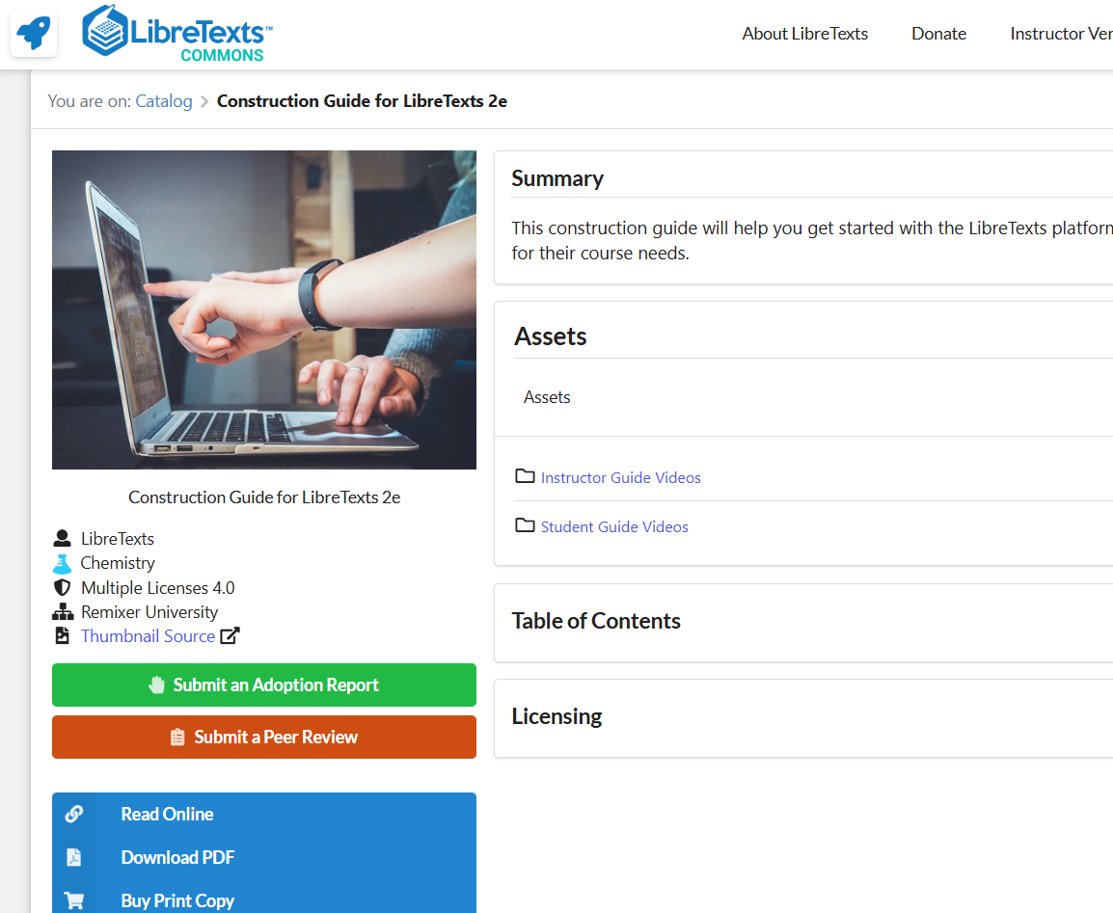
Assistance: The Construction Guide
There are ~20 How-To videos available on the Commons page of the Construction Guide.
Chapter 14 addresses using ADAPT
https://commons.libretexts.org/book/chem-483671

Slide 38
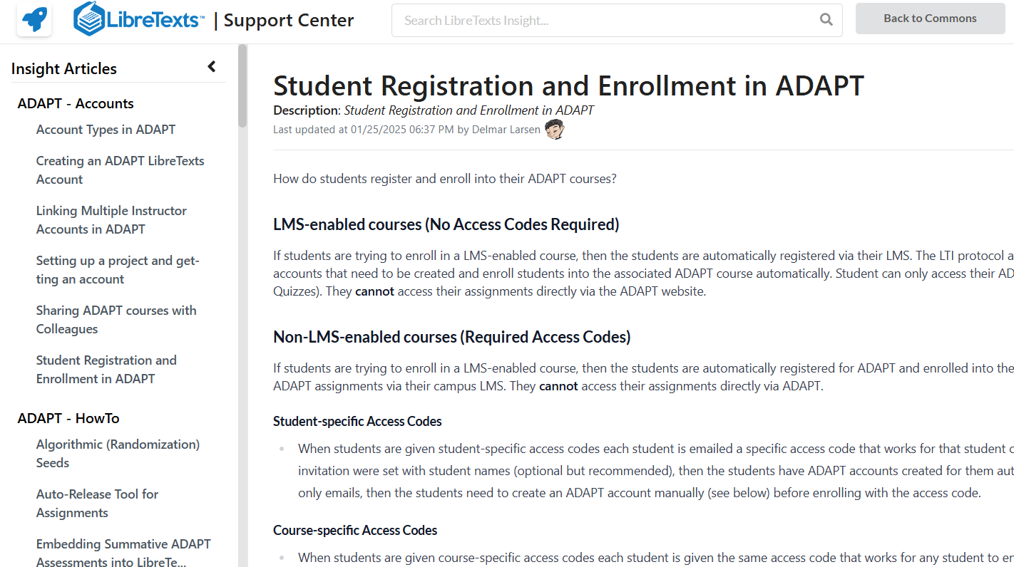
Assistance: The Insight Knowledge Base
https://commons.libretexts.org/insight
Notes:
https://commons.libretexts.org/insight

Slide 39
Questions?
Cristina Moon
Spanish Faculty
OER/ZTC Coordinator at Chabot College
ASCCC OERI Spanish Lead, H5P/ADAPT Lead, and OERI Liaison
cmoon@chabotcollege.edu

