Slide 1
ADAPT Summer Training
Part 2
Creating in ADAPT
This work is licensed under a Creative Commons Attribution 4.0 International License. Attribute this slide deck as: “ADAPT Training Part 2 by ASCCC OERI is licensed under CC BY 4.0.

Slide 2


QR Codes for ADAPT Spanish Demo and STEM Demo
ADAPT Spanish
Demo
STEM
Demo
Notes:
Spanish Demo: https://adapt.libretexts.org/students/assignments/73560/init-formative
STEM Demo: https://adapt.libretexts.org/students/assignments/73558/init-formative

Slide 3
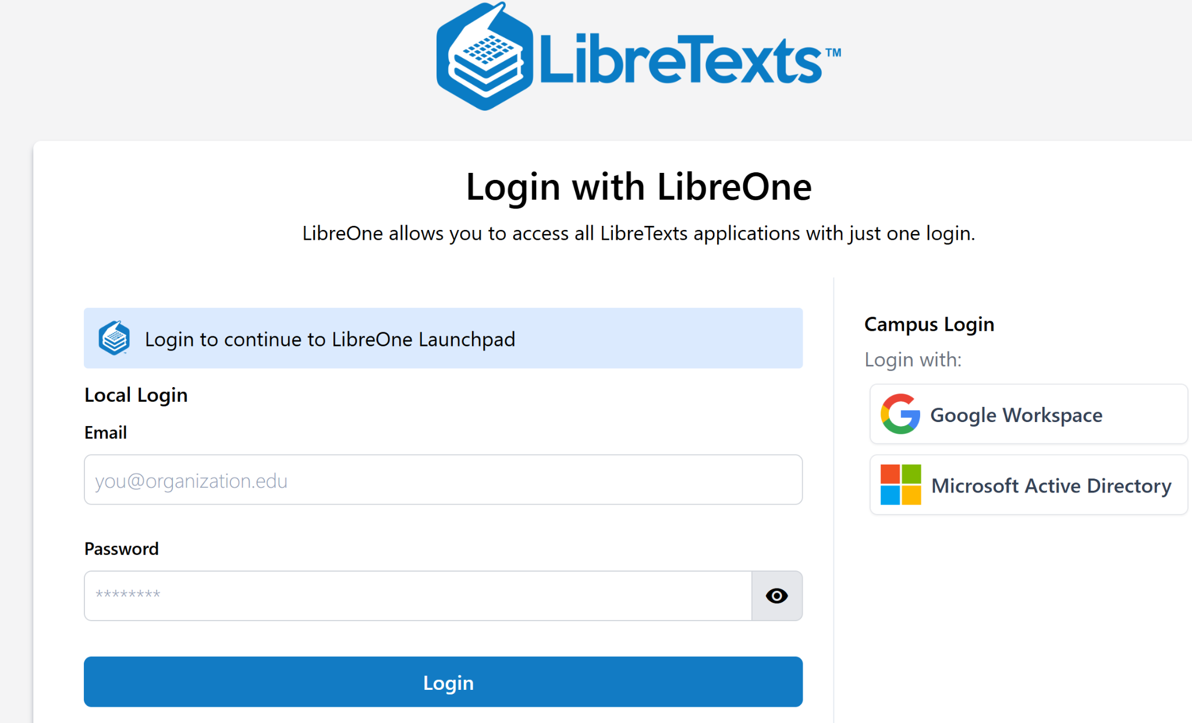
Login to LibreOne
https://one.libretexts.org/
Notes:
https://one.libretexts.org/

Slide 4
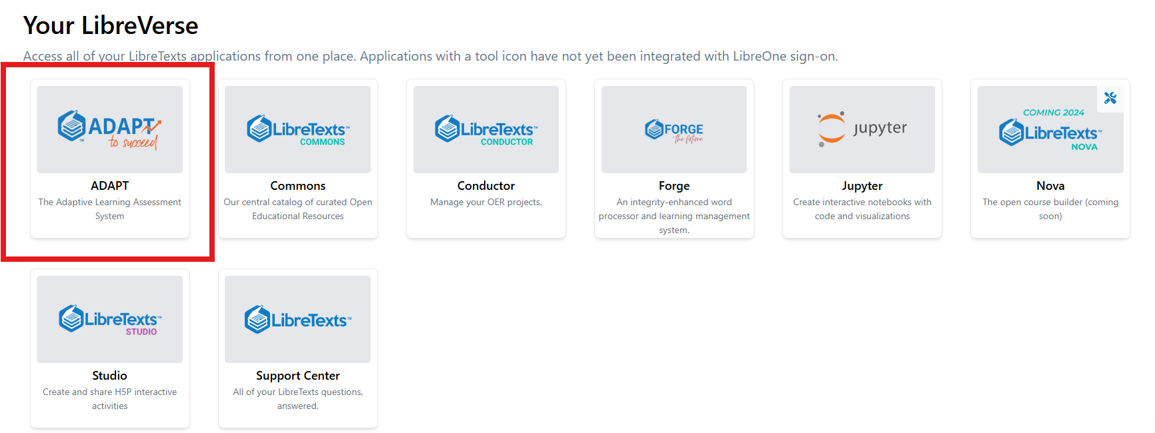
Finding ADAPT

Slide 5
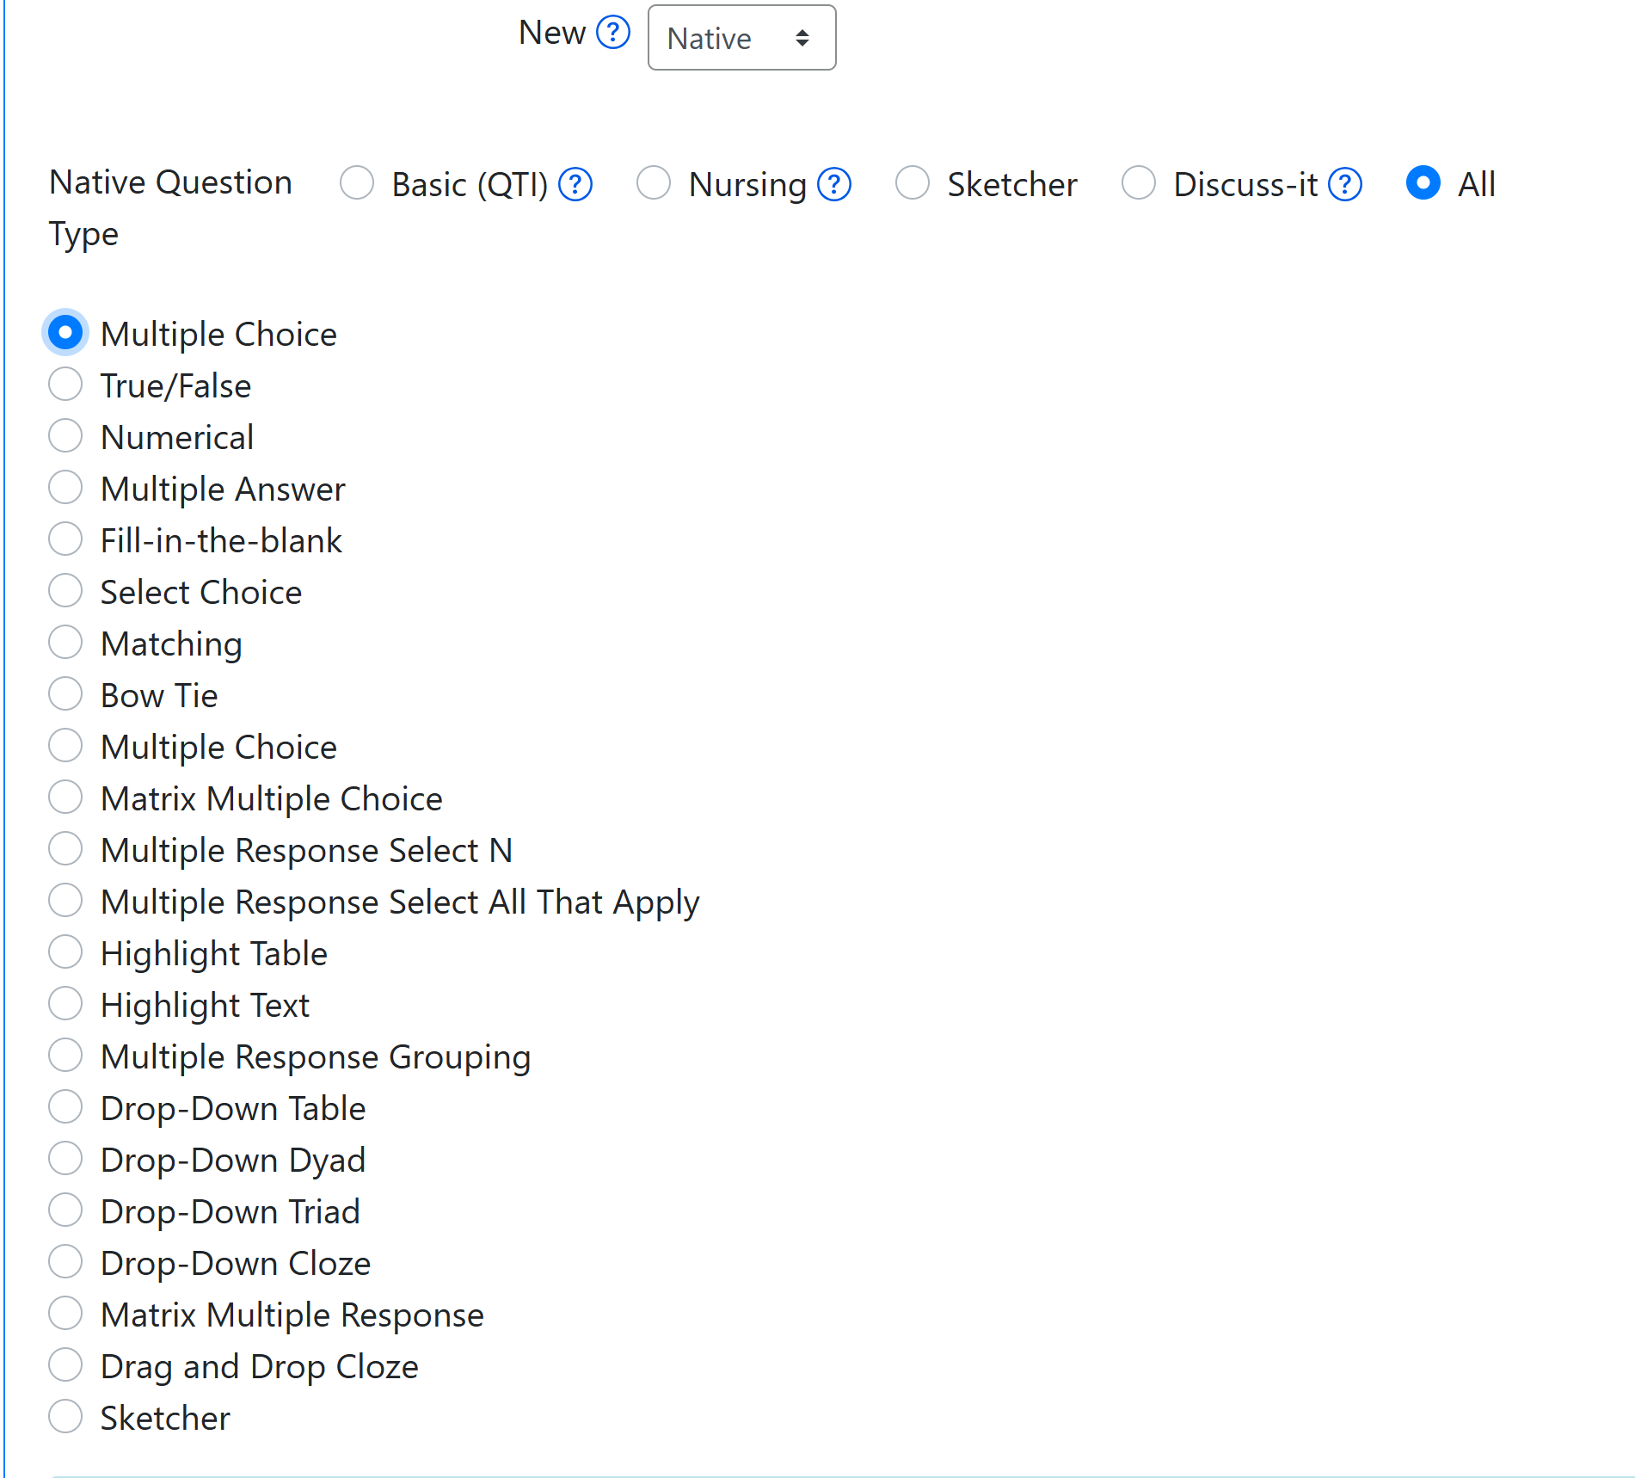
ADAPT Native Questions
Basic Questions (QTI)
Multiple Choice
True/False
Numerical
Multiple Answer
Fill-in-the-blank
Select Choice
Matching

Slide 6

Let’s get to work
Create auto-graded ADAPT native questions:
Fill-in the blanks
Select choice
Highlight text
Matching

Slide 7
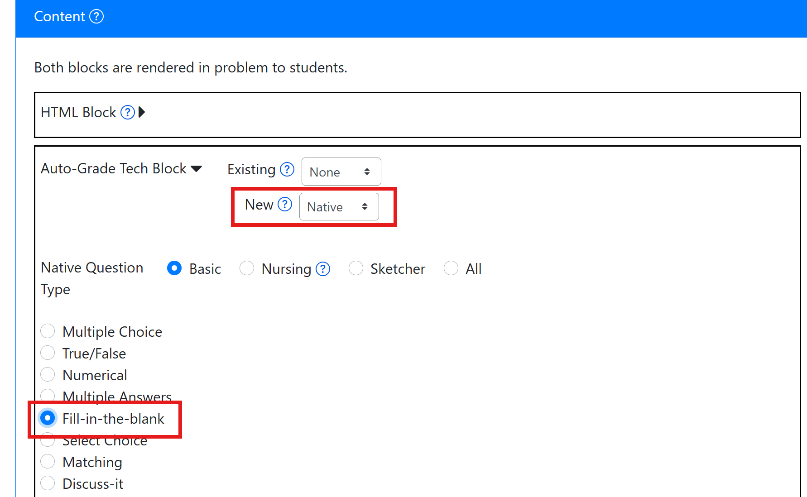
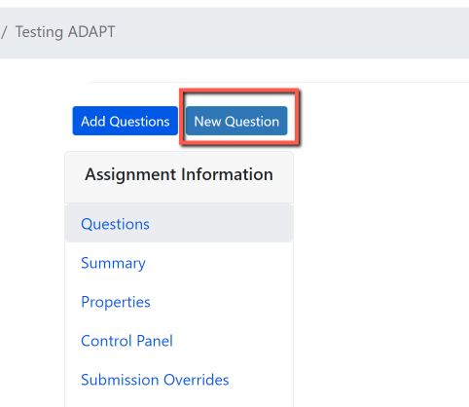
Activity # 1: Fill in the blanks
Step # 1: Click on New Question
Step # 2: Select “New” > “Native” question
Notes:
1:05

Slide 8
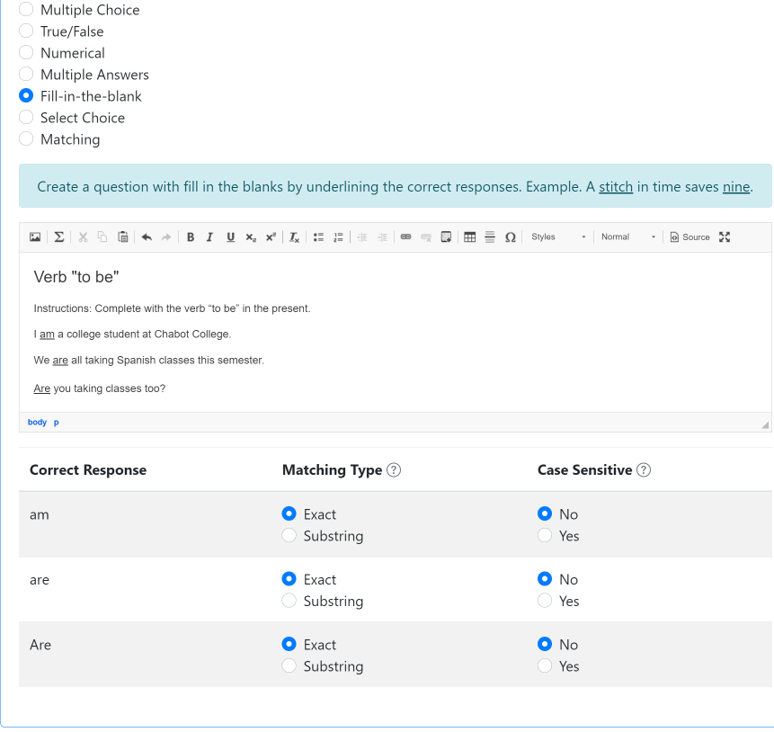
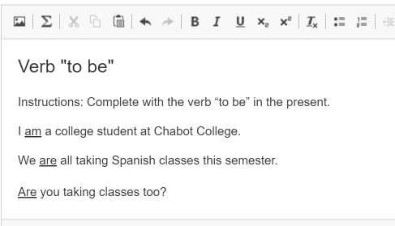
Fill-in the blanks Question
Create a question with fill-in-the blanks by underlining the correct responses.

Slide 9
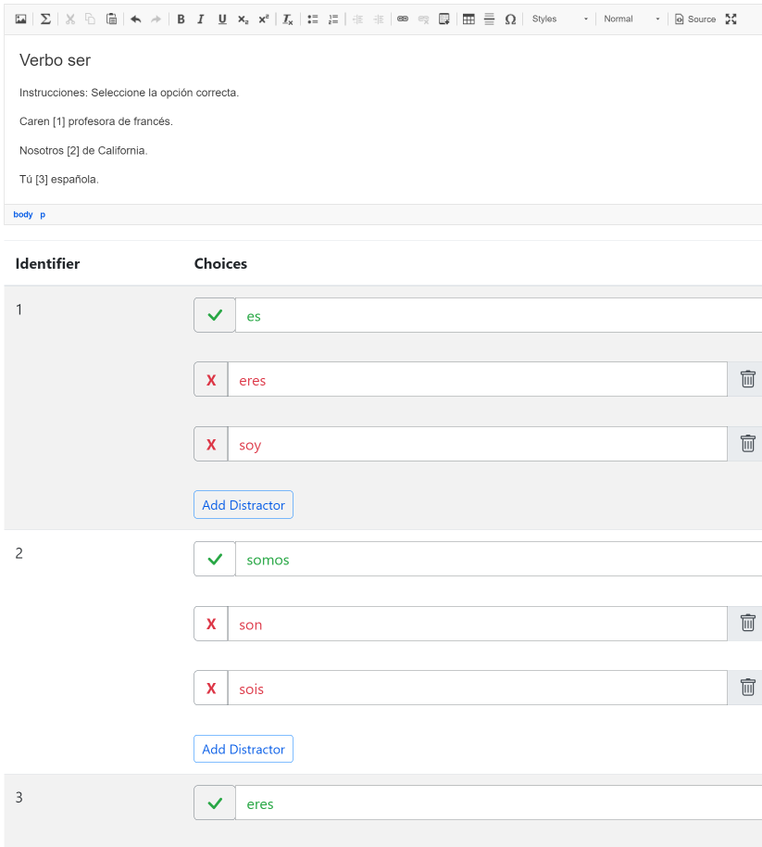
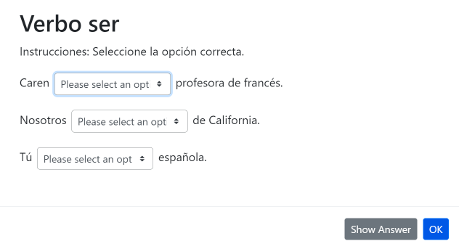
Activity # 2 Select Choice (drop-down) Question
Use brackets for answers. Example. The [planet] is the closest planet to the sun; there are [number-of-planets] planets. Then, add the choices below with your first choice being the correct response. Add distractors. Each student will receive a randomized ordering of the choices.

Slide 10
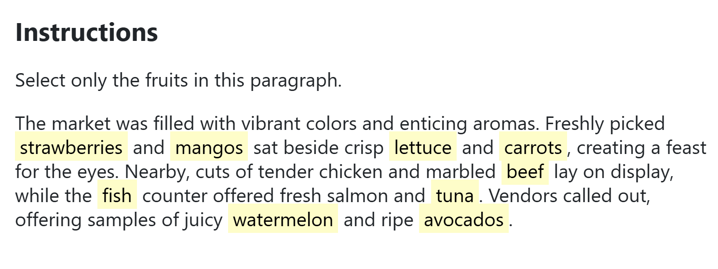
Activity # 3 Highlight text Question
Write out a prompt, where text within brackets will automatically become your highlighted text. Once the text is added, determine whether it is a correct answer or a distractor.

Slide 11
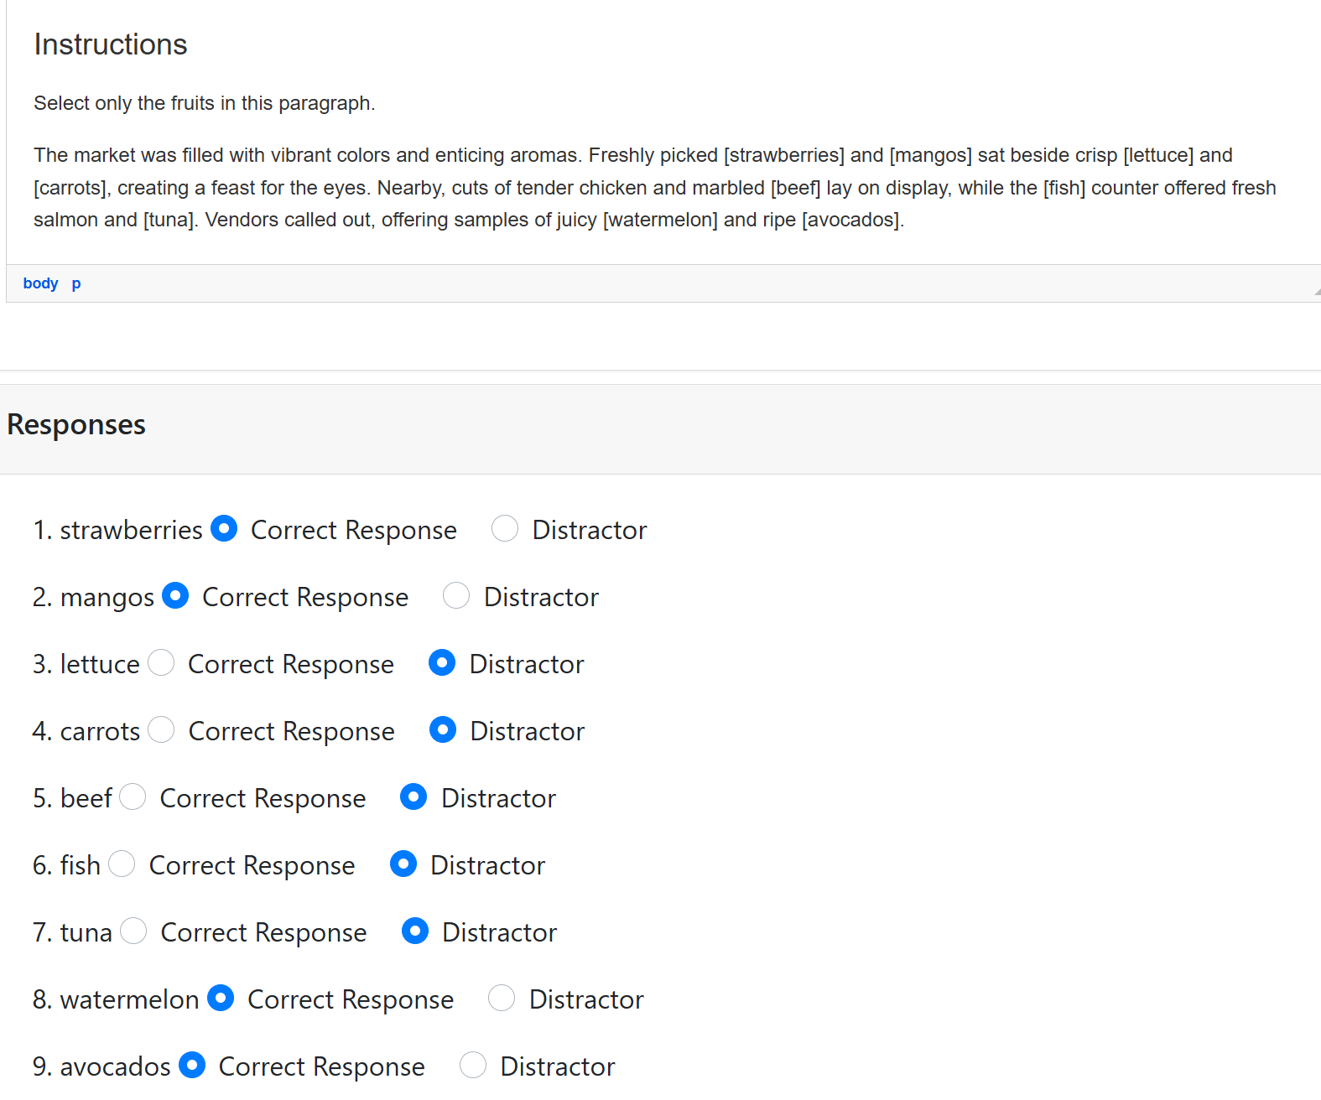
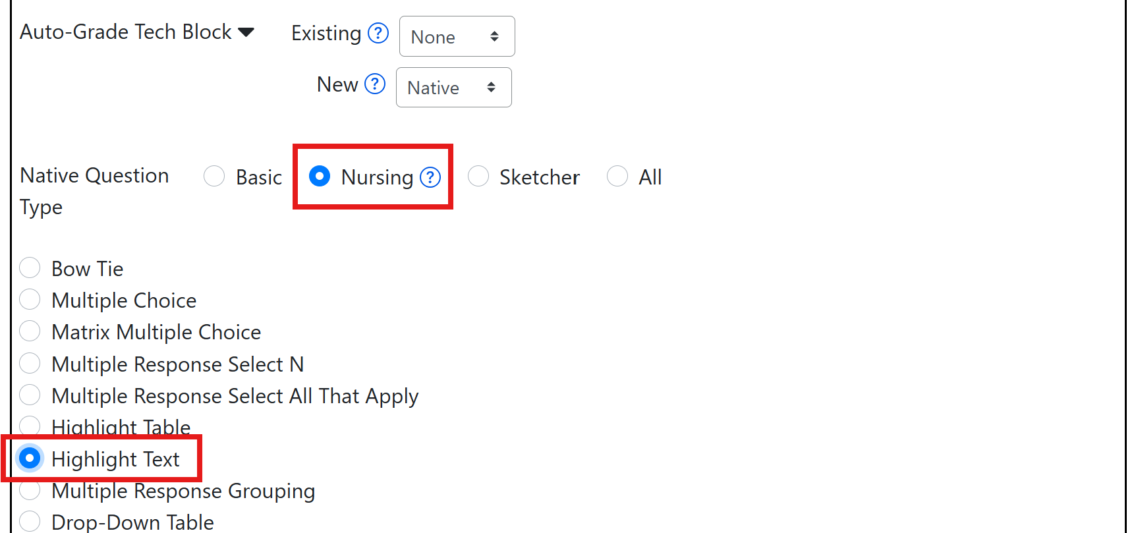
Screenshots of creating questions in ADAPT

Slide 12
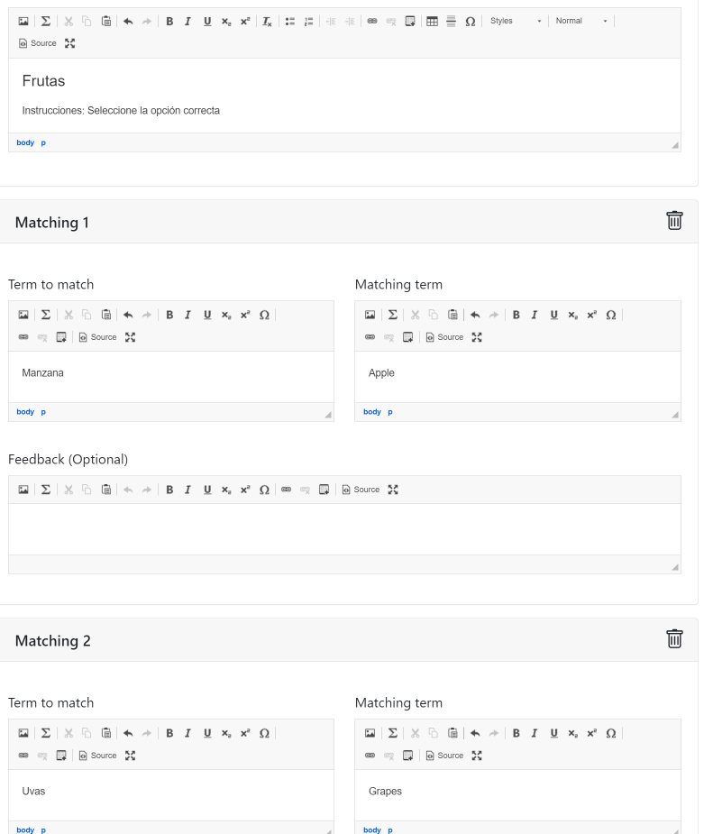
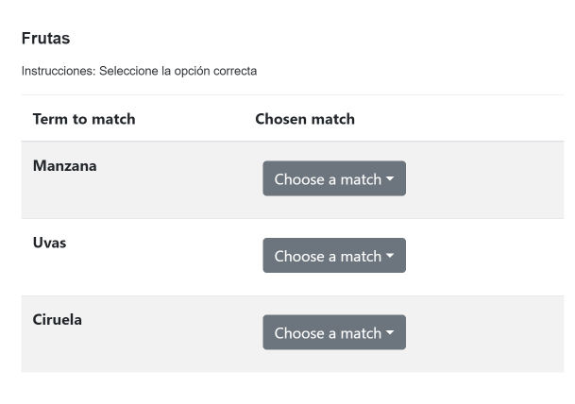
Activity # 4 Matching Question
Create a list of terms to match along with their matching terms. Matching terms can include media such as images. Optionally, add distractors which do not satisfy any of the matches.

Slide 13
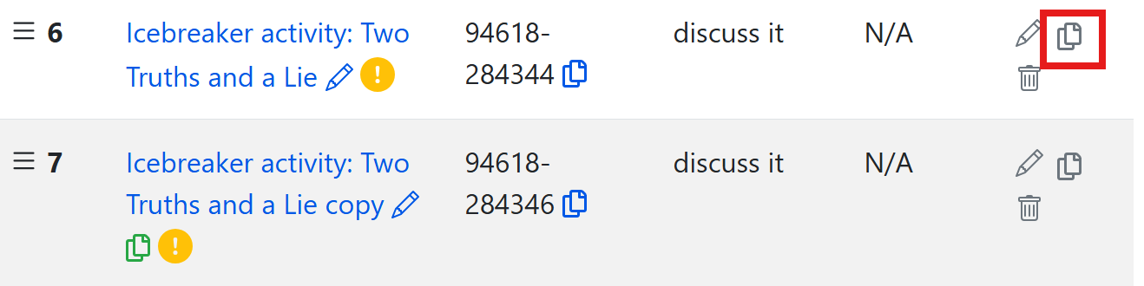
Once you clone an activity, you will be able to edit

Slide 14
Looking for more ADAPT resources?

Slide 15
OERI Summer ADAPT Webinar Series
ADAPT Level 3 – Fostering Oral Interaction with ADAPT’s Discuss-It Question Type
Monday, June 30, 2025 from 3:00 pm – 4:30 pm
In this webinar, you will learn how to create oral and listening assessments through threaded student-to-student interaction using text, audio, and video. The Discuss-It question type also offers auto-captioning, transcription, rubric-based grading, and seamless Canvas integration. Discover how Discuss-It fosters accessibility, engagement, and meaningful communication in multiple languages.
ADAPT Level 4 – Question Banks and ADAPT Canvas Integration
Monday, July 7, 2025 from 3:00 pm – 4:30 pm
In this webinar, you’ll learn how to organize your activities into question banks for randomized assessments and explore how to seamlessly integrate your ADAPT content into Canvas with automatic grade syncing.
Notes:
https://asccc-oeri.org/webinars-and-events/

Slide 16
LibreFest 2025 July 7-11
This virtual workshop will provide four and a half days of teaching and working sessions covering:
how to create Open Education Resources (OER);
how to edit/modify existing OER to build textbooks and other learning resources;
how to use our Conductor project management platform with our new Workbench;
and our ADAPT open homework and assessment system.
We will also hear Success Stories from LibreTexts super users each day.
If you do not already have a LibreTexts account, you will be prompted to create one during the LibreFest Registration process.
Notes:
https://commons.libretexts.org/events/chh3LwwtKr

Slide 17
LibreTexts Workshop Recordings
ASCCC OERI Webinars
Title | Date | Tags
LibreTexts’ ADAPT Homework Platform and the new Discuss-It | April 16, 2025 | ADAPT, Canvas, Discipline Webinar, Discuss-It, LibreTexts, LibreTexts ADAPT
Addressing the Homework Needs of Economics: Adaptive Homework Assignments and Graphing Technology | March 18, 2025 | Discipline Webinar, Economics, Homework Systems
Collaborating for Computer Science Success: Adopting/Adapting a Shared Open Educational Resource (OER) Canvas Course Shell | December 5, 2024 | Computer Science, Discipline Conversation, Information Technology and Information Systems
Boost Engagement with Discuss-It: Interactive Asynchronous Conversations in ADAPT | November 15, 2024 | ADAPT, Discipline Webinar, Spanish
Notes:
https://asccc-oeri.org/webinars-and-events/

Slide 18
More Information
ASCCC OERI Website (asccc-oeri.org)
  Resources
  Webinars and Events
LibreTexts (https://libretexts.org)
Office hours (https://zoom.libretexts.org)
Tuesdays at 9:00-10:00 PST
Thursdays at 9:00-10:00 PST

Slide 19
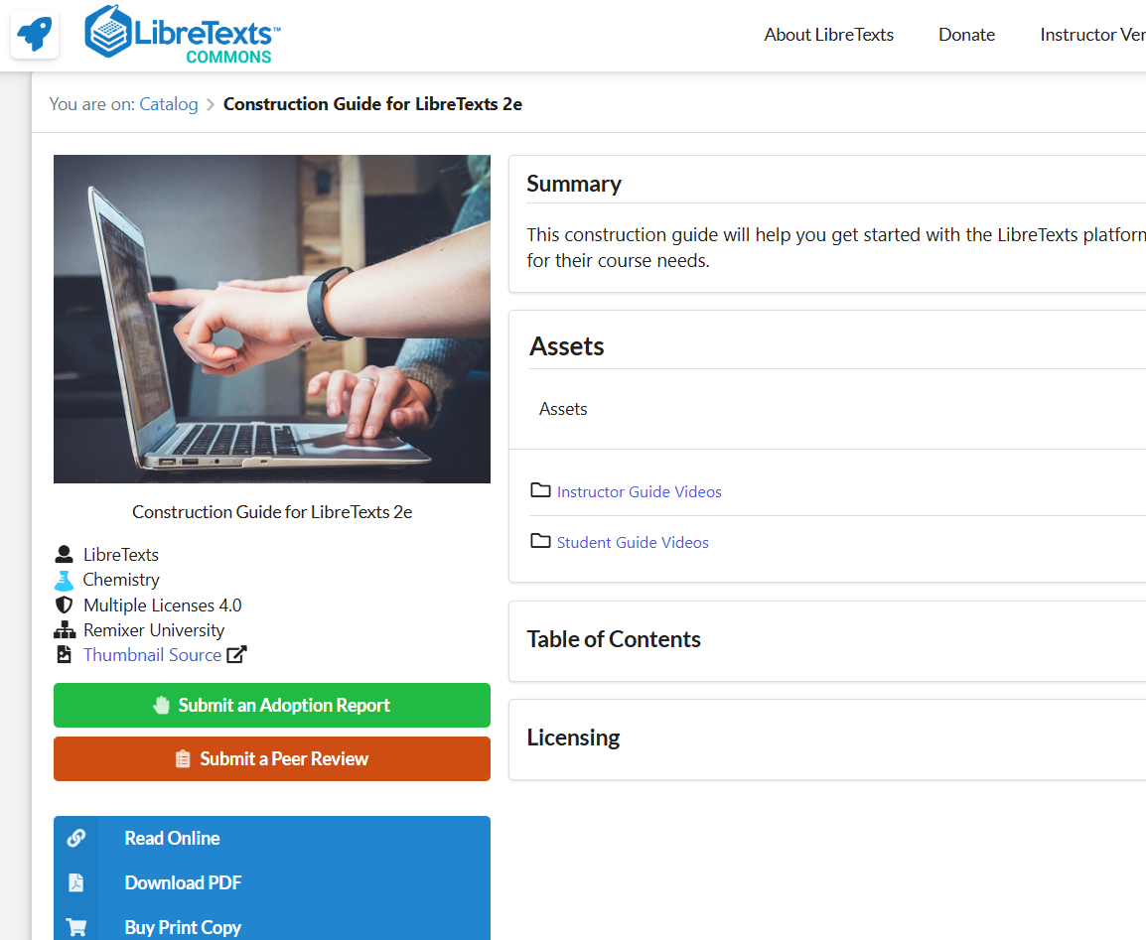
Assistance: The Construction Guide
There are ~20 How-To videos available on the Commons page of the Construction Guide.
Chapter 14 addresses using ADAPT
https://commons.libretexts.org/book/chem-483671

Slide 20
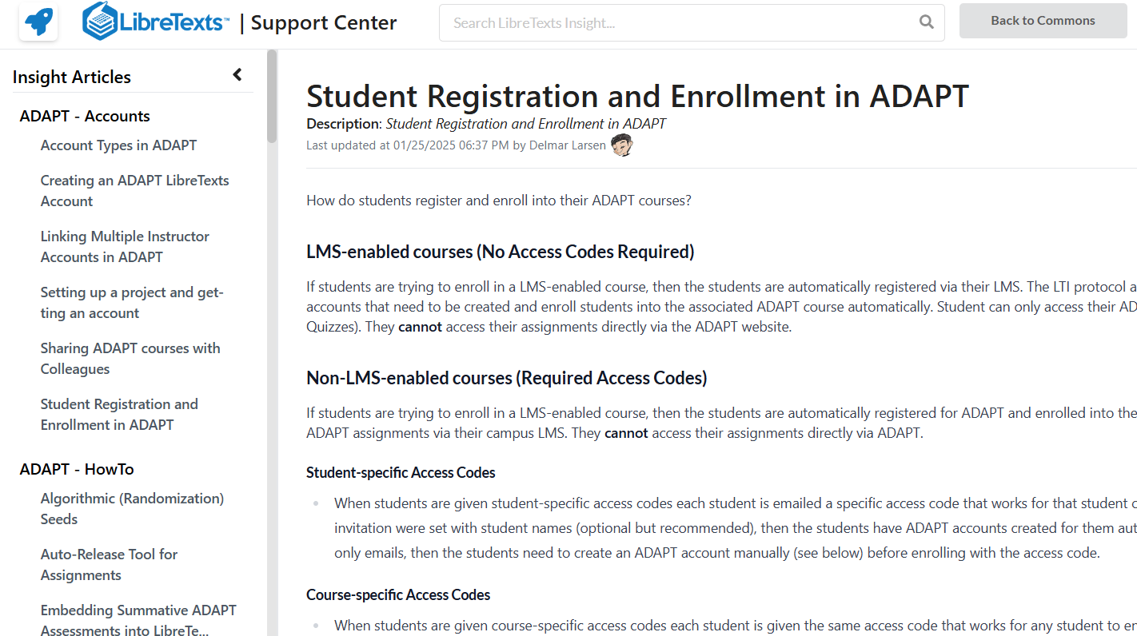
Assistance: The Insight Knowledge Base
https://commons.libretexts.org/insight
Notes:
https://commons.libretexts.org/insight

Slide 21
Questions?
Cristina Moon
Spanish Faculty
OER/ZTC Coordinator at Chabot College
ASCCC OERI Spanish Lead, H5P/ADAPT Lead, and OERI Liaison
cmoon@chabotcollege.edu

Slide 22
ADAPT Part I (review)
Create an ADAPT course and add assignments

Slide 23
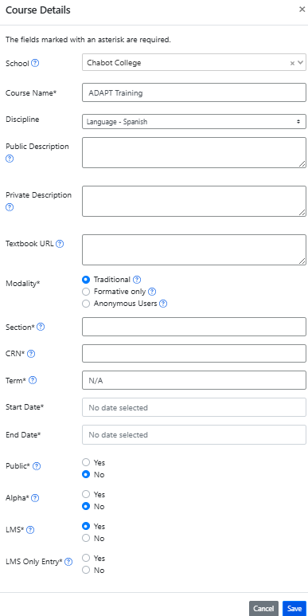
Create an ADAPT course and set the Gradebook integration with Canvas
Enter:
School
Course Name
Discipline
Section/CRN
Term
Start/end date
Public: Yes >if you want to share your course with other instructors
LMS: select “Yes” for Canvas integration. If you select yes. Then you will need to choose:
  If yes, student can only enter via Canvas.
  If no, student can enter via Canvas or directly via ADAPT.

Slide 24
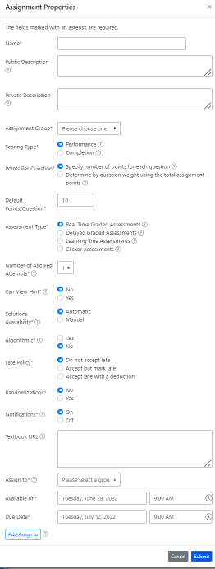
Create a new assignment
Enter:
Name of the assignment
Assignment group
Points (default is 10)
Assessment type
# of allowed attempts
Late policy
Assign to
Available on
Due date

