Slide 1
ADAPT Summer Training
Part 4
Question Banks and ADAPT Canvas Integration
July 7, 2025
This work is licensed under a Creative Commons Attribution 4.0 International License. Attribute this slide deck as: “ADAPT Part 4: Question Banks and ADAPT Canvas Integration” by ASCCC OERI is licensed under CC BY 4.0.

Slide 2
Goals for ADAPT Level 4
Find ADAPT questions, collections, and public courses.
Create an ADAPT course and set the Gradebook integration with Canvas.
Create an assignment, add existing questions, and select random sampling.
Link ADAPT assignment to Canvas.
Bonus: Learning Trees

Slide 3
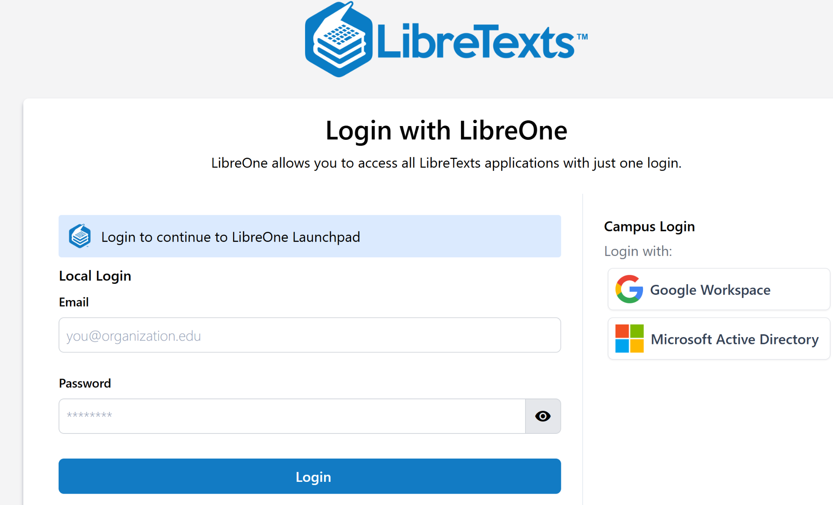
Create an account and
Login to LibreOne
https://one.libretexts.org/
Notes:
https://one.libretexts.org/

Slide 4


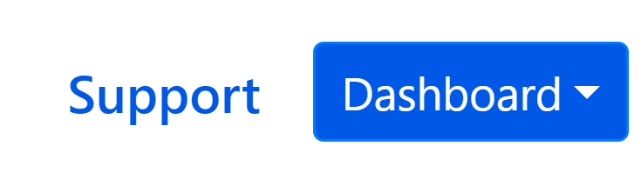
Useful Things to Remember
Click on the rocket ship icon (top left corner) to get to the Launchpad.
Go to “Consult Insight” for FAQs.
If you need help, submit a support ticket.

Slide 5
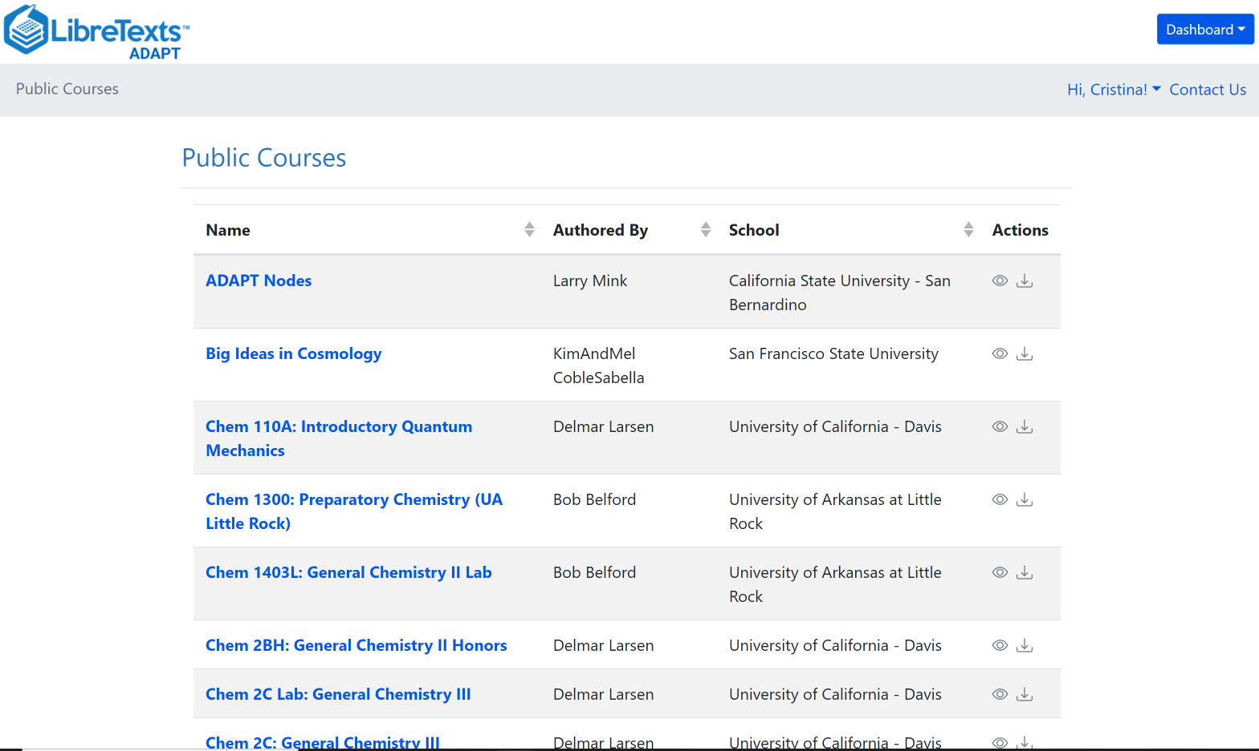
What is ADAPT?
ADAPT is a comprehensive online assessment and homework infrastructure that provides faculty the ability to include auto-graded and non-auto-graded activities from different platforms such as H5P, MyOpenMath, WeBWork, and its own native ADAPT questions.
ADAPT can be integrated into an LMS such as Canvas with full grade integration or it could be run independently.

Slide 6
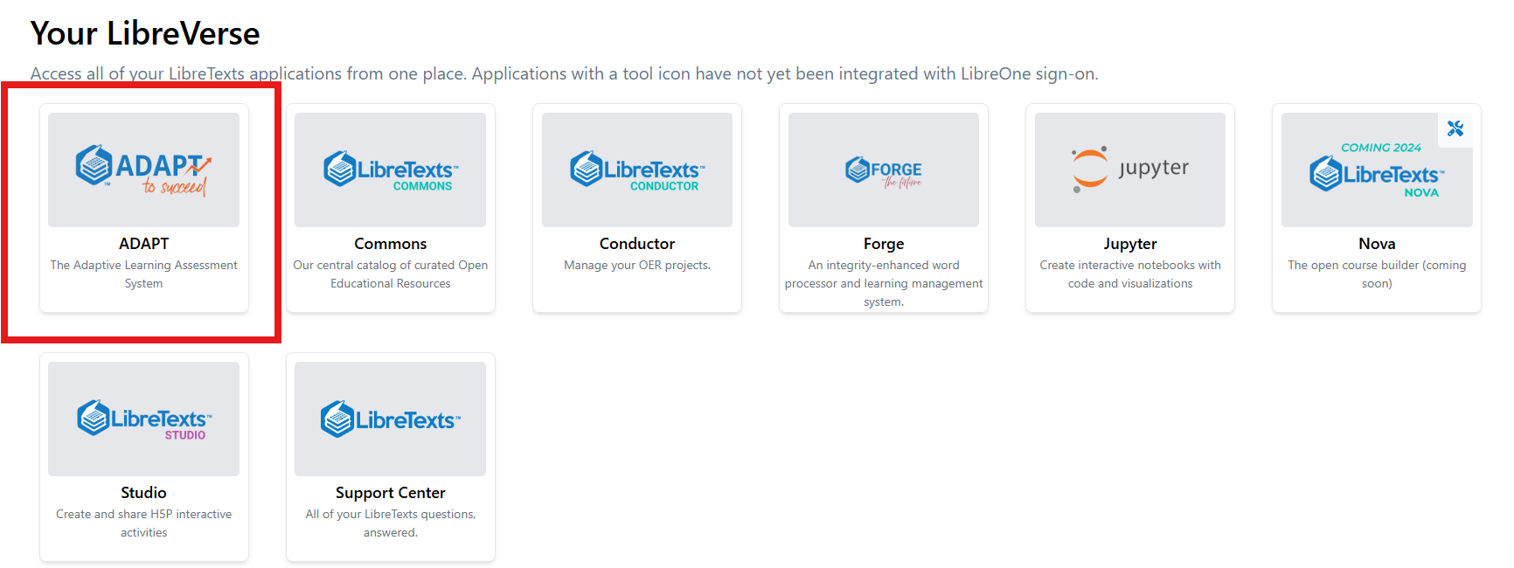
Finding ADAPT on the LaunchpadT
https://one.libretexts.org/

Slide 7
Recap:
Search for Questions, Collections, and Public Courses

Slide 8
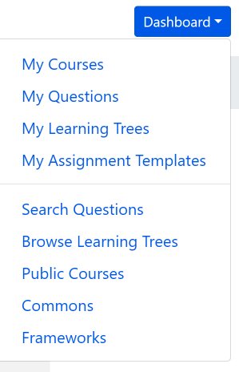
Search for ADAPT Questions, Collections, and Public Courses
Questions: Search among ADAPT questions.
Public Courses: Search among shared public courses.
Commons: Search from collections.

Slide 9
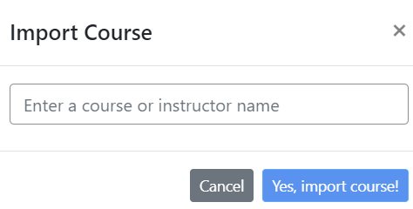
Import an existing course
You can look for public courses that other instructors have shared by going to “Public Courses”.
If you like what you see, you can import the course to your account:
Click on “Import course”
Search for course name or instructor name
Then, import.

Slide 10
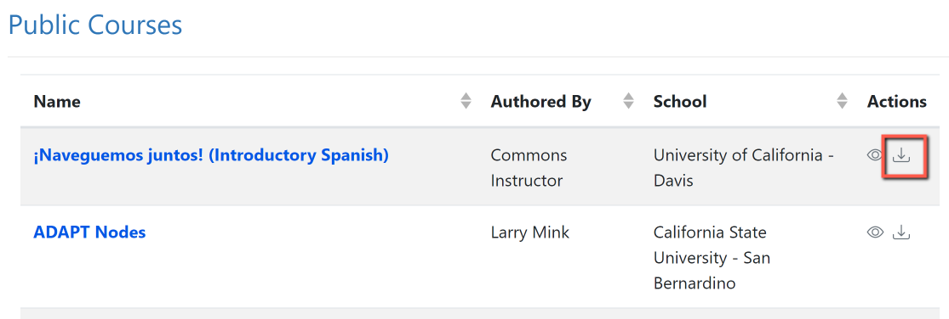
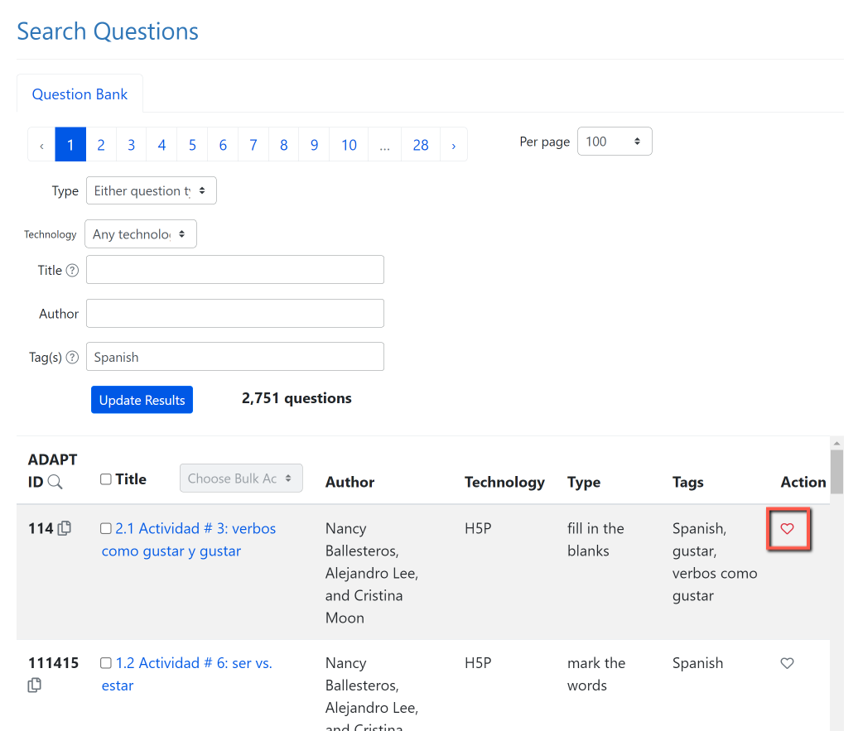
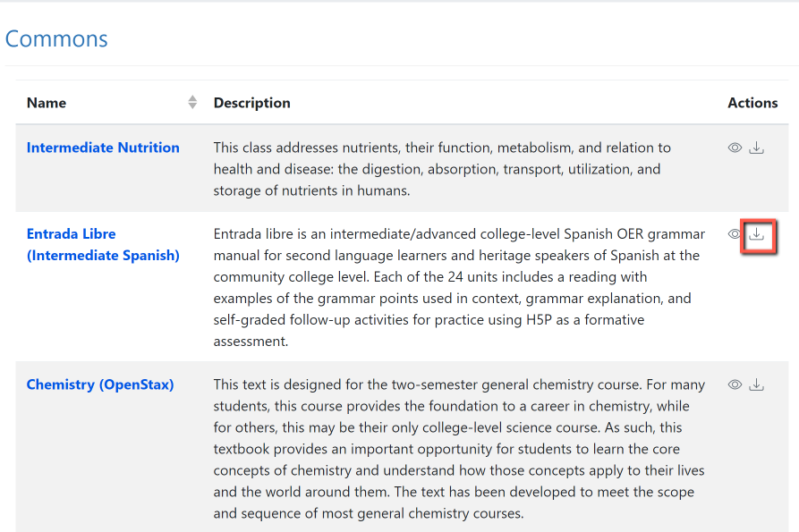
Now, You Do It …
Search and import a Public Course or a collection from Commons
2. Search for questions and save to favorites.
Notes:
12:45

Slide 11
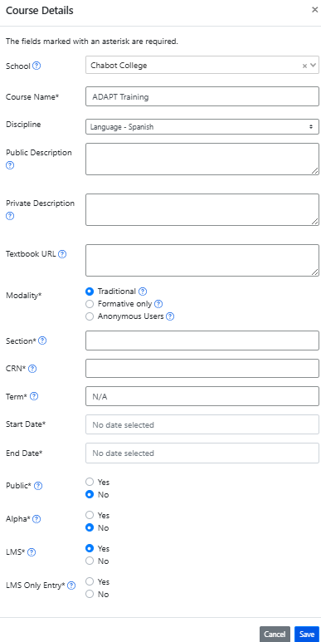
Create an ADAPT course and set the Gradebook integration with Canvas
Enter:
School
Course Name
Discipline
Section/CRN
Term
Start/end date
Public: Yes >if you want to share your course with other instructors
LMS: select “Yes” for Canvas integration. If you select yes. Then you will need to choose:
  If yes, student can only enter via Canvas.
  If no, student can enter via Canvas or directly via ADAPT.

Slide 12
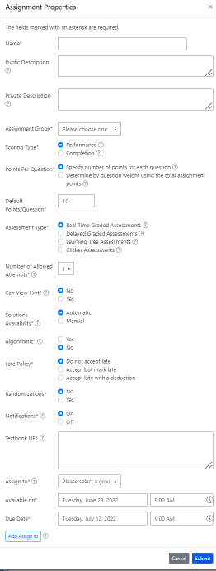
Create a New Assignment
Enter:
Name of the assignment
Assignment group
Points (default is 10)
Assessment type
# of allowed attempts
Late policy
Assign to
Available on
Due date

Slide 13
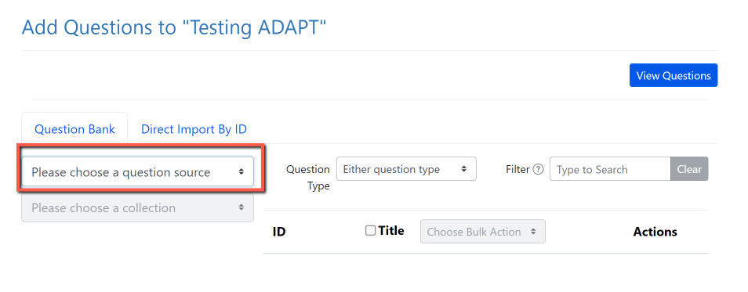
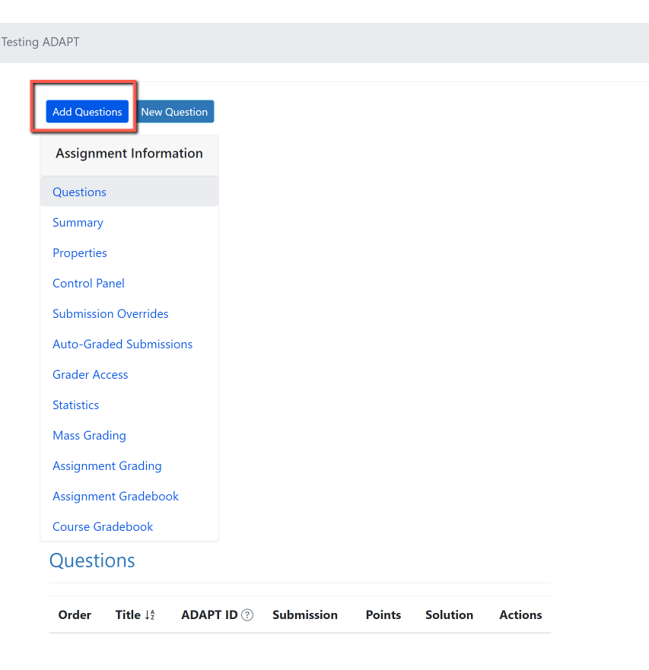
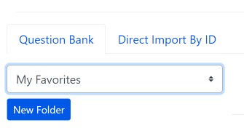
Add Questions
Step 2: Click on “Please choose a question source”
Step 1: Add Questions
Step 3: Go to “My Favorites” and find the question you saved on activity # 1.
Notes:
12:55

Slide 14
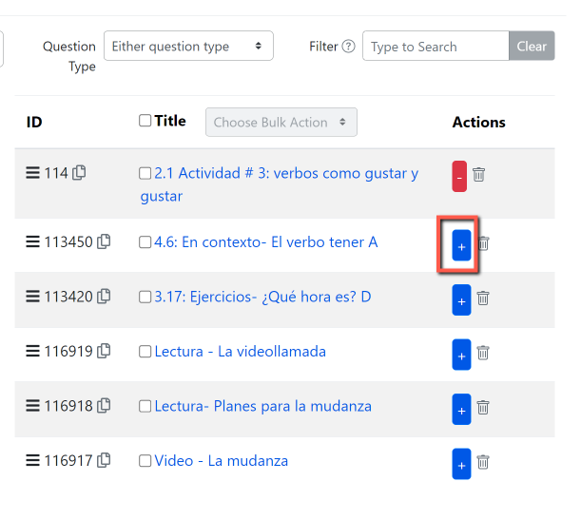
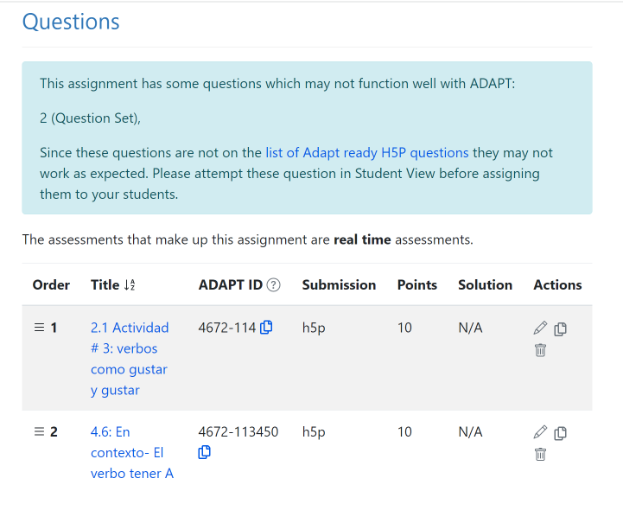
Step 4: Click on the + sign to add the activity to the assignment.

Slide 15
Random Sampling
(aka question bank)

Slide 16
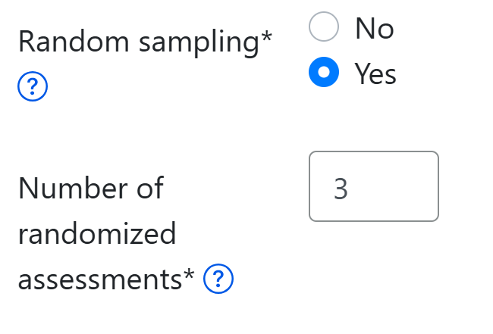
Random Sampling
If you want students to get randomized questions, under the assignment properties you can select “Random sampling”.
Then, you can choose the number of randomized questions.

Slide 17
Linking Canvas to ADAPT

Slide 18
California Community Colleges
Without ADAPT LTI/API
(as of 6/18/25)
Butte
Cerritos
College of the Redwoods
College of the Sequoias
College of the Siskiyous
Columbia
Copper Mountain
El Camino
Gavilan College
Grossmont
Hartnell College
Lassen College
Long Beach
Merced (IA)
Mission
Monterey Peninsula
Moorpark
North Orange Continuing Education
Oxnard
Palo Verde
Palomar
Porterville College
Saddleback College
Santa Ana
Santa Barbara City College
Santiago Canyon
Taft
88 CCCs already have the ADAPT LTI/API

Slide 19
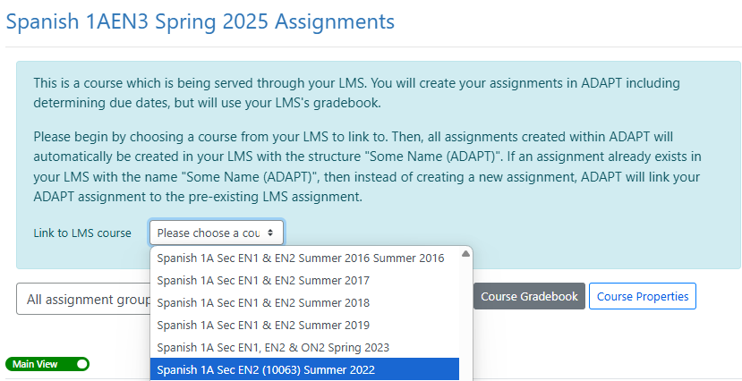
Linking Canvas Course to ADAPT Course via LTI/API
The API link to Canvas will automatically create individual Canvas assignments and gradebook entries.
Notes:
More info on API: https://docs.google.com/document/d/1ItwdvFXi6fqy-OilptSjTaxGZ7LeCPEZMDQtYElBsQg/edit?tab=t.0#heading=h.1f9oybosc2xn

Slide 20
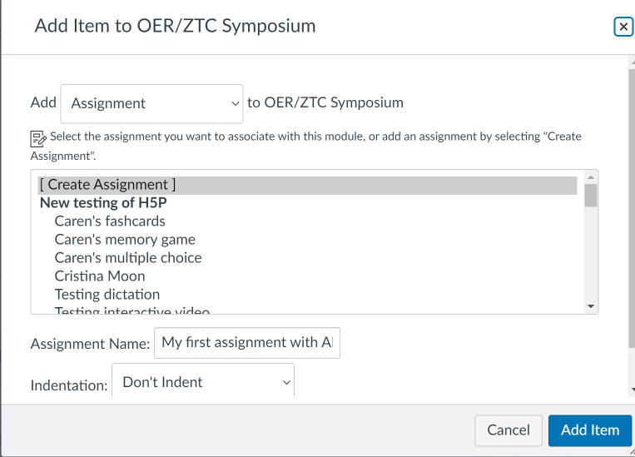
How to link ADAPT in Canvas via LTI
Create an assignment in Canvas
Notes:
1:25

Slide 21
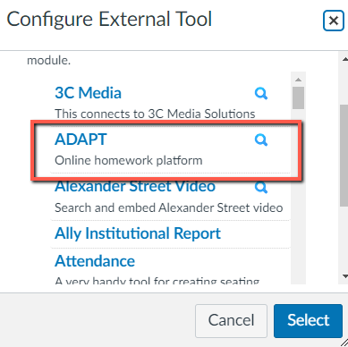
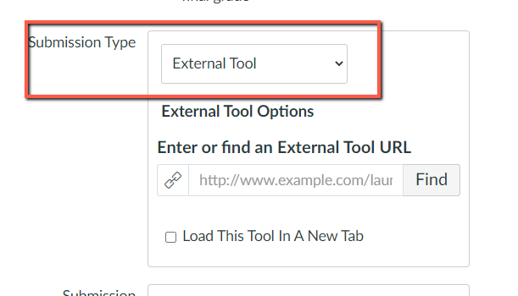
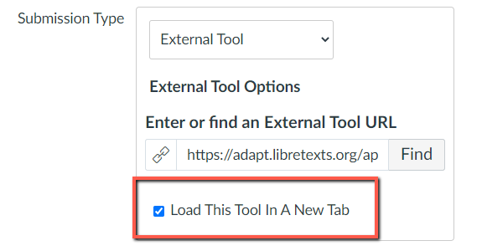
Select ADAPT in External Tool

Slide 22
Bonus: Learning Trees

Slide 23
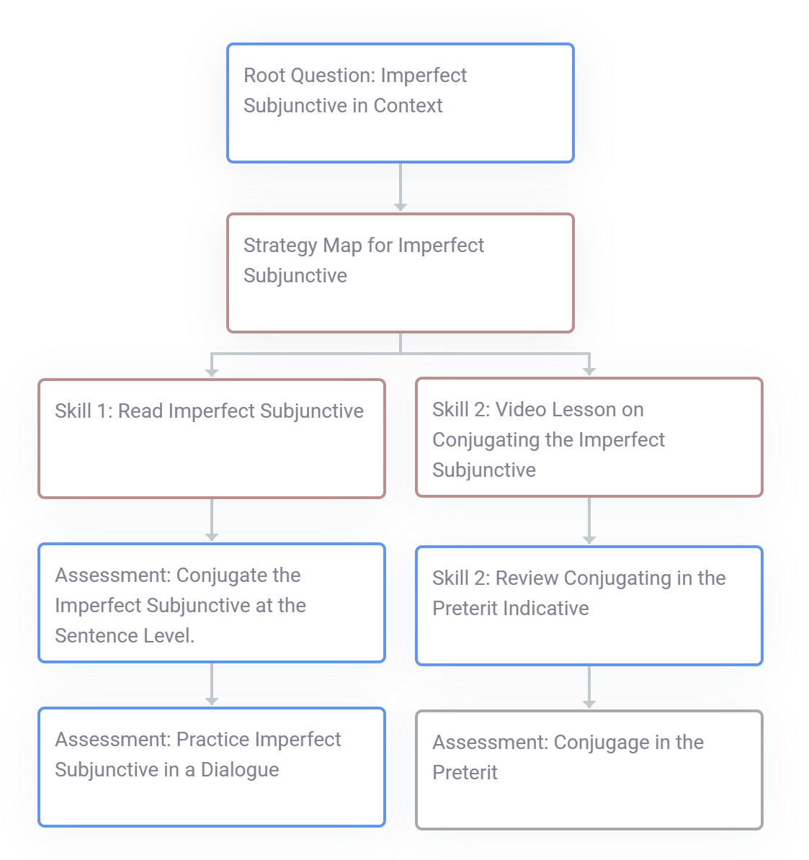
Learning Trees
Helps personalize learning based on student needs
Visual, tree-like structure that guides student learning
Starts with one main question (the root)
If answered incorrectly, student is directed to a review path (a branch)
Branches can include videos, notes, or more questions to support learning
Students can retry the main question after reviewing

Slide 24
Looking for more Resources?

Slide 25

LibreFest 2025
July 7-11
This virtual workshop will provide four and a half days of teaching and working sessions covering:
how to create Open Education Resources (OER);
how to edit/modify existing OER to build textbooks and other learning resources;
how to use our Conductor project management platform with our new Workbench;
and our ADAPT open homework and assessment system.
We will also hear Success Stories from LibreTexts super users each day.
If you do not already have a LibreTexts account, you will be prompted to create one during the LibreFest Registration process.

Slide 26
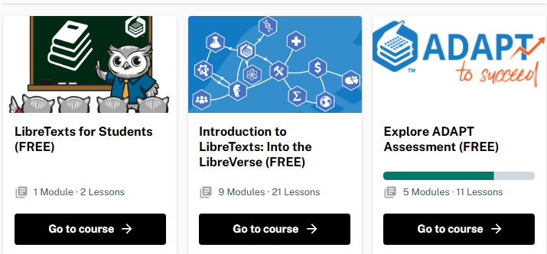
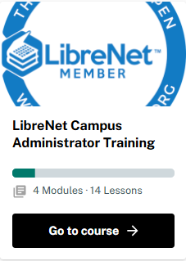
LibreTexts Training
General Introduction to ADAPT
Visit the LibreTexts Academy for more professional development services.
  Free PD courses

Slide 27
ADAPT Resources
Accessibility reports
ADAPT construction guide
Canvas LTI for ADAPT instructions
LibreTexts (https://libretexts.org)
LibreTexts weekly office hours in Zoom:
Tuesdays at 9:00-10:00 PST
Thursdays at 9:00-10:00 PST

Slide 28
LibreTexts Workshop Recordings
ASCCC OERI Webinars
Title | Date | Tags
Boost Engagement with Discuss-It: Interactive Asynchronous Conversations in ADAPT | November 15, 2024 | ADAPT, Discipline Webinar, Spanish
ADAPT Level 4 – Creating and Using Question Banks in ADAPT | July 22, 2024 | ADAPT, ADAPT Series, Canvas
ADAPT Level 3 – Using ADAPT in Canvas | July 15, 2024 | ADAPT, ADAPT Series, Canvas
ADAPT Level 2 – Creating in ADAPT | June 21, 2024 | ADAPT, ADAPT Series
ADAPT Level 1 – Accessing ADAPT and Finding Existing Assessments | June 14, 2024 | ADAPT, ADAPT Series
Spanish Open Educational Resources (OER) Homework Hackathon 2: Let’s have fun with ADAPT | May 10, 2024 | ADAPT, Discipline Webinar, LibreTexts ADAPT, Spanish
Notes:
Academic Senate for California Community Colleges (ASCCC); Open Educational Resources Initiative (OERI)

Slide 29

Thanks!
Photo by Thgusstavo Santana from Pexels

