Slide 1
ADAPT Level 3
Fostering Oral Interaction with ADAPT’s Discuss-It Question Type
June 30, 2025
This work is licensed under a Creative Commons Attribution 4.0 International License. Attribute this slide deck as: “ADAPT Training Part 3 by ASCCC OERI is licensed under CC BY 4.0.

Slide 2
Why do we require discussions in online learning?

Slide 3
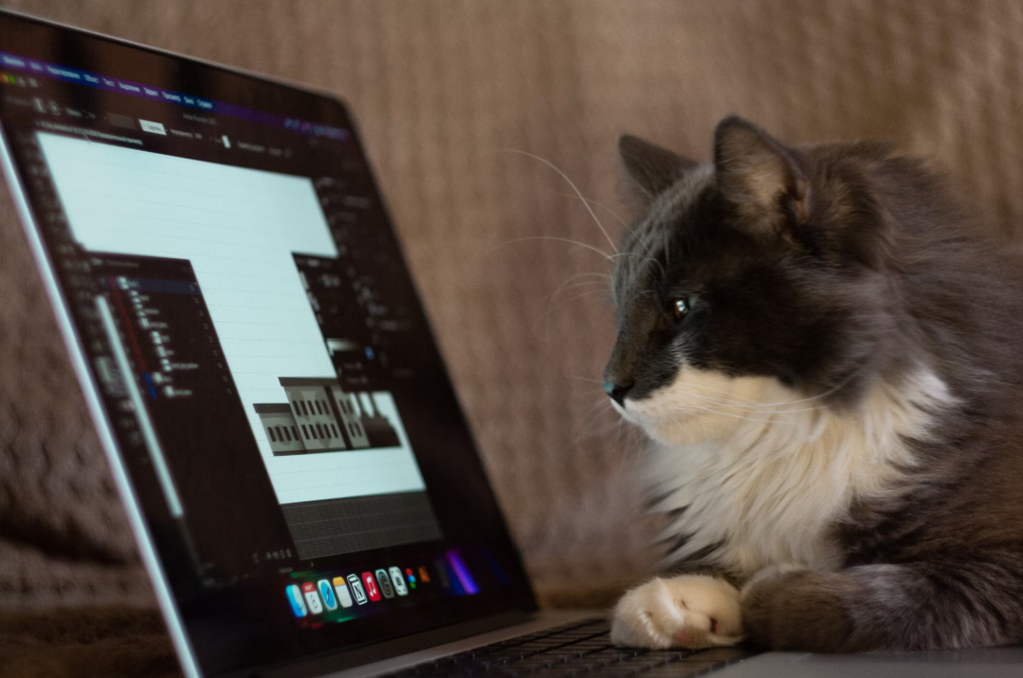
Why Discussions Matter in
Online Learning
Build community and social presence
Promote critical thinking and reflection
Provide opportunities for diverse perspectives
Support equitable participation in learning
BUT - are there challenges to using online discussions?
Photo by Anton Kraev on Unsplash

Slide 4
Challenges of Online
Asynchronous Discussions
One-dimensional (text-only) responses can limit expression
Low engagement: students often reply only to fulfill a requirement
Superficial responses or lack of true peer interaction
Increased use of AI tools (e.g., ChatGPT) for responses
Are there alternatives?

Slide 5
Have you heard of and/or used
these platforms?
VoiceThread
Flip or Flipgrid
Padlet
Extempore
Canvas Discussions with Studio
Notes:
New study on Voicethread: https://voicethread.cmail19.com/t/y-l-qqbud-ihjrkuful-y/
Article: “Assessing Replacements for Flip for Student Speaking”https://fltmag.com/replacements-for-flip/

Slide 6
Video Discussions
Why?
Why not?

Slide 7
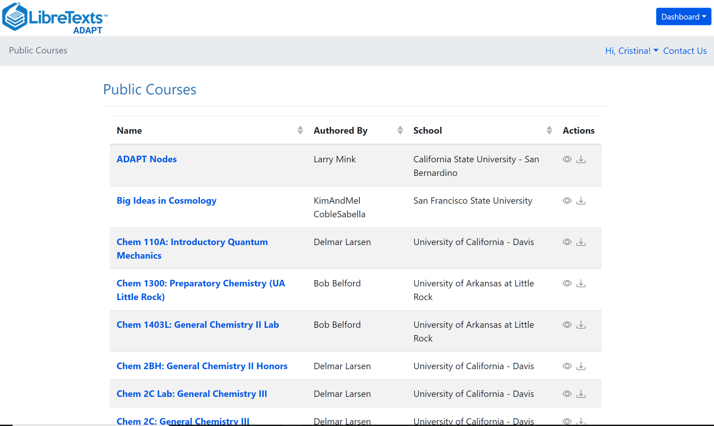
What is ADAPT?
ADAPT is a comprehensive online assessment and homework infrastructure that provides faculty the ability to include auto-graded and non-auto-graded activities from different platforms such as H5P, MyOpenMath, WeBWork, and its own native ADAPT questions.
ADAPT can be integrated into an LMS such as Canvas with full grade integration or it could be run independently.
Notes:
Given that this is the 3rd in a series, this feels a little odd - no?

Slide 8
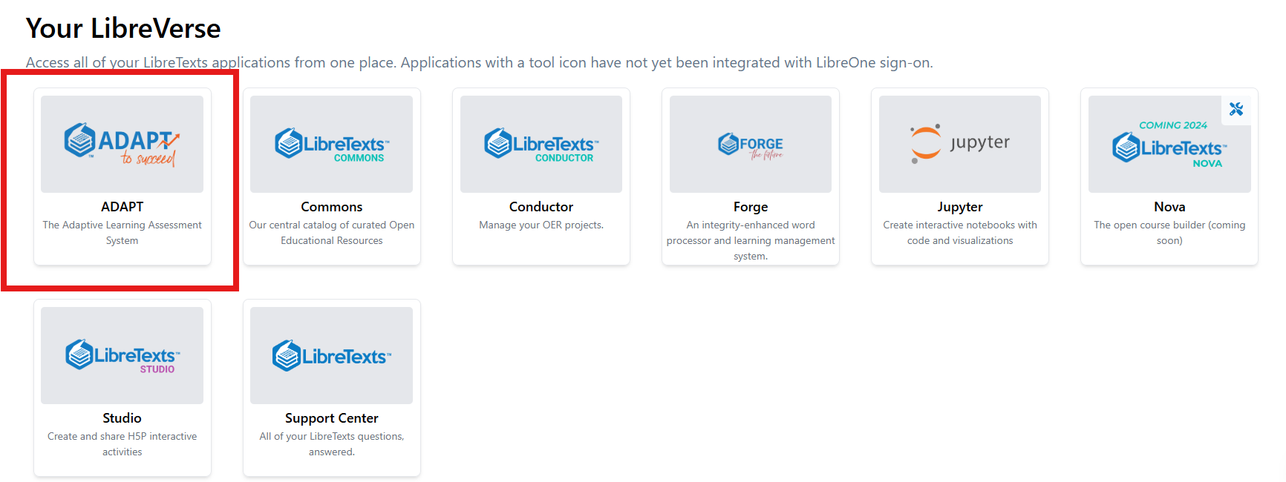
Finding ADAPT on the LaunchpadT
https://one.libretexts.org/

Slide 9
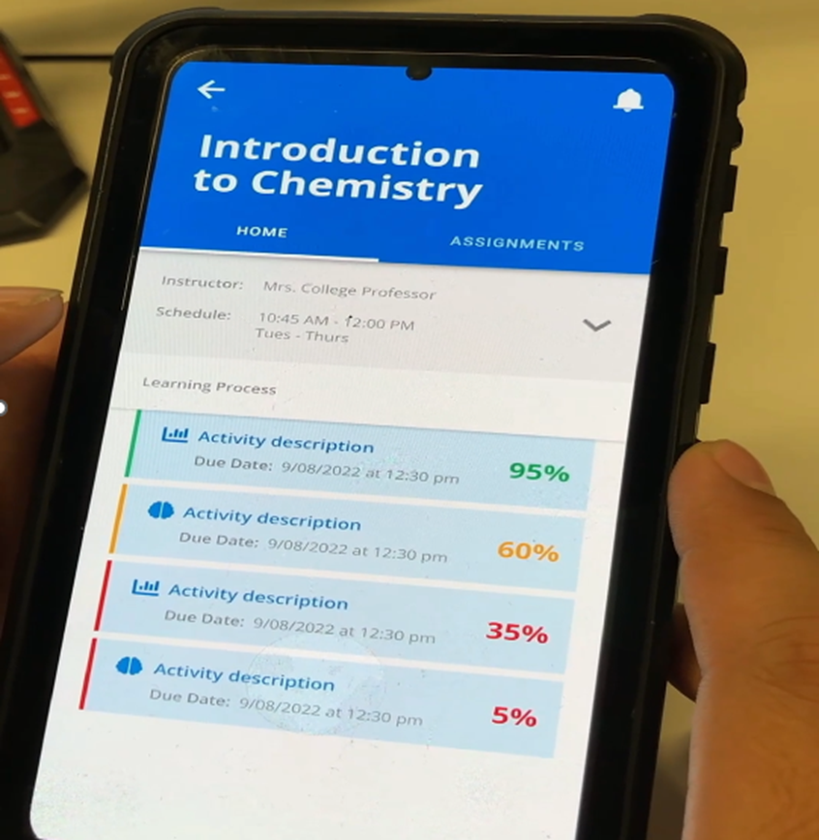
Anywhere and Anytime
User ADAPT as a handheld homework interface for easy access to homework.
Use ADAPT as a Personal Response Systems: This enables instructors to pose questions to students and immediately collect and view the responses of the entire class.
Useful for labs and collaborative projects (e.g., easy submission of pictures of collective or individual work)

Slide 10
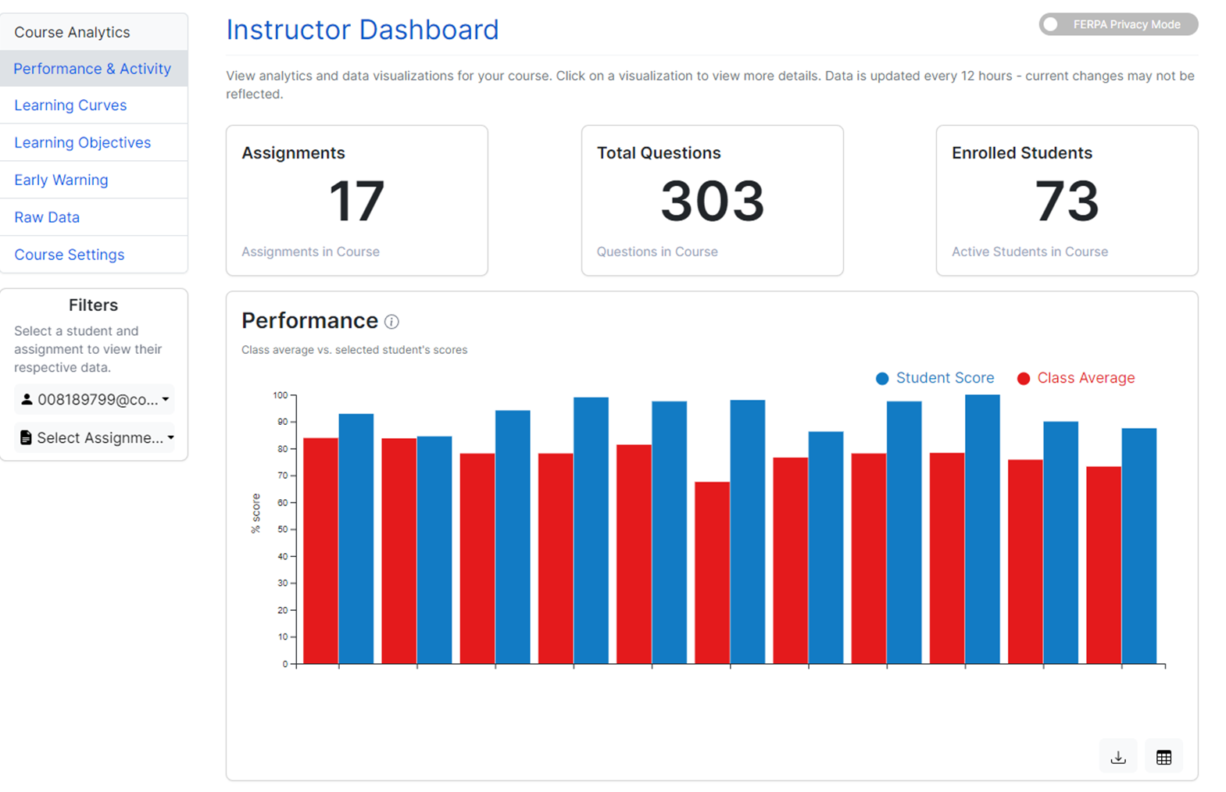
Learning Analytics

Slide 11
Discuss-It in ADAPT
It’s the newest native question type in LibreTexts’ ADAPT homework platform.
Fosters dynamic student-to-student regular and substantive interaction.
Boosts student engagement by enabling threaded text, audio, and video responses for meaningful interaction.
With auto-captioning and auto-transcription functions, the platform ensures accessibility for all learners.
Offers seamless LTI/API integration with Canvas, allowing for effortless course integration and automatic gradebook syncing.
New: Rubric for grading

Slide 12
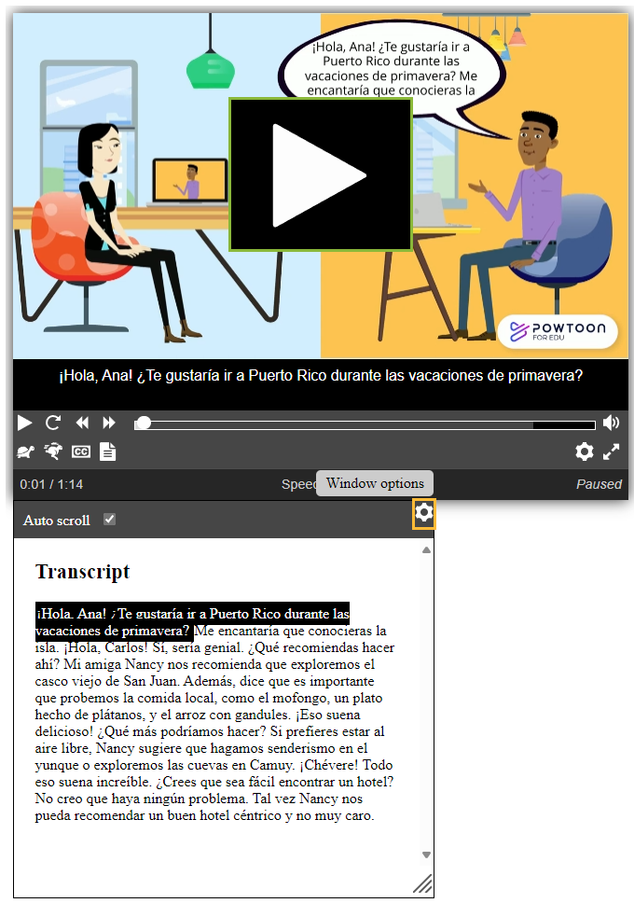
Auto-Captions and Auto-Transcript
All media recorded into ADAPT is automatically captioned and transcribed with very high fidelity rates.
Currently available for many languages (Arabic, Bengali, English, French, German, Hindi, Italian, Japanese, Mandarin, Portuguese, Punjabi, Russian, Spanish) and expanding.

Slide 13
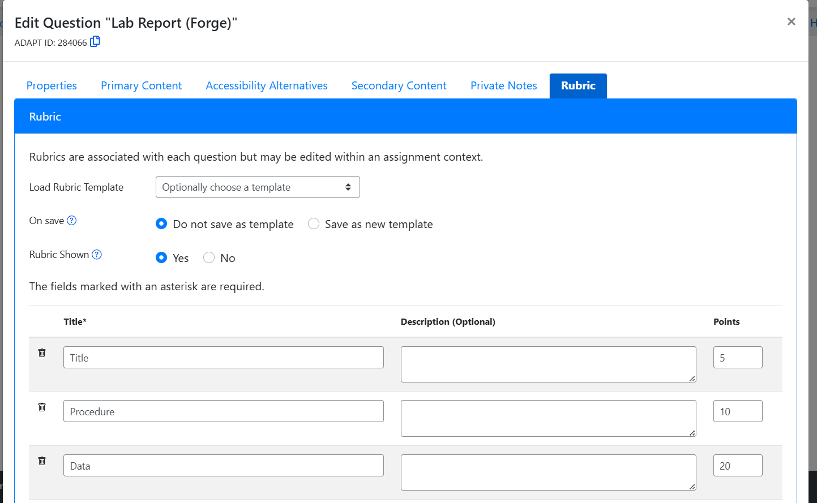
New: Grading with a Rubric
Rubric can be connected to the question (“Question Rubric”) or to assignment (“Assignment Rubric”) that overrides Question Rubric
See question #284066

Slide 14
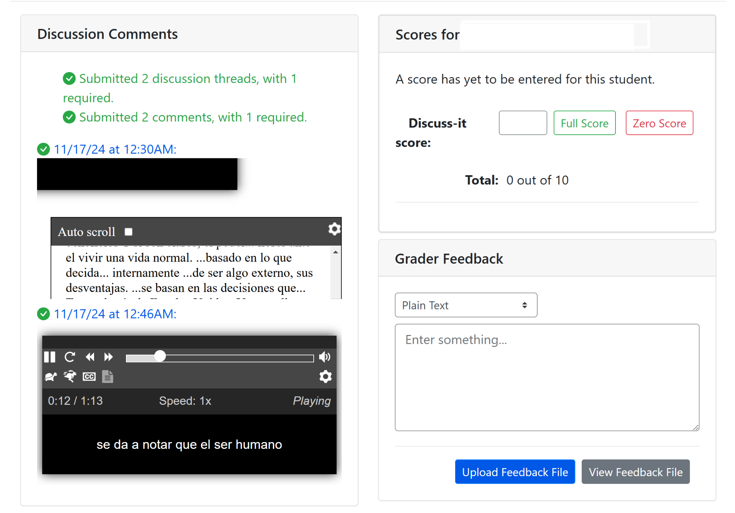
Easy Grading Discuss-It Questions

Slide 15
Bonus: As ADAPT resources are openly licensed, you can clone and edit activities
Once you clone an activity, you will be able to edit

Slide 16
Looking for a more powerful
OER Option?
Discuss-It Demo Site
Notes:
https://adapt.libretexts.org/students/assignments/94618/init-formative

Slide 17
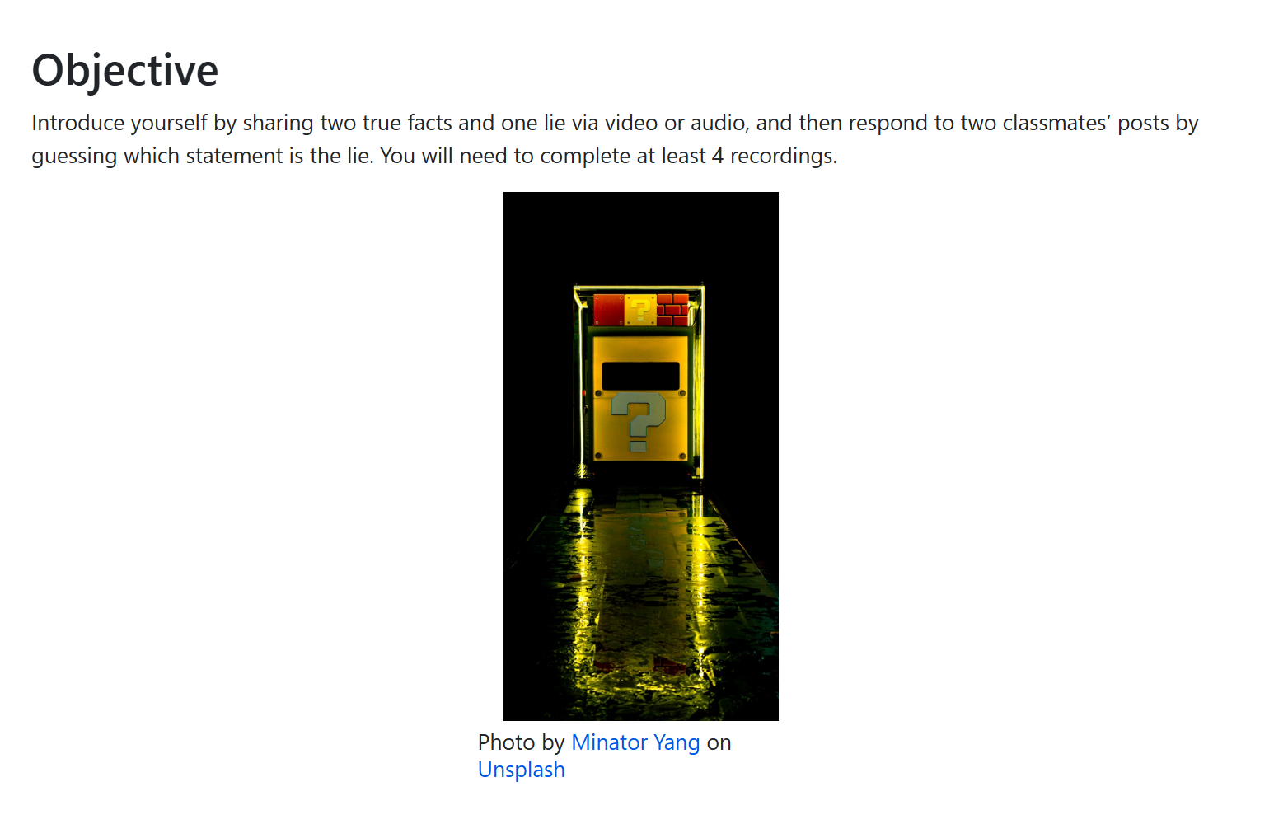
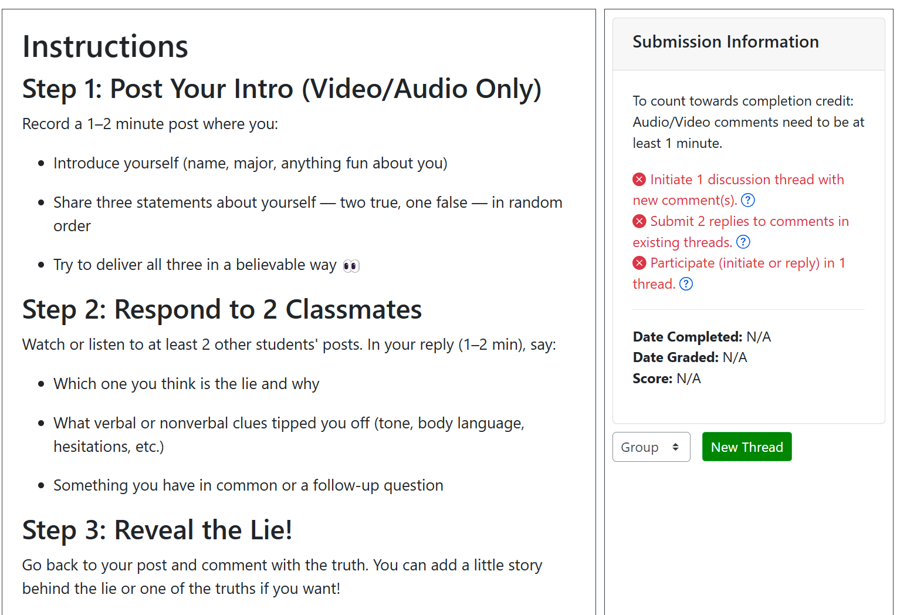
Icebreaker Activity Example 1:
Two Truths and One Lie

Slide 18
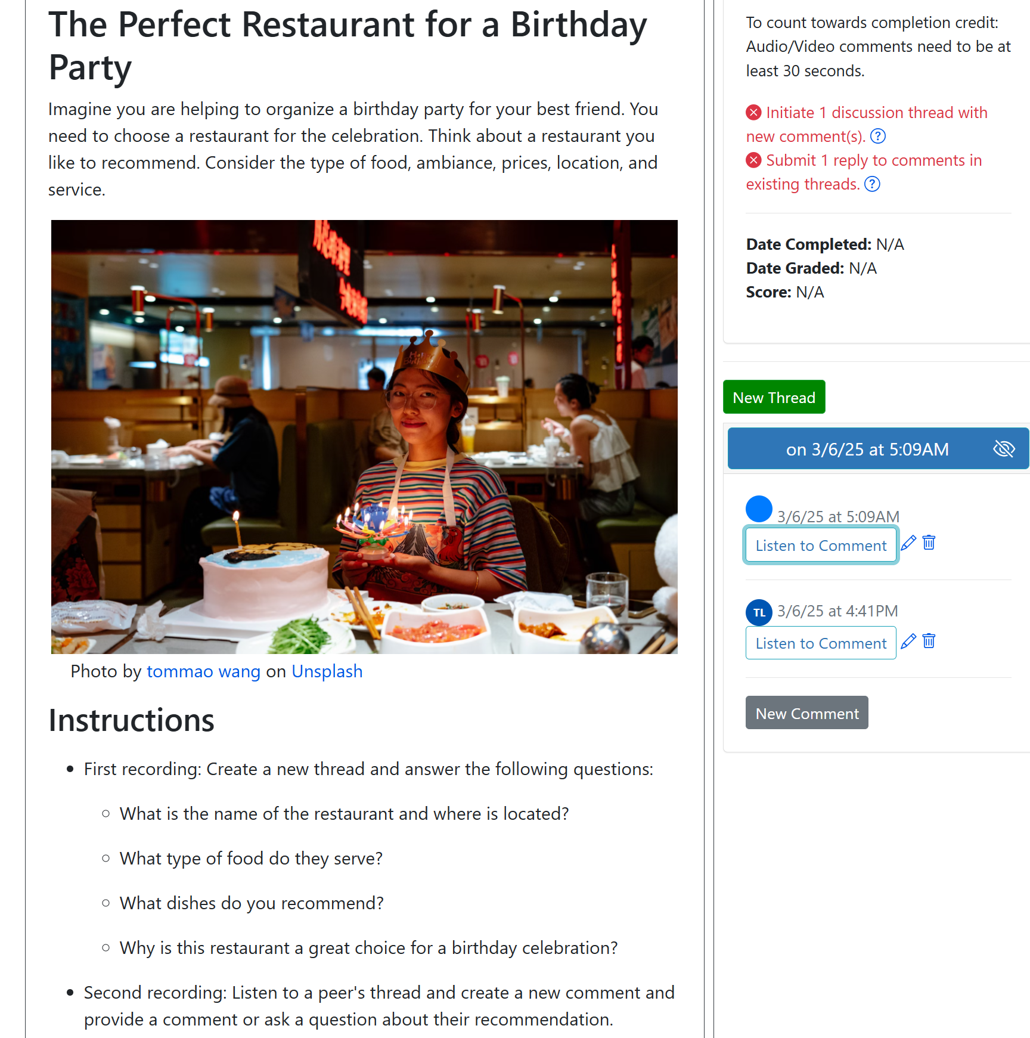
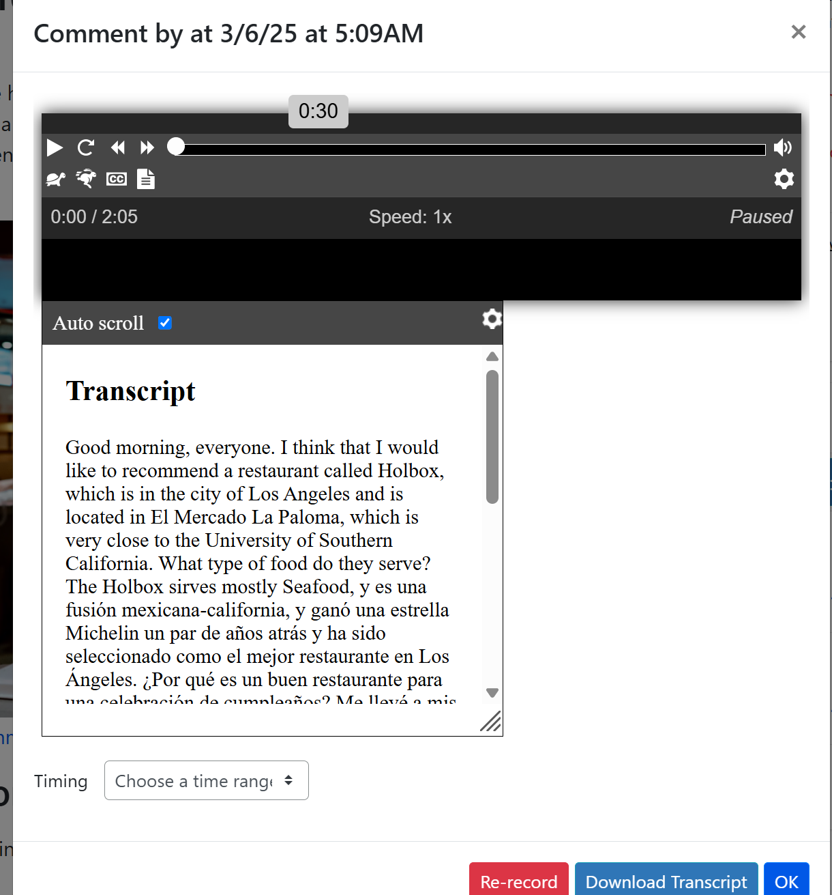
Icebreaker Activity Example 2:
The Perfect Restaurant

Slide 19
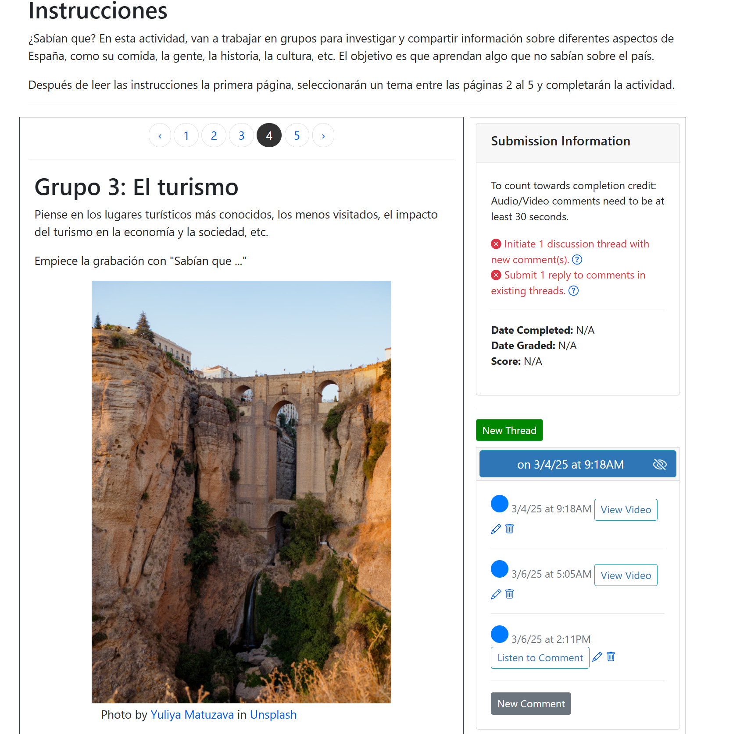
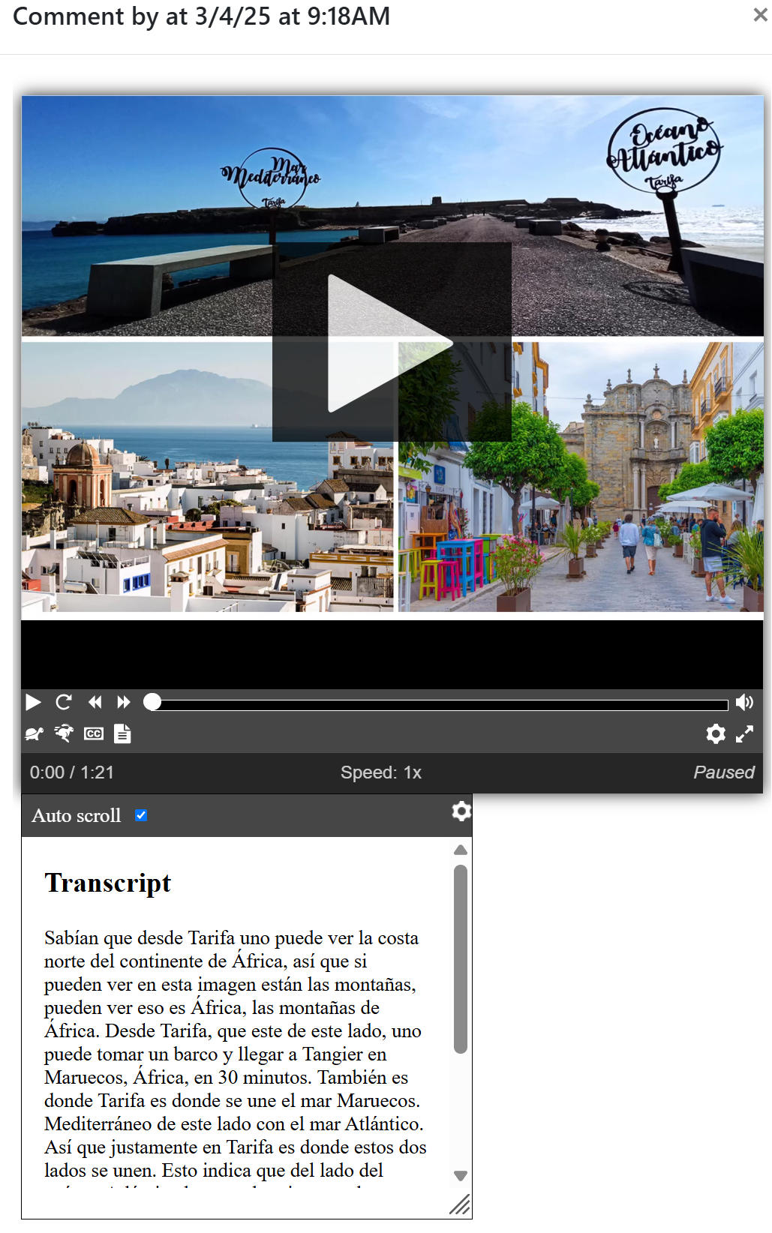
Spanish Example 1:
Did you know?
Fostering Collaborative Work

Slide 20
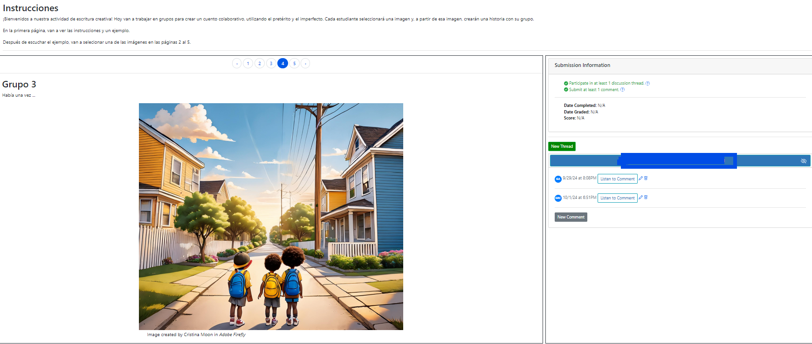
Spanish Example 2:
Chain Story
Students choose an image to narrate a story started by a peer.

Slide 21
Creating a Discuss-It Question

Slide 22
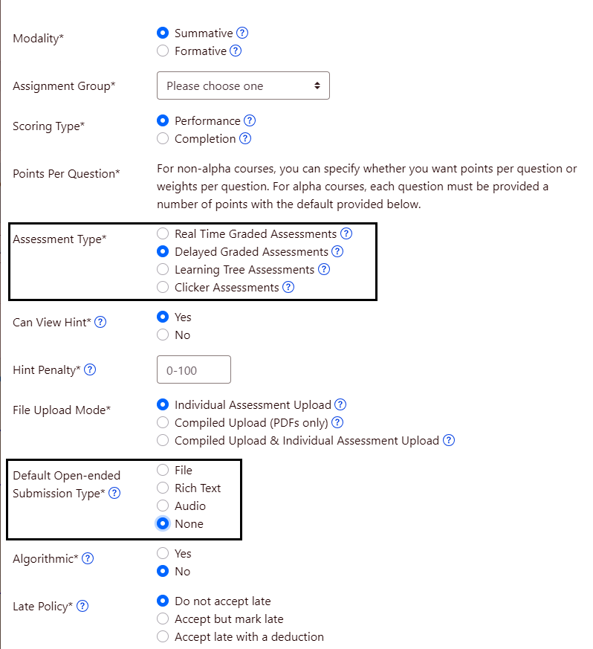
Step 1:
Create an assignment in ADAPT
Create a New Assignment
Under Assessment Type make sure to check “Delayed Graded Assessments”
For Submission type mark “None”

Slide 23
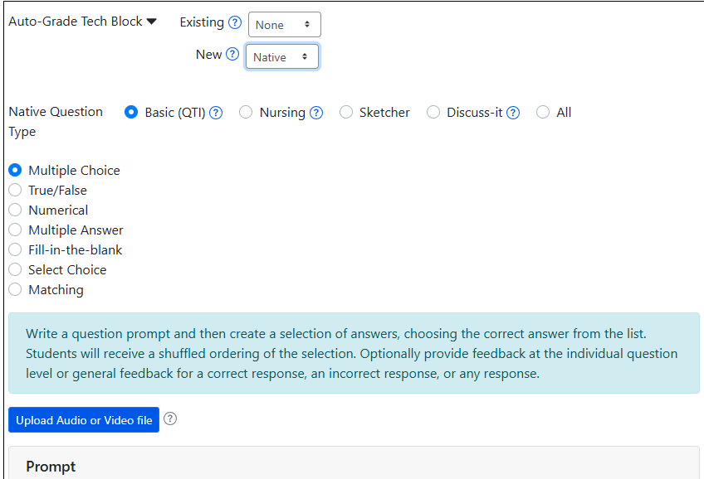
Step 2:
Select Discuss-It Question
Add a New Question in the assignment
In the Auto-Grade Tech Block, in the New drop-down select “Native”
Select the Discuss-It native question type

Slide 24
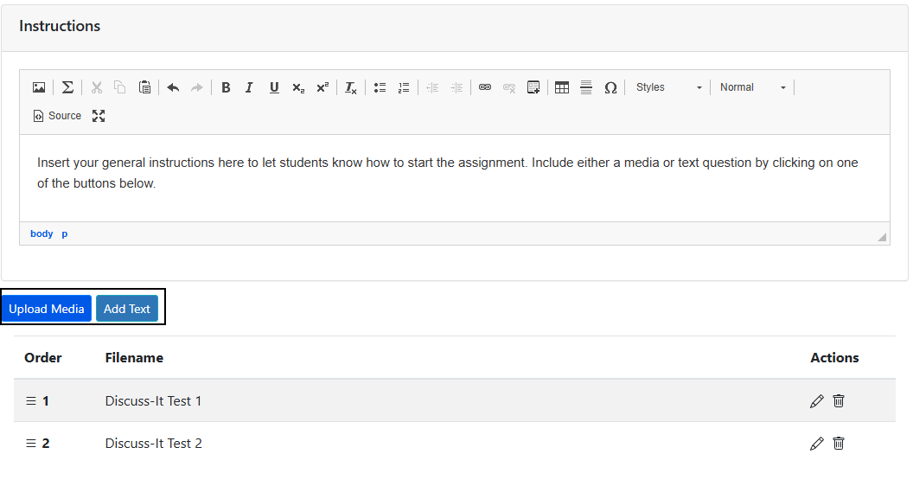
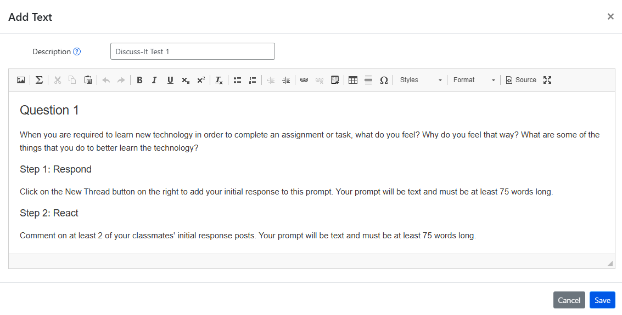
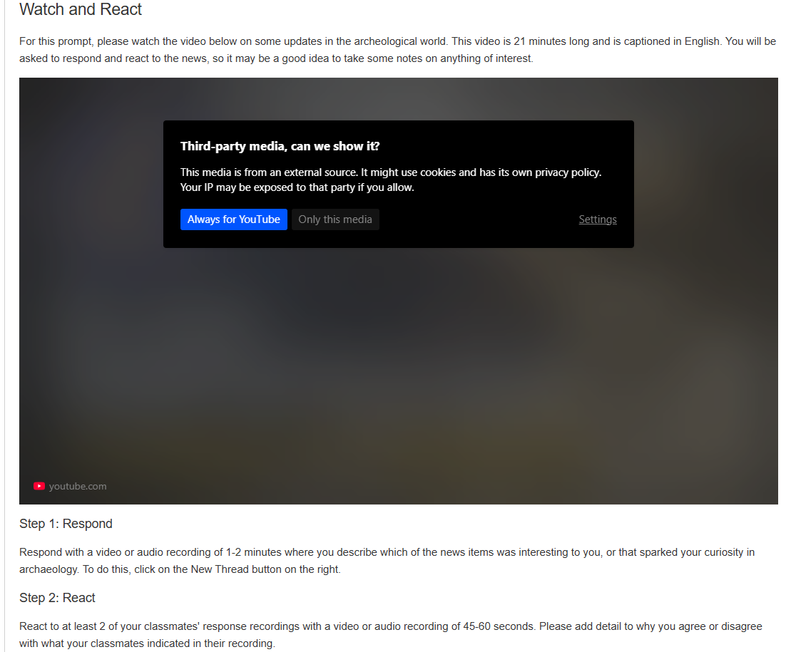
Step 3:
Add instructions and Content
In the Instructions box, add whatever information you want students to know to start working on it.
Add either a text or media prompt

Slide 25
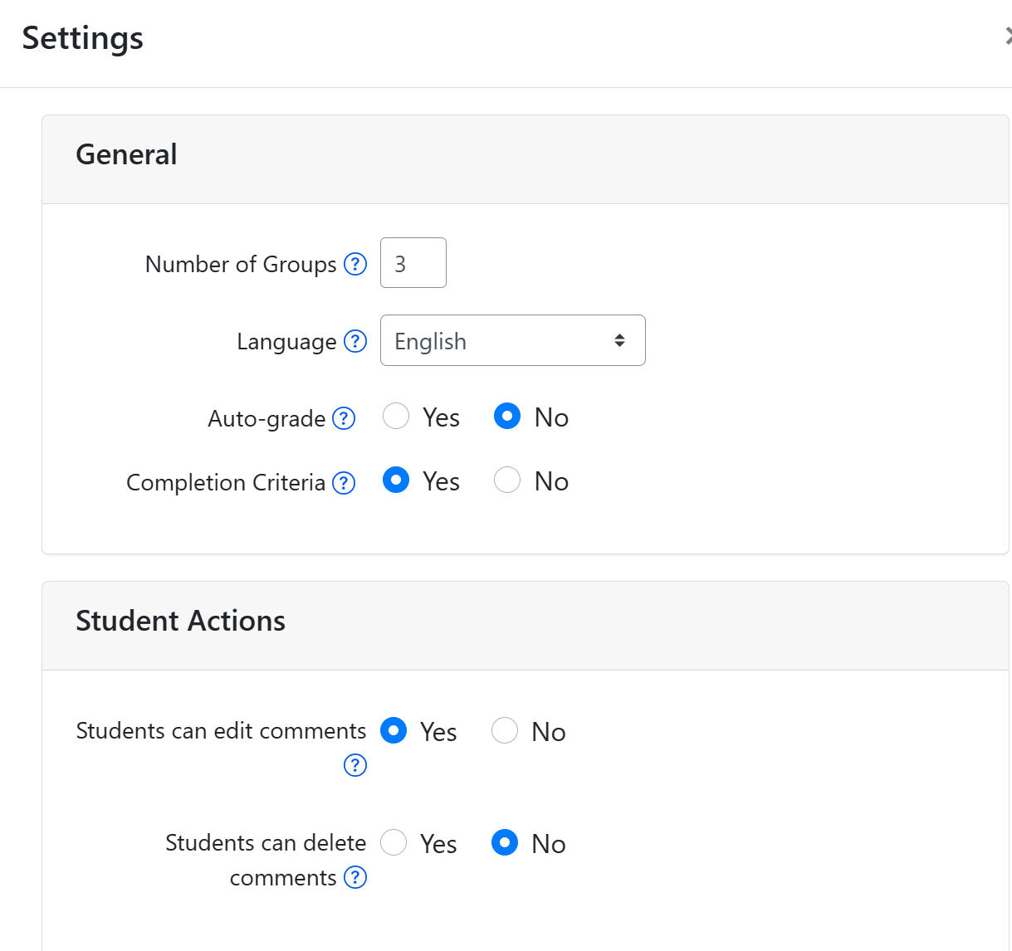
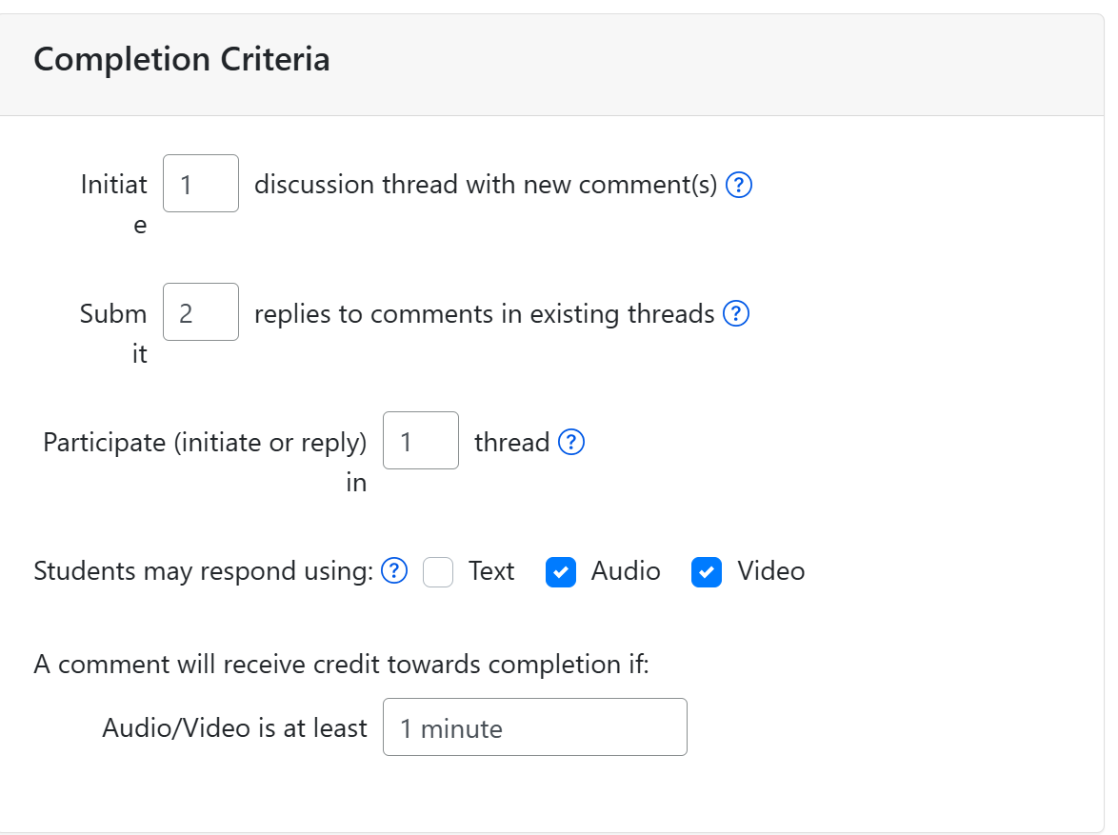
Step 4:
Select Settings in the assignment

Slide 26
Adding a rubric
Rubric can be connected to the question (“Question Rubric”) or to assignment (“Assignment Rubric”) that overrides Question Rubric
See question #284066

Slide 27
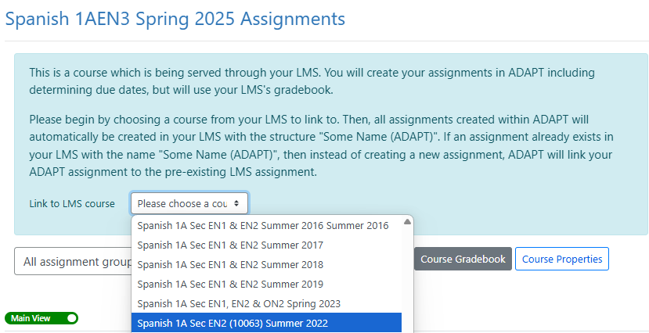
Linking Canvas Course to ADAPT Course via LTI/API
The API link to Canvas will automatically create individual Canvas assignments and gradebook entries.
Notes:
More info on API: https://docs.google.com/document/d/1ItwdvFXi6fqy-OilptSjTaxGZ7LeCPEZMDQtYElBsQg/edit?tab=t.0#heading=h.1f9oybosc2xn

Slide 28
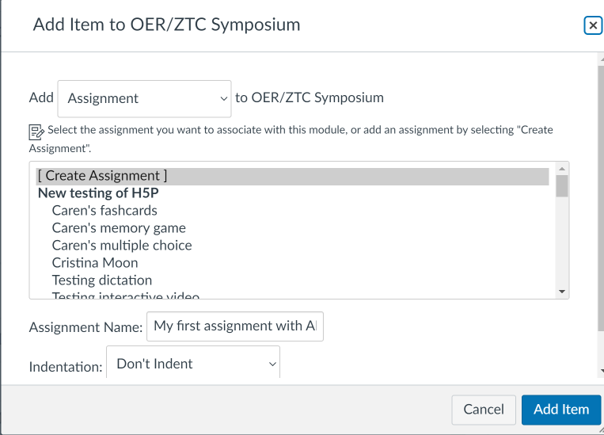
How to link ADAPT in Canvas via LTI
Create an assignment in Canvas
Notes:
1:25

Slide 29
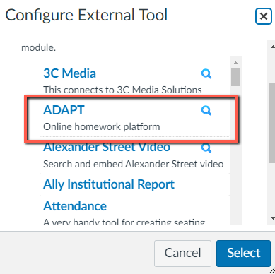
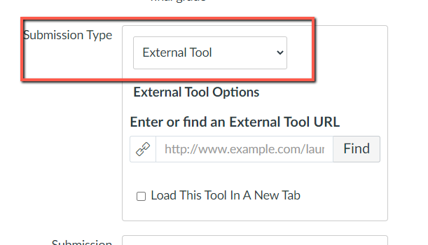
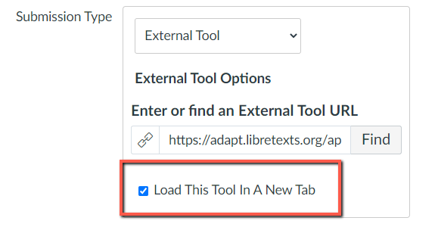
Select ADAPT in External Tool

Slide 30
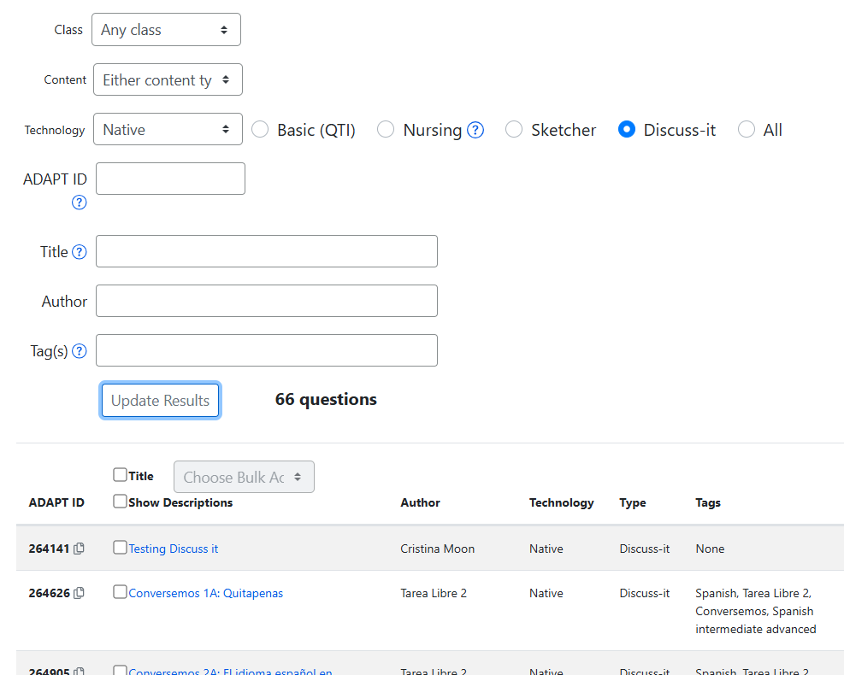
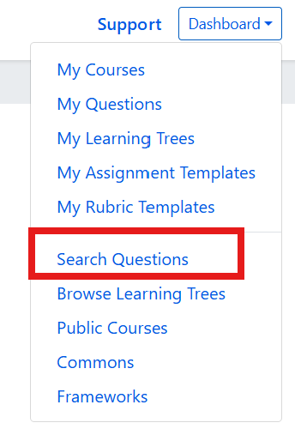
How to find Discuss-It questions
If you are looking for examples, you can search questions and select Discuss-It.

Slide 31
Looking for more Resources?

Slide 32
OERI Summer Webinars
ADAPT Level 4 – Question Banks and ADAPT Canvas Integration Monday, July 7, 2025 from 3:00 pm – 4:30 pm
In this webinar, you’ll learn how to organize your activities into question banks for randomized assessments and explore how to seamlessly integrate your ADAPT content into Canvas with automatic grade syncing. All attendees will need to register for a free LibreOne instructor account to fully participate in these webinars.
Register for ADAPT Level 4

Slide 33
LibreFest 2025
July 7-11
This virtual workshop will provide four and a half days of teaching and working sessions covering:
how to create Open Education Resources (OER);
how to edit/modify existing OER to build textbooks and other learning resources;
how to use our Conductor project management platform with our new Workbench;
and our ADAPT open homework and assessment system.
We will also hear Success Stories from LibreTexts super users each day.
If you do not already have a LibreTexts account, you will be prompted to create one during the LibreFest Registration process.

Slide 34
LibreTexts Training
Visit the LibreTexts Academy for more professional development services.
General Introduction to ADAPT

Slide 35
LibreTexts Workshop Recordings
ASCCC OERI Webinars
Webinar Title | Date | Tags
ADAPT Level 2 – Creating in ADAPT | June 20, 2025 | ADAPT, ADAPT Series, Homework Systems, LibreOne, LibreTexts ADAPT
ADAPT Level 1 – Accessing ADAPT and Finding Existing Assessments | June 13, 2025 | ADAPT, LibreTexts, LibreTexts ADAPT
LibreTexts’ ADAPT Homework Platform and the new Discuss-It | April 16, 2025 | ADAPT, Canvas, Discipline Webinar, Discuss-It, LibreTexts, LibreTexts ADAPT
Addressing the Homework Needs of Economics: Adaptive Homework Assignments and Graphing Technology | March 18, 2025 | Discipline Webinar, Economics, Homework Systems
Collaborating for Computer Science Success: Adopting/Adapting a Shared Open Educational Resource (OER) Canvas Course Shell | December 5, 2024 | Computer Science, Discipline Conversation, Information Technology and Information Systems
Boost Engagement with Discuss-It: Interactive Asynchronous Conversations in ADAPT | November 15, 2024 | ADAPT, Discipline Webinar, Spanish
ADAPT Level 4 – Creating and Using Question Banks in ADAPT | July 22, 2024 | ADAPT, ADAPT Series, Canvas
Notes:
Academic Senate for California Community Colleges (ASCCC); Open Educational Resources Initiative (OERI)

Slide 36
More Information
ASCCC OERI Website (asccc-oeri.org)
Resources
Webinars and Events
LibreTexts (https://libretexts.org)

Slide 37
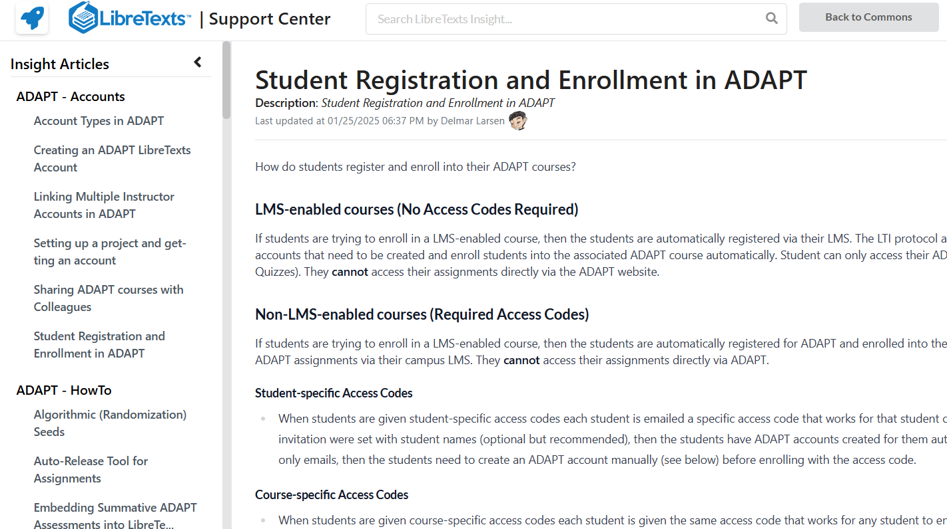
Assistance: The Insight Knowledge Base
https://commons.libretexts.org/insight
Notes:
https://commons.libretexts.org/insight

Slide 38
Questions?
Cristina Moon
Spanish Faculty
OER/ZTC Coordinator at Chabot College
ASCCC OERI Spanish Lead, H5P/ADAPT Lead, and OERI Liaison
cmoon@chabotcollege.edu

Slide 39
Thanks!
Photo by Thgusstavo Santana from Pexels

Slide 40
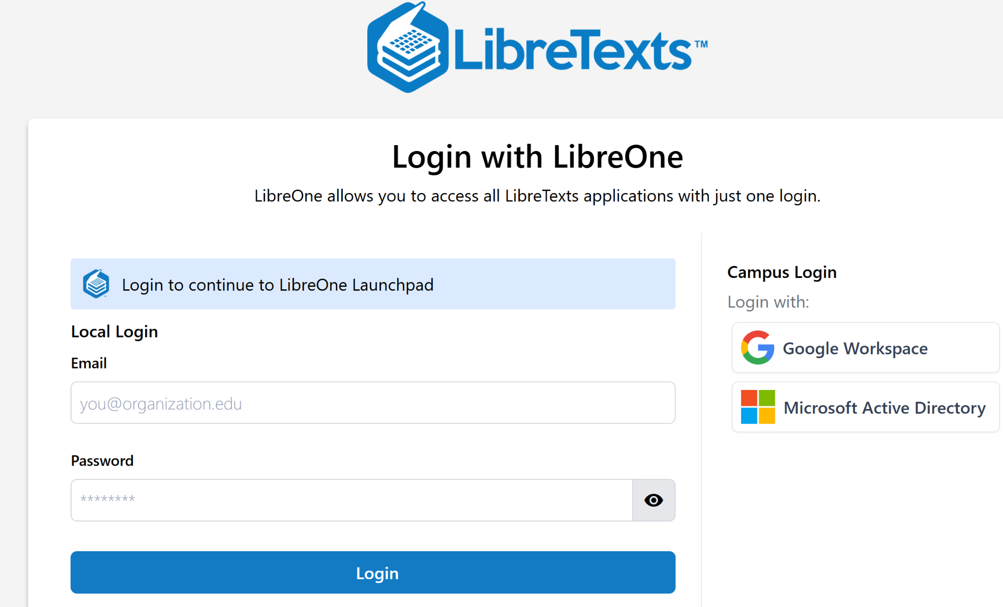
Create an account and
Login to LibreOne
https://one.libretexts.org/
Notes:
https://one.libretexts.org/

