Slide 1
AI At The OER Table: How Much Is Too Much?
Developed by Liz Encarnacion in September 2025
This work is licensed under a Creative Commons Attribution 4.0 International License.
Notes:
The Open Washington Open Attribution Builder is a handy tool for creating your attributions, if you’d like to indicate how your work should be attributed or if you are using resources that require attribution. https://www.openwa.org/attrib-builder/ Including how your presentation is licensed on your title slide is an effective way of making this clear. OERI resources are most commonly licensed CC BY, allowing others to use and modify them – but requiring that they be properly attributed.

Slide 2
Welcome!
On behalf of the ASCCC OERI, we are pleased to have you here with us for “AI at the OER Table: How Much Is Too Much?”
If you are not already muted, please mute yourself upon arrival.
Please note that you are encouraged to use the Zoom “chat” feature for questions and comments.
You’re invited to introduce yourself in the chat – please provide your name, college, discipline/role
This event will be recorded. Archives of all ASCCC OERI events are available at asccc-oeri.org > Webinars and Events

Slide 3
AI At The OER Table: How Much Is Too Much?
Friday Forum, Friday, September 19, 2025 10:30 am - 11:30 am
This work is licensed under a Creative Commons Attribution 4.0 International License.

Slide 4
Description
AI has joined the conversation of developing and improving existing OER — but how much should it contribute?
What are the ethical considerations and where are the technical red lines?
In this session, we’ll examine the benefits, boundaries, and potential pitfalls of integrating AI into OER creation.
The conversation will balance useful tips with guidance on responsible practice.
Notes:
A description of the presentation is included in the slide deck so that the purpose of the slide deck is established – and to inform anyone viewing the presentation as to what was planned.

Slide 5

Presenters
Liz Encarnacion (they/she), ASCCC OERI AI Lead
Communication Studies, Chaffey
Jim Julius, ASCCC OERI Distance Education Lead
Online Education, Mira Costa
Photo by Mailchimp on Unsplash
Notes:
Presenters can be included following the description or the overview. Where images are used, they should include an attribution (Photo by…) and appropriate alternative text should be used (or the image marked decorative).

Slide 6
Overview
Norming and Defining Terms
Opportunities for AI and OER Creation
Ethical and Technical Considerations
Determining “How Much Is Too Much?”
Recommendations and Takeaways
Interactive Discussion
Notes:
An Overview slide should be included that is an outline of the presentation.

Slide 7
Group Norms For Discussions About AI
Promote Access - Credit Sources
Consider Consequences - Think Securely
Understand Bias - Acknowledge Shortcomings
Work thoughtfully - Understand Costs
Keep Learning - Diversify Usage
Acknowledge Complexity - Be Transparent
Fred Hutch Cancer Center Data Science Lab “Exploring AI Possibilities” Course Ground Rules For AI. CC-BY

Slide 8
Defining Terms (Cont.)
Aggregate AI (agentic AI) is a type of AI that refers to AI systems that use a proactive powered approach to autonomously make decisions and act, with the ability to pursue complex goals with limited supervision.
Generative AI is a type of AI that refers to deep-learning models that “create” “new” content by generating output from vast amounts of existing data.
Finn, Downie (n.d.)

Slide 9
Defining Terms (Cont.)
Large Language Models (LLM) or Language Transformers are a specific type of neural network architecture designed to handle sequential data, especially text, that perform tasks like translation, text summarization, and question answering.
Martineau, 2023 ; Inamdar, 2025

Slide 10
Defining Terms
Prompt engineering is the process of writing instructions for AI so that it generates content that meets your intended goals.
Open Educational Resources (OER) is based on the 5R’s: Retain, Reuse, Revise, Remix, Redistribute!
Martineau, 2023 ; Open Educational Resources: Basics & Beyond, 2021 CC 4.0;

Slide 11
Defining Terms (Cont.)
“Generative OER combines the open-access principle with AI’s content-generation capabilities to facilitate new educational resource development” (Helper, 2024).
Generative OER is discussed as having the capability to broadly and overarchingly increase access to educational resources and opportunities (Wiley, 2025).
Helper, 2024; Wiley, 2025

Slide 12
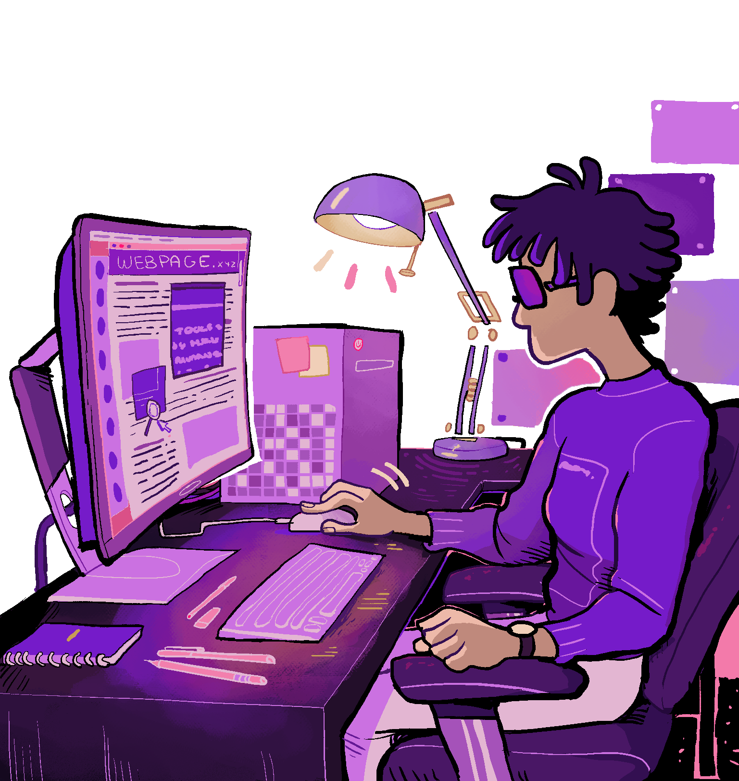
Opportunities for AI in OER Creation
Updating and Improving Existing Resources
Maintaining relevance in research or social context.
Simplifying existing text, such as adapting content for English Language Learners.
Identifying gaps or inaccuracies.
Creating ancillary materials.
Remixing and revising content.
Bozkurt, A. (2023)
“Sherm for Disabled And Here” is published under Creative Commons attribution licensing.

Slide 13
Opportunities for AI in OER Creation (Cont.)
Resource Curation and Recommendation.
Personalizing and Localizing Content.
Translation of Content.
Metadata Generation and Auto-tagging.
Remixing opportunities through open pedagogy, adapting to new outcomes or modify existing ones, as well as adapt or refine content.
Bozkurt, A. (2023); Kimmons, Veletsianos, & Trust (2025)

Slide 14

Ethical & Technical Considerations
There are numerous ways in which AI and AI literacy demonstrate ethical disparities, socioeconomic differences, racial biases, ecological depletion - the list goes on and on.
Photo by MetaLab from Nappy is licensed under Public Domain.

Slide 15
Ethical & Technical Considerations
Copyright and licensing challenges with AI-generated content.
“Ownership”, authorship, and attribution questions still fundamentally unanswered.
Accuracy, bias, and factuality monitoring concerns.
“Unlike humans, Generative AI ‘lacks the same level of context awareness and understanding, with its comprehension of language based solely on the patterns and structures learned from its training data.’” (Bozkurt, 2023, p. 200).
Legal implications for AI in education.
Bozkurt (2023)

Slide 16
Determining “How Much Is Too Much”? Discussion Questions
When does AI’s role become problematic in OER construction?
When does the time to prompt engineer outweigh the benefits of using AI?
Can using AI to brainstorm take away from creativity?
Can humans maintain pedagogical intent in a creation process that may be deemed as “AI generated content”?
Does prompt engineering mitigate bias inherent in AI?
Does generative OER’s improvement on productivity sacrifice quality?
How will CCC continue to battle the articulation problem of OER if AI generated content is the future?

Slide 17
Recommendations and Takeaways
Balance innovation, efficiency, and responsibility.
Maintain transparency and authenticity of AI use.
Utilize human expertise for contextualization, review, fact-checking, etc.
Use the right AI tool for the right job.
Maintain skepticism in AI output for bias, inaccuracies, and copyright infringement.
Advocate for campus policies and procedures for all employee groups and students on your campus to have clear and realistic expectations of AI use.

