Slide 1
Open Educational Resources (OER), and Inclusion, Diversity, Equity and Anti-Racism (IDEA): Leveraging OER to Support IDEA
ASCCC-OERI
9/5/25
Facilitated by Tiffany Lanoix, IDEA Faculty Lead, ASCCC

Slide 2
The Perfect Combo: OER & IDEA
ASCCC: Open educational resources (OER) are freely available and openly licensed teaching, learning, and research materials that students and faculty can use, revise, and redistribute without permission
Taking advantage of the “O” in OER
  Revise = Customizable!
    Opportunity to make materials relevant and responsive to your student population
    Use the framework to make sure the materials are inclusive, diverse, equity minded and anti-racist (IDEA!)

Slide 3
The Basics
What do we mean by IDEA?
Inclusion: Intentional efforts to ensure materials make students feel welcome, included, respected, and valued
Diversity: Materials are representative of the varied experiences of our diverse student body
Equity: Address issues of access to and relevancy of course materials for historically marginalized groups
Anti-racism: Materials intentionally address racial & ethnic inequities and white supremacy within our specific disciplines and academic in general

Slide 4
The Basics (cont.)
What is the IDEA Framework?
a process and review framework faculty can use to evaluate existing and create new ASCCC OERI-supported materials
Process
  Submit OER for IDEA assessment (1st round in process)
  OER author can participate in IDEA guided assessment (coming soon!)
Individual assessments
  Conduct IDEA assessment on OER you did not author (available now)
  ApplyIDEA Framework while creating new OER (available now)

Slide 5
The Basics (cont..)
Why was the IDEA Framework created?
ASCCC OERI created the IDEA Framework to support faculty as they implement culturally responsive and anti-racist pedagogy (Summer 2021)
OERI authors already receive accessibility training and resources are subject to accessibility reviews
Culturally responsive pedagogy
  Practices that are validating, affirming and empower students
  Centers students cultural background and experiences in teaching and learning
Anti-racist pedagogy
  Practices that centers the impact of racial histories and cultural experiences within and outside academic spaces
  Addresses systemic failures that perpetuate racial inequities

Slide 6
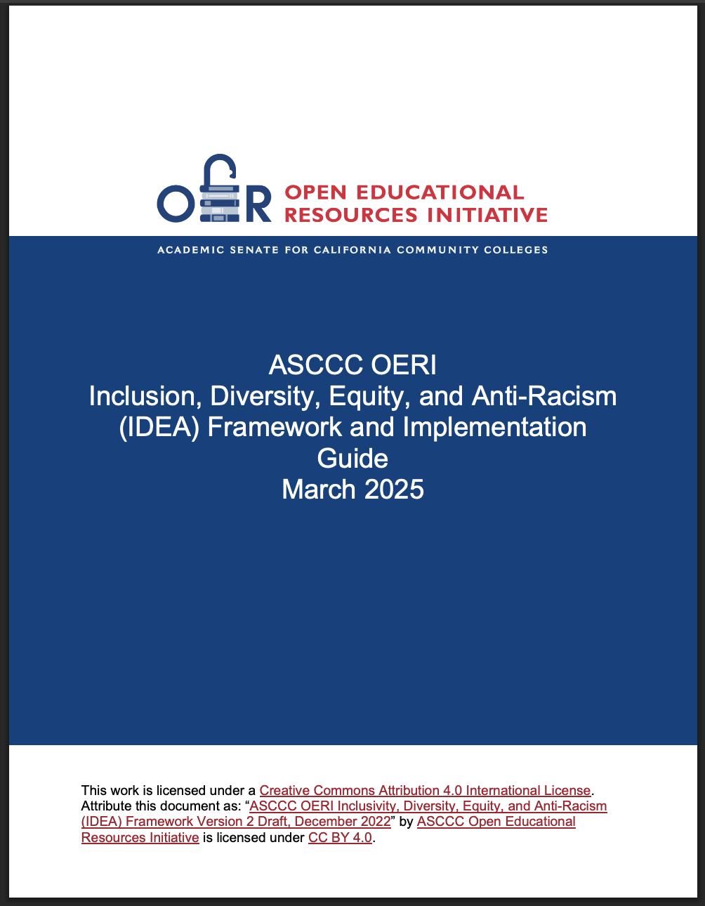
Where is the IDEA Framework?
ASCCC IDEA Framework website

Slide 7
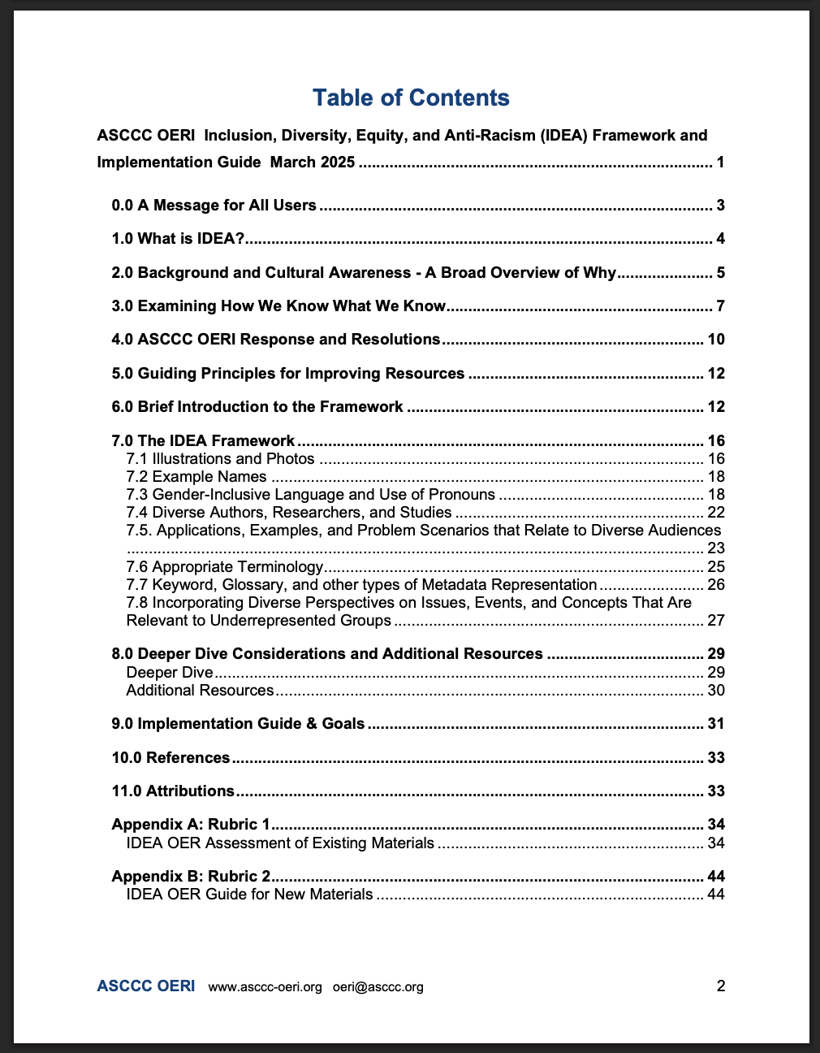
IDEA Assessment Categories
Illustrations and Photos
Example Names
Gender Inclusive Language & Use of Pronouns
Diverse Authors, Researchers, & Studies
Applications, Examples and Problem Scenarios That Relate to Diverse Audiences
Appropriate Terminology
Keyword, Glossary, & Metadata Representation
Incorporating Diverse Perspectives on Issues, Events, & Concepts That Are Relevant to Underrepresented Groups

Slide 8
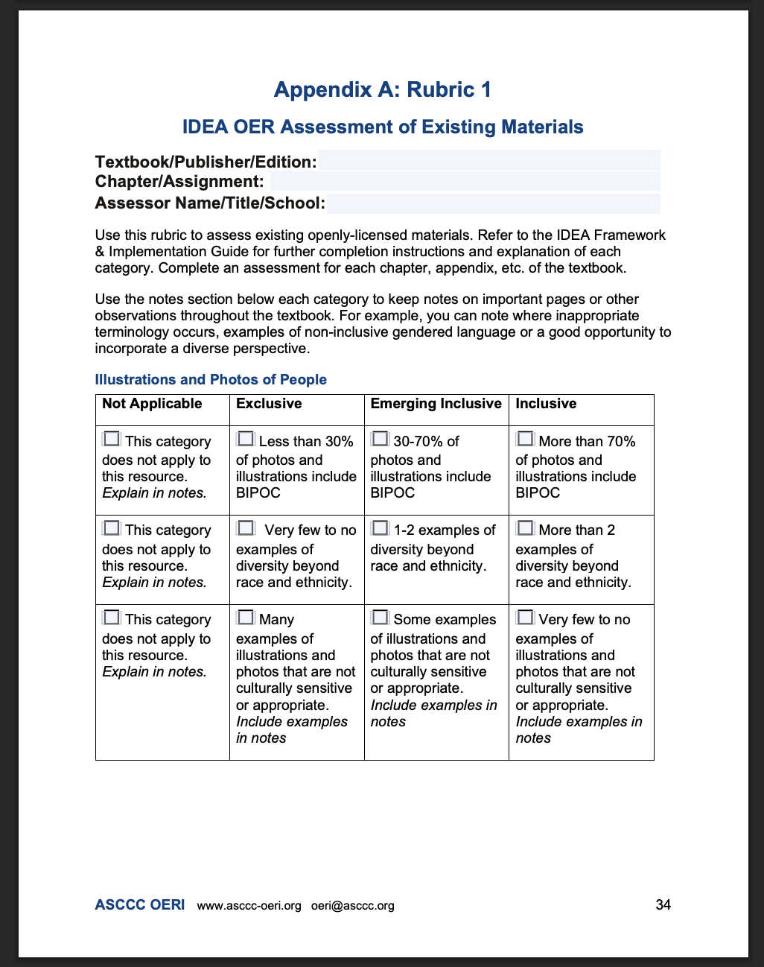
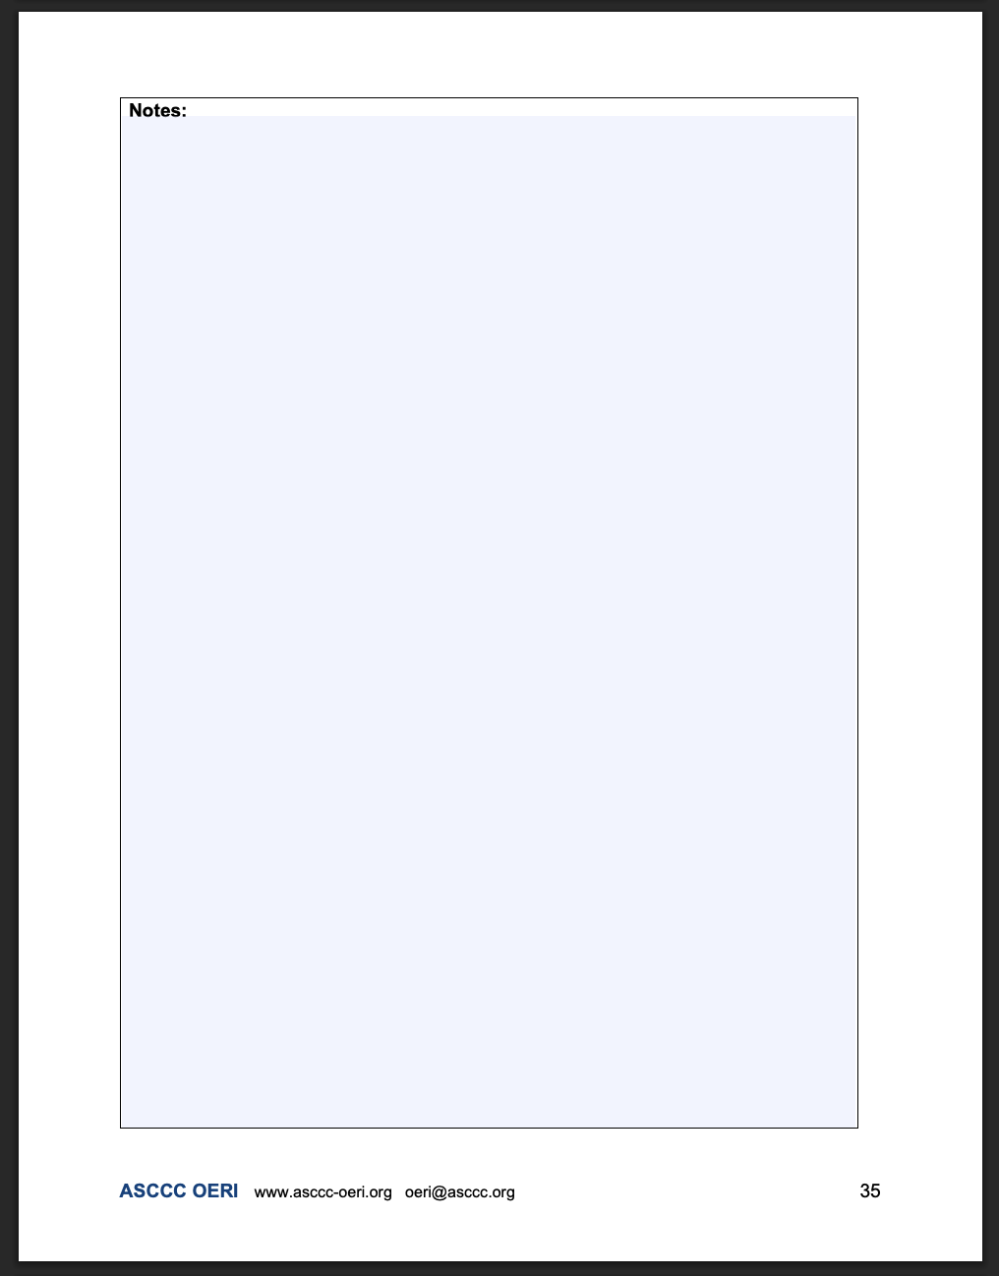
IDEA OER Assessment Appendix A: Rubric 1

Slide 9
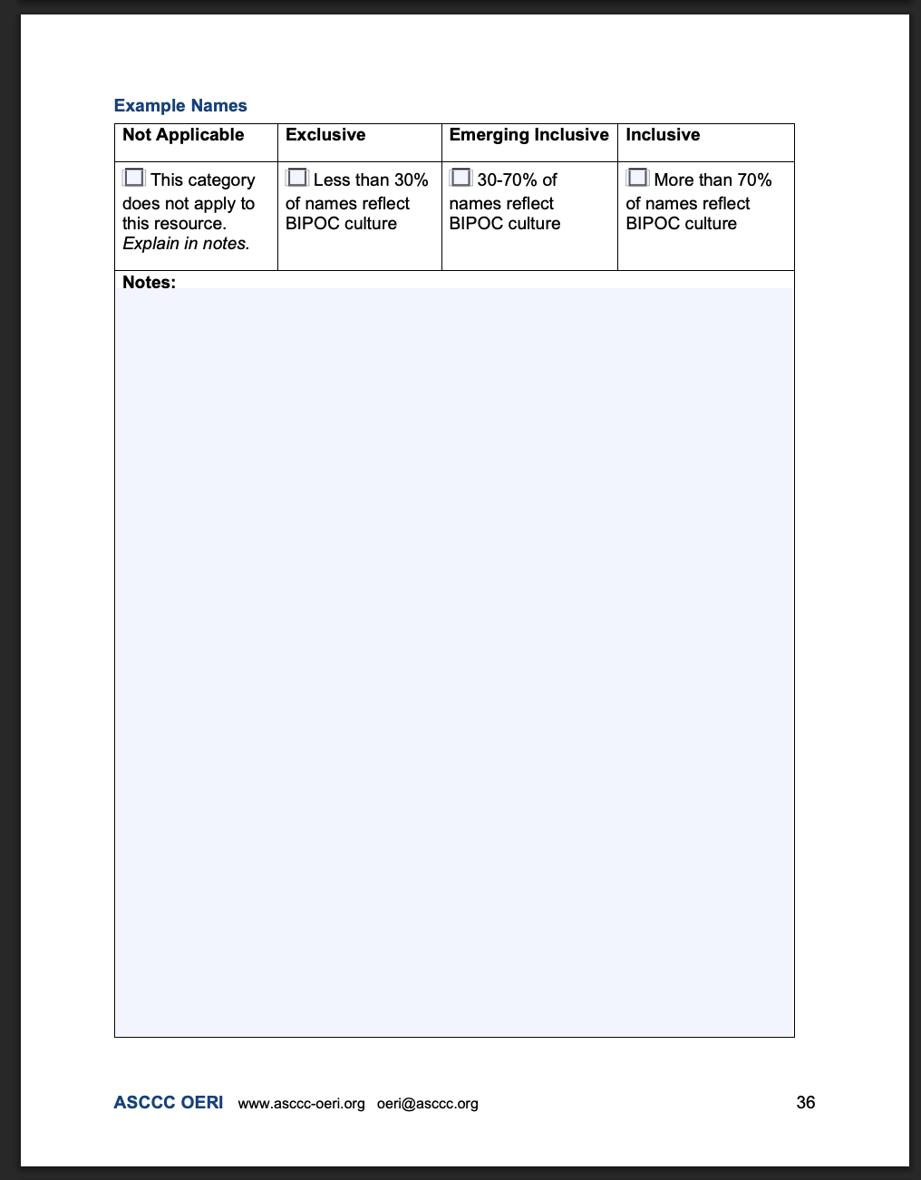
IDEA OER Assessment Appendix A: Rubric 1 part 2

Slide 10
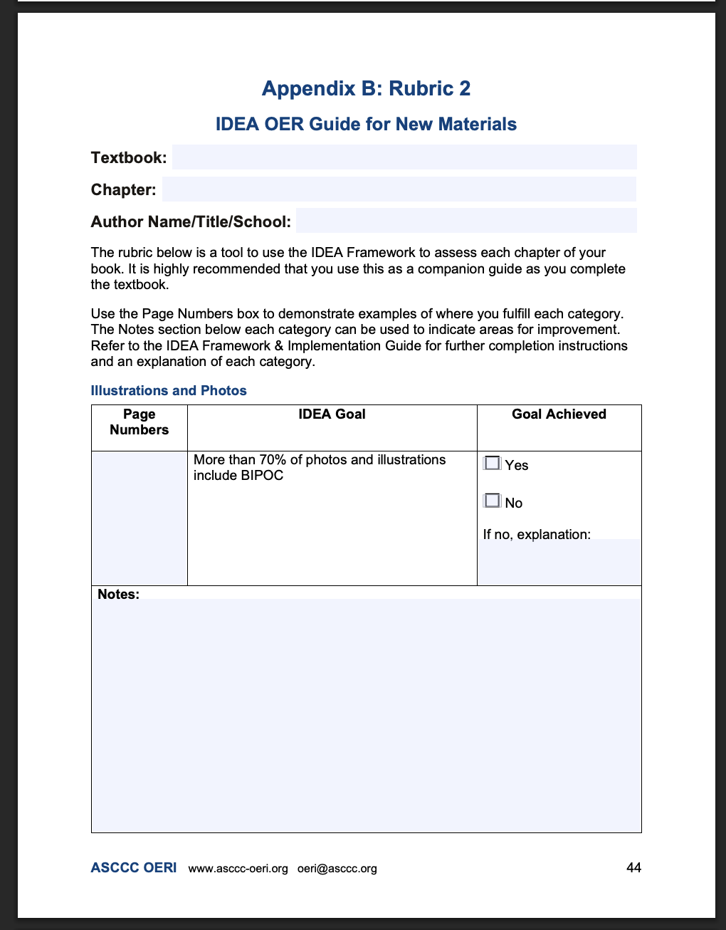
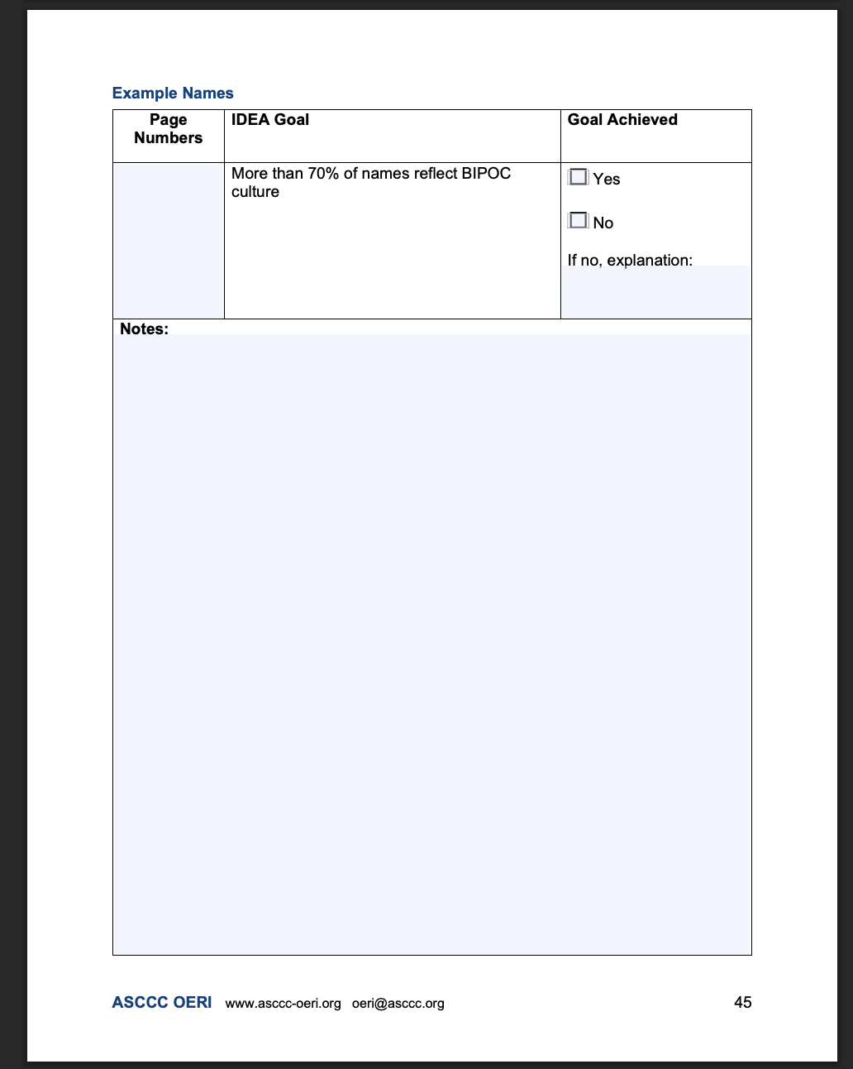
IDEA OER Assessment Appendix B: Rubric 2

Slide 11
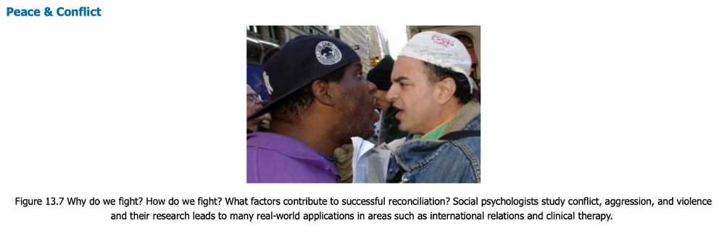
Illustrations and Photos
Reflective of diverse populations and should not perpetuate stereotypes
Analyze role, depiction, connotation, expressions of authority, and purpose of the people
Does this photo in a psychology OER Textbook below reflect IDEA?

Slide 12
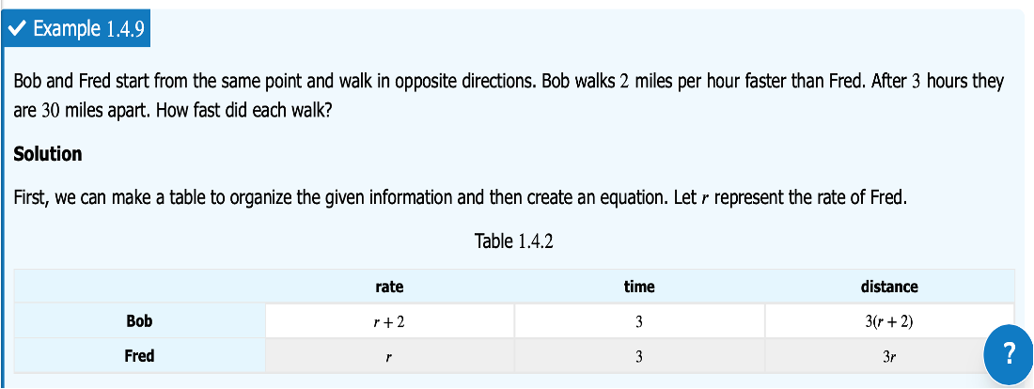
Example Names
Names used for examples, exercises, and scenarios, and should represent various countries of origin, ethnicities, genders, and races and be properly portrayed
Do the names below reflect the diversity of your students?

Slide 13

Diverse Authors, Researchers, and Studies
Reference discipline contributors—e.g., researchers, scholars, academics—with backgrounds like those of your students
Does this discussion of early contributions to math reflect IDEA?

Slide 14
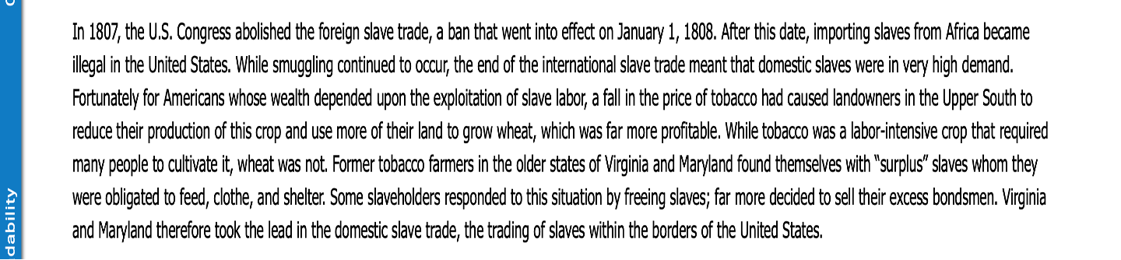
Appropriate Terminology
Examine for derogatory, colloquial, inappropriate, or otherwise incorrect language
Strive to not use terminology that reduces a person to something that was done to them or a medical condition they are living with
Does this use of “slave” in an OER economic textbook reflect IDEA?

Slide 15
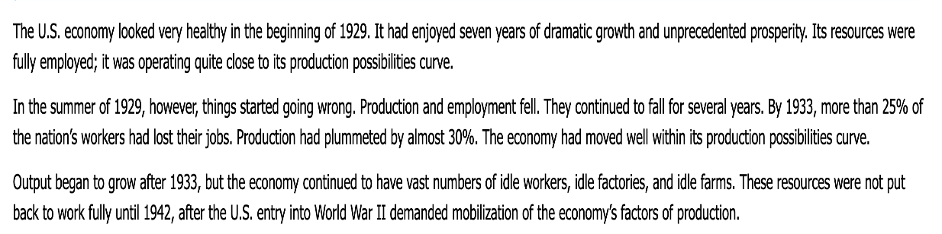
Incorporating Diverse Perspectives on Issues, Events & Concepts that are Relevant to Underrepresented Groups
Diverse populations experience issues such as social problems, health, politics, business practices, and economic conditions that may differ from the mainstream
Does this description of the impact of the Great Depression reflect IDEA?

Slide 16
IDEA: Summer 2025
Completed a 4-week IDEA Framework Assessor training
28 faculty members from various campuses and disciplines
The goals of the training:
  Develop an in-depth understanding of the IDEA Framework
  Learn how to use the IDEA Framework rubric
  Conduct OER assessments
  Pair with other trainees to compare findings and produce one final assessment
Assessing Commonly Adopted Textbooks
  Introduction to Psychology 2e (OpenStax)
  Stand up, Speak out - The Practice and Ethics of Public Speaking
  Introduction to Business (OpenStax)

Slide 17
IDEA: The Future
Fall 2025 implement IDEA Framework Assessment process
  Authors submit work for an IDEA Framework assessment
  providing IDEA framework feedback improve the OER
Create IDEA Framework badge and repository of IDEA assessed OER materials
In the works:
Guided IDEA assessment for OERI authors
Canvas self-paced IDEA Framework course

Slide 18
Interested in More??
Access IDEA resources and get to work!
Sign up for the OERI listserv on the ASCCC website to ensure you are informed
  Select ASCCC OER Initiative
Talk to me: lanoixtr@wlac.edu
Contact us: oeri@asccc.org & request being added to the IDEA Canvas Page

