Slide 1


Welcome!
On behalf of the ASCCC OERI, we are pleased to have you here for Open Educational Resources (OER) for Public Speaking – Filling Potential Gaps.
If you are not already muted, please mute yourself upon arrival. As this is set up as a meeting, we will be able to have an actual discussion – but we need all those who are not speaking to be muted.
You are also encouraged to use the “chat” feature.
Notes:
Liz and Julie

Slide 2
Open Educational Resources (OER) for Public Speaking – Filling Potential Gaps
Revised September 4, 2025. DL Webinar scheduled for Sept. 4, 2pm – 3pm
This work is licensed under a Creative Commons Attribution 4.0 International License.
Attribute this slide deck as: "OER for Public Speaking – Filling Potential Gaps" by ASCCC OERI is licensed under CC BY 4.0.
Notes:
Liz

Slide 3
Event Description
During the summer of 2025, a group of communication studies faculty met to identify OER that could be used to address required elements in the public speaking course due to recent statewide curriculum changes. Join us to learn about the summer work, the currently available resources, and the work that is in progress.
Notes:
Liz

Slide 4
Presenters
Julie Bruno, Communications Coordinator, ASCCC OERI
  Communication Studies, Sierra
Liz Encarnacion, Communication Studies Discipline Lead, ASCCC OERI
  Communication Studies, Chaffey
Notes:
Liz and Julie

Slide 5
Overview
The Course Identification Numbering System (C-ID), Common Course Numbering (CCN), Cal-GETC and Public Speaking
What’s New?
Summer Developments
Available Resources
Anticipated Resources
Notes:
Liz

Slide 6
C-ID COMM 110
Required course for the Communication Studies ADT
All colleges have at least one course with this C-ID designation
At least 106 CCCs offer the Communication Studies ADT
C-ID has been the “standard”
Notes:
Julie

Slide 7
Cal-GETC….
While an oral communication course was always a component of CSU GE Breadth, such courses were not a component of IGETC.
Extensive negotiations resulted in an oral communication requirement being included in Cal-GETC.
Notes:
Julie

Slide 8
The Cal-GETC Area 1C (Oral Communication) requirement can only be fulfilled by a course..
..taught in English (see Section 5.1.8).
..that provides students with the foundational knowledge and practice of public speaking in a democratic society, to enable them to successfully communicate ideas of an informative and persuasive nature in the public speaking mode, and to critically evaluate the speeches of others.
Notes:
Julie

Slide 9
Students who have completed this requirement shall have been exposed to coursework that is designed to convey and provide practice in:
understanding the theoretical foundations of creating and sharing knowledge, including the canons of rhetoric and the Aristotelian proofs of ethos, pathos, and logos
finding, critically examining, and using supporting materials from primary and secondary sources for credibility, accuracy, and relevance in their speeches and presentations
conceptualizing and effectively using compelling arguments in support of a guiding thesis and organizational pattern appropriate for the audience, occasion, and across a variety of contexts
knowing and adhering to ethical communication practices which include truthfulness, accuracy, honesty, and reason as essential to the integrity of communication
Notes:
Julie

Slide 10
And…
demonstrating rhetorical sensitivity to diversity, equity, inclusion, belonging, and accessibility
practicing and refining the concepts presented in the course through a variety of well-prepared faculty-supervised, faculty-evaluated speeches delivered to a live audience (one to many) using effective delivery techniques
employing effective verbal and nonverbal practices while delivering a speech and managing communication apprehension
listening critically to provide constructive criticism to peers
applying rhetorical principles to analyze historical and contemporary public discourse
Notes:
Julie

Slide 11
And then there was CCN
While C-ID was designed to establish what a course needs to have to receive a C-ID designation – allowing for local variations and C-ID determinations made based on a holistic review process…
CCN requires that the majority of the Course Outline of Record be an exact copy of the CCN template.
And the template for Introduction to Public Speaking goes above and beyond what is needed to receive the C-ID COMM 110 designation.
Notes:
Julie

Slide 12
Elements of CCN not in C-ID
Content
Foundational rhetorical theories, including the canons of rhetoric and Aristotelian proofs, as well as relevant principles of human communication.
Critical analysis of historical and contemporary public discourse.
Rhetorical sensitivity to diverse audiences.
Objectives/Outcomes
Apply rhetorical theories to create and analyze public speeches in a variety of contexts including historical and/or contemporary.
Demonstrate rhetorical sensitivity to diversity, equity, inclusion, accessibility, and belonging and adhere to ethical communication practices which include truthfulness, accuracy, honesty, and reason.
Note – this list may not be complete
Notes:
Julie

Slide 13
Summer Work
16 faculty responded to the survey that was distributed to gather input on a proposed resource to address the potential gaps.
The OERI had proposed to develop a stand-alone chapter that could be used in conjunction with any existing text for the course to support the content and objectives specified in the COMM C1000 template.
The first step in developing this resource will be to gather the material needed to address the additional content in the CNN template.
Notes:
Liz

Slide 14
The elements of the COMM C1000 template that may be missing from the texts commonly in used for the Public Speaking course include the following elements (edited)
Content
Foundational rhetorical theories
Canons of rhetoric
Aristotelian proofs, as well as relevant
Principles of human communication.
Critical analysis of historical and contemporary public discourse.
Rhetorical sensitivity to diverse audiences.
Objectives/Outcomes
Apply rhetorical theories to create and analyze public speeches in a variety of contexts including historical and/or contemporary.
Demonstrate rhetorical sensitivity to diversity, equity, inclusion, accessibility, and belonging
Adhere to ethical communication practices which include truthfulness, accuracy, honesty, and reason..
Notes:
Liz

Slide 15
What’s really missing and what’s really needed?
Unclear.
Most faculty probably touch on the “missing” elements, even if they are not present in the text they use.
Solutions?
  Provide a collection of OER from which missing elements can be obtained.
  Develop the stand-alone proposed chapter.
  Integrate the “missing” elements into a text.
Available now:
  Collection of OER
  An OER developed with the new expectations in mind
  Open Educational Resources and Communication Studies
Notes:
Liz

Slide 16
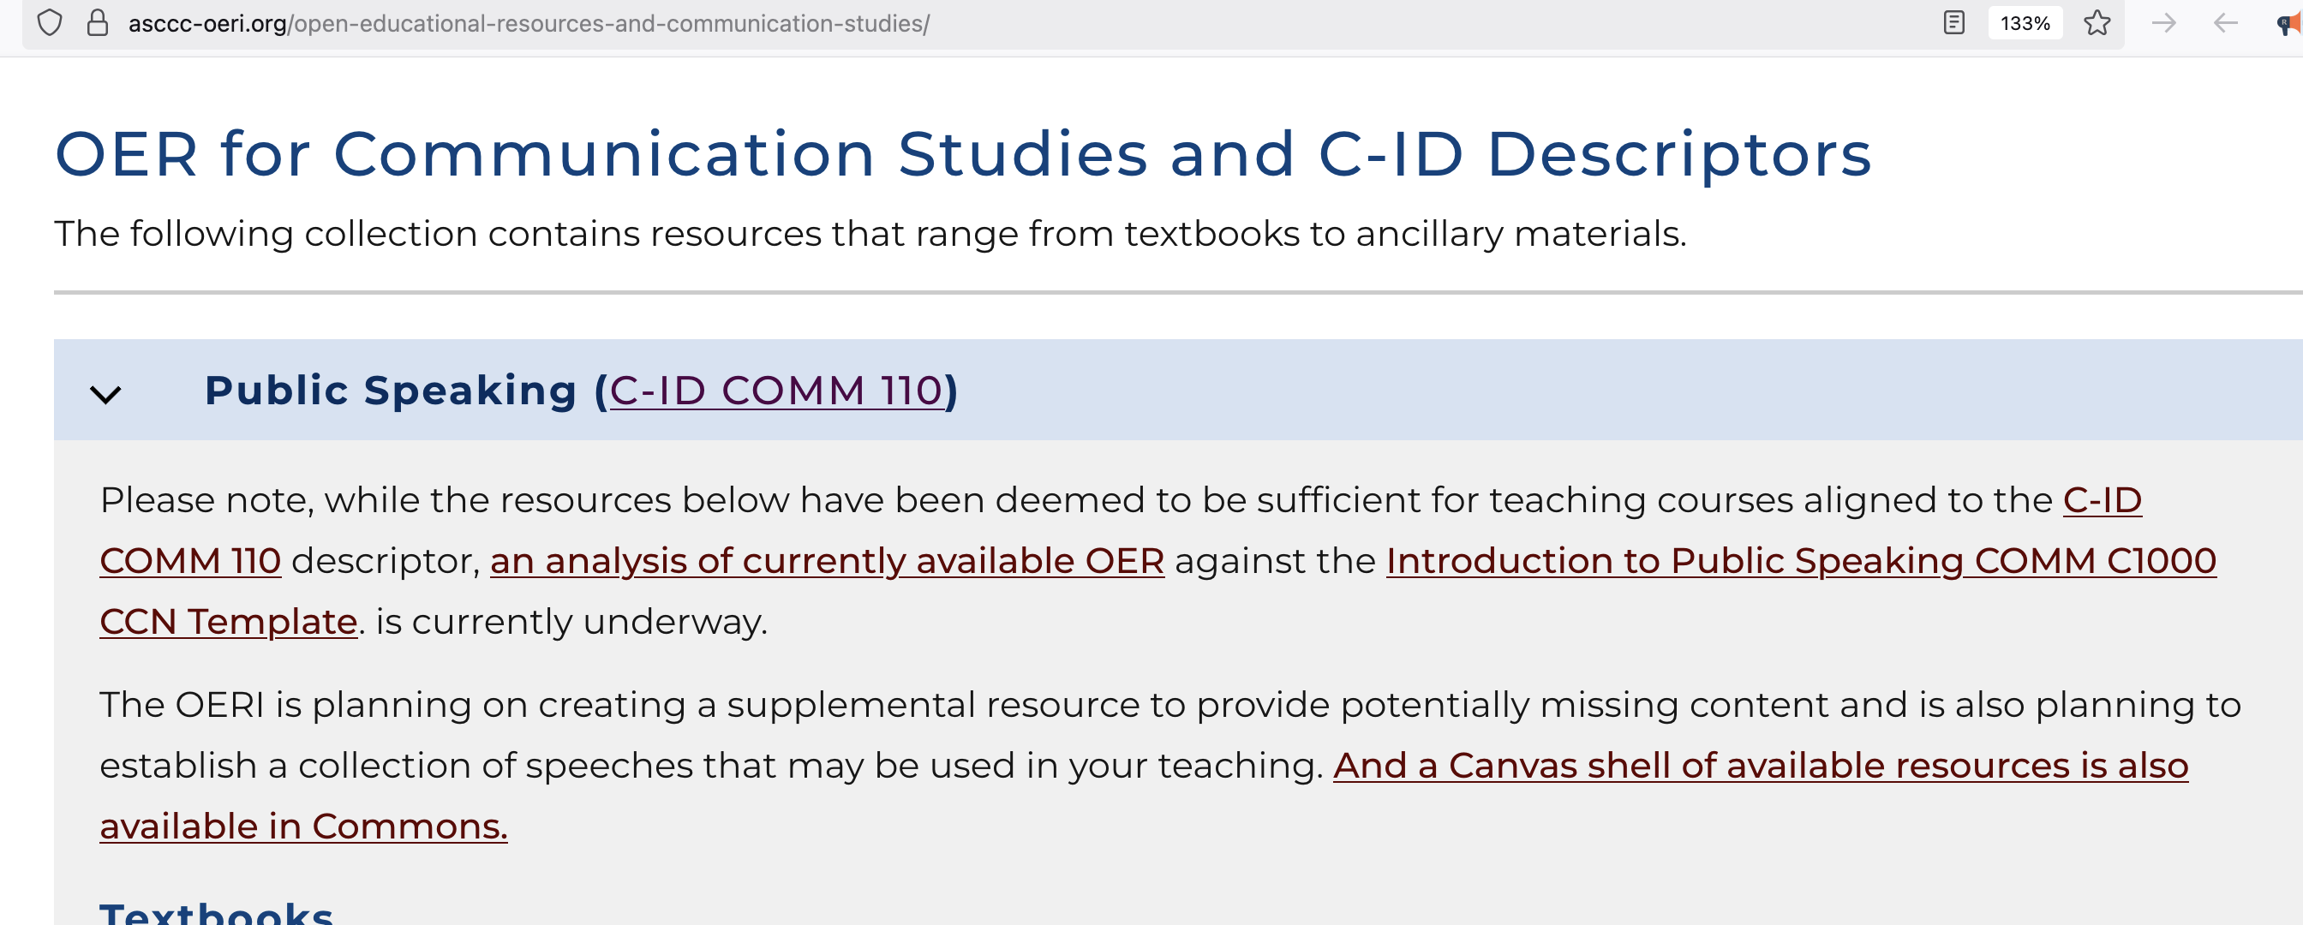
Access available information
Notes:
Liz

Slide 17
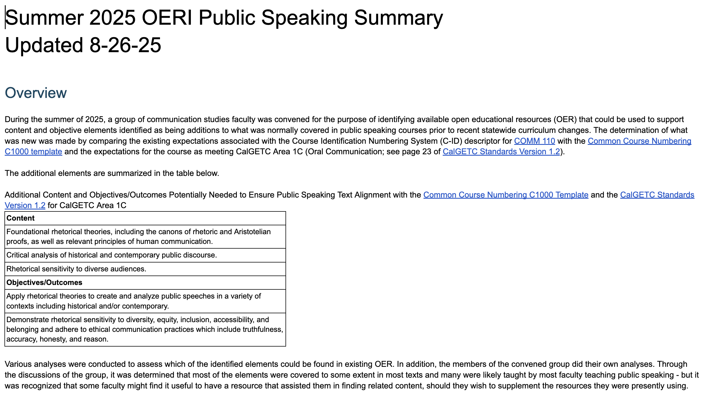
Summer 2025 Summary
Notes:
Liz

Slide 18
What do you need….
and/or what do you have to share?
Notes:
Liz and Julie

Slide 19
More Information
ASCCC OERI Website (asccc-oeri.org)
  Resources
  Webinars and Events
ASCCC OER E-Mail (oeri@asccc.org)
General OERI E-Mail: oeri@asccc.org
Notes:
Liz

Slide 20

Thanks!
Photo by Thgusstavo Santana from Pexels

