Slide 1
Welcome!
On behalf of the ASCCC OERI, we are pleased to have you here with us for this presentation.
If you are not already muted, please mute yourself upon arrival.
Please note that you are encouraged to use the Zoom “chat” feature for questions and comments.
You’re invited to introduce yourself in the chat – please provide your name, college, discipline/role
This event will be recorded. Archives of all ASCCC OERI events are available at asccc-oeri.org > Webinars and Events

Slide 2

Sin Fronteras: Inclusive Open Educational Resources (OER) in Spanish
Friday, October 24, 2025 from 11:00 am – 12:00 pm
Sin Fronteras:

Slide 3
Description
This presentation will examine the outcomes of our efforts to foster diverse pedagogical and curricular approaches to enhance student learning, encourage critical-thinking, and ultimately promote and celebrate diversity, equity, and inclusion.
More specifically, we will address the challenges and opportunities arising from fostering inclusivity in Spanish language instruction, offer strategies to include non-binary Spanish and voseo in the classroom, and share OER aimed at making Spanish language instruction affordable and accessible to effectively accommodate diverse learners and create equitable learning environments.
Notes:
Goretti

Slide 4

Presenters
Mercedes Fages Agudo, Master Lecturer (Teaching) of Spanish, Coordinator of Spanish II, USC, Department of Latin American and Iberican Cultures.
Dr. Liana Stepanyan, Professor (Teaching) of Spanish, Coordinator of Spanish III, USC, Department of Latin American and Iberican Cultures.
Dr. Goretti Prieto Botana, Professor (Teaching) of Spanish, Director of Basic Language Program, USC, Department of Latin American and Iberican Cultures.
Notes:
Presenters can be included following the description or the overview. Where images are used, they should include an attribution (Photo by…) and appropriate alternative text should be used (or the image marked decorative).

Slide 5
Overview
Sin Fronteras: Inclusive Spanish OER book: voseo and non-binary Spanish
How to include inclusive Spanish in class
Sample Activities
Other resources
Notes:
Goretti

Slide 6
Non-binary: gender vs. langauge
Non-binary: An umbrella term used to refer to those who do not conform to the traditional masculine-feminine gender binary.
Non-binary Spanish: Linguistic forms that are not strictly masculine or feminine and can refer to people of other/all genders, though pronoun use ≠ gender identity.
More than 1.2 million Americans identify as non-binary (Wilson & Meyer, 2021).
Gender is an unavoidable topic in the Spanish language classroom, and the language needs to express students’ unique gender identities prescriptively.
All students benefit from a lesson in gender diversity and exposure to the use of differently gendered Spanish forms in different contexts.
Notes:
Goretti

Slide 7
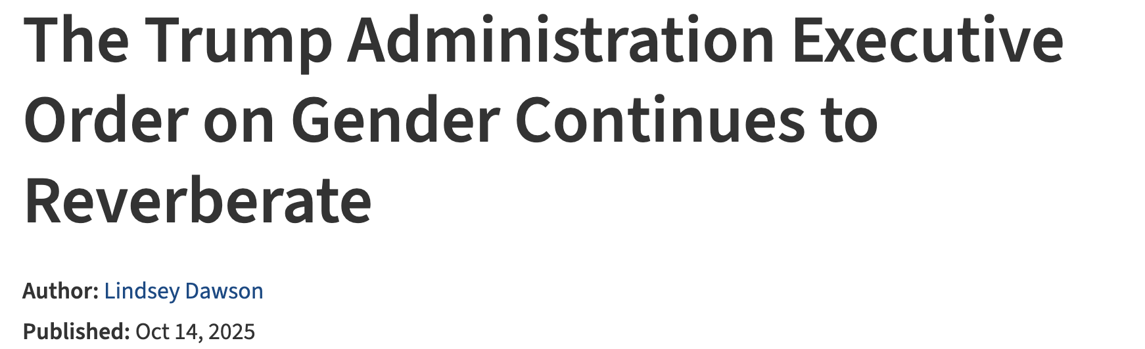
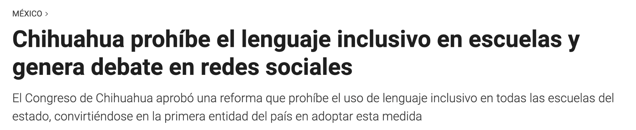
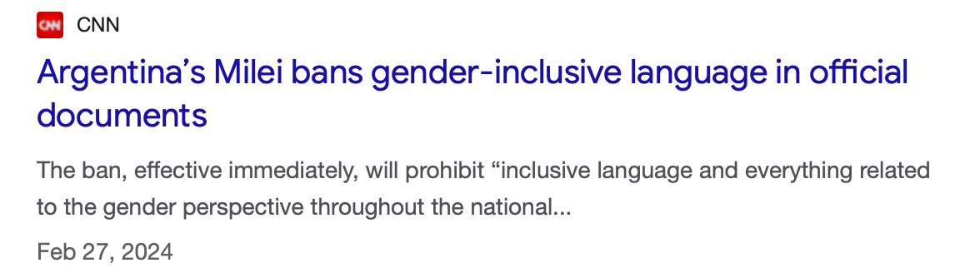
Important moment
Notes:
Goretti

Slide 8
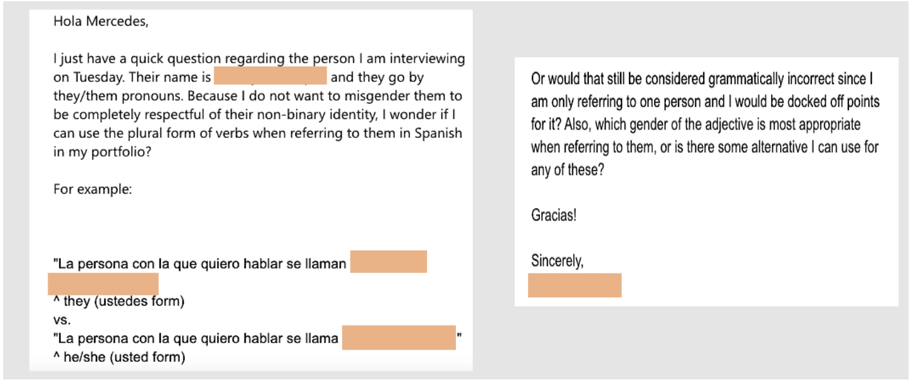
Reality in our classrooms
Students indicate the need for non-binary language in Spanish.
Notes:
Goretti

Slide 9
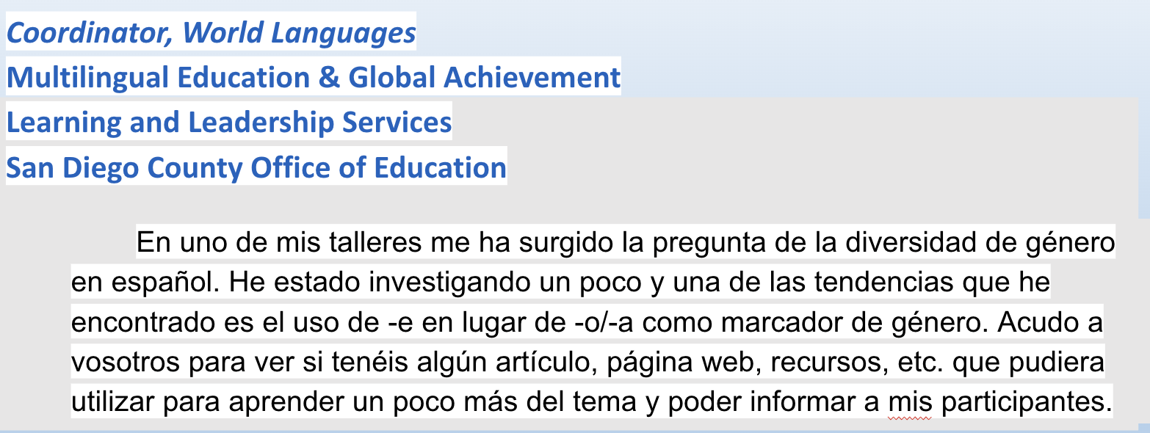
In our Community
Notes:
Goretti

Slide 10
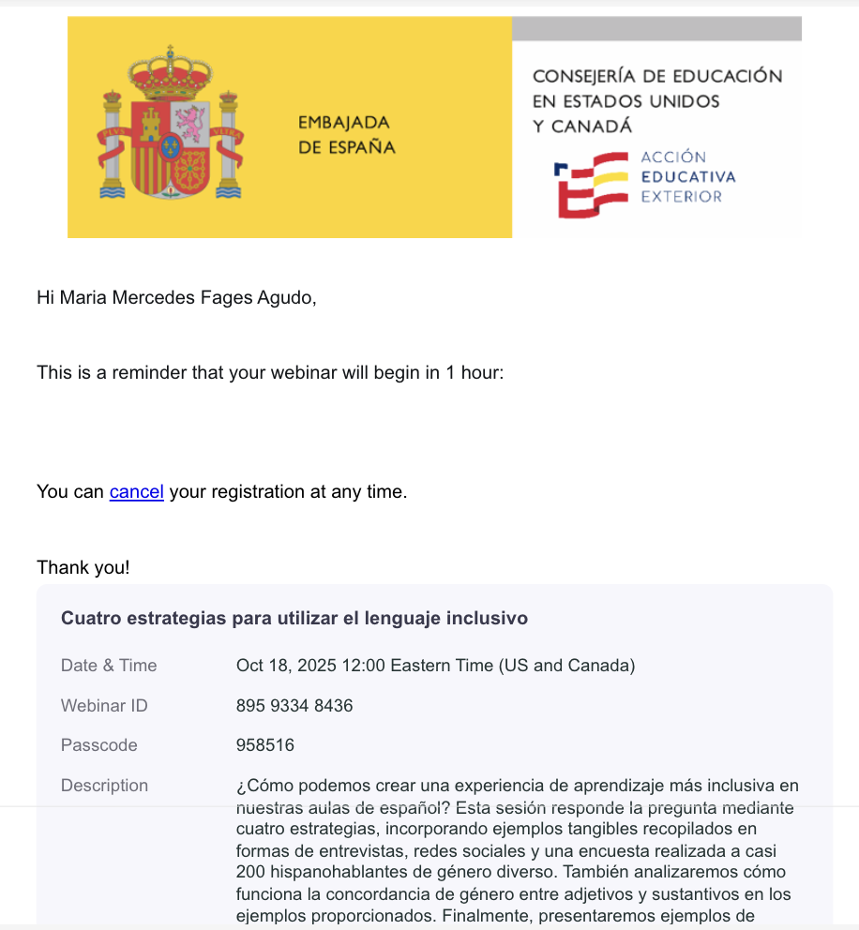
Ongoing conversation
Notes:
Goretti

Slide 11
Study USC (2019-2022)
Pre-test
Assignment
  Reading (topic: LGBTQI)
  Video (topic: non-binary individuals)
  Use of non-binary pronouns in Spanish
Post-test
Notes:
Liana

Slide 12
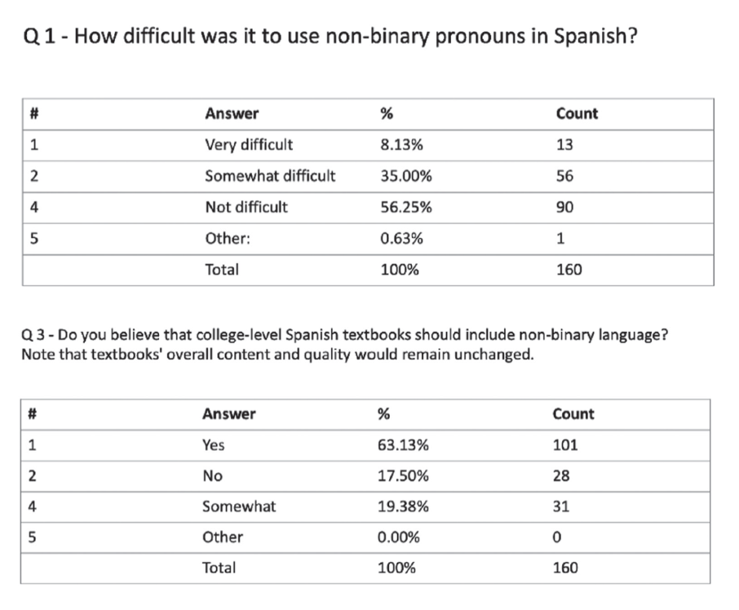
Study USC (2019-2022)
“Non-binary pronouns are just as valid as binary pronouns. They should be taught at the same time as the binary pronouns so that they aren't isolated. When they are taught separately, it "others" them.”
“We live in a world where everyone wants to be treated equally no matter their gender. This should be respected by everyone and should become common knowledge that it is the right thing to do.”
Notes:
Liana

Slide 13
El Voseo
Voseo: the use of vos as a second-person singular pronoun and the verbal forms associated with it. While over time, vos lost currency in Spain, it has survived particularly in regions with a greater cultural and geographic disconnect from Spain, such as Argentina and Uruguay. Today, at least one-third of the Spanish-speaking population of Latin America uses voseo.
Voseo is not typically taught to learners of Spanish as a second language.
We believe that in highlighting voseo, this volume both contributes to the destigmatization of this widespread linguistic variation and provides learners with a more complete, larger-scope view of the Spanish language.
Notes:
Liana

Slide 14
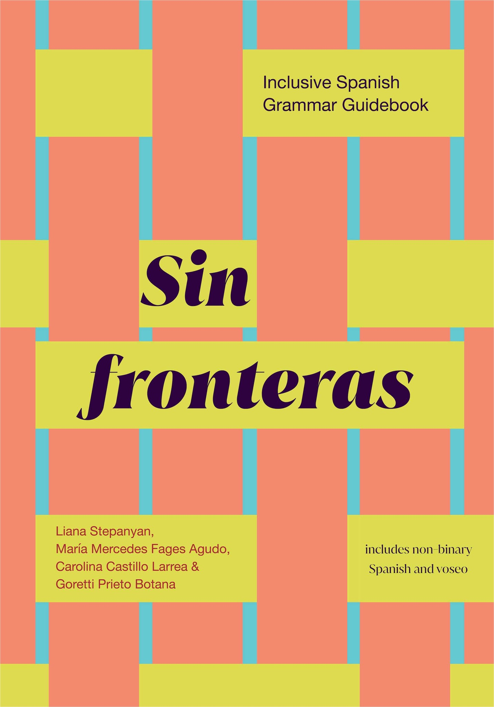
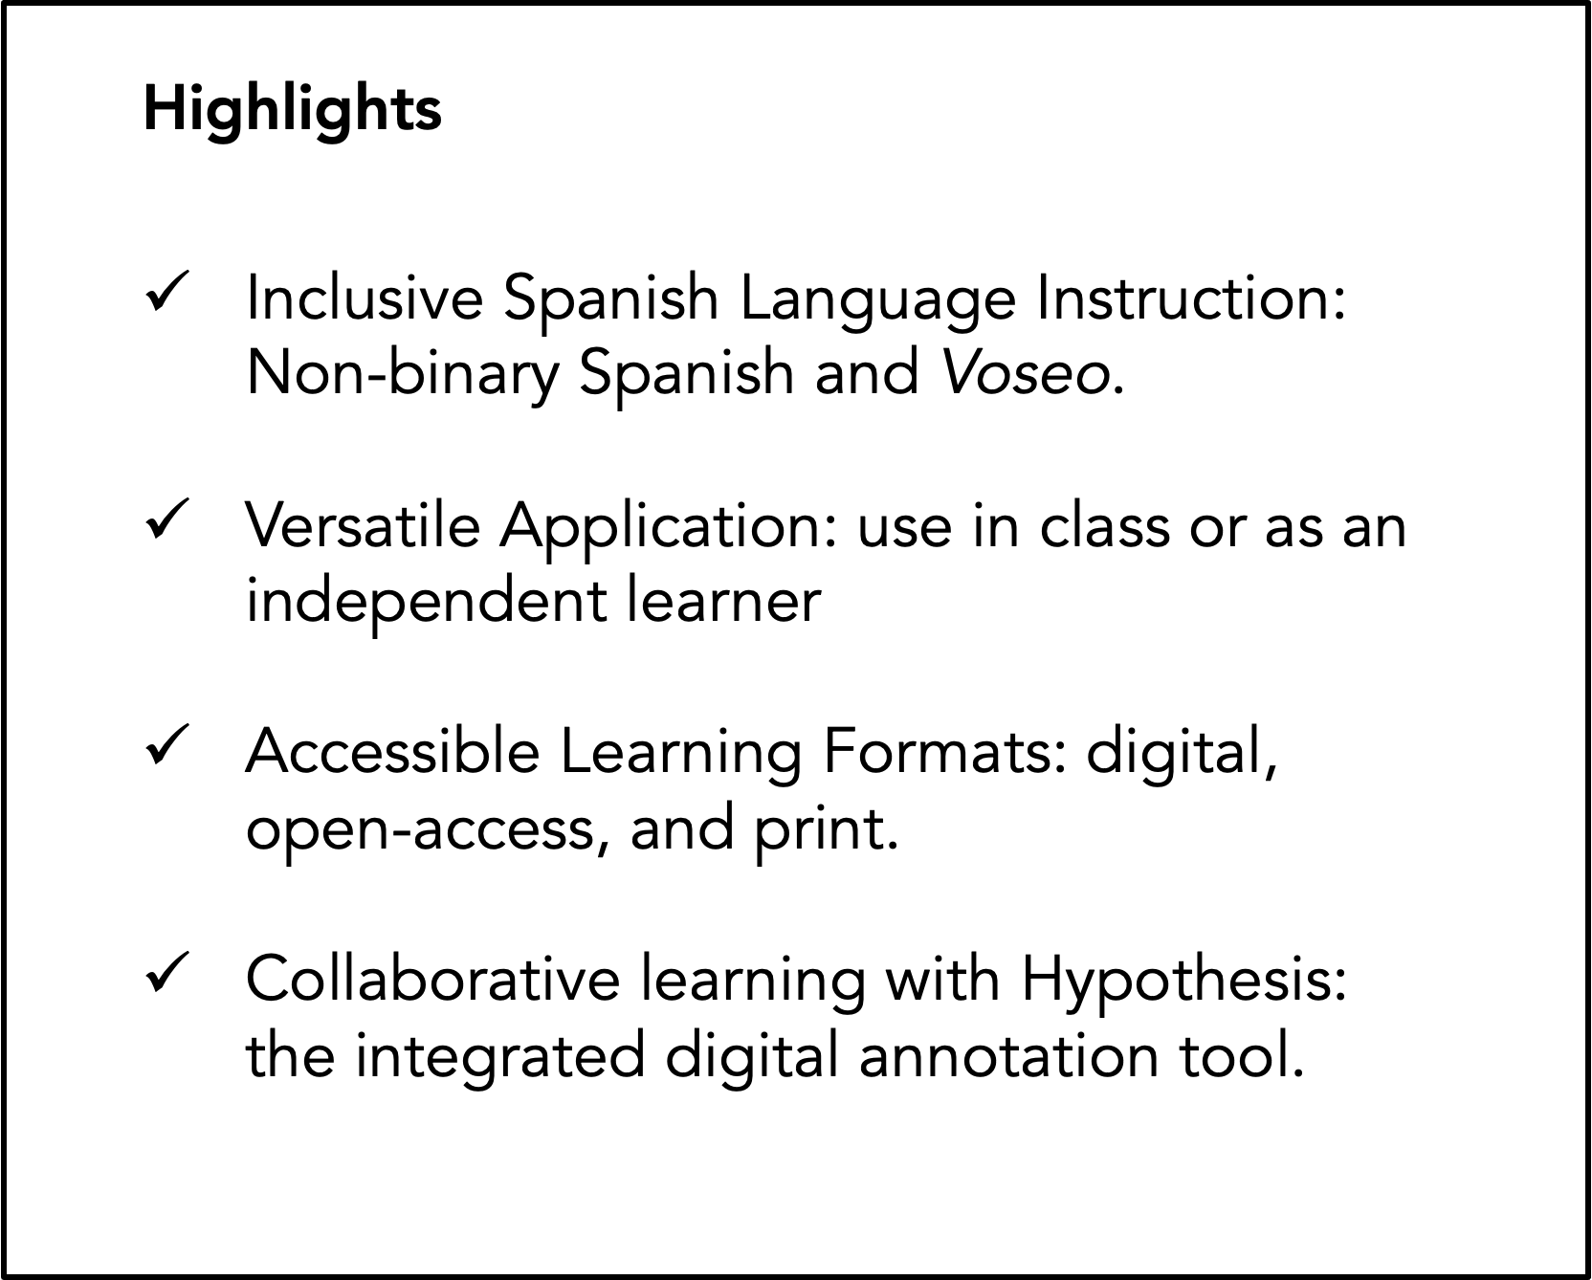
Sin Fronteras, Inclusive Spanish Grammar Guide, 2024
Notes:
Liana

Slide 15
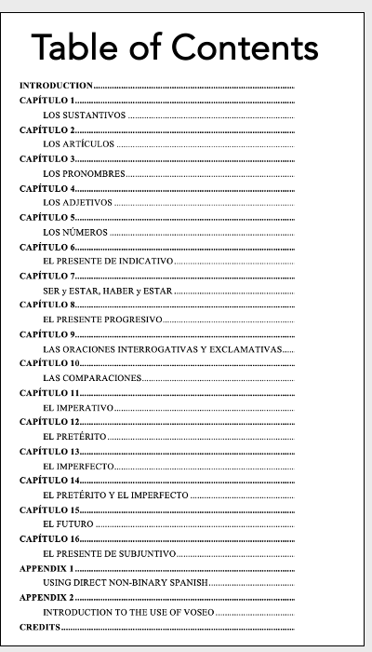
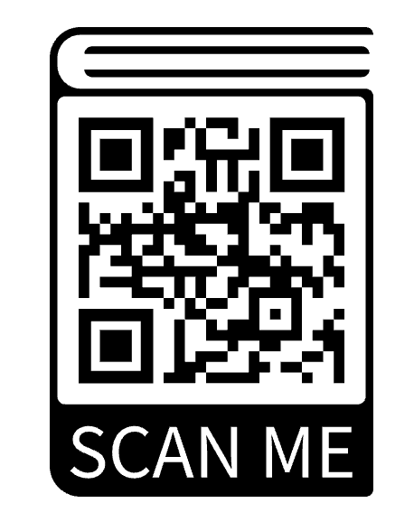
Sin Fronteras
Inclusive Spanish Grammar Guide, 2024
In each chapter:
•Explicaciones de gramática
•Practicar
•¿Sabías que…?
•A escribir
•Soluciones
Notes:
Liana

Slide 16
Incorporating non-binary Spanish and voseo in the classroom
model behavior; provide a safe environment.
start a conversation around heteronormativity and varieties of Spanish; encourage students to explore on their own.
introduce texts, art, etc. by non-binary individuals: non-binary Spanish in context
introduce texts, art, etc. by users of voseo: varieties of Spanish in context
offer additional resources
Notes:
Merche

Slide 17
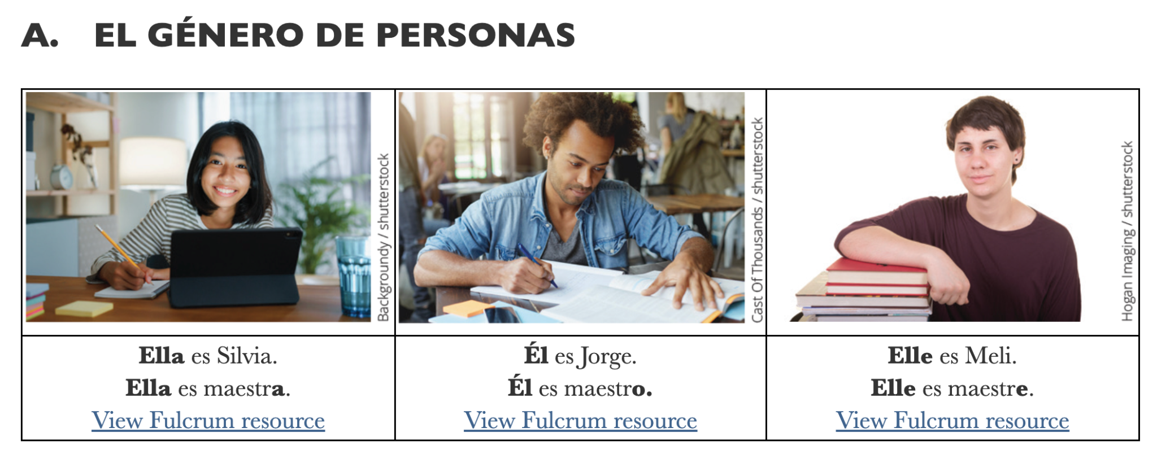
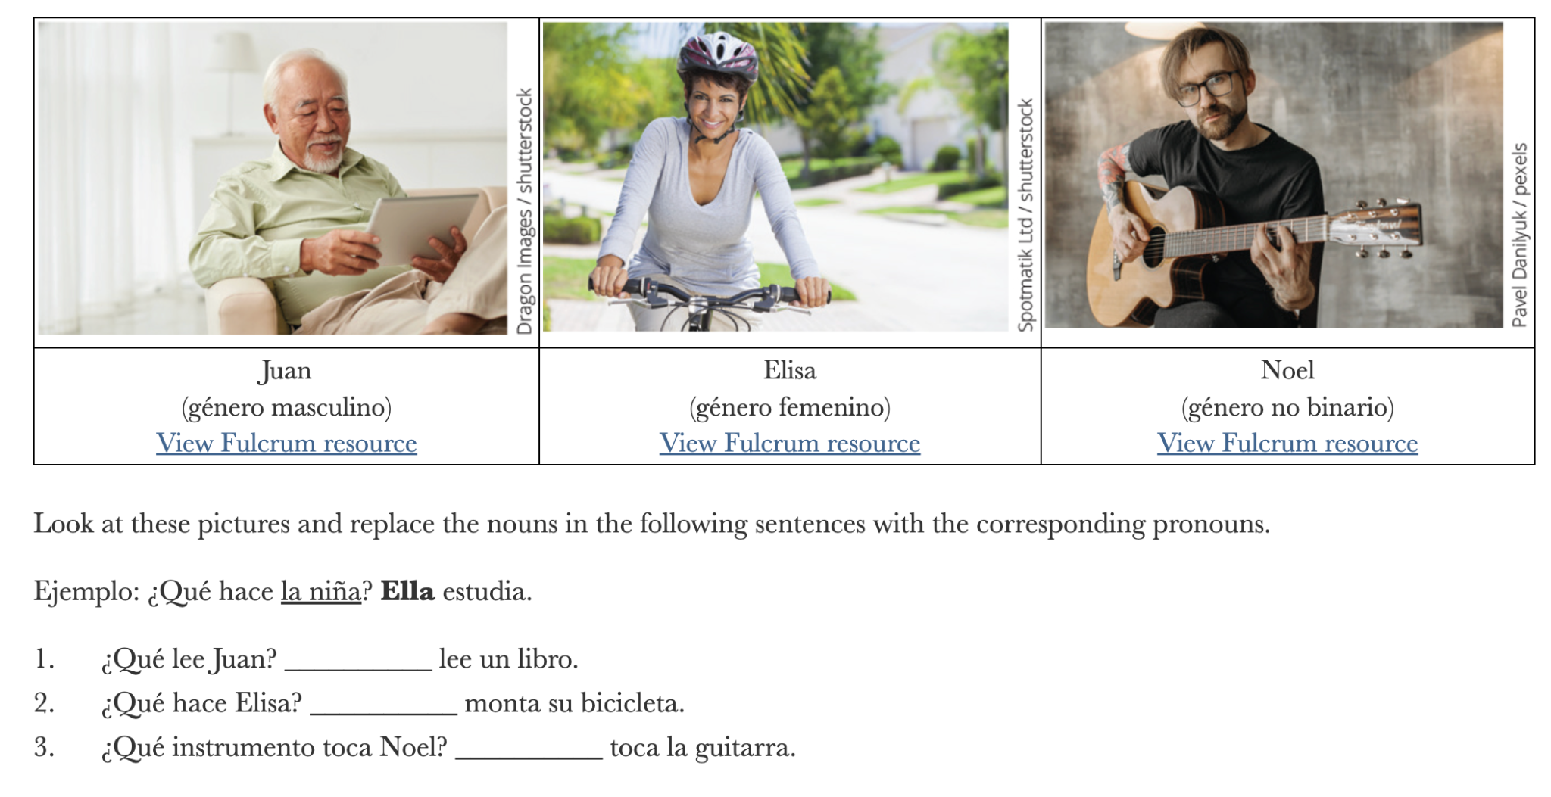
Sample Activity: Non-binary Spanish
Notes:
Mer

Slide 18
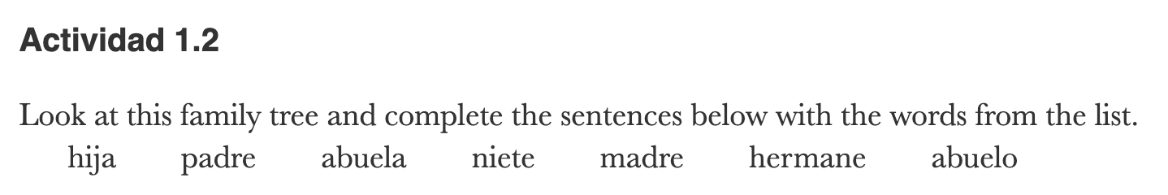
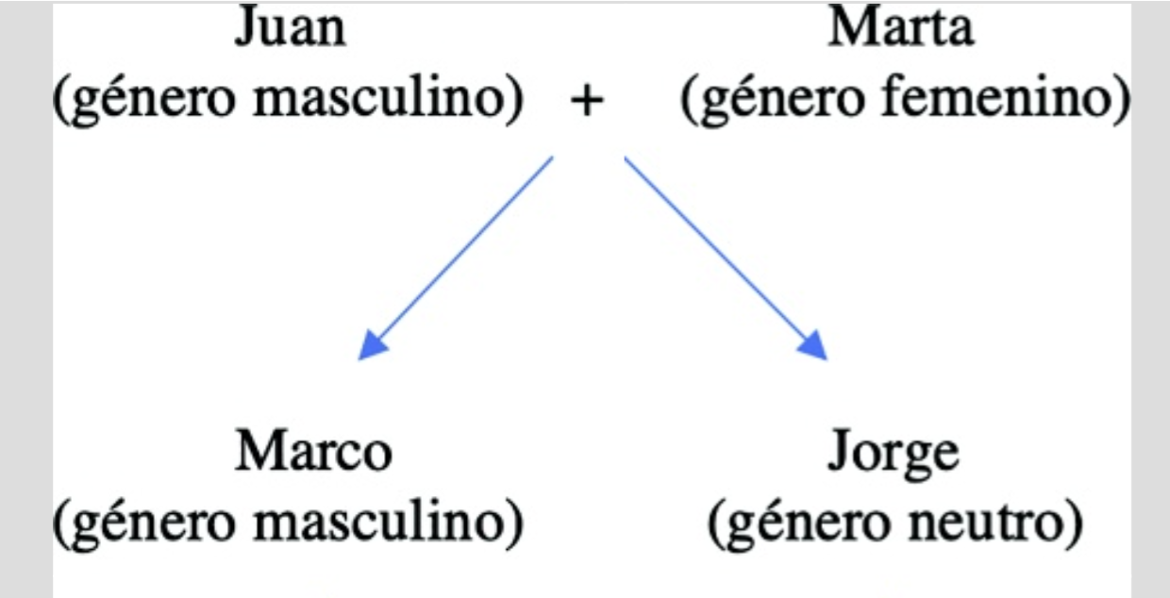
Sample Activity: Non-binary Spanish
Notes:
Mer

Slide 19
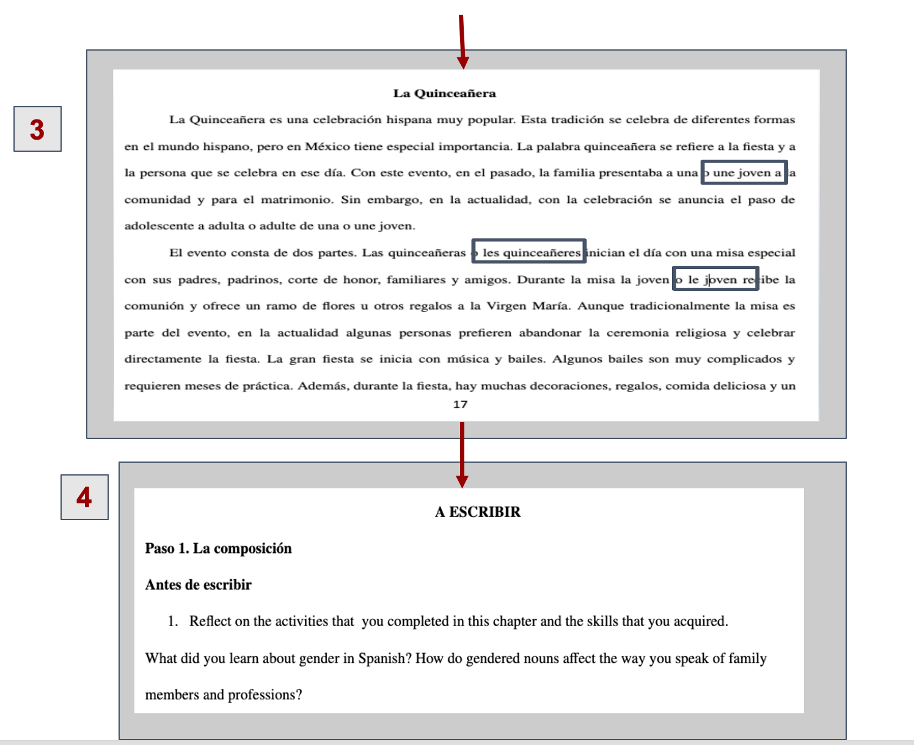

Sample Activity, Non-Binary Spanish, cont.
Notes:
Merche

Slide 20
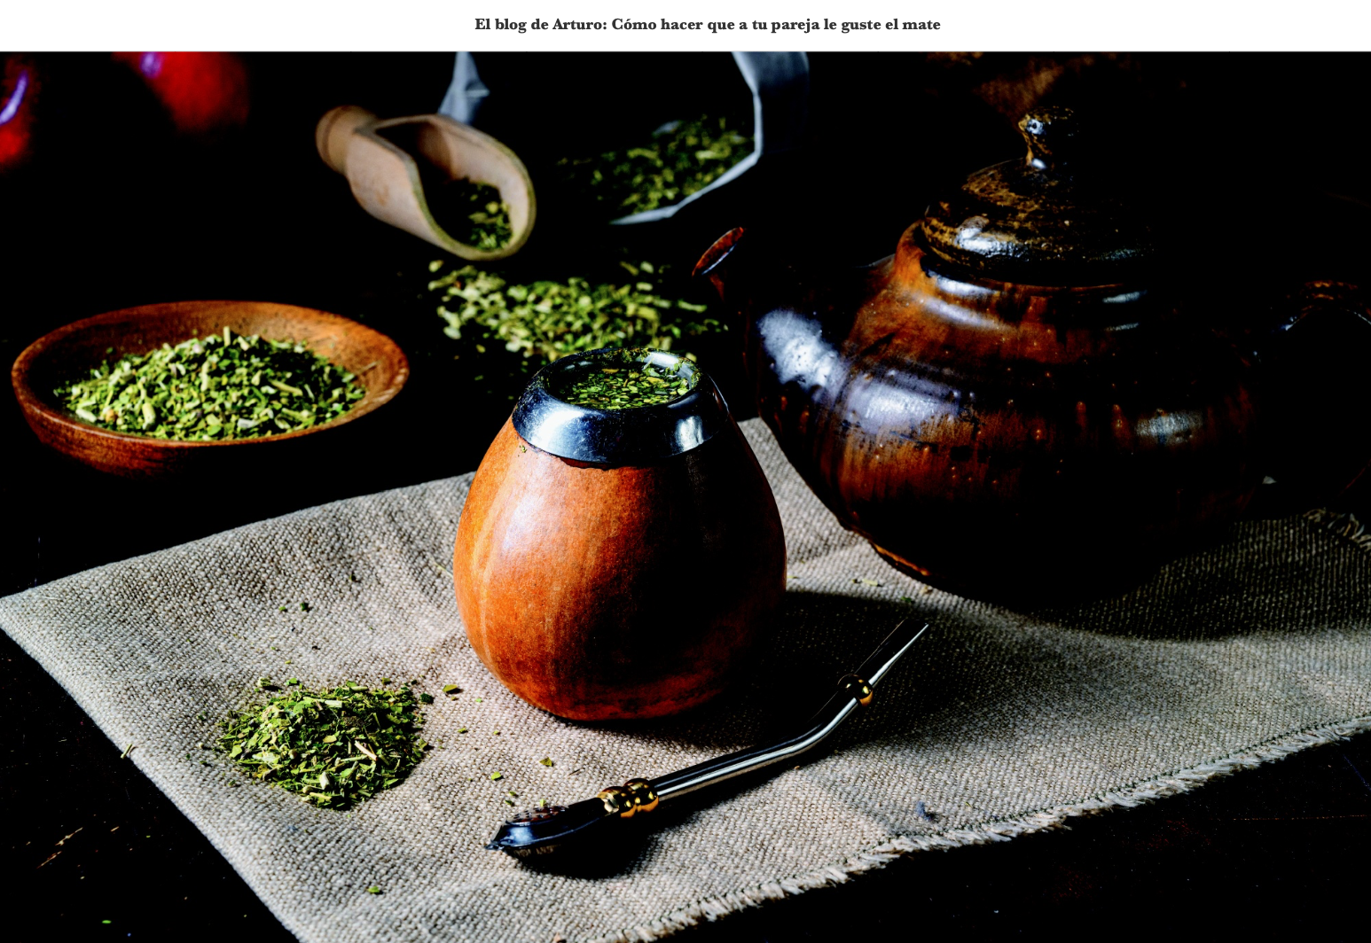
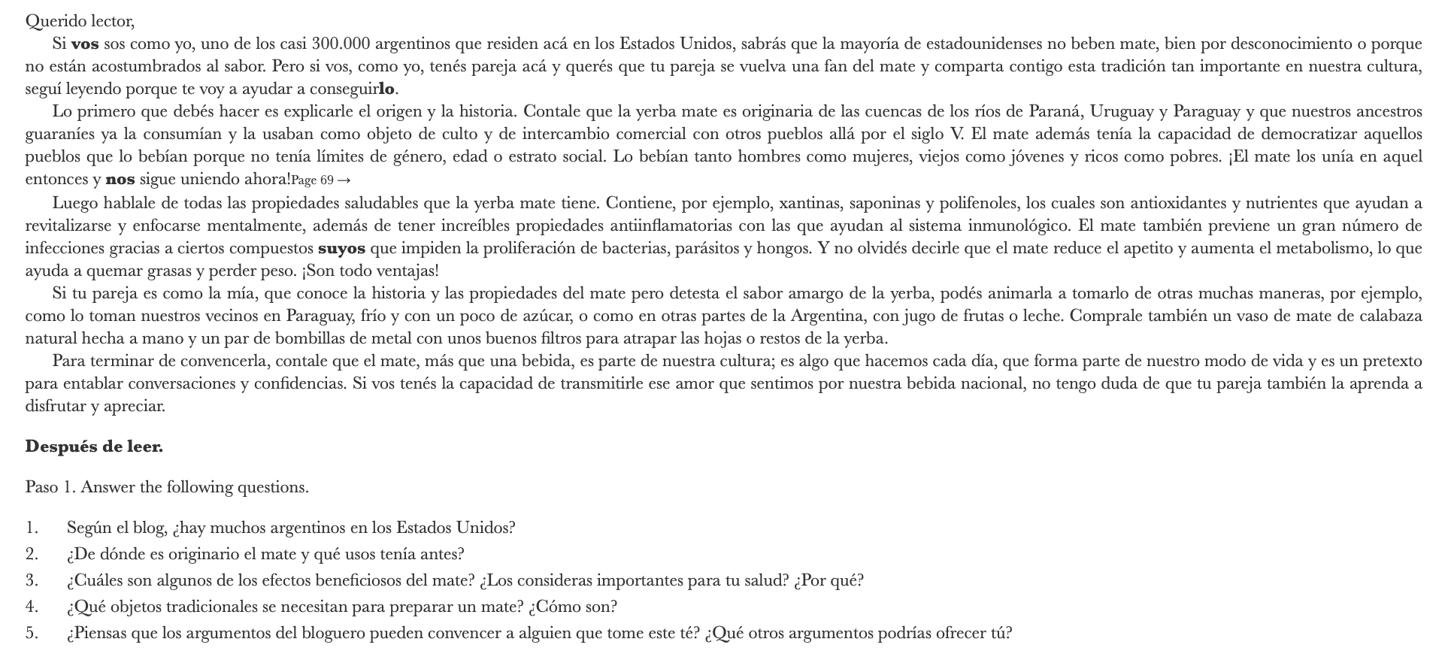
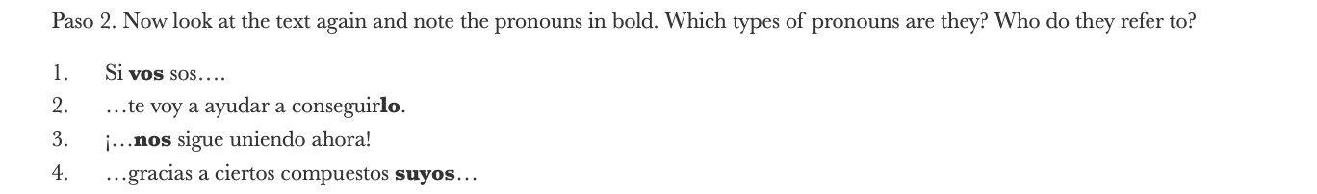
Sample Activity, voseo
Notes:
Merche

Slide 21
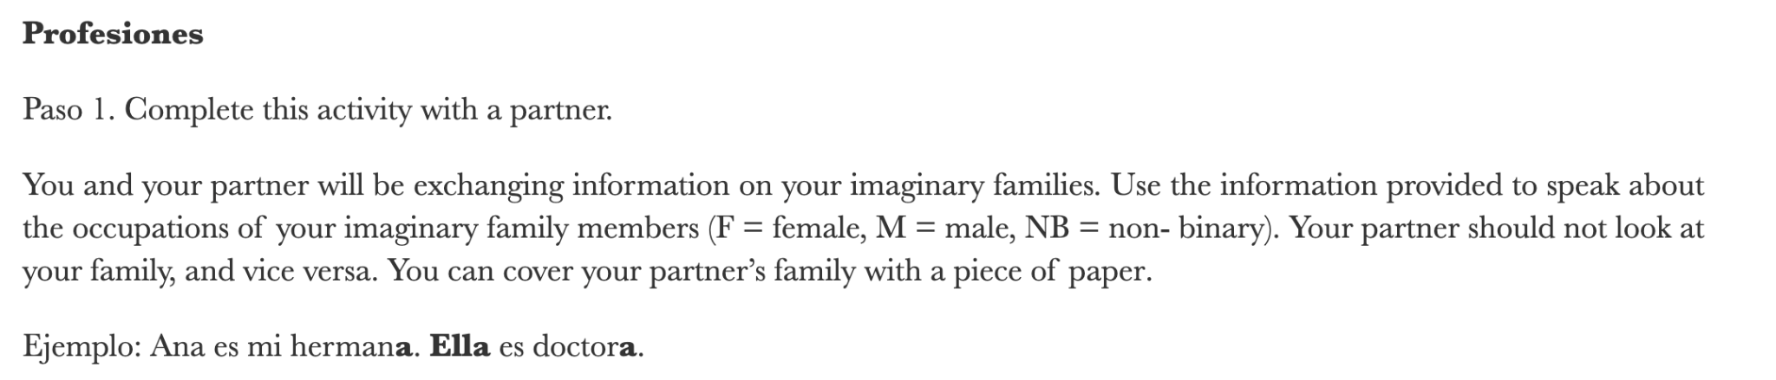
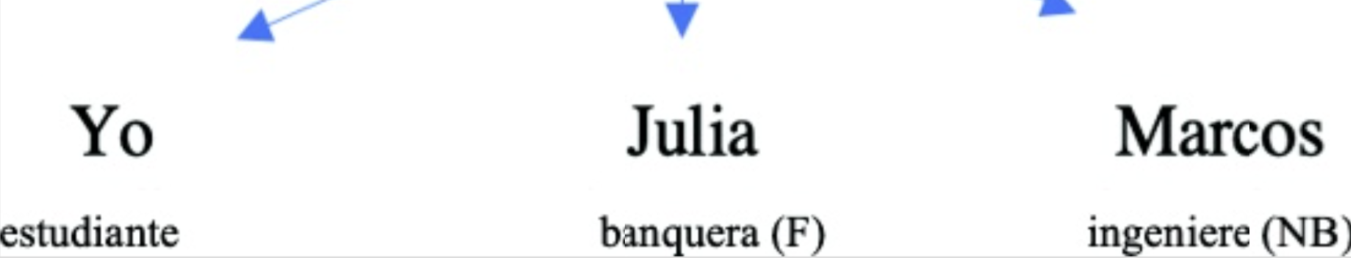
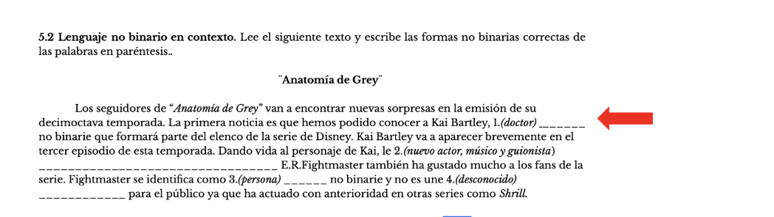
Consistency is Key: Non-Binary Spanish
Use non-binary Spanish all semester
Notes:
Merche

Slide 22
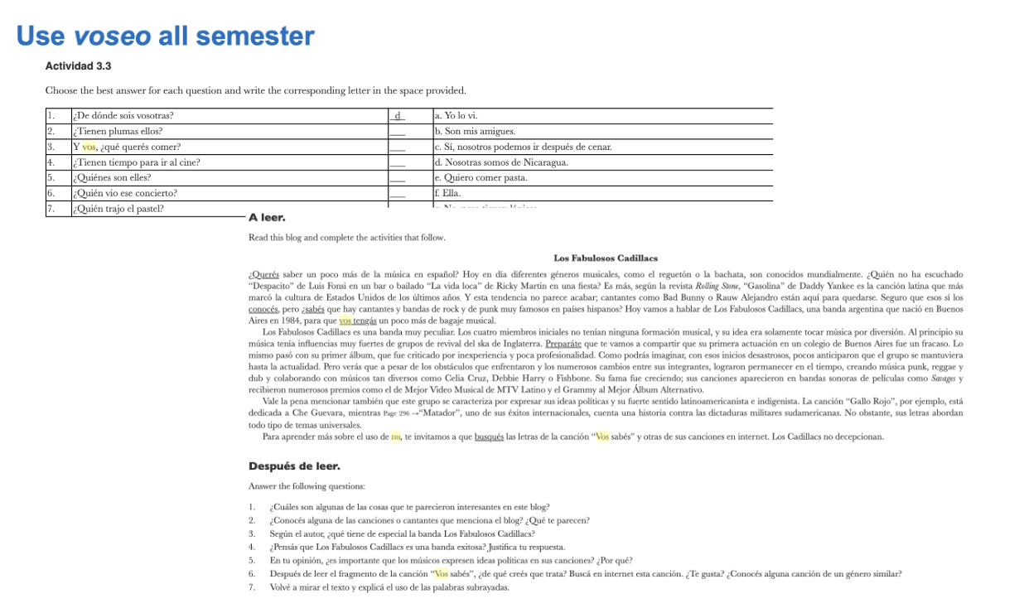
Consistency is Key: Voseo
Notes:
Merche

Slide 23
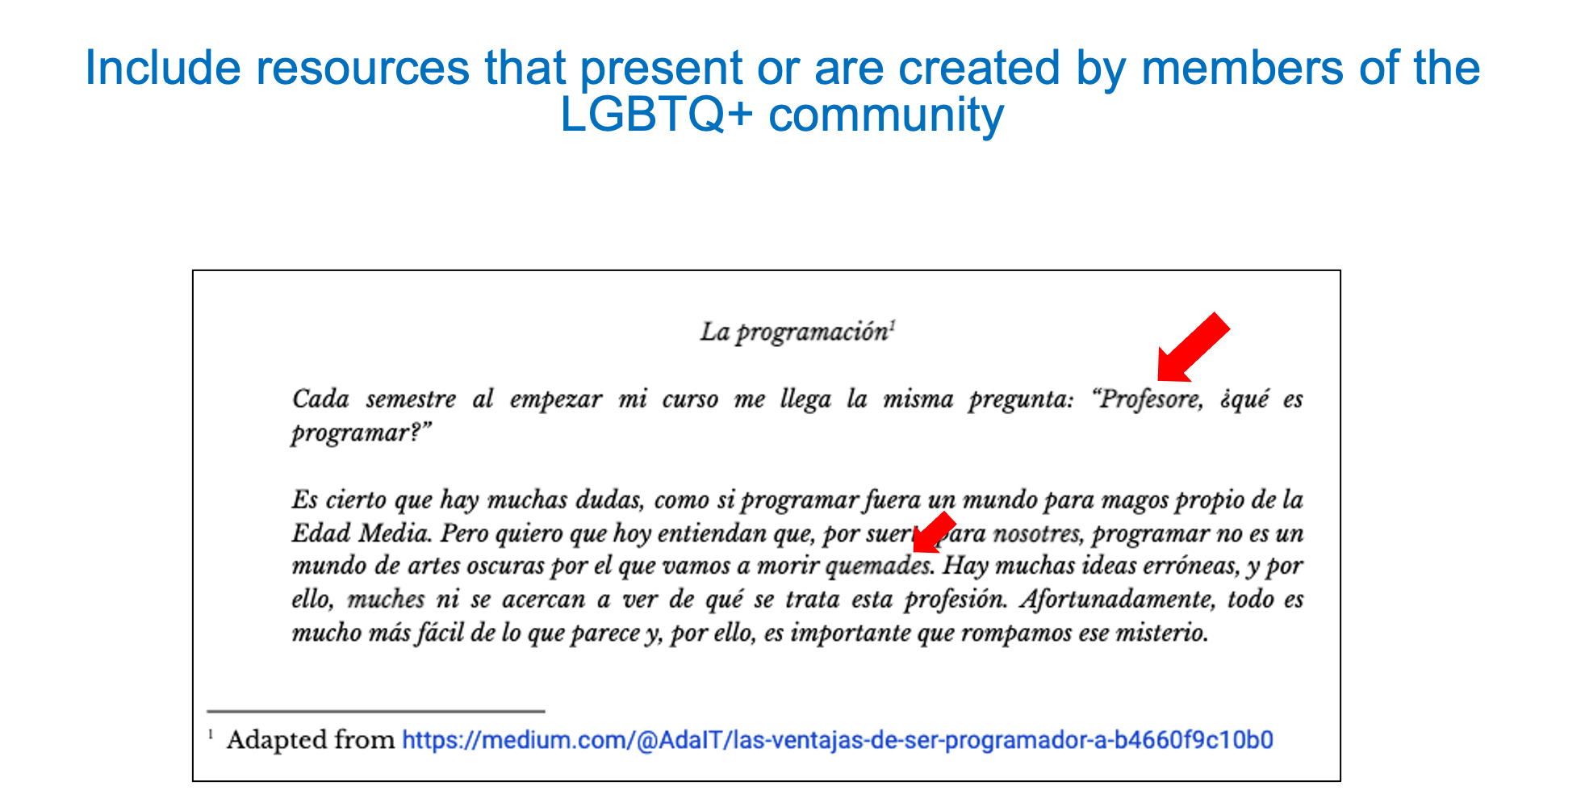
Nothing About Us Without Us:
Non-binary
Included resources that are presented or created by members
of the LGBTQ+ community
Notes:
Merche

Slide 24
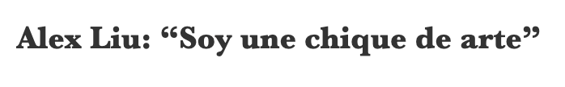
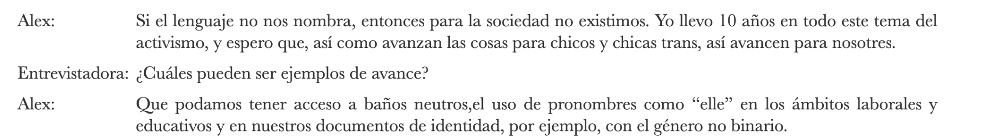
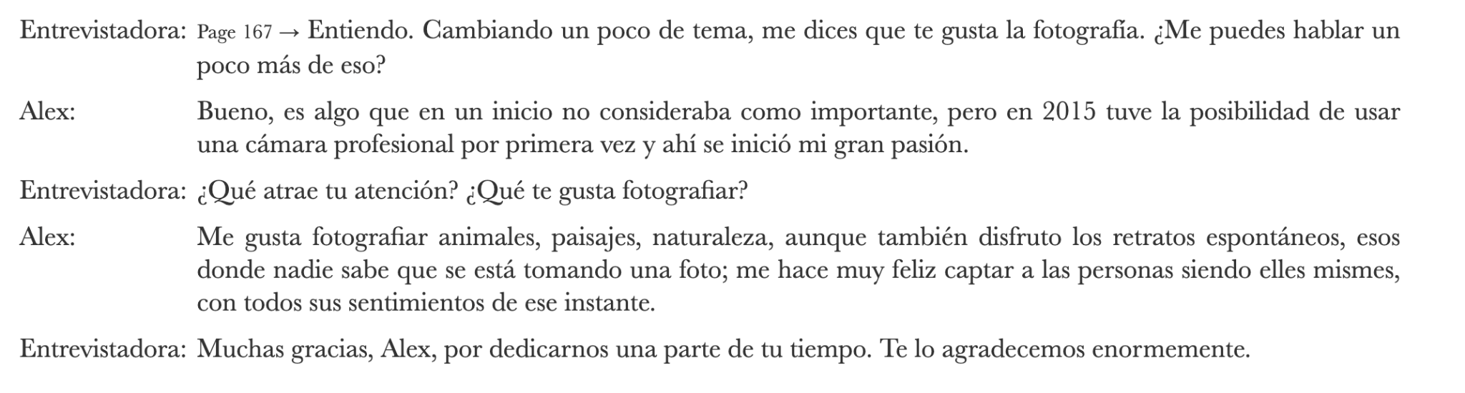
Nothing About Us Without Us:
Non-binary
Notes:
Merche

Slide 25
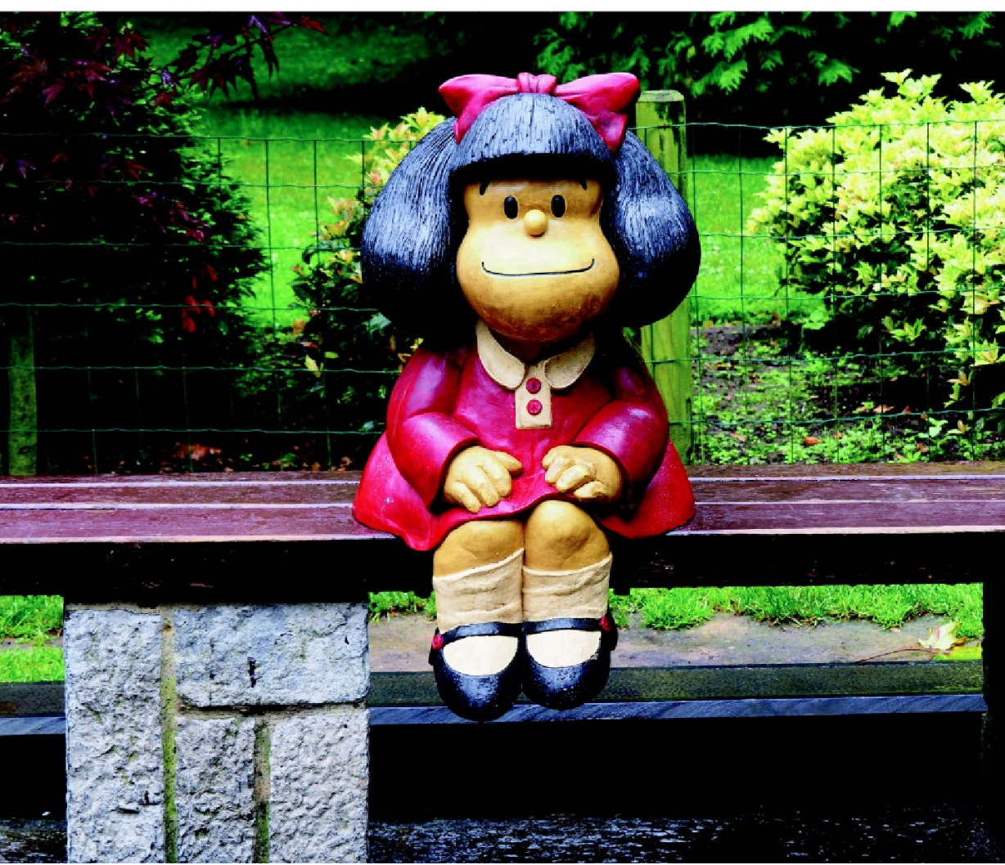
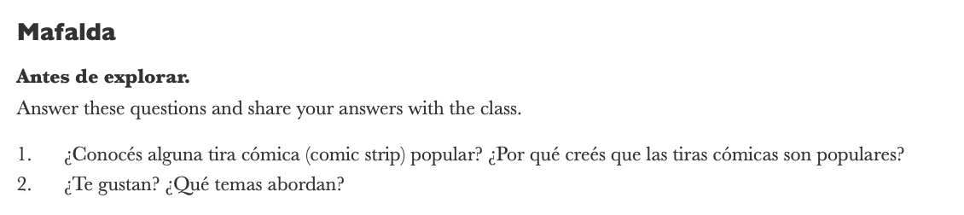
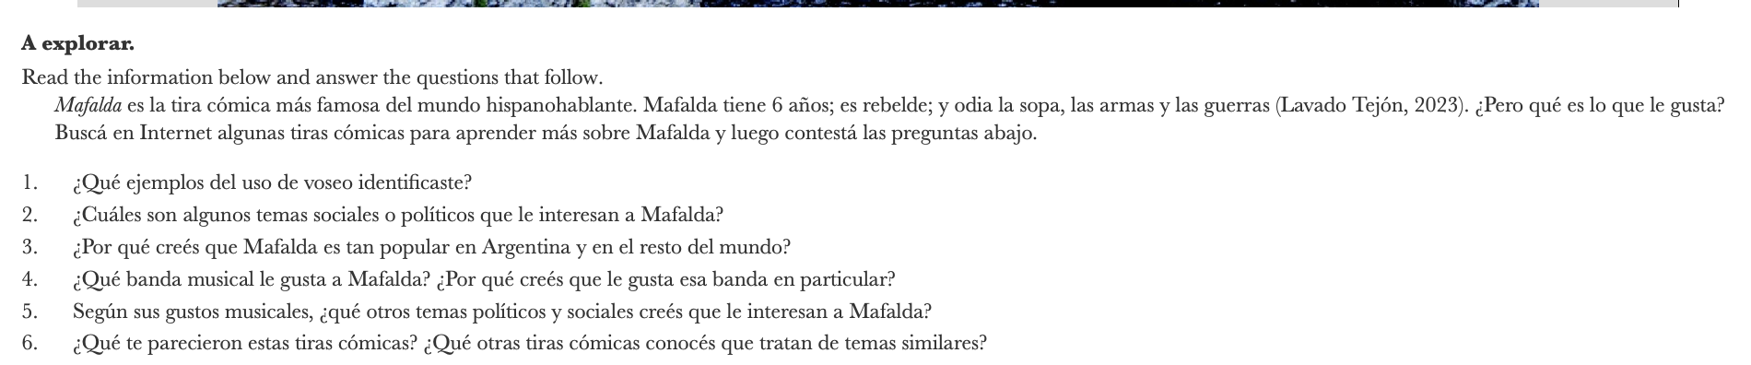
Nothing About Us Without Us
Voseo
Notes:
Merche

Slide 26
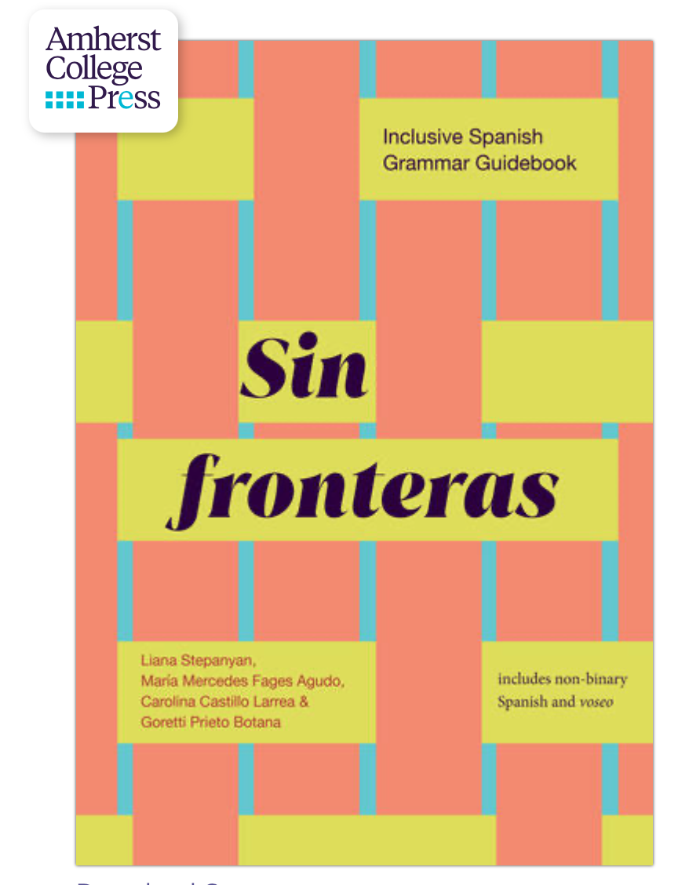
Sin Fronteras: Free Access
https://www.fulcrum.org/concern/monographs/0p0969510
Notes:
Merche

Slide 27
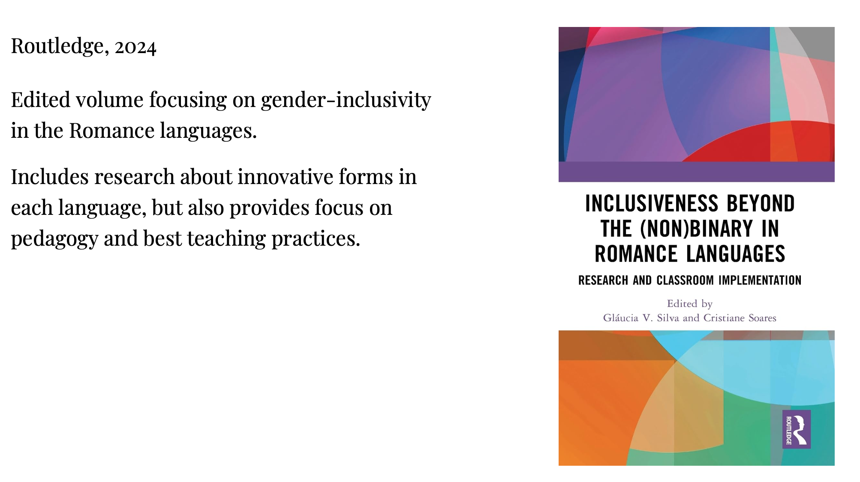
Other Resources
Notes:
Goretti

Slide 28
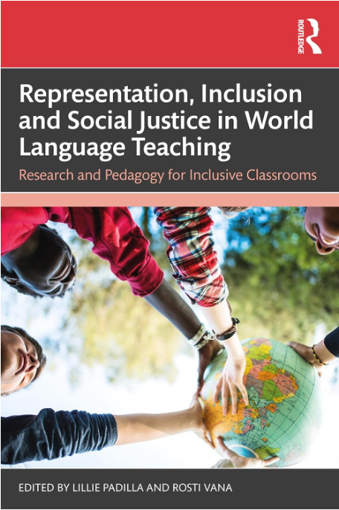
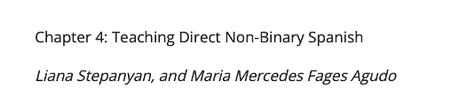
Other Resources
Routledge, 2024
Edited volume including research on English, Portuguese, Spanish, French, and Mandarin.
Focus on gender-inclusive language, critical race theory, teaching heritage speakers, representing Black and Afro-Latinx identities in the language classroom, etc.
Notes:
Goretti

Slide 29
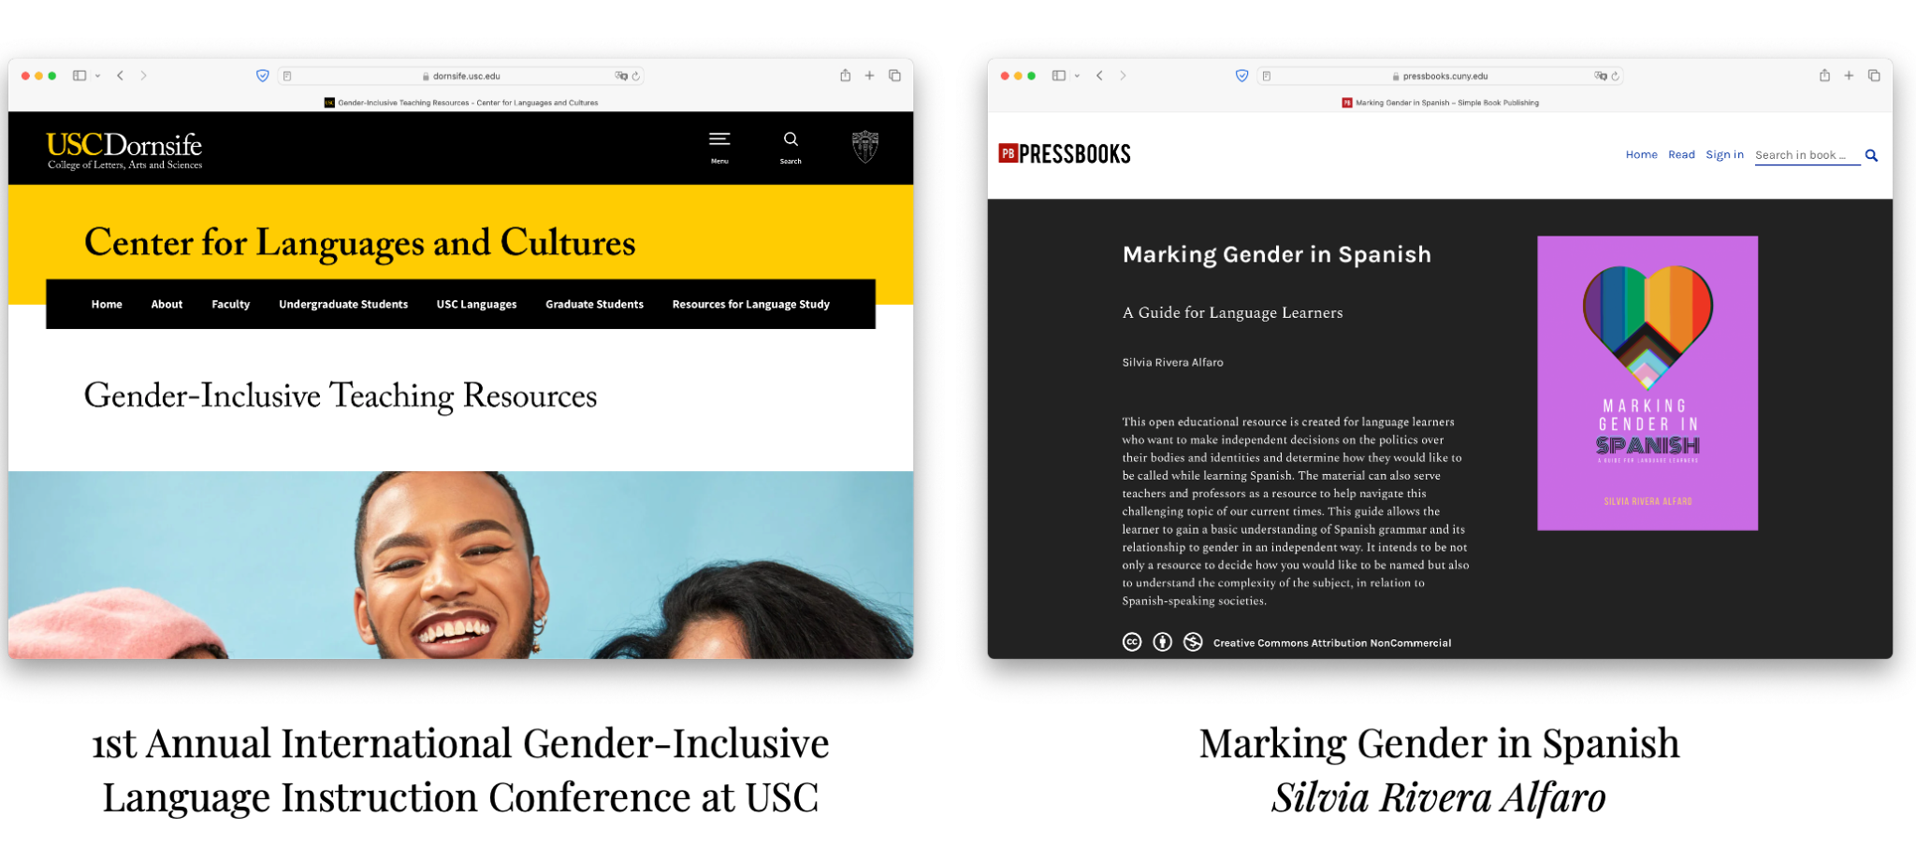
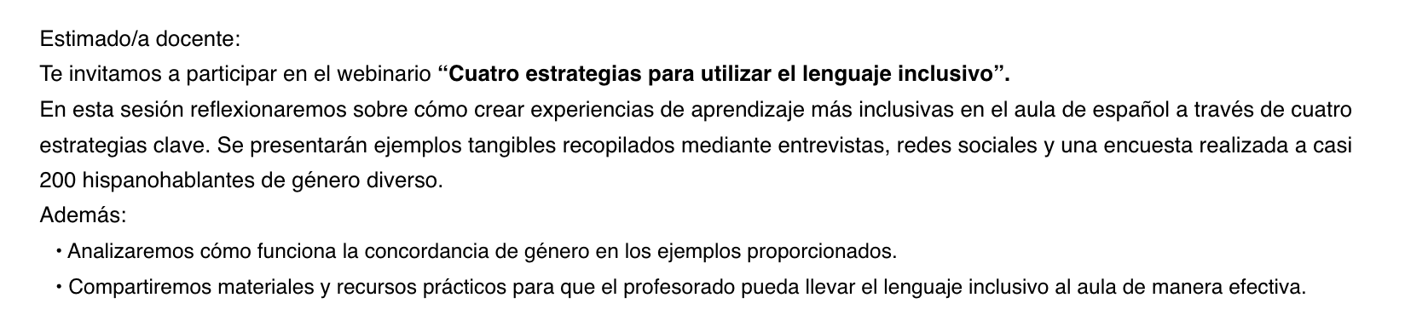
Other Resources
Notes:
Goretti

Slide 30
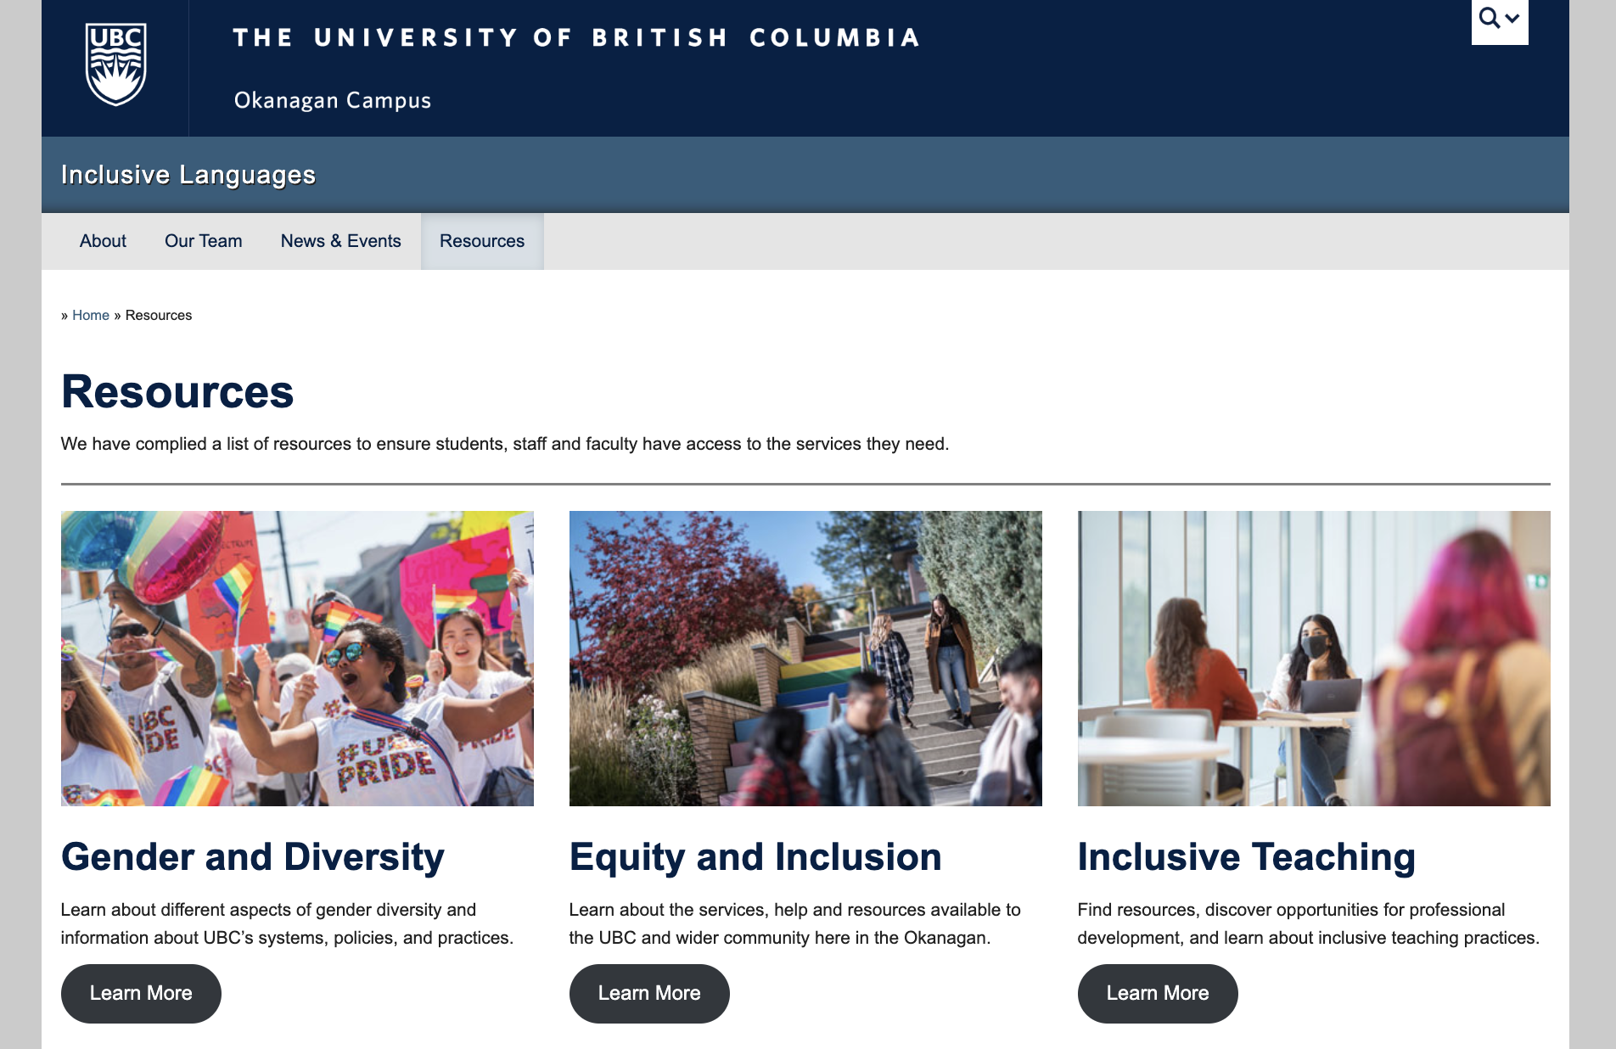
Notes:
Goretti

Slide 31

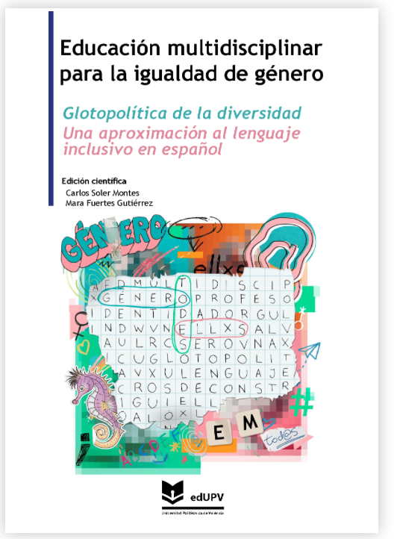
OER: https://monografias.editorial.upv.es/index.php/emig/issue/view/158
Notes:
Goretti?

Slide 32
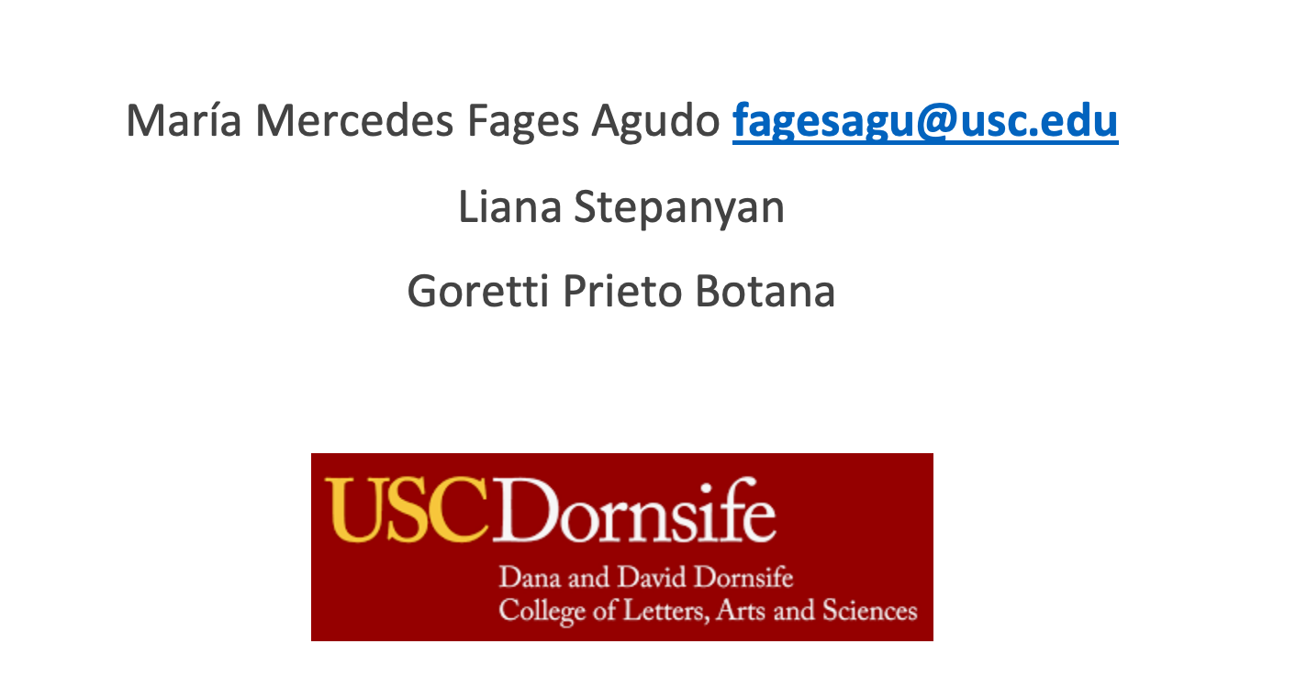
Questions? Suggestions? Collaboration?

