Slide 1
ASCCC OERI Presentation
Defining Return On Investment for Zero-Cost Textbooks: A Collaborative Conversation
Friday 10/10, 10am – 11am
This work is licensed under a Creative Commons Attribution 4.0 International License.
Notes:
Rachel 1-7

Slide 2
Welcome!
On behalf of the ASCCC OERI, we are pleased to have you here with us for a conversation on cost savings and ROI in OER!
If you are not already muted, please mute yourself upon arrival- OR open your mic and say hello!!
Please note that you are encouraged to use the Zoom “chat” feature for questions and comments.
You’re invited to introduce yourself in the chat – please provide your name, college, discipline/role
This event will be recorded. Archives of all ASCCC OERI events are available at asccc-oeri.org > Webinars and Events

Slide 3
Description
As more institutions adopt zero-cost textbook (ZTC) sections, the need for a consistent method of measuring return on investment (ROI) becomes increasingly important. But how exactly do we calculate the impact—financial, academic, and beyond—of something that costs nothing? Join us for an informal, interactive conversation exploring how we might define a standard approach to ROI for ZTC initiatives. This session isn’t about presenting a finished model—it’s about opening the door to shared ideas, challenges, and practical insights.

Slide 4

Facilitators
Kevin Smith, ASCCC OERI Regional Lead C
  Psychology, Rio Hondo College
Rachel Fleming, ASCCC OERI Regional Lead D
  OER Librarian, Irvine Valley College
Photo by Siora Photography on Unsplash

Slide 5

Overview
Let’s start with you! Campus Pulse Check
Define ROI & Current Status
  Looking Back: AB798
  Why chat about this?
Digging into the Details
Exploring Options
Discussion questions throughout!
Notes:
An Overview slide should be included that is an outline of the presentation.

Slide 6


Disclaimer
We don’t have all the answers.
We are not accountants or lawyers.
We are sharing and brainstorming with you!
We would love to know how you do this kind of thing!
Notes:
An Overview slide should be included that is an outline of the presentation.

Slide 7

Introductory questions
We want to hear from you!
Please post your answers in the chat:
Have you ever considered/thought about ROI/cost savings with respect to OER or do you already have a system?
Have you had discussions at your college about ROI/cost savings with respect to OER?
"That is the Question" by cogdogblog is licensed under CC BY 2.0.

Slide 8
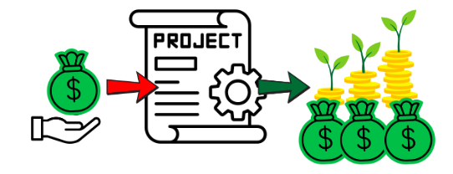
What does ROI/cost savings mean?
General idea is simple, but things get complicated fast
Notes:
Kevn 8-11

Slide 9

Current status
What has been done previously for ROI?
Wild Wild West!
Wild west blues by Peter Thoeny is licensed CC BY NC SA 2.0

Slide 10
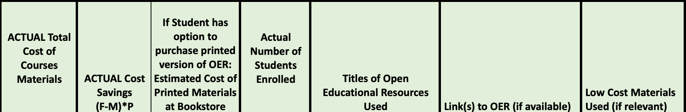
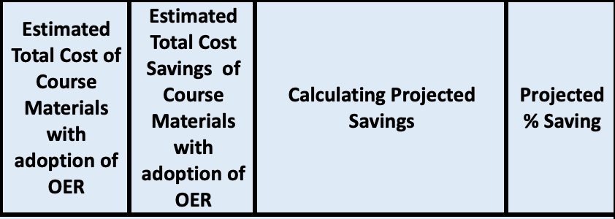
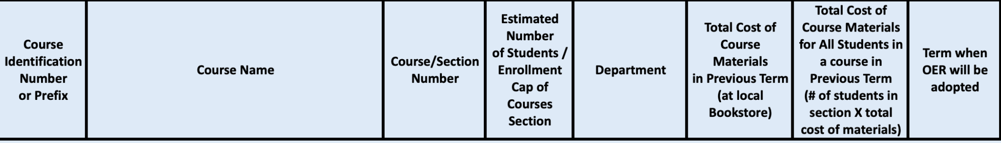
AB798: Textbook Affordability Act: Reporting Requirements [Granular]
Lots of reporting and calculations for EACH section at each participating institution
Notes:
Granular , accurate but labor intensive
is it with that labor?
To some extent it needs to be an estimation
balance, what we lose with standardization?

Slide 11

Discussion: Should the OERI proceed?
Is there merit to having standardized way(s) across colleges/institutions within the CCC to calculate ROI?
  Would that be helpful to your work at the college?
Notes:
An Overview slide should be included that is an outline of the presentation.

Slide 12
Why is the ROI/cost savings conversation important?
Advocacy and Sustainability
  Localization & Institutional Ownership of ZTC/OER Efforts
  Admin will ask “What’s the ROI?”
Affordability and Transparency
  Having clear numbers and outcomes
  Clear numbers can be hard to come by though
A metric for tracking progress
Notes:
Rachel

Slide 13
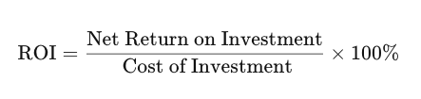
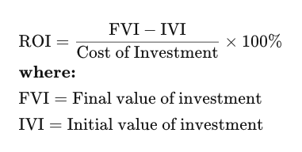
ROI Definition: Let’s dive in
Return on Investment (ROI) is a financial metric that quantifies the profitability or efficiency of an investment. It is calculated by dividing the net gain (or loss) from the investment by the cost of the investment, usually expressed as a percentage.
Notes:
combo

Slide 14
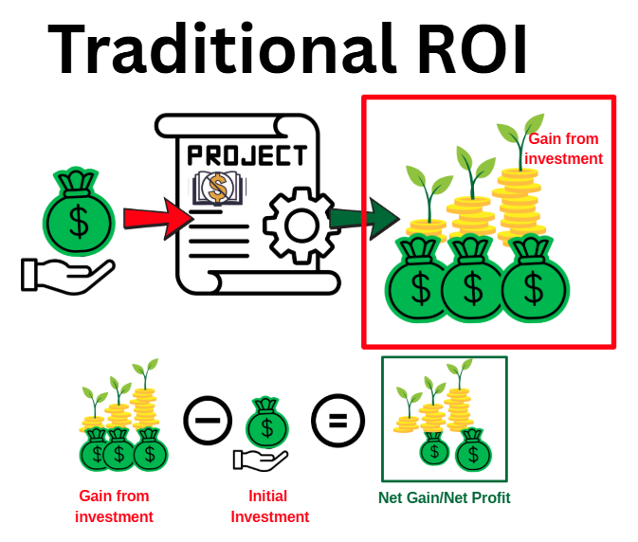
Its uh… complicated
Are we talking about “true fiscal ROI” for an institution/state investment?
Are we talking about cost savings for STUDENTS who didn’t invest?
Notes:
combo

Slide 15
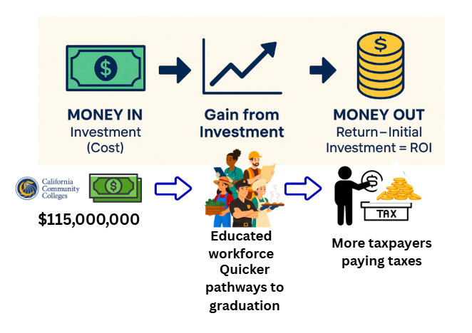
What the state gets for their investment:
The state invests $115m and ideally gets more tax payers paying taxes
Notes:
combo

Slide 16
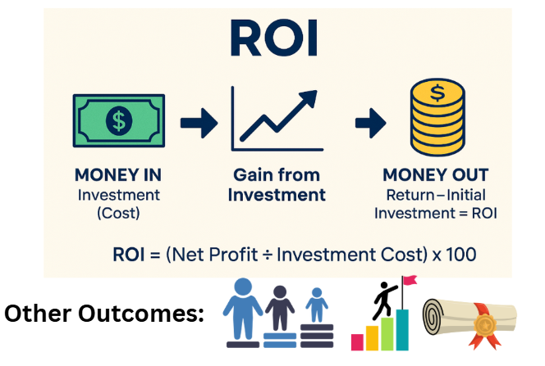
More complications
Are we talking about non monetary positive outcomes?
Equity outcomes
Achievement outcomes
Persistence vs Drop
Notes:
combo

Slide 17
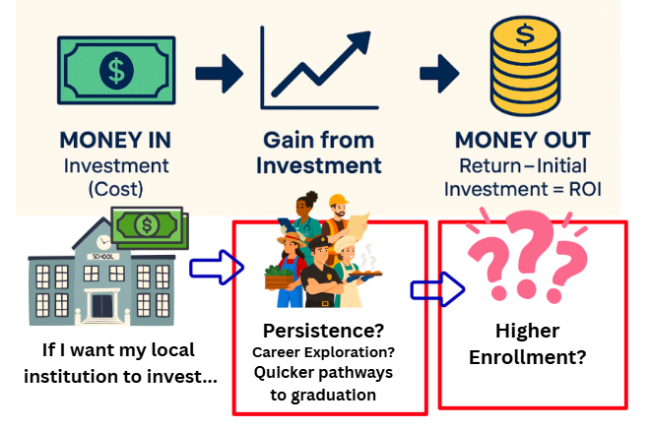
But if local college invests what do they get?
Asking your college for $100,000 a year for OER/ZTC leads to what?
Equity metrics?
Enrollment?
Notes:
combo

Slide 18
Discussion: Complicating factors
What other “complicating factors” should be in this discussion?
What does the ideal look like?
  One calculator?
  Multiple calculators?
    Cost Savings Calculator (doable by OERI)
    Equity Calculator (wishlist)
Notes:
An Overview slide should be included that is an outline of the presentation.

Slide 19
Different types of “ROI” Impacts/Outcomes
💵 Fiscal ROI= direct institutional dollars back
🎒 Student Financial ROI= Student cost savings (most common)
🎓 Student Academic ROI= learning, retention, success
👩‍🏫 Faculty ROI = workload efficiency, academic freedom, professional development, ability to customize curriculum.
♿ Accessibility ROI = compliance with ADA/UDL, improved access for students with disabilities, inclusive design baked in from the start.
🤝 Community ROI = public good, lifelong learning access, partnerships with K–12, local transfer institutions, and community stakeholders.
🏛️ Institutional ROI= compliance, accreditation, competitive positioning
🌐 State/System ROI= contribution to systemwide equity and policy goals.

Slide 20
Discussion: How to simplify?
How do we simplify the process into one ask?
What’re we willing to give up in that simplified standardized calculator?
  Standardizing across disciplines?

Slide 21
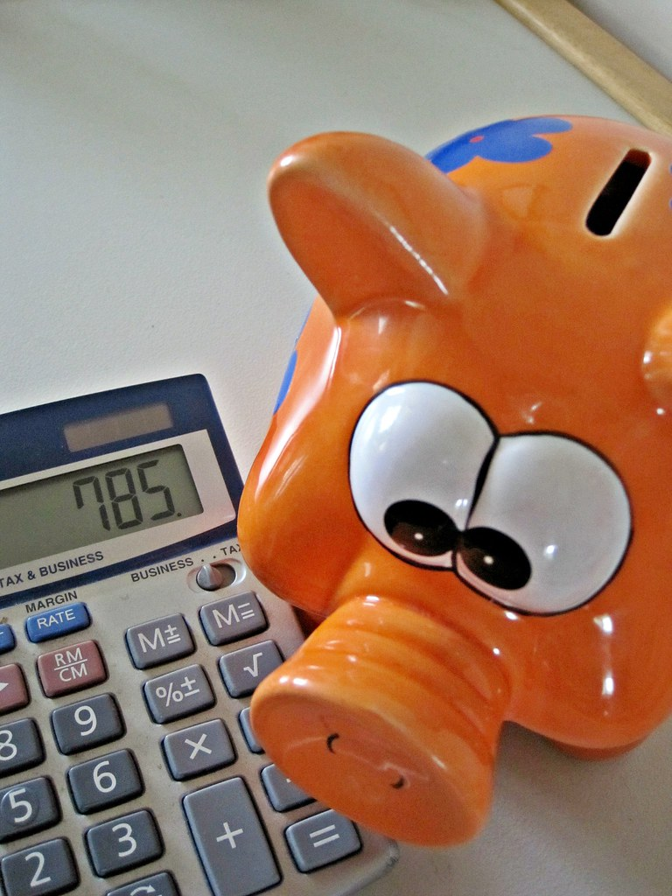
A spectrum of options
Focusing on cost savings
  Should it be simpler?
    For each section, assume that there are 30 students and that it would have cost $100 for the textbook.
      Therefore, each section converted to ZTC has a savings of $3,000?
  Strike a middle ground?
    STEM sections vs Non-STEM sections have different textbook costs used
      STEM: average textbook is $200 = $6,000
"Piggy Bank and Calculator" by Images_of_Money is licensed under CC BY 2.0.

Slide 22
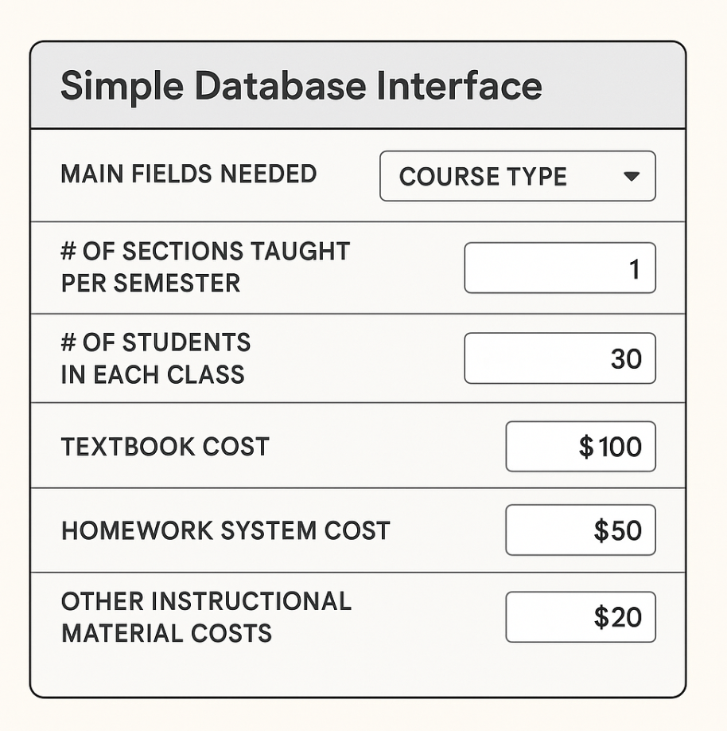
Or something more granular
Simplifying these calculations has a cost
So does going granular with them though

Slide 23
Discussion: State-level advocacy and local guidance
What do we advocate for state wide?
What types of advice and suggestions can we give, in terms of guidance, for local calculations that go beyond cost-savings?

Slide 24
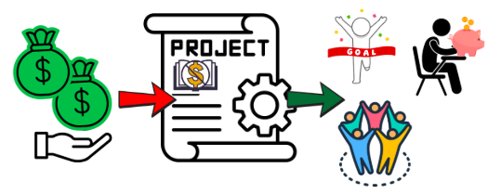
Thinking about tools for advocacy
Notes:
Rachel : wrap up WHY, state vs local, what can we ask the ASCCC OERI to do for us?

Slide 25

Resources and Notes
AB 798 Campus Plan & Reporting Template
Share what you’ve done
What you’d like to be done for you

Slide 26
Thank you!
OERL Webinar; FRIDAY 10/10 10AM
This work is licensed under a Creative Commons Attribution 4.0 International License.
All images and infographics without attribution created with Canva and under no license.

